Slide 1



Vaping & Nicotine
Notes:
Facilitator Guide
About this Resource:
This resource has been designed for trusted adults working with young people across the third sector.
The resource aims to encourage discussion, critical thinking and informed decision-making. The aim is not to tell young people what choices to make. The content and activities are designed to explore influences, consider consequences and develop confidence in making decisions that are right for the young person.
The slides can be displayed but could also just be used as structure/framework for facilitator to run the session. The resources are discussion and activity based with shorter games and some extended project-based work where there is more time available.
Choose the parts of the resource that are most relevant to your setting. The age groups for the resources are a guideline; it may be helpful to use games/activities from more than one age group resource. There is also more than one session’s content in each age group resource, facilitators should tailor to suit the session time/number of sessions they can allocate to the topic. The resource can be edited (by hiding slides) to allow the facilitator to shorten it to suit their group. Good practice around substance education tells us that revisiting topics is helpful, breaking the resource into smaller chunks is a good way to use it.
Certain topic areas have been set within one of the age group resources, where we feel the topic is most likely to become relevant. Please see following content list to support using parts of resource should the areas be raised by the young people at a different age and stage. For example, we have put information about vape spiking in the 16+ resource. It can be accessed there and used for younger age groups should this be an area of concern for trusted adults or an area of relevance/interest for the young people they are working with.
8 – 12 yrs resource:
What is Vaping?
What is Nicotine?
Impact on body/brain.
Influence/Pressure scenarios.
12 – 15 yrs resource:
Effects of nicotine and withdrawal.
Unregulated vapes
Fire Risk/Storing vapes safely/Vapes and the environment
Pressure/Influence and choices around vaping
Diversionary activities/alternative ways to relax/stay stress free
16+ resource:
Summary of vaping/nicotine knowledge
How does vaping affect each area of a person’s life
Unregulated vapes/THC vapes
Staying safe around vapes/vape spiking
Making choices around vapes/nicotine
Nicotine pouches
Vapes and Social Media
Vaping and the Law
Vaping: Is it a local issue. Includes creating a group agreement to manage vaping in youth organisation settings.
The resources may encourage questions/discussion about other areas that young people feel are relevant to them such as other substances, issues related to risk taking, relationship-based issues etc. This can be positive; facilitators don’t need to know all the answers to hold useful discussion and to agree to revisit any areas that are clearly important to work on with the group.
Overview of Outcomes:
Increase knowledge and understanding of vaping and nicotine
Consider risks and protective factors around vapes and nicotine.
Explore influences that can affect decision-making.
Practise discussing challenging situations.
Develop confidence in making informed choices.
Before starting a session:
Consider prior knowledge and lived experience of those within the group.
Agree group expectations.
Make it clear that nobody is required to share personal experiences.
Be prepared to signpost support where need arises.
Facilitation style:
Use open questions wherever possible.
Encourage discussion between young people.
Acknowledge different viewpoints.
Focus on curiosity rather than judgement.
Start with where young people are at, noting they may not have much interest or connection to longer term health harms.
Encourage critical thinking as opposed to ‘telling’ where possible.

Slide 2
What do we need to think about as a group when we talk about Vaping?
Careful sharing? Asking questions?
What do we need the adults to do?
Be honest? Give answers?
Group agreement
Notes:
Slide: Group Agreement
Facilitator establishes a group agreement with young people. It may be helpful to have some understanding of the lived experiences of the group to support best delivery of the resource. This may be something young people are happy to share, or something the group decides is private. In practice we found young people were keen to share their experiences when a safe space was facilitated by trusted adults.

Slide 3
What is Vaping?
What is Nicotine?
What is Nicotine?
Vaping & Nicotine
What can vaping do to
bodies and brains?
Vaping and the law
What can we do about it?
How do we stay safe?
Notes:
Slide: What are we covering?
Facilitator shares summary of the topics that will be covered during the session so young people have an idea of what they will be looking at.

Slide 4
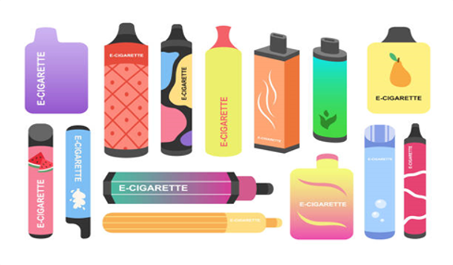
What is Vaping?
So, what do you know about vaping?
Notes:
Slide: So, what do you know about vaping?
Purpose
To find out what young people already know about vaping, identify any misconceptions and encourage curiosity before introducing the topic.
Facilitator Notes
Explain that this is a warm-up discussion and that there are no wrong questions or answers.
Some prompt questions for the group:
What is a vape?
What have you heard about vaping?
Where have you seen people vaping?
Why do you think some people use vapes?
Do all vapes contain nicotine?
Allow participants to share their ideas without immediately correcting them. Acknowledge contributions and make a note of any myths or misconceptions that can be revisited later in the session.
Use open questions to encourage discussion and reassure the group that they will explore the facts together throughout the activity.
Key message: Everyone starts with different knowledge and experiences. Today is an opportunity to ask questions, challenge myths and learn some facts about vaping.

Slide 5

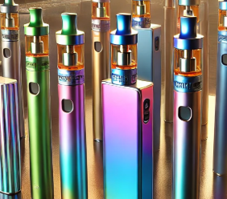
Yes/No Relay Game
What is Vaping?
In your teams select a runner.
The right side of the room is ‘Yes’ and the left side of the room is ‘No’.
Who will be first to ‘tag’ their answer and get back to base?
Notes:
Slide: Yes / No Relay Game
Purpose
To introduce key facts about vaping in an active way, while encouraging young people to think critically about common statements and myths.
Facilitator Notes
Explain that participants will play a quick relay game.
Split the group into teams and ask each team to choose a runner. Designate one side of the room as ‘Yes’ and the other side as ‘No’.
The group must decide whether the answer is Yes or No, then send the runner to that side of the room to ‘tag’ the answer then return to base.
After each statement, reveal the correct answer and discuss some of the answer detail. Encourage the whole group to join in with the discussion.
Remind participants that it is okay to get answers wrong—the aim is to learn together and challenge common myths about vaping.
Key message: Vaping can be confusing, and there is lots we might not know. Learning the facts helps young people make informed and healthy choices.

Slide 6
Yes/No Relay Game
What is Vaping?
Yes or No?​
​
“Vaping is addictive.”
Yes - Most vapes contain nicotine
Most vapes contain a high dose of nicotine which is an addictive drug.
Notes:
Slide: Yes / No Relay Game – “Vaping is addictive.”
Purpose
To help young people understand that most vapes contain nicotine, which is an addictive drug that can make it difficult to stop using.
Facilitator Notes
Read the statement aloud and ask groups to decide whether the answer is Yes or No before racing to the correct side of the room.
Reveal the answer and briefly discuss why.
Answer: ✅ Yes
Explain that most vapes contain nicotine, which is an addictive drug. Nicotine changes the way the brain works by creating feelings of reward, making people want to use it again and again.
The more someone uses nicotine, the harder it can become to stop. If they stop using it, they may experience cravings or withdrawal symptoms such as feeling irritable, restless or finding it difficult to concentrate.
Remind the group that not every vape contains nicotine, but the majority of disposable and popular vapes used by young people do.
Key message: Nicotine is an addictive drug. Because most vapes contain nicotine, regular vaping can lead to dependence and make quitting difficult.

Slide 7
Yes/No Relay Game
What is Vaping?
Yes or No?​
​
“Vaping is risk free.”
No - Vaping is not risk free. There are negative side effects.
Short-term effects can be coughing, dizziness, sore throats, headaches.
The long-term effects are not fully known, it can be harmful for lungs, heart and our mouths.
Notes:
Slide: Yes / No Relay Game – “Vaping is risk free.”
Purpose
To help young people understand that vaping is not risk free and that using vapes can have negative effects on health and wellbeing.
Facilitator Notes
Read the statement aloud and ask groups to decide whether the answer is Yes or No before racing to the correct side of the room.
Reveal the answer and briefly discuss why.
Answer: ❌ No
Explain that vaping is not risk free. Most vapes contain nicotine, which is an addictive drug, and using vapes can cause effects.
Some people experience coughing, sore throats, headaches, dizziness or feeling sick, especially when they first start vaping or use large amounts.
Scientists are still learning about the long-term effects of vaping, so we do not yet know all of the possible health risks. This is one reason why children and young people are advised not to vape.
You can also remind the group that nicotine can affect mood and concentration, making some people feel irritable or find it harder to focus when they are craving more.
Key message: Vaping is not harmless or risk free. It can have negative effects on health, and the long-term effects are still being researched.

Slide 8


Yes/No Relay Game
What is Vaping?
Yes or No?
“It is illegal to give or sell a vape to person under 18.”
Yes
If someone over 18 gives or sells vapes to anyone under 18 that is illegal.
Notes:
Slide: Yes / No Relay Game – “It is illegal to give or sell a vape to a person under 18.”
Purpose
To help young people understand that the law protects children and young people by making it illegal to sell or supply vapes to anyone under the age of 18.
Facilitator Notes
Read the statement aloud and ask groups to decide whether the answer is Yes or No before racing to the correct side of the room.
Reveal the answer and briefly discuss why.
Answer: ✅ Yes
Explain that in the UK it is illegal to sell a vape to anyone under the age of 18. It is also illegal for an adult to buy or supply a vape for someone who is under 18 (known as proxy purchasing).
Ask the group why they think this law exists. Encourage answers such as protecting young people from nicotine addiction and keeping them safe while their brains and bodies are still developing.
Reassure participants that these rules are there to help protect children and young people, just like age restrictions on cigarettes and alcohol.
Key message: Vapes are age-restricted products. It is illegal to sell or supply them to anyone under 18 because the law is designed to protect young people from harm.

Slide 9
Vapes: What are they?
What is Vaping?
Vapes are electronic devices for people to breathe in a flavoured mist, or vapour.
This vapour comes from a heated liquid inside the vape that contains nicotine and flavouring chemicals.
Notes:
Slide: Vapes: What are they?
Purpose
To introduce young people to what a vape is, how it works and what is inside it using simple, age-appropriate language.
Facilitator Notes
Explain that vapes are electronic devices that heat up a liquid to create a mist, or vapour, which is breathed into the lungs.
Sharing that while vapes come in lots of different colours, shapes and flavours, most contain nicotine, an addictive drug. They also contain other ingredients, including flavourings and chemicals that help create the vapour.
You may wish to explain that vapes were originally designed to help some adults who smoke cigarettes stop smoking, but they are not made for children or young people.
Keep the explanation simple and avoid technical detail. Encourage questions and correct any myths or misunderstandings that arise.
Key message: A vape is an electronic device that turns a liquid into a vapour. Most vapes contain nicotine, which is addictive, and they are not intended for children or young people.

Slide 10
Vapes: What are they for?
What is Vaping?
Vapes are not meant to be used by young people.
Vapes can be used to help adults to stop smoking.
Notes:
Slide: Vapes: What are they for?
Purpose
To help young people understand that vapes were designed to support adults who smoke to quit smoking and were not intended for children or young people.
Facilitator Notes
Explain that vapes are not meant to be used by children or young people. They were developed as a tool that can help some adults who smoke cigarettes to stop smoking by providing nicotine without burning tobacco.
Clarify that this does not mean vapes are harmless. They are intended for adult who smoke only and are not recommended for people who do not already smoke.
You may wish to point out that because children's brains are still developing, nicotine can be particularly harmful and addictive for them.
Reinforce that if someone has never smoked, starting to vape is not a healthy choice. If you don’t smoke, don’t vape.
Key message: Vapes were designed to help some adult smokers quit smoking. They are not intended for children or young people or for people who have never smoked.

Slide 11
Did you know ...
What is Vaping?
9 out of 10 young people aged 11 – 17 yrs old choose not to vape?
Why do you think this is?
be
Notes:
Slide: Did you know… 93% of young people aged 11–17 choose not to vape?
Purpose
To challenge the misconception that “everyone vapes” and reinforce that the vast majority of young people choose not to vape.
Facilitator Notes
Begin by revealing the statistic and ask the group if it surprises them.
Ask:
“Why do you think 93% of young people choose not to vape?”
“Why might people think vaping is more common than it really is?”
Give young people time to share their ideas and discuss some of the reasons.
Possible answers could include:
They know vaping can be addictive.
They want to look after their health.
Their friends and family don’t vape.
They are not interested.
They know it is only meant for adults who smoke.
They play sports or enjoy other hobbies and don’t want vaping to affect them.
They know it is illegal to buy vapes if you are under 18.
Explain that seeing people vape on social media, outside shops or in public can make it seem like “everyone is doing it”, but this is not the case.
Reinforce that most young people make the healthy choice not to vape.
Key message: The vast majority of young people choose not to vape. Just because you notice vaping doesn’t mean it is the norm.

Slide 12
Did you know ...
What is Vaping?
Only 2 out of 10 young people aged 11 – 17 years have tried vaping?
Why do you think this is?
be
Notes:
Slide: Did you know… 19.5% of young people aged 11–17 years have tried vaping?
Purpose
To encourage young people to think about why some people experiment with vaping while reinforcing that trying a vape does not mean someone will continue to use one.
Facilitator Notes
Reveal the statistic and ask the group:
“Why do you think some young people might try vaping?”
Give participants time to discuss and share their ideas.
Possible answers include:
Curiosity – wanting to know what it is like.
Friends are doing it.
They have seen it on social media.
They like the colourful designs or flavours.
They think it looks fun or “cool”.
Someone offered them a vape.
They do not know much about the risks.
They think “just one try won’t matter.”
Explain that trying a vape once does not mean someone will become a regular user, but because most vapes contain nicotine, they can be addictive and some people find it difficult to stop.
You can contrast this with the previous slide by reminding the group that although around one in five young people have tried vaping, the vast majority do not vape regularly and most choose not to vape at all.
Key message: Some young people may try vaping out of curiosity or because of others around them, but most young people choose not to vape, and trying it carries risks because many vapes contain addictive nicotine.

Slide 13

Vape Radpuff!
What is Nicotine?
Watch this video. Vape Radpuff introduces us to Nicotine
​
Notes:
Slide: Vape Radpuff!
Purpose
To introduce nicotine in a fun, age-appropriate way and help young people understand that nicotine is the substance in most vapes that can make people want to keep using them.
Facilitator Notes
Explain that we are about to watch a short-animated video called Vape Radpuff, which introduces nicotine and how it affects the body and brain.
Before playing the video, ask:
"Has anyone heard of nicotine before?“
“What do you understand about it?”
Play the embedded video where resources allow.
After the video, ask participants what they can remember. Encourage simple answers and reassure them there are no wrong answers.
You may wish to draw out the following key points from the video:
Nicotine is a drug found in most vapes.
Nicotine can make people want to keep using a vape.
The more nicotine someone uses, the harder it can be to stop.
Children and young people's brains are still growing and developing.
Keep the discussion light and interactive. The aim is not to overload participants with information but to introduce the idea that nicotine is the ingredient in vapes that can make them addictive.
Key message: Nicotine is the addictive substance found in most vapes. It can make people want to keep using a vape, which is why vapes are not intended for children and young people.

Slide 14

What is Nicotine?
What is Nicotine?
Nicotine is a chemical that can change how a person feels.
At first, it can make a person feel more awake, jumpy, and ready to react quickly.
It also makes a person's breathing and heartbeat faster.
When the nicotine wears off a person can
feel tired and flat.
Notes:
Slide: What is Nicotine?
Purpose
To introduce nicotine as the main drug found in most vapes and help young people understand some of the effects it can have on the body and how they feel.
Facilitator Notes
Explain that nicotine is a chemical found in most vapes and tobacco products. It is the ingredient that can make people want to keep using them.
Nicotine is a chemical that affects the brain and body.
It can make people feel more alert or awake for a short time.
It can make the heartbeat faster and increase breathing rate.
The effects do not last long and can be followed by feeling tired, irritable or wanting more nicotine.
You could compare nicotine to a rollercoaster that gives a quick burst of energy before dropping again. This can help children understand why some people keep using nicotine repeatedly throughout the day.
The central idea is that nicotine changes how the body feels and can make people want to keep using it.
Discussion Questions
Have you ever had a burst of energy that didn't last very long?
Why do you think someone might want to keep using something that makes them feel different?
What do you think happens when the effects wear off?
Key Message
Nicotine is a chemical found in most vapes. It changes how the brain and body feel for a short time and can make people want to keep using it.

Slide 15
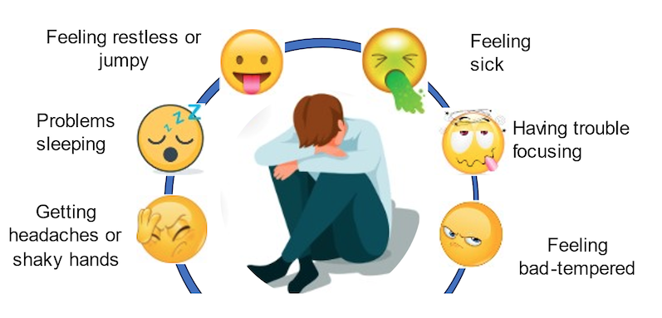
Nicotine Withdrawal
What is Nicotine?
When someone stops using nicotine, their body can react in uncomfortable ways, called withdrawal.
Notes:
Slide: Nicotine Withdrawal
Purpose
To help young people understand that when someone becomes used to nicotine, they may feel uncomfortable if they stop using it. These feelings are called withdrawal symptoms and are a sign that the body has become used to having nicotine.
Facilitator Notes
Explain that nicotine can make the brain and body get used to having it. When someone who regularly uses nicotine stops, their body may react because it is missing the nicotine it has become used to.
Introduce the word withdrawal as the name for these uncomfortable feelings.
Using the pictures on the slide, discuss some common withdrawal symptoms:
Feeling restless, fidgety or jumpy.
Finding it hard to concentrate.
Feeling grumpy, frustrated or bad-tempered.
Headaches.
Trouble sleeping.
Feeling unwell or sick.
Emphasise that not everyone experiences all these symptoms, but they can happen when someone becomes dependent on nicotine.
You may wish to compare it to how people sometimes feel tired, hungry or irritable when they miss something their body has become used to, although nicotine withdrawal can be stronger because nicotine is an addictive drug.
Keep the explanation simple and avoid creating worry. The goal is to help children understand why some people find it difficult to stop vaping once they have started.
Discussion Questions
Which of these symptoms do you think would be most difficult to deal with?
Why might someone find it hard to stop vaping if they experience these feelings?
Do any of these symptoms surprise you?
How might friends or family support someone who is trying to stop using nicotine?
Quick Summary
Withdrawal symptoms are a sign that the body has become used to nicotine.
These feelings are usually temporary and improve with time.
One reason people continue vaping is to avoid these uncomfortable feelings.
This is why it is easier not to start using nicotine in the first place.
Key Message
Nicotine can make the body become dependent on it. When someone stops using nicotine, they may experience withdrawal symptoms such as headaches, difficulty concentrating, poor sleep or feeling grumpy, which can make it harder to quit.

Slide 16
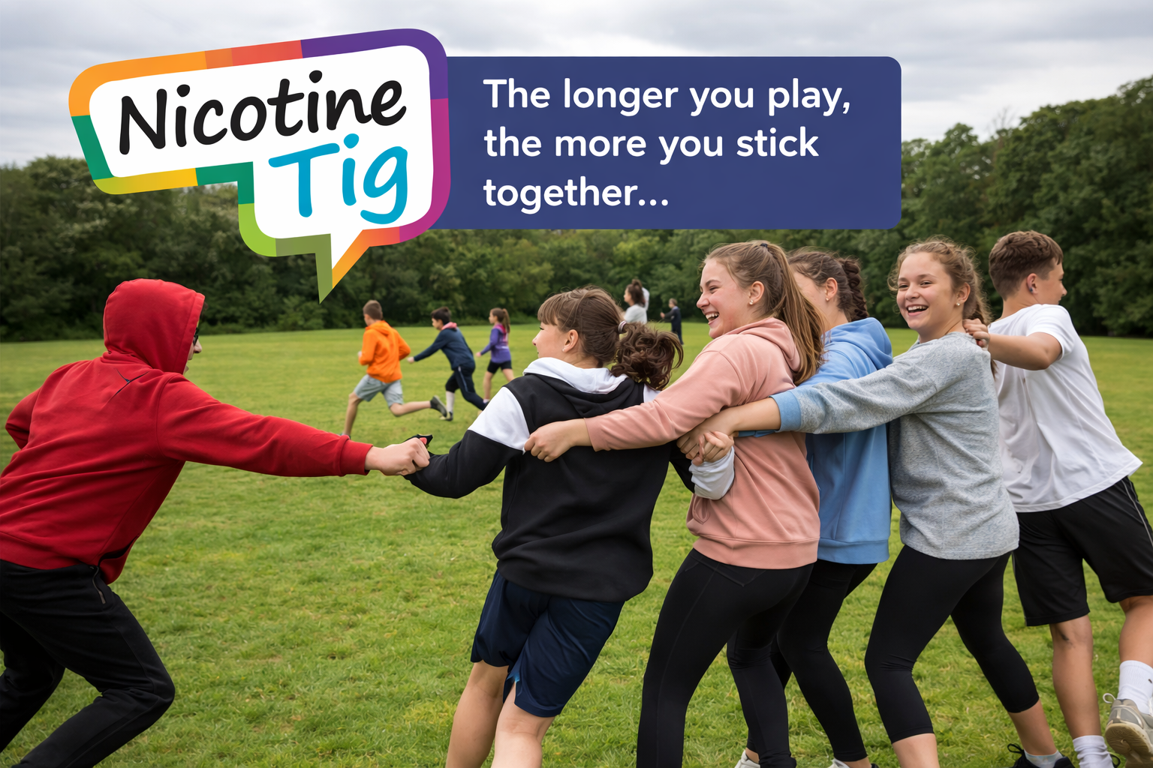
Nicotine Tig Game
What is Nicotine?
How to Play:
1 person will be ‘it’.
Everyone else moves around the space.
If you are tagged you join the chain by holding hands.
Keep moving together and tag more players.
Each tagged player joins the chain.
Keep going until everyone is connected!
Notes:
Slide: Nicotine Tig Game
Purpose
To provide an active way for young people to explore how nicotine addiction can grow over time and become harder to break away from.
Please note: This activity uses an analogy to communicate a key learning point about nicotine dependence; it is not intended to show exactly how nicotine affects the body or how addiction develops.
Facilitator Notes
Explain that the group will take part in a quick game called Nicotine Tig.
Read through the instructions on the slide and ensure everyone understands the rules before starting.
Safety reminders:
Use a clear area free from hazards.
Walking/gentle jogging should be encouraged.
If holding hands is uncomfortable, participants can link elbows or lightly touch shoulders instead.
Facilitator can observe
"At the start, everyone could move freely. As more people joined the chain, movement became harder. Nicotine can work in a similar way. The longer someone uses nicotine, the more their body can become used to it, making it harder to stop."
Keep the discussion simple and age appropriate. The aim is to support understanding that addiction often develops gradually rather than all at once.
Key Message
Nicotine addiction can grow over time. The longer someone uses nicotine, the harder it can become to break away from it.

Slide 17
Nicotine Tig Discussion
What is Nicotine?
What did we notice?​
​
What happened as the group got bigger? ​
​
Was it easier or harder to move? ​
​
How did it feel being stuck?​
​
Nicotine works a bit like this, the addiction grows and it gets harder to break away
the longer it’s there.​
Notes:
Slide: Nicotine Tig Discussion
Purpose
To help young people understand how nicotine addiction can develop over time and why it can become harder to stop the longer someone uses nicotine.
Facilitator Notes
This slide follows the Nicotine Tig activity and is designed to help participants reflect on what happened during the game.
Begin by asking participants to describe what they noticed during the activity
Use the discussion questions on the slide:
What happened as the group got bigger?
Was it easier or harder to move?
How did it feel being stuck to other people?
What strategies helped you keep moving?
Encourage participants to notice that at the start of the game it was easy to move freely, but as more people became connected, movement became slower and more difficult.
Explain that the game is a simple way of thinking about addiction. At first, someone may feel they are in control and can stop whenever they want. However, the longer nicotine is used, the more the body and brain can become used to it, making it harder to break away.
For younger children, avoid complex discussions about addiction. Focus on the idea that:
"The more people joined together in the game, the harder it was to move around. Nicotine can be a bit like that. The longer someone uses it, the harder it can be to stop.“
Quick Summary
Addiction does not happen instantly.
Nicotine can make people want to keep using it.
The earlier someone avoids nicotine, the easier it is to stay nicotine-free.
People who are addicted to nicotine can get support to help them stop.
Key Message
Nicotine addiction can grow over time. Just like in the game, the longer it continues, the harder it can become to break free.

Slide 18
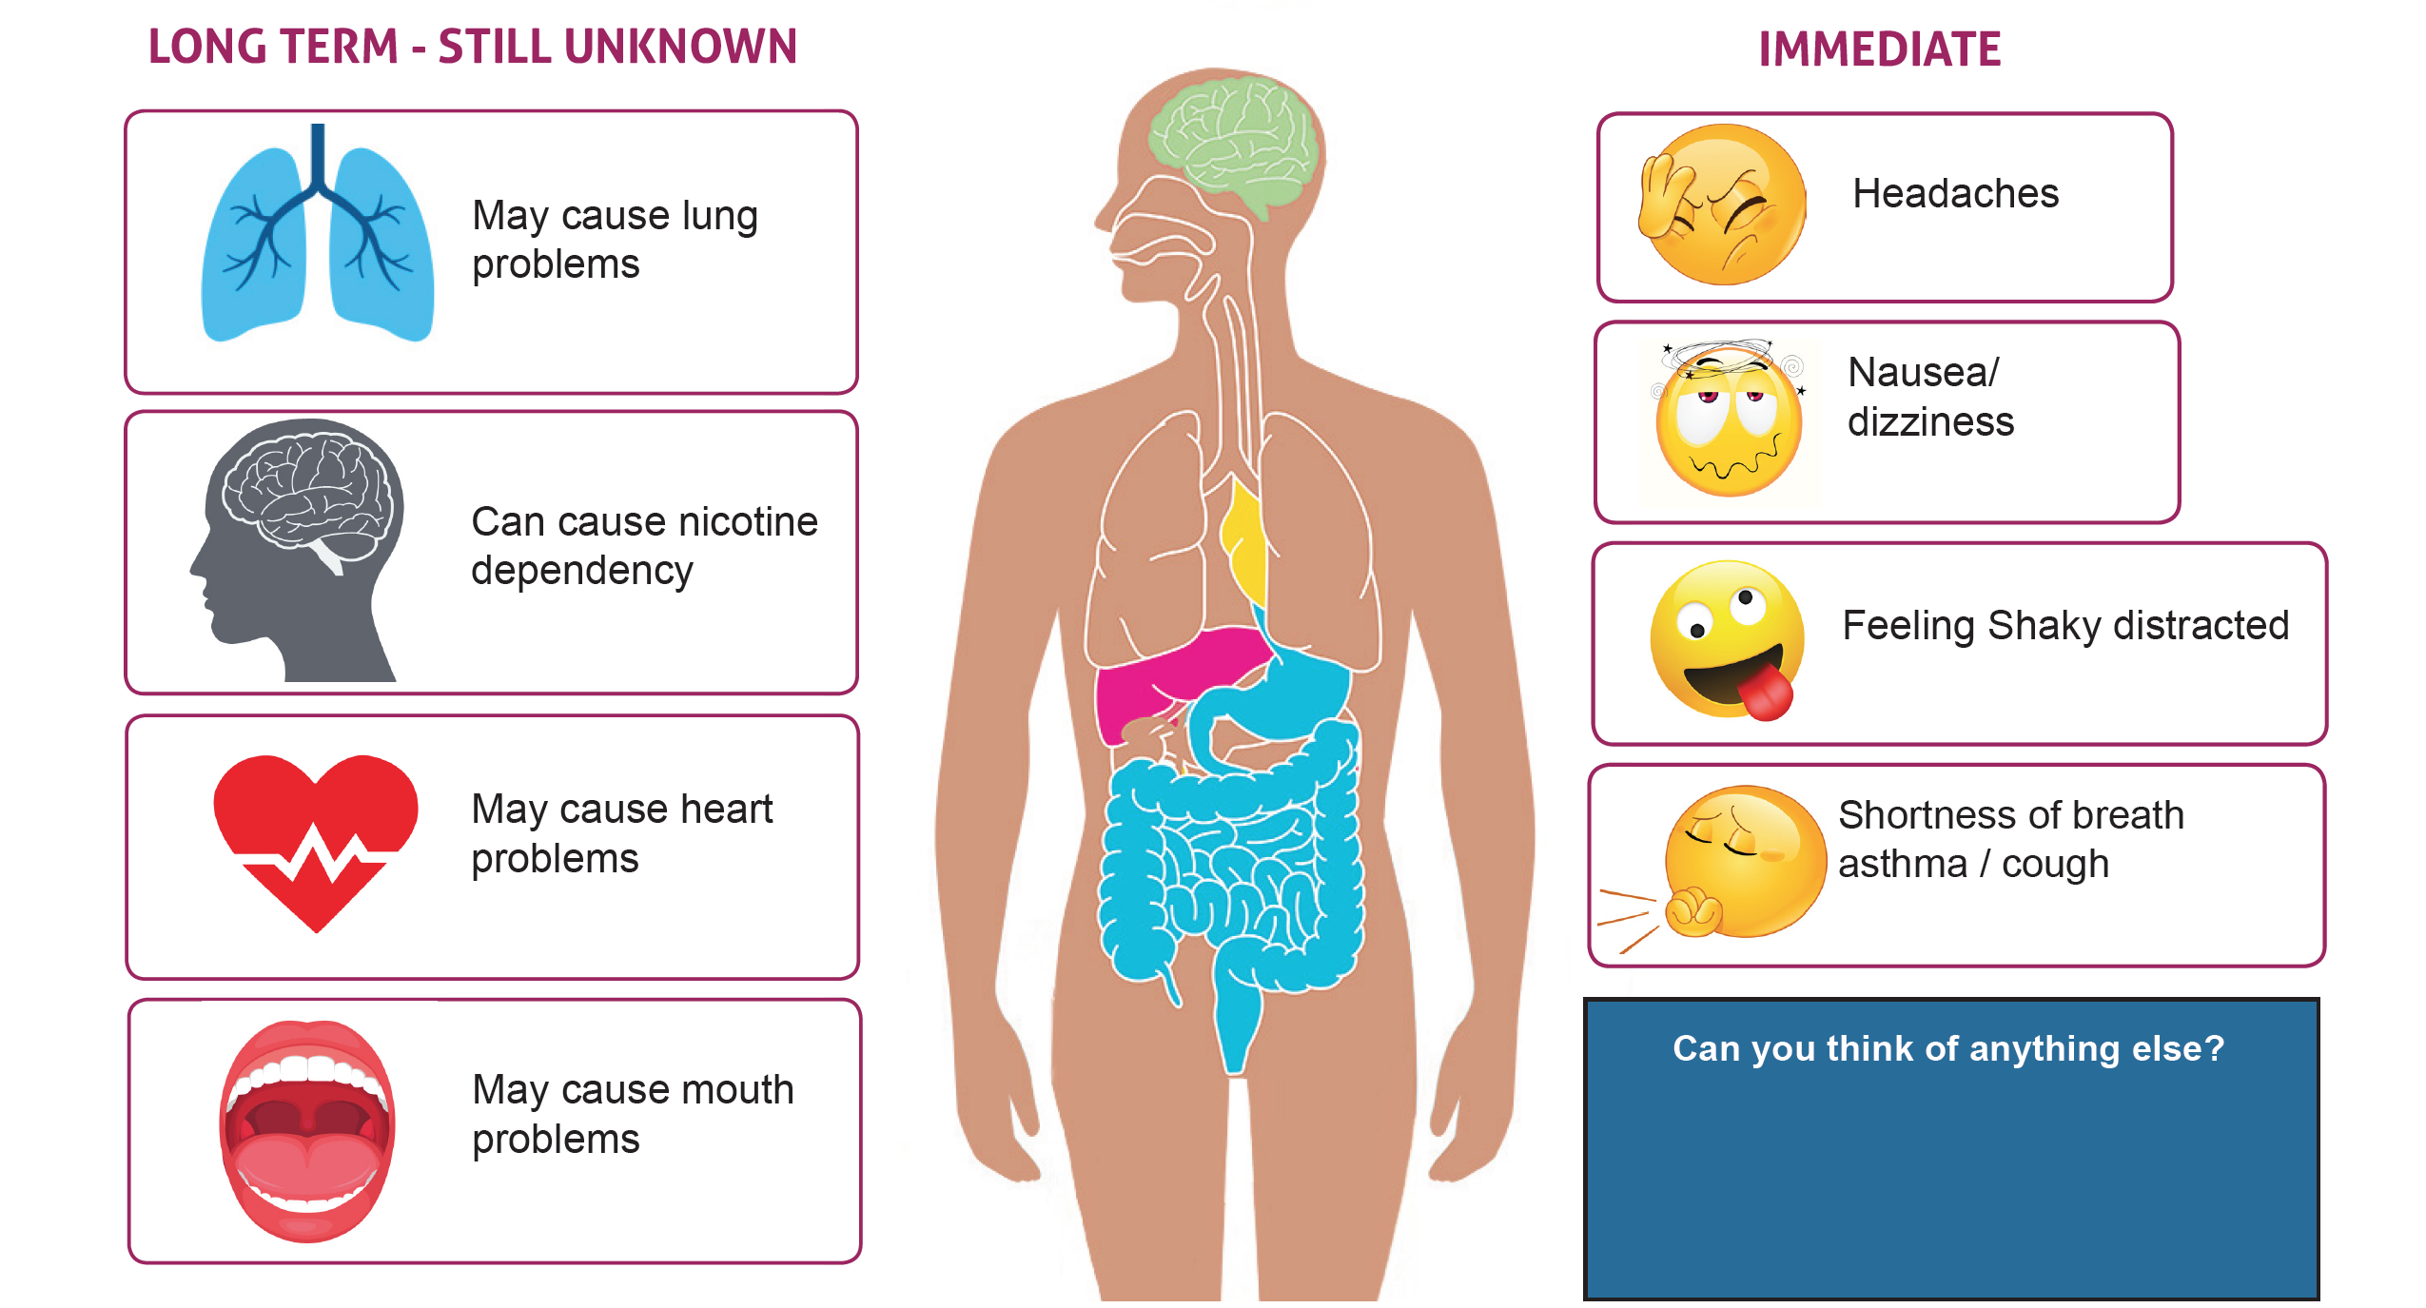
How does it affect us?
What does vaping do to bodies and brains?
Can you think of anything else?
Notes:
Slide: Vaping: How does it affect us?
Purpose
To help young people understand that vaping can affect different parts of the body and that some effects can happen straight away, while the long-term effects are still being studied.
Facilitator Notes
Begin by asking participants what they think happens to the body when someone vapes. Encourage a few responses before exploring the slide together.
Explain that vaping can affect different parts of the body in different ways.
Start with the Immediate Effects section on the right-hand side. Explain that some people can experience effects shortly after vaping, including:
Headaches
Feeling dizzy or sick
Feeling shaky, restless or distracted
Coughing, wheezing or shortness of breath
Ask if any of these effects surprise the group.
Next, move to the Long-Term Effects section.
Explain that because vapes are relatively new, scientists are still learning about their long-term effects. However, there are concerns that vaping may:
Cause problems with the lungs
Lead to nicotine dependence or addiction
Affect heart health
Cause problems with the mouth, teeth and gums
Point out that scientists continue to study vaping to better understand how it affects health over many years.
Use the body image in the centre to reinforce that vaping can affect more than just the lungs.
Discussion Questions
Which of the immediate effects would be most unpleasant?
Why do you think headaches or dizziness might happen?
Which parts of the body do you think vaping affects?
Why do you think scientists are still researching the long-term effects?
Quick Summary
Most vapes contain nicotine, which affects the brain and body.
Young people's bodies and brains are still growing and developing.
Not everyone experiences the same effects, but there are known risks.
Choosing not to vape is the best way to avoid these effects.
Key Message
Vaping can affect different parts of the body. Some effects can happen straight away, and scientists are still learning about the long-term effects on health.

Slide 19
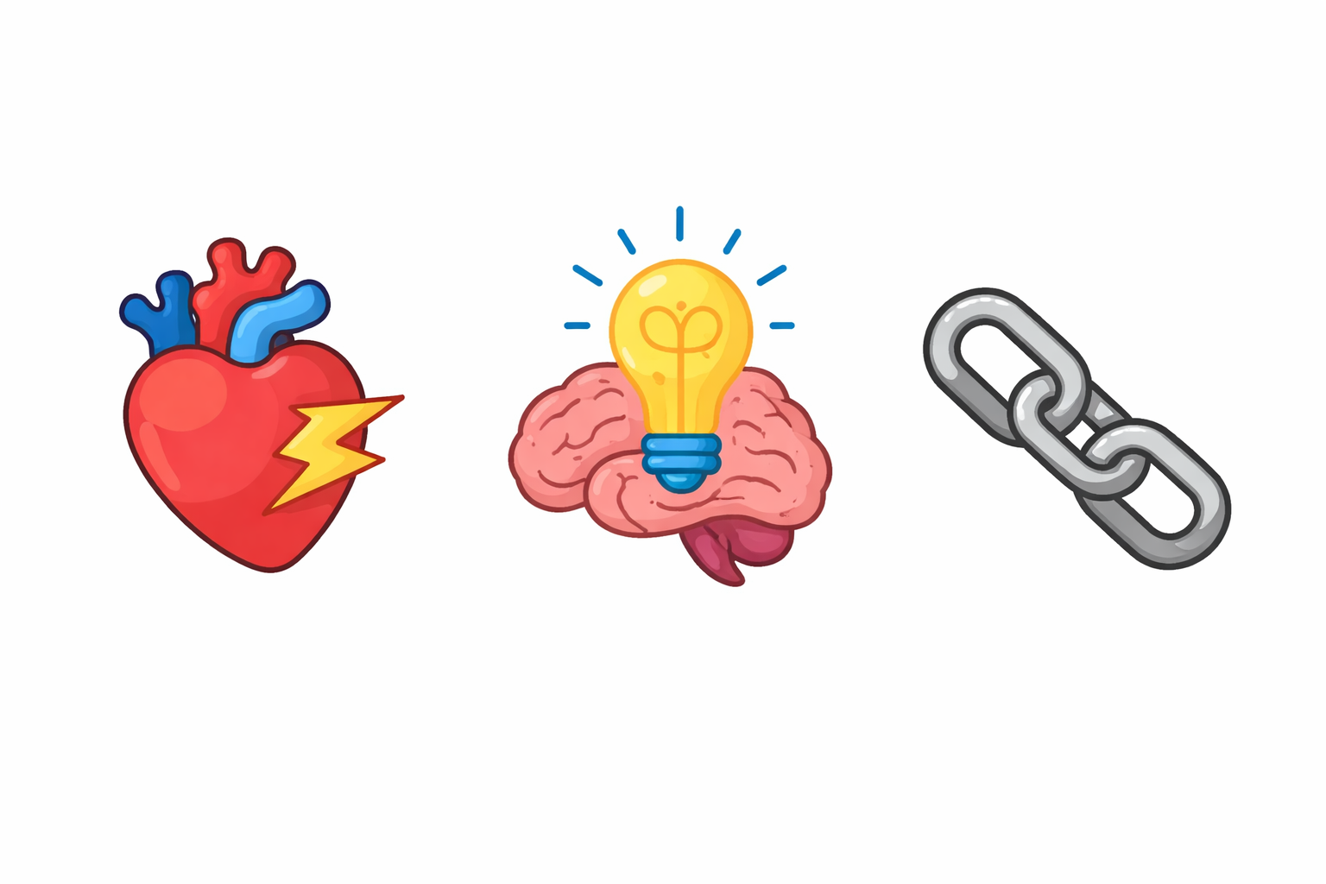
Heart rate spiking
What does vaping do to bodies and brains?
Nicotine can increase our heart rate
🔥 Challenge:
Do fast high knees or shuttle runs for 30 seconds
Then straight away: Count backwards from 50
💡 Think about:
Was it harder to think after moving fast?
Notes:
Slide: Heart Rate Spiking
Purpose
To help young people understand that nicotine can make the heart work faster and that this can affect how the body and brain feel.
Please note: This activity uses an analogy to communicate a key learning point about nicotine dependence; it is not intended to show exactly how nicotine affects the body or how addiction develops.
Facilitator Notes
Explain that nicotine is a stimulant, which means it can make the body work harder and faster for a short time.
Tell the group they are going to take part in a quick challenge to experience what it feels like when their heart rate increases.
Ask participants to:
Do high knees, shuttle runs or another safe energetic activity for 30 seconds.
Stop immediately when instructed.
Count backwards from 50 as quickly and accurately as they can.
Afterwards, ask the group:
Was your heart beating faster?
Were you breathing harder?
Was it harder to think clearly or concentrate?
Did anyone make mistakes when counting?
Explain that when our bodies are working hard, it can sometimes be more difficult to concentrate or think clearly. Nicotine can also increase heart rate and make the body feel more alert, restless or jumpy.
Make it clear that this activity is only a simple demonstration and is not exactly the same as nicotine use, but it helps show how changes in heart rate can affect how we feel.
Discussion Questions
How did your body feel after the exercise?
What happened to your breathing?
Was counting backwards easy or difficult?
Why do you think nicotine might affect how someone feels or concentrates?
Quick Summary
Nicotine can make the heart beat faster.
Nicotine can make people feel restless or jittery.
The effects are usually temporary but can make some people feel uncomfortable.
Young people's hearts and bodies are still developing.
Key Message
Nicotine can make the heart beat faster and may affect how a person feels, concentrates and reacts.

Slide 20
Brain Power
What does vaping do to bodies and brains?
Nicotine can affect memory, focus and learning​
​
🔥 Challenge:​
​
Remember the 5 items on the next slid​e
​
👉 WHILE…​
Your teammates will distract you (noise, counting, calling words!)​
​
💡 Think about:​
​
Was it easy or hard to focus?​
Notes:
Slide: Brain Power
Purpose
To help young people understand that nicotine can affect concentration, memory and learning, and to demonstrate how distractions can make it harder for the brain to focus on a task.
Please note: This activity uses an analogy to communicate a key learning point about nicotine dependence; it is not intended to show exactly how nicotine affects the body or how addiction develops.
Facilitator Notes
Explain that our brains work best when they can concentrate on one thing at a time. Nicotine can affect attention, focus and learning, especially in young people whose brains are still developing.
Tell the group they are going to take part in a quick memory challenge.
Ask participants to carefully look at the next slide and try to remember the five items shown.
While they are trying to memorise the items, ask the rest of their team to create distractions such as:
Counting aloud
Saying random words
Making background noise
Asking simple questions
After the memory challenge, ask participants to recall as many items as possible.
Use the discussion questions on the slide:
Was it easy or hard to focus?
What made it difficult?
Did the distractions affect your memory?
Would it have been easier in a quiet room?
Explain that this activity demonstrates how distractions can affect concentration and memory. Scientists are concerned that nicotine may also affect attention, learning and memory, particularly while young people's brains are still developing.
Discussion Questions
What helped you remember the items?
What distracted you the most?
Why is concentration important in school, sports and hobbies?
How might it feel if focusing became more difficult?
Quick Summary
The brain continues developing throughout childhood and adolescence.
Good concentration helps us learn new skills and information.
Nicotine can affect parts of the brain involved in attention and memory.
Looking after our brains helps us learn, play and make decisions.
Key Message
Our brains need focus to learn and remember. Nicotine can affect attention, memory and learning, especially while young people's brains are still developing.

Slide 21

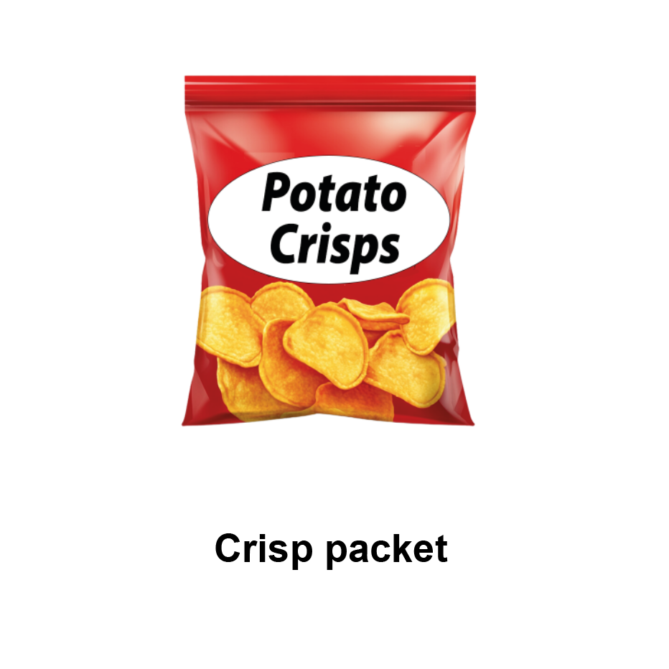
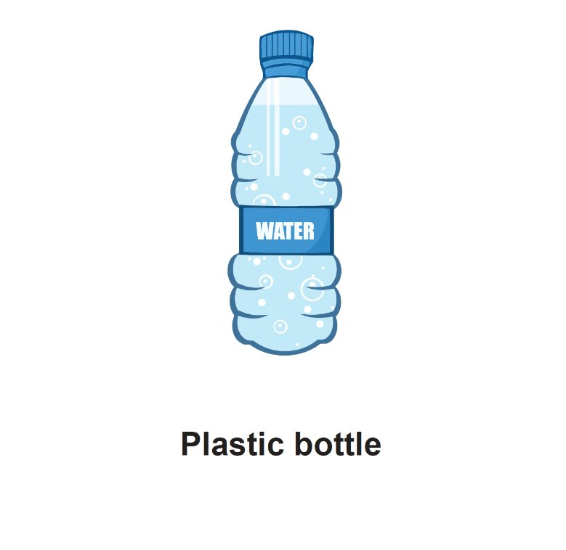
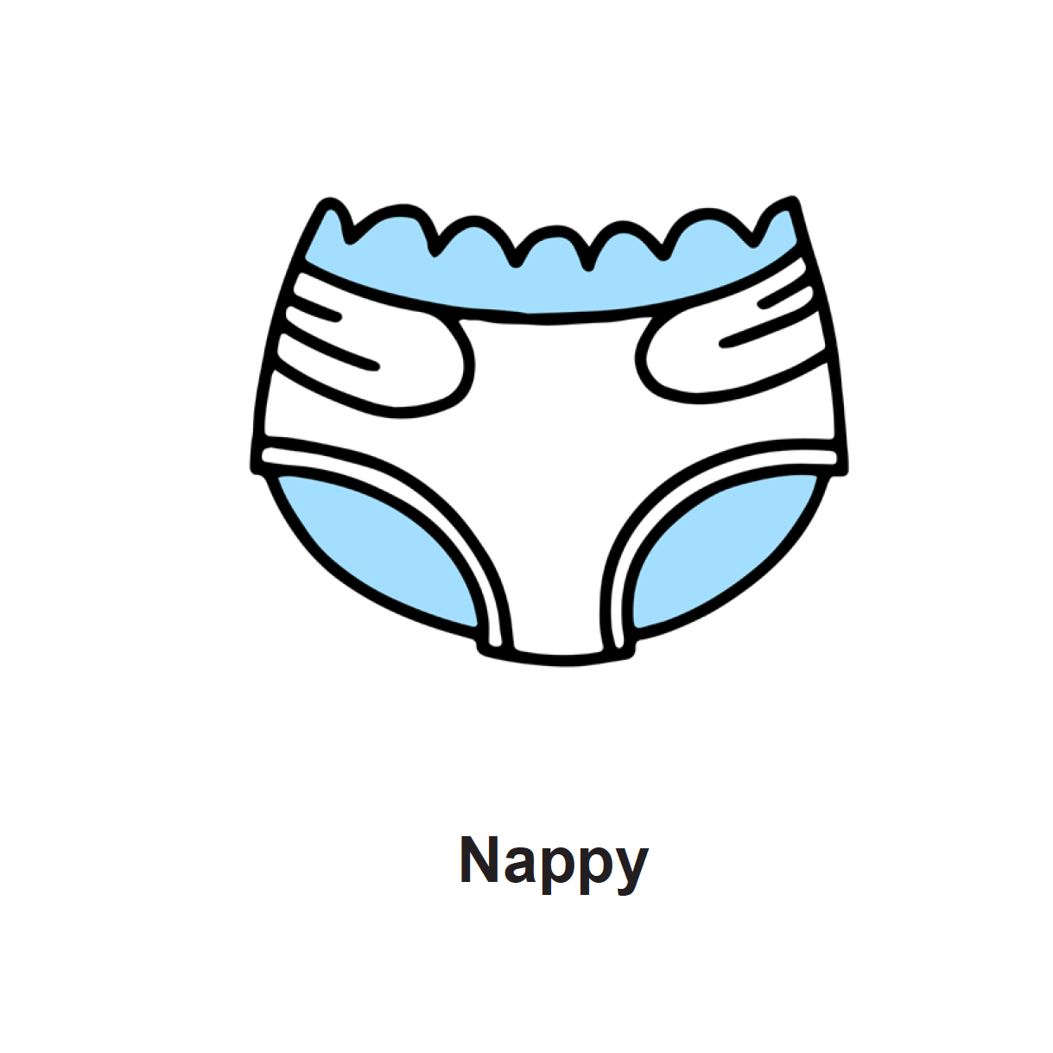
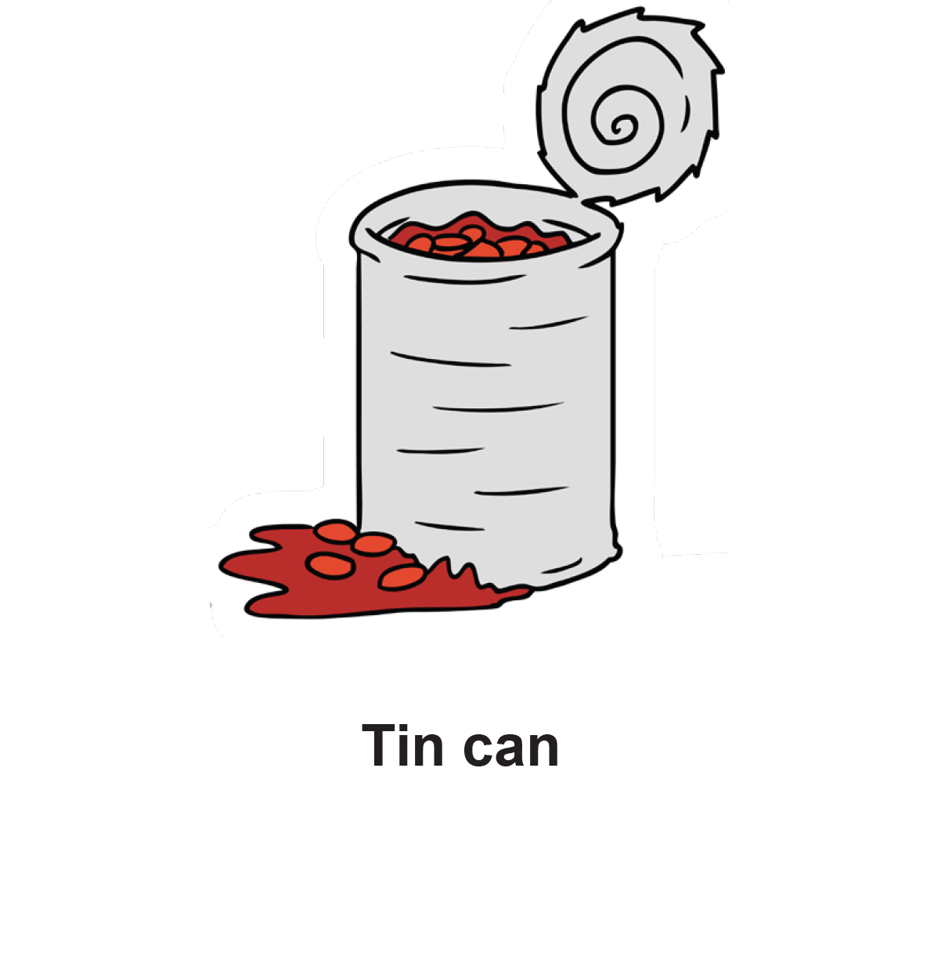


Brain Power
What does vaping do to bodies and brains?
Can you think of anything else ?
Notes:
Slide: Brain Power
Purpose
To help young people understand that nicotine can affect concentration, memory and learning, and to demonstrate how distractions can make it harder for the brain to focus on a task.
Facilitator Notes
Explain that our brains work best when they can concentrate on one thing at a time. Nicotine can affect attention, focus and learning, especially in young people whose brains are still developing.
Tell the group they are going to take part in a quick memory challenge.
Ask participants to carefully look at the next slide and try to remember the five items shown.
While they are trying to memorise the items, ask the rest of their team to create distractions such as:
Counting aloud
Saying random words
Making background noise
Asking simple questions
After the memory challenge, ask participants to recall as many items as possible.
Use the discussion questions on the slide:
Was it easy or hard to focus?
What made it difficult?
Did the distractions affect your memory?
Would it have been easier in a quiet room?
Explain that this activity demonstrates how distractions can affect concentration and memory. Scientists are concerned that nicotine may also affect attention, learning and memory, particularly while young people's brains are still developing.
Discussion Questions
What helped you remember the items?
What distracted you the most?
Why is concentration important in school, sports and hobbies?
How might it feel if focusing became more difficult?
Quick Summary
The brain continues developing throughout childhood and adolescence.
Good concentration helps us learn new skills and information.
Nicotine can affect parts of the brain involved in attention and memory.
Looking after our brains helps us learn, play and make decisions.
Key Message
Our brains need focus to learn and remember. Nicotine can affect attention, memory and learning, especially while young people's brains are still developing.

Slide 22
Nicotine Loop
What does vaping do to bodies and brains?
Nicotine is addictive
🔥 Challenge:
One person at a time:
Run to a cone and back
👉 You can’t stop unless someone decides to replace you
💡 Think about:
Did you want to stop? Did you feel stuck?
Notes:
Slide: Nicotine Loop
Purpose
To help young people understand how addiction can make someone feel stuck in a cycle, even when they want to stop.
Please note: This activity uses an analogy to communicate a key learning point about nicotine dependence; it is not intended to show exactly how nicotine affects the body or how addiction develops.
Facilitator Notes
Remind young people that nicotine is addictive. This means it can make people feel like they need to keep using it, even when they no longer want to.
Tell the group they are going to take part in a quick challenge.
Ask for a volunteer to start. Place a cone or marker a short distance away.
The volunteer must keep running to the cone and back repeatedly. They are not allowed to stop on their own. The only way they can stop is if another participant volunteers to take their place.
Allow the activity to continue for a few rounds so participants experience the feeling of wanting a break but needing someone else to step in.
After the activity, ask:
Did you want to stop?
How did it feel when you couldn't stop straight away?
Were you hoping someone would replace you?
Did anyone feel stuck?
Explain that addiction is not the same as this game, but it can sometimes feel similar. People may want to stop using nicotine but find it difficult because their body has become used to it.
Emphasise that addiction is not about being weak or making bad choices. Nicotine changes the way the brain responds, which can make stopping feel challenging.
Discussion Questions
Why do you think some people keep vaping even if they know the risks?
What might help someone who wants to stop?
Why is it easier not to start than to stop later?
Key Message
Nicotine can create a cycle that is hard to break. The best way to avoid nicotine addiction is not to start using nicotine products in the first place.

Slide 23
What do we know now…?
How do we stay safe?
In pairs or small groups share at least 1 thing
you’ve discovered:
be
Notes:
Slide: What do we know now?
Purpose
To help young people reflect on what they have learned about vaping and nicotine and reinforce key messages through discussion with peers.
Facilitator Notes
Explain that the group has now explored what vaping is, what nicotine does, and how vaping can affect our bodies and brains.
Ask participants to turn to a partner or small group and share at least one thing they learned, found surprising, or will remember from today's session.
Give groups 2–3 minutes to discuss. Encourage everyone to contribute, even if it is just one fact or idea.
After the discussion, invite volunteers to share their thoughts with the wider group. Use the speech bubbles on the slide to record key points if appropriate.
If needed, prompt with questions such as:
What was the most surprising thing you learned?
What did you learn about nicotine?
What did you learn about addiction?
What did you learn about how vaping affects the body or brain?
What advice would you give another young person about vaping?
Key Messages
Most young people choose not to vape.
Vapes are designed for adults trying to stop smoking, not for children.
Most vapes contain nicotine, which is addictive.
Nicotine can affect the body, brain, focus, mood and heart rate.
The best way to avoid nicotine addiction is not to start vaping.

Slide 24

What should Katie do?
How do we stay safe?
At break, Katie is near the school gates.
A well-dressed older teen, Jay, walks over.
Jay nods at Katie and says...
Hey, you cool?
You want one?
Jay pulls out a vape and hands
it to Katie, saying ...
Don't worry it's free. First one's always free. I've got loads.
Katie is unsure.
She's never vaped before, and she doesn’t really
know Jay, but he seems friendly and confident.
If you ever need more
- or anything else - I can hook
you up. Easy.
Jay smiles and adds ...
Notes:
Slide: What should Katie do?
Purpose
To help young people recognise some of the warning signs of grooming or exploitation, practise how to respond safely if they are offered a vape or another substance and build confidence to say no and seek support.
Facilitator Notes
Explain that this story is fictional, but situations like this can happen. Share that there are no perfect answers, but they should think about what feels safe and why.
Hold discussions around:
What warning signs did you notice?
Why do you think Jay offered the vape for free?
Why might Katie find it difficult to say no?
What could Katie do next?
Consider the warning signs, such as:
Jay is much older than Katie.
Katie doesn't really know him.
He offers something for free.
He tells her the first one is free.
He says he can get her "more" or "anything else" later.
He is trying to build trust quickly.
Explain that people who want something from someone don't always seem scary. They can appear friendly, generous or confident. Offering gifts or free items is sometimes a way of encouraging someone to come back for more.
For the final activity, invite pairs to either:
Act out how Katie could respond safely, or
Write a short script showing what Katie might say.
If groups struggle, suggest simple responses such as:
"No thanks."
"I'm not interested."
"I've got to go."
Walking away and joining friends.
Telling a trusted adult if the interaction continues.
Key Messages
If something feels wrong, trust your instincts.
You never have to accept something because it is free.
It is okay to say no and walk away.
If someone you don't know well keeps offering you vapes, alcohol, drugs or gifts, tell a trusted adult.
Being able to recognise these warning signs can help keep you and your friends safe.

Slide 25
What should Katie do?
How do we stay safe?
In pairs discuss:
Are there any warning signs for Katie?​
​
​
What do you think Katie should do?​
​​
be
Can you act this out? Or write a script? ​
​
Notes:
Slide: What should Katie do?
Purpose
To help young people recognise some of the warning signs of grooming or exploitation, practise how to respond safely if they are offered a vape or another substance and build confidence to say no and seek support.
Facilitator Notes
Explain that this story is fictional, but situations like this can happen. Share that there are no perfect answers, but they should think about what feels safe and why.
Hold discussions around:
What warning signs did you notice?
Why do you think Jay offered the vape for free?
Why might Katie find it difficult to say no?
What could Katie do next?
Consider the warning signs, such as:
Jay is much older than Katie.
Katie doesn't really know him.
He offers something for free.
He tells her the first one is free.
He says he can get her "more" or "anything else" later.
He is trying to build trust quickly.
Explain that people who want something from someone don't always seem scary. They can appear friendly, generous or confident. Offering gifts or free items is sometimes a way of encouraging someone to come back for more.
For the final activity, invite pairs to either:
Act out how Katie could respond safely, or
Write a short script showing what Katie might say.
If groups struggle, suggest simple responses such as:
"No thanks."
"I'm not interested."
"I've got to go."
Walking away and joining friends.
Telling a trusted adult if the interaction continues.
Key Messages
If something feels wrong, trust your instincts.
You never have to accept something because it is free.
It is okay to say no and walk away.
If someone you don't know well keeps offering you vapes, alcohol, drugs or gifts, tell a trusted adult.
Being able to recognise these warning signs can help keep you and your friends safe.

Slide 26

Role Play – How to say ‘No.’
How do we stay safe?
In pairs take it in turns to suggest different scenarios and practicing ‘fudging’ answers to resist/refuse someone.
For example:
Jamie is at the park with his pals when someone’s older cousin offers him a vape, saying,
‘Go on have a puff it tastes just like sweets.’ Jamie feels unsure and doesn’t want to look daft.
What should he do?
Notes:
Slide: Role Play
Purpose
To give young people the opportunity to practise responding confidently and safely if they are offered a vape or find themselves in a situation where they feel pressured. This scenario builds on the previous two, supporting young people to play it forward around what happens next.
Facilitator Notes
Explain that practising what to say makes it much easier to respond in real life. Remind everyone that there are lots of safe ways to refuse and leave a situation.
Ask young people to work in pairs. One person creates a simple scenario where someone is being offered a vape, and the other practises responding. They should then swap roles and try a different situation.
You may use the example on the slide or encourage participants to think of their own scenarios, such as:
An older young person offers them a vape.
A friend says, "Everyone's doing it."
Someone offers a free vape at the park.
Someone says, "Don't be boring—just try it once."
Encourage participants to use one of the refusal strategies they have already learned, such as:
Saying "No thanks."
Giving a simple reason.
Walking away.
Joining another group of friends.
Telling a trusted adult if they continue to feel uncomfortable.
After a few minutes, bring the group back together and ask:
Which responses felt easiest?
Which felt hardest?
What would make it easier to say no in real life?
What could you do if someone kept asking?
Remind participants that they do not have to be rude or argue. Their safety is the priority, and it is always okay to leave a situation that makes them feel uncomfortable.
Key Message
The more you practise saying no, the easier it becomes. You have the right to make your own choices, walk away from pressure, and ask a trusted adult for help if you need it.

Slide 27
What could I say?
How do we stay safe?
I think home is calling, I have to answer!
That's not something I want to do.
I don't have a phone, so I can't stay out.
I just remembered that I have dancing tonight,
I need to go.
I have to go, I can't be home too late.
Notes:
Slide: What should I say?
Purpose
To help young people practise simple, confident ways to say no, leave a situation safely, and avoid feeling pressured into accepting a vape or another substance.
Facilitator Notes
Explain that saying no does not always have to mean simply saying "No." Sometimes it can feel easier to give a reason, change the subject, or leave the situation.
Read through the examples on the slide together. Ask which responses they think would work best and why.
Remind the group that there is no single "right" answer. Different responses work for different people and situations. The most important thing is to get away safely and not feel pressured into doing something they don't want to do.
Invite participants to work in pairs and either:
Choose one of the responses and act it out.
Think of another safe response they could use.
Practise saying it confidently.
Encourage everyone to use a clear voice, make eye contact if they feel comfortable, and then walk away or rejoin friends.
If appropriate, introduce the idea of the "broken record" technique—calmly repeating the same response if someone keeps asking.
Examples include:
"No thanks."
"I'm not interested."
"That's not for me."
"I've got to go."
"My friends are waiting."
Key Message
You don't need to make excuses or argue. It's okay to say no, leave the situation, and ask for help if someone won't take no for an answer.

Slide 28
What should we remember?
How do we stay safe?
be
Surround yourself with trusted friends who respect your decisions​
You don’t have to impress others -
your health and future matter most​
You are
strong enough
to have a voice​
be
If you ever feel unsure, talk to an adult you trust​
Doing your thing is always braver than following the crowd.​
Notes:
Slide: What should we remember?
Facilitator Notes
Finish by reminding the group that today's session isn’t just about vaping—it was about making confident choices.
Reinforcing:
How to recognise peer influence and the risks it can bring
How you can say "no" confidently when you want to.
How to have a plan for tough choices
How to support each other
What's one thing you'll remember from today?
What's one thing you could do if someone offered you a vape?
Reinforce that everyone has the right to make their own choices, say no, and ask for help if they ever need it.
Key message: Being yourself and making healthy choices is always stronger than following the crowd.

Slide 29
Need to talk?
Speak to a trusted adult if anything you’ve learned or discussed has worried you…
If you are worried anything we have talked about today, you can find support or information
Childline Scotland is a free, confidential telephone counselling service for children and young people.
Call: 0800 1111
https://www.childline.org.uk/
Notes:
Slide: Need to Talk?
Purpose
To ensure young people know where they can access support, information or someone to talk to if anything discussed during the session has raised questions, worries or concerns.
Facilitator Notes
Explain that sometimes discussions about vaping, nicotine, health, family members or friends can make people think about their own experiences or leave them with questions.
Remind young people that they do not need to deal with worries on their own and that there are trusted adults and organisations that can help.
Briefly introduce Childline as a free, confidential service for children and young people where they can talk about anything that is worrying them.
You may also wish to remind participants that they can speak to:
A parent, carer or trusted family member
A youth worker
A teacher or school staff member
A school nurse
Another trusted adult
Reassure the group that asking for help is a positive thing to do and that support is available even if a problem feels small.
Key Message
If something is worrying you, talk to someone you trust. Support and advice are available, and you do not have to deal with problems on your own.
Quit your way Youth - NHSGGC
Young people and vaping briefing paper - NHSGGC
Vaping addiction soon takes hold | NHS inform

