Slide 1



Vaping & Nicotine
Notes:
Facilitator Guide
About this Resource:
This resource has been designed for trusted adults working with young people across the third sector.
The resource aims to encourage discussion, critical thinking and informed decision-making. The aim is not to tell young people what choices to make. The content and activities are designed to explore influences, consider consequences and develop confidence in making decisions that are right for the young person.
The slides can be displayed but could also just be used as structure/framework for facilitator to run the session. The resources are discussion and activity based with shorter games and some extended project-based work where there is more time available.
Choose the parts of the course that are most relevant to your setting. The age groups for the resources are a guideline; it may be helpful to use games/activities from more than one age group resource. There is also more than one session’s content in each age group resource, facilitators should tailor to suit the session time/number of sessions they can allocate to the topic.
Good practice around substance education tells us that revisiting topics is helpful, breaking the resource into smaller chunks is a good way to use it.
Certain topic areas have been set within one of the age group resources, where we feel the topic is most likely to become relevant. Please see following content list to support using parts of resource should the areas be raised by the young people at a different age and stage. For example, we have put information about vape spiking in the 16+ resource. It can be accessed there and used for younger age groups should this be an area of concern for trusted adults or an area of relevance/interest for the young people they are working with.
8 – 12 yrs resource:
What is Vaping?
What is Nicotine?
Impact on body/brain.
Influence/Pressure scenarios.
12 – 15 yrs resource:
Effects of nicotine and withdrawal.
Unregulated vapes
Fire Risk/Storing vapes safely
Pressure/Influence and choices around vaping
Diversionary activities/alternative ways to relax/stay stress free
16+ resource:
Summary of vaping/nicotine knowledge
How does vaping affect each area of a person’s life
Unregulated vapes/THC vapes
Staying safe around vapes/vape spiking
Making choices around vapes/nicotine
Nicotine pouches
Vapes and Social Media
Vaping and the Law
Vaping: Is it a local issue. Includes creating a group agreement to manage vaping in youth organisation settings.
The resources may encourage questions/discussion about other areas that young people feel are relevant to them such as other substances, issues related to risk taking, relationship-based issues etc. This can be positive; facilitators don’t need to know all the answers to hold useful discussion and to agree to revisit any areas that are clearly important to work on with the group.
Overview of Outcomes:
Increase knowledge and understanding of vaping and nicotine
Consider risks and protective factors around vapes and nicotine.
Explore influences that can affect decision-making.
Practise discussing challenging situations.
Develop confidence in making informed choices.
Before starting a session:
Consider prior knowledge and lived experience of those within the group.
Agree group expectations.
Make it clear that nobody is required to share personal experiences.
Be prepared to signpost support where need arises.
Facilitation style:
Use open questions wherever possible.
Encourage discussion between young people.
Acknowledge different viewpoints.
Focus on curiosity rather than judgement.
Start with where young people are at, noting they may not have much interest or connection to longer term health harms.
Encourage critical thinking as opposed to ‘telling’ where possible.

Slide 2
What do we need to think about as a group when we discuss Vaping and Nicotine?
Group agreement
Notes:
Slide: Group Agreement
Facilitator establishes a group agreement with young people. It may be helpful to have some understanding of the lived experiences of the group to support best delivery of the resource. This may be something young people are happy to share, or something the group decides is private. In practice we found young people were keen to share their experiences when a safe space was facilitated by trusted adults.

Slide 3
Vaping knowledge
Vaping and social media
What are we covering?
Vaping and the law
What can we do about it?
Notes:
Slide: What are we covering?
Facilitator shares summary of the topics that will be covered during the session so young people have an idea of what they will be looking at. It may be relevant to look at the resources designed for other age groups to fill in any prior knowledge gaps.

Slide 4
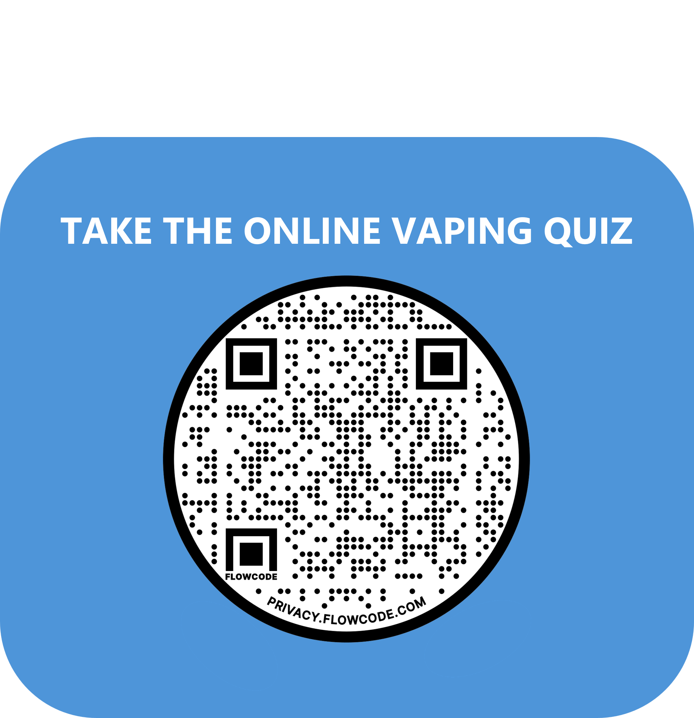
Vaping: what do we know?
Vaping knowledge
https://talkabouttrust.org/resources/schools/vaping-what-do-we-know/
Notes:
Slide: Vaping Knowledge Quiz
https://talkabouttrust.org/resources/schools/vaping-what-do-we-know/
Purpose
This opening activity helps establish what young people already know about vaping and identifies common myths and misconceptions. It also provides a baseline for discussion throughout the session.
What to Do
Invite participants to scan the QR code and complete the quiz individually.
If technology is unavailable, questions can be read aloud and answered by a show of hands or by moving to different areas of the room representing different answers.
Discussion Points
After the quiz, ask:
Which question surprised you most?
Were there any questions that caused disagreement?
Q1.
“What % of 11 – 17 yr olds do you think vape regularly?”
Options:
7.5%
25%
50%
75%
Answer Detail: 7.5%
Most young people do not vape
Although youth vaping receives a lot of attention, the majority of 11–17-year-olds do not vape regularly. It can feel more common than it actually is because vaping is highly visible on social media, in schools and in public spaces.
Q2.
“Vaping is safe, it’s just water vapour”
Answer Detail:❌ False
Vaping is not "just water vapour"
Vapes contain a range of substances including nicotine, flavourings and other chemicals. While vaping is considered less harmful than smoking, it is not risk-free.
Q3.
“Most vapes contain nicotine”
Answer Detail:✅ True
Nicotine can affect developing brains, increase heart rate and blood pressure, affect oral health and may contribute to feelings of anxiety or stress. Many young people start vaping for social reasons but continue because nicotine creates dependence.
Q4.
“Rank these from LOW → HIGH risk”
Someone over 18 using a regulated vape bought from a supermarket
Sharing a vape with a friend
Buying a vape online
Someone using a THC vape
Answer Detail: There is no ‘right’ answer as all examples carry risk.
Encouraging debate around the risks of each scenario adds value to the quiz.
Q5.
If someone spends £5 a day on vaping, how much is the cost for the year?
Answer Detail:
£1825
365 days at £5 per day
365 X £5 = £1825
Q6.
Nicotine raises blood pressure and can cause feelings of anxiety
Answer Detail: True
Nicotine is a stimulant. It can increase heart rate and blood pressure and may contribute to feelings of anxiety, nervousness or restlessness. When nicotine levels drop, some people experience cravings, which can make them feel irritable, stressed and can raise anxiety.
Q7.
What % of vapes sold have Trading Standards found to be fake/unregulated?
Answer Detail:33%
Trading Standards regularly identify illegal and non-compliant vaping products. These products may contain higher nicotine levels, larger tank sizes or ingredients that do not meet UK safety regulations. Key takeaway: Buying from unreliable sources can increase risk because users cannot always be sure what the product contains.
Key Messages:
Not all vapes are equally risky
Risk can vary depending on how it is bought and used.
Generally:
Regulated products purchased legally are lower risk.
Sharing vapes increases the risk of spiking and spreading infections.
Products bought online may not always meet UK regulations.
Illegal or THC-containing vapes can carry significantly higher risks because users may not know exactly what they contain.

Slide 5

How can vaping affect young people?
How vaping can affect young people?
Vaping knowledge
Draw the outline of a person
Choose a character:
“A young person who vapes at the weekends”
“A young person who vapes daily”
“A young person trying to quit vaping”
“A young person who has never tried vaping”
Build their story:
👉 What happens to this person over time
Stick post its around the character mapping their outcomes:
Think about their:
Body Mood
Lifestyle Health
Finance
Notes:
Slide: How Vaping Can Affect Young People
Purpose
To help young people explore the potential impacts of vaping from multiple perspectives and recognise that vaping can affect different areas of a person's life, not just physical health.
This activity encourages critical thinking and discussion. It is aiming to support young people to consider impact on personal outcomes.
Resources Needed
Large sheet of paper or flipchart paper
Pens or markers
Sticky notes/Post-it notes
Instructions
Divide participants into small groups.
Ask each group to draw the outline of a person or provide a pre-printed body template.
Allocate or allow groups to choose one of the following characters:
A young person who vapes at weekends
A young person who vapes daily
A young person trying to quit vaping
A young person who has never tried vaping
Ask groups to think about what might happen to that person over time.
Participants should write ideas on sticky notes and place them around their character.
Encourage groups to think about:
Body
Mood
Lifestyle
Health
Finances
Invite each group to share their character's story with the wider group.
Facilitator Notes
There are no correct answers in this activity. The aim is to explore possibilities and understand that different experiences can lead to different outcomes.
Encourage participants to consider both short-term and longer-term effects.
If groups become focused only on negative impacts, invite them to think about why the person may have started vaping and what needs or motivations might be influencing/underpinning their behaviour.
Suggested Prompts
Body
How might vaping affect energy levels?
Could it impact sporting performance?
What physical effects might someone notice?
Mood
How might they feel when vaping?
How might they feel if they can’t vape?
Could vaping affect stress, anxiety or concentration?
Lifestyle
Who do they spend time with?
Does vaping influence their daily routine?
Does it affect activities, hobbies or interests?
Health
Are there any short-term health effects?
How might their health be different after months or years?
What could happen if they continue or stop?
Finances
How much money might they spend?
What else could that money be used for?
Could cost affect future choices?
Possible Discussion Points
Young Person Who Vapes at Weekends
May see vaping as a social activity.
May not view themselves as dependent.
Are still exposed to nicotine and risk developing a habit.
Spending may seem small but can accumulate over time.
Young Person Who Vapes Daily
More likely to develop nicotine dependence.
May experience cravings.
Increased financial costs.
Vaping may become part of daily routines and decision-making.
Young Person Trying to Quit
May experience cravings and frustration.
Could feel proud of progress.
May save money.
Might notice improvements in fitness or wellbeing over time.
Young Person Who Has Never Tried Vaping
Avoids nicotine dependence.
Keeps money for other priorities.
May still experience peer influence or curiosity.
Demonstrates that not vaping is a common choice among young people.
Debrief Questions
Which character might face the biggest challenges?
Which outcomes surprised you?
What factors influenced whether someone starts, continues or stops vaping?
What support might each character need?
Key Messages
Vaping can affect many different aspects of a person's life.
Experiences vary from person to person.
Nicotine dependence can influence behaviour, mood and spending habits.
Most young people do not vape and there are many reasons why people choose not to.
Understanding the wider impacts of vaping can help young people make informed decisions.

Slide 6
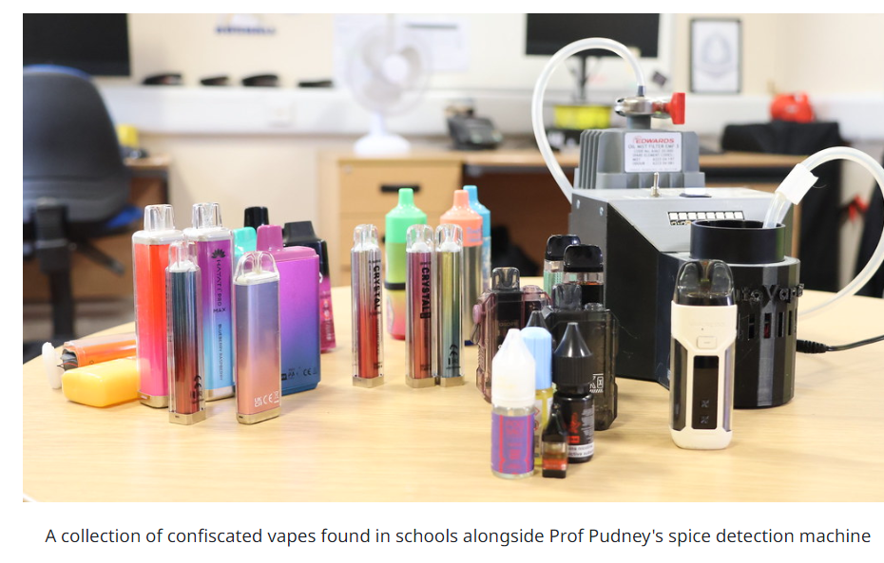
Unregulated/fake vapes
Vaping knowledge
You need to know ...
Fake vapes had chemicals including lead, nickel, chromium, acetaldehyde, formaldehyde, spice & THC in them when tested.
Over 6,000 fake vapes were seized in Glasgow in 2024.
Remember if you don’t know where a vape came from then you don’t know what is in it!
Notes:
Slide: Unregulated/Fake Vapes
Purpose
To raise awareness that not all vapes meet UK safety regulations and that the source of a vape can affect the level of risk.
Facilitator Notes
Use this slide to encourage critical thinking about where products come from and why regulations exist. Focus on uncertainty and unknown contents rather than using scare tactics.
Discussion Questions
Why might some people choose cheaper or unregulated products?
How would someone know if a vape is fake?
Why do you think regulations are important?
Key Message
When products are unregulated, users cannot always be sure what they contain. Understanding the difference between regulated and unregulated products can help young people make safer and more informed choices.
Sources: Trading Standards Glasgow and UK

Slide 7
'THC' Vapes
Vaping knowledge
You need to know ...
Some contain Spice
which has a much higher
risk of adverse effects.​
THC vapes have led to hospitalisations.
We don’t always know what’s in a vape. ​
​
Refillable vapes can
have substances added to them.
Around 1 in 6 vapes,
tested from
across 38 schools in the UK,
contained Spice. ​
Notes:
Slide: THC Vapes
Purpose
To increase awareness that some vapes may contain substances other than nicotine and that people cannot always be certain what is inside a vape.
Facilitator Notes
Approach this topic factually and without judgement. Focusing on the risks associated with unknown contents and unregulated products rather than the legal status of substances.
Discussion Questions
Why might someone not know what is inside a vape?
What risks come with using a product if you don't know exactly what it contains?
Why might some people be more willing to take this risk than others?
Key Message
Not all vapes contain what people think they do. When products are altered, shared or obtained from unregulated sources, there is greater uncertainty and increased risk.

Slide 8
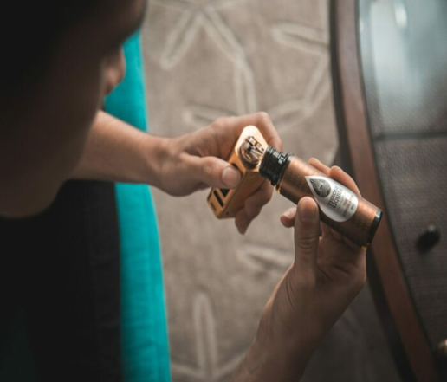
Staying safe around vapes
Vaping knowledge
You need to know ...
Don't share vapes
especially with someone you don’t know.
Keep your vape safe: store it like a phone or bank card.
Vape spiking is:
adding a substance, such as THC/Spice, to a vape without someone knowing.
If a vape is dropped or lost and found again don’t use it.​
If it has gone missing it could have been spiked.
Notes:
Slide: Staying safe around vapes
Purpose
To raise awareness that people should not use a vape if they are unsure of its contents and to encourage safer decision-making around sharing or borrowing vapes.
Facilitator Notes
Approach this as a personal safety message. Avoid creating unnecessary fear but reinforce that people should only use products they trust and know the source of.
Discussion Questions
Why might someone share a vape?
What could happen if someone doesn't know what is inside a vape?
What advice would you give a friend who was offered a vape by someone they don't know well?
Key Message
Young people should never feel pressured to use a vape and should avoid using vapes if they are unsure what is inside them. Knowing where a product comes from can help reduce risk.
Signposting
Remind participants that if someone feels unwell after vaping or believes a vape may have been tampered with, they should seek help from a trusted adult or medical professional as soon as possible.

Slide 9


Making Choices: What do you think?
Vaping knowledge
Scenario:
Ava’s boyfriend often has a THC vape with him.
He’s offered it to her before and laughed at her
for being scared to try it.
In groups:
Discuss the scenario
What positive and negative thoughts might Ava have?
Agree 3 possible choices she could make.
Play each choice forward in your mind.
What are the consequences of each choice?
Can you think of anything else ?
Notes:
Slide: Making Choices – What Do You Think?
Purpose
To help young people explore how peer pressure, relationships and personal values can influence decision-making.
Facilitator Notes
There is no single "correct" answer. Encourage participants to consider different viewpoints and recognise that choices often involve weighing up short-term and long-term consequences.
Keep the focus on decision-making skills rather than judging Ava or her boyfriend.
Discussion Questions
What pressures might Ava be experiencing?
Why might it be difficult to say no in this situation?
What qualities would a healthy and respectful relationship show?
Key Message
Good decisions are not always the easiest decisions. Being able to make choices that reflect your own values and boundaries is an important life skill.
This activity supports young people to explore the feeling of being torn between options and use the technique of linking cause and effect to support decision making.
The question can be altered to suit and/or young people can be encouraged to create relevant questions for the Making Choices approach.
Although the activity doesn’t demand it discussions may expand to young people exploring the relationship between Ava and her boyfriend and the possible risks. Vape spiking may be tabled by some as a possibility.

Slide 10


Making Choices: What do you think?
Vaping knowledge
Scenario:
Leah is at a party. She doesn’t know a lot of people and is feeling anxious. A guy passes her a vape and says, “it’ll help you relax.”
Leah is playing football the next morning. She’s not actually sure what’s in the vape.
In groups:
Play forward this scenario. Create 3 possible endings to Leah’s story.
Can you think of anything else ?
Notes:
Slide: Making Choices – What Do You Think?
Purpose
To help young people explore how peer pressure, relationships and personal values can influence decision-making.
Facilitator Notes
Read through Leah’s scenario and ask young people to work in small groups to create three possible endings.
Encourage them to think about what might influence Leah’s choice, including anxiety, peer pressure, not knowing what is in the vape and wanting to play well at football the next day.
Ask groups to share their endings and discuss which choices would help Leah stay safe. Other areas to explore could be how to say no and how she could find another way to manage her anxiety.
Key Message
Good decisions are not always the easiest decisions. Being able to make choices that reflect your own values and boundaries is an important life skill.
This activity supports young people to explore the feeling of being torn between options and use the technique of linking cause and effect to support decision making.
The question can be altered to suit and/or young people can be encouraged to create relevant questions for the Making Choices approach.
Although the activity doesn’t demand it discussions may expand to young people exploring the intentions of the guy who offers Leah the vape and the possible risks. Vape spiking may be tabled by some as a possibility.

Slide 11
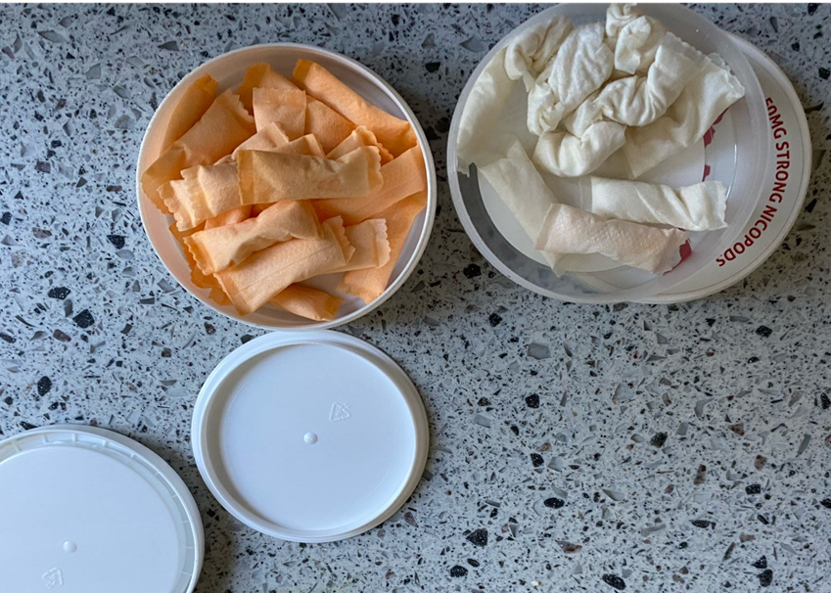
Nicotine pouches
Vaping knowledge
You need to know ...
Testing has shown
snus often have very
high levels of nicotine.
This can make a person feel
dizzy and unwell.
Nicotine pouches,
or white snus, are small sachets containing nicotine, sweeteners and flavourings. ​
They do not contain tobacco.
Research shows that
using nicotine pouches
can lead to oral health concerns, increased heart rate and blood pressure.
Notes:
Slide: Nicotine Pouches
Purpose
To introduce nicotine pouches and explore how they differ from vaping.
Facilitator Notes
Young people may know Nicotine Pouches as "snus" or "white snus". Use this slide to raise awareness that nicotine can be delivered in different ways and that nicotine dependence is not limited to vaping.
Discussion Questions
Why might someone choose nicotine pouches instead of vaping?
Why do you think some young people see nicotine pouches as lower risk?
What might someone do if they started feeling unwell after using a pouch?
Key Message
Nicotine pouches may look different from vapes, but they contain high levels of nicotine and have negative effects on the body. Young people should be aware of what products contain nicotine and the potential risks associated with their use.
Source
Trading standards
English school children unwittingly smoking spice-spiked vapes, finds University of Bath
Millions of illicit vapes and tobacco products seized by Trading Standards - National Trading Standards

Slide 12
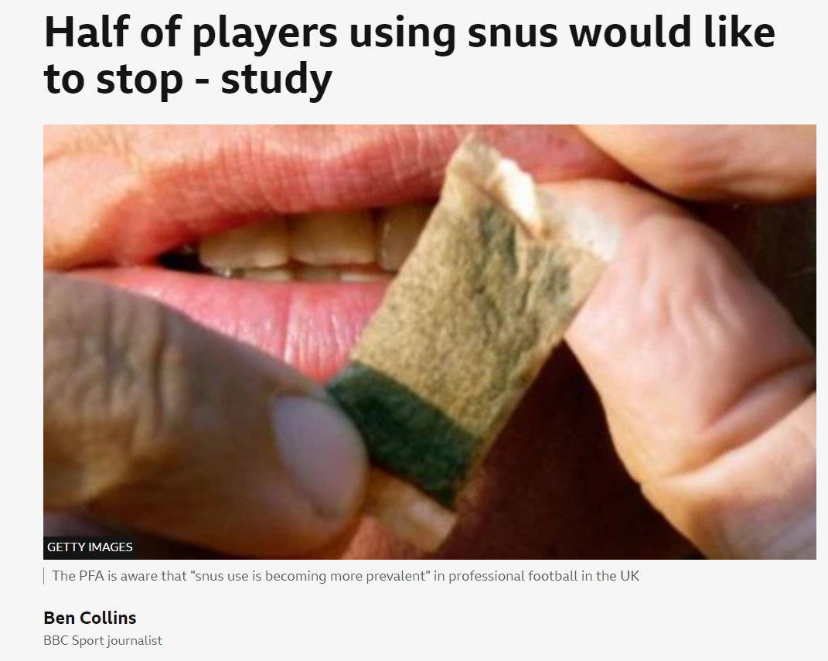
What do you think?
Vaping knowledge
Influencers and sports people using nicotine pouches:
Why might over half want to stop?
What do you feel about the role of influencers promoting nicotine products?
Notes:
Slide: What Do You Think?
Purpose
To encourage critical thinking about nicotine use in sport, the influence of role models and the challenges of nicotine dependence.
Facilitator Notes
This slide is designed to explore opinions rather than provide right or wrong answers. Encourage open discussion with sensitivity that even successful athletes and influencers can make choices that have drawbacks.
Discussion Questions
Why might athletes or influencers decide to use nicotine products?
Why do you think some want to stop?
How might nicotine use affect performance, health or daily life?
Do influencers have a responsibility when promoting products to young people?
Key Message
It is important to think critically about the messages we receive from influencers, celebrities and sports personalities.
https://www.bbc.co.uk/sport/football/articles/c100p6572n4o

Slide 13
Vaping knowledge
Where do you see vaping?
Notes:
Slide: Where Do You See Vaping?
Purpose
To encourage young people to think about how visible vaping is in their everyday lives and explore the influence of environments, advertising, social media and peer groups.
Facilitator Notes
There are no right or wrong answers. The aim is to help participants recognise how repeated exposure can shape perceptions of what is normal or common.
Discussion Questions
Where do you notice vaping most often?
Do you see vaping more in real life or online?
How might seeing vaping regularly influence people's attitudes towards it?
Are there places where vaping is more visible than others?
Key Message
The more often we see something, the more normal it can seem. Taking time to notice where messages about vaping come from can help us think critically about the influences around us.

Slide 14

Vaping & social media
Discussion: Vapes & Social Media
Watch the short clip of young people
discussing vapes and social media
Notes:
Slide: Vaping & Social Media
Purpose
To encourage young people to think critically about how vaping is presented on social media and how online content can influence attitudes, beliefs and behaviour.
Discussion Questions
What messages about vaping did you notice in the clip?
How might social media influence young people's choices?
Do social media posts always show the full picture?
Key Message
Social media can influence what young people think is normal, popular or low risk. Taking time to question where information comes from and what might be missing can help people make informed decisions.

Slide 15










Vaping & social media
Have you seen vaping online? Where does it appear?
YouTube
Telegram
TikTok
Instagram
Snapchat
X (Twitter)
Facebook
Discord
Twitch
Google
Can you think of anything else ?
Does this influence young people? Is it a concern?
Notes:
Slide: Have You Seen Vaping Online?
Purpose
To help young people recognise how vaping content appears online and explore how social media, influencers, algorithms and advertising can shape attitudes and behaviours.
Facilitator Notes
This activity is not about criticising social media. Instead, encourage participants to think critically about the content they see and why it appears in their feeds.
Young people may mention seeing vaping through:
Influencers
Memes and trends
Product reviews
Sponsored content
Friends' posts
Livestreams
Online shops
Search results
Discussion Activity:
Divide participants into small groups.
Ask each group to rank the platforms shown on the slide from:
Most likely to influence young people → Least likely to influence young people
Groups should explain:
Why they ranked them that way.
What type of vaping content might appear there.
Whether the influence may be positive, negative or mixed.
Discussion Questions:
Which platforms are most likely to expose young people to vaping content?
Does seeing vaping online make it seem more normal?
Why do influencers sometimes promote products?
How can we tell if content is advertising?
Key Message
Social media does not just reflect culture—it can help shape it. Repeated exposure to vaping content can make vaping appear more common, acceptable or appealing than it really is.
Further Discussion:
Ask the group:
"If someone sees 20 vaping videos in a week, does that mean lots of people vape, or does it mean the algorithm thinks they want to see vaping content?"
Use this to introduce the idea that algorithms can influence what people think is normal.
Debrief
Finish by asking:
"What can young people do if they think social media is influencing them more than they would like?"
Possible answers:
Follow different creators.
Use 'Not Interested' features.
Fact-check information.
Think critically about who benefits from the content.
Talk with trusted adults or friends about what they see online.

Slide 16


What do you think?
Vaping and the law
Vaping and the law
You have 10 seconds to decide which
corner of the room to go to when the
scenarios are read out…
Four corners
✅ Legal ❌ Illegal
🤔 Not Sure ⚖️ Depends
Notes:
Slides: Vaping and the Law – Four Corners Activity
Purpose
To increase awareness of laws relating to vaping, encourage critical thinking and help young people understand that some situations are not always straightforward.
Activity Type
Four Corners
Preparation
Label four areas of the room:
✅ Legal
❌ Illegal
🤔 Not Sure
⚖️ Depends
Instructions
Read each scenario aloud and give participants 10 seconds to move to the corner that best matches their answer.
Once participants have chosen a corner:
Ask volunteers to explain their reasoning.
Invite others to move if they hear an argument that changes their mind.
Reveal and discuss the answer before moving to the next scenario.
Facilitator Notes
The aim is discussion rather than getting every answer correct. Encourage participants to think about:
Age restrictions
Supply versus possession
Venue rules versus the law
The difference between legal and safe
Personal responsibility
Answers
An 18-year-old buys a vape for their 17-year-old friend❌ Illegal
A 17-year-old buys a nicotine-free vape online ❌ Illegal
Someone vaping on a train platform⚖️ Depends (usually against rail network policy but not necessarily a criminal offence)
A shop sells a vape without checking ID⚖️ Depends (legal if the purchaser is clearly over 25; illegal if sold to someone under 18)
Someone brings a THC vape to a party❌ Illegal
A young person buys a vape that looks legal but is fake🤔 Not Sure / ⚖️ Depends (purchasing may not be the offence, but selling illegal products is)
Someone vapes in a restaurant toilet⚖️ Depends (usually against venue rules but not necessarily a criminal offence)
A 19-year-old gives their vape to a 16-year-old to try❌ Illegal
Key Message
The law around vaping is not always straightforward. Understanding age restrictions, product regulations and the difference between legal, safe and socially acceptable can help young people make informed choices.
It's illegal for someone 18 and older to buy vapes for anyone under 18. This is called proxy buying.
Shops must not sell vapes to anyone under 18.
If someone looks under 25 a retailer must ask for proof of age.
A person must be still be 18+ to buy a nicotine free vape/liquid.
Most public places don’t allow vaping: trains, buses, stations, shops, restaurants and planes.
Single use (disposable) vapes are now illegal. All vapes must be rechargeable and refillable.
THC vapes are illegal.

Slide 17
What do you think?
Vaping and the law
✅ Legal ❌ Illegal
🤔 Not Sure ⚖️ Depends
“An 18-year-old buys a vape for their 17-year-old friend”
“A 17-year-old buys a nicotine-free vape online”
“Someone vaping on a train platform”
“A shop sells a vape to someone without checking ID”
“Someone brings a THC vape to a party”
“A young person buys a vape that looks legal but is fake”
“Someone vapes in a restaurant toilet”
“A 19-year-old gives their vape to a 16-year-old to try”
Notes:
Slides: Vaping and the Law – Four Corners Activity
Purpose
To increase awareness of laws relating to vaping, encourage critical thinking and help young people understand that some situations are not always straightforward.
Activity Type
Four Corners
Preparation
Label four areas of the room:
✅ Legal
❌ Illegal
🤔 Not Sure
⚖️ Depends
Instructions
Read each scenario aloud and give participants 10 seconds to move to the corner that best matches their answer.
Once participants have chosen a corner:
Ask volunteers to explain their reasoning.
Invite others to move if they hear an argument that changes their mind.
Reveal and discuss the answer before moving to the next scenario.
Facilitator Notes
The aim is discussion rather than getting every answer correct. Encourage participants to think about:
Age restrictions
Supply versus possession
Venue rules versus the law
The difference between legal and safe
Personal responsibility
Answers
An 18-year-old buys a vape for their 17-year-old friend❌ Illegal
A 17-year-old buys a nicotine-free vape online ❌ Illegal
Someone vaping on a train platform⚖️ Depends (usually against rail network policy but not necessarily a criminal offence)
A shop sells a vape without checking ID⚖️ Depends (legal if the purchaser is clearly over 25; illegal if sold to someone under 18)
Someone brings a THC vape to a party❌ Illegal
A young person buys a vape that looks legal but is fake🤔 Not Sure / ⚖️ Depends (purchasing may not be the offence, but selling illegal products is)
Someone vapes in a restaurant toilet⚖️ Depends (usually against venue rules but not necessarily a criminal offence)
A 19-year-old gives their vape to a 16-year-old to try❌ Illegal
Key Message
The law around vaping is not always straightforward. Understanding age restrictions, product regulations and the difference between legal, safe and socially acceptable can help young people make informed choices.
It's illegal for someone 18 and older to buy vapes for anyone under 18. This is called proxy buying.
Shops must not sell vapes to anyone under 18.
If someone looks under 25 a retailer must ask for proof of age.
A person must be still be 18+ to buy a nicotine free vape/liquid.
Most public places don’t allow vaping: trains, buses, stations, shops, restaurants and planes.
Single use (disposable) vapes are now illegal. All vapes must be rechargeable and refillable.
THC vapes are illegal.

Slide 18

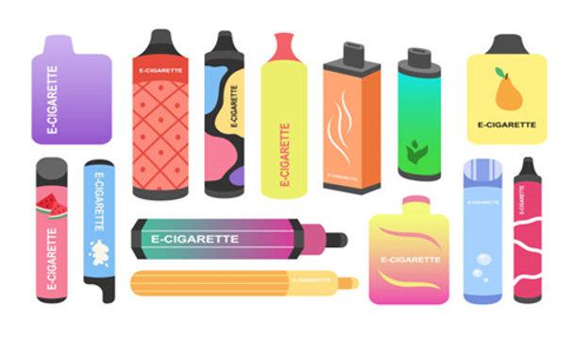
Vaping: Is it a local issue?
What can we do about it?
What can we do about it?
🔍 Task 1: Community Snapshot – What’s Actually Going On?
🧠 What to do
In groups, explore what vaping looks like in your community.
🎯 Your task
Gather some quick insights using any of these methods:
Ask people (friends, peers, others your age)
Run a quick anonymous poll (online or in person)
Notice what’s happening in places you spend time
Look at what’s being shared on social media
https://forms.office.com/
https://www.surveymonkey.com/
Notes:
Slides: Vaping – Is It a Local Issue?
Purpose
To encourage young people to explore vaping within their own community and identify local influences, trends and concerns.
Facilitator Notes
This activity is about gathering observations and perspectives rather than finding right or wrong answers. Encourage participants to think about what they see, hear and experience locally.
Instructions
In groups, discuss what vaping looks like in your community and identify any patterns or concerns. Participants can use conversations, observations, polls or social media as sources of information.
Discussion Questions
Is vaping something you notice regularly in your community?
Where is it most visible?
What do young people say about vaping locally?
Are there any local concerns or trends that stand out?
Key Message
Understanding what is happening locally can help communities identify issues, challenge assumptions and develop solutions that are relevant to young people's experiences.

Slide 19
Vaping: Is it a local issue?
What can we do about it?
🧩 Find out:
How common vaping is
Where it tends to happen
Why people vape
Whether people think “everyone is doing it”
If people want to stop or cut down
📣 Be ready to share:
3 facts you discovered
1 thing that surprised you
1 thing you’re not sure about
Notes:
Slides: Vaping – Is It a Local Issue?
Purpose
To encourage young people to explore vaping within their own community and identify local influences, trends and concerns.
Facilitator Notes
This activity is about gathering observations and perspectives rather than finding right or wrong answers. Encourage participants to think about what they see, hear and experience locally.
Instructions
In groups, discuss what vaping looks like in your community and identify any patterns or concerns. Participants can use conversations, observations, polls or social media as sources of information.
Discussion Questions
Is vaping something you notice regularly in your community?
Where is it most visible?
What do young people say about vaping locally?
Are there any local concerns or trends that stand out?
Key Message
Understanding what is happening locally can help communities identify issues, challenge assumptions and develop solutions that are relevant to young people's experiences.

Slide 20
Vaping: Is it a local issue?
What can we do about it?
🔍 Task 2: If you were in Charge …
🧠 What to do
Using what you’ve learned design a vaping agreement for your
group or local area.
🎯 Your task
Create an agreement everyone can stick to.
🧩 Consider:
How should situations be handled?
(someone vaping around others, someone influencing/pressuring others)
What’s allowed / not allowed?
(where, when, who)
What support should be available?
(who to talk to, what would help)
What makes it fair and realistic?
Notes:
Slide: If You Were in Charge...
Purpose
To encourage young people to have some ownership over best ways to manage vaping with relevant settings.
Facilitator Notes
Encourage participants to balance rules with support and think about what would realistically work in their setting.
Instructions
In groups, create a vaping agreement about how vaping should be managed within your setting. Encourage participants to agree a small number of clear, realistic actions.
Discussion Questions
What rules would be fair?
How can people be supported rather than judged?
What should happen if someone breaks the agreement?
How can everyone's views be considered?
Key Message
Communities are more likely to create positive change when people work together to develop solutions that are fair, realistic and supportive.

Slide 21

Vaping: Is it a local issue?
What can we do about it?
Produce a poster or meme for young people highlighting the risks around vaping/nicotine pouches.
OR
Record a podcast style discussion about the tobacco & vapes bill recently approved in the UK Parliament.
Tobacco and Vapes Bill: creating a smoke-free UK and tackling youth vaping factsheet - GOV.UK
Notes:
Slide: Create a Campaign
Purpose
To encourage young people to use what they have learned to create messages that inform, engage and influence peers.
Facilitator Notes
Participants can choose the format that best suits their interests and skills. Encourage creativity and remind groups to think about what messages would be most effective for other young people.
Instructions
Working in groups, choose one of the following:
Design a poster, social media graphic or meme highlighting key facts about vaping or nicotine pouches.
Record a short podcast-style discussion exploring youth vaping, nicotine pouches or proposed changes in the Tobacco and Vapes Bill.
Discussion Questions
What message do you want young people to remember?
What would make someone stop and pay attention?
How can information be shared in a way that is accurate and engaging?
Key Message
Young people can play an important role in raising awareness, challenging myths and helping others make informed decisions about vaping and nicotine products.

Slide 22




Where to go for help and information
Vaping knowledge
Quit your way website: with tips to cut down & stop
https://www.nhsggc.scot/your-health/quit-your-way/quit-your-way-youth/
NHS Inform website: with tips to cut down & stop
https://www.nhsinform.scot/campaigns/vaping/
Quit your way Information guide: Facts about vaping
https://talkabouttrust.org/resources/schools/nhs-ggc-vaping-information-guide
ChildLine: Advice and information for young people
https://www.childline.org.uk/info-advice/you-your-body/drugs-alcohol-smoking/vaping/
Can you think of anything else ?
If you see or suspect spiking of any kind call Police Scotland on 101​
Notes:
Information Slide: Where to go for help and information
Facilitator shares information with young people. Links can be accessed together as a group to familiarise young people with the resources.
https://www.nhsggc.scot/your-health/quit-your-way/quit-your-way-youth/
https://www.nhsinform.scot/campaigns/vaping/
https://talkabouttrust.org/resources/schools/nhs-ggc-vaping-information-guide
https://www.childline.org.uk/info-advice/you-your-body/drugs-alcohol-smoking/vaping/
Encourage discussion about accessing support. How easy is this for young people to do? Who are their trusted adults?

