Slide 1



Vaping & Nicotine
Notes:
Facilitator Guide
About this Resource:
This resource has been designed for trusted adults working with young people across the third sector.
The resource aims to encourage discussion, critical thinking and informed decision-making. The aim is not to tell young people what choices to make. The content and activities are designed to explore influences, consider consequences and develop confidence in making decisions that are right for the young person.
The slides can be displayed but could also just be used as structure/framework for facilitator to run the session. The resources are discussion and activity based with shorter games and some extended project-based work where there is more time available.
Choose the parts of the course that are most relevant to your setting. The age groups for the resources are a guideline; it may be helpful to use games/activities from more than one age group resource. There is also more than one session’s content in each age group resource, facilitators should tailor to suit the session time/number of sessions they can allocate to the topic.
Good practice around substance education tells us that revisiting topics is helpful, breaking the resource into smaller chunks is a good way to use it.
Certain topic areas have been set within one of the age group resources, where we feel the topic is most likely to become relevant. Please see following content list to support using parts of resource should the areas be raised by the young people at a different age and stage. For example, we have put information about vape spiking in the 16+ resource. It can be accessed there and used for younger age groups should this be an area of concern for trusted adults or an area of relevance/interest for the young people they are working with.
8 – 12 yrs resource:
What is Vaping?
What is Nicotine?
Impact on body/brain.
Influence/Pressure scenarios.
12 – 15 yrs resource:
Effects of nicotine and withdrawal.
Unregulated vapes
Fire Risk/Storing vapes safely
Pressure/Influence and choices around vaping
Diversionary activities/alternative ways to relax/stay stress free
16+ resource:
Summary of vaping/nicotine knowledge
How does vaping affect each area of a person’s life
Unregulated vapes/THC vapes
Staying safe around vapes/vape spiking
Making choices around vapes/nicotine
Nicotine pouches
Vapes and Social Media
Vaping and the Law
Vaping: Is it a local issue. Includes creating a group agreement to manage vaping in youth organisation settings.
The resources may encourage questions/discussion about other areas that young people feel are relevant to them such as other substances, issues related to risk taking, relationship-based issues etc. This can be positive; facilitators don’t need to know all the answers to hold useful discussion and to agree to revisit any areas that are clearly important to work on with the group.
Overview of Outcomes:
Increase knowledge and understanding of vaping and nicotine
Consider risks and protective factors around vapes and nicotine.
Explore influences that can affect decision-making.
Practise discussing challenging situations.
Develop confidence in making informed choices.
Before starting a session:
Consider prior knowledge and lived experience of those within the group.
Agree group expectations.
Make it clear that nobody is required to share personal experiences.
Be prepared to signpost support where need arises.
Facilitation style:
Use open questions wherever possible.
Encourage discussion between young people.
Acknowledge different viewpoints.
Focus on curiosity rather than judgement.
Start with where young people are at, noting they may not have much interest or connection to longer term health harms.
Encourage critical thinking as opposed to ‘telling’ where possible.

Slide 2
What do we need to think about as a group when we talk about Vaping?
Careful sharing? Asking questions?
What do we need the adults to do?
Honest answers? Zero judgement?
Group agreement
Notes:
Slide: Group Agreement
Facilitator establishes a group agreement with young people. It may be helpful to have some understanding of the lived experiences of the group to support best delivery of the resource. This may be something young people are happy to share, or something the group decides is private. In practice we found young people were keen to share their experiences when a safe space was facilitated by trusted adults.

Slide 3
Think about how vaping and nicotine affects young people
Together we will ...
Explore levels of risk
around vaping​
Vaping and the law
What can we do about it?
Consider pressure, influence and choice
Notes:
Slide: What are we covering?
Facilitator shares summary of the topics that will be covered during the session so young people have an idea of what they will be looking at. It may be relevant to look at the resources designed for other age groups to fill in any prior knowledge gaps.

Slide 4
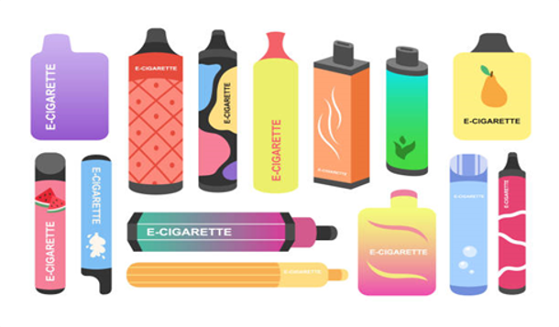
Vaping: What is it?
Vaping/Nicotine effects
Vaping is the use of an electronic device to inhale vapour coming from a heated liquid that can contain:
  Propylene glycol and vegetable glycerine
  Nicotine – a stimulant drug
  Flavourings and artificial chemical sweeteners
Regulated vapes have a maximum strength (20mg/ml) some vapes are unregulated and can be very high strength.
Notes:
Slide: What is Vaping?
Purpose
To introduce what vaping is, what vapes contain and the key ingredients commonly found in vape liquids.
Facilitator Notes
Many young people know what a vape looks like but may not understand what is inside it. Use this slide to explain that vapes heat a liquid to create an aerosol that is inhaled and that many products contain nicotine.
Emphasise that nicotine is a stimulant and the ingredient responsible for dependence.
Discussion Questions
Were you surprised by any of the ingredients in vape liquid?
Why do you think flavourings are added to vapes?

Slide 5
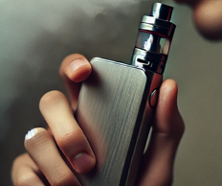
Vaping: Effects on young people? ​
Vaping/Nicotine effects
Vaping isn't risk free:
May affect brain development
Risk of
other addictions
Nicotine
addiction
Nicotine
Addiction
May affect
lung health
Expense
Toxins in
system
Nicotine
Addiction
Social and
emotional effects
Sports
performance
Scientists haven’t had time to learn enough about long-term health effects yet, especially for young people.
Notes:
Slide: How Can Vaping Affect Young People?
Purpose
To explore the potential effects of vaping on young people and encourage discussion about the physical, emotional and social impacts of nicotine use.
Facilitator Notes
Use the bubbles on the slide as prompts for discussion. Encourage participants to think about both short-term and longer-term effects and reinforce that experiences can vary between individuals.
Discussion Questions
Which of these effects do you think young people are most aware of?
Are there any you think young people are not aware of?
Why do you think young people may be more vulnerable to nicotine than adults?
Key Message
Vaping is not risk-free, particularly for children and young people. Nicotine can affect both physical and mental wellbeing, and because vaping is relatively new, the long-term effects on young people’s health are not yet fully understood.
Vaping can affect young people in several ways:
Nicotine Addiction: Many vapes contain nicotine, which is highly addictive. Younger brains are still developing, making them more vulnerable to addiction. This can lead to cravings and make quitting harder later.
Brain Development: Nicotine can harm brain development, affecting areas that control attention, learning, and impulse control. This can have long-term effects on memory and behaviour.
Lung Health: Vaping can irritate and damage the lungs. Some chemicals in vape liquid can cause inflammation and other respiratory issues, even though it might seem less harmful than smoking.
Risk of Other Addictions: Young people who vape may be more likely to try cigarettes or other substances later.
Social and Emotional Effects: Peer pressure and the habit of vaping can create stress, impact school performance, and interfere with relationships.
It’s important for young people to know that vaping isn’t risk-free and can have lasting effects on their health.

Slide 6
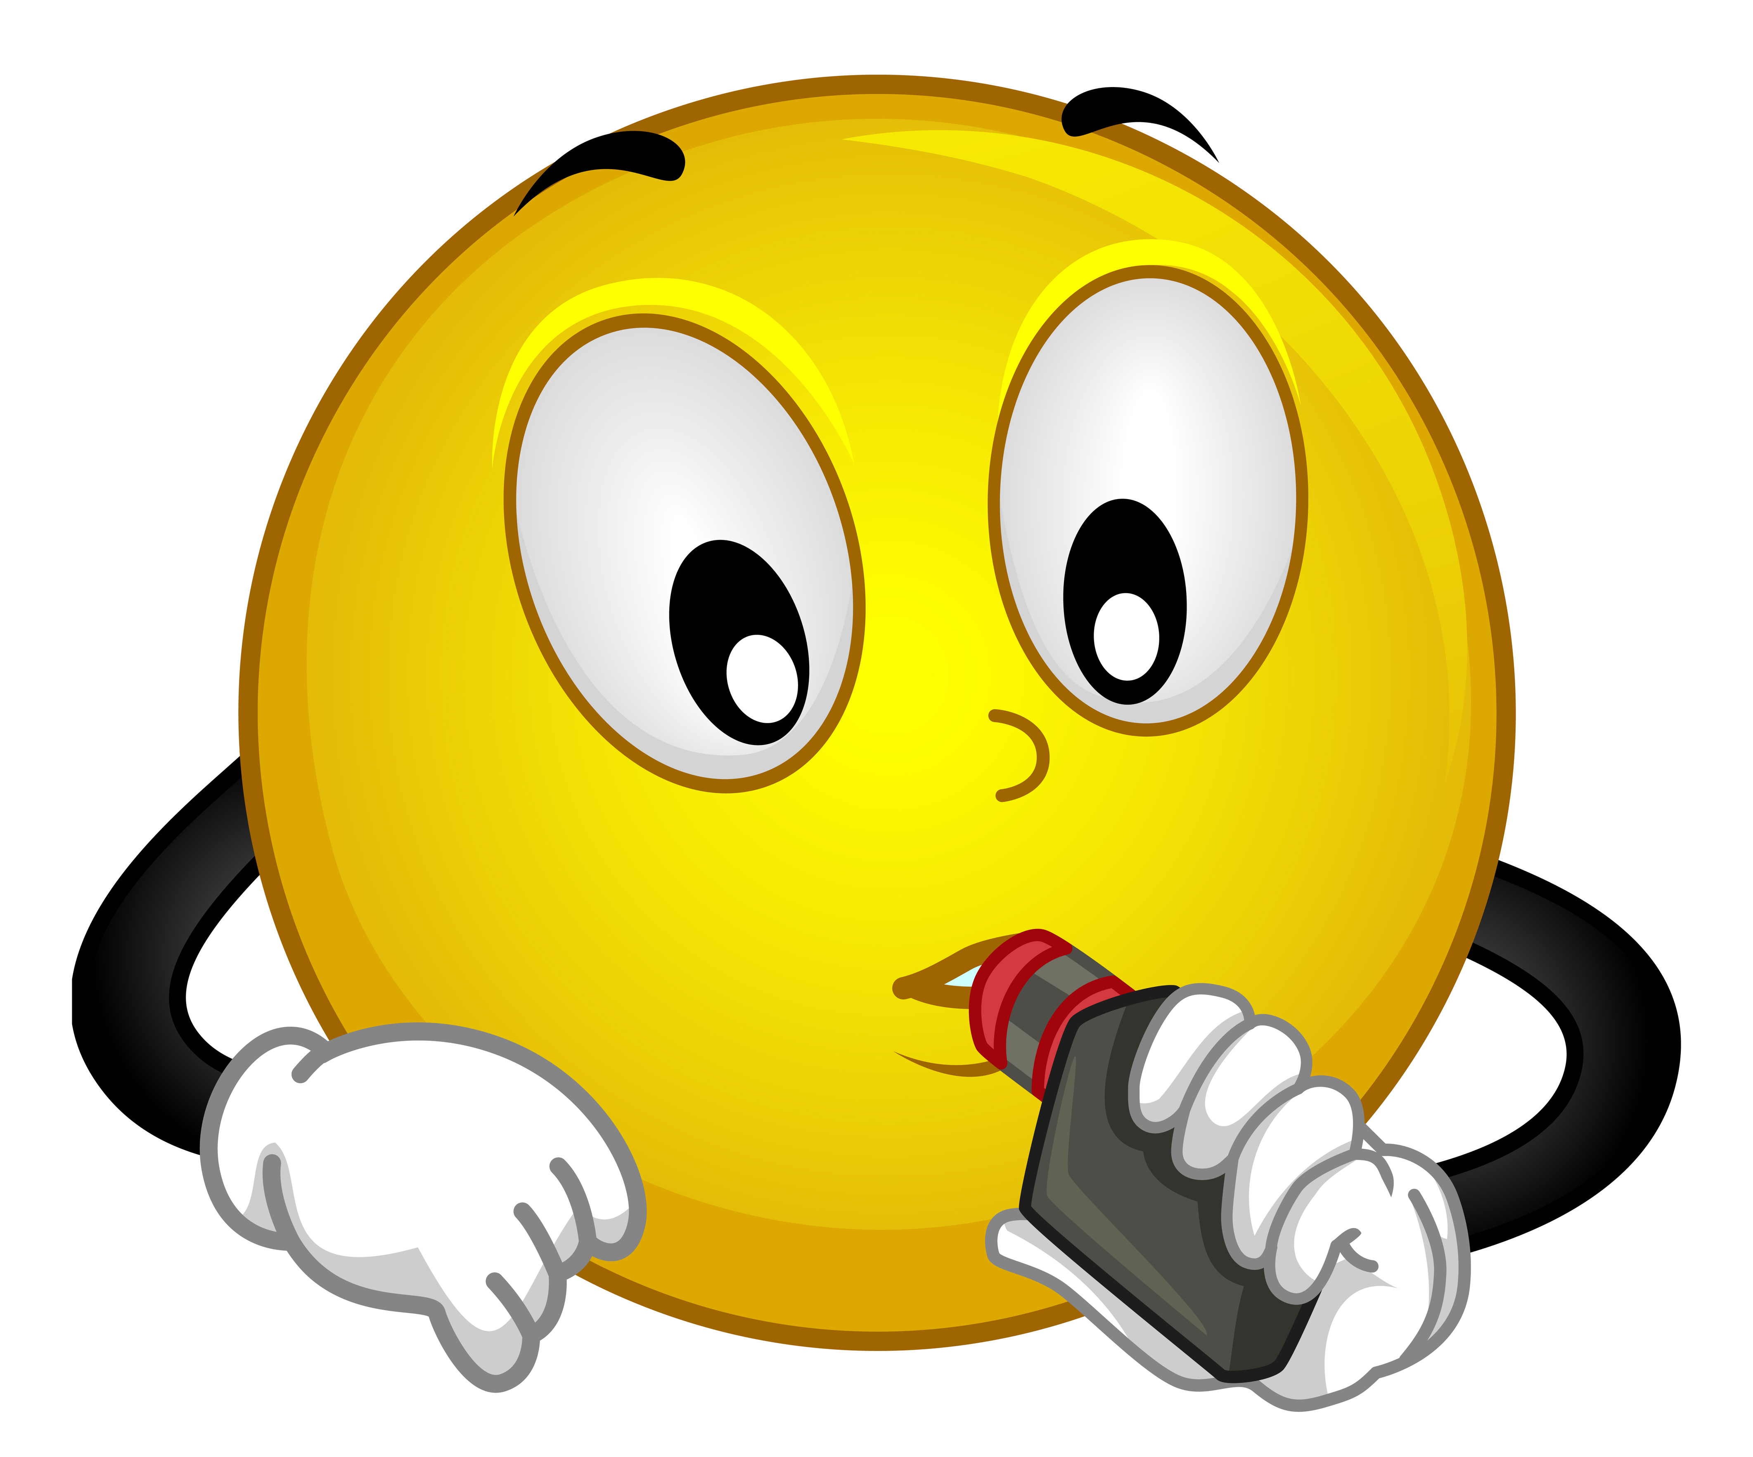
Fact or Fiction Game
Vaping/Nicotine effects
In your teams select a runner.
The right side of the room is ‘Fact’ and the left side of the room is ‘Fiction’.
Who will be first to ‘tag’ their answer and get back to base?
Notes:
Slide: Fact or Fiction Relay Instructions
Purpose
To challenge common misconceptions and help young people understand that vaping is not the norm.
Facilitator Notes
Explain that this is a quick team challenge to test what young people know.
Read each statement aloud and give teams a few seconds to decide together whether it is fact or fiction. Their runner then races to tag the correct side and return to their team.
After each answer, briefly explain why it is fact or fiction before moving on.
Encourage discussion rather than guessing — the fastest team isn’t necessarily right!

Slide 7

Fact or Fiction Game
Vaping/Nicotine effects
Fact or Fiction?
“Most young people in Scotland vape.”
Fiction
93% of 11 – 17 yrs in Scotland choose not to vape regularly.
19.5% of this age group have tried vaping.
Notes:
Slide: Fact or Fiction Relay – “Most young people in Scotland vape.”
Purpose
To challenge common misconceptions and help young people understand that vaping is not the norm.
Facilitator Notes
Split the group into teams and ask each team to choose a runner. Read the statement aloud and have runners race to the ‘Fact’ or ‘Fiction’ side of the room before returning to tag the next person.
Reveal the answer and briefly discuss why.
Answer: ❌ Fiction
ASH UK statistics from 2024 show that only 18% of 11 – 17-year-olds have EVER vaped.
Only 4.5% of 11 – 17 year olds vape regularly.
Explain that although youth vaping has increased in recent years, most young people in Scotland do not vape. Sometimes social media, friendship groups or seeing people vape in public can make it seem more common than it really is.
Key message: Our brains often overestimate behaviours we notice regularly, but most young people choose not to vape.
Sources
https://www.gov.scot/publications/vaping-smoking-scottish-adolescents-results-ash-smokefree-gb-youth-survey-2025/pages/3

Slide 8
Fact or Fiction Game
Vaping/Nicotine effects
Fact or Fiction?
“All vapes contain the same amount of nicotine.”
Fiction
Vapes are sold with different levels of nicotine.
Sometimes the label is not accurate, and the levels can be much higher than stated.
Notes:
Slide: Fact or Fiction Relay – “All vapes contain the same amount of nicotine.”
Purpose
To help young people understand that nicotine strength varies between different vaping products and that you cannot tell how much nicotine a vape contains just by looking at it.
Facilitator Notes
Split the group into teams and ask each team to choose a runner. Read the statement aloud and have runners race to the ‘Fact’ or ‘Fiction’ side of the room before returning to tag the next person.
Reveal the answer and briefly discuss why.
Answer: ❌ Fiction
Vapes come in a range of nicotine strengths. Some contain no nicotine at all, while legal nicotine-containing vapes in the UK can contain up to 20mg/ml (2%) nicotine.
Illegal or fake vapes may contain higher nicotine levels than permitted or substances that are not listed on the packaging.
Key message: You cannot tell how much nicotine is in a vape by its appearance, flavour or brand. Always be cautious about assumptions and recognise that some products may not contain what they claim.

Slide 9
Fact or Fiction Game
What is Vaping?
Fact or Fiction?
"Vaping can help people with stress."
Fiction
Some young people have said they thought vaping would help them stay calm.
Being addicted to nicotine is a cause of stress, not a cure.
Nicotine can disrupt sleep and increase
anxiety.
Notes:
Slide: Fact or Fiction Relay – “Vaping can help people with stress.”
Purpose
To help young people understand the relationship between nicotine and stress and challenge the myth that vaping is an effective way to manage emotions.
Facilitator Notes
Split the group into teams and ask each team to choose a runner. Read the statement aloud and have runners race to the ‘Fact’ or ‘Fiction’ side of the room before returning to tag the next person.
Reveal the answer and briefly discuss why.
Answer: ❌ Fiction
Nicotine is a stimulant drug. It can temporarily reduce cravings in someone who is dependent on nicotine, but this is different from reducing stress. As nicotine levels drop, withdrawal symptoms can make people feel more anxious or irritable, creating a cycle where vaping appears to relieve stress when it is actually relieving nicotine withdrawal. Young people may turn to vaping to try to deal with stress or anxiety, creating a cycle of nicotine dependence. But nicotine dependency can be a source of stress in itself. Nicotine does not relax a person or support them with stress.
Key message: Vaping is not a healthy stress management tool. While it may seem to provide short-term relief, nicotine dependence can actually contribute to feelings of stress and anxiety over time.

Slide 10

Fact or Fiction Game
Vaping/Nicotine effects
Fact or Fiction?
“Nicotine is harmful for the developing brain.”
Fact
Nicotine can change how a young person's brain develops.
Nicotine can make it harder to learn and concentrate.
Some of the brain changes can lower mood
and ability to control impulses.
Notes:
Slide: Fact or Fiction Relay – “Nicotine is harmful for the young person's brain.”
Purpose
To increase awareness that nicotine can affect the developing brain and may have long-term impacts on learning, attention and addiction.
Facilitator Notes
Split the group into teams and ask each team to choose a runner. Read the statement aloud and have runners race to the ‘Fact’ or ‘Fiction’ side of the room before returning to tag the next person.
Reveal the answer and briefly discuss why.
Answer: ✅ Fact
The brain continues to develop until around the age of 25. Research suggests that nicotine exposure during this time can affect areas involved in attention, learning, memory and impulse control. Young people can also become dependent on nicotine more quickly than adults. Nicotine can harm the developing adolescent brain. The brain keeps developing until about age 25. As nicotine affects brain development, this can make it harder to learn and concentrate. Some of the brain changes are permanent and can affect mood and ability to control impulses into adulthood
Key message: Nicotine is not harmless. During adolescence, it can affect the developing brain and increase the risk of addiction.

Slide 11
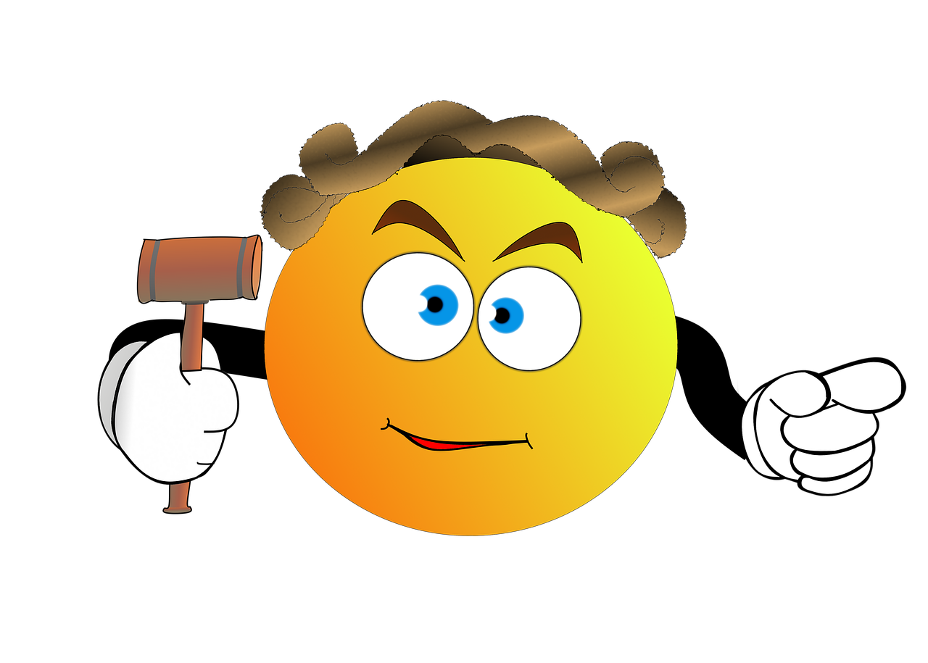
Fact or Fiction Game
Vaping/Nicotine effects
Fact or Fiction?
“There are laws in the UK designed to control what is inside a vape.”
Fact
There are very strict laws in UK to control what vapes contain, new laws are coming as part of the Vaping Bill (2026)
However, Trading Standards in Glasgow say 33% of vapes sold are unregulated, and we don’t know what’s in these devices.
Notes:
Slide: Fact or Fiction Relay – “There are laws in the UK that try to control what is inside a vape.”
Purpose
To help young people understand that legal vapes are regulated in the UK, but illegal and fake products may not meet these standards.
Facilitator Notes
Split the group into teams and ask each team to choose a runner. Read the statement aloud and have runners race to the ‘Fact’ or ‘Fiction’ side of the room before returning to tag the next person.
Reveal the answer and briefly discuss why.
Answer: ✅ Fact
The UK has laws that limit nicotine strength, tank size and refill bottle size, and manufacturers must follow safety and quality standards before products can be legally sold. For example, vapes can have a maximum tank size of 2ml and nicotine level of 20mg/ml.
However, illegal or fake vapes exist and may contain higher nicotine levels or other harmful substances that are not listed on the packaging. Trading Standards say 33% of vapes sold are ‘illegal. You can’t know what’s in these devices.
Key message: Laws help make legal vapes safer, but not every vape being sold or shared follows those rules. Young people should be aware that some products may not contain what they claim.
Source Trading standards
English school children unwittingly smoking spice-spiked vapes, finds University of Bath
Millions of illicit vapes and tobacco products seized by Trading Standards - National Trading Standards

Slide 12

Nicotine: Effects
Vaping/Nicotine effects
Nicotine causes the body to
release adrenaline, a hormone that
makes us alert and stimulated
(fight or flight).
Adrenaline increases
the speed of breathing, heart rate and blood pressure; this may cause dizziness.
Nicotine also causes the
release of dopamine, linked to
feelings of reward.
After vaping or smoking for a while, the body starts to release less dopamine naturally.
Notes:
Slide: Nicotine: Effects
Purpose
To help young people understand how nicotine affects the brain and body and how it can lead to dependence.
Facilitator Notes
Explain that nicotine is a stimulant drug that changes the way the brain and body work. Encourage young people to think about how these effects might influence mood, concentration and behaviour.
Discuss how nicotine triggers the release of adrenaline, making the body feel more alert by increasing heart rate and blood pressure, and how it also releases dopamine, the brain chemical linked with pleasure and reward.
Over time, the brain adapts to regular nicotine use and begins to rely on it, making it harder to feel good without it and increasing the risk of addiction.
Key message: Nicotine changes how the brain works. The short-term feelings of alertness or reward can lead to dependence, making it difficult to stop using nicotine products. Young people are more at risk of addiction to nicotine due to the vulnerability of the developing brain.

Slide 13
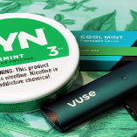
Nicotine Rush Activity
Vaping- The Risks
Step 1​
Nicotine causes adrenaline - the body speeds up
​ Jog on the spot or do star jumps as FAST as you can for 30 seconds.
​Step 2​
Nicotine releases dopamine - that’s the ‘reward’ part​
​Congratulate each other on the hard work. Give each other a Cheer/High Five/Thumbs Up/Well Done!
​Step 3​
Now there is a dopamine crash, the body produces lower levels naturally
​Everyone drop to the ground and stay very still. ​
Notes:
Slide: Nicotine Rush Activity
Purpose
To provide a simple, active learning experience of how nicotine affects the body and creates a cycle of dependence.
Please note: This activity uses an analogy to communicate a key learning point about nicotine dependence; it is not intended to show exactly how nicotine affects the body or how addiction develops.
Facilitator Notes
Guide young people through the three steps on the slide, explaining what each stage represents. After the activity, ask participants how their bodies felt when moving quickly compared with when they suddenly stopped.
Young people often feel the urge to move quickly after the ‘excitement’ of step 1 and step 2. This can be likened to seeking nicotine out again as cravings kick in, becoming stuck in a cycle.
Reinforce that nicotine triggers the release of adrenaline, increasing heart rate and breathing. It also releases dopamine, creating a feeling of reward. Over time, the brain adapts and relies on nicotine to produce these feelings, making it harder to feel good naturally and increasing the risk of dependence.
Key message: Nicotine temporarily changes how the brain and body work, repeated use can lead to dependence as the brain becomes less able to produce its own natural reward signals.

Slide 14
Nicotine Rush Discussion
Vaping- The Risks
“How did your body feel when you sped up?”
“Did the ‘reward’ feel good?”
“What did the crash feel like? Was it easy to keep still?”
“Would you want to keep repeating that cycle?”
👉 Adrenaline = fast heart, breathing
👉 Dopamine = reward
👉 Less dopamine later = needing more
Notes:
Slide: Nicotine Rush Activity – Discussion
Purpose
To help young people reflect on the activity and connect the physical demonstration with how nicotine affects the brain and body.
Facilitator Notes
Lead a short discussion using the questions on the slide. Encourage participants to describe how they felt when moving quickly, receiving praise and then suddenly stopping. Young people often feel the urge to move quickly after the ‘excitement’ of step 1 and step 2. This can be likened to seeking nicotine out again as cravings kick in, becoming stuck in a cycle.
Reinforce that nicotine triggers the release of adrenaline, increasing heart rate and breathing. It also releases dopamine, creating a feeling of reward. Over time, the brain adapts and relies on nicotine to produce these feelings, making it harder to feel good naturally and increasing the risk of dependence.
Over time, the brain adapts and releases less dopamine naturally, meaning people may feel they need nicotine just to feel normal or to get the same effect. This is one reason nicotine can be addictive. We can share that nicotine is more addictive to the developing brain up to age 25 than a fully developed older adult brain.
Key message: The short-term “rush” from nicotine is temporary. Repeated use can change how the brain’s reward system works, increasing the risk of dependence.

Slide 15
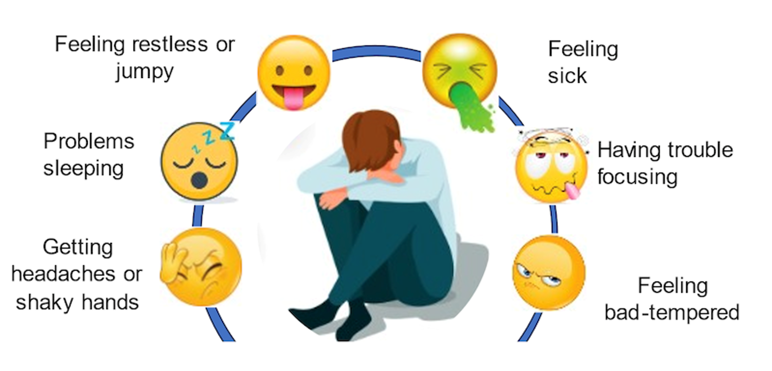
Nicotine Withdrawal
Vaping- The Risks
As nicotine levels fall, the body can react in uncomfortable ways, called withdrawal. Including:
These uncomfortable feelings can lead a person to need/crave more nicotine to stop these withdrawal feelings. This makes nicotine addictive.
Notes:
Slide: Nicotine Withdrawal
Purpose
To help young people understand what nicotine withdrawal is, recognise common symptoms and explain why withdrawal can make nicotine difficult to stop using.
Facilitator Notes
Explain that when someone regularly uses nicotine, the brain and body become used to having it. When nicotine levels drop, they may experience withdrawal symptoms as the body adjusts.
Ask the group if they have heard of withdrawal before and discuss some of the symptoms shown on the slide, including headaches, irritability, difficulty concentrating, trouble sleeping and feeling restless.
Reinforce that these symptoms can make someone want to use nicotine again to relieve the discomfort, creating a cycle that can lead to dependence.
Key message: Unpleasant feelings can happen when nicotine leaves the body.

Slide 16

Unregulated Vapes
Vaping- The Risks
6,000 fake vapes were
seized in Glasgow by Trading Standards in 2024.
Many contained SPICE and other dangerous substances
Fake vapes had other chemicals including lead, nickel, chromium, acetaldehyde, formaldehyde & THC in them when tested.
Remember: if you don’t know where a vape came from then you don’t know what is inside it!
Notes:
Slide: Unregulated Nicotine Products – Trading Standards
Purpose
To raise awareness that not all nicotine products are legal or regulated and highlight the role of Trading Standards in protecting communities.
Facilitator Notes
Introduce Boo, the specially trained detection dog used by Trading Standards to locate hidden illegal and counterfeit nicotine products. The video clip can be played where resources allow. https://youtube.com/shorts/ZK6pp9AAzRY?feature=share
Explain that in 2024, around 6,000 fake vapes were seized in Glasgow, with some found to contain dangerous substances such as SPICE rather than the ingredients people expected.
Discuss why this is particularly risky. People using counterfeit products cannot be sure what they are inhaling, how much nicotine they contain or whether they contain harmful drugs or chemicals.
Explain that legal nicotine vapes sold in the UK must meet strict regulations. For example, vapes should contain no more than 2 ml of e-liquid, have a maximum nicotine strength of 20 mg/ml (2%), and refill bottles are limited to 10 ml.
Counterfeit or illegal vapes do not follow these rules. Testing has found some fake products containing harmful substances such as lead, nickel, chromium, formaldehyde, THC and SPICE, which users would not expect to be inhaling.
Discuss why this is concerning and remind the group that people cannot tell what is inside a counterfeit vape simply by looking at it.
Key message: Illegal and counterfeit vapes are a real issue. They may contain unknown or dangerous substances, which is why enforcement agencies work to remove them from communities.
Legal products are regulated, but fake or unregulated vapes may contain unknown and dangerous substances, making them particularly risky.
Sources: Trading Standards Glasgow and UK

Slide 17
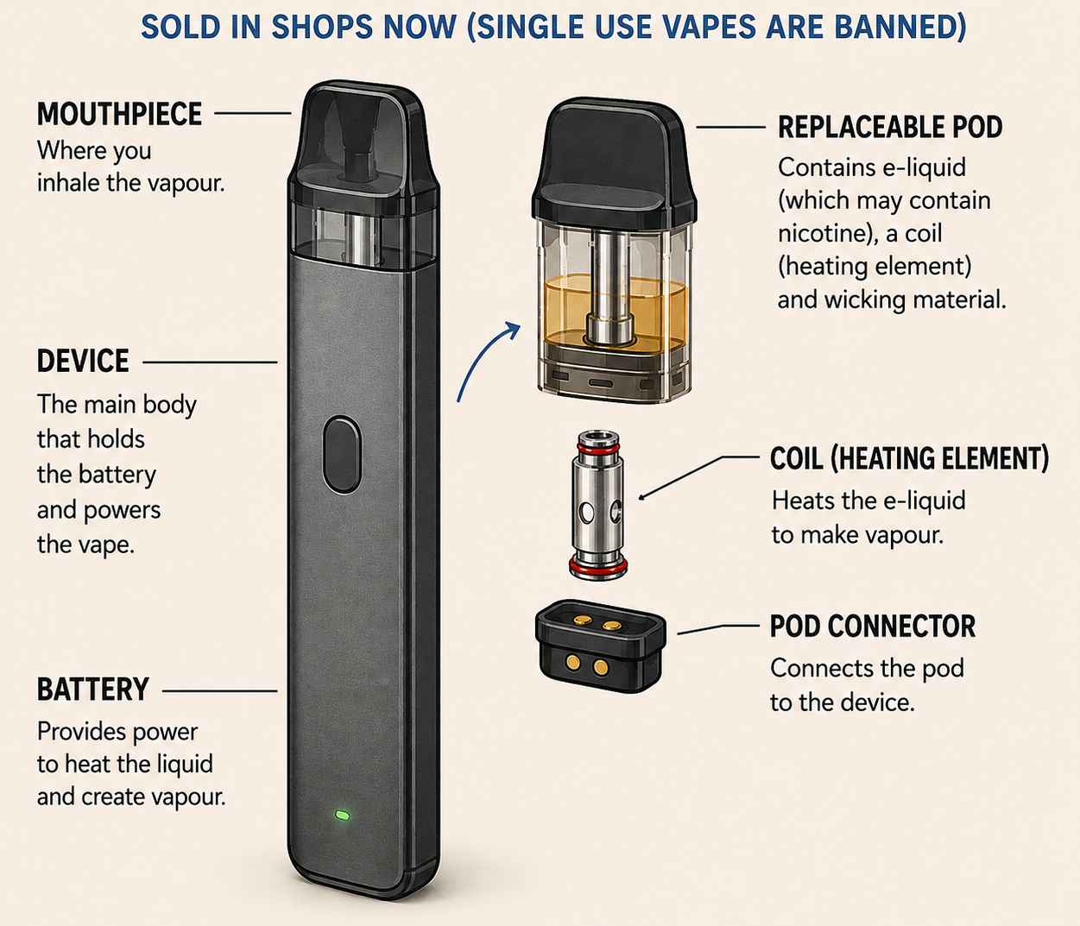
What are vapes made from?
Vaping- The Risks
Vapes are made from:
Plastic
Foam
Aluminium
They also contain:
Lithium - ion batteries
Notes:
Slide: What are vapes made from?
Purpose
To introduce environmental and storage concerns around vapes by understanding what vapes are made from.
Ask the group:
"What do you think is inside a vape?“
Explain that the vapes sold in shops today are reusable devices with replaceable pods, because single-use vapes are now banned. Even though they look small, they contain a range of materials.
Point out:
Plastic, foam and aluminium make up the body and pod.
A lithium-ion battery powers the device.
The replaceable pod contains the e-liquid and a small metal heating coil that turns the liquid into vapour.
Finish by asking:
"What happens to all these parts when people throw vapes away?"
Lead into the idea that vapes aren't just a health issue—they can also create electronic waste and litter if they aren't disposed of properly.

Slide 18
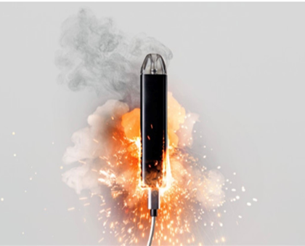
Fire risk
Vaping- The Risks
Most legal vapes have safety
features, there is a risk of fire or
explosion due to the batteries.
Adults who use a vape should store it safely.
What advice would you give to those adults?
Notes:
Slide: Fire Risk
Purpose
To introduce environmental and storage concerns around vapes by understanding what vapes are made from.
Explain that the battery inside a vape stores a lot of energy. Like the batteries in phones or tablets, it is usually safe when used properly, but it can become dangerous if it is damaged, overheated or charged incorrectly.
Emphasise:
Most legal vapes have safety features, but there is still a small risk of fire if batteries are damaged or misused.
This is another reason why vapes should only be used by adults and kept safely out of the reach of children.
Ask the group:
"What advice would you give an adult who uses a vape?“
Look for answers such as:
Keep it away from young children.
Use the correct charger.
Don't leave it charging overnight or unattended.
Don't use a damaged vape.
Keep it away from heat or direct sunlight.
Recycle or dispose of it properly—don't put batteries in household bins.
Key message: Vapes contain powerful batteries. They need to be treated carefully and stored safely.
While these batteries are generally safe when used and maintained properly, they can pose risks if mishandled or if there are manufacturing defects.

Slide 19
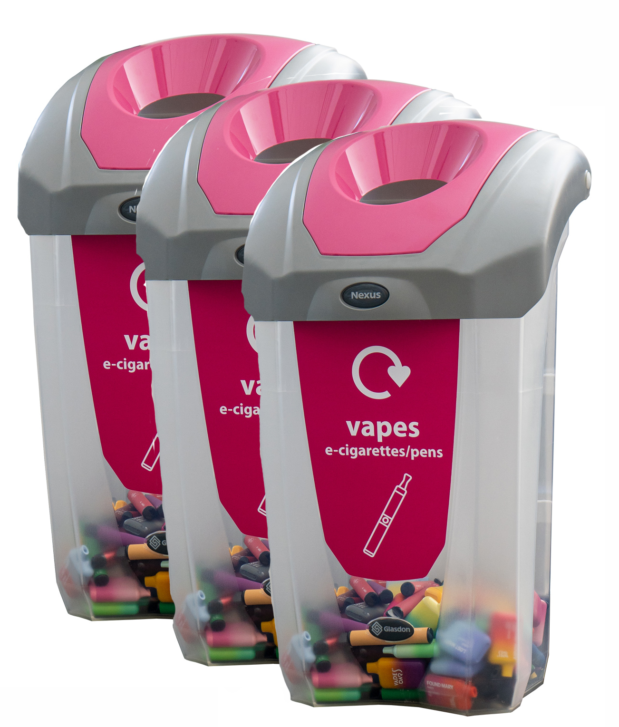
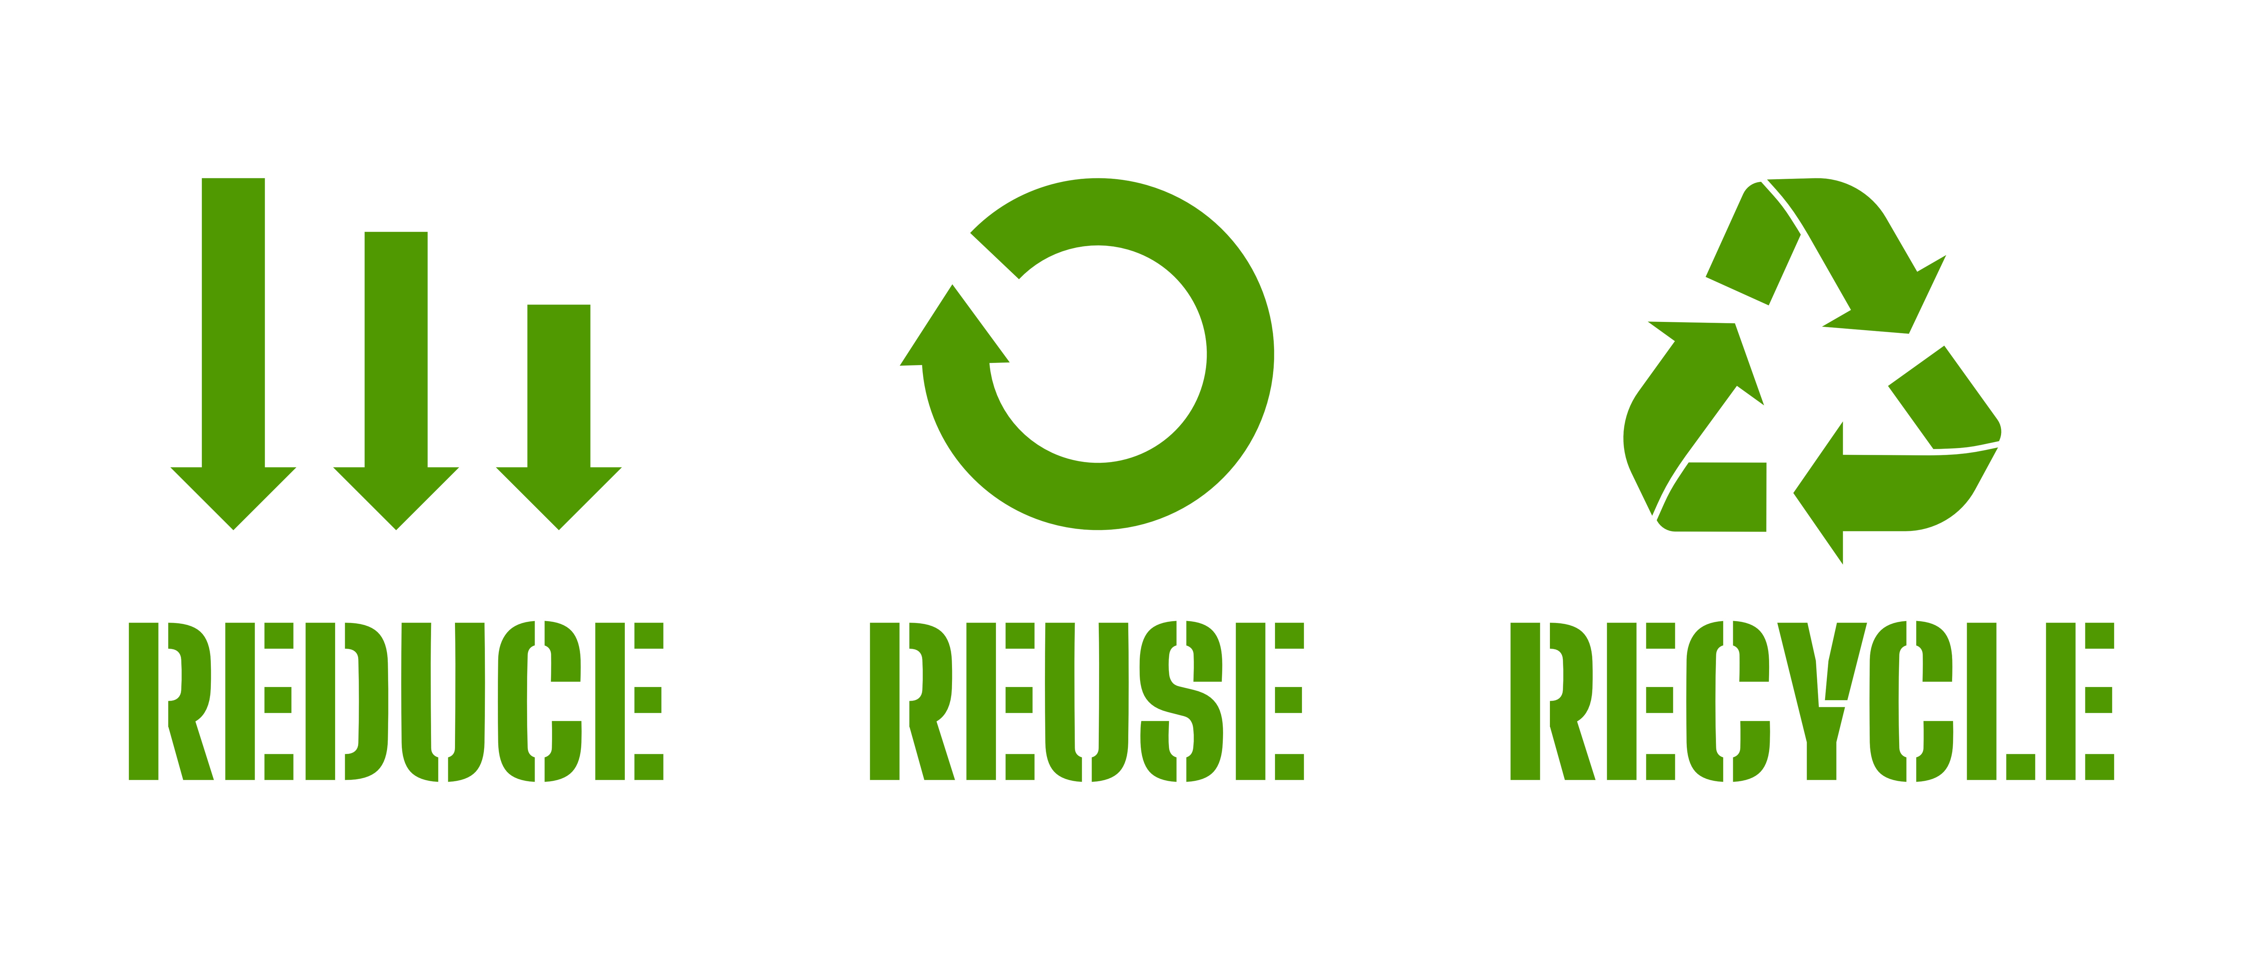


How can adults reduce risk?
Vaping- The Risks
Notes:
Slide: How can adults can reduce risk?
Purpose
To introduce environmental and storage concerns around vapes by understanding what vapes are made from.
Facilitator Notes
Explain that everyone can help reduce the risks that vapes create—for people and for the environment.
Ask:
"What could adults who vape do to make things safer?“
Encourage answers such as:
Reduce – only use a vape if it's needed to help stop smoking.
Reuse – use a refillable device instead of buying lots of disposable products.
Recycle – never throw vapes in a normal bin. Return them to a shop or recycling point so the batteries and materials can be safely recycled.
Point out that vapes contain plastic, metal and lithium batteries, which can harm wildlife, damage the environment and even cause fires if they end up in household bins.
Key message: If adults choose to vape, using refillable devices, reducing waste and recycling properly helps protect people and the planet.

Slide 20
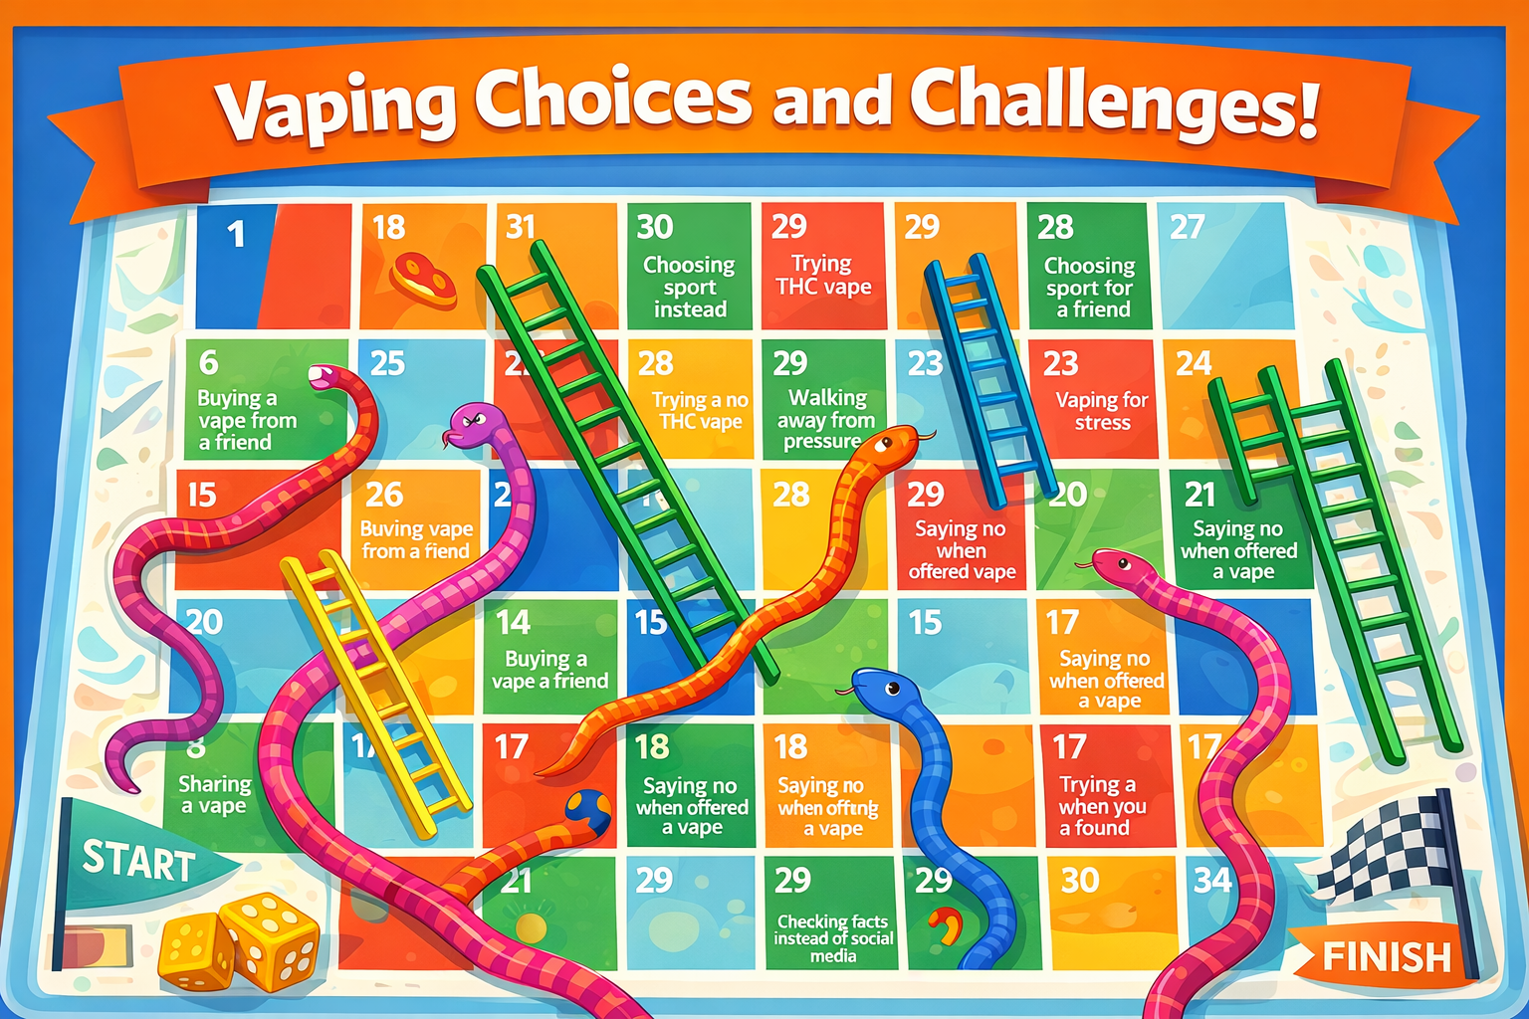
Vaping Choices & Challenges​
Vaping- The Risks
Step 1​​
Build Your Board
Draw a grid (like snakes and ladders). Add numbers from start to finish
Mark START and FINISH
​Step 2​​
Add Snakes (Risky Choices)
On some squares, write risky situations, for example:
🐍Trying a vape you found in the park 🐍Buying a vape from someone at school
🐍Charging a vape with a mobile charger
👉 These squares send players down
​
​Step 3​​
Add Ladders (Healthy Choices)
On other squares, write positive choices, for example:
🪜Saying no to a vape 🪜Walking away from pressure
🪜Choosing sport or other activities
👉 These squares move players up
​
Unhealthy
Healthy
High Risk
Low Risk
Notes:
Slides: Vaping Choices & Challenges / Snakes & Ladders
Purpose
To encourage young people to think about how everyday choices can either increase or reduce the risks associated with vaping and nicotine through a creative, collaborative activity.
Facilitator Notes
This is an optional activity for groups who can facilitate longer pieces of work.
Split participants into small groups and ask each group to design their own Snakes & Ladders board based on vaping-related choices and consequences.
Encourage them to include snakes for risky behaviours (e.g. using a vape found on the ground, giving in to peer pressure or buying from an unknown source) and ladders for positive choices (e.g. saying no, choosing other activities or supporting a friend to avoid vaping).
Once complete, ask groups to swap boards and play each other’s games. Finish with a discussion about which choices helped players move forward and which caused setbacks.
Key message: Small decisions can have a big impact. Positive choices and supportive friendships can help young people avoid unnecessary risks and stay in control of their health.

Slide 21
Vaping Choices & Challenges​
Vaping- The Risks
Step 4​​
Play & Reflect
Swap boards with another group and play.
​
​
Unhealthy
Healthy
Which choices helped you move forward? ​
​
Which choices set you back?
High Risk
Low Risk
Notes:
Slides: Vaping Choices & Challenges / Snakes & Ladders
Purpose
To encourage young people to think about how everyday choices can either increase or reduce the risks associated with vaping and nicotine through a creative, collaborative activity.
Facilitator Notes
This is an optional activity for groups who can facilitate longer pieces of work.
Split participants into small groups and ask each group to design their own Snakes & Ladders board based on vaping-related choices and consequences.
Encourage them to include snakes for risky behaviours (e.g. using a vape found on the ground, giving in to peer pressure or buying from an unknown source) and ladders for positive choices (e.g. saying no, choosing other activities or supporting a friend to avoid vaping).
Once complete, ask groups to swap boards and play each other’s games. Finish with a discussion about which choices helped players move forward and which caused setbacks.
Key message: Small decisions can have a big impact. Positive choices and supportive friendships can help young people avoid unnecessary risks and stay in control of their health.

Slide 22
Pressure, influence, choice
Where do you see vaping?
Notes:
Slide: Where do you see vaping?
Purpose
To encourage young people to think about where vaping is visible in everyday life and explore how this might influence attitudes and behaviours. Discuss whether seeing vaping regularly can make it feel more normal than it actually is.
Facilitator Notes
Invite participants to create a mind map by suggesting all the places they have seen vaping or vaping-related content. Record their answers around the central bubble.
Examples could be:
Social media (TikTok, Instagram, Snapchat, YouTube)
Friends or peers
Family members
Parks or outside shops
Bus stops or train stations
Town centres
Outside youth clubs or sports venues
Music festivals or events
TV programmes, films or music videos
Online influencers or livestreams
Key message: The more often we see something, the more common we may think it is. Seeing vaping frequently does not mean that most young people vape.

Slide 23
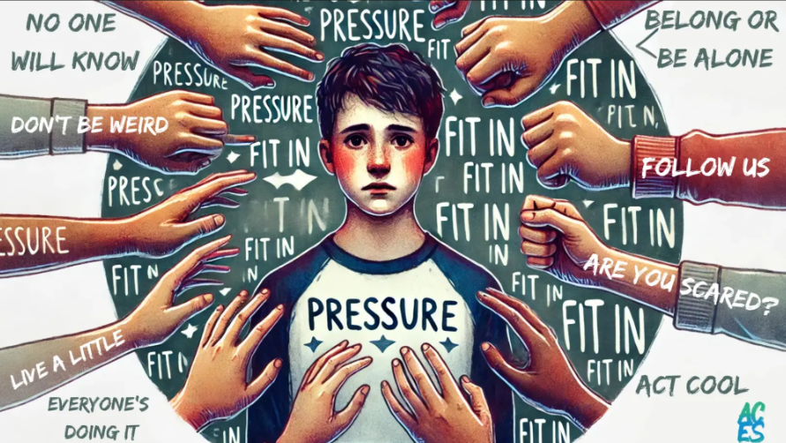

Pressure or influence?
Pressure, influence, choice
Peer pressure involves directly saying something/making someone do something.
Peer influence is where someone copies others to be like them.
Notes:
Slide: What is peer pressure? What is peer influence?
Purpose
To help young people understand the difference between direct peer pressure and the more subtle ways that friends and social groups can influence behaviour.
Facilitator Notes
Introduce the idea that not everyone starts vaping because someone tells them to. Sometimes people are influenced simply by seeing others do it or wanting to fit in.
Ask the group:
What’s the difference between someone saying “Have a vape” and seeing lots of your friends vaping?
Which do you think is more common?
Explain:
Peer pressure is when someone directly encourages, dares or pressures another person to do something. This might include repeatedly offering a vape, saying “everyone does it,” or making fun of someone for saying no.
Peer influence is more indirect. It happens when people copy the behaviour of others because they want to fit in, be accepted or feel part of the group, even if nobody has asked them to vape.
Give some simple examples:
A friend keeps offering you a vape after you’ve said no = peer pressure?
Seeing your friendship group vaping and deciding to try it so you don’t feel left out = peer influence?
Key message: Peer influence is often more powerful than peer pressure because it can happen without anyone saying a word. Recognising both can help young people make choices that are right for them rather than simply following others.

Slide 24
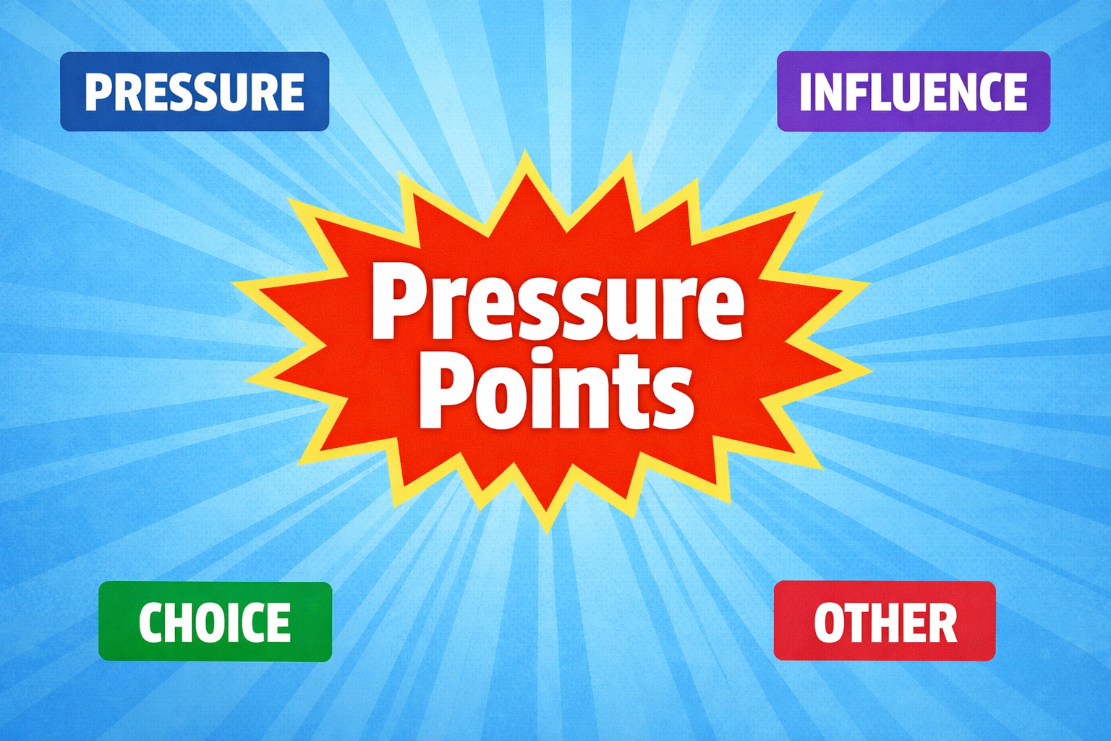
Pressure Points activity
Pressure, influence, choice
You have 10 seconds to decide which
corner to go to when you hear each scenario…
Four corners
PRESSURE INFLUENCE
CHOICE OTHER
The pressure is on!
Notes:
Slide: Pressure Points
Purpose
To help young people recognise the different reasons someone might vape and understand the difference between peer pressure, peer influence, personal choice and other factors.
Facilitator Notes
Explain that you are going to read out a series of scenarios. Participants have 10 seconds to move to the corner they think best explains why the person in the scenario might vape:
Pressure – someone is directly encouraging or pushing them.
Influence – they are copying others or trying to fit in.
Choice – they have made the decision themselves.
Other – there may be another reason, such as curiosity, stress, addiction or family influences.
After each scenario, ask a few participants why they chose their corner. Emphasise that there may be more than one reasonable answer and encourage respectful discussion.
Avoid telling participants they are “wrong” or “right”. Instead, explore their thinking before summarising the key learning point.
Key message: People start or continue vaping for many different reasons. Being able to recognise pressure and influence can make it easier to make informed choices and support others to do the same.

Slide 25
Pressure Points scenarios
Pressure, influence, choice
​
“A friend offers everyone a draw on their vape” ​
“A young person selling vapes on Snapchat” ​
“Someone saying ‘everyone’s doing it, just try it once’” ​
“Vapes lying around at a gaff/party”​
“A shop selling a 14yr old a vape without asking their age” ​
“Someone not vaping when their friends do” ​
“A group laughing when someone says they don’t vape” ​
“Someone deciding to leave when others start vaping” ​
“Seeing influencers using vapes online” ​
“Older young people vaping at the bus stop”
​
Notes:
Slide: Pressure Points
Purpose
To help young people recognise the different reasons someone might vape and understand the difference between peer pressure, peer influence, personal choice and other factors.
Facilitator Notes
Explain that you are going to read out a series of scenarios. Participants have 10 seconds to move to the corner they think best explains why the person in the scenario might vape:
Pressure – someone is directly encouraging or pushing them.
Influence – they are copying others or trying to fit in.
Choice – they have made the decision themselves.
Other – there may be another reason, such as curiosity, stress, addiction or family influences.
After each scenario, ask a few participants why they chose their corner. Emphasise that there may be more than one reasonable answer and encourage respectful discussion.
Avoid telling participants they are “wrong” or “right”. Instead, explore their thinking before summarising the key learning point.
Key message: People start or continue vaping for many different reasons. Being able to recognise pressure and influence can make it easier to make informed choices and support others to do the same.

Slide 26
Pressure Points scenarios
Pressure, influence, choice
“A dare from a friend to take a draw on a vape” ​
“Someone vaping alone” ​
“People filming each other trying new vapes” ​
“A best friend offering a vape after a stressful day” ​
“Bright, colourful vapes in a shop display cabinet” ​
“A group hiding to vape somewhere quiet” ​
“Friends talking about flavours and which ones are best” ​
“Someone being called boring for not joining in” ​
“Someone saying vaping helps with anxiety” ​
“People vaping in toilets”​
Notes:
Slide: Pressure Points
Purpose
To help young people recognise the different reasons someone might vape and understand the difference between peer pressure, peer influence, personal choice and other factors.
Facilitator Notes
Explain that you are going to read out a series of scenarios. Participants have 10 seconds to move to the corner they think best explains why the person in the scenario might vape:
Pressure – someone is directly encouraging or pushing them.
Influence – they are copying others or trying to fit in.
Choice – they have made the decision themselves.
Other – there may be another reason, such as curiosity, stress, addiction or family influences.
After each scenario, ask a few participants why they chose their corner. Emphasise that there may be more than one reasonable answer and encourage respectful discussion.
Avoid telling participants they are “wrong” or “right”. Instead, explore their thinking before summarising the key learning point.
Key message: People start or continue vaping for many different reasons. Being able to recognise pressure and influence can make it easier to make informed choices and support others to do the same.

Slide 27
Choices
Pressure, influence, choice
Are young people more influenced or pressured by each other? ​
​
Do you feel like you can make your own choices?​
Notes:
Slide: Influence / Pressure / Choice
Purpose
To encourage young people to reflect on how much their decisions are shaped by other people and to reinforce that they can make their own informed choices.
Facilitator Notes
Use this slide as a group discussion following the Pressure Points activity.
Ask:
Do you think young people are more often influenced or pressured by each other? Why?
Can you think of examples where people copy others without being asked?
Do you feel confident making your own choices, even if your friends choose differently?
Encourage participants to share examples from everyday life, such as fashion, social media trends, music, sport or vaping. Highlight that influence is often subtle and can happen without anyone saying a word.
Reinforce that although friends and social groups can have a strong impact, young people should try to stop, think and feel empowered to make their own decisions.
Key message: Being aware of peer influence and peer pressure can help young people recognise when others are affecting their choices and make decisions that reflect their own values rather than simply following the crowd.

Slide 28
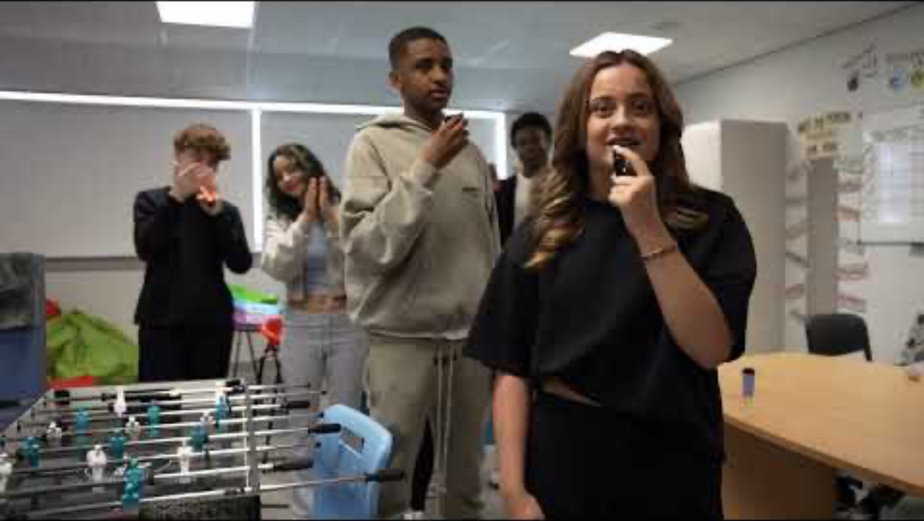
Positive Influences
Pressure, influence, choice
Some people say they vape to help with stress​ or anxiety​
Can you make a video short for social media that
gives advice on how to stay relaxed in a positive way?
Notes:
Slide: Positive Influences
Purpose
To encourage young people to think critically about the perception that vaping helps with stress and to explore healthier coping strategies.
Facilitator Notes
If possible, show the embedded video in which young people discuss positive ways to relax.
Play the video and ask participants to listen for the ideas suggested. https://youtu.be/o0mKnH04sdE
After the video, discuss:
Which relaxation ideas stood out to you?
Which of these would work for you?
Can you think of any other healthy ways to cope with stress or anxiety?
Reinforce that while some people believe vaping helps them relax, nicotine actually stimulates the body by releasing adrenaline and can contribute to a cycle of craving and withdrawal that may increase feelings of stress and anxiety over time.
Encourage participants to think about practical alternatives such as listening to music, exercising, spending time with friends, talking to someone they trust, gaming in moderation, mindfulness, breathing exercises or taking part in hobbies they enjoy.
As an optional task for groups where there is time to allocate to longer project style work young people could create a short social media-style video promoting healthy alternatives to vaping.
Key message: There are many healthy ways to manage stress and anxiety. Although vaping may feel like it provides temporary relief, for someone who is dependent on nicotine, it can reinforce a cycle that makes people want to keep using it rather than addressing the underlying cause of stress.

Slide 29






Where to go for help and information
Vaping knowledge
Quit your way website: with tips to cut down & stop
https://www.nhsggc.scot/your-health/quit-your-way/quit-your-way-youth/
Speak to a trusted adult if anything you’ve learned or discussed has worried you…
NHS Inform website: with tips to cut down & stop
https://www.nhsinform.scot/campaigns/vaping/
Quit your way Information guide: Facts about vaping
https://talkabouttrust.org/resources/schools/nhs-ggc-vaping-information-guide
ChildLine: Advice and information for young people
https://www.childline.org.uk/info-advice/you-your-body/drugs-alcohol-smoking/vaping/
Can you think of anything else ?
Notes:
Information Slide: Where to go for help and information
Facilitator shares information with young people. Links can be accessed together as a group to familiarise young people with the resources.
https://www.nhsggc.scot/your-health/quit-your-way/quit-your-way-youth/
https://www.nhsinform.scot/campaigns/vaping/
https://talkabouttrust.org/resources/schools/nhs-ggc-vaping-information-guide
https://www.childline.org.uk/info-advice/you-your-body/drugs-alcohol-smoking/vaping/
Encourage discussion about accessing support. How easy is this for young people to do? Who are their trusted adults?

