Slide 1


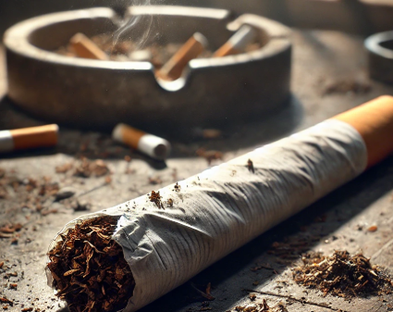
Smoking:
Tobacco and Nicotine Dependency
PSE Lesson S4 – S6
Notes:
Summary of Curriculum for Excellence Experiences & Outcomes
I understand the positive effects that some substances have on the mind and body, but I am also aware of the negative and serious physical, mental, emotional, social and legal consequences of substances HWB 4-38a
Through investigation, I can explain how images of substance use and misuse can influence people’s behaviour. HWB 4-39a
I am developing a range of skills which can support decision making about substance use. I can demonstrate strategies for making informed choices to maintain and improve my health and wellbeing and can apply these in situations that may be stressful or challenging or involve peer pressure. HWB 4-40a
I know how to access information and support for substance-related issues. HWB 4-40b
After accessing options and the consequences of my decisions, I can identify safe and unsafe behaviours and actions. HWB 4-41a
By researching the impact of substances misuse nationally and internationally I can explain similarities and differences among communities. HWB 4-43b
I understand the local, national and international impact of substance misuse. HWB 4-43c

Slide 2
Respectful
Listening
Group Agreement
Focused
Careful Sharing
Anything else?
Notes:
Activity Slide: Group Agreement
Teacher/Facilitator establishes a group agreement with young people.
Prompts on slide can be used to gather other ideas through class discussion/post it note suggestions from young people.
‘Careful sharing’ refers to pupils not feeling pressured to directly disclose theirs/others use of nicotine and considering what/how much they wish to share about themselves.
Teacher/Facilitator will be aware of child protection and health & wellbeing procedures for their own setting should anything arise following lesson/workshop.

Slide 3
What will we learn?
Identify the impact of smoking on health.​
Explore the financial, environmental and societal impact of smoking.​
Develop critical thinking to manage peer/societal influence.
Notes:
Information Slide: What will we learn?
Learning Intentions
Identify the impact of smoking on health.​
Explore the financial, environmental and societal impact of smoking.​
Develop critical thinking to manage peer/societal influence.

Slide 4

The Confidence Ruler
Not Sure
Need to know more
Very knowledgeable
Notes:
Activity Slide: The Confidence Ruler
Teacher/Facilitator can ask young people to rate their knowledge and understanding around smoking and the areas to be covered in the lesson out of 10, providing a baseline. This can be repeated at the end of input as a measure of progress.
How confident are you in what you already know about Smoking/Tobacco?

Slide 5

Smoking: What do we know?
Smoking
What comes to mind with the word ‘smoking’?
Can you think of anything else ?
Notes:
Activity: Smoking: What do we know?
In groups or as a class.
Write "Smoking" on the board and ask students to write down any words, phrases or ideas they associate with the word ‘smoking’ (e.g., cigarettes, addiction, health, social pressure).
This will activate prior knowledge and identify what they already understand about smoking.

Slide 6
Smoking: What do we know?
Smoking
Toxic chemicals/tar
Poor Health
Cost
Cigarettes
Environment
Tobacco
Yellow teeth/ hands
Adverts
Stress relief
Influences & social media
Cancer/
lung disease
Nicotine
Peer pressure
Can you think of anything else ?
Minority / FOMO
Anything else?
Notes:
Activity: Smoking: What do we know?
Collate responses into categories, discuss how they may overlap. Areas may include: physical effects, mental wellbeing, environmental issues.

Slide 7
Smoking: True or False
Most adults who smoke began smoking before the age of 18.
True
Most adults who smoke first tried smoking when they were under 18. Earlier use is linked to increased levels of smoking and dependence throughout life, a lower chance of quitting, and higher risk of smoking related disease and mortality.
90% of people who smoke started between the ages of 10 and 20 years in the UK.
Can you think of anything else ?
Notes:
Activity: Smoking: True or False: Most adult people who smoke began smoking before the age of 18.
True
Most adults who smoke first tried smoking when they were under 18, earlier use is linked to increased levels of smoking and dependence throughout life, a lower chance of quitting, and higher risk of smoking related disease and mortality.
90% of people who smoke started between the ages of 10 and 20 years in the UK.
Source: https://ash.org.uk/resources/view/young-people-and-smoking?utm

Slide 8
Smoking: True or False
Most teenagers smoke
False
Most teenagers in Scotland do not smoke. In fact, smoking rates among young people have been decreasing for years.
Choosing not to smoke is the norm.
Action for Smoking and Health (ASH) shared that less than 6 in 100 15-year-olds in Scotland currently smoke.
New legislation passed in 2026 means that from 1 January 2027, it will be illegal to sell tobacco products to anyone born on or after 1 January 2009.
Can you think of anything else ?
Notes:
True or False: Most teenagers smoke
False
Most teenagers in Scotland do NOT smoke. In fact, smoking rates among young people have been decreasing for years. Choosing not to smoke is the norm, not the exception
Recent data from the ASH SmokeFree GB Youth survey 2024 provides insights into smoking behaviours among Scottish adolescents aged 11 to 17:
The survey indicates that 3.6% of 15-year-olds in Scotland are current smokers.
(Source: https://ashscotland.org.uk/wp-content/uploads/2024/07/Smoking-and-Health-Inequalities_April-2024.pdf?utm_)

Slide 9
Smoking: True or False
Smoking relieves stress/anxiety
False
For a person who smokes it may feel as if having a cigarette relieves stress and anxiety. This is because smoking relieves the craving they experienced. This is the cycle of addiction.
Nicotine dependency does not support with stress/anxiety.
Can you think of anything else ?
Notes:
True or False: Smoking relieves stress/anxiety
False
For a person who smokes it may feel as if having a cigarette relieves stress and anxiety. This is not true, it is smoking tricking the body into thinking it’s helping with stress.
Nicotine dependency does not support with stress/anxiety.
https://www.nhs.uk/better-health/quit-smoking/why-quit-smoking/the-truth-about-smoking-stress-and-mental-health/
Source: https://www.healthforteens.co.uk/lifestyle/tobacco/smoking-rumours/?utm

Slide 10
Smoking: True or False
Rolling tobacco is better for you than pre rolled cigarettes
False
Some people think rolling tobacco is ‘natural’ or ‘organic’ but they contain the same tobacco, the same additives, carcinogens and chemicals as in pre-rolled cigarettes. Filters or butt ends do not reduce harm.
Can you think of anything else ?
Notes:
True or False -Rolling tobacco is better for you than pre rolled cigarettes
False
Some people think rolling tobacco is ‘natural’ or ‘organic’ but they contain the same tobacco, the same additives, carcinogens and chemicals as in pre-rolled cigarettes.
Source – Tobacco-Free Generation resources
https://news.cancerresearchuk.org/2009/07/07/roll-your-own-cigarettes-how-dangerous-are-they/?utm

Slide 11


Smoking: True or False
Tobacco in Shisha is less harmful
False
Smoking shisha is not safer than smoking cigarettes. People may think that drawing tobacco smoke through water makes shisha less harmful than cigarettes. This is not true.
Smoking shisha exposes users to tar, carbon monoxide and high levels of toxins.
Can you think of anything else ?
Notes:
Tobacco in Shisha is less harmful
False
Smoking shisha is not safer than smoking cigarettes. People may think that drawing tobacco smoke through water makes shisha less harmful than cigarettes. This is not true.
Smoking shisha exposes users to tar, carbon monoxide and high levels of toxins.
Shisha pipes are waterpipes that are used to smoke specially made tobacco mixtures that come in a wide variety of flavours. They usually work by passing charcoal-heated air through the tobacco mixture and ultimately through a water-filled chamber. Smoking shisha varies in popularity depending on the culture.
Shisha is popular in the Middle East, North Africa, and South Asia, where it's an integral part of social traditions and cultural practices. It's gaining popularity in Europe and North America, particularly among younger generations.

Slide 12
Smoking: True or False
Smoking can help someone keep weight down
False
While smoking can reduce appetite, it is often linked to an unhealthy diet, resulting in less energy for physical activity and potentially causing weight gain.
Can you think of anything else ?
Notes:
True or False: Smoking can help someone keep weight down
False
While smoking can reduce appetite, it is often linked to an unhealthy diet, resulting in less energy for physical activity and potentially causing weight gain.
Source: https://www.healthforteens.co.uk/lifestyle/tobacco/smoking-rumours/?utm

Slide 13
Smoking: True or False
Smoking can reduce your physical fitness and ability to play sports
True
Smoking can reduce your physical fitness and ability to play sport and do other kinds of exercise.
This is due to smoke inhalation causing shortness of breath and reduced lung function, reducing fitness and energy levels.
Can you think of anything else ?
Notes:
True or False - Smoking can reduce your physical fitness and ability to play sports
True
Smoking can reduce your physical fitness and ability to play sport and do other kinds of exercise.
This is due to smoke inhalation causing shortness of breath and reduced lung function, reducing fitness and energy levels.
Source: https://www.healthforteens.co.uk/lifestyle/tobacco/smoking-rumours/?utm

Slide 14
Smoking: True or False
Smoking doesn't harm anyone else
False
When someone smokes indoors, the smoke lingers in the air for up to 5 hours or more. People can’t see or smell it, but it will be inhaled by anyone there.
The damaging particles are so small 85% of them are invisible and odourless.
Can you think of anything else ?
Notes:
True or false – Smoking doesn't harm anyone else
False
When someone smokes indoors, the smoke lingers in the air for up to 5 hours or more. People can’t see or smell it, but it will be inhaled by anyone there.
The damaging particles are so small 85% of them are invisible and odourless.
Source – Tobacco-Free Generation resources
https://ashscotland.org.uk/about-us/charter/#:~:text=Scotland%20has%20a%20goal%20of,be%20living%20tobacco%2Dfree%20lives.

Slide 15
Smoking: True or False
Smoking-related diseases cost the NHS in Scotland just less than £100 million per year
False
Smoking-related diseases cost the NHS in Scotland over £300 million per year (ASH Scotland, 2023)
Smoking-related hospital admissions: 88,779 per year in Scotland.
Can you think of anything else ?
Notes:
True or False - Smoking-related diseases cost the NHS in Scotland just less than £100 million per year
False
Smoking-related diseases cost the NHS in Scotland over £300 million per year (ASH Scotland, 2023).
Smoking-related hospital admissions: 56,000 per year in Scotland.
Source: Tobacco-free generation resources
https://ashscotland.org.uk/about-us/charter/#:~:text=Scotland%20has%20a%20goal%20of,be%20living%20tobacco%2Dfree%20lives.

Slide 16
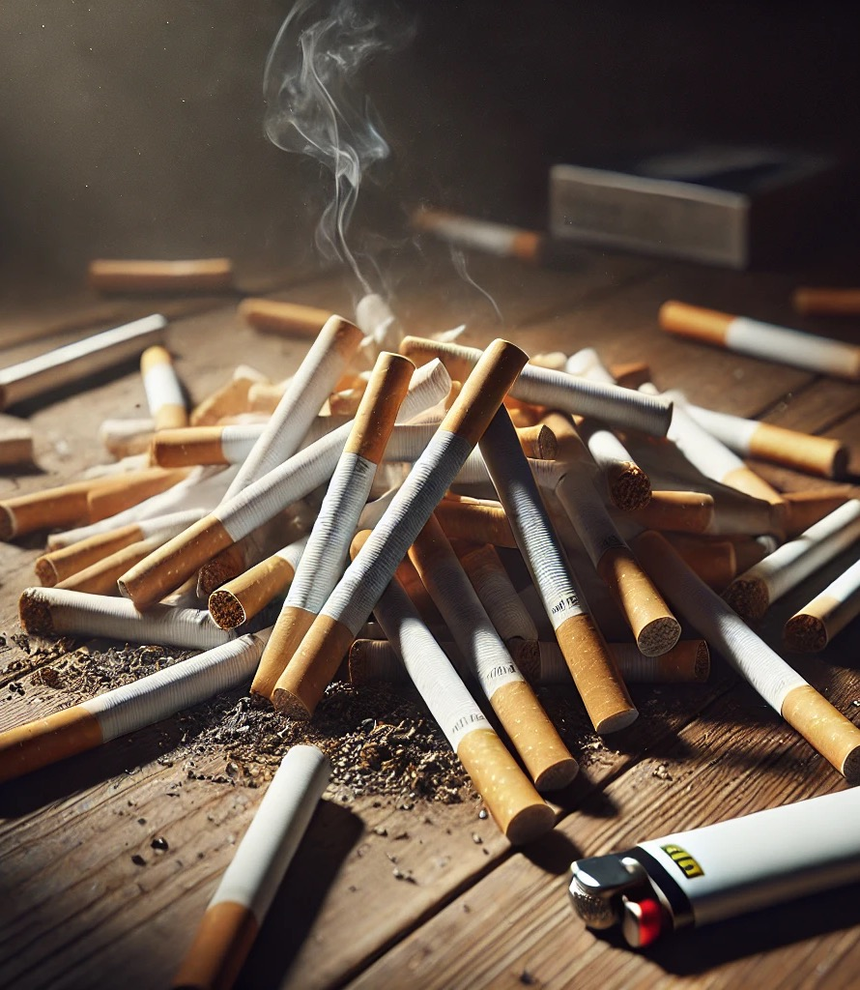
Cigarettes: What’s inside?
Cigarettes contain over 7,000 chemicals, at least 70 of which cause cancer.
(Cancer Research UK, 2023)
Some examples of harmful chemicals:
Nicotine – Addictive, increases heart rate and blood pressure.
Tar – Coats lungs, leads to cancer.
Carbon Monoxide – Reduces oxygen in the blood.
Hydrogen cyanide - which is used as an industrial pesticide.
Notes:
Information Slide: What’s in a cigarette?
Cigarettes contain over 7,000 chemicals, at least 70 of which cause cancer (Cancer Research UK, 2023)
Some examples of harmful chemicals:
Nicotine – Addictive, increases heart rate and blood pressure.
Tar – Coats lungs, leads to cancer.
Carbon Monoxide – Reduces oxygen in the blood.
Hydrogen cyanide - which is used as an industrial pesticide.
Source: https://www.cancerresearchuk.org/about-cancer/causes-of-cancer/smoking-and-cancer/whats-in-a-cigarette-0?utm

Slide 17
Cigarettes: What’s inside?
Cigarettes contain over 7,000 chemicals
Research the chemicals in tobacco:
How many more chemicals can you find?
What is the most obscure/strange chemical?
What other purposes do these chemicals have?
Notes:
Activity: What’s in a cigarette?
Cigarettes contain over 7,000 chemicals
Research the chemicals in tobacco:
How many more chemicals can you find?
What is the most obscure/strange chemical?
What other purposes do these chemicals have?
Source: https://www.cancerresearchuk.org/about-cancer/causes-of-cancer/smoking-and-cancer/whats-in-a-cigarette-0?utm

Slide 18
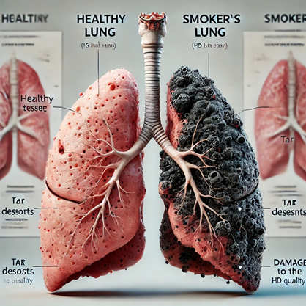

Health Effects/Risks
Watch:
Watch the short clip of a Dentist explaining risks of smoking related to oral health.
Notes:
Discussion Slide: Health Effects/Risks
Teacher to facilitate class discussion using following questions:
What are the main risks of smoking?
Why might someone smoke?
What impact might this have on their life?

Slide 19
Health Effects/Risks
Discuss:
Having watched the clip about oral health, discuss as a group:
What are the main risks of smoking?
Why might someone smoke?
What impact might this have on their life?
Notes:
Discussion Slide: Health Effects/Risks
Teacher to facilitate class discussion using following questions:
What are the main risks of smoking?
Why might someone smoke?
What impact might this have on their life?

Slide 20
Health Effects/Risks
Most of the deaths directly caused by smoking are due to three main conditions:
Cancer
Chronic Obstructive Pulmonary Disease (COPD)
Cardiovascular disease (Heart & Circulation)
On average smoking longer term reduces life expectancy by 10 years.
Notes:
Information Slide: Health Effects/Risks
Most of the deaths directly caused by smoking are due to three main conditions:
Cancer
Chronic Obstructive Pulmonary Disease (COPD)
Cardiovascular disease (Heart & Circulation)
On average smoking longer term reduces life expectancy by 10 years.
https://www.theguardian.com/society/2024/dec/30/single-cigarette-takes-20-minutes-off-life-expectancy-study
https://www.nhsinform.scot/care-support-and-rights/nhs-services/helplines/quit-your-way-scotland

Slide 21

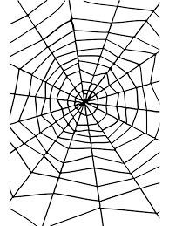

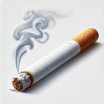
Activity: ‘Risks Around Smoking’ web
We need:
Sticky notes/pens
We will:
Think about the wider risks around smoking
Create a web by sticking post its with ‘risks’ on the board
Draw images or symbols to represent each risk
Use lines to connect related risks
Each group can present one part of the web
Other Effects
Respiratory Diseases
Cancer
Heart & Circulatory Problems
Fire hazard
Money worries
Secondhand Smoking
Notes:
Activity: ‘Risks Around Smoking’ web
Teacher supports class through following activity. This can be done as outlined for whole class using the board, or in small groups using large sheets of paper. This can also be an individual activity for pupils working in jotters or making a poster.
Think about the wider risks around smoking
Create a web by sticking post its with ‘risks’ on the board
Draw images or symbols to represent each risk
Use lines to connect related risks
Each group can present one part of the web
This activity encourages young people to think about the wider risks of smoking in addition to the health issues detailed below.
Areas to consider are:
Health
Finance
Impact on others: second hand smoke, smoking in pregnancy, risk of fire etc.
Detailed Health Information:
1. Cancer
Lung cancer: Tobacco is the leading cause of lung cancer.
Mouth and throat cancer: Smoking or chewing tobacco increases the risk.
Other cancers: Includes esophageal, stomach, pancreatic, kidney, bladder, and cervical cancer.
2. Respiratory Diseases
Chronic Obstructive Pulmonary Disease (COPD): Smoking is a major cause of emphysema and chronic bronchitis.
Asthma: Tobacco smoke can worsen asthma symptoms.
Reduced lung function: Smokers have decreased lung capacity and chronic coughing.
3. Heart and Circulatory Problems
Heart disease: Smoking increases the risk of coronary artery disease and heart attacks.
Stroke: Tobacco use contributes to strokes by damaging blood vessels.
High blood pressure: Smoking can lead to long-term elevated blood pressure.
4. Weakened Immune System
Smokers are more prone to infections, including pneumonia and the flu.
5. Reproductive Health Issues
In men: Increased risk of erectile dysfunction.
In women: Greater risk of infertility and complications during pregnancy.
In pregnancy: Smoking can cause low birth weight, premature birth, and developmental issues in the baby.
6. Secondhand Smoke Risks
Non-smokers exposed to secondhand smoke can suffer from similar health problems, including lung cancer, heart disease, and respiratory illnesses.
7. Other Effects
Dental problems: Stained teeth, gum disease, and tooth loss.
Skin aging: Smoking accelerates skin aging, causing wrinkles.
Vision issues: Increased risk of cataracts and macular degeneration.

Slide 22
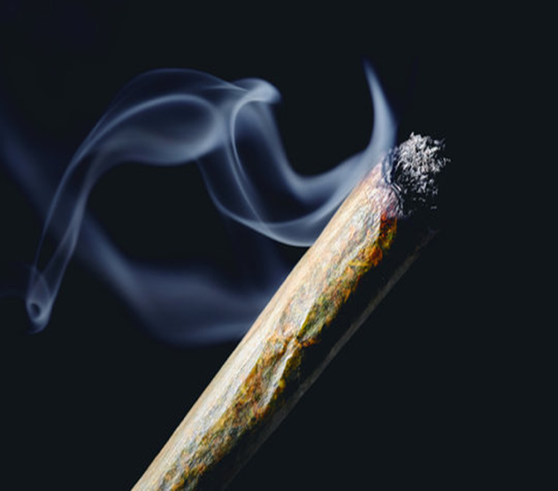
Using Cannabis with Tobacco
The most common way to consume cannabis in the UK is by mixing it with tobacco and rolling it into a joint.
Using cannabis in this way can be a route into nicotine dependency as well as the risk of cannabis dependency.
Can you think of anything else ?
Notes:
Information Slide: Using cannabis with tobacco
The most common way to consume cannabis in the UK is by mixing it with tobacco and rolling it into a joint
Using cannabis in this way can be a route into nicotine dependency as well as cannabis dependency

Slide 23

Financial Cost of Smoking
Notes:
Financial cost of Smoking
Source: Image creator in Bing

Slide 24

Activity: Wish List
You have a budget of £500.00
(birthday money/wages)
What would you buy with £500.00?
Your wish list must have 5 – 10 items
It must be as close to £500.00 as possible
Can you think of anything else ?
Notes:
Activity: Wish List
You have a budget of £500.00
(birthday money/wages)
What would you buy with £500.00?
Your wish list must have 5 – 10 items
It must be as close to £500.00 as possible

Slide 25
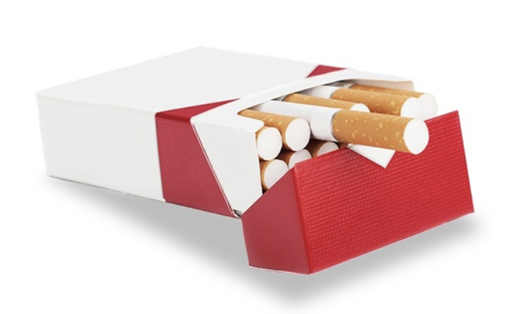
Activity: Financial Cost of Smoking
In June 2025, 20 cigarettes cost on average £17.75
Using the 'NHS stop smoking calculator' work out the total cost for someone who smokes 20 a day from the age of 18 – 60 years old for:
1 month
1 Year
Lifetime
NHS stop smoking calculator
Can you think of anything else ?
Notes:
Activity: Financial cost of smoking
In June 2025, 20 cigarettes cost on average £17.75
Using the 'NHS stop smoking calculator' work out the total cost for someone who smokes 20 a day from the age of 18 – 60 years old for:
1 month
1 Year
Lifetime
NHS stop smoking calculator

Slide 26
How much of your wish list could a person buy from the money they saved from stopping smoking?
Based on 20 a day over a month.
Activity: Wish List
Can you think of anything else ?
Notes:
Activity: Wish List
Young people work out how much of their wish list they could buy from the equivalent cost of smoking 20 cigarettes a day.
Teacher can facilitate class discussion around this with young people sharing their wish lists/thoughts and feelings around the comparison and significant financial cost of smoking.
Further discussion could be had around % of tax on tobacco and the wider financial costs of smoking to services such as NHS.

Slide 27
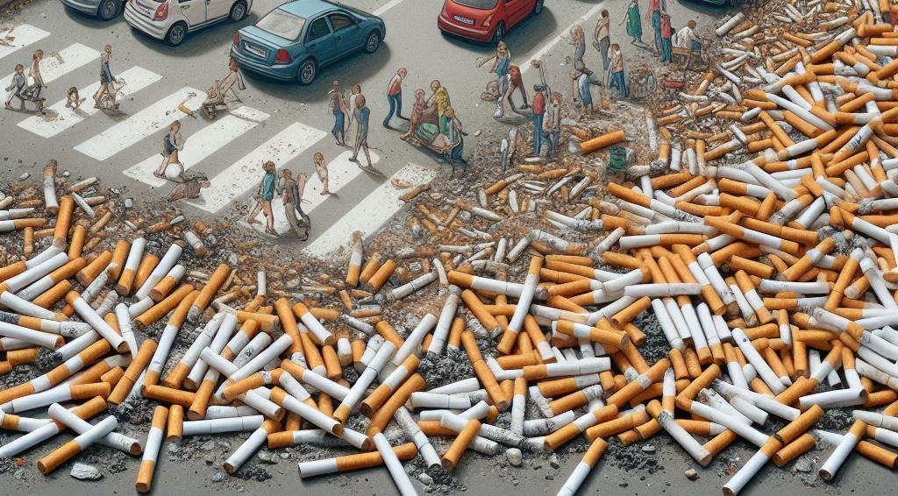
Environmental Cost of Smoking:
Cigarettes are not biodegradable.
Cigarette ends contain plastic filters, toxic chemicals like arsenic, lead, and nicotine.
Used cigarette ends can take up to 15 years to break down.
Notes:
Information slide: Environmental cost of smoking:
Teacher/Facilitator shares information with young people.
Cigarettes are not biodegradable.
Cigarette ends contain plastic filters, toxic chemicals like arsenic, lead, and nicotine.
Used cigarette ends can take up to 15 years to break down.
https://ash.wales/

Slide 28
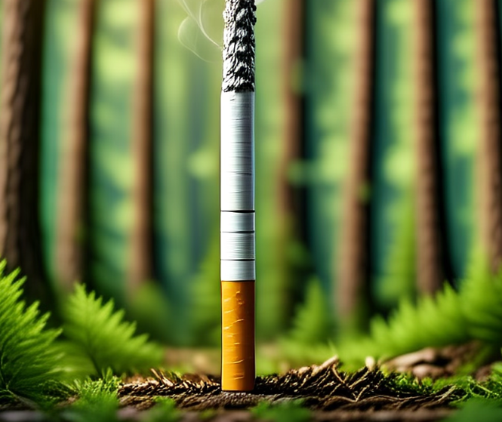
Cigarette ends are the most common form of litter, as an estimated 4.5 trillion cigarette ends are thrown away annually worldwide.
122 tonnes of smoking-related litter is dropped across the UK every day.
In 2022, volunteers removed more than 1,200 cigarette ends from 129 beach cleans on Scottish shores.
It is estimated that clearing smoking related litter costs the Scottish economy £34 million each year.
Environmental Cost of Smoking:
Notes:
Information slide: Environmental cost of smoking:
Teacher/Facilitator shares information with young people.
Cigarette ends are the most common form of litter, as an estimated 4.5 trillion cigarette ends are thrown away annually worldwide.
122 tonnes of smoking-related litter is dropped across the UK every day.
In 2022, volunteers removed more than 1,200 cigarette ends from 129 beach cleans on Scottish shores.
It is estimated that clearing smoking related litter costs the Scottish economy £34million each year.
References:
World Health Organisation 2023, https://www.who.int/news-room/fact-sheets/detail/tobacco
Ash Scotland, https://ashscotland.org.uk/tobacco-free-schools-pack/
https://ashscotland.org.uk/butts-and-disposable-vapes/?utm
Ash Wales https://ash.wales/

Slide 29
Environmental Cost of Smoking:
Discuss:
To what extent does smoking impact your local community?
Research the wider impact tobacco and smoking has on the environment.
Consider:
Local community
Cigarette production
Animal wildlife
Notes:
Discussion slide: Environmental cost of smoking:
Teacher/Facilitator poses questions, encourages group discussion and supports the research task:
To what extent does smoking impact your local community?
Research the wider impact tobacco and smoking has on the environment.
Consider:
Local community
Cigarette production
Animal wildlife
https://ash.wales/

Slide 30
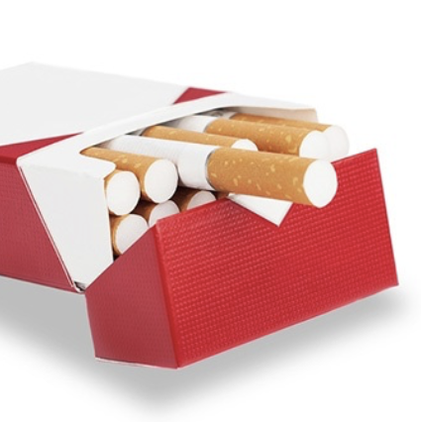
The Role of Marketing/ Advertising
Research the advertising rules around tobacco/cigarettes in Scotland.
How are cigarettes being promoted?
Do we see smoking on our screens?
How can smoking be made to look in the media?
Who may manufacturers want to target?
Notes:
Discussion slide: The role of marketing/advertising
Teacher/Facilitator poses questions, encourages group discussion and supports the research task:
Research the advertising rules around tobacco/cigarettes in Scotland.
How are cigarettes being promoted?
Do we see smoking on our screens?
How can smoking be made to look in the media?
Who may manufacturers want to target?

Slide 31


Learning Objectives
What Marketing Strategies do we see?
✅ Making It Look Cool – stylish people smoking in exciting settings.
✅ Influencers & Celebrities – Fans may copy what their idols do, even if it's harmful.
✅ Targeting Emotions – connecting smoking with fun, relaxation, or stress relief.
✅ Hiding the Negative Side no reference to addiction or health issues.
Notes:
Information slide: What marketing strategies do we see?
Teacher/Facilitator shares information with young people explaining each strategy with examples and encouraging students to share their thoughts and examples:
Making It Look Cool – media may show stylish people smoking in exciting settings. (Example: Movies where the "bad boy" or "cool girl" smokes.)
Using Influencers & Celebrities – Fans may copy what their idols do, even if it's harmful. (Example: A popular musician seen vaping on Instagram.)
Targeting Emotions – connecting smoking with fun, relaxation, or stress relief. (Example: “Take a break, have a cig.”)
Hiding the Negative Side – media only showing the "good" parts, never the addiction or health issues. (Example: happy people smoking at a party, but no mention of lung disease.)
Optional extension - Have students create a "Truth Ad“. A poster or video that counters the misleading messages of tobacco marketing and highlights some of the harmful effects.

Slide 32
International Research around Tobacco Advertising
Learning Objectives
Countries where Tobacco can be advertised have higher smoking rates, especially among young people.
Bans on tobacco advertising lead to a decrease in smoking, as shown in countries that have implemented full bans.
Partial bans are less effective because tobacco companies shift to other advertising methods.
Young people are highly influenced by tobacco ads and are more likely to start smoking if exposed to them.
After the UK tobacco ad ban in 2002, awareness of tobacco marketing dropped among youth, and smoking rates continued to fall.
Notes:
Information slide: International research around tobacco advertising
Teacher/Facilitator shares information with young people
Countries where Tobacco can be advertised have higher smoking rates, especially among young people.
.
Bans on tobacco advertising lead to a decrease in smoking, as shown in countries that have implemented full bans.
Partial bans are less effective because tobacco companies shift to other advertising methods.
Young people are highly influenced by tobacco ads and are more likely to start smoking if exposed to them.
After the UK tobacco ad ban in 2002, awareness of tobacco marketing dropped among youth, and smoking rates continued to fall.
Extended activities
Debate: “Should smoking be completely banned?”
Marketing Analysis: Analyse cigarette packaging & how companies have tried to adapt to regulations.
References
Action on Smoking and Health (ASH). (2023). Tobacco advertising and promotion in the UK. Retrieved from https://ash.org.uk/resources/view/tobacco-advertising-and-promotion-in-the-uk
National Cancer Institute. (2008). The role of the media in promoting and reducing tobacco use (Tobacco Control Monograph No. 19). Bethesda, MD: U.S. Department of Health and Human Services, National Institutes of Health. Retrieved from https://www.ncbi.nlm.nih.gov/books/NBK236761/
Scollo, M., & Winstanley, M. (Eds.). (2018). Tobacco in Australia: Facts and issues. Melbourne: Cancer Council Victoria. Chapter 11.1 – The merits of banning tobacco advertising. Retrieved from https://www.tobaccoinaustralia.org.au/chapter-11-advertising/11-1-the-merits-of-banning-tobacco-advertising
World Health Organization (WHO). (2008). WHO report on the global tobacco epidemic, 2008: The MPOWER package. Geneva: World Health Organization.
Agaku, I. T., & Filippidis, F. T. (2024). Effect of tobacco advertising bans on smoking prevalence and initiation: A systematic review and meta-analysis. Tobacco Control, Advance online publication. Retrieved from https://pubmed.ncbi.nlm.nih.gov/39805696/
Lovato, C., Watts, A., & Stead, L. F. (2011). Impact of tobacco advertising and promotion on increasing adolescent smoking behaviours. Cochrane Database of Systematic Reviews, (10), CD003439. https://doi.org/10.1002/14651858.CD003439.pub2
Moodie, C., Stead, M., Bauld, L., McNeill, A., Angus, K., Hinds, K., & Kwan, I. (2010). Awareness of marketing for tobacco products and perceptions of tobacco marketing among young people after the introduction of advertising restrictions in the United Kingdom. European Journal of Public Health, 21(4), 512–517. https://europepmc.org/articles/PMC4256379

Slide 33
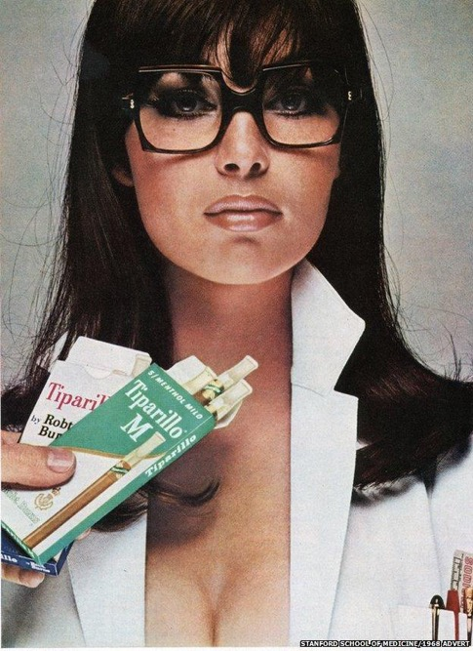
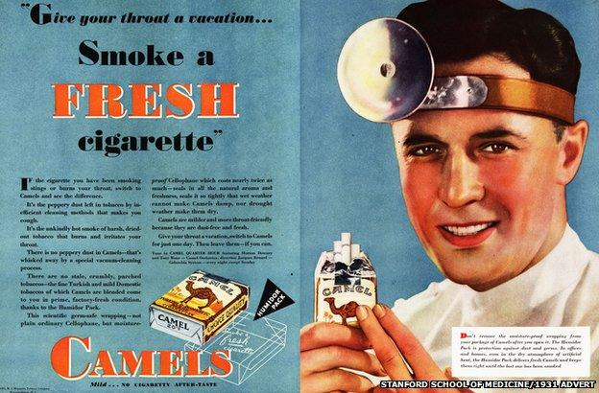
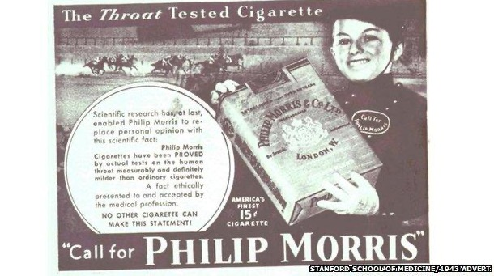
Activity: Media Influence over the years...
Look at the pictures from the past and discuss:
What different images do these adverts try to create around smoking?
Can you spot different approaches to influencing?
What impact do you feel these messages had on people?
Notes:
Activity: Media Influence on Smoking over the years:
Looking at the images from the past, Discuss:
What different images do these adverts try to create around smoking?
Can you spot different approaches to influencing?
What impact do you feel these messages had on people?
Breaking the Illusion: Class Reflection
Discuss how these ads manipulate emotions (coolness, rebellion, relaxation).
Talk about real consequences of smoking vs. what ads show.
Resisting Pressure: Strategy Building
Brainstorm ways to resist peer pressure to smoke.
Role-play different scenarios (e.g., a friend offering a cigarette).
Encourage creative responses like humour, confidence, or changing the subject.
Smoking adverts and the 'outrageous' cigarette promotions of the past - BBC News

Slide 34
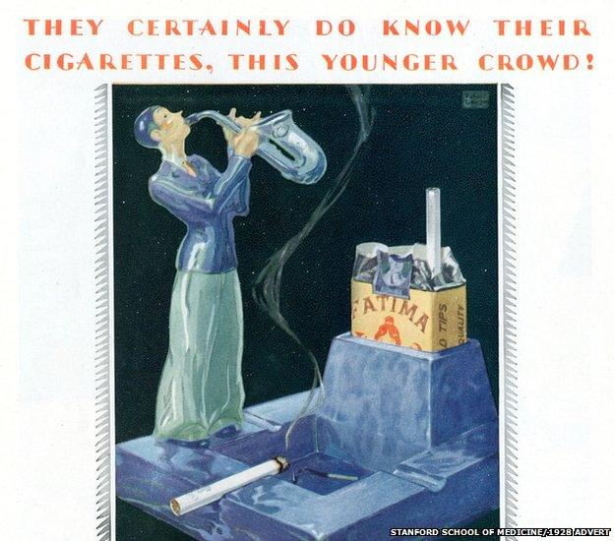
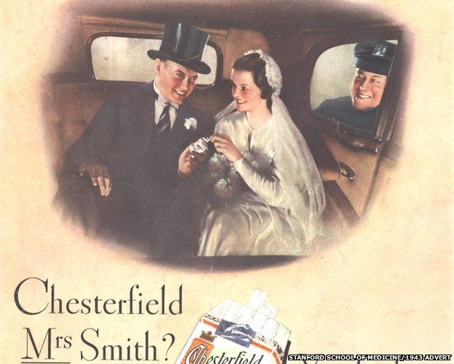

Activity: Media Influence over the years...
Smoking adverts and the 'outrageous' cigarette promotions of the past - BBC News
Notes:
Activity: Media Influence on Smoking over the years:
Looking at the images from the past, Discuss:
What different images do these adverts try to create around smoking?
Can you spot different approaches to influencing?
What impact do you feel these messages had on people?
Breaking the Illusion: Class Reflection
Discuss how these ads manipulate emotions (coolness, rebellion, relaxation).
Talk about real consequences of smoking vs. what ads show.
Smoking adverts and the 'outrageous' cigarette promotions of the past - BBC News

Slide 35

Social Pressures/
Influence
What messaging are young people exposed to through Social Media?
Have you seen examples of tobacco featuring online?
Notes:
Discussion Slide: Social Pressures/influence
Show short clip of young people's discussion around social media
Teacher/Facilitator holds discussion with young people.
What messaging are young people exposed to through Social Media?
Can you list examples of tobacco featuring online?

Slide 36
Resisting Influence:
What advice would you give young people?
Learning Objectives
What does peer pressure look like for young people? Is it direct, are friends pushy with each other? Or is it more subtle?
Resisting Pressure/Influence: Strategy Building
Think creatively around how young people can resist peer pressure/influence to smoke.
Can you design an activity, poster or leaflet for Primary pupils around resisting pressure/influence from others?
Notes:
Activity Slide: Resisting influence: What advice would you give young people?
Teacher/Facilitator introduces discussion around resisting influence. Supports young people to complete activity around advice they can give to Primary ages pupils.
Resisting Pressure: Strategy Building
Think creatively around how young people can resist peer pressure/influence to smoke.
Can you design an activity, poster or leaflet for Primary pupils around resisting pressure/influence from others?
Consider:
Role-playing different scenarios (e.g. a friend offering a cigarette).
Encourage creative responses like humour, confidence, or changing the subject.
Additional Info:
If you ever feel pressured to smoke, here are 4 powerful strategies to help you stay in control
Be Confident in Saying No
You don’t owe anyone an explanation. A simple, firm "No, I don’t smoke" is enough.
If needed, add a reason: "I care about my health" or "I don’t want to waste money on that."
Choose Friends Who Respect Your Choices
Real friends won’t pressure you into doing something harmful.
If people constantly push you to smoke, ask yourself: Are they really my friends?
Know the Tricks of Tobacco Marketing
Companies make smoking look “cool” in movies, social media, and ads.
Recognizing these manipulation tactics makes it easier to resist them.
Use Humor & Distraction
Deflect the pressure with a joke:
"Nah, I’m trying to keep my lungs in mint condition!"
"I prefer my money in my wallet, not in smoke."

Slide 37
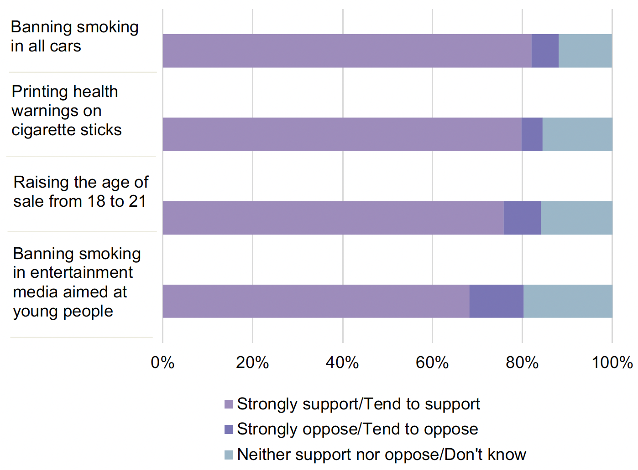
Strategies to reduce tobacco harm
Can you do a class survey seeking opinion on these methods of tobacco control?
Can you think of other measures to reduce tobacco harm?
Can you think of anything else ?
Notes:
Activity Slide: Strategies to reduce tobacco harm
Can you do a class survey seeking opinion on these methods of tobacco control? Young people could use Microsoft Forms/Survey Monkey or simply use tally marks on a sheet they’ve designed.
Can you think of other measures? This question could be included as part of the surveys young people design.
Young people could research the historical timeline of tobacco control measures being implemented in Scotland since early 2000’s.
1960s–1990s: Early Awareness and Advertising Restrictions
1965: Ban on cigarette TV advertising (UK-wide).
1971: Health warnings made mandatory on tobacco packaging.
1986: Ban on tobacco advertising in cinemas (UK-wide).
1991: UK-wide restrictions on tobacco sponsorship and advertising tightened.
2000s: Major Legislative Interventions
2002: NHS smoking cessation services expanded in Scotland.
2005: Ban on tobacco advertising and sponsorship under the Tobacco Advertising and Promotion Act 2002 (UK law).
March 2006: Comprehensive public smoking ban introduced — smoking prohibited in enclosed public places and workplaces (Scotland was the first UK nation to do this).
2007: Increase in the legal age for tobacco purchase from 16 to 18.
2010s: Packaging, Sales, and Display Controls
2010: Tobacco and Primary Medical Services (Scotland) Act 2010 introduced:
Ban on tobacco sales from vending machines.
Requirement for retailers to register to sell tobacco.
Ban on tobacco displays in large shops (implemented in 2013) and smaller shops (2015).
2013: Ban on tobacco displays in supermarkets implemented.
2016: Introduction of standardised (plain) packaging and ban on promotional branding (UK-wide law but implemented in Scotland too).
2017: Full implementation of plain packaging and new graphic health warnings.
2020s: Targeting Youth and Future Goals
2021: Scottish Government publishes updated Tobacco Control Action Plan, reaffirming the goal of becoming "tobacco-free" by 2034 (defined as <5% of adults smoking).
2022: Consultation on banning disposable vapes and restricting youth access to vaping products.
Ongoing: Measures being explored include restrictions on smoking near schools and hospitals, and further reducing retail availability of tobacco.
Summary of Goals:
The overarching goal is to reduce smoking prevalence to below 5% by 2034.
Focus areas include youth prevention, cessation support, regulating new products (like vapes), and public health education.
Case Study: How Australia reduced smoking with strict laws.
Australia significantly reduced smoking rates by implementing a comprehensive set of strict tobacco control laws, most notably including a nationwide ban on smoking in enclosed public spaces, large increases in tobacco taxes, a prohibition on tobacco advertising, and most significantly, the introduction of plain packaging for all tobacco products, which removes any branding or attractive design from cigarette packs; this multi-pronged approach has been widely recognized as a global leader in tobacco control policy.
Key aspects of Australia's tobacco control strategy:
Smoke-free environments: Extensive bans on smoking in most public places, including workplaces, restaurants, bars, public transport, and outdoor dining areas.
Plain packaging: All tobacco products must be sold in plain packaging with large graphic health warnings, removing any branding appeal.
High tobacco taxes: Consistently raising tobacco taxes to make cigarettes less affordable.
Advertising bans: Strict limitations on tobacco advertising across all media platforms.
Public education campaigns: Extensive public health campaigns to raise awareness of the dangers of smoking.
Impact of these laws:
Dramatic decline in smoking rates:
Australia has seen a significant drop in the percentage of smokers since implementing these policies.
Reduced youth smoking initiation:
Plain packaging and strong messaging have been particularly effective in deterring young people from starting to smoke.
Global model for tobacco control:
Australia's approach is often cited as a successful example for other countries looking to reduce smoking rates.
Source: Vaping and smoking among Scottish adolescents
https://www.gov.scot/publications/vaping-smoking-scottish-adolescents/pages/3/

Slide 38


Scottish Government data:
Young people’s views
Can you think of anything else ?
Notes:
Information Slide: Scottish Government data: young people’s views
Among all respondents aged 11-17, 47.4% said Government’s activities to limit tobacco smoking are not enough. The majority (67.7%) supported the recently announced legislation to raise the age of sale for tobacco for those born in 2009 or later by one year, every year, so that it will be never legal to sell them tobacco. Support was also high for banning smoking in all cars (82%), printing health warnings on cigarette sticks to encourage smokers to quit (79.8%), raising the age of sale from 18 to 21 for tobacco (75.8%) and excluding smoking in entertainment media aimed at young people (e.g. films for under 18s or music videos) (68.2%).
Source: Vaping and smoking among Scottish adolescents
https://www.gov.scot/publications/vaping-smoking-scottish-adolescents/pages/3/

Slide 39

Reflection and Discussion:
  What has surprised you about the risks of smoking?
  Does smoking pose a wider risk than just for people who smoke?
  What steps can someone take to avoid or reduce these risks?
Notes:
Plenary: Reflection and discussion:
What has surprised you about the risks of smoking?
Does smoking pose a wider risk than just for people who smoke?
What steps can someone take to avoid or reduce these risks?

Slide 40

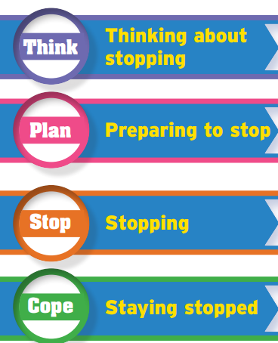






Where to go for help and information
Where to go for help and support
Quit your way website: with tips to cut down & stop
https://www.nhsggc.scot/your-health/quit-your-way/quit-your-way-youth/
NHS Inform website: with tips to cut down & stop
https://www.nhsinform.scot/campaigns/vaping/
Can you think of anything else ?
Notes:
Information Slide: Where to go for help and information
Teacher shares information with young people. Links can be accessed together as a class to familiarise young people with the resources.
Quit your way Youth - NHSGGC
https://www.nhsinform.scot/campaigns/vaping/
Encourage discussion about accessing support. How easy is this for young people to do? Who are their trusted adults both in and out of school?

Slide 41
How do you feel now?
The Confidence Ruler
Not Sure
Need to know more
Very knowledgeable
Notes:
Activity Slide: The confidence ruler
Teacher/Facilitator can ask young people to rate their knowledge and understanding around vaping out of 10, following the input.
How confident are you in what you already know about Smoking/Tobacco?

