Slide 1





Vaping
What You Need to Know
The TALK ABOUT Trust is a youth charity that works across the UK to ensure young people are equipped to make safer choices around alcohol and other substances such as vaping and cannabis.
The TALK ABOUT Trust supports 11 to 25-year-olds with advice, workshops and resources on a range of life choices via schools, children’s homes, pupil referral units, youth and sports clubs. We train teachers and youth workers, empower parents and carers and provide diversionary activities for young people.
Primary 7
Notes:
Vaping Primary 7
Summary of Curriculum for Excellence Experiences & Outcomes
I understand the effect that a range of substances including tobacco and alcohol can have on the body. HWB 2-38a
I can identify the different kinds of risks associated with the use and misuse of a range of substances HWB 2-41a
I can discuss the environmental impact of human activity and suggest ways in which we can live in a more environmentally responsible way. SOC 2-08a
I know that popular culture, the media and peer groups as well as own attitudes and values can influence how I feel about substance use and recognise the impact this may have on my own actions. HWB 2-39a
Learning Intentions
I understand the health effects that vaping can have on the body, including impact of nicotine on the developing brain and nicotine dependency.
I can discuss the environmental impact of vapes.
I can understand the different kinds of risks associated with the use of vapes.
I understand the impact that vapes can have on individuals, their families and friends
I understand the impact vapes and nicotine dependency can have on people’s ability to make decisions.
I understand that popular culture, the media and peer groups as well as own attitudes and values can influence how someone feels about vaping and recognise the impact this may have on their own actions.
I can consider the impact my decisions may have on my health and wellbeing and the wellbeing of others.
Success Criteria
I can give examples of what can happen to the body as a result of vaping.
I can suggest ways in which we can live in a more environmentally responsible way.
I can identify risks associated with the use of vapes for example nicotine dependency and unknown long term health impacts.
I can give examples of how vapes and nicotine dependency can impact on people’s ability to make decisions.
I can give examples of how peer, media and other pressures can influence decision making.
I can recognise the ways in which my decisions impact me and others around me.

Slide 2
Respectful
Our Ground Rules for Learning
Listening
Focused
Careful Sharing
Anything else?
Notes:
Discussion Slide: Ground Rules for Learning
The aim of this slide is to establish expectations to ensure all pupils can effectively participate in the lesson.
Discuss each “ground rule” with the class. Teachers can check pupils’ understanding of the ground rules by asking them for a thumbs-up to confirm their agreement. It is important to note that some pupils may know adults who vape. Information about how vaping affects health might cause concern for these pupils. Teachers should be mindful of this and remind them they can speak to a "Trusted Adult" refer to the symbol to support discussing this. Teachers may wish to remind pupils of what a trusted adult is and provide examples, such as a parent, teacher, or other member of staff.
The slides also include an opportunity to ask pupils if there are any additional ground rules they wish to add.

Slide 3
The facts about vaping
Who influences our thoughts, decisions and choices
What we will learn about today
How does vaping impact the environment
Further help and support
Notes:
Information Slide : What we will learn about today
Teacher shares summary of the learning outcomes for lesson with young people.

Slide 4
Activity: 4 Corners: True or False?
Around the room are 4 statements.
Visit them, discuss and decide true or false.
Vapes support adults who smoke to stop.​
2. All vapes have the same amount of nicotine.
3. There are no laws in the UK around vaping.
4. If someone does not smoke, they should not vape.
Notes:
Activity Slide: “4 Corners: True or False?”
Aim:
To help learners build critical thinking skills about vaping and nicotine.
To encourage group discussion, reasoning, and respectful conversation.
Place each statement in a different corner/area of the room.
In small groups, pupils rotate to each station.
At each statement, they discuss:
Is it true or false?
Why do they think that?
What evidence or examples can they give?
Bring everyone together at the end for a whole-class debrief.
Discussion notes for each statement
1. “Vapes support adults who smoke to stop.”
This statement is partly true.
Some adults use vapes as a tool to try to stop smoking cigarettes.
Vaping is not recommended for children or non-smokers, and it is not risk-free.
2. “All vapes have the same amount of nicotine.”
This statement is false.
Nicotine levels vary widely between vape products—some have a lot, some a little, and some are labelled as “nicotine-free” (though even those can sometimes contain small amounts).
3. “There are no laws in the UK around vaping.”
This statement is false.
In the UK there are laws about:
Age restrictions (you must be over a certain age to buy vapes)
What strength of vapes are sold
Recent ban on disposable vapes
4. “If someone does not smoke, they should not vape.”
This statement is true.
Vaping is not harmless, especially for young people and non-smokers.
It can affect the lungs, heart, mouth, and brain development.
The safest choice for non-smokers is not to vape at all.

Slide 5

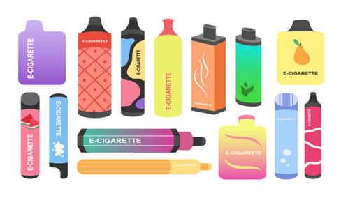
Vapes: What are they?
Vapes are electronic devices for people to breathe in a flavoured mist, or vapour.
Vapes are not meant to be used by children
Vapes can be used to help adults to stop smoking.
Notes:
Information Slide: Vapes: What are they?
Teacher shares information with young people.
Vapes are electronic devices for people to breathe in a flavoured mist, or vapour.
Vapes are not meant to be used by children
Vapes can be used to help adults to stop smoking.

Slide 6
Vapes: What’s inside?
be
Notes:
Discussion Slide: Vapes: What’s inside?
Teacher asks young people if they know what is inside a vape. Answers are on next slide.

Slide 7
Vapes: What’s inside?
be
Vegetable glycerol​:
Makes it visible, like a mist. ​
Nicotine:​
This is a drug that can make people want to keep using it. It is addictive.
Chemicals:​
These are for flavour. Some can damage your lungs.
Notes:
Discussion Slide: Vapes: What’s inside?
Answers
Teacher shares information with young people.

Slide 8

What is nicotine?
Nicotine is a chemical that makes our bodies release a burst of energy.
This can make a person feel more awake, jumpy, and ready to react quickly.
It also makes a person's breathing and heartbeat faster. This feeling wears off and it can make a person feel tired.
Notes:
Information Slide: What is nicotine?
Teacher shares with young people.
Teachers should be mindful that some pupils may have family members who vape and might feel worried.
Nicotine is a chemical that comes from tobacco plants. It’s found in cigarettes, vapes, and some other products. When people use these products, nicotine can get into their body.
Nicotine affects the brain by making it feel good for a little while, but it’s also very addictive. That means it’s hard to stop using it once once a person starts. Over time, it can harm the brain and body, especially in young people, because the brain is still developing until a person’s mid-20s.
Using nicotine can make it harder to focus, learn, and control emotions. It can also lead to serious health problems later, like heart and lung issues. That’s why it’s better to stay away from nicotine and make choices that keep your body and brain healthy.

Slide 9
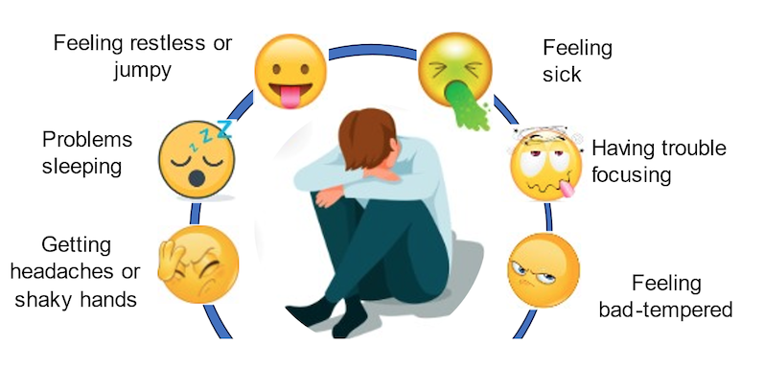
Nicotine withdrawal
When someone stops using nicotine, their body can react in uncomfortable ways, called withdrawal.
Notes:
Information Slide: Nicotine withdrawal
Teacher shares information with young people. This slide introduces the concept of something being addictive.
Teacher Explanation – What does “addictive” mean?
“Addictive” means something that makes a person’s body or brain want more and more of it, even if it’s not good for them.
Some thing, like nicotine, can trick the brain into thinking it makes someone feel good or relaxed. After using it for a while, the brain starts to crave it and it then becomes hard to stop.
When someone tries to stop using something addictive, they might feel uncomfortable, sad, or grumpy—that’s because their body is used to having it and needs time to adjust.
You could say:
“Addictive means it’s really hard to stop using something once you start, because your brain keeps telling you that you need it—even when you don’t.”
Example for context:
“Nicotine, which is in vapes, is addictive. When people start using it, their brain gets used to it. Later, even if they want to quit, their body might make them feel like they need more.”

Slide 10
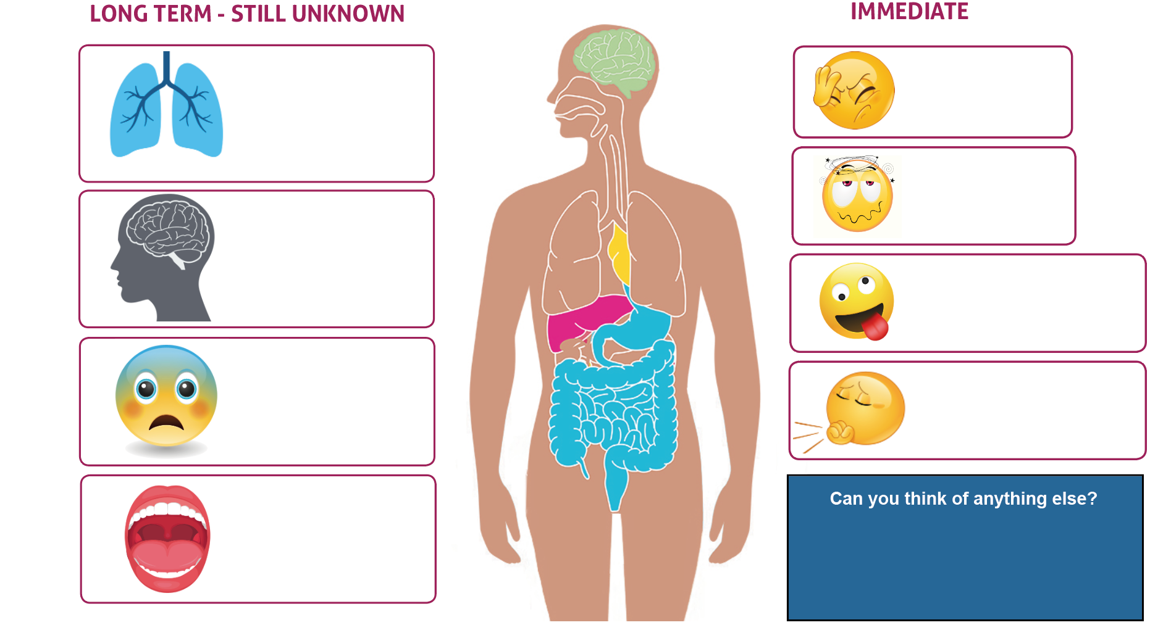














How can vaping affect someone's health?
Notes:
Activity Slide: How Can Vaping Affect Someone’s Health?
Aim:
To help pupils understand that vaping can have immediate effects and possible long-term effects, important to note long-term research is still developing.
Point out the two categories:
Long Term – Still Unknown
Immediate
Explain that scientists are still learning how vaping affects the body over many years because vapes are relatively new. It is also difficult to research as many people who vape have also smoked, so uncertain as to cause of health issues.
Encourage pupils to match the icons to parts of the body or feelings they might represent and consider the possible health outcomes. This section builds on knowledge from previous lessons so may be recall for some pupils.

Slide 11
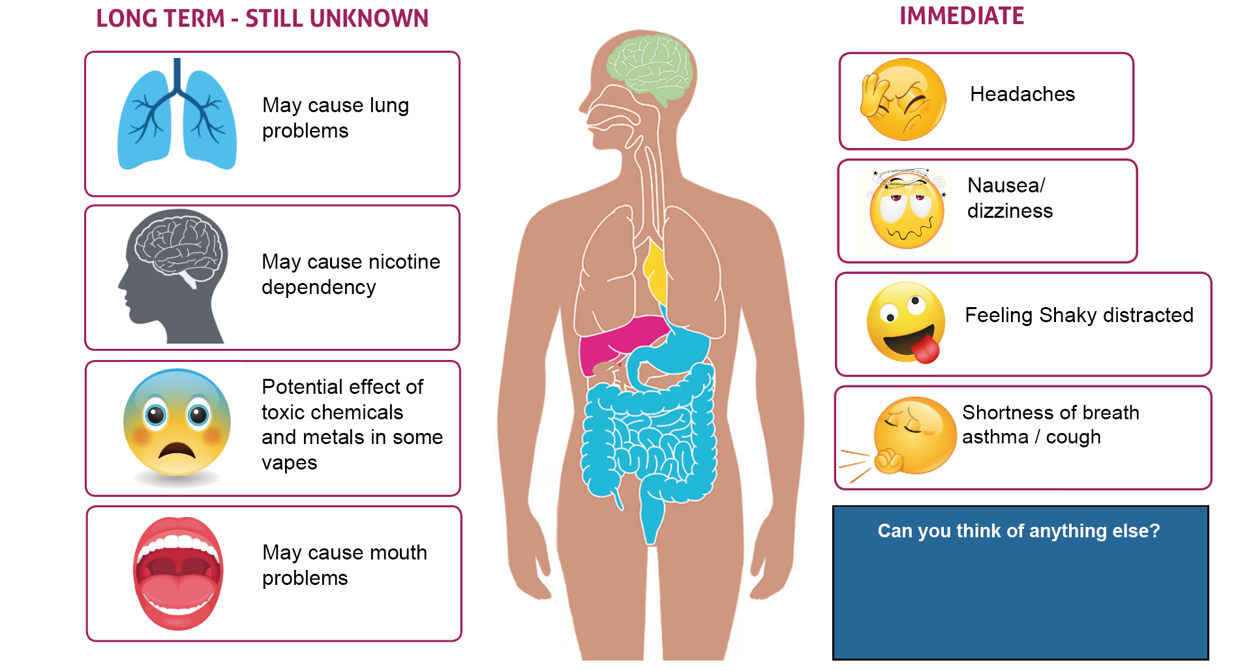

How can vaping affect someone's health?
May cause mouth problems
May cause heart problems
Notes:
Activity Slide: How Can Vaping Affect Someone’s Health?
Aim:
To help pupils understand that vaping can have immediate effects and possible long-term effects, important to note long-term research is still developing.
LEFT SIDE: Long Term — Still Unknown
Explain to pupils that these long-term effects are not fully understood yet, but early research suggests there may be risks to important body systems.
1. May Cause Lung Problems
Chemicals in vape liquids can affect how the lungs work.
Long-term effects are still being studied.
2. May Cause Mouth Problems
Vaping can dry out the mouth and irritate the throat.
Concerns include gum irritation and increased risk of gum disease/infections.
More research is needed to understand long-term impacts.
3. May Cause Heart Problems
Nicotine can raise heart rate and blood pressure.
Scientists are studying how vaping might affect the heart over many years.
Key Message:
Even though long-term effects are still unknown, they may include problems with the lungs, mouth, and heart—so avoiding vaping is the safest choice.
RIGHT SIDE: Immediate Effects
1. Headaches
Some people experience headaches after vaping due to nicotine and irritation.
2. Nausea / Dizziness
Nicotine acts quickly on the brain and can make people feel sick or light-headed.
3. Feeling Shaky / Distracted
Nicotine can make the body feel jittery or anxious.
It may affect concentration and mood.
4. Shortness of Breath / Asthma / Cough
Vaping can irritate the airways, leading to coughing or breathing difficulties.
It can trigger asthma symptoms.
Key Message:
Vaping has known immediate effects.

Slide 12





How can vaping affect someone's health?
How could we warn others about the health risks of vaping?
Optional Activity:
Create a poster showing people the risks of vaping.
Feeling jittery, or shaky
Coughing, asthma, and may cause long-term lung problems
Headache, and being unable to concentrate
Dizziness
Sickness
Notes:
Optional Activity Slide: How Can Vaping Affect Someone’s Health?
Aim:
To summarise some immediate health effects that vaping can cause.
To help pupils think about how they can share accurate information with others.
To provide an optional creative task (poster-making) to reinforce learning.
Immediate Effects of Vaping
Explain each symptom briefly:
Feeling jittery or shaky
Nicotine affects the brain and nerves.
This can make a person feel shaky, restless, or unable to sit still.
Coughing, asthma, and potential long-term lung irritation
Vaping can irritate the throat and lungs.
It can trigger asthma symptoms in people who have asthma.
Headache and difficulty concentrating
Nicotine can cause headaches and may affect focus and attention.
Some people feel foggy or distracted when vaping.
Dizziness
Nicotine acts fast in the body and can make someone feel light-headed or unsteady.
Sickness (nausea)
Vaping can upset the stomach or make someone feel sick, especially if they are not used to nicotine.
Class Discussion Prompt
“How could we warn others about the health risks of vaping?”
Use this as a short discussion to encourage critical thinking and communication skills.
Possible prompts for pupils:
What messages do people your age need to hear?
What information is important?
What images or symbols would catch someone’s attention?
How can we share facts without scaring or shaming people?
Encourage empathy — the goal is helping others stay safe.
Optional Activity: Create a Poster
If you choose to run the activity:
Explain the poster purpose: to show others the risks of vaping using clear, simple messages.
Remind pupils to use:
Basic facts from the lesson
Images/symbols that help people understand
Positive messages about staying healthy
Pupils can work individually, in pairs, or small groups.

Slide 13
Reflect:
Na
What is one fact about vaping you learned so far?
Notes:
Reflection Slide: What is one fact about vaping you learned so far?
Teacher to facilitate gathering answers of knowledge learned so far. Opportunity for gaps to be identified or any misconceptions to be tabled for further learning.

Slide 14
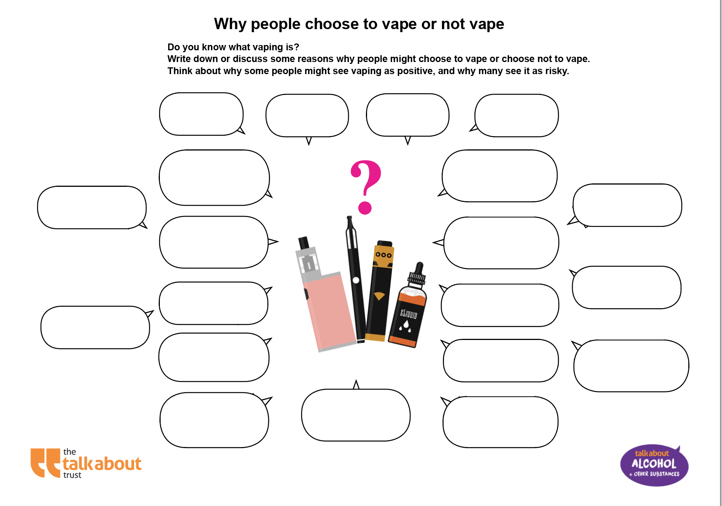
Activity: Decisions about Vaping
Why might adults vape?
Write down 3 reasons why most young people decide not to vape.
Notes:
Activity Slide: Decisions about vaping
Ask the pupils to write down their answers to why people decide to vape and why people decide not to vape. This activity helps pupils explore why people choose not to vape by identifying potential risks, health concerns, or personal values that align with making positive life choices. This can reinforce their own decisions to avoid harmful behaviours.
Answers on next slide.

Slide 15
Activity: Decisions about Vaping
Write down a reason why adults might vape
Write down three reasons why most young people decide not to vape
To help them stop smoking
Bad for me?
Get into trouble?
It’s addictive
Notes:
Activity Slide: Decisions about vaping
Ask the pupils to write down their answers to why people decide to vape and why people decide not to vape. This activity helps pupils explore why people choose not to vape by identifying potential risks, health concerns, or personal values that align with making positive life choices. This can reinforce their own decisions to avoid harmful behaviours.
Answer slide.

Slide 16
What can you remember?
Na
Na
Name two immediate effects of vaping
Name two long term effects of vaping
Na
Give a reason why people under 18 should not vape
Notes:
Recall Slide: What can you remember?
Aim: To consolidate understanding of the immediate and long-term effects of vaping on a person's health.
Outcome: Pupils will be able to recall what two immediate, and two long term effects of vaping on a person's health. Pupils will be able to give one reason why people under the age of 18 should not vape.
Activity: Go through the speech bubbles one-by-one.
Answers:
- Name two immediate effects of vaping on a person's health: feeling sick, feeling shaky/jittery, coughing, dizziness, headaches.
- Name two long term effects of vaping on a person's health: lung problems, heart problems, mouth problems.
- Give one reason why people under the age of 18 should not vape: it could harm brain development, it is addictive, it could make someone use other addictive substances.

Slide 17
What can you remember?
Na
Na
Name two long term effects of vaping:
Lung problems, mouth problems, heart problems
Name two immediate effects of vaping:
Feeling sick, jittery, headache, dizzy
Na
Give a reason why people under 18 should not vape:
Damages brain development, learning development, concentration levels
Notes:
Recall Slide: Answers
Aim: To consolidate understanding of the immediate and long-term effects of vaping on a person's health.
Outcome: Pupils will be able to recall what two immediate, and two long term effects of vaping on a person's health. Pupils will be able to give one reason why people under the age of 18 should not vape.
Activity: Go through the speech bubbles one-by-one.
Answers:
- Name two immediate effects of vaping on a person's health: feeling sick, feeling shaky/jittery, coughing, dizziness, headaches.
- Name two long term effects of vaping on a person's health: lung problems, heart problems, mouth problems.
- Give one reason why people under the age of 18 should not vape: it could harm brain development, it is addictive, it could make someone use other addictive substances.

Slide 18




Who influences our thoughts, views and decisions?
Think/Pair/Share:
Who has an influence on our thoughts, actions or behaviour?
Notes:
Discussion Slide: Who influences our thoughts, views and decisions?
Facilitate discussion around who influences our choices, actions and behaviour.
Who has the biggest effect on their choices, what they know, trust and who they turn to for advice and support?
This might be
A friend
A parent
A sibling
A grand parents
A teacher
A youth or club leader
Another trusted adult
pupils may say TV, older siblings, things they watch online, gaming heroes.
Take a few moments to discuss who might be a good influence and how a pupil would recognise that.

Slide 19

In pairs, think of all the reasons why Sam should, or should not try the vape.
For example:
"Sam should not try the vape because he knows that vaping can be harmful"
"Sam should try the vape because he doesn't want to let his brother down"
Optional Activity: Peer Pressure Role Play
Sam is in his older brother’s room, looking for a phone charger. He finds a vape.
A few minutes later, his brother walks in and sees Sam holding it. “Hey, that’s mine,” he says. “It’s not a big deal. I only use it sometimes - it’s not like smoking. Do you want to try it?”
Sam feels nervous. He trusts his brother but also remembers a school assembly where the nurse talked about how vapes can harm lungs and brain development in young people.
What should Sam do?
Learning
Digital
detox​
Notes:
Optional Activity Slide: Peer Pressure Role Play
Teachers should go through the scenario with the class. Think/Pair/Share approach gives time to think about their answer in pairs and prepare before participating in the role play.

Slide 20




What is peer pressure?
What is peer influence?
Peer pressure involves directly saying something/insisting someone do something.
Peer influence is where an individual copies others to be like them.
Notes:
Information Slide: Peer Pressure vs. Peer Influence
Aim:
To help pupils understand the difference between peer pressure and peer influence.
To encourage pupils to recognise situations that may feel uncomfortable and think about how to respond.
What is Peer Pressure? - Key Explanation
Peer pressure is direct.
Someone tells, pushes, or insists that another person should do something.
It often feels uncomfortable or difficult to say no.
Examples you can offer the class (age-appropriate):
“Come on, just try it.”
“If you do this, you can sit with us.”
“Everyone is doing it—don’t be boring.”
Clarify that peer pressure can have positive intent (e.g., encouraging someone to join a team, try a new club) or negative intent (e.g., pressuring someone to vape, be unkind, break a rule).
What is Peer Influence? - Key Explanation
Peer influence is indirect.
It happens when a student copies others to fit in, look “cool,” or be accepted.
No one has to say anything directly—the behaviour of the group influences the individual.
Examples you can give the class:
A student starts wearing the same clothes their friends wear.
Someone begins using slang that classmates use.
Someone tries something risky because they see others doing it, not because they were asked to or pressured.
Emphasise that peer influence can also be positive (e.g., copying friends who work hard, behave kindly, or make healthy choices).

Slide 21
Peer pressure/peer influence/safe/legal?
Today, you’ll be the judge!
You’ll see a situation on the screen.
Decide: Peer pressure/peer influence/safe/legal?
Notes:
Activity Slide: You Decide: peer pressure/peer influence/safe/legal?
Aim: To help pupils explore and understand the differences between safe, unsafe, legal, and illegal situations related to vaping. They will demonstrate their understanding by categorising real-life scenarios and explaining their reasoning, deepening their awareness of health risks, peer pressure, and legal issues surrounding vaping.
Activity: Teachers will read out or display one scenario at a time from the slide deck. Each scenario presents a situation related to vaping, such as trying a vape, buying one, or resisting peer pressure.
Ask pupils to decide whether the situation is Safe, Unsafe, Legal, or Illegal. After each response, ask pupils to explain their reasoning, highlight positive behaviours like knowing and showing our boundaries and seeking help from trusted adults.
Share that some answers may fall into more than one category (e.g., a behaviour might be legal but unsafe).
This activity can be done as a whole class or in small groups. The teacher can decide to label the four corners of the room "legal", "illegal", "safe", "unsafe" labels and have pupils move around the room.

Slide 22

Refusing to try a vape when others are doing it.
Safe?
Peer influence?
Peer Pressure?
Legal?
Notes:
Activity Slide: You Decide: peer pressure/peer influence/safe/legal?
"Refusing to try a vape even when others are doing it.". Safe. Legal. Emphasise that it is okay to say "no" to something that makes you uncomfortable, or that you know is wrong. Highlight that a person has to be over the age of 18 to buy a vape. Vaping can lead to dizziness, headaches and vomiting. Vapes contain nicotine which is a drug. This is not meant for children. Highlight that it is illegal to give or buy a vape for a person who is under 18.

Slide 23
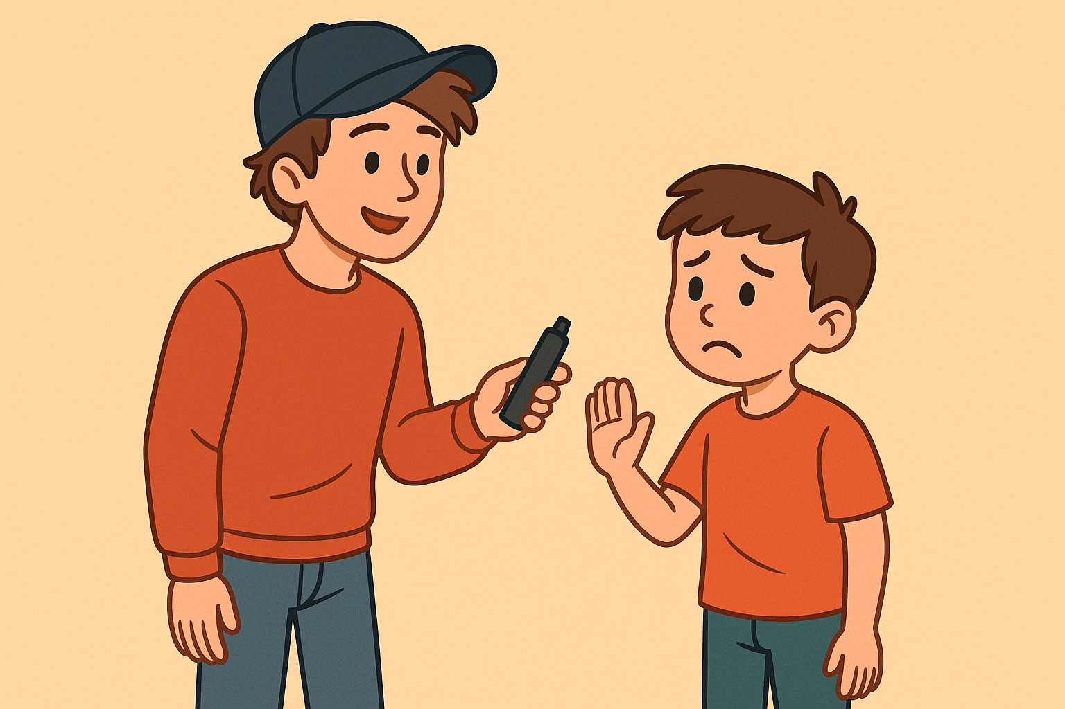
An older teenager buys a vape and dares a child to try it.
Safe?
Peer pressure?
Peer influence?
Legal?
Notes:
Activity Slide: You Decide: peer pressure/peer influence/safe/legal?
"An older teenager buys a vape and dares a child to try it." Illegal. Unsafe. It is illegal for anyone under 18 to buy a vape in the UK. It is illegal for someone over the age of 18 to buy a vape for someone under the age of 18 - this is calling buying by proxy. Encouraging someone else who is underage to try a vape also breaks the law, especially if it involves pressure or sharing. Vaping can be harmful to young people's lungs and heart and may lead to nicotine addiction. Peer pressure in this context makes it emotionally unsafe, too - it can make someone feel uncomfortable or pressured to do something harmful.

Slide 24
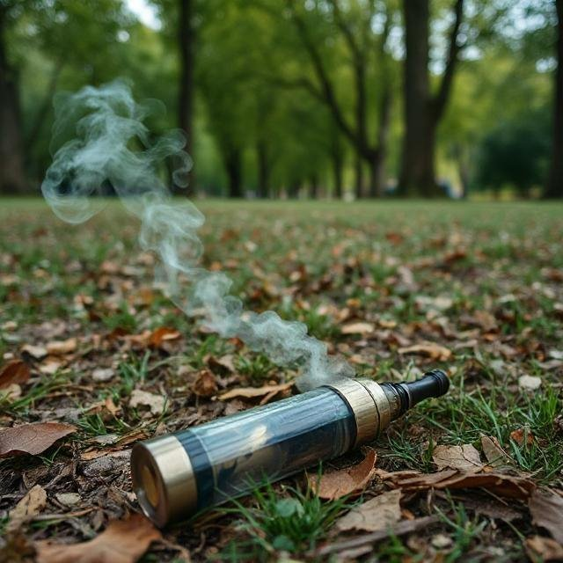
A child picks up a vape in the park and tries it.
Peer pressure?
Safe?
Legal?
Peer influence?
Notes:
Activity Slide: You Decide: peer pressure/peer influence/safe/legal?
"Picking up a vape in the park and trying it." Unsafe. Picking up a vape in a public place can be very dangerous. It could be contaminated, damaged, or contain unknown substances. Vapes often contain nicotine, which is a drug and can be highly addictive. Vaping can lead to dizziness, headaches and vomiting. This is not safe for children.

Slide 25

What is the difference?
Influencer
Positive real person
Notes:
Discussion Slide: Influencer/Positive real person – what is the difference?
Teacher facilitates class discussion about the difference between influencers and positive real people to help pupils reflect on where they find good advice and support. It teaches them to critically think about who influences their decisions and encourages them to value people who genuinely care for their wellbeing, such as family, friends, and teachers. This learning promotes sound decision-making, self-esteem, and resilience by recognising positive role models who support healthy choices and personal growth.

Slide 26
The difference is….
A positive real person is someone you know in real life, like a friend, family member, or teacher.
They encourage you to make good choices and support you in being yourself.
An influencer is someone who has followers online.
They may shape what people think or do, like buying products or trying new things.
Notes:
Discussion Slide: Influencer/Positive real person – what is the difference?
Answers
Teacher shares the answers defining each term.
Influencer: An influencer is someone who has lots of followers online and can shape what people think or do, like buying products or trying new things, because people pay attention to what they say or share.​
Positive Real Person: A positive real person is someone you know in real life, like a friend, family member, or teacher, who encourages you to make good choices and supports you in being yourself, not just copying what you see online.

Slide 27
Influencers v real people
Online influencers do not care about you as a real person would.
Influencing is their job; they care about online engagement.
Just because something looks good doesn't mean it's good for YOU.
We need to think first.
Real-life positive influencers are invested in YOU!
YOUR future, YOUR safety, and YOUR happiness.
Notes:
Information Slide: Influencers v real people
Explain that some online influencers make vaping look cool, fun, or harmless. They may be paid by companies or motivated by gaining more likes and followers. These influencers often post controversial or eye-catching content to grow their online presence, even if it promotes something harmful.
You could pose the question: “Do you think influencers really care about the people who follow them?”
Answers may be: “No, not really.”, “They don’t even know who’s watching.”, “They just want followers.”, “They care about being popular.”
Explain that influencers don’t know their individual followers, including children, and often don’t think about the long-term impact of what they post. Their main goal may be to build their brand or earn money, not to protect their audience. Reinforce: Influencers promoting harmful products like vapes don’t take responsibility if someone is harmed. There is no personal accountability. That’s why it’s important to think for yourself and question the motivation behind their posts. Explain that not only people, but also AI chatbots, can sometimes give advice online. Most AI systems are designed to avoid promoting harmful behaviours, but not all are well-built or used responsibly.

Slide 28
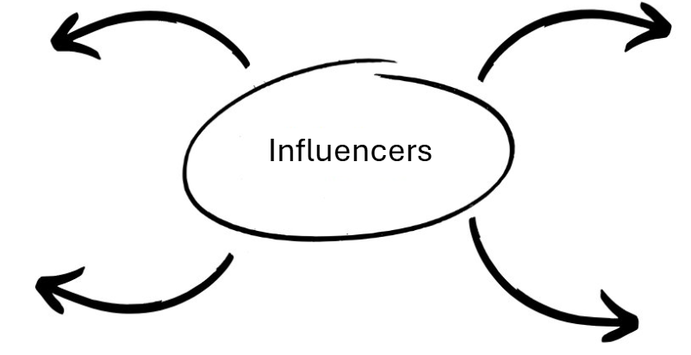


What is an online influencer?
Notes:
Summary Slide: What is an online influencer?
Ask pupils what an "influencer" is. pupils may suggest ideas such as "content creators", "YouTubers", "TikTokers", "people who make money from social media", "people who promote products on social media". Explain that a modern day "influencer" is someone who posts content on social media to make money. Part of their role might be to advertise products to an audience.

Slide 29
What is an online influencer?
Someone who is on social media?
Someone who makes money from posting online?
Content Creators?
Gamers?
Notes:
Summary Slide: Answers
Ask pupils what an "influencer" is. pupils may suggest ideas such as "content creators", "YouTubers", "TikTokers", "people who make money from social media", "people who promote products on social media". Explain that a modern day "influencer" is someone who posts content on social media in order to make money. Part of their role might be to advertise products to an audience.

Slide 30
Online influencers and Vaping
Many people under 18 are seeing vapes advertised by influencers online.
Why do you think influencers might promote vapes?
How do you think online influencers might promote vapes?
How could you spot if an influencer has been paid to promote something?
Notes:
Discussion Slide: Online influencers and vaping
Introduce the question “Why do you think influencers might promote vapes?” Ask the pupils for their thoughts. Answers could be: “To make money.”, “Because they’re paid by companies.”, “So they can get free stuff.”, “To get more likes or followers.”, “Maybe they think it looks cool.” Acknowledge their responses and explain that companies sometimes choose influencers because they know young people watch their content and might copy what they see. Influencers may be given money, free products, or sponsorship deals in return for promotion.
“How do you think online influencers might promote vapes?” Ask pupils what they think. Reinforce the idea that just because someone posts about a product doesn’t mean they use it or believe in it. This is why it’s important to think critically about what you see online. Now show the question: “How could you spot if an influencer has been paid to promote something?” Explain: This is one reason why it’s serious when influencers promote vapes without warning people about the risks, it can mislead young viewers into thinking they’re harmless or even cool.
“How can you spot if an influencer has been paid to promote a product on their social media?” pupils might say: “It says #ad or #sponsored.”, “They say they’re working with a brand.”, “There’s a tag that says ‘paid partnership’.”, “It might look too perfect or professional.”, “They talk a lot about the product.” Confirm and expand: By law, influencers must include labels like “#ad”, “#sponsored”, or “paid partnership” if they’ve been paid to promote something. But not everyone follows the rules, so it’s important to keep an eye out for hidden advertising tricks.

Slide 31
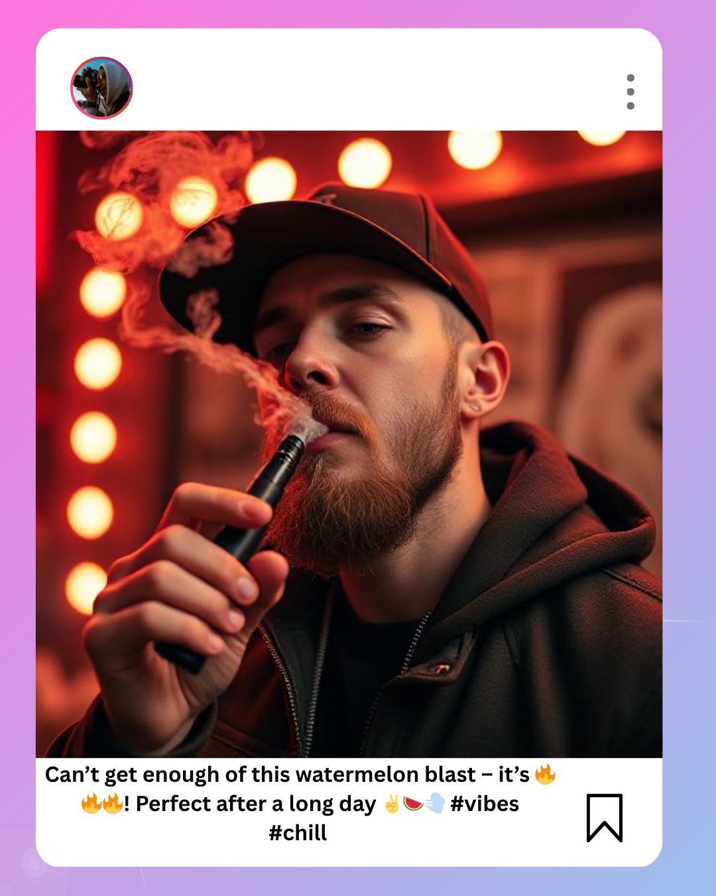
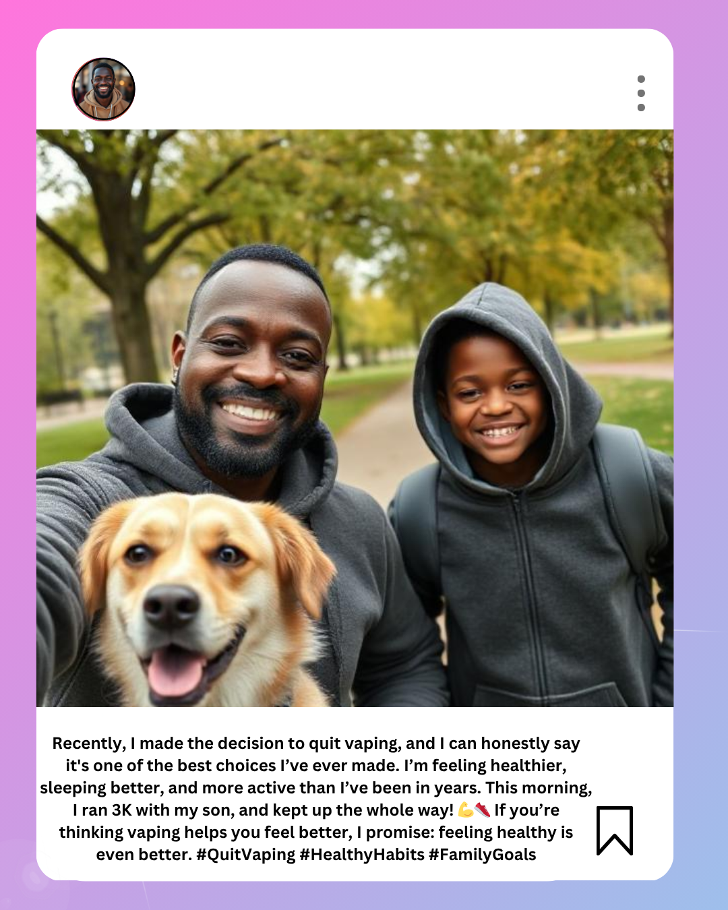
Online Influencers and Vaping
Look at the online posts on the next slides.
  Do you think they are influencing young people?
  Do you think the influence is positive or negative?
Notes:
Activity Slide: Online Influencers and Vaping
Aim:
To help pupils think critically about how social media posts and influencers can shape attitudes, both positively and negatively.
Key points to emphasise:
This slide introduces media influence.
Explain to pupils that the next slides will show two contrasting influencer-style posts:
– One promoting vaping
– One promoting quitting or avoiding vaping
The aim is to analyse how these posts might affect young people.
Influence on young people:
Ask pupils to consider:
– Do influencers make vaping seem “cool,” harmless, or trendy?
– Do positive role-model posts (e.g., quitting vaping, being healthy) also influence behaviour?
– Are young people particularly influenced by what they see online? (e.g., relatability, trends, aesthetics, FOMO)
Positive vs negative influence:
Encourage pupils to explore both sides:
– Negative influence: Posts that glamorise vaping, show attractive settings, colourful devices, or flavours that appeal to young people.
– Positive influence: Posts that promote health, role modelling, quitting, spending time with family, or living an active lifestyle.
Critical thinking focus:
Remind pupils to question:
– What message is each post trying to send?
– What techniques do influencers use? (filters, hashtags, emotional appeal, lifestyle branding)
– What impact could these posts have on attitudes or behaviour?

Slide 32
  What message is this post making?
  Could it influence young people?
  Would the influence be positive or negative?
Notes:
Activity Slide: Online Influencers and Vaping
Aim:
To help pupils think critically about how social media posts and influencers can shape attitudes, both positively and negatively.
Guide pupils to notice that the post portrays vaping as:
– Relaxing (“perfect after a long day”)
– Trendy and enjoyable (“🔥 vibes”, emojis, colourful background)
– Flavoured and appealing (“watermelon blast”)
– Something associated with a cool, stylish lifestyle
Explain that influencers often make behaviours seem more attractive by presenting them in appealing settings with positive language.
Potential to influence young people:
Encourage pupils to consider:
– Young people may see this as normal, fun, or desirable.
– The mood, lighting, and confident pose can make vaping seem cool or adult-like.
– The hashtags and emojis target younger audiences familiar with online culture.
This is an opportunity to discuss how quickly trends spread through social media.
Positive or negative influence:
– The influence is negative because it promotes and normalises vaping.
– The post leaves out the health risks and the environmental damage.
– pupils should recognise that social media posts often show the “good parts” and hide the harms.
Discussion prompts:
How does the setting (lighting, colours, pose) affect the message?
Why do influencers use exciting language and emojis?
What’s missing from this post that might help someone make an informed decision?

Slide 33
  What message is this post making?
  Could it influence young people?
  Would the influence be positive or negative?
Notes:
Activity Slide: Online Influencers and Vaping
Aim:
To help pupils think critically about how social media posts and influencers can shape attitudes, both positively and negatively.
Guide pupils to notice that the post is promoting:
– The benefits of quitting vaping (better sleep, more energy, improved health).
– Spending quality time with family.
– Feeling proud and motivated (“one of the best choices I’ve ever made”).
– A healthy, active lifestyle (e.g., running together).
The tone is encouraging, supportive, and relatable.
Could it influence young people?
Encourage pupils to consider:
– Positive influencers can be powerful role models.
– Young people might feel inspired to avoid vaping or support someone who is trying to quit.
– The image of a happy family and pet creates a warm, trustworthy feeling, making the message more convincing.
Positive or negative influence:
– This post is an example of positive influence because it promotes healthy habits and shows the real-life benefits of not vaping.
– It counters harmful online messages by showing that quitting vaping leads to better wellbeing.
– It normalises not vaping in a world where social media often glamorises it.
Discussion prompts:
What emotions does this post try to create? (e.g., happiness, pride, connection)
What makes this influencer seem like a positive role model?

Slide 34
Reflection: Who's influencing you?
Think, pair, share:
List two people in your real life who influence the choices you make.
Think, pair, share:
Name one positive thing that a real-life influencer might encourage you to do.
Think, pair, share:
Why?
Notes:
Reflection Slide: Who’s influencing you?
Aim: To help pupils reflect on the people in their lives who influence their choices, and to encourage them to distinguish between real-life influencers (who care about their well-being) and online influencers (who often have different motivations, such as promoting products).
Ask pupils who they think influences their decisions in real life. These can include family members, teachers, coaches, or friends. Emphasise that real-life influencers are people who care about their well-being, know them personally, and are likely to provide advice that protects their health and safety. Ask pupils to list two people in their real life who influence their choices. This can help identify who they trust and turn to for guidance. Ask if these people would encourage smoking or vaping, and why or why not. This question helps them think critically about the role of trusted adults or peers in their decision-making process. Following thing/pair/share, invite some to share their answers with the class. Discuss the importance of real-life influencers who provide support, care, and safe advice, and contrast with the often profit-driven motivations of online influencers.

Slide 35
What can we do if we feel unsafe/unsure online or in real life?
Tell a trusted adult about a situation as soon as you can
Buddy Up: Stay with a trusted friend or adult, avoid being alone with new people that make you feel uneasy
Say "no, thank you" and walk away
Have a "safe" emoji to text a trusted adult
Call a trusted adult
Make an excuse to leave "I have to be home on time because I have football tonight"
Let a trusted adult know where you are going, who with, and agree a time for you to be home
Notes:
Discussion Slide: What can we do if we feel unsafe/unsure online or in real life?
Pose the question to the class and invite responses. The bubbles can then be revealed one by one to prompt further reflection and discussion.

Slide 36

In pairs discuss:
Are there any warning signs for Katie?
What do you think Katie should do?
Can you act this out? Or write a script?
Optional Activity: Role Play
At break, Katie is near the school gates. An older teen, Jay, walks over.
Jay is always well dressed and seems to have money to spend.
Jay nods at Katie and says, “Hey, you’re cool. You want one of these?”
Jay pulls out a vape and hands it to Katie. “Don’t worry, it’s free. First one’s always free. I’ve got loads.”
Katie hesitates. She's never vaped before, and she doesn’t really know Jay, but he seems friendly and confident.
Jay smiles and adds, “If you ever need more - or anything else - I can hook you up. Easy.”
Learning
Digital
detox​
Notes:
Optional Activity: Role Play
Teacher should read out the scenario to the class. Think/Pair/Share approach gives time to think about their answer in pairs before participating in the role play in small groups as an optional activity. To further extend the task, pupils could be invited to create their own role plays around the emerging themes: Vaping/Peer Pressure/Peer Influence.

Slide 37
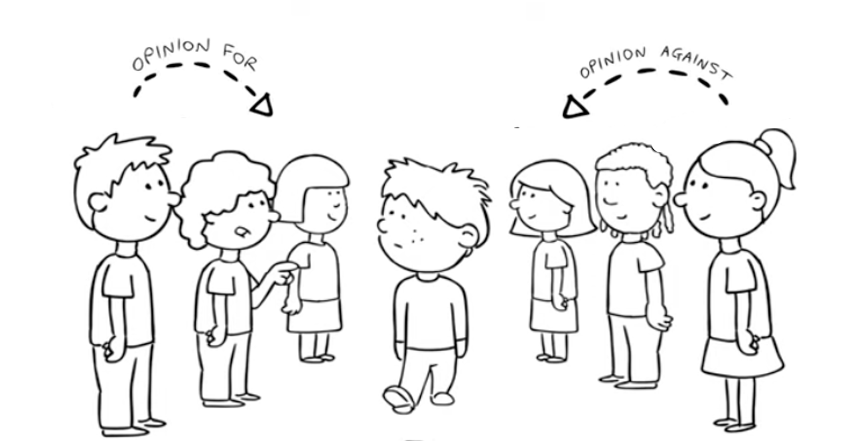


Optional Activity: Role Play
In pairs take it in turns to suggest different scenarios and practicing ‘fudging’ answers to resist/refuse someone.
Learning
For example:
Jamie is at the park with his pals when someone’s older cousin offers him a vape, saying,
‘Go on have a puff it tastes just like sweets.’ Jamie feels unsure and doesn’t want to look daft.
What should he do?
Digital
detox​
Eatwell
Notes:
Optional Activity: Role Play
This is a whole class activity. Divide the group equally into two and ask them to face each other about a metre apart and ask for a volunteer to walk down the alley. One side can be called ‘greens’ and the opposite side ‘reds’.
One person has a role play to read out and walk down the middle asking each person what they should do
The greens on one side think of reasons why the volunteer should refuse the offer in the role play
The reds on the other side give reasons why the volunteer should say yes to the offer in the role play

Slide 38
What could your character say to leave the situation quickly?
I don't have a phone, so I can't stay out.
That's not something I want to do.
I think my mum is calling me, I have to answer!
I just remembered that I have dancing tonight, I need to go.
I have to go, I can't be home too late.
Notes:
Optional Activity: Role Play
Aim: This activity aims to provide quick answers that pupils could use to leave a situation in which they are experiencing peer pressure. They can develop strategies for making informed decisions, increase their confidence in saying "no," and feel more supported by their peers in navigating challenging social situations.
Activity: Ask pupils what the characters could say to help them leave the conversation quickly. They could do this in pairs initially and then feedback as a class. The teacher should then reveal the answers, highlighting that these are responses pupils could use in real life to help them navigate peer pressure.

Slide 39
How to recognise peer influence and the risks it can bring
How you can say "no" confidently when you want to.
How to have a plan for tough choices
How to support each other
What are we learning?
You are strong enough to have a voice
You don’t have to impress others - your health and future matter most
Surround yourself with trusted friends who respect your decisions
If you ever feel unsure, talk to an adult you trust
Doing your thing is always braver than following the crowd.
Notes:
Summary Slide: What are we learning?
Read through the slides to summarise the main learning outcomes for the session.

Slide 40

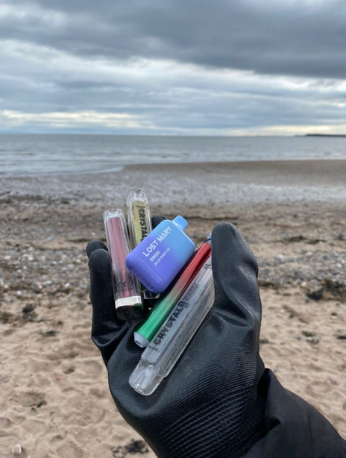
Vapes and the environment!
Notes:
Title Slide: Vapes and the environment!

Slide 41

Do you know how vapes impact the environment?
Discuss what you remember about how vapes affect the environment.
Notes:
Discussion Slide:
Discuss what you remember about how vapes affect the environment.
Further information:
Plastic Waste:
Many vape pens and e-cigarettes are made from plastic, which is not biodegradable. When discarded improperly, these devices contribute to plastic pollution, which can harm wildlife and pollute the oceans. The small parts, like mouthpieces and cartridges, are especially problematic as they are often too small to be properly recycled.
Battery Pollution:
Many disposable vapes contain batteries, which contribute to electronic waste (e-waste). Improper disposal of these devices can lead to hazardous materials, such as lithium and other heavy metals, leaching into the soil and water, contaminating ecosystems
Nicotine Leaks:
E-liquid used in vapes contains nicotine, a toxic substance. When disposed of improperly, such as in landfills or through leaks in packaging, nicotine can seep into the soil and water, causing potential harm to plants, animals, and aquatic life.
Littering:
Disposable vapes, pods, and packaging are often littered, making parks, streets, and beaches dirty.
Harm to Wildlife:
Animals might eat vape pods or batteries by mistake, which can make them very sick or even kill them.
Non-Recyclable Materials:
Many vape parts can’t be recycled, so they end up in landfills and pollute the environment.
Production Impact: The production of vape products requires resources, including plastics, metals, and chemicals. Mining and manufacturing processes contribute to pollution, greenhouse gas emissions, and resource depletion, negatively impacting the environment.
Carbon Footprint: The production, shipping, and disposal of vape products have a carbon footprint. The use of disposable vapes or frequent replacements of pods increases this impact, contributing to global warming.
Air Pollution: While vaping produces less air pollution than traditional cigarette smoking, the vapor emitted can still contribute to air quality degradation in some areas, especially when large numbers of people vape in crowded spaces.

Slide 42
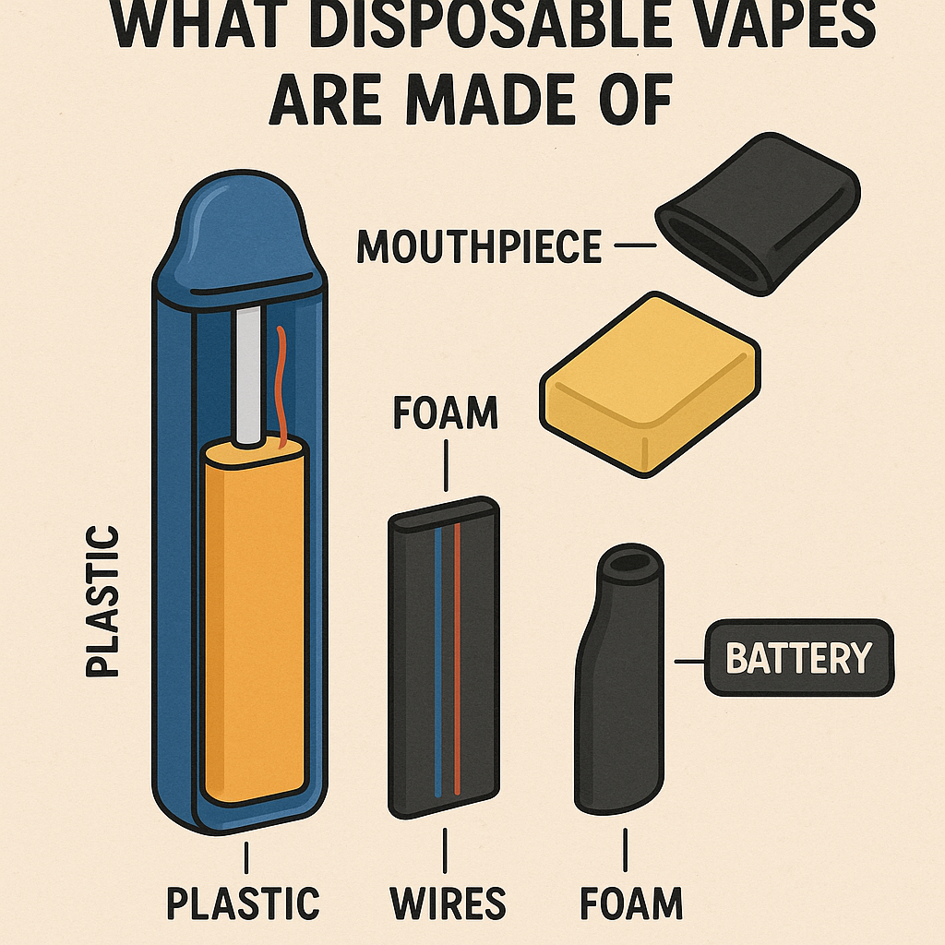
What are vapes made from?
Vapes are made from materials which are difficult to recycle such as:
plastic, foam, aluminium and lithium.
They also contain lithium - ion batteries that can make them a fire risk
Notes:
Information Slide: What are vapes made from?
Vapes are made from materials which are difficult to recycle such as:
plastic, foam, aluminium and lithium.
They also contain lithium - ion batteries that can make them a fire risk
Waste Generation:
Vapes are often made of plastic and other materials that are difficult to recycle, leading to a significant amount of waste that ends up in landfills or littering public areas
Hazardous Materials:
Vapes contain lithium-ion batteries, which can cause fires if crushed or improperly disposed of, and toxic chemicals that can leach into the environment as they degrade.
Nicotine:
Nicotine, a key component of vaping liquids, is a toxic substance that can contaminate the environment if vapes are disposed of improperly.
Sources: https://www.greenpeace.org.uk/news/are-disposable-vapes-bad-for-the-environment/, https://news.sky.com/story/why-are-disposable-vapes-bad-for-the-environment-13059299

Slide 43
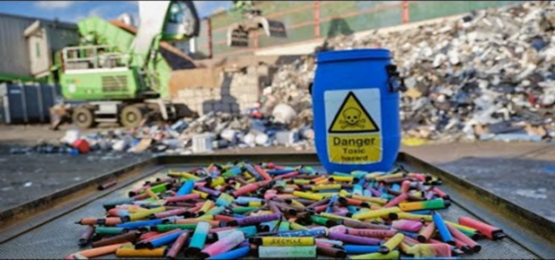
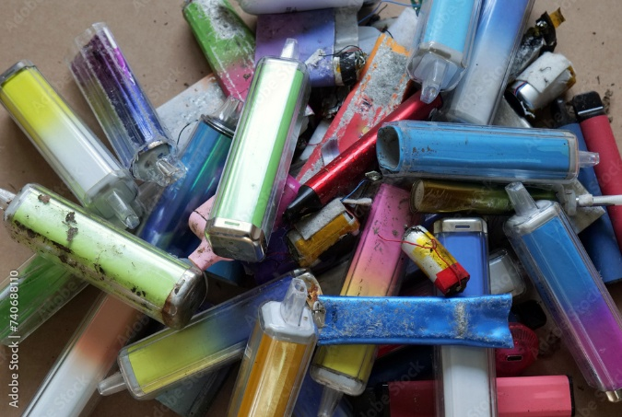
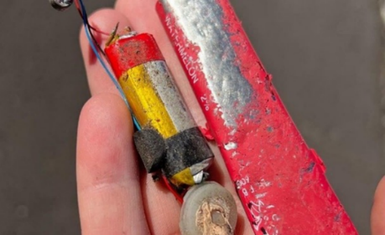
Vapes and the environment
Vape waste is harmful to our environment.
Vapes contain:
Plastic waste
Electronic waste
Chemical waste
Littering of vapes results in toxins such as nicotine; heavy metals and battery acid, leaking into the environment. This poses a threat to our wildlife.
Over 40 tonnes of lithium was thrown out from vapes in the UK in 2022.
Enough lithium to make batteries for 10,000 electric cars
Disposable vapes were banned on 1st June 2025.
Notes:
Information Slide: Vapes and the Environment
Aim:
To help pupils understand the environmental impact of disposable vapes and why regulations, such as the June 2025 ban in the UK, were introduced.
Key points to emphasise:
Vape waste is a growing environmental problem.
Disposable vapes contain several types of waste: plastic, electronics, and chemical waste. These materials are difficult to recycle and often end up in general waste or as litter.
Toxins leaking into the environment:
When vapes are thrown on the ground or improperly disposed of, chemicals such as nicotine, heavy metals, and battery acid can leak out. Explain that these substances can contaminate soil and water, harming plants and wildlife.
Lithium waste:
Highlight that over 40 tonnes of lithium were thrown away from vapes in the UK in 2022 alone.
– Lithium is a valuable resource used in rechargeable batteries, including those in electric cars.
– The wasted lithium from vapes could have helped make batteries for around 10,000 electric cars, showing how significant this loss is.
Link to the 2025 disposable vape ban:
The UK ban (1st June 2025) was introduced partly because of this environmental harm. The aim is to reduce waste, protect wildlife, and cut down on misuse by young people.

Slide 44

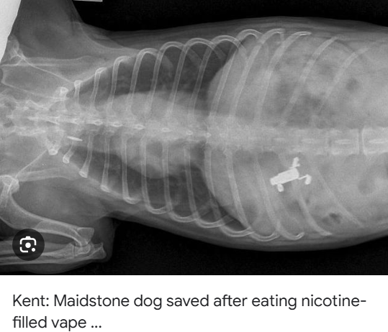
Vapes and the environment
1200 fires a year are caused by vapes
Animals and birds, our soil and sea are affected by vapes in landfill
80% of the materials vapes are made from can be recycled.
Notes:
Information Slide: Vapes and the Environment
Aim:
To help pupils understand the wider environmental and safety risks linked to disposable vapes, including fire hazards and harm to wildlife.
Key points to emphasise:
Fire risks:
Explain that the lithium batteries inside vapes can cause fires if they are damaged, crushed, or thrown into general waste.
– Around 1,200 fires a year in refuse trucks and waste centres are linked to batteries in vapes.
– This is why vapes should not be put in household bins.
Impact on animals and ecosystems:
Highlight that vape litter affects animals, birds, soil, and the sea.
– Animals may eat vapes or their components, leading to poisoning or internal injury.
– Show the X-ray image as an example of how dangerous ingestion can be for pets and wildlife.
– Chemicals like nicotine and heavy metals can leak into soil and waterways.
Recycling potential:
Stress that around 80% of the materials in vapes can be recycled, including the battery, metal, and some plastics—but only if disposed of correctly.
– Encourage pupils to think about why people don’t usually recycle them (inconvenience, lack of awareness, design of disposables).
For more information visit:
Recycle vapes - Find a local recycling point (recycleyourelectricals.org.uk)
Material Focus’ research last year

Slide 45

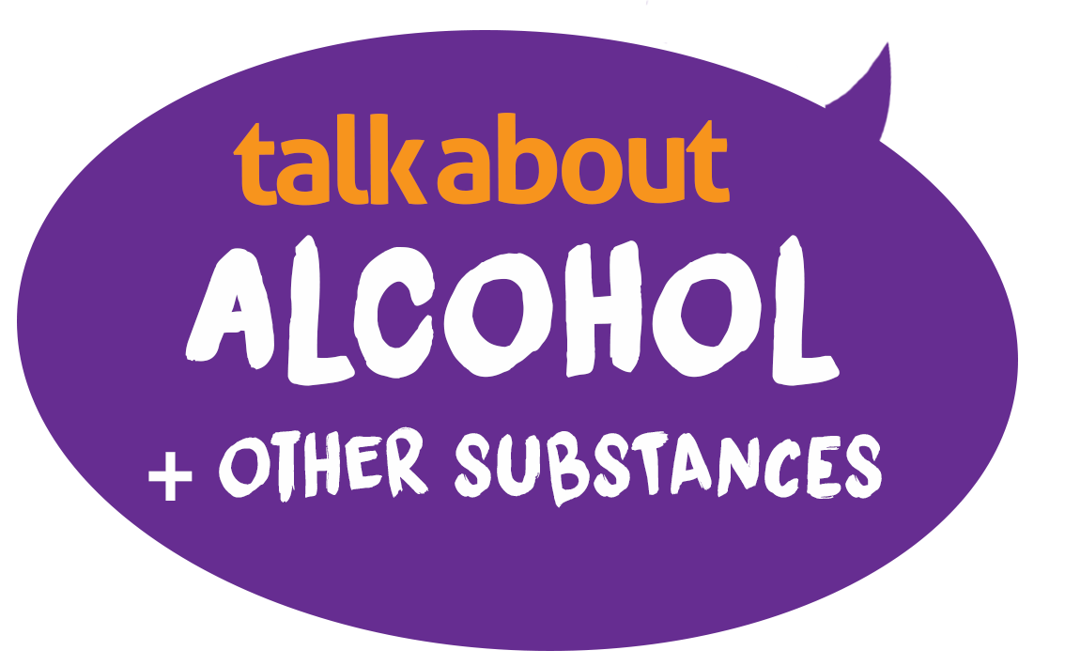
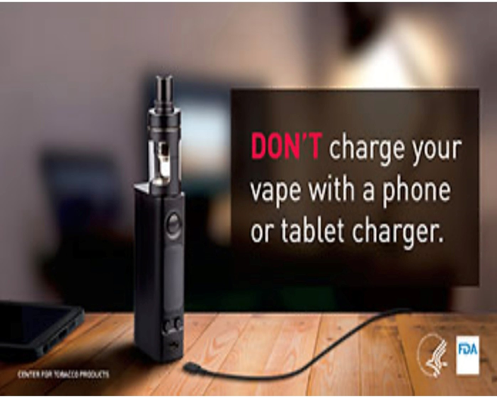
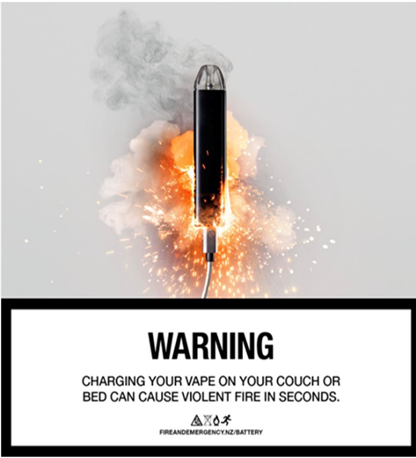

Batteries and charging: fire risks
ns
Most legal vapes have safety features, like any electronic device, there is a small risk of fire or explosion related to the batteries.
Lithium-ion batteries are found in many electronic devices, including smartphones, laptops, and vapes.
.
Notes:
Information Slide: Batteries and charging: fire risks
While these batteries are generally safe when used and maintained properly, they can pose risks if mishandled or if there are manufacturing defects.
For further information
https://www.london-fire.gov.uk/safety/the-home/smoking/vaping-and-e-cigarettes/

Slide 46
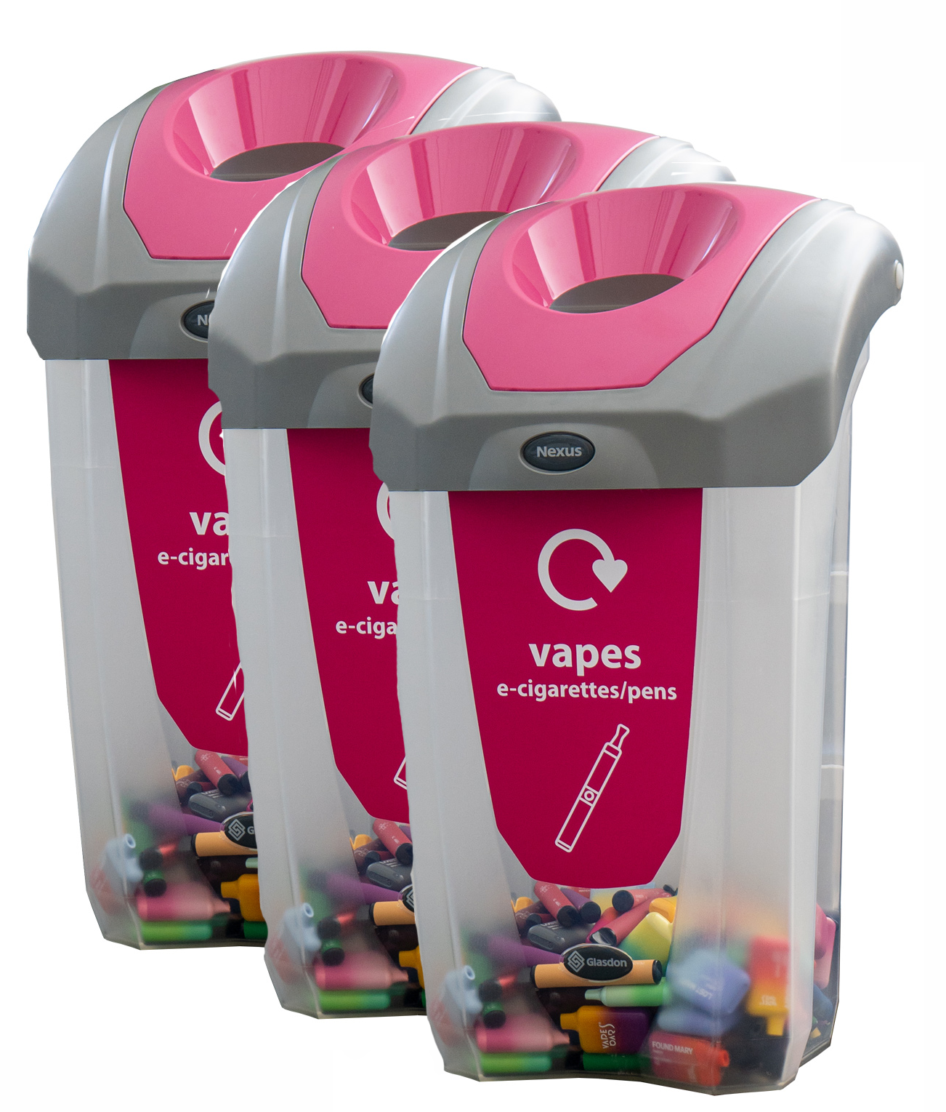



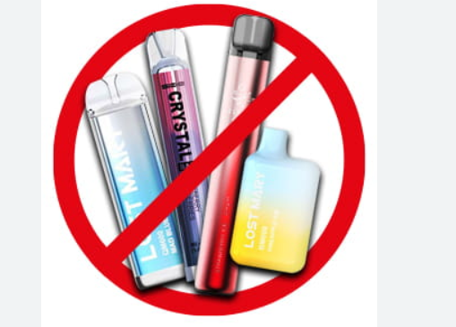

Possible solutions? What can you think of?
Notes:
Discussion Slide: Possible solutions? What can you think of?
Aim:
To encourage pupils to think about realistic, practical solutions for reducing vape waste and protecting the environment. This slide supports discussion, problem-solving, and critical thinking.
Key points to emphasise:
This slide is about solutions, not problems.
Pupils should now explore what could be done to reduce the environmental impact of vapes.
Make recycling easier:
One idea is placing vape recycling bins in supermarkets, shops, schools, or other public places.
– Explain that the easier it is for people to do the right thing, the more likely they are to do it.
Deposit-return schemes:
This works like returning glass bottles.
– People get money back when they return used vapes.
– Encourage pupils to consider whether this would motivate young people and adults.
Penalties for littering:
Fines could discourage people from throwing vapes into general waste or onto the ground.
– Discuss whether this would work in their community or if other support is needed.
Better product design:
Companies could be required to make vapes from recyclable or biodegradable materials, or make them easier to take apart.
– This links to “designing out waste” and encourages thinking beyond consumer behaviour.
Health and environment overlap:
“Don’t vape” is highlighted as both a health choice and an environmental one.
– It frames vaping as something that affects more than just the individual.
Introduce the concepts of Reduce, Reuse, Recycle:
– Reduce: fewer vapes used → less waste.
– Reuse: rechargeable vapes or return schemes.
– Recycle: disposing of vapes properly so materials can be recovered.
Discussion suggestions:
Which solution do pupils think would work best? Why?
What could the government do? What could shops do? What could individuals do?
Are there any barriers (cost, convenience, awareness)? How could these be addressed?

Slide 47



Possible solutions? What can you think of?
Make it easy for people to recycle vapes at shops/
supermarkets
Give people money back for returning old vapes
Fine people for putting vapes into general waste or littering ​
Ensure vapes are made with recyclable or biodegradable materials
Don’t vape and save the planet, animals, sea and soil!
Notes:
Discussion Slide: Possible solutions? What can you think of?
Aim:
To encourage pupils to think about realistic, practical solutions for reducing vape waste and protecting the environment. This slide supports discussion, problem-solving, and critical thinking.
Key points to emphasise:
This slide is about solutions, not problems.
Pupils should now explore what could be done to reduce the environmental impact of vapes.
Make recycling easier:
One idea is placing vape recycling bins in supermarkets, shops, schools, or other public places.
– Explain that the easier it is for people to do the right thing, the more likely they are to do it.
Deposit-return schemes:
This works like returning glass bottles.
– People get money back when they return used vapes.
– Encourage pupils to consider whether this would motivate young people and adults.
Penalties for littering:
Fines could discourage people from throwing vapes into general waste or onto the ground.
– Discuss whether this would work in their community or if other support is needed.
Better product design:
Companies could be required to make vapes from recyclable or biodegradable materials, or make them easier to take apart.
– This links to “designing out waste” and encourages thinking beyond consumer behaviour.
Health and environment overlap:
“Don’t vape” is highlighted as both a health choice and an environmental one.
– It frames vaping as something that affects more than just the individual.
Introduce the concepts of Reduce, Reuse, Recycle:
– Reduce: fewer vapes used → less waste.
– Reuse: rechargeable vapes or return schemes.
– Recycle: disposing of vapes properly so materials can be recovered.
Discussion suggestions:
Which solution do pupils think would work best? Why?
What could the government do? What could shops do? What could individuals do?
Are there any barriers (cost, convenience, awareness)? How could these be addressed?

Slide 48

Optional Postcard Activity
Write on a post card 3 things that you would like to tell your older self about vaping ………..
Notes:
Optional Activity Slide: Postcard
Write on a post card 3 things that you would like to tell your older self about vaping ………..
Example
🧠 1. “Remember, vaping isn’t harmless — it’s full of chemicals.”
Even though it may look safe, vapes can contain nicotine, metals, and toxic substances that can hurt your lungs and brain.
❤️ 2. “Your health is worth more than fitting in.”
It might seem cool or popular, but your real friends won’t make you risk your health just to belong.
🌬️ 3. “Protect your lungs — they’re still growing.”
As a young person, your lungs and body are still developing. Vaping can damage them early, making it harder to breathe, run, or play sports.
⚡ 4. “Don’t let addiction control you.”
Nicotine in vapes is highly addictive — once you start, it’s hard to stop. Stay in charge of your choices, not the other way around.
🕵️ 5. “The vape companies don’t care about you.”
Many companies target young people with bright colors and fruity flavors. They just want your money, not your wellbeing.
🌈 6. “Your future self will thank you for saying no.”
By avoiding vaping, you’ll keep your body strong, your mind clear, and your future wide open — for sports, dreams, and a healthy life.

Slide 49


Optional Postcard Activity
Examples…..
Remember, vaping isn’t harmless — it’s full of chemicals
Your health is worth more than fitting in
Hi future me ….
Just want to tell you
Protect your lungs — they’re still growing
The vape companies don’t care about you
Your future self will thank you for saying no
Notes:
Optional Activity Slide: Postcard
Write on a post card 3 things that you would like to tell your older self about vaping ………..
Example
🧠 1. “Remember, vaping isn’t harmless — it’s full of chemicals.”
Even though it may look safe, vapes can contain nicotine, metals, and toxic substances that can hurt your lungs and brain.
❤️ 2. “Your health is worth more than fitting in.”
It might seem cool or popular, but your real friends won’t make you risk your health just to belong.
🌬️ 3. “Protect your lungs — they’re still growing.”
As a young person, your lungs and body are still developing. Vaping can damage them early, making it harder to breathe, run, or play sports.
⚡ 4. “Don’t let addiction control you.”
Nicotine in vapes is highly addictive — once you start, it’s hard to stop. Stay in charge of your choices, not the other way around.
🕵️ 5. “The vape companies don’t care about you.”
Many companies target young people with bright colors and fruity flavors. They just want your money, not your wellbeing.
🌈 6. “Your future self will thank you for saying no.”
By avoiding vaping, you’ll keep your body strong, your mind clear, and your future wide open — for sports, dreams, and a healthy life.

Slide 50

If you are worried anything we have talked about today, you can find support or information
Childline Scotland is a free, confidential telephone counselling service for children and young people.
Call: 0800 1111
https://www.childline.org.uk/
Notes:
Further signposting for support.
On pupil slide details for child line are shared.
Please see further support, information and guidance for teaching staff:
Quit your way Youth - NHSGGC
Young people and vaping briefing paper - NHSGGC
Vaping addiction soon takes hold | NHS inform
Further guidance and support regarding digital technology
BBC Bitesize:
https://www.bbc.co.uk/teach/topics/cp440njz78zt
Google: Be internet awesome:
https://beinternetawesome.withgoogle.com/en_uk
Ceop Education
https://www.ceopeducation.co.uk/8_10/stay-safe/
Internet Matters : How can I help my child think critically about social media influencers?
https://www.internetmatters.org/hub/question/how-can-i-help-my-child-think-critically-about-the-social-media-influencers-they-follow/

