Slide 1




Vaping
Primary 5
Notes:
Vaping Primary 5
Summary of Curriculum for Excellence Experiences & Outcomes
I understand the impact that misuse of substances can have on individuals, their families and friends. HWB 2-43a
I understand the effect that a range of substances including tobacco and alcohol can have on the body. HWB 2-38a
I can identify the different kinds of risks associated with the use and misuse of a range of substances HWB 2-41a
Learning Intentions
I understand the health effects that vaping can have on the body
I understand the impact that vapes can have on individuals, their families and friends
I can consider the impact my decisions may have on my health and wellbeing and the wellbeing of others.
I am developing skills I may need to use to cope in difficult situations.
Success Criteria
I can give examples of what can happen to the body as a result of vaping.
I can Identify the impact of risk-taking behaviours on life choices
I can identify strategies to help me cope in difficult situations.

Slide 2

Respectful
Listening
Our Ground Rules for Learning
Focused
Careful Sharing
TRUSTED ADULT
Anything else?
Notes:
Discussion Slide: Ground Rules for Learning
The aim of this slide is to establish expectations to ensure all pupils can effectively participate in the lesson.
Discuss each “ground rule” with the class. Teachers can check pupils’ understanding of the ground rules by asking them for a thumbs-up to confirm their agreement. It is important to note that some pupils may know adults who vape. Information about how vaping affects health might cause concern for these pupils. Teachers should be mindful of this and remind them they can speak to a "Trusted Adult" refer to the symbol to support discussing this. Teachers may wish to remind pupils of what a trusted adult is and provide examples, such as a parent, teacher, or other member of staff.
The slides also include an opportunity to ask pupils if there are any additional ground rules they wish to add.

Slide 3
What hearts, lungs and gums do.
What we will learn about today
What a drug is. What vaping is.
How vaping can affect hearts, lungs and gums.
How to decide if something is healthy.
How to decide is something is safe.
Notes:
Information Slide : What we will learn about today
Teacher shares summary of the learning outcomes for lesson with young people.

Slide 4
Our Amazing Bodies
Your Amazing Body
🫁
The body has special parts that keep you alive
We are going to look at our:
Lungs 🫁, Heart ❤️, Gums 😁
Let’s find out why they matter!
❤️
😁
Your body is amazing – let’s look after it!
Notes:
Slides 4 - 7
Information Slide:
Teacher introduces these key body parts to young people. Ask pupils to identify where these parts are on their own bodies. Explore with pupils any prior knowledge. Ask pupils about how they look after these body parts.

Slide 5
Lungs
🫁
Breathe in fresh air 🌬️
Give you energy to play ⚽🏃‍♀️
Stay strong with exercise 💪
Your lungs love fresh air!
Notes:
Slides 4 - 7
Information Slide:
Teacher introduces these key body parts to young people. Ask pupils to identify where these parts are on their own bodies. Explore with pupils any prior knowledge. Ask pupils about how they look after these body parts.

Slide 6
Heart
A powerful pump moving blood around the body 💓
Bringing oxygen & food🍎
Needs activity & healthy food 🚴‍♀️🥦
❤️
A healthy heart keeps you moving!
Notes:
Slides 4 - 7
Information Slide:
Teacher introduces these key body parts to young people. Ask pupils to identify where these parts are on their own bodies. Explore with pupils any prior knowledge. Ask pupils about how they look after these body parts.

Slide 7
Gums
Hold your teeth in place 🦷
Keep your smile strong 😀
Stay healthy with brushing & care 🪥
😁
Happy gums = healthy teeth!
Notes:
Slides 4 - 7
Information Slide:
Teacher introduces these key body parts to young people. Ask pupils to identify where these parts are on their own bodies. Explore with pupils any prior knowledge. Ask pupils about how they look after these body parts.

Slide 8
Talk About it…
Why are the lungs, heart, and gums important?
Which one would be hardest to live without? Why?
How can we keep them healthy?
🧠
Notes:
Discussion Slide: Talk About it…
Teacher facilitates class discussion around how important these body parts are. Summarise suggestions so far for keeping them healthy. Are there any themes or general principles emerging from the pupils’ answers? Is there a list of things to do (example: teeth cleaning/exercise) or things not to do (example: breathe in smoke/eat too many sweets).
The next slide introduces the concept of ‘what is a drug?’ ‘Taking prescribed medication’ can be introduced as an answer about keeping our bodies healthy this can make a link to next section.

Slide 9
What is a drug?
Something that goes into the body 💊
It can change how the body works ⚡
Some are helpful, some are harmful 🧠
💊
Not all drugs are the same.
Notes:
Information Slide: What is a drug?
Teacher shares information with young people.
Key Points:
A drug is something that goes into the body and changes how it works.
Explain that some drugs are medicines that help people get better when they are sick (e.g., antibiotics, painkillers).
Other drugs can be harmful if they are not used properly or are illegal (e.g., they can affect the brain or body in dangerous ways).
Reinforce that not all drugs are the same, and context matters—a medicine can be helpful when used correctly but harmful if too much is taken.
Teacher can facilitate additional discussion as follows: Can you think of a time when a doctor gave you medicine to help you feel better? Why do you think some drugs are dangerous? Who should you talk to before taking any medicine or drug?

Slide 10
How can a drug be helpful?
Medicine from a doctor or pharmacist 👩‍⚕️
Help people get better when sick 🤒
Safe when used the right way
❤️
Some drugs help us heal.
Notes:
Information Slide: How can a drug be helpful?
Teacher shares information with young people.
Key Points:
Helpful drugs are medicines. They come from a doctor, nurse, or pharmacist and are meant to help us feel better.
Medicines can treat illness, reduce pain, fight infection, or help the body heal.
Emphasise that medicines are safe only when used the right way—at the right dose, at the right time, and only by the person they’re prescribed for.
Explain that taking medicine that isn’t meant for you, or taking more than prescribed, can be unsafe even if it’s a “helpful” drug.
Teacher can facilitate additional discussion as follows: What kinds of medicines have you taken when you were sick? Who might give you medicine at home or at school?
Why is it important to follow directions when taking medicine?
Use real-life examples that children can relate to, like cough syrup, antibiotics, or pain relievers. Reinforce the idea that trusted adults (parents, teachers, doctors, pharmacists) are the only ones who should give or prescribe medicine.

Slide 11
How can a drug be harmful?
Some drugs can damage the body 🛑
Some drugs are harmful when you take too much⚠️
Harmful drugs are not healthy choices.
Notes:
Information Slide: How can a drug be harmful?
Teacher shares information with young people.
Key Points:
Some drugs are harmful and can damage the body, especially illegal drugs or medicines not prescribed for you.
Even helpful medicines can become dangerous if taken the wrong way—for example, taking too much, mixing with other things, or taking someone else’s medication.
Harmful drugs can affect the brain, heart, and other organs, and may make people feel sick, dizzy, or out of control.
Reinforce that only trusted adults (like parents, doctors, or nurses) should give or approve any drug or medicine.
Teacher can facilitate additional discussion as follows: What could happen if someone takes too much medicine? Why is it important not to take drugs from friends or other people? How can you tell if a drug might be harmful?
Keep the discussion age-appropriate and factual—focus on safety and making healthy choices rather than fear. Encourage pupils to talk to a trusted adult if they ever feel unsure about a drug or medicine.

Slide 12
Talk About it…
What’s the difference between a helpful drug and a harmful one?
Who should give us medicine?
How does someone take medicine safely?
Notes:
Discussion Slide: Talk About it…
Teacher facilitates discussion summarising the learning from Slides 9 – 12. Teacher can introduce that learning is going to focus on nicotine .

Slide 13

What is nicotine?
Have you heard of nicotine?
Do you know how it makes a person feel?
Do you know what happens if a person uses it often?
Is Nicotine a drug?
Notes:
Discussion Slide: What is nicotine?
Teacher facilitates discussion shares information with young people.
Nicotine is a chemical that comes from tobacco plants. It’s found in cigarettes, vapes, and some other products. When people use these products, nicotine can get into their body.
Nicotine affects the brain by making it feel good for a little while, but it’s also very addictive. That means it’s hard to stop using it once once a person starts. Over time, it can harm the brain and body, especially in young people, because the brain is still developing until a person’s mid-20s.
Using nicotine can make it harder to focus, learn, and control emotions. It can also lead to serious health problems later, like heart and lung issues. That’s why it’s better to stay away from nicotine and make choices that keep your body and brain healthy.

Slide 14
What is nicotine?
Nicotine is a drug that makes our bodies release a burst of energy.
This can make a person feel more awake, jumpy, and ready to react quickly.
It also makes a person's breathing and heartbeat faster. This feeling wears off and it can make a person feel tired.
Notes:
Information Slide: What is nicotine?
Teacher shares with young people.
Teachers should be mindful that some pupils may have family members who vape and might feel worried.
Nicotine is a chemical that comes from tobacco plants. It’s found in cigarettes, vapes, and some other products. When people use these products, nicotine can get into their body.
Nicotine affects the brain by making it feel good for a little while, but it’s also very addictive. That means it’s hard to stop using it once once a person starts. Over time, it can harm the brain and body, especially in young people, because the brain is still developing until a person’s mid-20s.
Using nicotine can make it harder to focus, learn, and control emotions. It can also lead to serious health problems later, like heart and lung issues. That’s why it’s better to stay away from nicotine and make choices that keep your body and brain healthy.

Slide 15
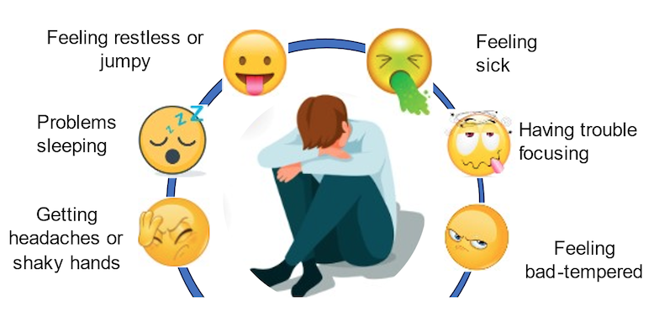
Nicotine withdrawal
When someone stops using nicotine, their body can react in uncomfortable ways, called withdrawal.
Notes:
Information Slide: Nicotine Withdrawal
Teacher shares information with young people. This slide introduces the concept of something being addictive.
Teacher Explanation – What does “addictive” mean?
“Addictive” means something that makes a person’s body or brain want more and more of it, even if it’s not good for them.
Some thing, like nicotine, can trick the brain into thinking it makes someone feel good or relaxed. After using it for a while, the brain starts to crave it and it then becomes hard to stop.
When someone tries to stop using something addictive, they might feel uncomfortable, sad, or grumpy—that’s because their body is used to having it and needs time to adjust.
You could say:
“Addictive means it’s really hard to stop using something once you start, because your brain keeps telling you that you need it—even when you don’t.”
Example for context:
“Nicotine, which is in vapes, is addictive. When people start using it, their brain gets used to it. Later, even if they want to quit, their body might make them feel like they need more.”

Slide 16
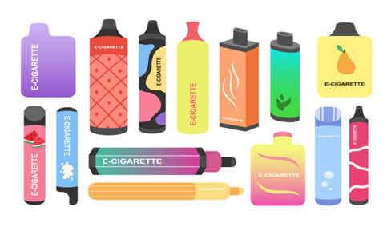
Vapes: What are they?
Vapes are electronic devices for people to breathe in a flavoured mist, or vapour.
Vapes are not meant to be used by children
Vapes can be used to help adults to stop smoking.
Notes:
Information Slide: Vapes: What are they?
Teacher shares information with young people.

Slide 17
Vapes: What’s inside?
be
Notes:
Discussion Slide: Vapes: What’s inside?
Teacher asks young people if they know what is inside a vape. Answers are on next slide.

Slide 18
Vapes: What’s inside?
be
Vegetable glycerol​:
Makes it visible, like a mist. ​
Nicotine:​ This is a drug that can make people want to keep using it. It is addictive.
Chemicals:​
These are for flavour. Some can damage your lungs.
Notes:
Information Slide: Vapes: What’s inside?
Teacher shares information with young people.

Slide 19
How can vaping affect someone's health?
Lungs & Vaping 🫁
Chemicals can make lungs sore 😣
Harder to breathe in sport 🏃‍♂️
Can cause coughing 🤧
Vaping makes lungs weaker.
Notes:
Information Slide: How can vaping affect someone’s health?
Teacher shares information with young people.
Key Points:
Vapes can contain harmful chemicals that can irritate the lungs.
These chemicals can make the lungs sore, inflamed, and less able to take in oxygen.
People who vape may find it harder to breathe—especially when running or playing sports.
Vaping can also cause coughing, chest tightness, and shortness of breath.
Explain that healthy lungs are strong and clean, but vaping makes them weaker and less efficient.

Slide 20
How can vaping affect someone's health?
Heart & Vaping ❤️
Can make the heart beat faster 💓
Leaves a person feeling tired 😴
Not good for a growing body 🧒
Vaping puts stress on the heart.
Notes:
Information Slide: How can vaping affect someone’s health?
Teacher shares information with young people.
Key Points:
Nicotine in vapes can make the heartbeat faster than normal. This puts extra stress on the heart and blood vessels.
When the heart has to work harder, it can leave a person feeling tired, dizzy, or weak.
Vaping can also make it harder to stay active, because the body has to work overtime to pump blood and oxygen.
For young people, whose hearts and bodies are still growing and developing, vaping can interfere with healthy growth.
Reinforce that a healthy heart helps with energy, sports, and overall well-being, and vaping works against that.
Relate this topic to real-life activities: running, playing, dancing, or any movement that makes the heart stronger. Explain that vaping does the opposite—it makes the heart work too hard for the wrong reasons. Encourage pupils to think of ways they can keep their heart healthy, like staying active, eating well, and making smart choices.

Slide 21
How can vaping affect someone's health?
Gums & Vaping 😁
Can give you sore gums 🤕
Causes bad breath 😷
Makes teeth less healthy 🦷
Vaping is bad for gums.
Notes:
Information Slide: How can vaping affect someone’s health?
Teacher shares information with young people.
Key Points:
Nicotine can cause gum disease.
Vaping can lead to bad breath because it dries out the mouth and allows bacteria to grow more easily.
Over time, gum disease can make teeth weaker and less healthy, increasing the risk of cavities and tooth loss. Good mouth health helps people eat, smile, and speak comfortably. Reinforce that a healthy smile comes from brushing, eating well, and staying away from things like vaping that hurt the mouth.

Slide 22
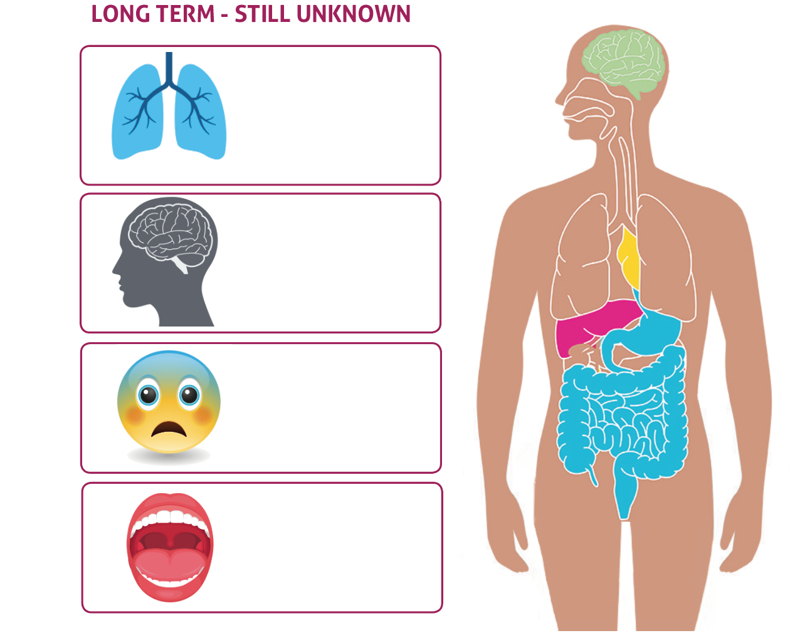












How can vaping affect someone's health?
Notes:
Discussion Slide: How can vaping affect someone’s health?
Using their knowledge about nicotine addiction, withdrawal, and the harmful chemicals contained in vapes, pupils can summarise some of the immediate and long-term effects of vaping covered so far in this lesson.

Slide 23
Reflect:
Na
What is one fact you have learned about vaping?
Notes:
Discussion Slide:
To consolidate knowledge, the teacher could ask the pupils one fact they have learned so far. This could be discussed in pairs and fed back to the class. Answers could be recorded on post it notes and shared as part of a wider class discussion.

Slide 24
Talk About it…
Na
Na
Name two effects of vaping
How do you know if a drug is harmful?
Na
Give a reason why young people should not start to vape
Notes:
Summary Slide:
Key Points:
Reinforce key messages from the lesson:
Drugs can be helpful or harmful, depending on how they are used.
Vaping has negative effects on the body, including the lungs, heart, and gums.
Young people should avoid vaping and other harmful substances to protect their growing bodies.
Encourage pupils to express their opinions and listen respectfully to others.
Discussion Prompts (with examples):
Name two effects of vaping.
Example answers: Can make lungs sore, Can cause coughing, can make the heart beat faster, can cause bad breath.
How do you know if a drug is harmful?
Example answers: If it hurts your body, makes you feel sick, isn’t given by a doctor, or is illegal.
Give a reason why young people should not start to vape.
Example answers: It’s bad for your health, it’s addictive, it can make breathing or sports harder, or it can damage gums.
Allow pairs or small groups to discuss, then share their ideas with the class.

Slide 25

Talk About |
Healthy choices
Making Healthy Choices
On each slide are some everyday things.
How healthy do you think each thing is?
Are some things unhealthy?
Does it depend?
Notes:
Activity Slide – Making Healthy Choices: Aim: To help pupils identify and understand the difference between healthy and unhealthy behaviours, with a focus on how positive choices, like playing sport or eating well, can help them avoid risky behaviours such as vaping. Outcome: Recognise examples of healthy and unhealthy behaviours, describe how healthy habits support their physical and mental wellbeing, begin to make informed decisions about their own health by discussing realistic and age-appropriate scenarios. Activity: Each slide will show an item or an activity. Click to reveal an image one at a time. Ask the class: Is this a healthy choice? Why? How do we know?

Slide 26
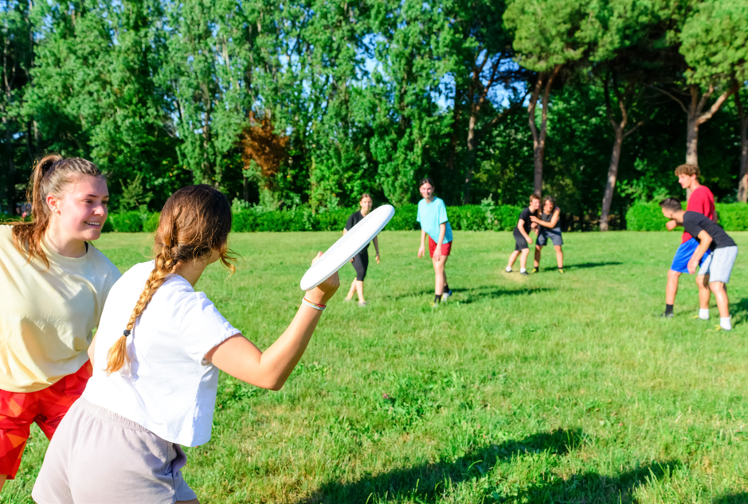
Playing outside with friends
Notes:
Activity Slide – Making Healthy Choices:
"Playing outside with friends" - Healthy.
Playing outside often includes movement, running, climbing, riding a bike, or playing games, which helps keep the body strong, fit, and active. It’s a great way to exercise without even realising it. Being outdoors helps you feel happier and more relaxed. Sunshine and fresh air can boost your mood and energy and help reduce stress or worry. When children play together, they practise teamwork, communication, problem-solving, and sharing. This helps them build friendships and feel connected.

Slide 27

Going on a walk
Notes:
Activity Slide – Making Healthy Choices:
"Going on a walk" - Healthy. Going on a walk gets your body moving. It helps build stronger muscles and bones, improves heart health, and supports better posture and balance; even a short walk makes a difference.

Slide 28
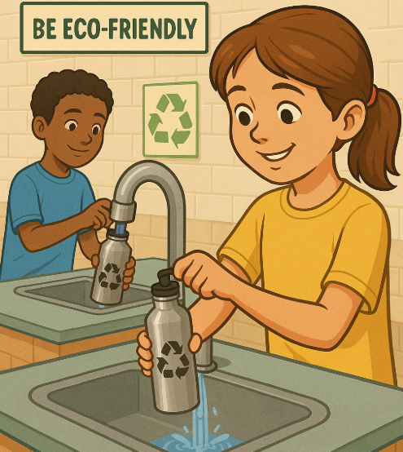
Drinking water
Notes:
Activity Slide – Making Healthy Choices:
"Drinking water" - Healthy. Water helps every part of the body work properly — including the brain, heart, muscles, and skin. It keeps you hydrated, which means your body has the right amount of fluid to stay healthy and alert. Water helps with concentration and staying focused at school. If you’re feeling tired or getting a headache, you might just need a drink of water. It also helps with digestion and keeps your body cool during exercise or warm days.

Slide 29

Having lots of sweets
Notes:
Activity Slide – Making Healthy Choices:
"Eating sweets" - Unhealthy, although not always harmful. Let pupils know that eating sweets occasionally as a treat is okay, but sweets are not something we should eat lots of every day. They are often high in sugar. They don’t provide much nutrition; sweets won’t give us the vitamins, fibre, or energy we need to grow strong or stay active. Balance and Moderation: Emphasise that sweets aren’t “bad” on their own, but they should be part of a balanced diet, not consumed in excess.

Slide 30

Vaping
Notes:
Activity Slide – Making Healthy Choices:
"Vaping" Unhealthy. Vaping can be harmful to a person's lungs and heart and contains nicotine which is highly addictive and could lead to nicotine addiction.

Slide 31

Drinking A Fizzy Drink
Notes:
Activity Slide – Making Healthy Choices:
"Drinking a fizzy drink" – Unhealthy, although not always harmful. Let pupils know that fizzy drinks occasionally as a treat is okay, but not something we should drink lots of every day. They are often high in sugar. They don’t provide much nutrition; and won’t give us the vitamins, fibre, or energy we need to grow strong or stay active. Balance and Moderation: Emphasise that fizzy drinks aren’t “bad” on their own, but they should be part of a balanced diet, not consumed in excess.

Slide 32

Gaming
Notes:
Activity Slide – Making Healthy Choices:
"Online gaming" – Mixed. Online gaming can be a fun way to relax, be creative, and connect with friends. Some games can help build problem-solving skills and teamwork. But playing too much can affect sleep, schoolwork, and mental health. Some games also have online chats, which can expose children to unkind or unsafe behaviour. It’s important to take breaks, balance screen time with other activities, and talk to a trusted adult if anything online makes you feel uncomfortable.

Slide 33
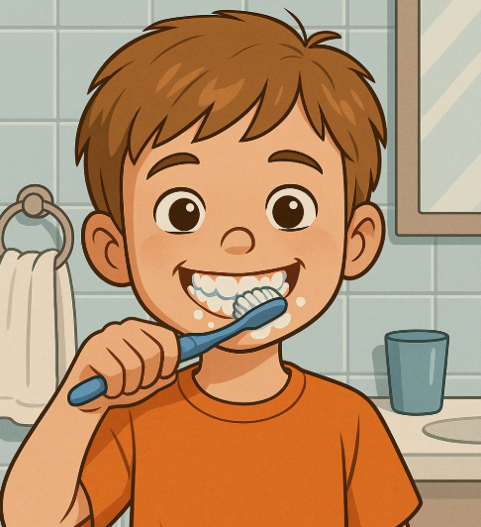
Cleaning your teeth
Notes:
Activity Slide – Making Healthy Choices:
"Teeth cleaning" – Healthy. Cleaning your teeth twice a day helps keep your mouth healthy. Brushing removes plaque and food that can cause holes in your teeth, bad breath, and gum disease. Healthy teeth help you chew your food, speak clearly, and smile with confidence. Using toothpaste with fluoride makes your teeth stronger. Looking after your teeth every day supports your whole-body and can help to prevent dental treatment. However, important to note overbrushing can cause damage to gums and enamel erosion.

Slide 34
We are learning…
Tools to help us make healthy choices.
How being in charge of our choices can help us feel strong, focused, and happy.
The importance of being able to recognise unhealthy choices and understand how they can affect our bodies and minds.
Notes:
Information/Summary Slide:
Teacher shares summary of learning from the slide.

Slide 35

Healthy/Unhealthy: How do we know?
Do you know what is inside something?
It is healthy if you have balance
It might be unhealthy if you have too much
Does it make your body feel good?
Where did it come from?
Does it make you feel sick?
Notes:
Discussion Slide: Healthy/Unhealthy: How do we know?
Aim:
To support pupils in thinking critically about what makes something healthy or unhealthy.
To introduce the idea that health is not just “good vs. bad,” but depends on balance, ingredients, quantity, and how something affects the body.
Discussion:
Ask pupils to share examples of how they know/decide if something is healthy or unhealthy.
Encourage them to consider more than one factor (balance, ingredients, quantity, how it feels).
Reinforce that this is not about labelling things as “good” or “bad,” but about making informed choices.
Discussion Points on slide:
“It is healthy if you have balance.”
Explain that no single thing determines health—what matters is overall balance.
“Do you know what is inside something?”
Encourage pupils to think about ingredients and nutrients.
Mention reading labels or asking questions when unsure.
“It might be unhealthy if you have too much.”
Introduce the idea of moderation. It could be helpful to refer back to the ‘does/response’ concept when lesson explored medication.
“Where did it come from?”
Prompt pupils to think about the source of something. Do we know where it came from? Is the source trustworthy. How would we know?
“Does it make your body feel good?”
Connect healthy choices to energy, mood, and overall well-being.
Invite pupils to share examples of things that help them feel energised or strong.
“Does it make you feel sick?”
Explain that things that cause someone to feel unwell or have discomfort might not be good choices for that person.
Normalise that everyone’s body is different—what’s healthy for one person might not feel good for another (allergies, sensitivities).

Slide 36
Talk About It…
What’s a healthy habit you have that helps you feel good?
Can you think of a new healthy choice you might try?
Why is it important to make informed choices every day?
Notes:
Discussion Slide:
1. “What’s a healthy habit you have that helps you feel good?”
Invite pupils to share habits related to:
Eating (e.g., drinking water, eating breakfast)
Physical activity (e.g., playing outside, sports)
Sleep (e.g., going to bed on time)
Emotional well-being (e.g., talking about feelings, taking breaks)
Reinforce that healthy habits help us feel good physically and emotionally.
2. “Can you think of a new healthy choice you might try?”
Encourage pupils to think of simple, doable actions, such as:
Trying a new fruit or vegetable
Adding 5 extra minutes of movement
Drinking more water
Practicing mindfulness or deep breathing
Emphasise one small change rather than something overly ambitious.
Let pupils know it’s okay to try something and adjust if it doesn’t work for them.
3. “Why is it important to make informed choices every day?”
Connect back to the previous slide’s ideas about:
Knowing what’s in things
Balance and moderation
How things make your body feel
Help pupils understand that informed choices allow them to:
Feel strong and energized
Stay safe and healthy
Take care of their bodies and brains

Slide 37
Talk About |
Staying Safe
Safe, Unsafe, Legal, Illegal?
You decide!
You’ll see a situation on the screen.
Is it SAFE? UNSAFE? LEGAL? ILLEGAL?
Some situations will have more than one answer!
Notes:
Activity Slide: Staying Safe Aim: To help pupils explore and understand the differences between safe, unsafe, legal, and illegal situations.
Activity: Teachers will read out or display one scenario at a time. Ask pupils to decide whether the situation is Safe, Unsafe, Legal, or Illegal. This can be done interactively by using classroom corners, finger signals (thumbs up/down), or pointing to labelled sections on the board/screen.
After each response, ask pupils to explain their reasoning. Encourage respectful discussion, especially when opinions vary.
Let pupils know some answers may fall into more than one category (a behaviour might be legal but unsafe).
This activity can be done as a whole class or in small groups.

Slide 38





What does Legal mean?
What does Illegal mean?
“Legal” means something that is allowed by the rules or laws of a place.
“Illegal” means something that is not allowed by the rules or laws of a place.
Notes:
Information Slide:
“Legal” means something that is allowed by the rules or laws:
It is legal to ride your bike in the park if the park rules say it’s okay.
It is not legal to drive a car when you’re 9 years old, because the law says only adults can.
“Illegal” means not allowed by the law.
It’s like breaking the big rules that everyone has to follow.
Examples:
It’s illegal to steal someone’s toys, because the law says you can’t take things that don’t belong to you.
It’s illegal to drive a car when you’re 9, because only grown-ups with a license can drive.
But it’s legal to play football in the park, because there’s no law against it.

Slide 39
What does unsafe mean?
What does safe mean?
“Safe” means that you are not in danger, and nothing is likely to hurt you.
“Unsafe” means not safe — it could hurt you or put you in danger.
Notes:
Information Slide:
“Safe” means that you are not in danger, and nothing is likely to hurt you.
For example:
Wearing a helmet on your bike helps keep you safe.
Crossing the street while holding an adult’s hand is safe.
Touching a hot stove is not safe.
So when something is safe, it means you can feel okay and protected.
“Unsafe” means not safe — it could hurt you or put you in danger.
Examples:
Riding your bike without a helmet is unsafe.
Running across the street without looking is unsafe.
Playing in a place with broken glass is unsafe.
So if something is unsafe, it means it’s risky and could cause harm.

Slide 40
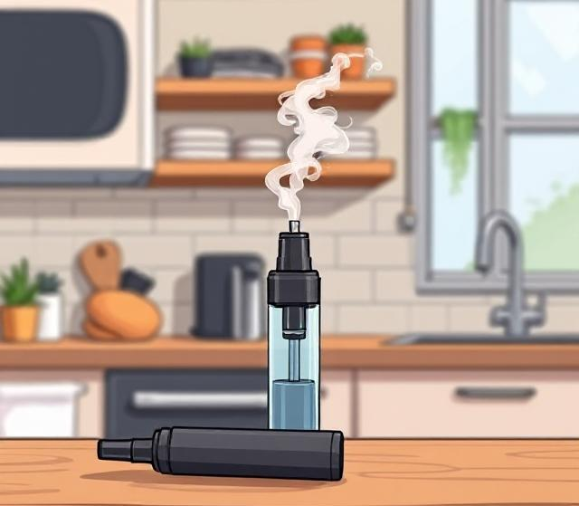
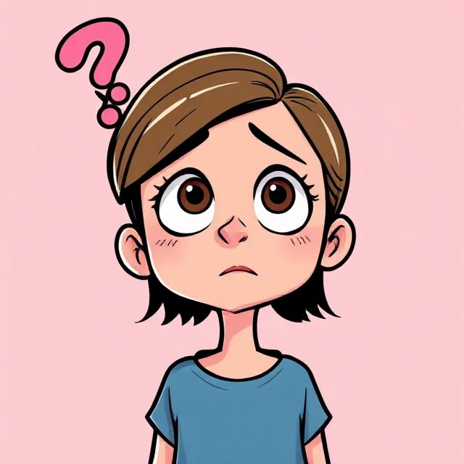
A 12-year-old tries a vape they find at home
UNSAFE?
SAFE?
Notes:
Activity Slide: Staying Safe
"A 12-year-old tries a vape they find at home." Unsafe. Highlight that legally a person must be over the age of 18 to purchase a vape. Vapes contain nicotine which is a drug. This is not meant for children.

Slide 41


An adult uses a vape to try to stop smoking.
SAFE?
ILLEGAL?
UNSAFE?
LEGAL?
Notes:
Activity Slide: Staying Safe
"An adult uses a vape to try to stop smoking." Legal. There may be some discussion around whether this is "safe", or "unsafe". Highlight that vapes were originally created to help adults stop smoking and are considered less harmful than cigarettes. However, be clear that vaping still has health risks including lung problems, shortness of breath, dizziness and headaches.

Slide 42

A child knowing what vaping is.
SAFE?
ILLEGAL?
UNSAFE?
LEGAL?
Notes:
Activity Slide: Staying Safe
"A child knowing what vaping is." Safe. Legal. Some children may be worried that they should not know anything about vaping because it's not for children. Emphasise that it is acceptable for young people to know about vaping and it's risks so they are able to make positive healthy choices as they grow up.

Slide 43

Someone over 18 years old buying a vape from a shop
SAFE?
ILLEGAL?
UNSAFE?
LEGAL?
Notes:
Activity Slide: Staying Safe
“Someone over 18 years old buying a vape from a shop". Legal. There may be some discussion around whether this is "safe", or "unsafe". Discuss with the pupils the health risks of vaping. Vapes contain nicotine, which is addictive and can affect the heart and lungs. Even though vapes are sometimes used to help people quit smoking, they are not harmless. Some vapes have harmful chemicals or incorrect labels, especially disposable or unregulated ones. Even though it’s legal for adults, buying a vape is not necessarily safe, and using it still has risks, especially for younger people who might see adults doing it and think it’s okay for them too. Buying a vape from a supermarket is the "safest" way to buy a vape because the sale of vapes from well-known supermarkets is regulated, unlike, for example, buying a vape online.

Slide 44

Buying a vape online under 18
SAFE?
ILLEGAL?
UNSAFE?
LEGAL?
Notes:
Activity Slide: Staying Safe
“Buying a vape online under 18.” Unsafe, illegal. It is illegal for anyone under the age of 18 to be sold a vape, even online. Vapes bought online may not be safe - they can come from unregulated sources and contain harmful substances. Vaping can cause side effects like headaches, nausea and addiction. This behaviour is unsafe and not legal for young people.

Slide 45
4 Corners: True or False?
Around the room are 4 statements.
Visit them in small groups and discuss if each statement is true, give reasons/examples.
Nicotine is a drug.
People who vape are trying to stop smoking.
There are laws about vaping in Scotland.
Vaping is good for the heart, lungs and gums.
.
Notes:
Activity Slide: “4 Corners: True or False?”
Aim:
To reinforce key facts about nicotine, vaping, and laws in Scotland in a safe, factual way.
Place the four statements in different corners or areas of the room.
Divide pupils into small groups.
Groups rotate around the room, discussing each statement.
Encourage them to decide why they think statement is true or false, using examples or explanations.
After rotation, bring the class together to debrief each statement.
Discussion notes for each statement
1. “Nicotine is a drug.”
This statement is true.
Nicotine is a chemical that affects the brain and body.
It can cause addiction, meaning people may find it hard to stop using it.
2. “People who vape are trying to stop smoking.”
This statement is sometimes true, sometimes not.
Some adults use vaping as an attempt to quit smoking.
However, many young people who vape have never smoked, so this statement is not true for everyone.
3. “There are laws about vaping in Scotland.”
This statement is true.
There are laws about:
Age restrictions (you must be over a certain age to buy vapes)
What strength of vapes are sold
Recent ban on disposable vapes
4. “Vaping is good for the heart, lungs and gums.”
This statement is false.
Vaping is not good for heart, lungs, gums, or the body in general.
It can harm these body parts as explored at beginning of lesson.
If you don’t smoke don’t vape is the key message.

Slide 46



Support & Advice
TRUSTED ADULT
If you are worried about vaping talk to a trusted adult, such as a teacher, parent/carer.
You can talk to Childline about anything.
No problem is too big or too small
Vaping | Childline
Call 0800 1111
Can you think of anything else ?
Notes:
Information Slide: Support & Advice
Teacher shares information about further support & advice for pupils.
Please see further support, information and guidance for teaching staff: ​
Quit your way Youth - NHSGGC ​
Young people and vaping briefing paper - NHSGGC ​
Vaping addiction soon takes hold | NHS inform ​

