Slide 1


talk about |
vaping
Prime Minister Activity
Notes:
Teacher Notes - Teachers should ask the students to imagine that they are the Prime Minister for the day. It is their job to put together a plan on how to discourage young people from vaping. They must do this through a persuasive campaign. This should include creating a badge or logo to support their campaign. This could be done individually, in groups, or as a whole class.

Slide 2
?
Imagine you are the Prime Minister for a day. Your job is to protect young people from the dangers of vaping. What rules or changes would you make?
Choose 2–3 ideas from the list below or come up with your own.
Write your ideas in full sentences on the worksheet.
Draw a badge or create a logo for your campaign!
Ban fruity flavours?
What would you do?
Stop Influencers advertising vapes?
Teach information about vaping in schools?
Including more warning labels on packaging?
Increase the legal age?
Price?

Slide 3
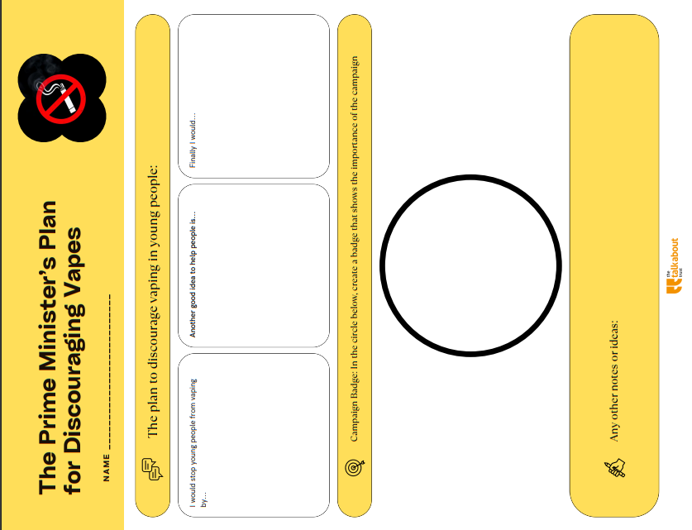
Notes:
Teacher Notes - Teachers can use this worksheet template to help scaffold the task.

