Slide 1



talk about |
vaping
Traffic Light Activity
You are going to see a number of situations. Rate the situation based on how safe you think it is.
Red: Very unsafe
Amber: Could be unsafe Green: Safe

Slide 2
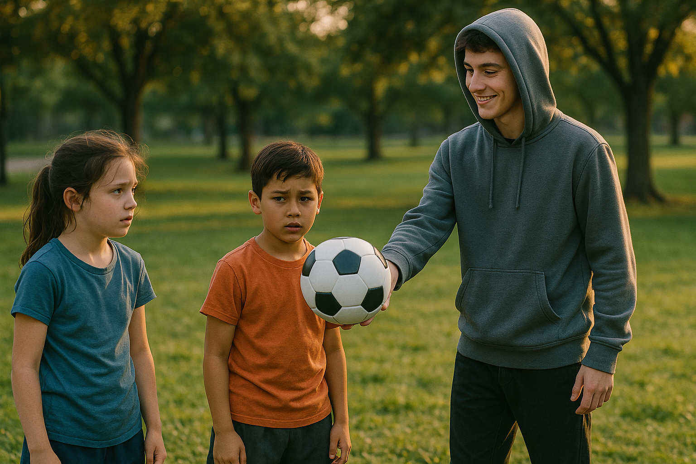
A new football...
You are playing football after school in the park. A teenager walks up, smiling, holding out a brand-new football as an offer.
Notes:
Teacher Notes – You are playing football after school in the park. A teenager is smiling, holding out a brand-new football as an offer.
Rating: Red Why: Unexpected gifts from older individuals, especially strangers, can be a grooming tactic. It's a common way to build trust before asking for something in return. Even if the person seems nice, this situation is unsafe and should be avoided.

Slide 3
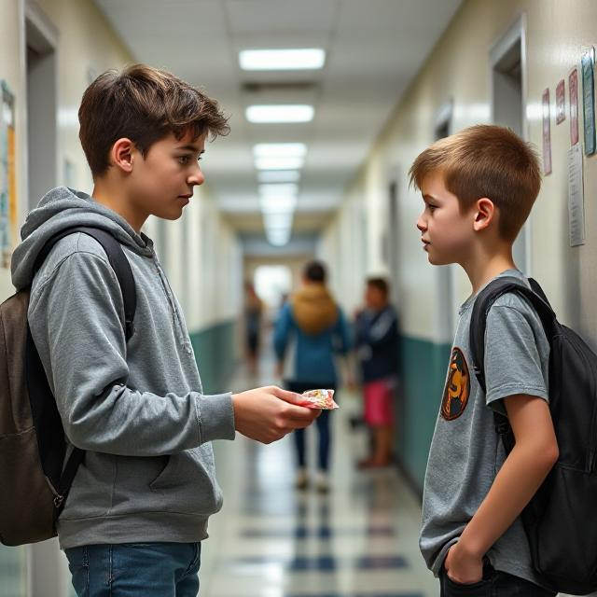
Accepting secret gifts...
An older child hands a gift to you. The older student whispers 'Don't tell anyone.’
Notes:
Teacher Notes – An older child hands a gift to you. The older student whispers 'Don't tell anyone.’
Rating: Red Why: Secrecy is a red flag. Safe situations never require keeping secrets from trusted adults. Groomers often use gifts and secrecy to test boundaries and gain control.

Slide 4
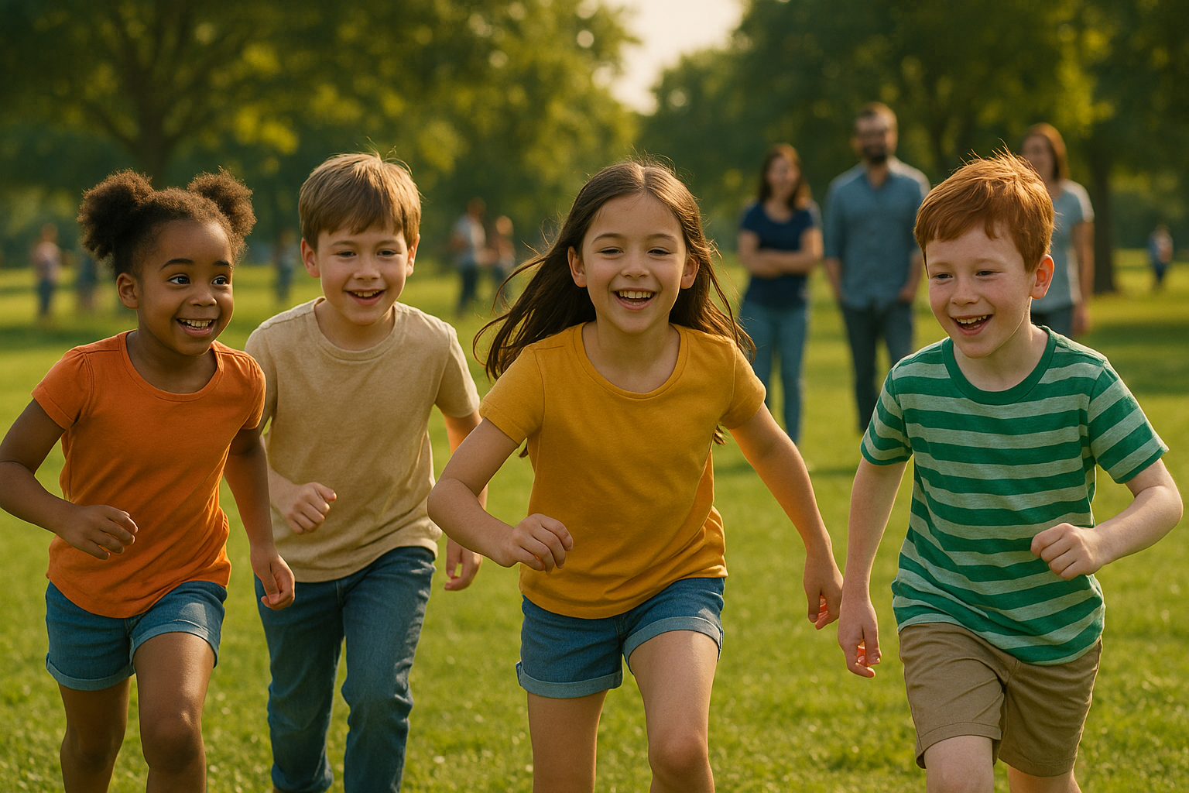
Playing outside...
People from your class have invited you to play football in the park. There are lots of your friends' parents and guardians around.
Notes:
Teacher Notes – People from your class have invited you to play football in the park. There are lots of your friends' parents and guardians around.
Rating: Green Why: Safe, supervised play with classmates and known adults present. This setting reduces risk and builds positive peer relationships.

Slide 5
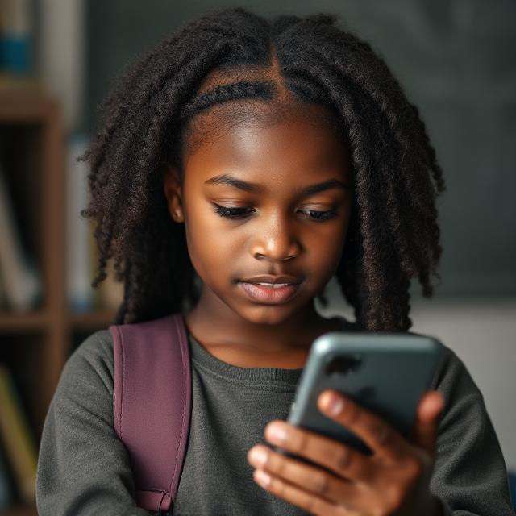
Group chat mystery...
You receive a message saying, “Join this group! The older kids are funny!” The name of the group chat is “Cool Crew.”
Notes:
Teacher Notes – You receive a message saying, “Join this group! The older kids are funny!” The name of the group chat is “Cool Crew.”
Rating: Amber or Red Why: Social media and messaging apps can introduce children to older peers with unknown intentions. It might seem fun, but joining groups with people you don’t know well can expose you to unsafe conversations or pressure.

Slide 6
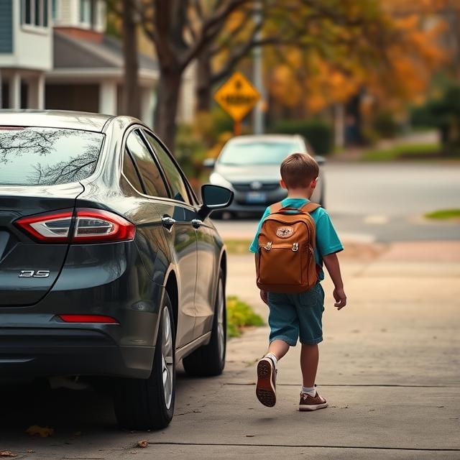
Offered a lift...
Someone you recognise from an older year is driving while you're walking home from school. The driver shouts, "Your mum told me to give you a lift home!"
Notes:
Teacher Notes – Someone you recognise from an older year is driving while you're walking home from school. The driver shouts "Your mum told me to give you a lift home!"
Rating: Red Why: Even if the person is vaguely familiar, getting into a car with someone you weren’t expecting is unsafe. Groomers might pretend to be sent by family. Always check with a trusted adult before accepting lifts.

Slide 7
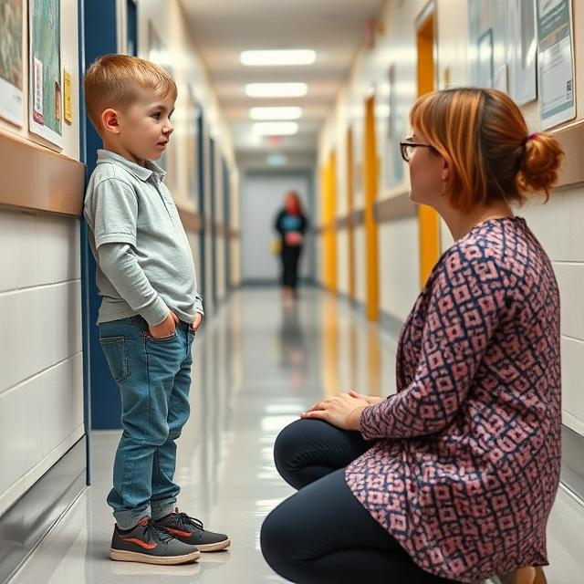
Speaking to an adult...
A teacher stops you in school to ask you if you're feeling okay.
Notes:
Teacher Notes – A teacher stops you in school to ask you if you're feeling okay. Rating: Green
Why: Trusted adults like teachers are safe people to talk to. They’re trained to help and support students, especially when something feels wrong.

Slide 8
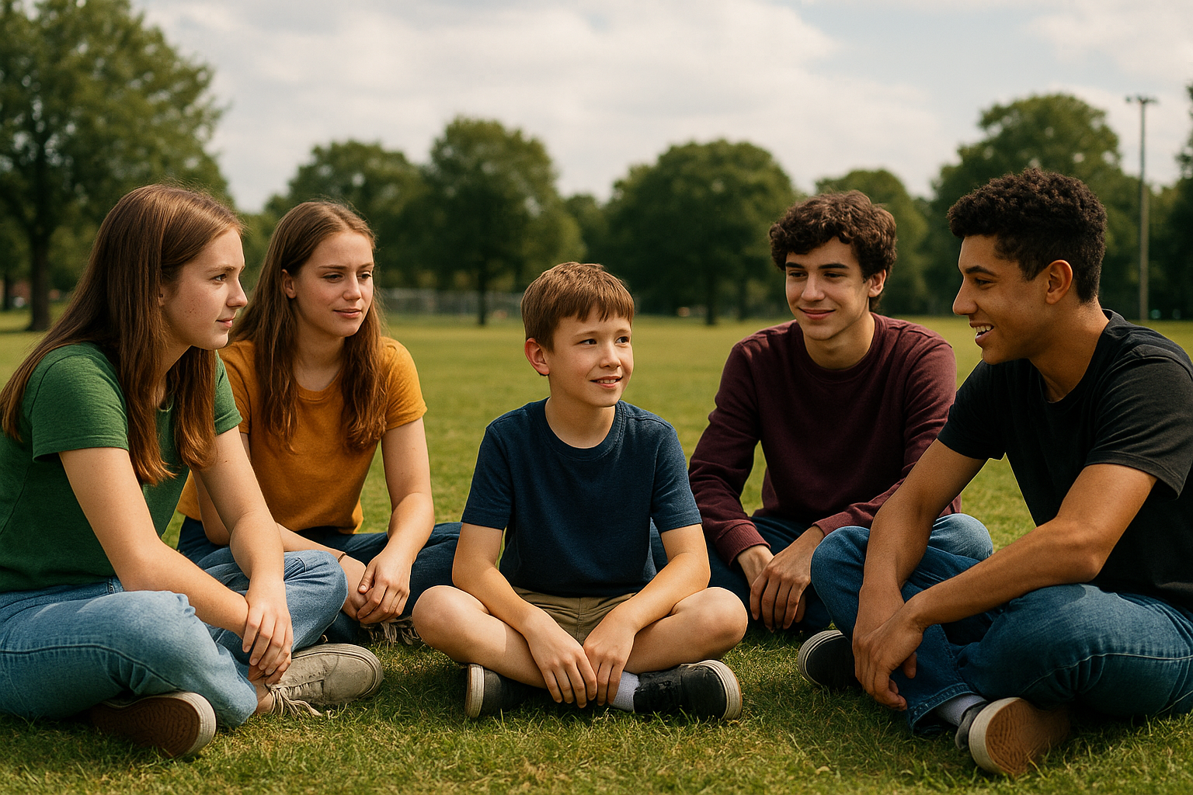
Older friends...
Your older sibling and their teenage friends invite you to the park.
Notes:
Teacher Notes – Your older sibling and their teenage friends invite you to the park.
Rating: Amber Why: Being around older siblings may feel safe, but older teens may engage in risky behaviour or be influenced by unsafe peers. It depends on supervision and the nature of the group. Discuss this with the students. Would the situation be "greener" if a parent knew where you were? Should you have an emoji to text a trusted adult when you're feeling uncomfortable?

Slide 9

Working with different students...
Your school is running a project where you've been asked to work with students in a different class.
Notes:
Teacher Notes – Your school is running a project where you've been asked to work with students in a different class.
Rating: Green Why: A structured, adult-led activity that involves positive peer interaction. No secrecy or unsafe behaviour, and all students are known in the school environment.

Slide 10

What makes a situation Red or Amber?
It's a mix of safe and unsafe: like a familiar person, but in an unfamiliar setting.
You feel a little uncomfortable or unsure.
You start to feel pressured.
You're being invited to do something that feels okay but without an adult knowing.
You're not sure if your parent or carer would say yes.
It involves someone you don't know very well asking you to do something.
When the person involved asks you to keep something a secret.
It just feels "wrong" - trust your gut!

Slide 11

What could we do if we find ourselves in a Red or Amber situation?
Tell a trusted adult about the situation as soon as you can
Buddy Up: Stay with a trusted friend or adult, avoid being alone in situations with new people that are making you feel uneasy
Say "no, thank you" and walk away
Have a "safe" emoji to text a trusted adult
Call a trusted adult
Make an excuse to leave such as "I have to be home on time because I have football tonight"
Let a trusted adult know where you are going, who with, and agree a time for you to be home

Slide 12

If you are worried about anything we have talked about today, you can find support or information from Childline or talk to a trusted adult.
Childline has a website and a free, confidential telephone counselling service for children.
Call: 0800 1111 https://www.childline.org.uk/
Children aged 10+ can visit Kooth. Kooth is a free, safe, and anonymous online mental health and wellbeing platform. https://www.kooth.com/
Catch 22 - Works with children and young people of any age to help get them out of situations they're worried about, including County Lines. https://www.catch-22.org.uk/
YoungMinds – youngminds.org.uk (Great tips and support on mental health for young people and their families)
Need to talk?

