Slide 1



vaping
talk about |
Safe, Unsafe, Legal, Illegal?
Today, you’ll be the judge! Can you work out which situations are safe or unsafe, legal or illegal?
You’ll see a situation on the screen.
Think: Is it SAFE? UNSAFE? LEGAL? ILLEGAL?
Some answers might have more than one correct label!
Notes:
Teacher Notes - Teachers will read out or display one scenario at a time from the PowerPoint slide deck. Each scenario presents a situation related to vaping, such as trying a vape, buying one, or resisting peer pressure. Ask students to decide whether the situation is Safe, Unsafe, Legal, or Illegal. This can be done interactively with minimal printing by using classroom corners, finger signals, or pointing to labelled sections on the board/screen. After each response, ask students to explain their reasoning. Encourage respectful discussion, especially when opinions vary. Use this opportunity to clarify the law around vaping (e.g., age limits, what makes an ad legal or illegal) and highlight positive behaviours like saying no to peer pressure or seeking help from trusted adults.
Let students know some answers may fall into more than one category (e.g., a behaviour might be legal but unsafe). This activity can be done as a whole class or in small groups. The teacher can decide to print out "legal", "illegal", "safe", "unsafe" labels and place them around the room. Alternatively, the teacher could print off the slides and place them around the room, asking the students to visit each statement and discuss it before feeding back as a whole class.

Slide 2
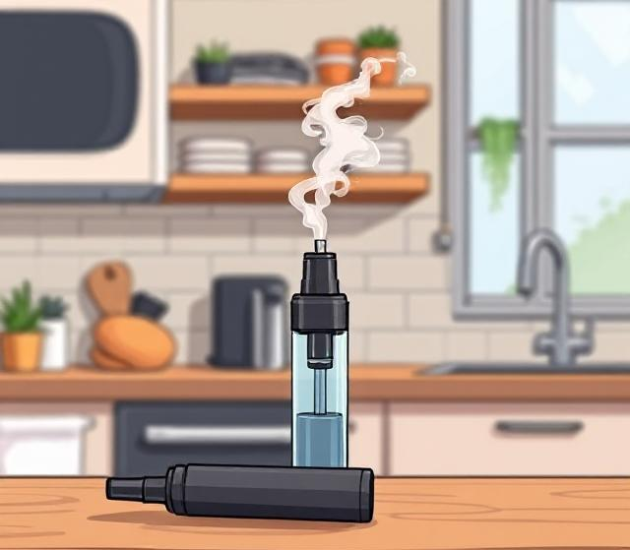

A 12-year-old tries a vape they find at home
UNSAFE?
SAFE?
Notes:
Teacher Notes – "A 12-year-old tries a vape they find at home." Unsafe. Highlight that it is illegal to sell a vape to anyone under 18 in the UK. Vaping can lead to dizziness, headaches and vomiting. Vapes contain nicotine which is a drug. This is not meant for children.

Slide 3


A parent uses a vape to help them stop smoking.
SAFE?
ILLEGAL?
LEGAL?
UNSAFE?
Notes:
Teacher Notes – "A parent uses a vape to help them stop smoking." Legal. There may be some discussion around whether this is "safe", or "unsafe". Highlight that vapes were originally created to help adults stop smoking and are considered less harmful than cigarettes. However, be clear that vaping still has health risks including lung problems, shortness of breath, dizziness, jitteriness and headaches.

Slide 4

A child knowing what vaping is, and the risks
SAFE?
ILLEGAL?
LEGAL?
UNSAFE?
Notes:
Teacher Notes – "A child knowing what vaping is, and the risks". Safe. Legal. Some children are worried that they should not know anything about vaping because it's not for children. Emphasise that it is acceptable for young people to know about vaping and its risks so they are able to make positive decisions outside of school.

Slide 5

Refusing to try a vape even when others are doing it.
SAFE?
ILLEGAL?
LEGAL?
UNSAFE?
Notes:
Teacher Notes – "Refusing to try a vape even when others are doing it.". Safe. Legal. Emphasise that it is okay to say “no” to something that makes you uncomfortable, or that you know is wrong. Highlight that a person has to be over the age of 18 to vape. Vaping under the age of 18 is illegal. Vaping can lead to dizziness, headaches and vomiting. Vapes contain nicotine which is a drug. This is not meant for children. Highlight that it is illegal to give or buy a vape for a person who is under 18.

Slide 6
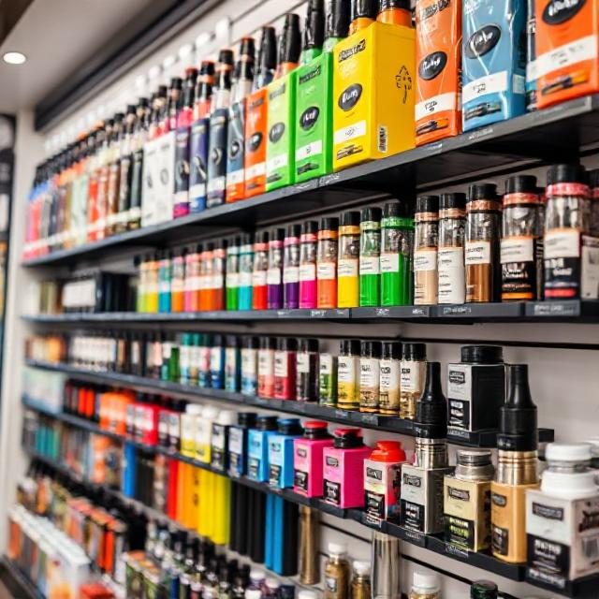
Someone over 18 years old buys a vape from a supermarket
SAFE?
ILLEGAL?
LEGAL?
UNSAFE?
Notes:
Teacher Notes – "An adult buys a vape from a supermarket". Legal. There may be some discussion around whether this is "safe", or "unsafe". Discuss with the students the health risks of vaping. Vapes contain nicotine, which is addictive and can affect the heart and lungs. Even though vapes are sometimes used to help people quit smoking, they are not harmless. Some vapes have harmful chemicals or incorrect labels, especially disposable or unregulated brands. Even though it’s legal for adults, buying a vape is not necessarily safe, and using it still has risks, especially for younger people who might see adults doing it and think it’s okay for them too. Buying a vape from a supermarket is the "safest" way to buy a vape because the sale of vapes from well-known supermarkets is highlight regulated, unlike, for example, buying a vape online.

Slide 7
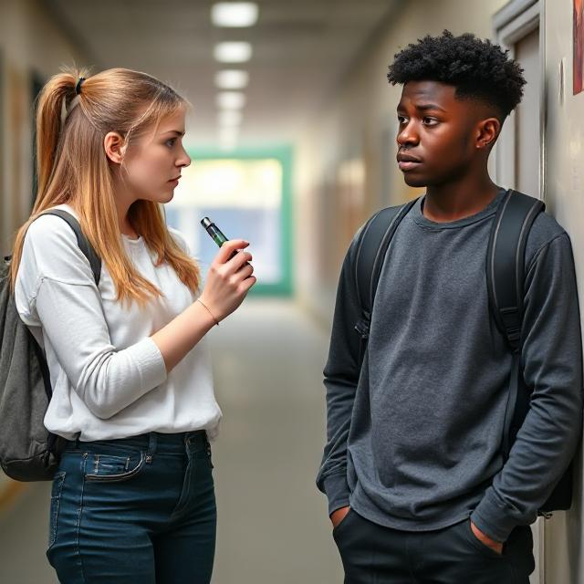
A friend buys a vape and dares a child to try it.
SAFE?
ILLEGAL?
LEGAL?
UNSAFE?
Notes:
Teacher Notes – "A friend buys a vape and dares a child to try it." Illegal. Unsafe. It is illegal to sell a vape to anyone under 18 in the UK. It is illegal for someone aged 18 or over to buy a vape for anyone under the age of 18 - this is called buying by proxy. Encouraging someone else who is underage to try a vape also breaks the law, especially if it involves pressure or sharing. Vaping can be harmful to young people’s lungs and heart and may lead to nicotine addiction. Peer pressure in this context makes it emotionally unsafe, too - it can make someone feel uncomfortable or pressured to do something harmful.

Slide 8
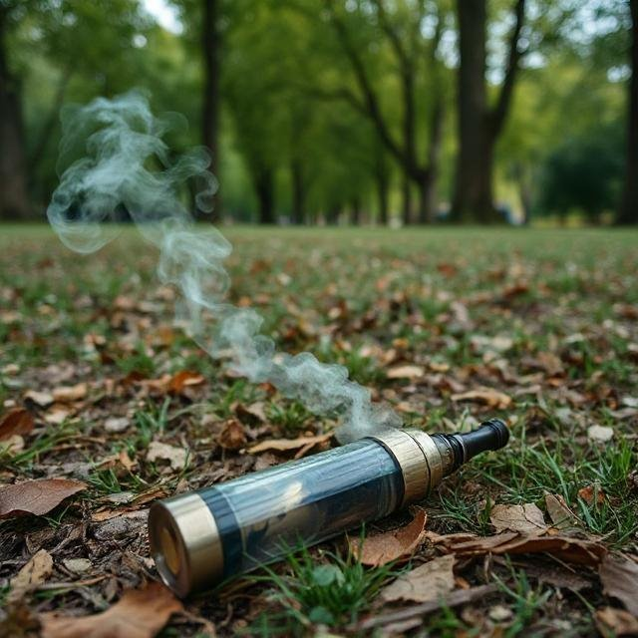
Picking up a vape in the park and trying it.
SAFE?
UNSAFE?
Notes:
Teacher Notes – "Picking up a vape in the park and trying it." Unsafe. Picking up a vape in a public place can be very dangerous. It could be contaminated, damaged, or contain unknown substances. Vaping under the age of 18 is illegal. Vapes often contain nicotine, which is a drug and can be highly addictive. Vaping can lead to dizziness, headaches and vomiting. This is not safe for children.

Slide 9

Buying a vape online under the age of 18
SAFE?
ILLEGAL?
LEGAL?
UNSAFE?
Notes:
Teacher Notes – Unsafe, illegal. It is illegal to sell a vape to anyone who is under the age of 18, including online. Vapes bought online may not be safe - they can come from unregulated sources and contain harmful substances. Vaping can cause side effects like headaches, nausea and addiction. This behaviour is unsafe for young people and is not legal.

Slide 10

Reflection
If you are worried about anything we have talked about today, you can find support or information from Childline or talk to a trusted adult.
Childline has a website and a free, confidential telephone counselling service for children. Call: 0800 1111
https://www.childline.org.uk/
Children aged 10+ can visit Kooth. Kooth is a free, safe, and anonymous online mental health and wellbeing platform. https://www.kooth.com/
YoungMinds – youngminds.org.uk (Great tips and support on mental health for young people and their families)
​How old should someone be to buy a vape legally?​
18 years old ​
Give a situation where vaping would be both unsafe and illegal​
Buying a vape under the age of 18​
Buying a vape for someone under the age of 18.

