Slide 1


talk about |
vaping
How do social media influencers promote vapes? Whose social media posts can you trust?

Slide 2
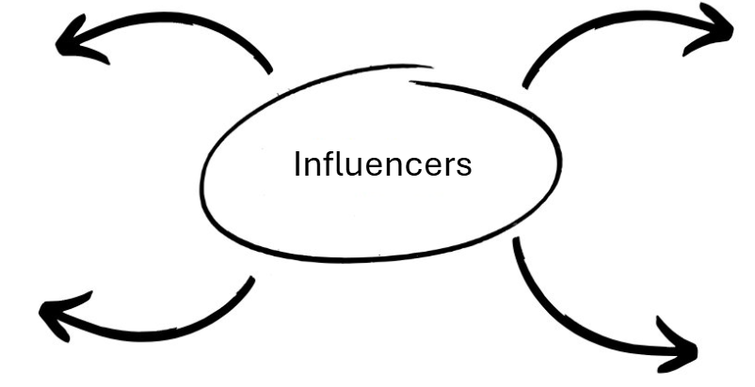





What is an online influencer?
Notes:
Teacher Notes - Ask the students what an "online influencer" is. Students may suggest ideas such as "content creators", "YouTubers", "TikTokers", "people who make money from social media", "people who promote products on social media". Explain that a modern-day "influencer" is someone who posts content on social media to make money. Part of their role might be to advertise products to an audience

Slide 3
What is an online influencer?
Someone who is on social media?
TikTok, Instagram, Snapchat, YouTube?
Someone who makes money from posting online?
Content Creators?
Gamers?

Slide 4
Influencers and Vapes
In the UK, an individual must be 18 or over to buy or use a vape.
Many people under the age of 18 are now seeing vapes advertised by influencers on social media sites like TikTok, Instagram, and Snapchat.
Why do you think influencers promote vapes?
Do influencers always use the vapes they are paid to promote?
Why could it be dangerous for an influencer to promote a vape?
How can you spot if an influencer has been paid to promote a product on their social media?
You are now going to see 4 social media posts. You must decide which ones are advertisements and why.
Notes:
Teacher Notes - Ask: “Why do you think influencers promote vapes?” Students might say: “To make money”, “For free stuff”, “To get more followers”, “They think it looks cool”. Explain: "Companies often choose influencers because young people follow them, and might copy what they see. Influencers might get paid, free products, or sponsorships in return." Ask: “Do you think they actually use the vapes they promote?” Students might respond: “Probably not”, “They just pretend.”, “They don’t even like it.” Explain: "Just because someone posts about a product doesn’t mean they use it. That’s why we need to think critically about what we see online." Ask: Why could it be dangerous for influencers to promote vapes?” Students might say: “It makes it look safe or cool.”, “Kids might copy them.”, “It seems normal or harmless.” Reinforce: "This is why it’s serious. When influencers promote vaping without warning about the risks, it can mislead people into thinking it’s fun or safe." Ask: “How can you tell if a post is an ad?” Students might say: “It says #ad or #sponsored”, “Paid partnership”, “It looks polished or professional.” Explain: "By law, influencers must label paid posts. But not all do, so it’s important to stay alert and question what you see."

Slide 5
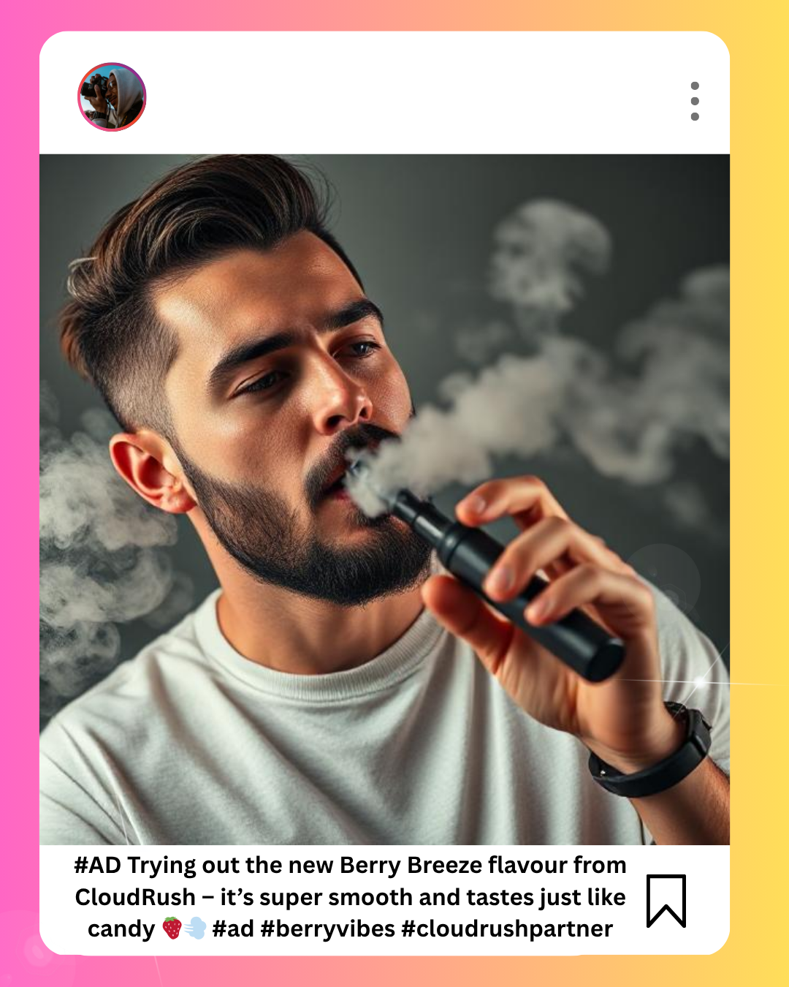
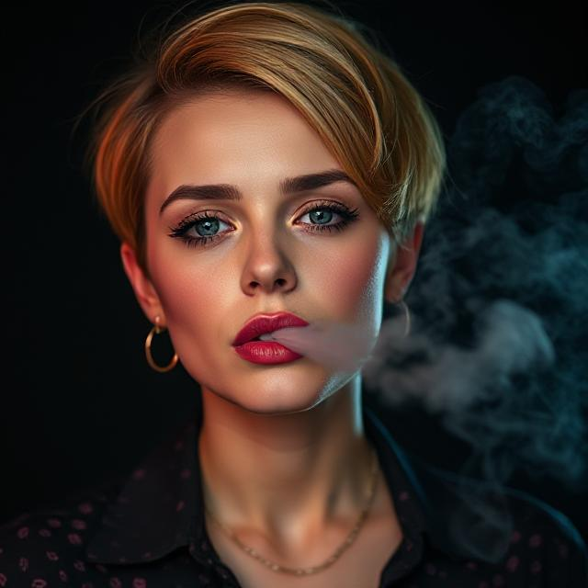
Is this post an advertisement?
  Is this post an ad?
What are they trying to make the product look like?
Does this ad highlight the risks of vaping? Why/why not?

Slide 6
Is this post an advertisement?
  Is this post an ad?
  Yes, it says "#AD" "#cloudrushpartner"
What are they trying to make the product look like?
Exciting, cool, easy to use, sweet/fruity
Does this ad highlight the risks of vaping? Why/why not?
No, it doesn't highlight the risks of vaping. It doesn't say that the sweet or fruity taste is made from harmful chemicals. It doesn't want the audience to be informed about the risks because it might lead to decrease in sales, it wants to make vaping look harmless so that the company and influencer make as much money as possible.

Slide 7
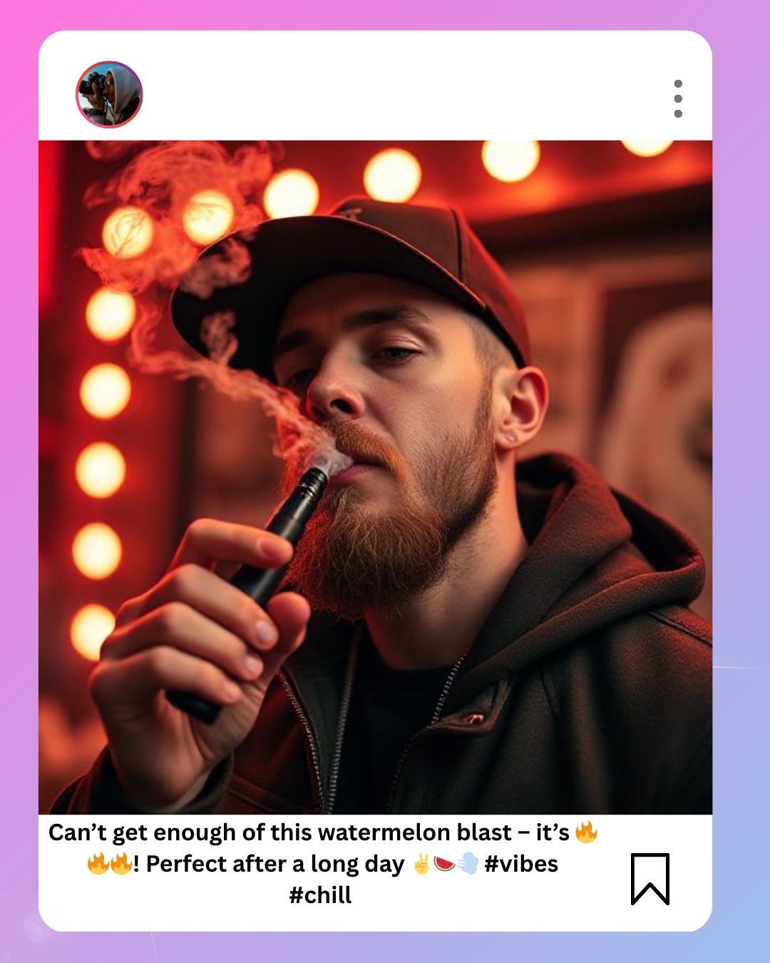
Is this post an advertisement?
  Is this post an ad?
  How can you tell it’s an ad or not? What clues helped you decide?
  If it is an ad, is the product clear?
  Do you think the person was paid to post this? Why?
  Would you trust this person based on this post?

Slide 8
Is this post an advertisement?
What makes this post sneaky?
It doesn’t say it's an advert (illegal).
It uses fun emojis and language kids relate to.
It promotes the flavour and lifestyle rather than talking about the product or highlighting the risks.
No warning that it’s a vape, or that it contains nicotine or harmful chemicals.
When ads don’t look like ads, they can trick you into thinking vaping is normal, harmless, or cool - when it’s not. That’s what makes this a sneaky ad. It’s trying to make money for a company, even if it puts people at risk.

Slide 9
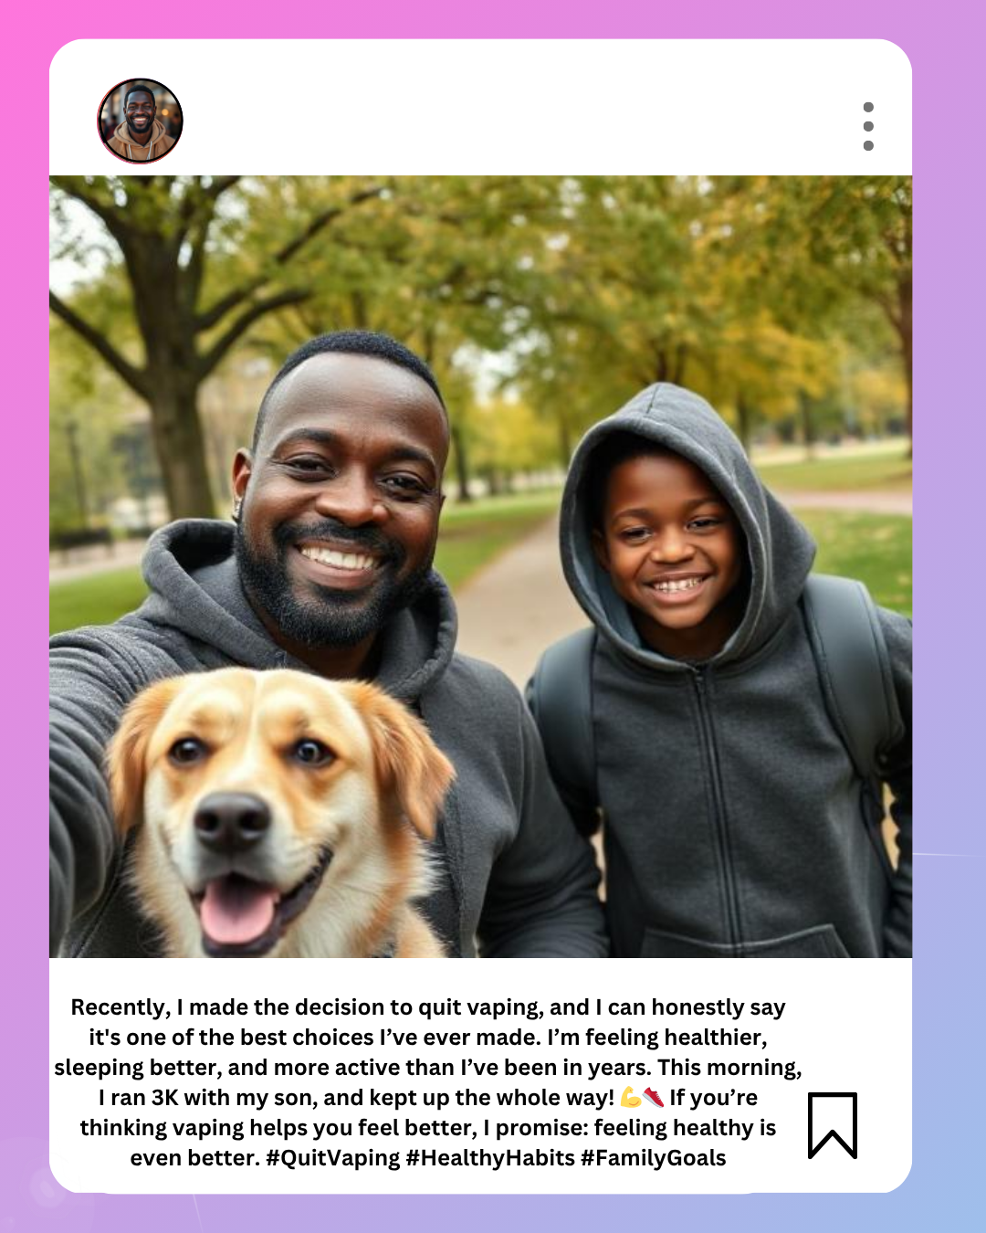
Is this post an advertisement?
Who is this post from?
What message is the parent sharing?
Is this post an ad? What clues can you use to work it out?
How is this different from a post by an influencer?
Would you trust this message? Why?

Slide 10
Is this post an advertisement?
Who is this post from?
A parent
What message is the parent sharing?
That he quit vaping and has taken up running with his son. He feels healthier because of this.
Is this post an ad? What clues can you use to work it out?
This post is not an add, it doesn't promote anything that would make money – quitting vaping and running are free!
How is this different from a post by an influencer?
He does not receive money for posting or promoting a product. He is talking about his personal experience to raise awareness of vaping. The message is honest and down-to-earth, not scripted or sponsored. There’s a positive, inspiring message that others might connect with or feel encouraged by. It features everyday people (a dad and his son, with their dog), not models or influencers.
Would you trust this message? Why?

Slide 11
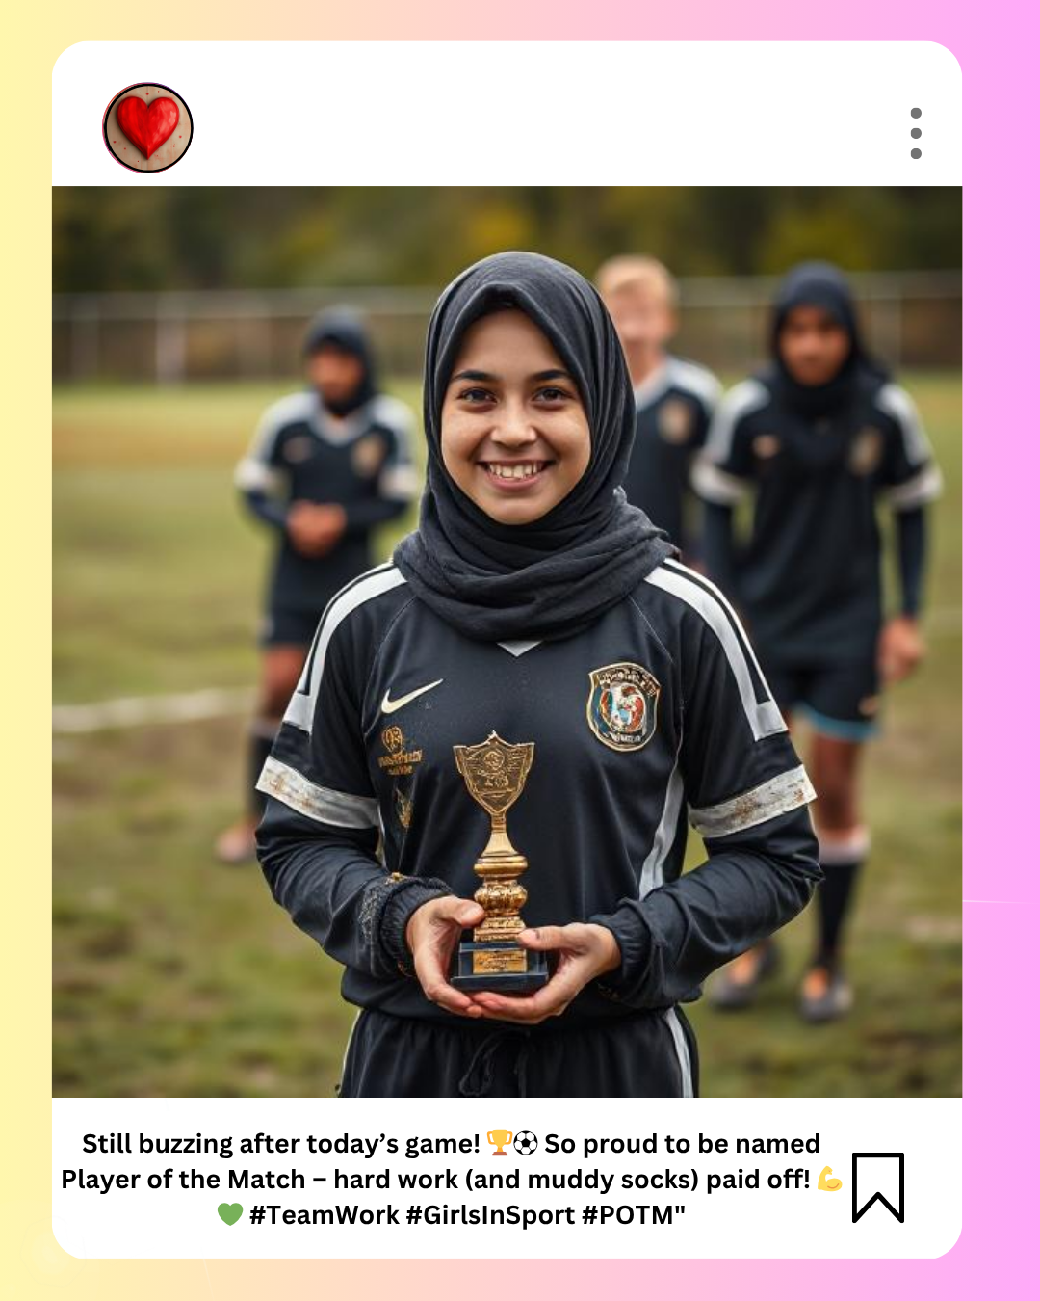
Is this post an advertisement?
Is this an ad?
What clues tell you it’s just a personal post?
Why might this kind of post be more real or relatable than an influencer’s ad?

Slide 12
Is this post an advertisement?
Is this an ad?
No
What clues tell you it’s just a personal post?
She is talking about her experience playing football, she has a picture of herself at the football match, she is not trying to promote a product.
Why might this kind of post be more real or relatable than an influencer’s ad?
It shows real emotion like excitement, surprise, pride. It reflects a personal achievement, not a paid promotion. The girl is someone people can relate to - a student, a teammate, just being herself. There’s no filter or sales pitch - just a celebration of effort and teamwork.

Slide 13

What is an influencer?
The original meaning of "influencer" is someone that can change a person's beliefs or behaviours.
Who are our positive real-life influencers?
How is this different to an online influencer?

Slide 14
What is an influencer?
Critical thinking and personal values must come first.
Just because something looks cool doesn't mean it's good for YOU.
Real-life positive influencers are invested in YOU! YOUR future, YOUR safety, and YOUR happiness.
Online influencers do not care about you in the same way. Influencing is their job; they care about the engagement with their post.

Slide 15
Reflection: Who's influencing you?
Think, pair, share: List two people in your real life who positively influence the choices you make.
Think, pair, share: Name one positive behaviour that a real-life influencer might encourage you to do.
Think, pair, share: Why?

Slide 16

Where to go for more information...
BBC Bitesize:
https://www.bbc.co.uk/teach/topics/cp440njz78zt
Google: Be internet awesome:
https://beinternetawesome.withgoogle.com/en_uk
Ceop Education:
https://www.ceopeducation.co.uk/8_10/stay-safe/

