Slide 1


talk about | our rubbish and the environment
Environmental Timeline Activity
When we throw used items into the bin, some break down and mix with the soil. How long an item takes to break down depends on what the item is made of. Some things are good for the soil when they break down, but others can be harmful.
For example, an apple breaks down in a few weeks and is good for the soil, but a plastic bottle takes hundreds of years to break down and can leave tiny harmful pieces called microplastics in the soil.
Notes:
Teacher Notes - PowerPoint or Interactive Whiteboard Option: Display the timeline (from “2 weeks” to “1–2 million years”) on an interactive whiteboard. Show item images one at a time and write on the board with a regular or interactive whiteboard pen the students' suggestions. Printed Option: Print out the timeline and item cards. Lay them on the floor, a desk, or pin them on a wall or board. Students can come up, choose an item, and place it where they think it belongs on the timeline. Once all guesses have been made, reveal the correct breakdown times. Then, discuss and rearrange any misplaced items as a class.

Slide 2
talk about | our rubbish and the environment
Instructions:
Look at the pictures in small groups or as a class and write or discuss how long you think each one takes to break down. Or place each item on the timeline. Discuss together and find out the correct answer!

Slide 3
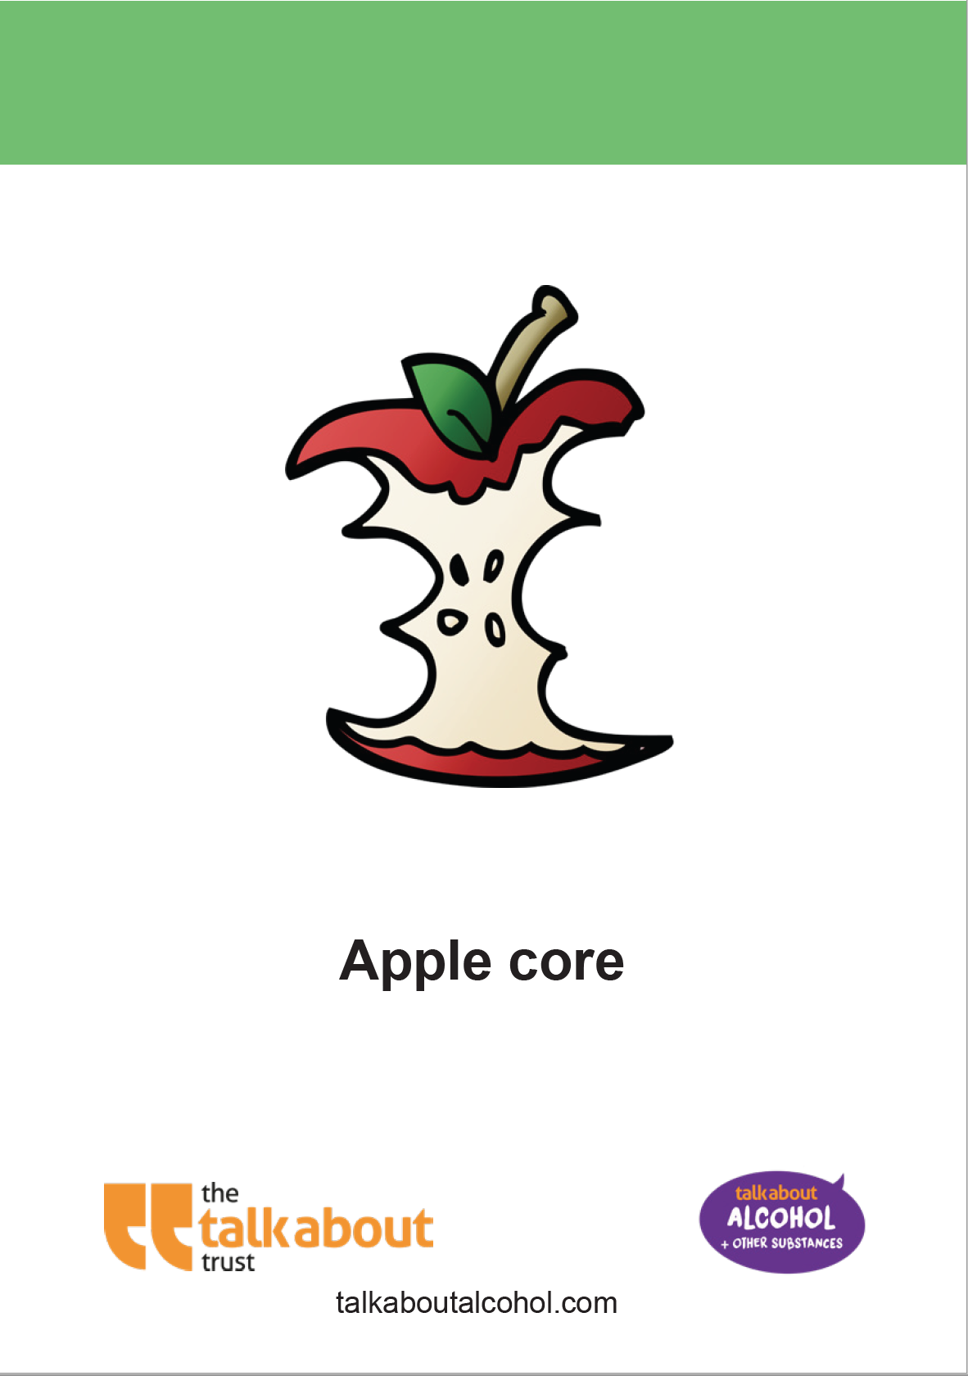
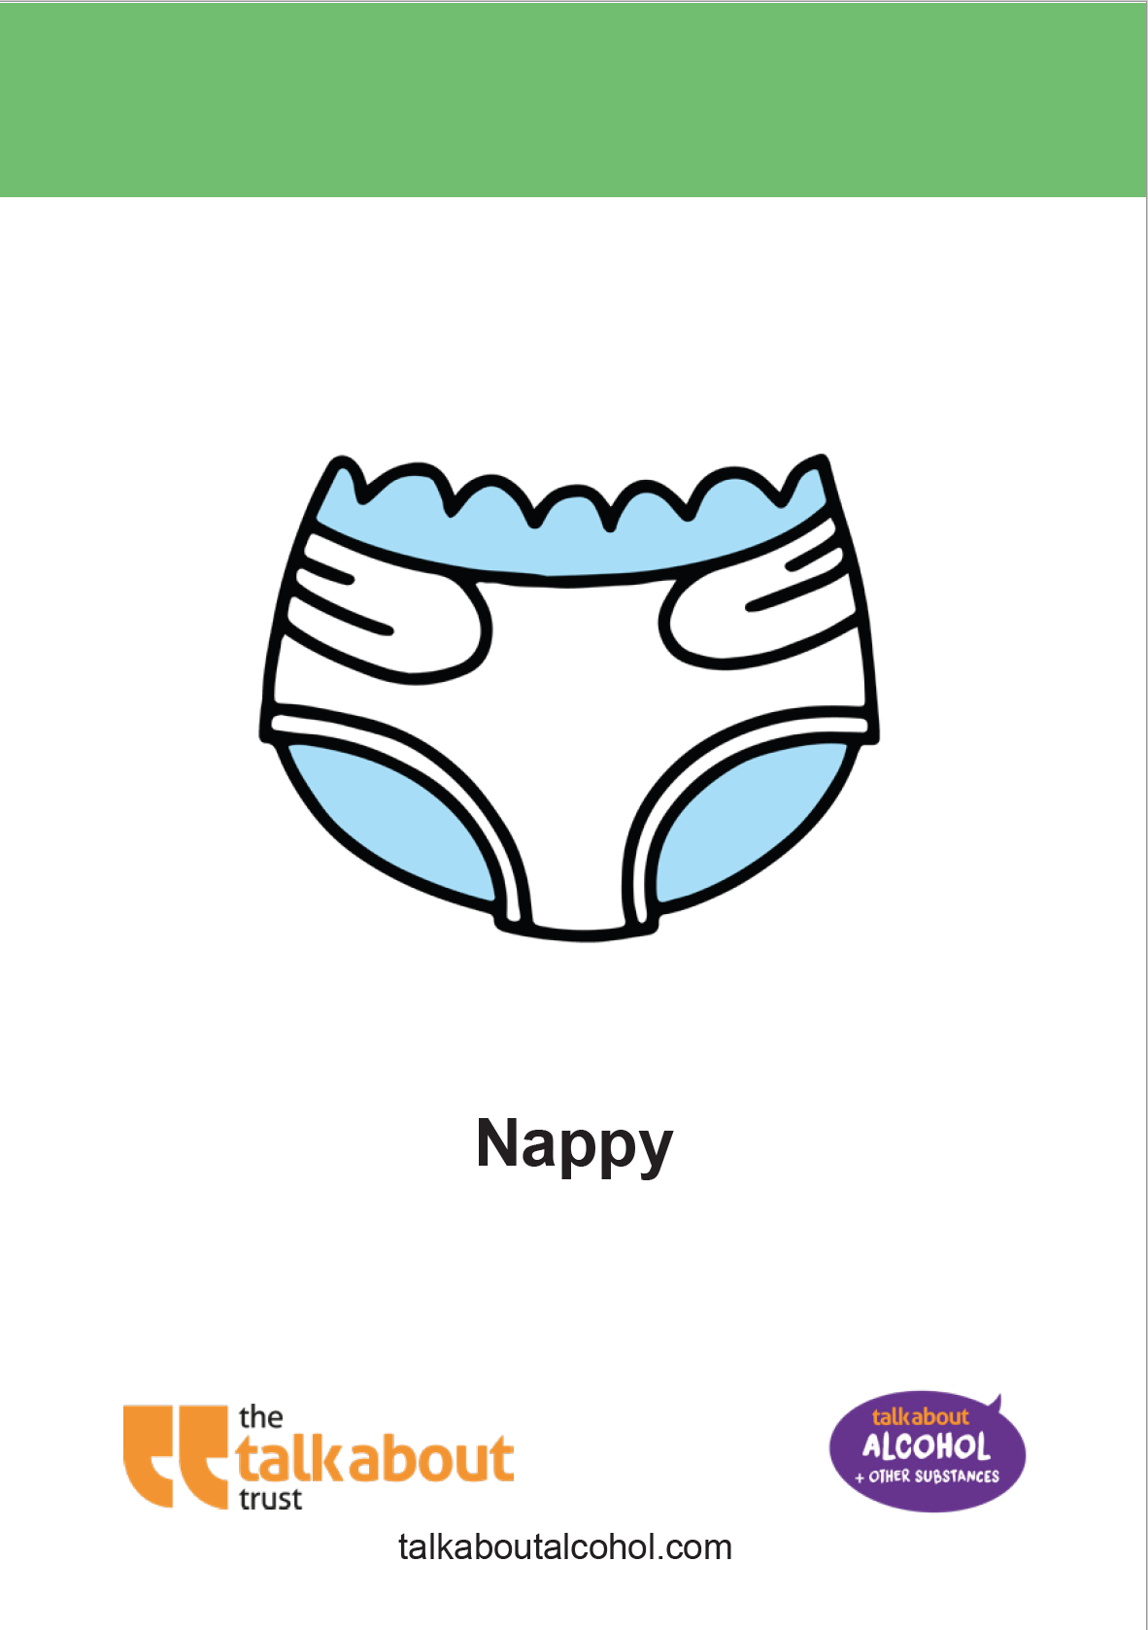
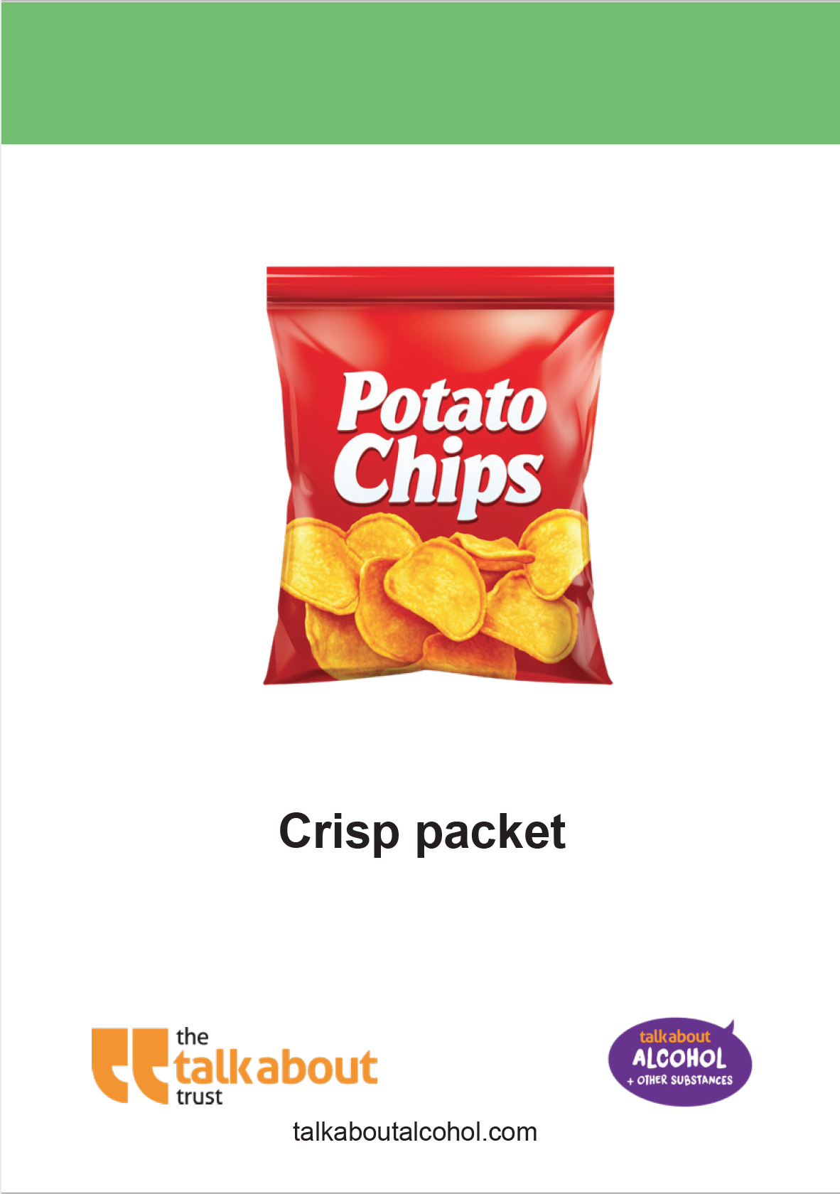
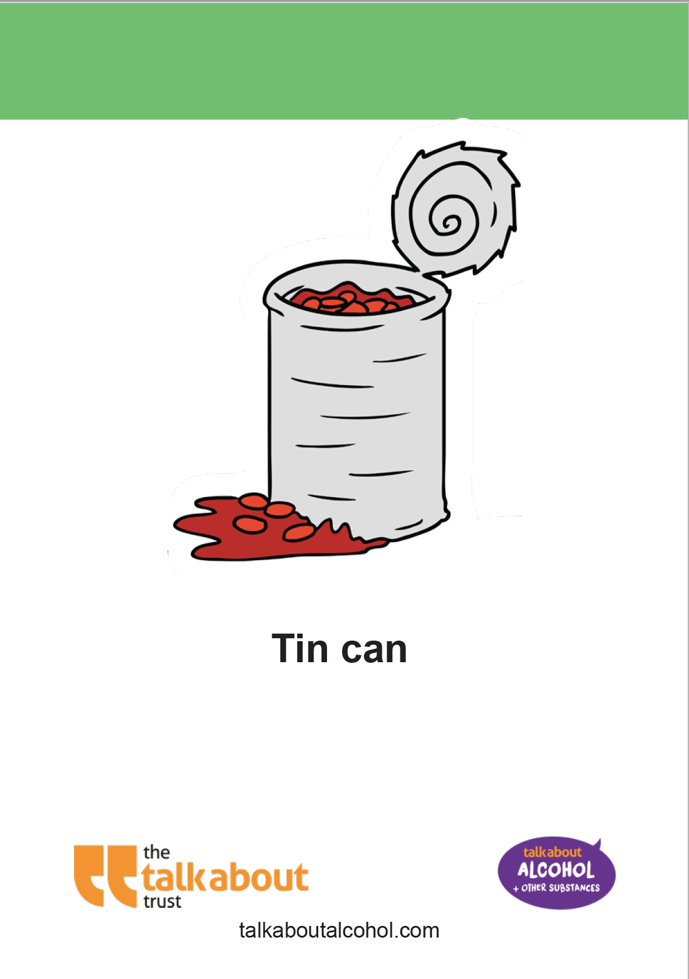


Environmental Continuum Activity

Slide 4
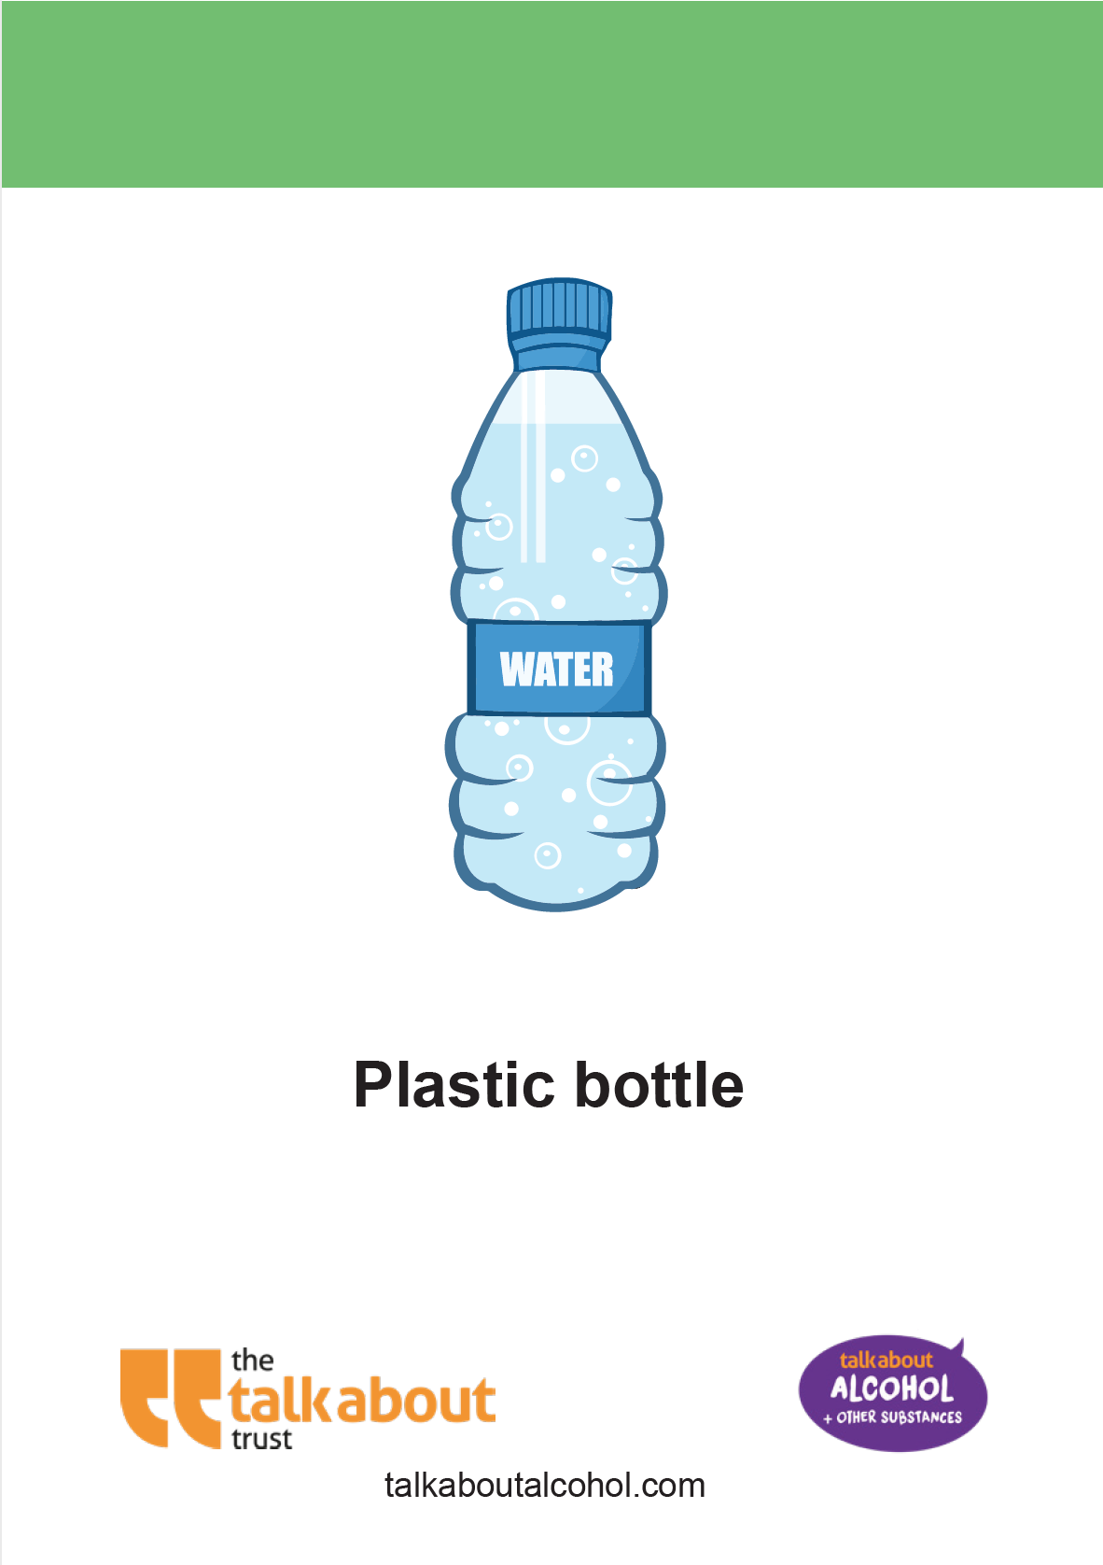
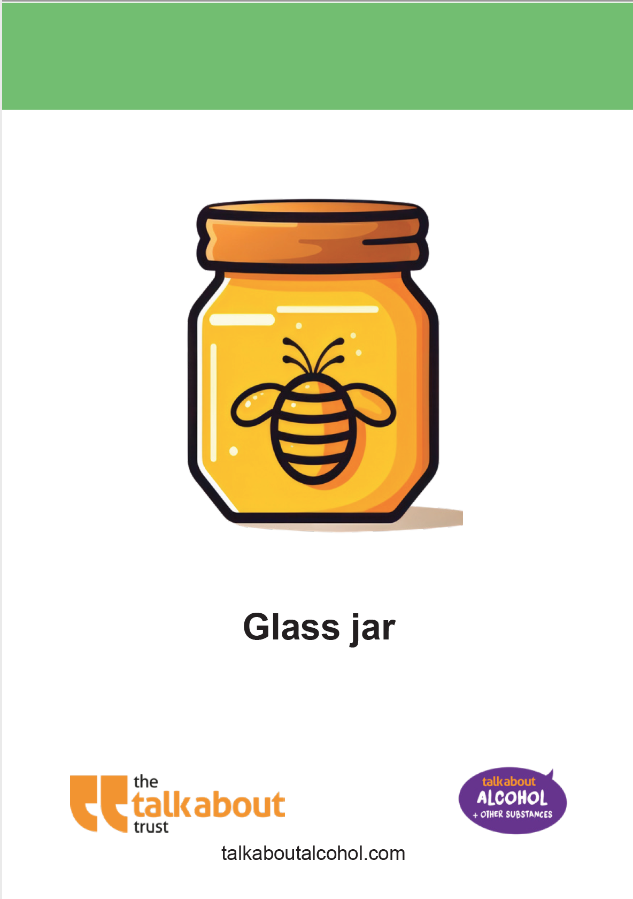
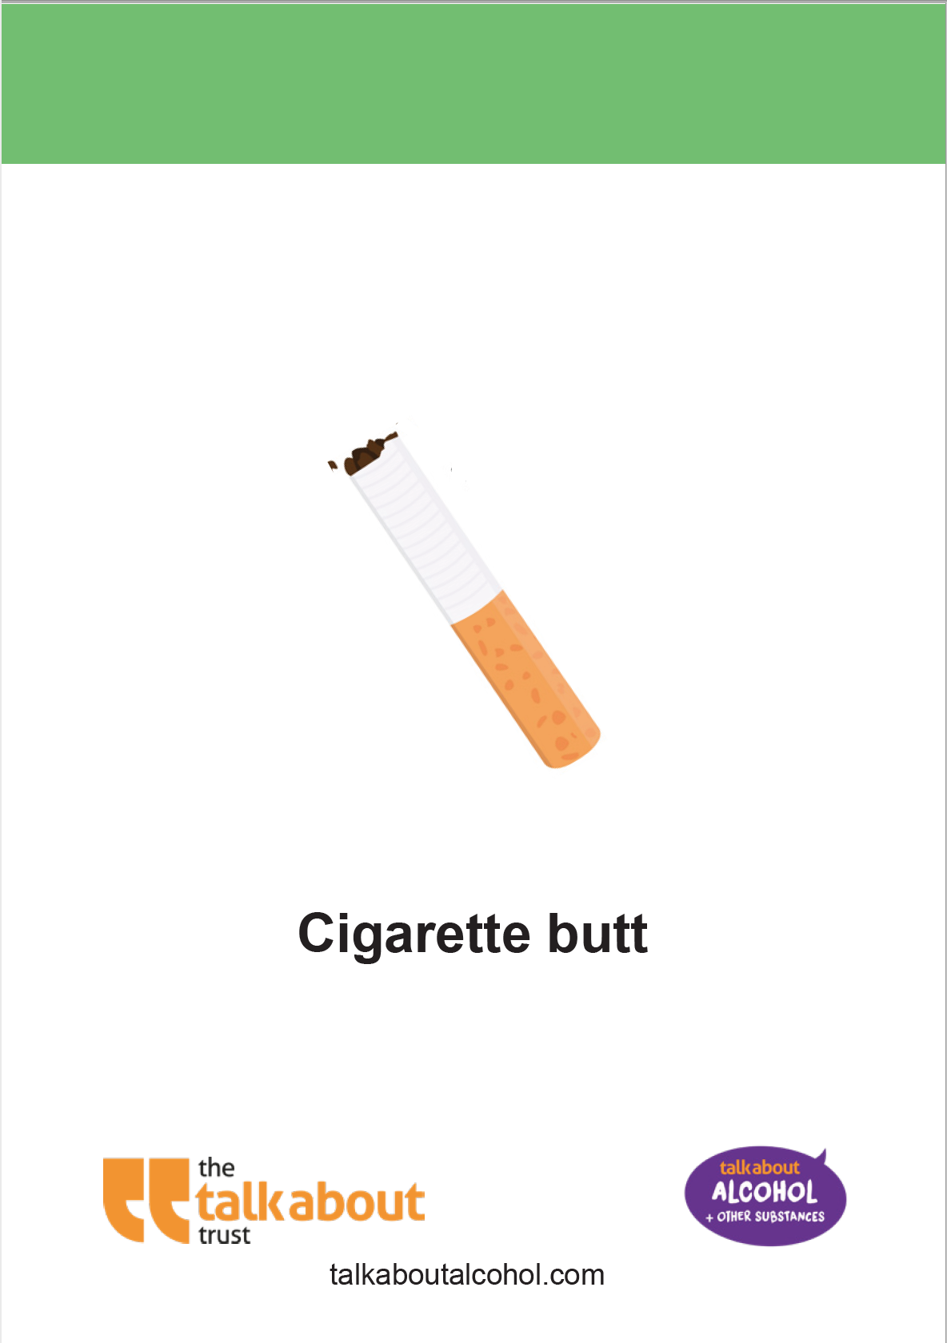
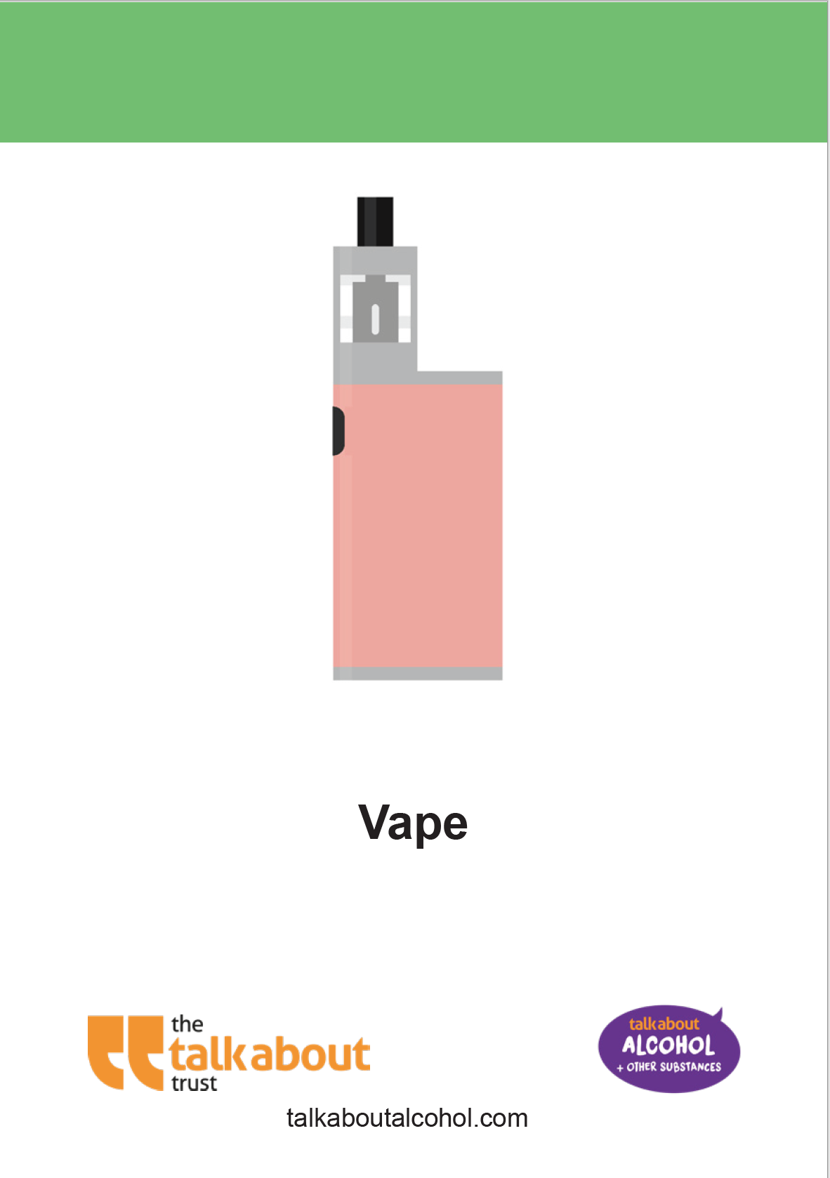
Environmental Continuum Activity

Slide 5
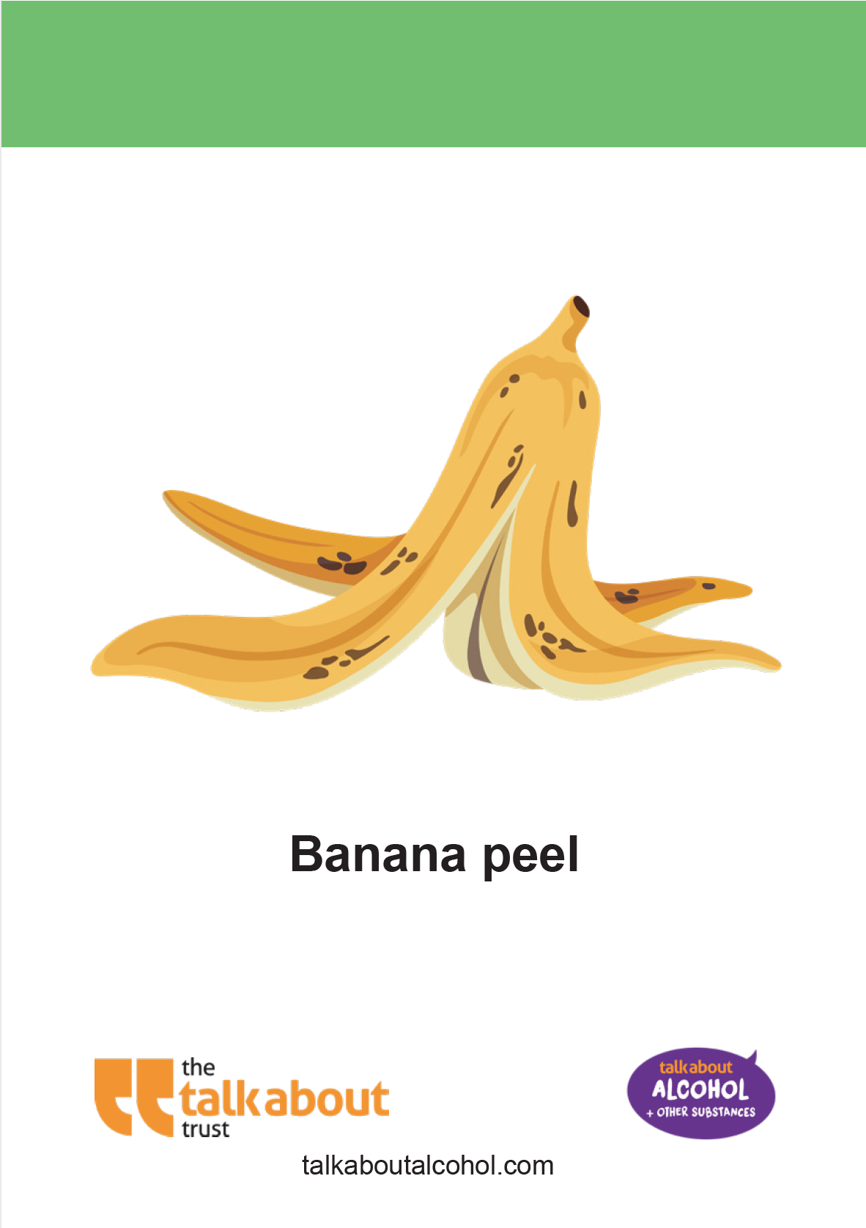
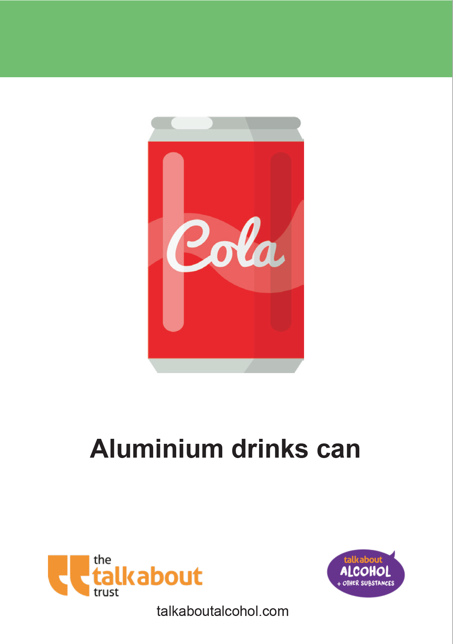
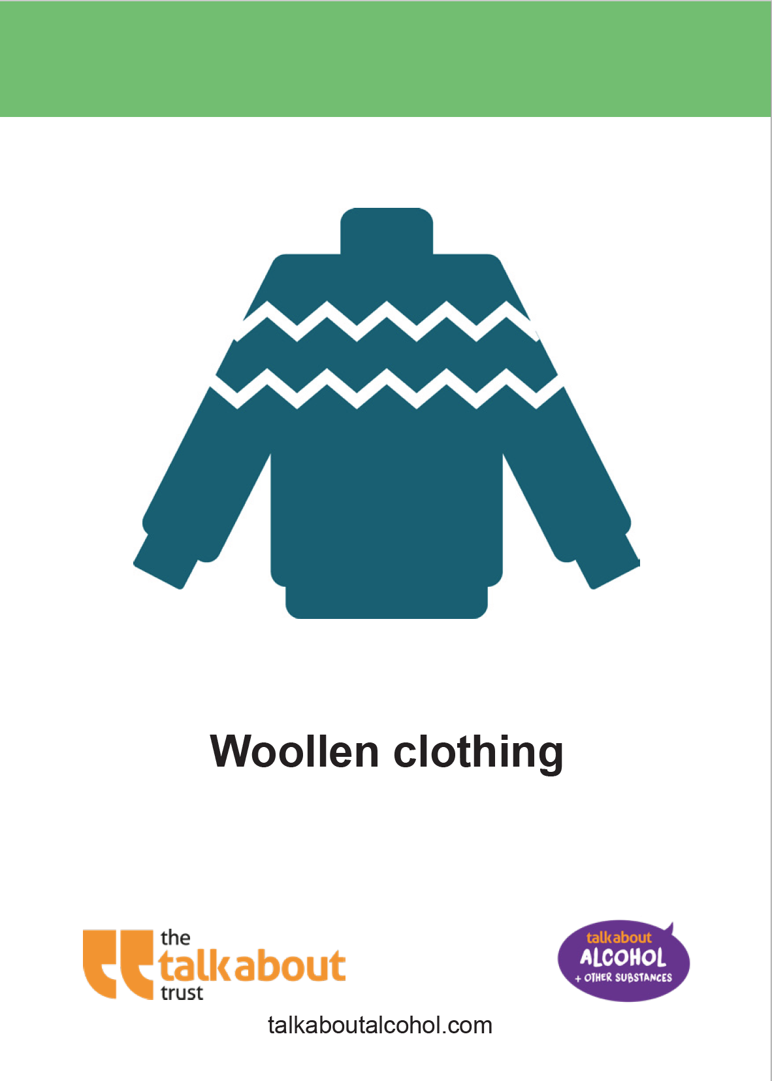
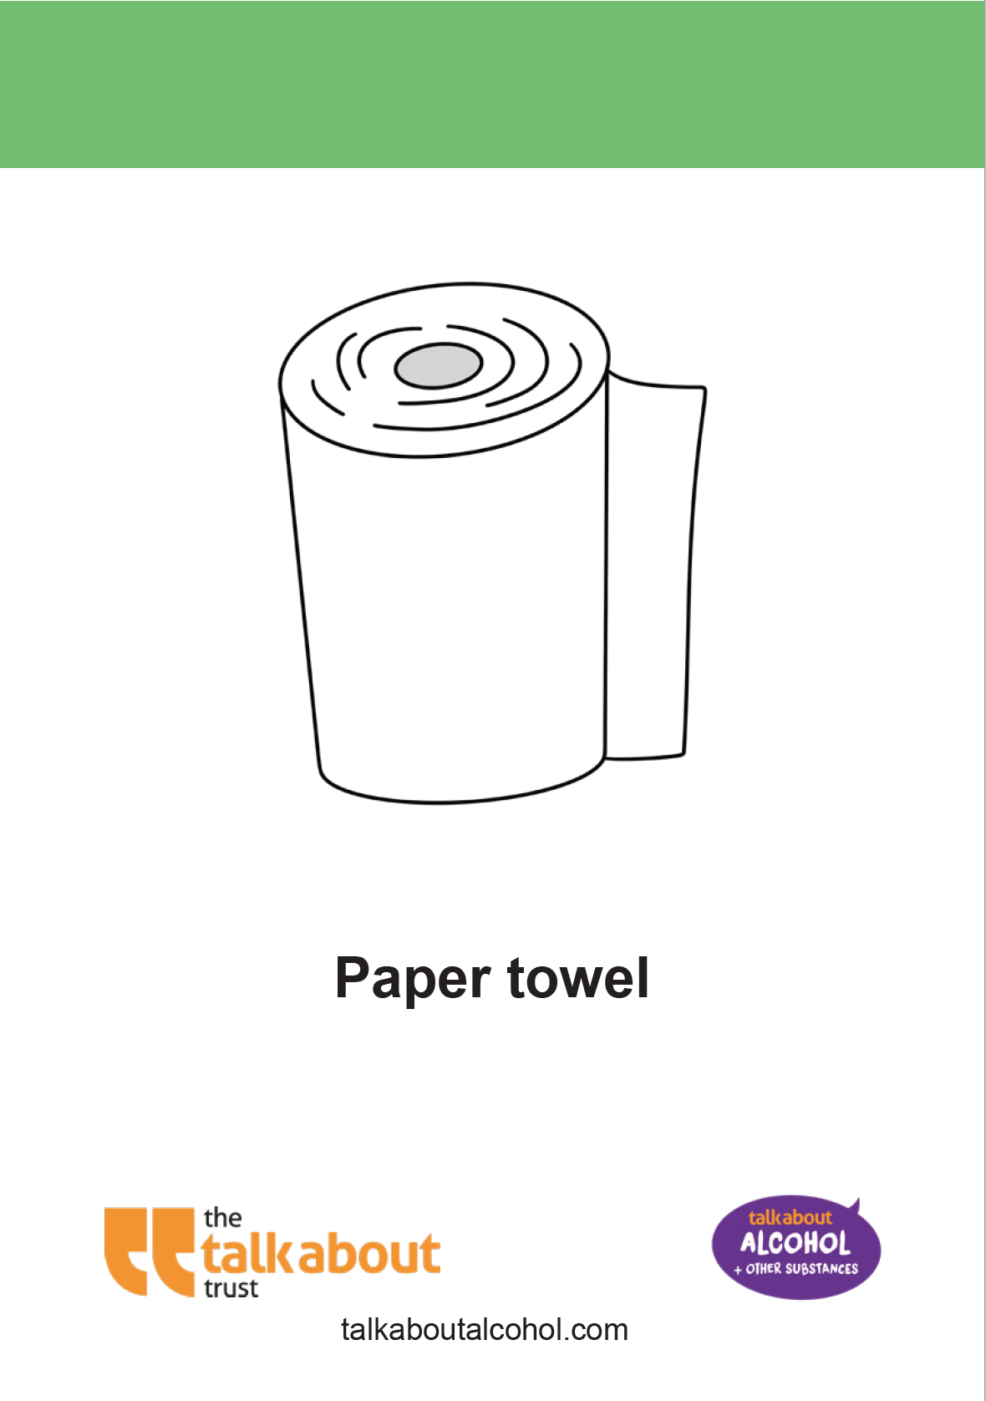
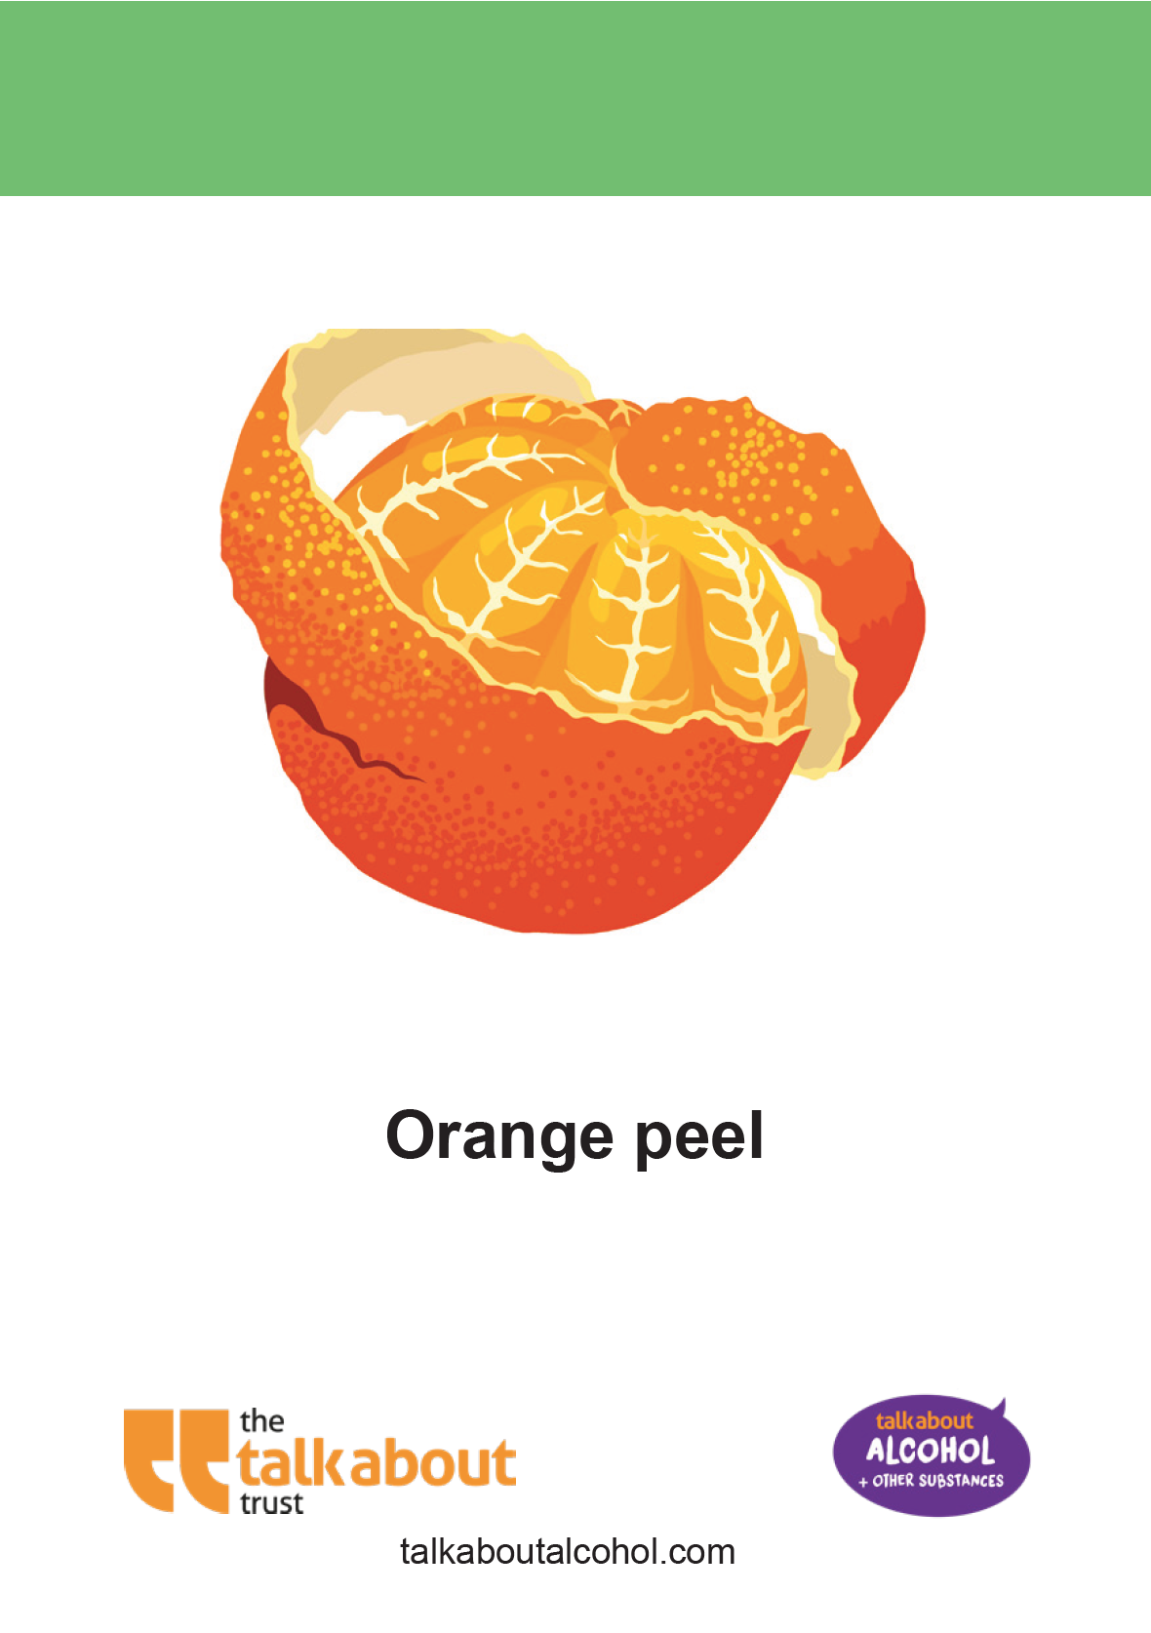
Environmental Continuum Activity

Slide 6
Environmental Continuum Activity: Answers
Notes:
Teacher Notes – Reveal the answers.

Slide 7
talk about | our rubbish and the environment
a) How do these facts make you feel?
b) Is there anything that surprised you?
c) How could we reduce the impact of waste on the environment?

