Slide 1


talk about |
vaping
The Environmental Impact of Vaping
In this activity, we will look at:
What vapes are made from
How vapes negatively impact the environment
What can adults do to limit the environmental impact of vapes.

Slide 2
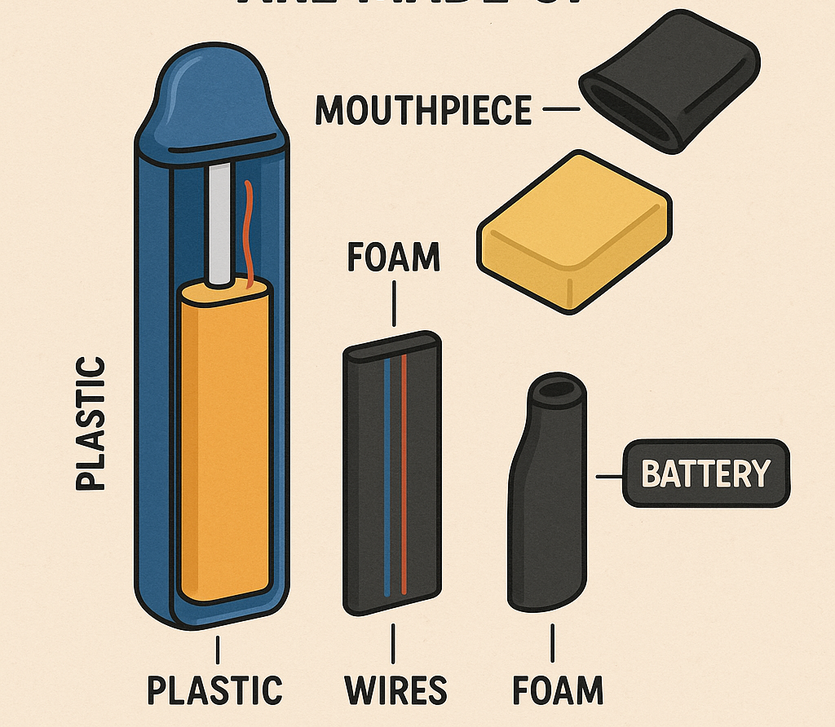

Vapes – what are they made from?
Vapes are sometimes called "e-cigarettes". The "e" stands for "electric".
Vapes are made from materials which are difficult to recycle such as: plastic, foam, aluminium and lithium.

Slide 3
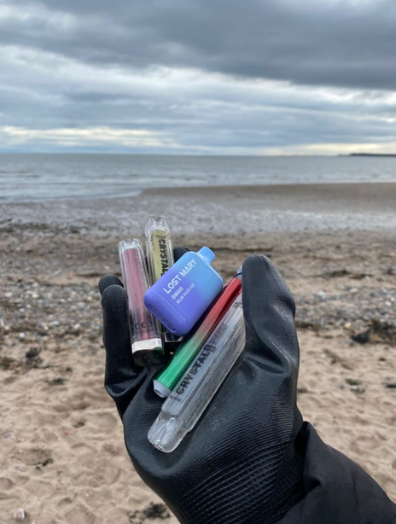
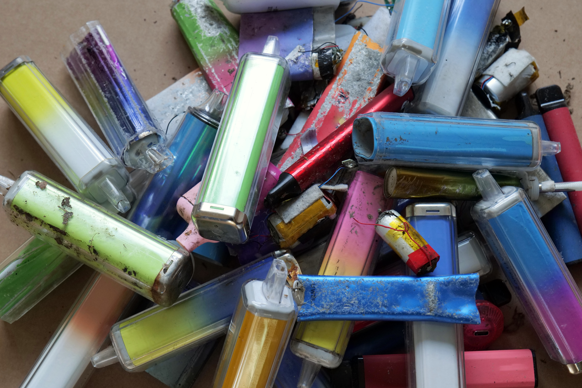
How vaping harms the environment
Around 8.2 million vapes are thrown away each week in the UK.
Enough to fill over 139 football pitches every year.
Vapes contain batteries, chemicals and hard to recycle plastics.
Many are dumped in landfill causing dangerous chemicals to pollute our soil, water and oceans.
The plastics and toxic waste affect birds and animals.
40 vapes go into landfill every 5 seconds.
Valuable metals and rare earths are wasted. Over 40 tonnes of lithium was thrown out with disposable vapes in the UK in 2024.
That’s enough to make batteries for 10,000 electric cars
This is part of the reason why since June 2025 any single use vapes are illegal.

Slide 4

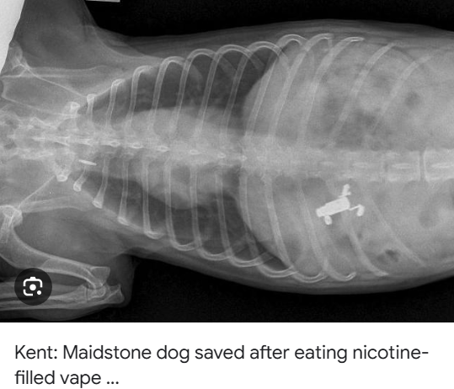
Vapes should never be put in a normal bin.
Do you know why?
1200 fires a year are caused by vapes
Animals and birds, our soil and sea are affected by the vapes in landfill
80% of the materials vapes are made from can be recycled!

Slide 5

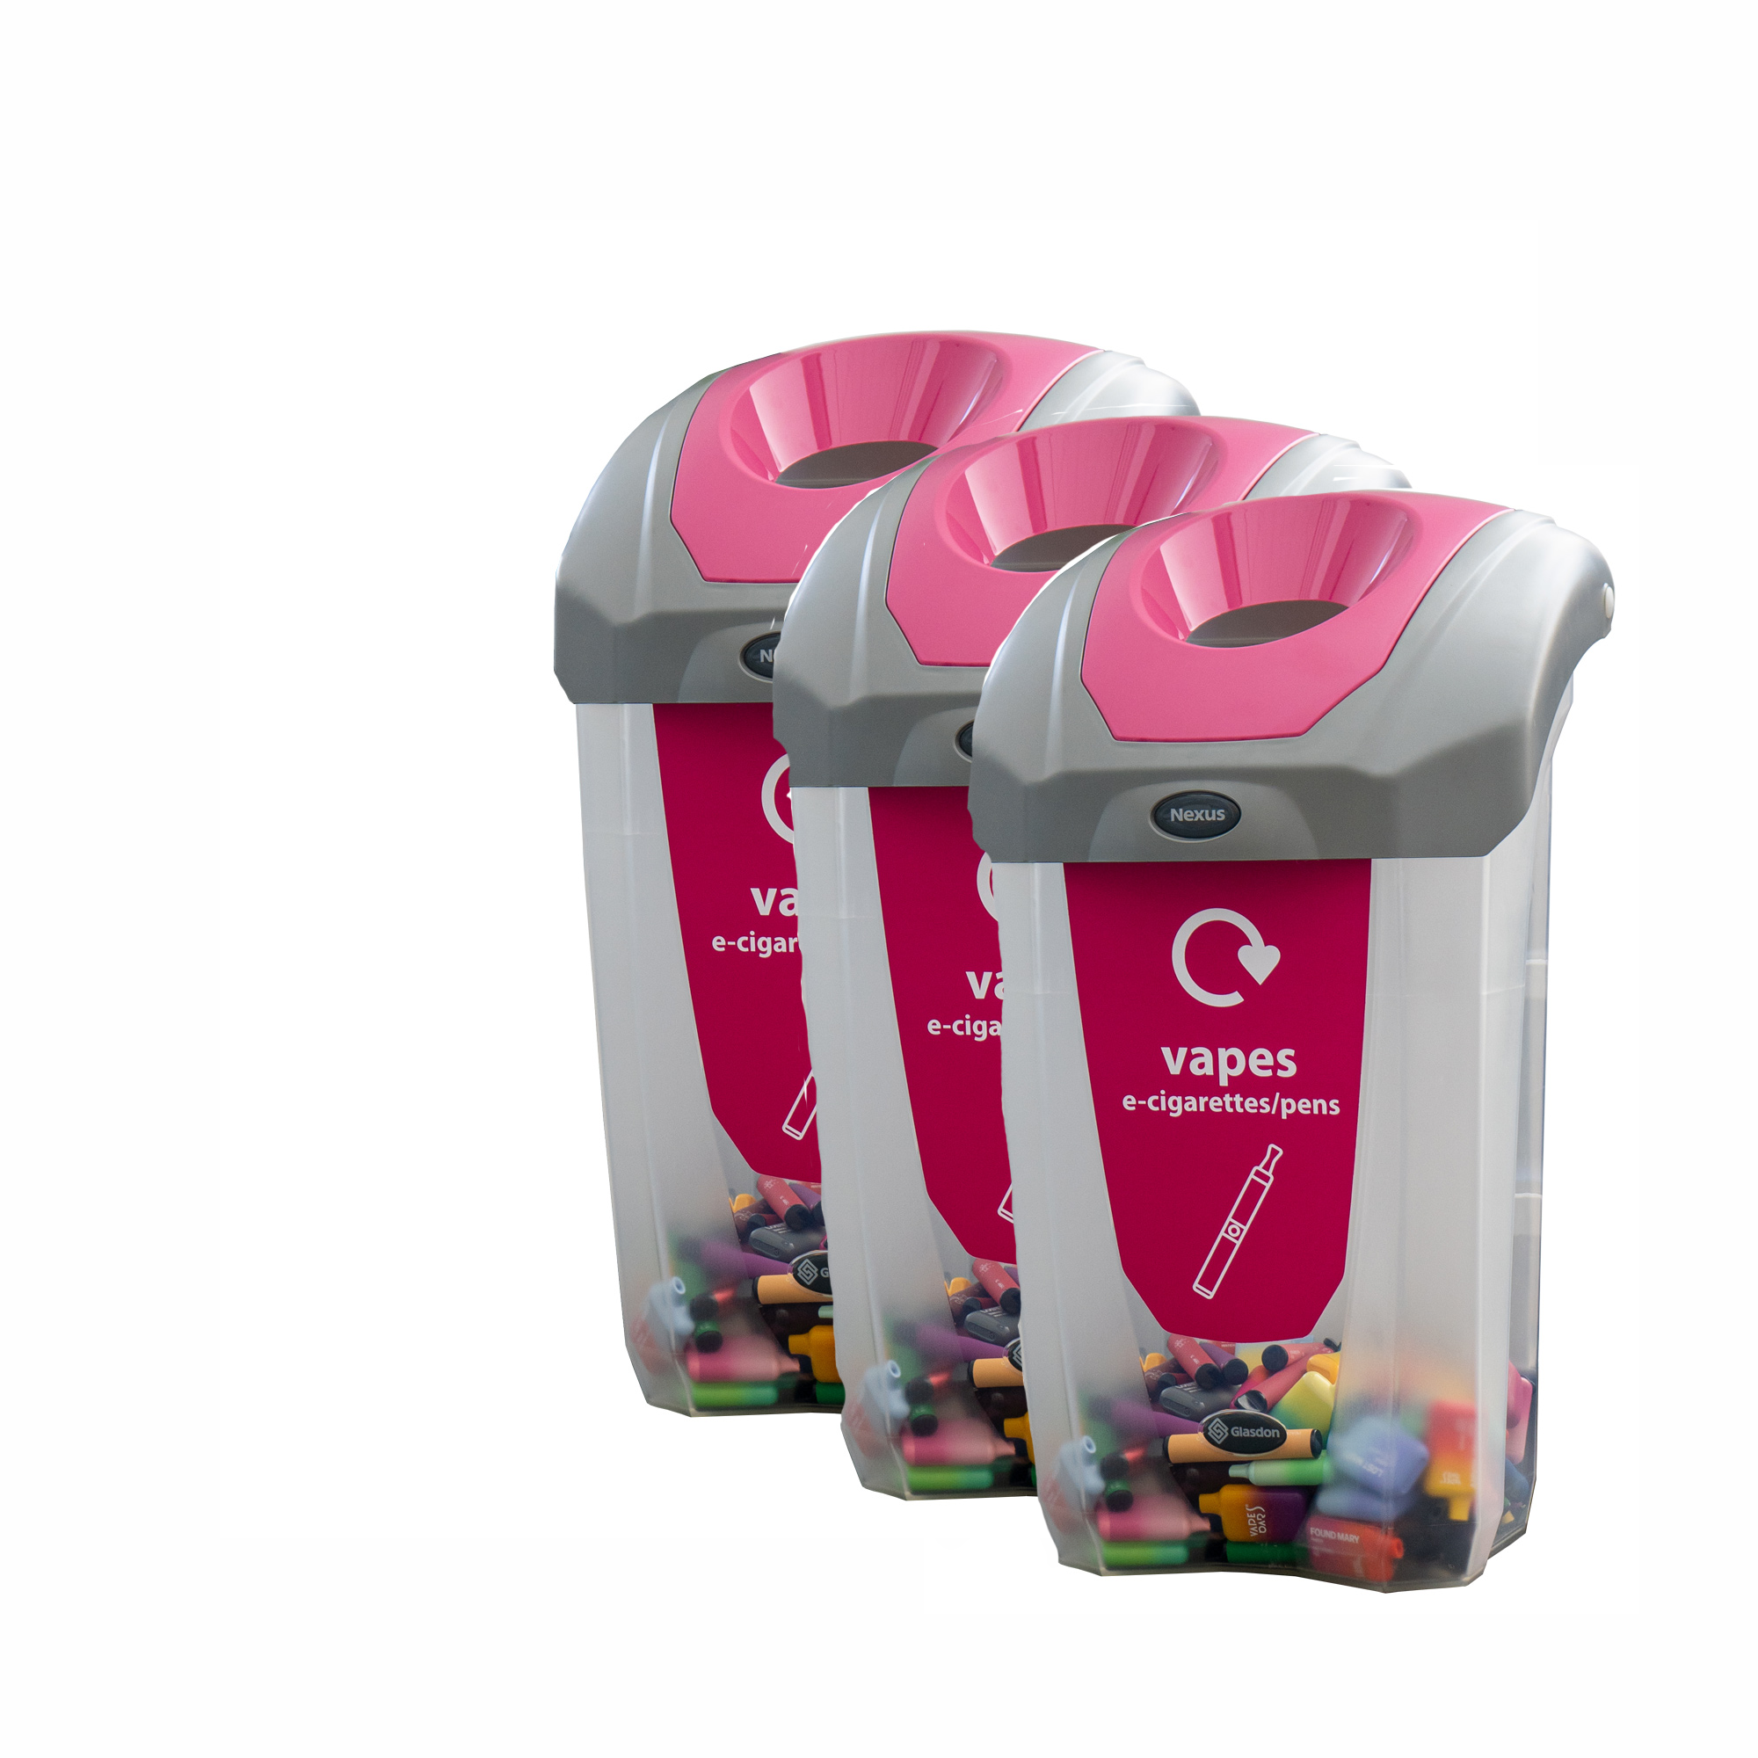
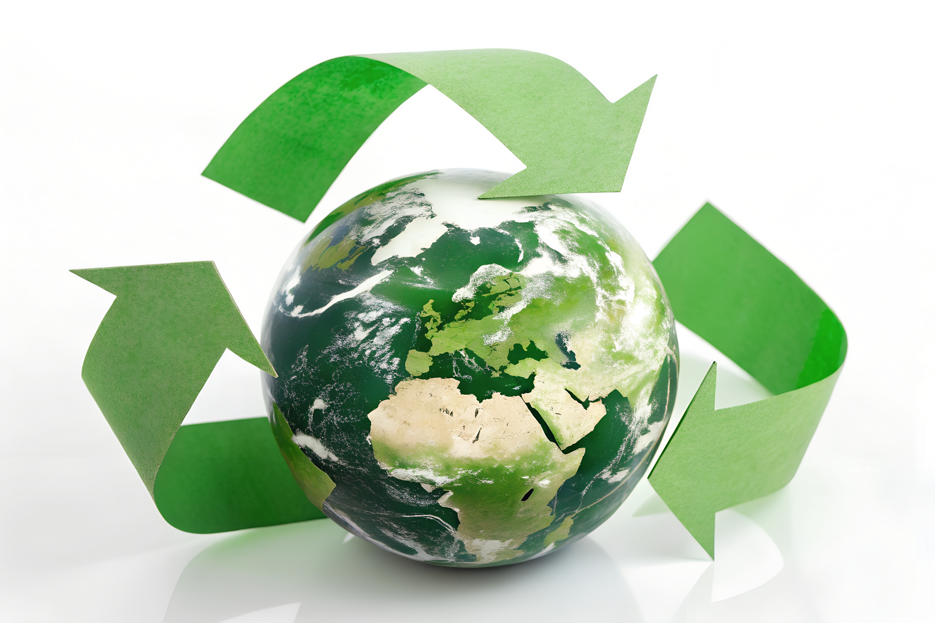
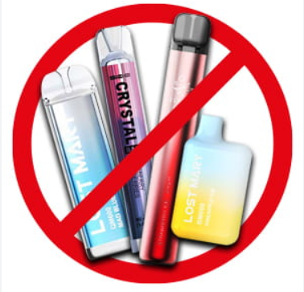

Think about vapes and the effects of plastic, batteries and chemicals in them on the environment, can you think of 3 things that could help reduce the negative impact?
Notes:
Teacher Notes – Teachers can print out this slide if appropriate.

Slide 6
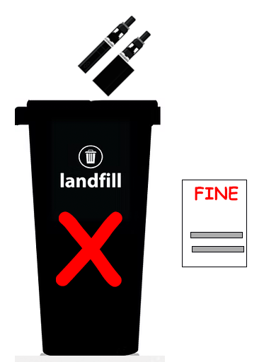
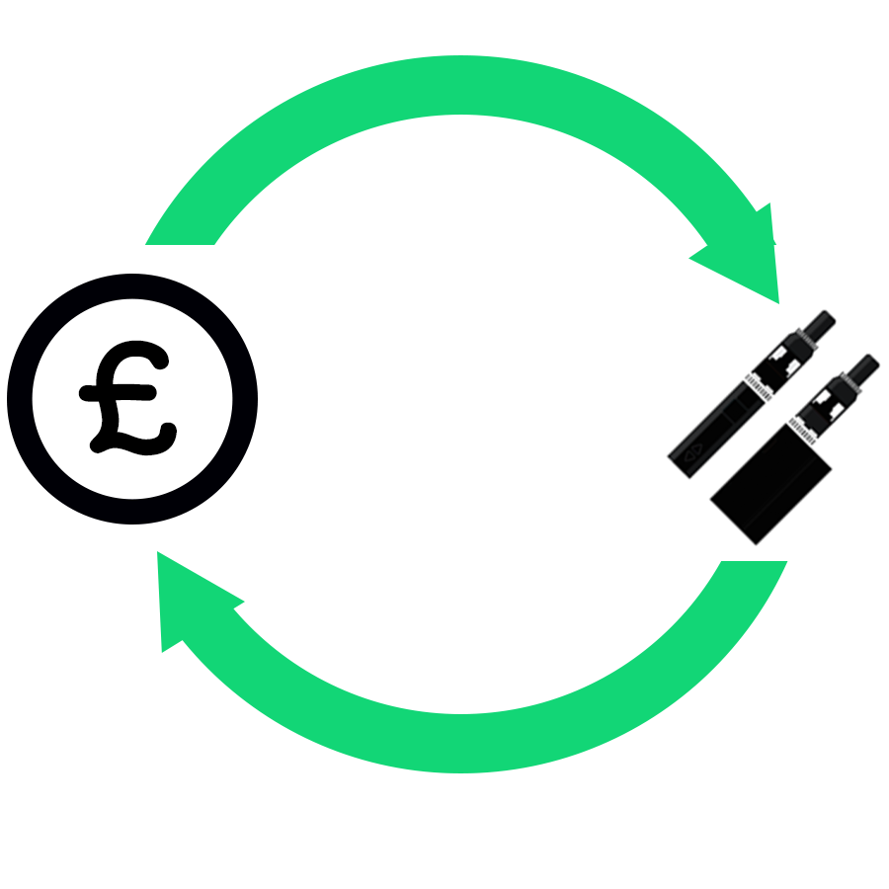

Possible solutions? What did you think of?
Make it easier for people to recycle vapes at shops and supermarkets
Give people money back if they return empty vapes to recycle
Have a fine for putting vapes/ ecigs into general waste or littering (like £80 for cigarettes​​)
​
Ensure vapes are made with fully recyclable or biodegradable materials
Make vape creators
pay for the cost of
the waste and
recycling
Don’t vape and help the planet, animals, the sea and soil!

Slide 7
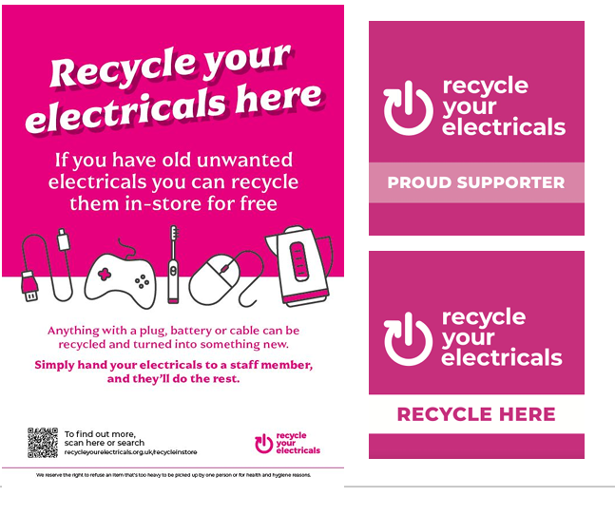
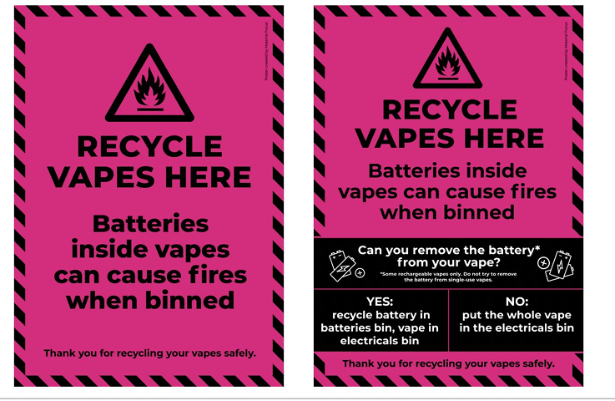

According to Recycle Your Electricals, almost 80% of materials in vapes can be recycled, and if every vape were properly recycled, we would have enough lithium to power 10,000 e-cars a year!

Slide 8
Possible solutions? What did you think of?
Imagine you rule the world for one day.
Your mission?
To make rules that protect the environment from the impact of vaping. Think like a leader, a scientist, and an activist.
Vaping doesn’t just affect your health - it affects the environment too.
Here are a few things to consider:
Disposable vapes contribute to plastic pollution and battery waste.
E-liquid pods and packaging create e-waste.
Manufacturing and shipping vapes produce carbon emissions.
Your Task:
Write or draw 3 - 5 rules or ideas to reduce the environmental harm caused by vaping.

Slide 9
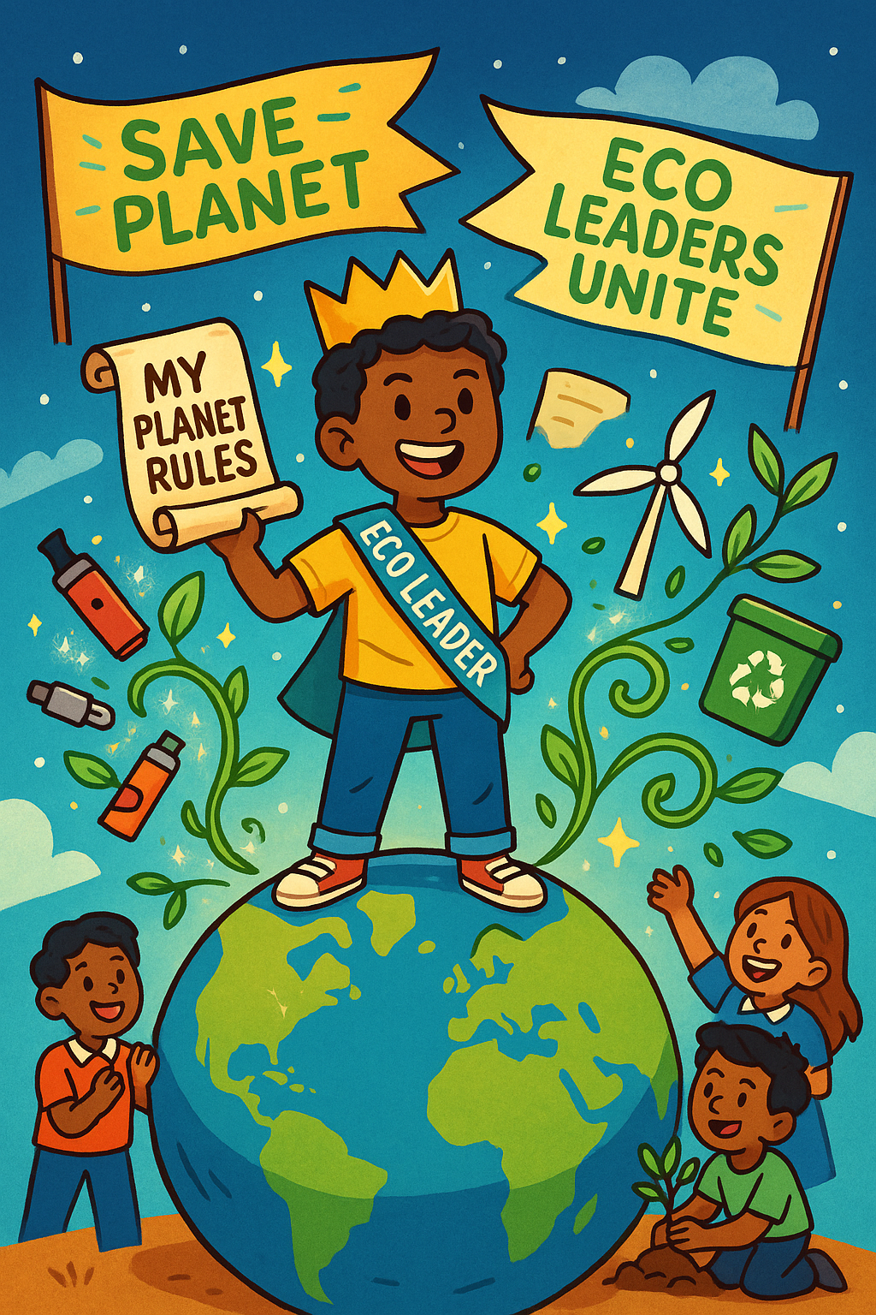
You rule the world for ONE day! Create three rules that will help tackle the environmental issues of vaping
My first rule is...
My second rule is...
My third rule is...
Notes:
Teacher Notes – Teachers can print out this slide if appropriate.

Slide 10
What can you remember?
Na
Na
Name two things you can remember about the impact of vaping on the environment.
Name two things that someone can do to limit the impact of vaping on the environment.

Slide 11
What can you remember?
Na
Na
Name two things you can remember about the impact of vaping on the environment:
Wildfires, dangerous chemicals being leaked into the soil/water, animals eat them, waste of important metals when not recycled
Name two things that someone can do to limit the impact of vaping on the environment.
Recycle vapes or choose not to vape!

