Slide 1


talk about |
healthy choices
Making Healthy Choices.
In this activity, we are going to design a shield that represents the values of making healthy choices.
A shield is used to protect knights in battle, but our healthy choices shield will be used to remind us how to protect our health!
The more we make healthy choices, the more our bodies stay strong, and our brains stay calm. Each part of your shield shows something that helps you stay healthy and feel good.

Slide 2


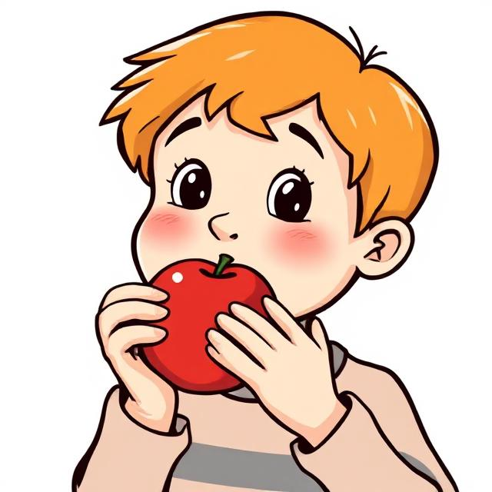
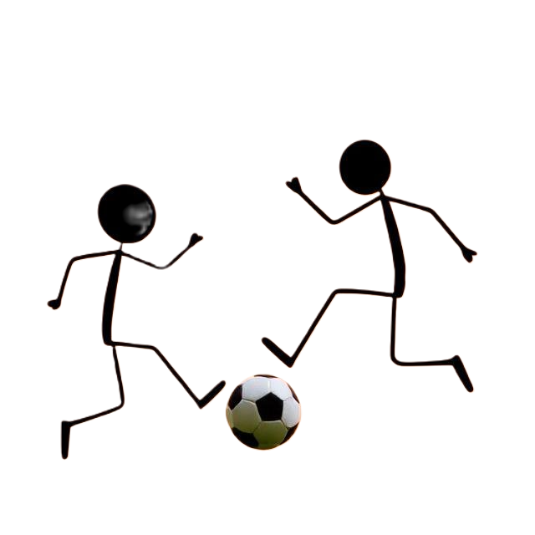
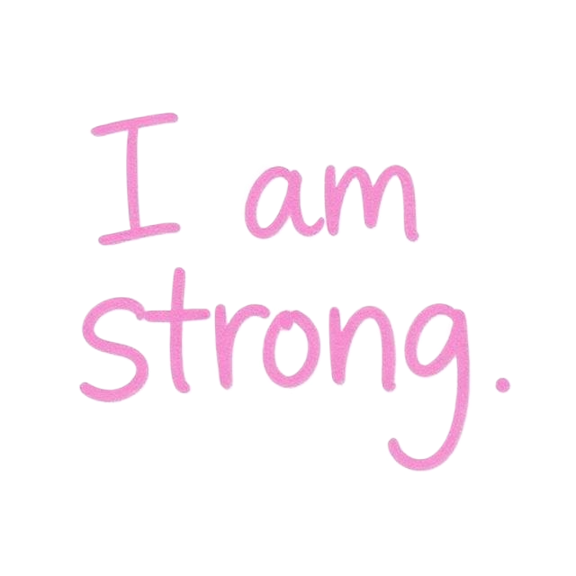

Here is an example to help you...
A Symbol of Strength
A Healthy Choice
A drawing of you and your friends making good choices
A Positive Message

Slide 3
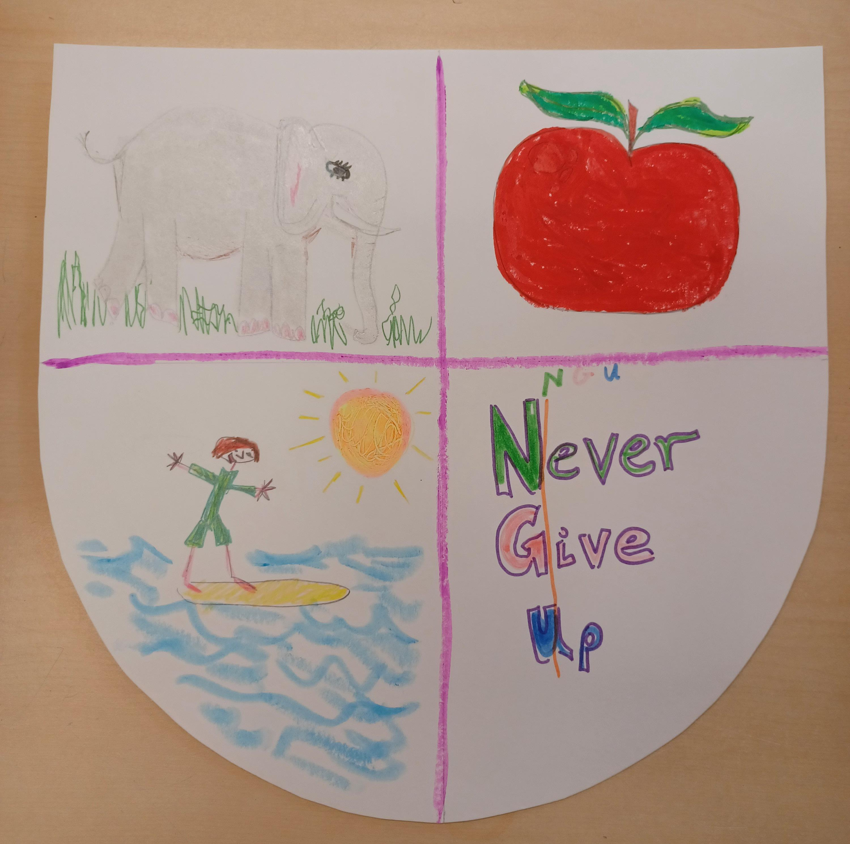

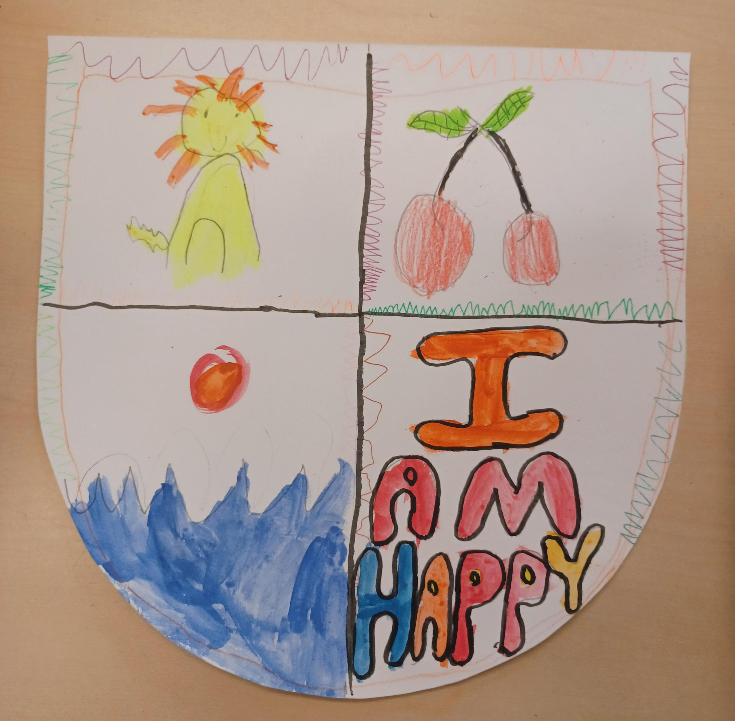
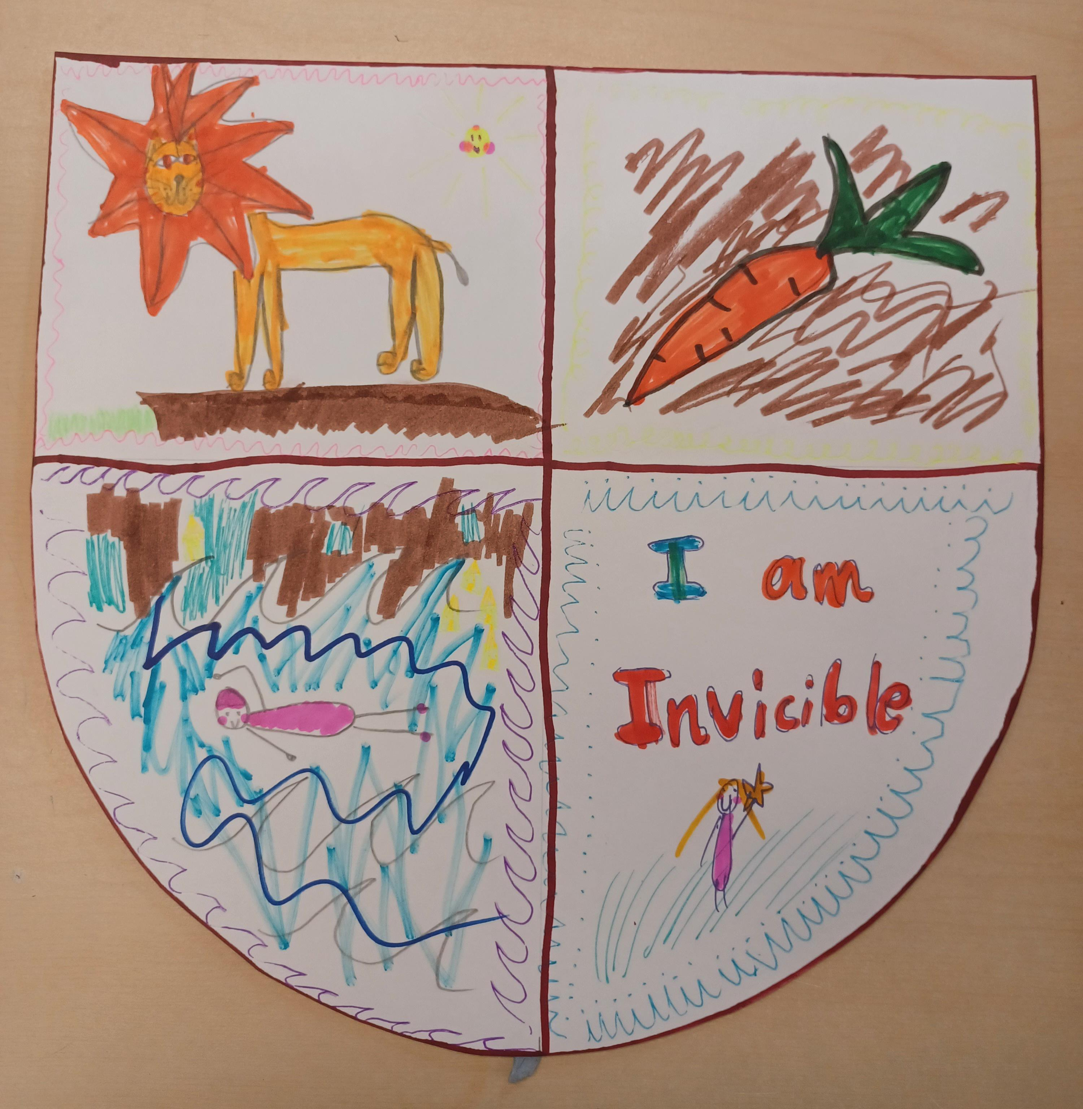
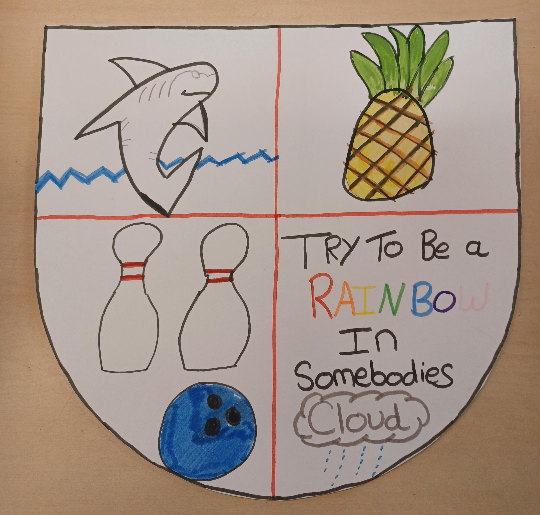
Here are some examples to help you...

Slide 4
A Symbol of Strength
A Healthy Choice
A drawing of you and your friends making good choices
A Positive Message
Notes:
Teacher Notes - Teachers can print slide.

Slide 5
Today we learnt that...
Making healthy choices helps keep our bodies strong and our minds calm .
When we do things that help us feel better - like playing, talking to a friend, or taking deep breaths - we’re helping ourselves stay calm and strong, even when things are hard.
Our Healthy Shield reminds us how to protect ourselves every day.

Slide 6

Today we learnt that...
Let's reflect...
What healthy choice did you include on your shield?
What helps you feel calm when you’re stressed or upset?
Who can you talk to when you need support?

Slide 7
If you are worried about anything we have talked about today, you can find support or information from Childline or talk to a trusted adult.
Childline has a website and a free, confidential telephone counselling service for children.
Call: 0800 1111 https://www.childline.org.uk/
Children aged 10+ can visit Kooth. Kooth is a free, safe, and anonymous online mental health and wellbeing platform. https://www.kooth.com/
Catch 22 - Works with children and young people of any age to help get them out of situations they're worried about, including County Lines. https://www.catch-22.org.uk/
YoungMinds – youngminds.org.uk (Great tips and support on mental health for young people and their families)
Need to talk?

