Slide 1


Talk About |
Healthy choices
Making Healthy Choices
On each slide are some everyday items or activities... some are healthier choices than others.
Go through each image and discuss whether how healthy or unhealthy they are.
Notes:
Teacher Notes - Each slide will show an item or an activity. Click to reveal an image one at a time. Ask the class: How healthy is this choice? Why? If the item is healthy, ask: “How does this help you stay strong, active, or happy?”. If the item is vaping-related, ask: “Why is this not a healthy choice? What harm can it cause?”.

Slide 2
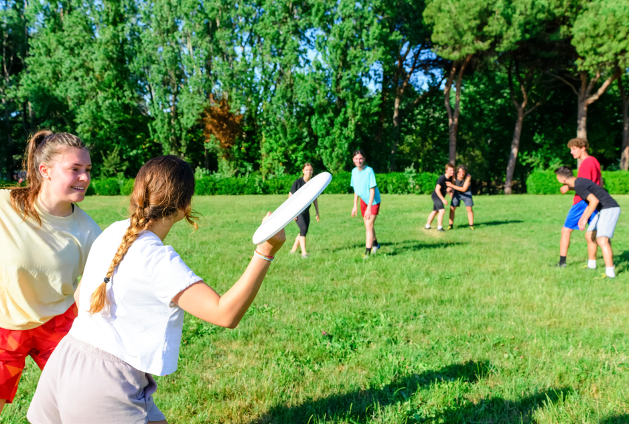
Playing outside with friends
Notes:
Teacher Notes – "Playing outside with friends" - Healthy. Playing outside often includes movement, running, climbing, riding a bike, or playing games, which helps keep the body strong, fit, and active. It’s a great way to exercise without even realising it. Being outdoors helps you feel happier and more relaxed. Sunshine and fresh air can boost your mood and energy, and help reduce stress or worry. When children play together, they practise teamwork, communication, problem-solving, and sharing. This helps them build friendships and feel connected.

Slide 3

Eating crisps
Notes:
Teacher Notes – "Eating crisps" - Unhealthy, although not always harmful. Let students know that eating crisps occasionally as a treat is okay, but crisps are not something we should eat every day. They are often high in salt, which can be bad for your heart if eaten too often. They don’t provide much nutrition; crisps won’t give us the vitamins, fibre, or energy we need to grow strong or stay active. Balance and Moderation: Emphasise that crisps aren’t “bad” on their own, but they should be part of a balanced diet, a regular snack.

Slide 4
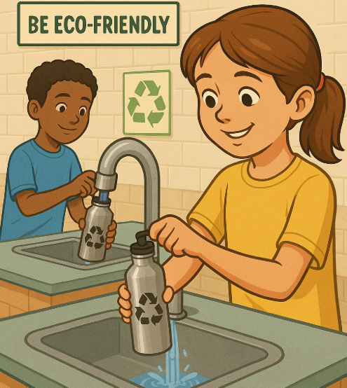
Drinking water
Notes:
Teacher Notes – "Drinking water" - Healthy. Water helps every part of the body work properly — including the brain, heart, muscles, and skin. It keeps you hydrated, which means your body has the right amount of fluid to stay healthy and alert. Water helps with concentration and staying focused at school. If you’re feeling tired or getting a headache, you might just need a drink of water. It also helps with digestion and keeps your body cool during exercise or warm days.

Slide 5

Smoking cigarettes
Notes:
Teacher Notes – "Smoking cigarettes" - Unhealthy. Cigarettes contain a drug called nicotine, which is very addictive. This means once people start, it’s hard to stop, even when they know it’s bad for them. Smoking can make it hard to breathe, cause bad breath, yellow teeth, and make someone tired more easily when doing sport or playing. Remind students that it is illegal to sell cigarettes to anyone under 18 and that smoking is not safe at any age.

Slide 6
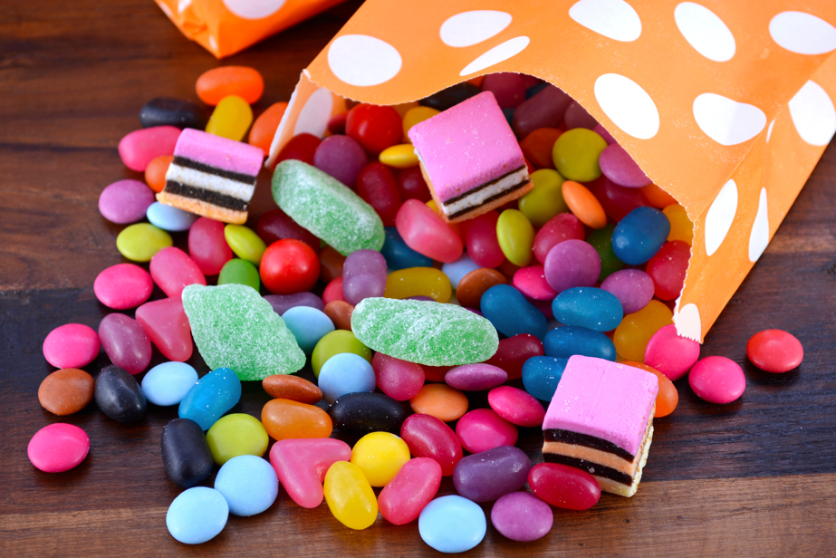
Eating lots of sweets
Notes:
Teacher Notes – "Eating sweets" - Unhealthy, although not always harmful. Let students know that eating sweets occasionally as a treat is okay, but sweets are not something we should eat every day. They are often high in sugar, which can be bad for your heart if eaten too often. They don’t provide much nutrition; sweets won’t give us the vitamins, fibre, or energy we need to grow strong or stay active. Balance and Moderation: Emphasise that sweets aren’t “bad” on their own, but they should be part of a balanced diet, not a regular snack.

Slide 7

Vaping
Notes:
Teacher Notes – "Vaping" Unhealthy. It is illegal for anyone under 18 to buy, possess, or use a vape in the UK. Vaping can be harmful to a person's lungs and heart and contains nicotine (even "zero-nicotine" vapes) which is highly addictive and could lead to nicotine addiction.

Slide 8

Drinking An Energy Drink
Notes:
Teacher Notes – "Drinking an energy drink" - Unhealthy for children. Energy drinks often contain high amounts of caffeine and added sugar, which are drugs. These can give people a short burst of energy, but afterwards, people might feel tired, anxious, or have trouble concentrating. Too much caffeine can also affect your heart and sleep. These drinks may look fun or cool, but they don’t support your body or brain in a healthy way - especially for children. It is the law that individuals must be 16+ to purchase energy drinks.

Slide 9
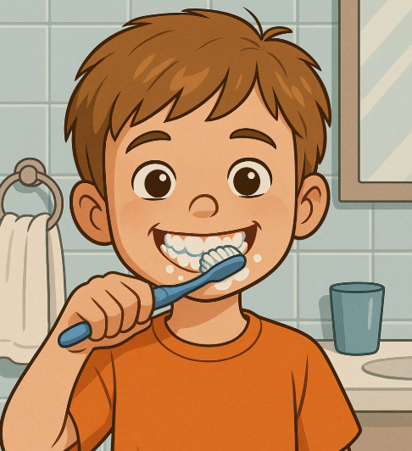
Teeth Cleaning
Notes:
Teacher Notes – "Teeth cleaning" – Healthy. Cleaning your teeth twice a day helps keep your mouth healthy. Brushing removes plaque and food that can cause holes in your teeth, bad breath, and gum disease. Healthy teeth help you chew your food, speak clearly, and smile with confidence. Using toothpaste with fluoride makes your teeth stronger. Looking after your teeth every day supports your whole-body health, and helps prevent painful trips to the dentist. However, overbrushing can cause enamel erosion.

Slide 10

Going on a walk
Notes:
Teacher Notes – "Going on a walk" - Healthy. Going on a walk gets your body moving. It helps build stronger muscles and bones, improves heart health, and supports better posture and balance; even a short walk makes a difference.

Slide 11

Eating fruit
Notes:
Teacher Notes – "Eating fruit" - Healthy. Fruit includes vitamins, minerals, and natural energy that help your body stay strong and your brain stay healthy. While fruit tastes sweet, it’s a natural kind of sugar, not the same as the added sugars in sweets or fizzy drinks. It gives you a boost without the harmful effects.

Slide 12
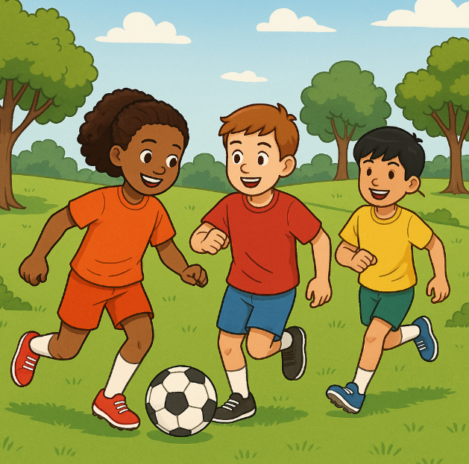
Playing sport
Notes:
Teacher Notes – "Playing sport" - Healthy. Playing sport helps keep your body strong, fit, and flexible. It strengthens your heart, muscles, and bones and helps you build stamina. Sport also improves your mental health. It can boost your mood, reduce stress, and help you feel more confident. Being active during the day helps you sleep better at night and stay focused in school. Sport helps you make new friends, learn about teamwork, and feel part of a group.

Slide 13

Gaming
Notes:
Teacher Notes – "Online gaming" – Mixed. Online gaming can be a fun way to relax, be creative, and connect with friends. Some games can help build problem-solving skills and teamwork. But playing too much can affect sleep, schoolwork, and mental health. Some games also have online chats, which can expose children to unkind or unsafe behaviour. It’s important to take breaks, balance screen time with other activities, and talk to a trusted adult if anything online makes you feel uncomfortable.

Slide 14
Today we learnt...
How to tell the difference between healthy and unhealthy behaviours.
That healthy choices - like eating well, being active, and resting - help us feel strong, focused, and happy.
That unhealthy choices, like vaping or drinking energy drinks, can harm our bodies and minds.

Slide 15
Today we learnt...
Let's reflect...
What’s one healthy habit you already do that helps you feel good?
Can you think of a new healthy choice you might try after today?
Why is it important to make positive choices every day?

Slide 16

If you are worried about anything we have talked about today, you can find support or information from Childline or talk to a trusted adult.
Childline has a website and a free, confidential telephone counselling service for children. Call: 0800 1111
https://www.childline.org.uk/
Children aged 10+ can visit Kooth. Kooth is a free, safe, and anonymous online mental health and wellbeing platform. https://www.kooth.com/
YoungMinds – youngminds.org.uk (Great tips and support on mental health for young people and their families)
Need to talk?

