Slide 1



talk about |
vaping
What can help us to stay calm and boost our mood?
Some people think that vaping helps them stay calm, but this only lasts a short time.
In this activity we will think of different ways to make ourselves feel good long-term, and in a healthy way.

Slide 2

What do we need to help us breathe?
Activity:
Take a deep breath in through our nose, hold it for a moment... and now slowly breathe out through your mouth.
When we breathe in, what is it that our body needs from the air?​
Oxygen
And what do we breathe out? ​
Carbon Dioxide
What vital organs keep us alive through breathing? ​
Our lungs... that's why it's so important that we keep them clean and healthy.

Slide 3
What do we need to help us breathe?
How does the body feel after taking those deep breaths
Calm, relaxed
Did you know deep breathing slows the heart rate, helps our body feel safe and calm, and
helps us focus?!

Slide 4


Working on your own or in small groups, think about simple things that could help someone reduce their anxiety or stress.

Slide 5

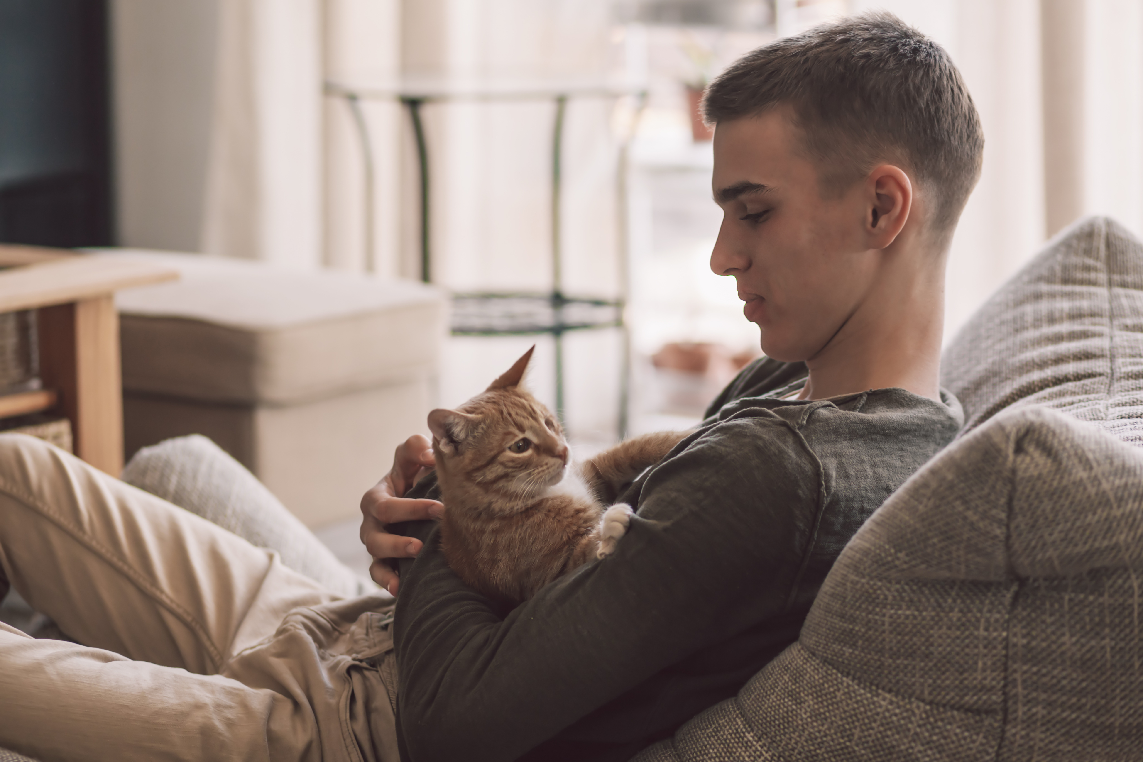

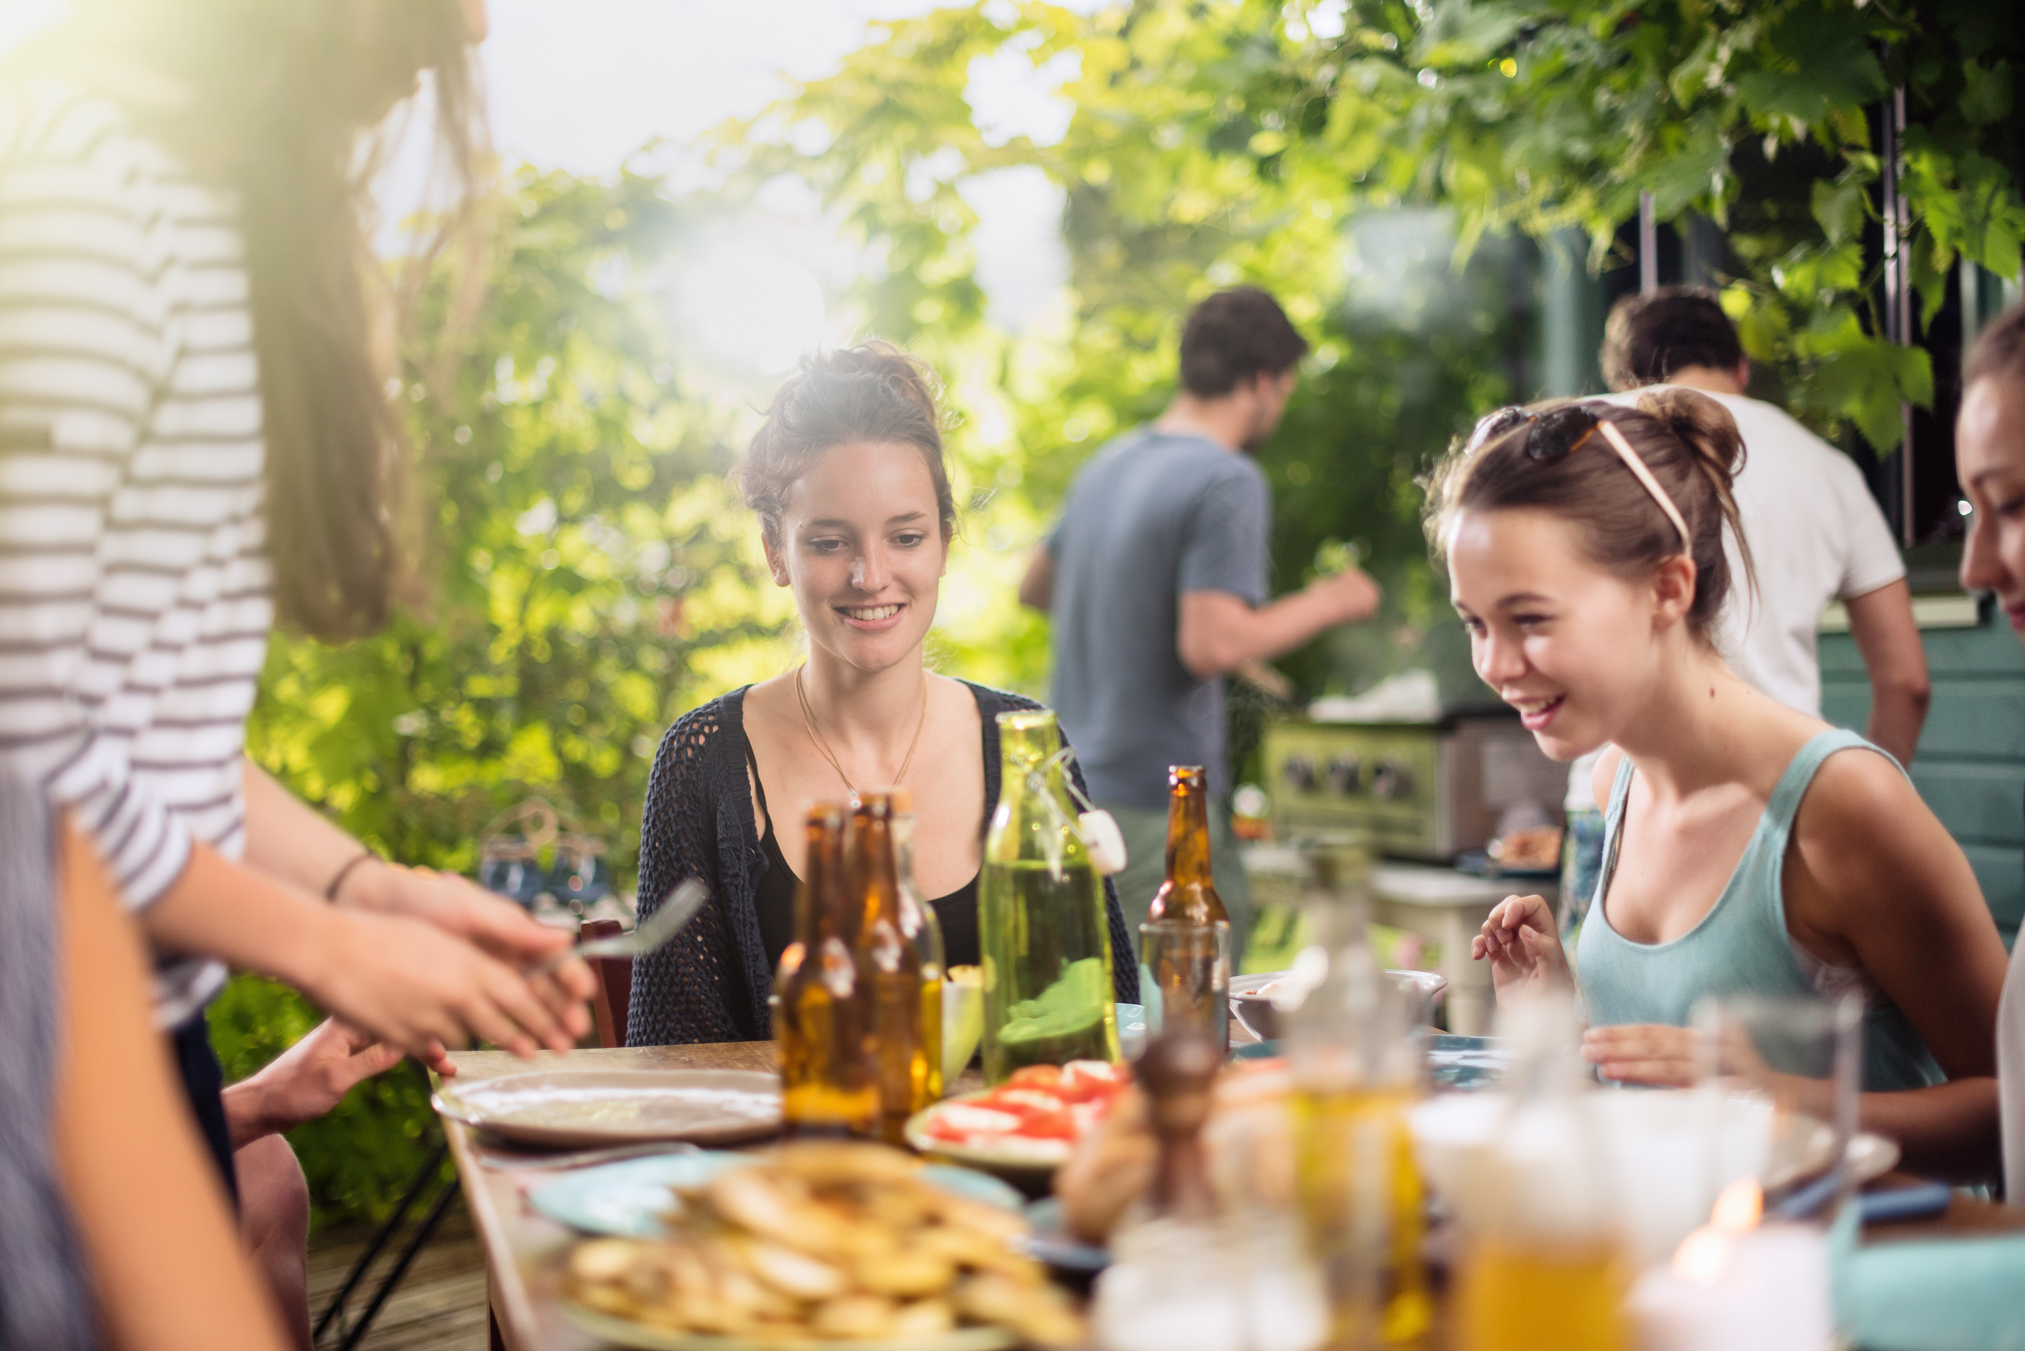
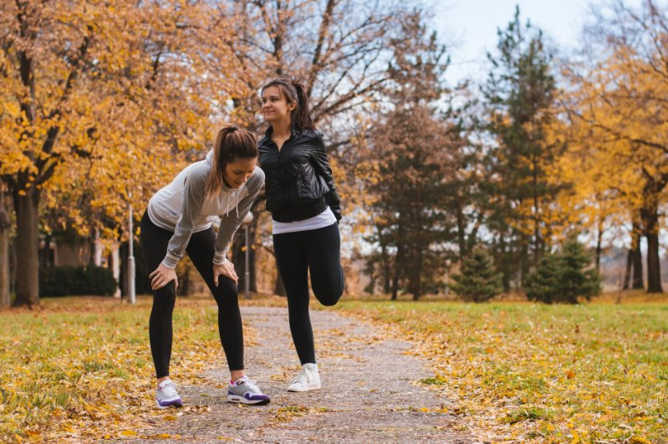
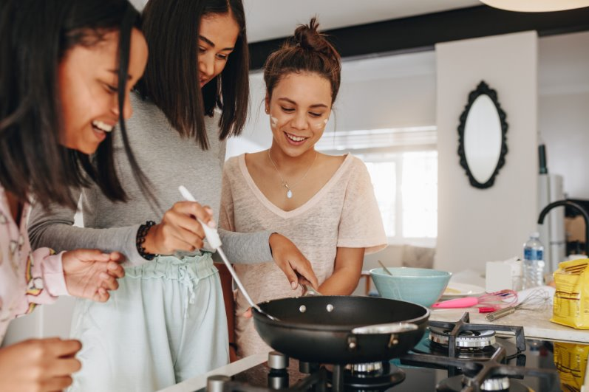

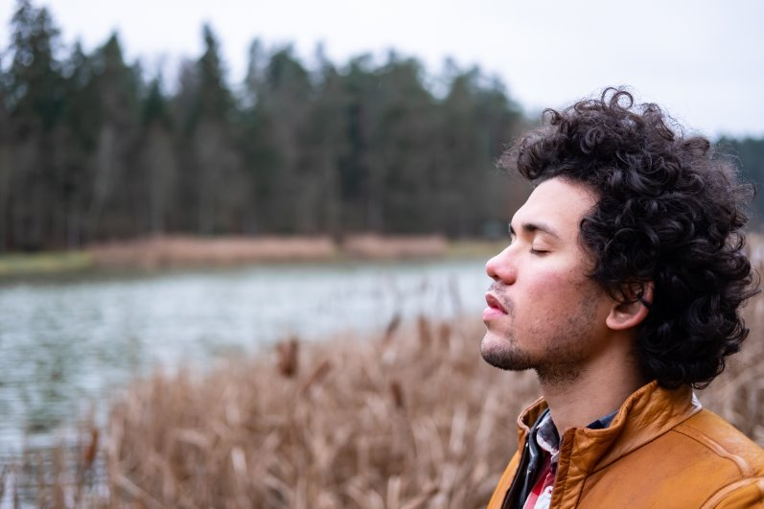
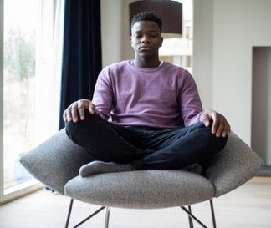

Things to chill out like colouring or drawing​​​​​​​​​​​
Cuddles with a pet
Listening to your favourite music
What are good ways for someone to feel calm and naturally boost their mood?
Relaxing with friends or family
Exercise (e.g. football or dance)
Learning a new skill(e.g. cooking/baking)
Doing things for others (e.g. volunteering)
Going out in nature
Taking 5 deep breaths

Slide 6
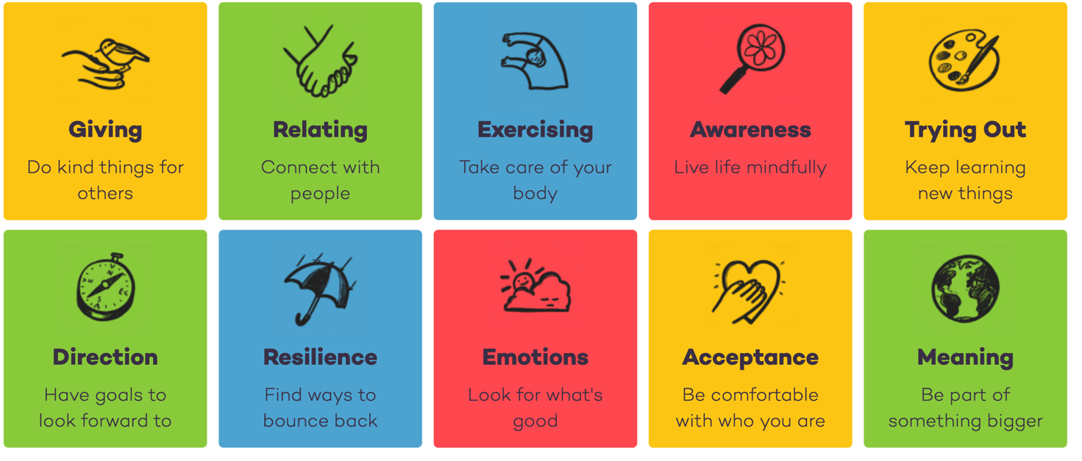
Key To Living
Things that make us feel happier!
G R E A T
D R E A M
SOURCE: actionforhappiness.org/
Notes:
Teacher Notes – Teachers can discuss this slide and make connections between any school values or buddy systems. Teachers could ask students for examples of different ways they can give or build resilience, for example. They could use the ideas from the last slide to help them. Be mindful that some children may feel that they don’t have any friends to connect with. Highlight to students that it is their responsibility to be kind and inclusive to everyone.

Slide 7

Reflect:
Vaping is not a healthy way to stay calm. Can you name two natural and healthy activities that help us feel relaxed and happy?
Connecting with others, being active, being kind to others, and doing things we enjoy are the best ways to care for my body and mind.
You can make positive choices to look after your wellbeing.

Slide 8

If you are worried about anything we have talked about today, you can find support or information from Childline or talk to a trusted adult.
Childline – Call 0800 1111 or visit childline.org.uk (Free, private, and available any time to talk about anything)
YoungMinds – youngminds.org.uk (Great tips and support on mental health for young people and their families)
BBC Own It – bbc.co.uk/ownit (Advice for being happy, healthy and safe online and offline)
Kooth - https://www.kooth.com/ (age 10+ - mental health tips and anonymous mental health support)
Need to talk?

