Slide 1


vaping
talk about |
Conscience Alley and role play
Resisting peer pressure
Sometimes, when we are put in a situation that makes us feel stressed, we might not know what to do. We can have lots of different thoughts and might find it difficult to make a good decision.
Read through the scenario on the next slide and help the character decide what they should do...
Notes:
Teacher Notes - Teachers should read through one of the scenarios from slides 2-5 (either Jack, Sophia, Samir, or Katie). The students are tasked with thinking of the reasons why the character should, or should not, try the vape. This is a think, pair, share activity which is used to scaffold the next activity.

Slide 2
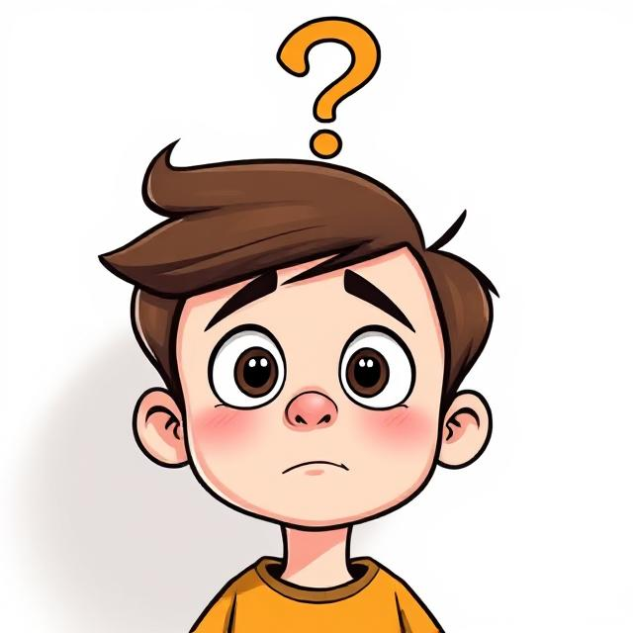

In pairs, think of all the reasons why Jack should, or should not try the vape.
For example:
"Jack should not try the vape because he knows that vaping can be harmful"
"Jack should try the vape because he doesn't want to let his friend down"
Activity: Conscience Alley Role Play
Jack and Molly are playing at Molly’s house after school.
Molly’s mum vapes and leaves her vape in one of the kitchen drawers.
Molly says, “Why don’t we try my mums vape? She does it all the time so I’m sure it’s okay, it makes these big clouds when you blow out, come on, it will be fun!”.
Jack knows that vapes are harmful for children but doesn’t want to disappoint his friend.
What should he do?
Learning
Digital
detox​

Slide 3
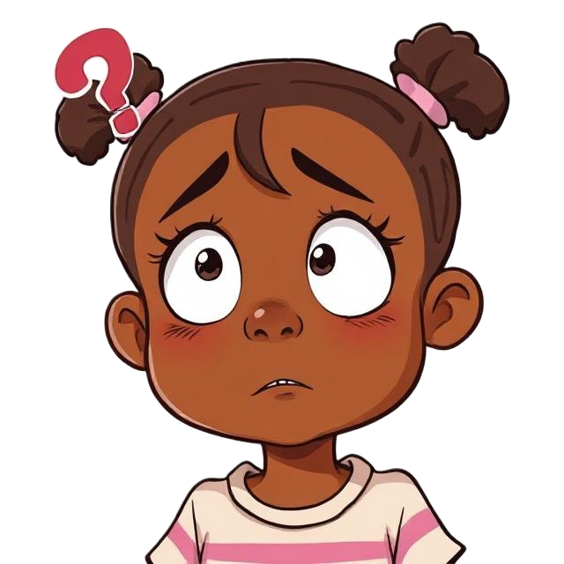
In pairs, think of all the reasons why Sophia should, or should not try the vape.
For example:
"Sophia should not try the vape because she knows that vaping can be harmful"
"Sophia should try the vape because she doesn't want to let his friend down"
Activity: Conscience Alley Role Play
Sophia is walking through the park on her way home from school. She notices something shiny near the bench and picks it up - it’s a vape.
Her friend Emma, who’s with her, says, “Cool! That’s a vape! I’ve seen people use those on YouTube. We should try it - just once.”
Sophia remembers hearing in school that vapes can be dangerous, especially for kids. But Emma seems excited, and Sophie doesn’t want to look boring or scared.
What should Sophia do?
Learning
Digital
detox​

Slide 4
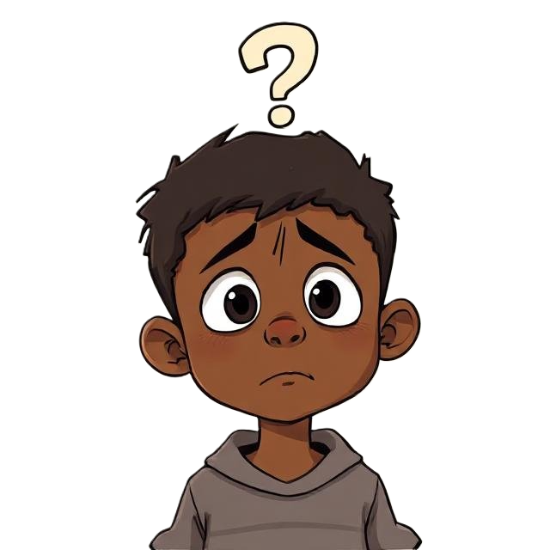
In pairs, think of all the reasons why Samir should, or should not try the vape.
For example:
"Samir should not try the vape because he knows that vaping can be harmful"
"Samir should try the vape because he doesn't want to let his friend down"
Activity: Conscience Alley Role Play
Samir is in his older brother’s room, looking for a phone charger. While searching the drawer, he finds a vape.
A few minutes later, his brother walks in and sees Samir holding it. “Hey, that’s mine,” he says. “It’s not a big deal. I only use it sometimes - it’s not like smoking. Do you want to try it?”
Samir feels nervous. He trusts his brother but also remembers a school assembly where the nurse talked about how vapes can harm lungs and brain development in young people.
What should Samir do?
Learning
Digital
detox​

Slide 5
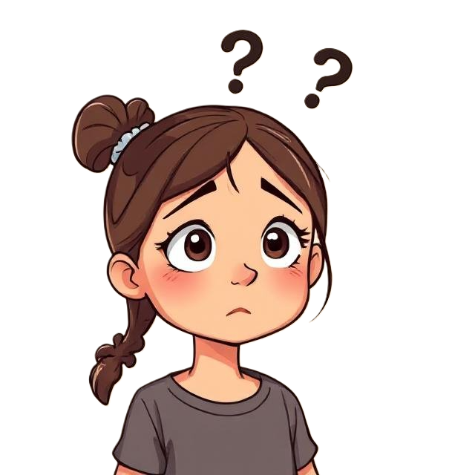
In pairs, think of all the reasons why Katie should, or should not try the vape.
For example:
"Katie should not try the vape because she knows that vaping can be harmful"
"Katie should try the vape because she doesn't want to let his friend down"
Activity: Conscience Alley Role Play
During break time, Katie is hanging out near the school gates when an older teen from the neighbourhood, Jay, walks over.
Jay is well-known, always dressed in the latest clothes, and seems to have money to spend.
Jay nods at Katie and says, “Hey, you’re cool. You want one of these?” Jay pulls out a vape from his jacket and hands it to Katie. “Don’t worry, it’s free. First one’s always free. I’ve got loads.”
Katie hesitates. She's never vaped before, and she doesn’t really know Jay, but Jay seems friendly and confident.
Jay smiles and adds, “If you ever need more - or anything else - I can hook you up. Easy.”
Learning
Digital
detox​
What are some warnings signs for Katie which tell her that Jay does not have good intentions? What should Katie do?

Slide 6
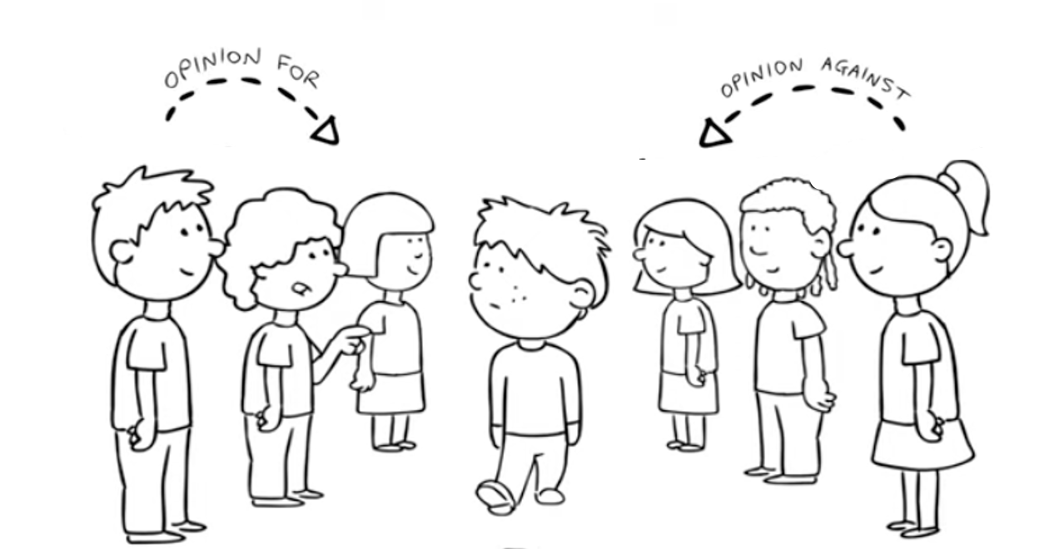

Activity: Conscience Alley Role Play
Instructions:
Stand in two equal lines opposite each other
One person will be Jack/Sophia/Samir/Katie depending on the scenario the class has chosen. This person will walk down the middle asking each person what they should do.
One side, group A, should take it in turns shout out one reason each why the character should refuse the offer in the role play
The other side, group B, should take it in turns shout out one reason each why the volunteer should say yes to the offer in the role play
Notes:
Teacher Notes - This is a whole-class activity. First, divide the group into two equal sections, asking them to face each other about a meter apart. One side will Group "A" and the other will be called the Group "B". Ask for a volunteer to walk down the alley who will be the one facing peer pressure. For more information, please see the following video: https://www.youtube.com/watch?v=-Hs0LirW9v8

Slide 7
What could your character say to leave the situation quickly?
I think my mum is calling me, I have to answer her!
I don't have a phone, so I can't stay out.
That's not something I want to do.
I have to go, I can't be home too late.
I just remembered that I have sports/dance practice tonight, so I need to leave.

Slide 8

How to recognise peer pressure and the risks it can bring
Ways to say "no" confidently and stand by your values
The importance of having a plan when faced with tough choices
How to support each other in doing what’s right
What have you learnt today?
You are strong enough to say no
You don’t have to impress anyone - your health and future matter most
Surround yourself with trusted friends who respect your decisions
If you ever feel unsure, talk to an adult you trust
Remember: Doing the right thing is always braver than following the crowd.

Slide 9

If you are worried about anything we have talked about today, you can find support or information from Childline or talk to a trusted adult.
Childline has a website and a free, confidential telephone counselling service for children. Call: 0800 1111
https://www.childline.org.uk/
Children aged 10+ can visit Kooth. Kooth is a free, safe, and anonymous online mental health and wellbeing platform.
https://www.kooth.com/
Catch 22 - Works with children and young people of any age to help get them out of situations they're worried about, including County Lines.
https://www.catch-22.org.uk/
YoungMinds – youngminds.org.uk
(Great tips and support on mental health for young people and their families)
Need to talk?

