Slide 1


talk about |
vaping
How does vaping affect someone's health?
Vapes are a newer product than cigarettes, which means scientists are still learning about how they affect our health.
Although we don't know everything yet, we already have some understanding of the health risks, especially for children and young people.

Slide 2
talk about |
vaping
How does vaping affect someone's health?
In this activity, you'll look at a group of emojis that give clues about what vaping might do to the body. Your job is to match the emojis to possible health effects. Let’s see how many you can figure out.

Slide 3
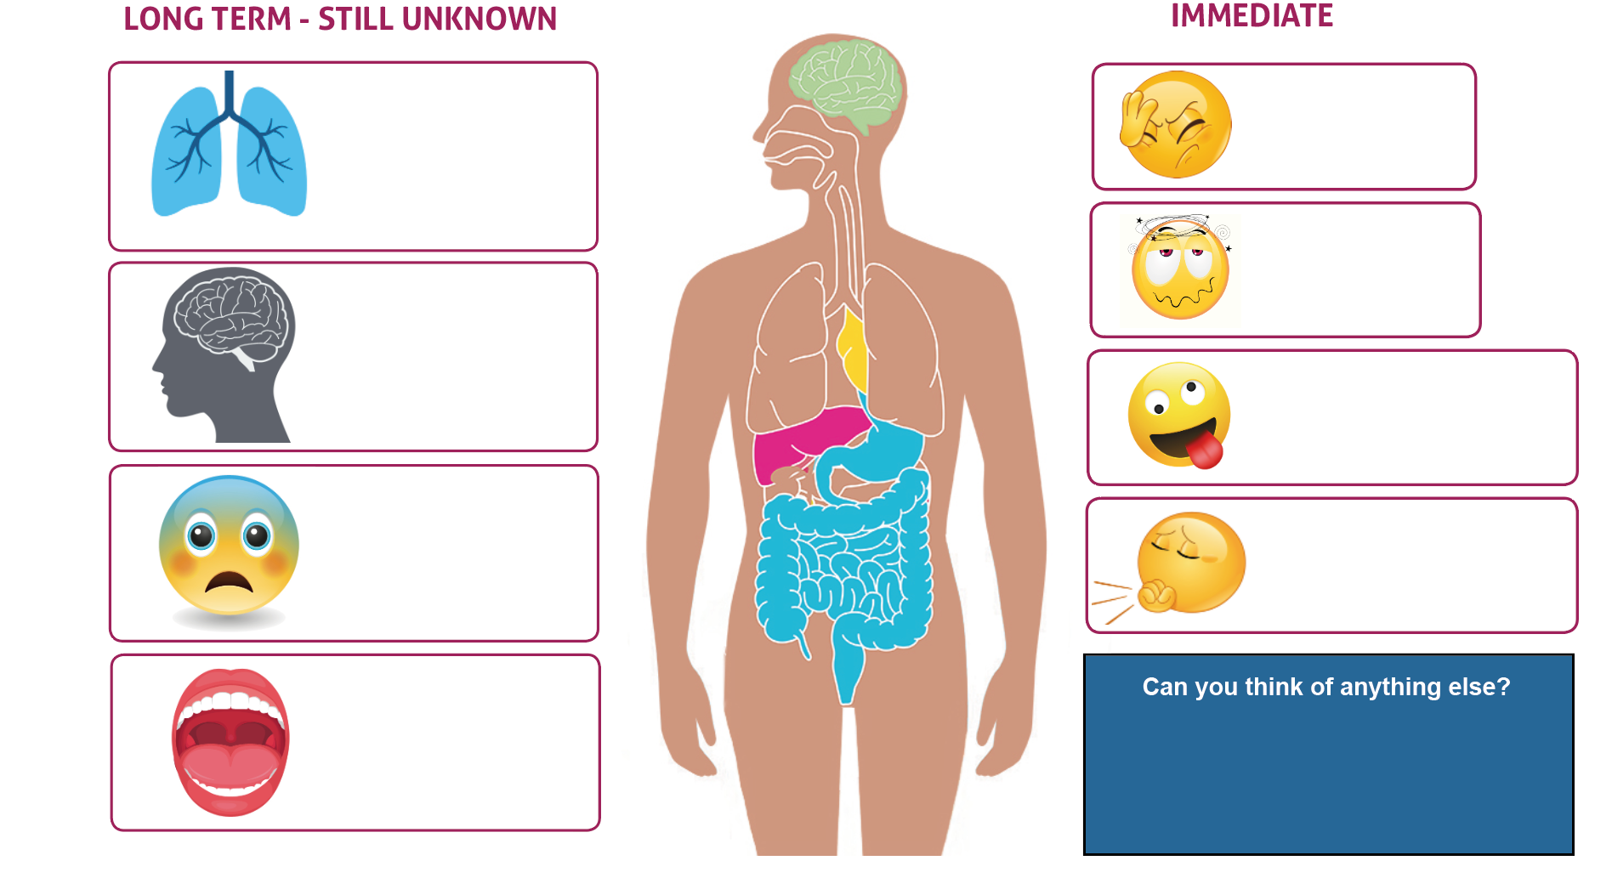













How can vaping affect someone's health?
Notes:
Teacher Notes - This blank slide could be printed to help support the students with the activity. Using their knowledge about nicotine addiction, withdrawal, and the harmful chemicals contained in vapes, students can anticipate some of the immediate and long-term effects. Students can use the emojis to assist them in expressing their thoughts. Reveal the answers on the following slide.

Slide 4
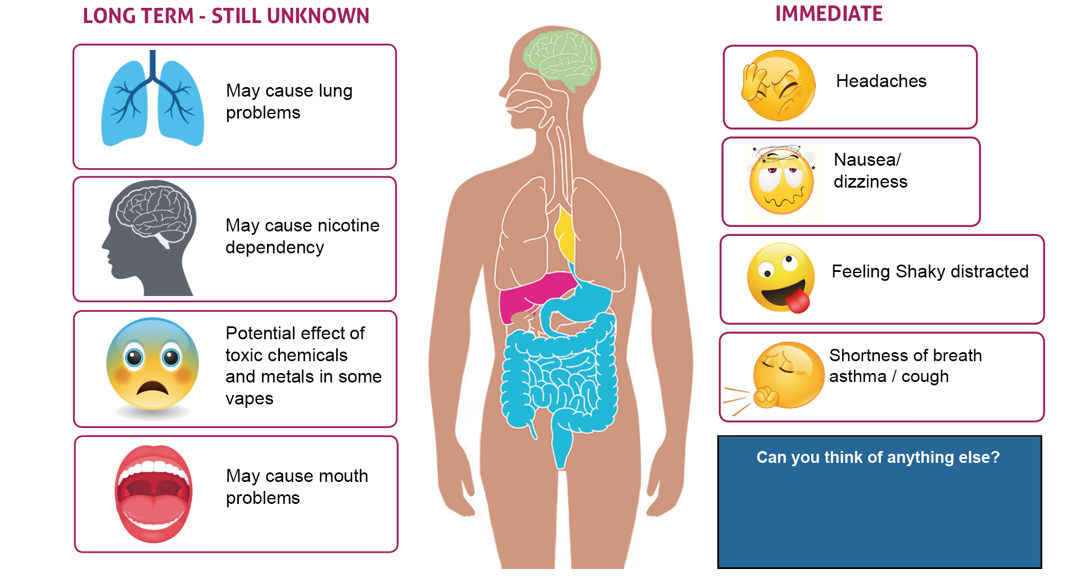

How can vaping effect someone's health?
May cause mouth problems
May cause heart problems
TRUSTED​ ADULT

Slide 5


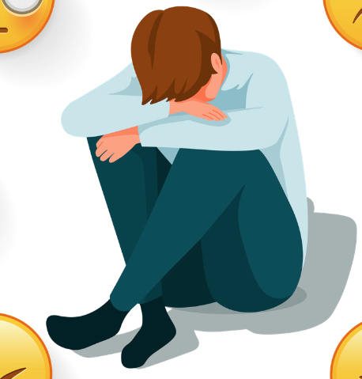
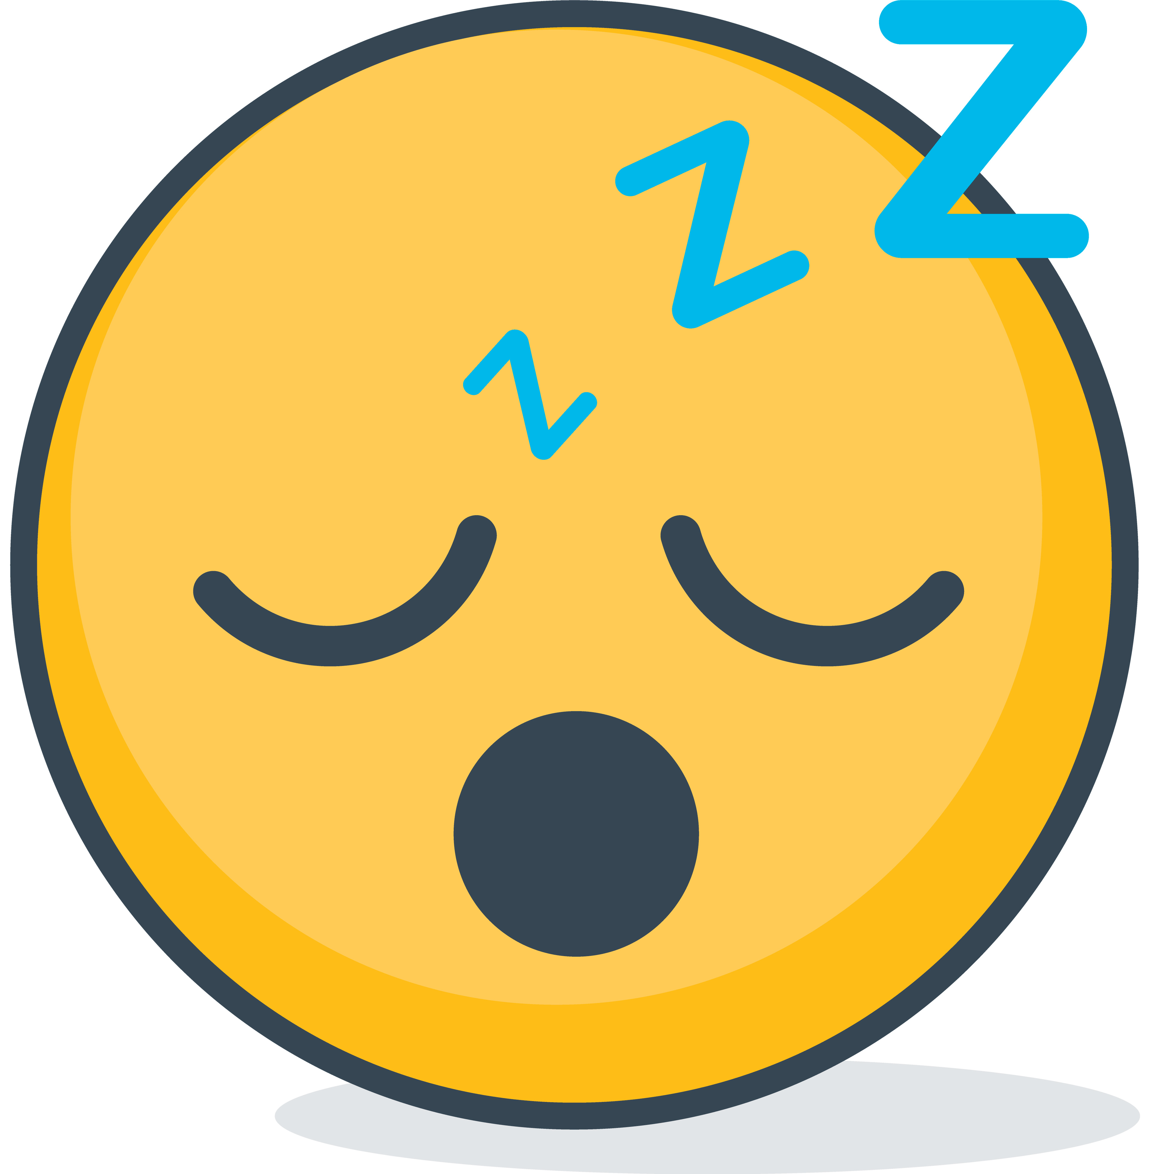




A bit more about
nicotine…
If someone stops using nicotine, their body can react in uncomfortable ways, called withdrawal.
Use the emojis to work out how a person might feel when they stop using nicotine.
Nicotine is a drug that makes our bodies release a burst of energy. This can make a person feel more awake, jumpy, and ready to react quickly. It also makes a person's breathing and heartbeat faster. This feeling wears of and it can make a person feel tired.
Feeling restless or jumpy​​
Feeling sick​​​
Problems sleeping​​​​​
Having trouble focusing​​​​
Getting headaches or shaky hands
Feeling
bad-tempered​
These uncomfortable feelings can lead a person to need more nicotine to stop these withdrawal feelings. This makes nicotine addictive. ​​ Nicotine is found in vapes,
as well as in cigarettes
TRUSTED​ ADULT
Notes:
Teacher Notes - Facilitators should be mindful that some students may have family members who vape and might feel worried. Remind students about the "Trusted Adult" symbol, which is also included in their workbooks.

Slide 6

Why vapes are illegal for children and young people
Vapes are not meant to be used by children and young people.
Why?
Nicotine can harm children's brain development, affecting the parts of the brain that influence concentration levels, learning ability, mood, and self-control.
Nicotine is drug which is addictive.
Notes:
Teacher Notes - Be mindful that some students might feel worried if someone in their family vapes. Remind students that they can speak to a trusted adult if they are concerned. Key messages: vapes are not meant to be used by young people, they can be used to help adults who smoke to quit smoking, but if someone doesn’t smoke, they should avoid vaping, vaping is not risk-free, it can lead to both short and medium term health impacts, using nicotine from a young age can harm young people’s brain development, affecting the parts of the brain that influence concentration levels, learning ability, mood, and self control. Nicotine is a stimulant drug that is highly addictive. Using nicotine during teenage years may lead to subsequent dependency on nicotine and other substances.

Slide 7
What can you remember?
Na
Na
Name two immediate effects of vaping on a person's health
Name two long term effects of vaping on a person's health
Na
Give one reason why people under the age of 18 should not vape

Slide 8
What can you remember?
Na
Na
Name two long term effects of vaping:
Lung problems, mouth problems, heart problems
Name two immediate effects of vaping: Feeling sick, jittery, headache, dizzy
Na
Give one reason why people under the age of 18 should not vape:
Damages brain development, learning development, concentration levels

Slide 9


If you are worried about anything we have talked about today, you can find support or information from Childline or talk to a trusted adult.
Childline has a website and a free, confidential telephone counselling service for children. Call: 0800 1111
https://www.childline.org.uk/
Children aged 10+ can visit Kooth.
Kooth is a free, safe, and anonymous online mental health and wellbeing platform. https://www.kooth.com/
Need to talk?

