Slide 1

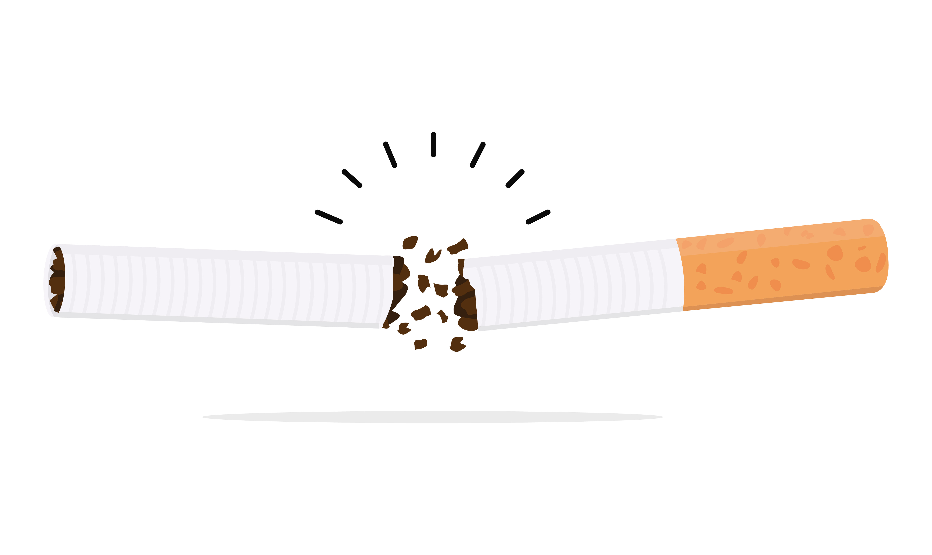


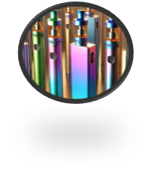




Four Corners: True or False?
Around the room are four statements. Visit each statement and discuss whether the answers are true or false.
?
Notes:
Teacher Notes - Teachers should pick four statements from the options. Place the statements in four corners of the room or inside four PE hoops. Ask students to visit each corner or hoop and discuss the statement. Then, revisit each statement as a class to review the responses. This could be done in a variety of ways: 1) The teacher could place the statements around the room and instruct the students to visit each statement and discuss whether the statement is true or false and why. Students can then provide feedback to the teacher on their ideas in a whole-class setting. 2) Students could put their hands up if they think the statement is true or false.
3) Students could use thumbs up or down for true or false, or put their thumbs in the middle if they are unsure.
4) Students could stand up if they think the statement is true.
5) Students could move to one side of the room labelled “true” and another side of the room labelled “false,” or could stand in the middle if they’re unsure.
The duration of the activity will depend on the method the teacher chooses.
At the end of the session, the facilitator could ask the students one fact that surprised them most from the session. This could be discussed in pairs and fed back to the class, or students could individually write this in their PSHE book.

Slide 2
Vaping Quiz
True or false?
Vapes contain nicotine
Notes:
TRUE - Most vapes contain nicotine

Slide 3
Vaping Quiz
True or false?
Vapes contain nicotine
TRUE - Most vapes contain nicotine
Many vapes contain a high dose of nicotine which is addictive and bad for people's health. Even vapes labelled "zero nicotine" have been found to contain nicotine. If you see a vape, always assume it has nicotine in it.

Slide 4
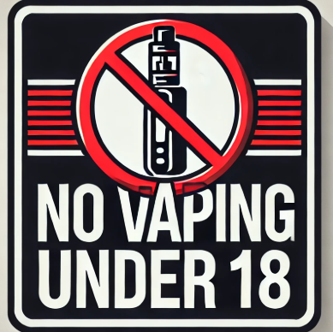
Vaping Quiz
True or false?
It is illegal to give or buy a vape for someone under 18
Notes:
TRUE - It is illegal to give or buy a vape for someone under 18.

Slide 5
Vaping Quiz
True or false?
It is illegal to give or buy a vape for someone under 18
TRUE - It is illegal to give or buy a vape for someone under 18.
Vaping is illegal for under 18s. If someone over 18 gives or sells vapes to anyone under 18 that is against the law.

Slide 6

Vaping Quiz
True or false?
?
Vaping is harmless
Notes:
FALSE - Vaping does have some health effects.

Slide 7


Vaping Quiz
True or false?
?
Vaping is harmless
FALSE - Vaping does have some health effects.
Vaping can make people cough, give them a dry or sore mouth and throat, and even cause headaches. It can also make it harder to focus and make someone feel grumpy.
Some vapes have been found to contain dangerous chemicals and illegal drugs. Some of them even have a lot more nicotine than cigarettes, which can make people really sick or addicted.

Slide 8
Vaping Quiz
True or false?
Vapes are bad for the environment
Notes:
TRUE - Vapes are bad for the planet

Slide 9
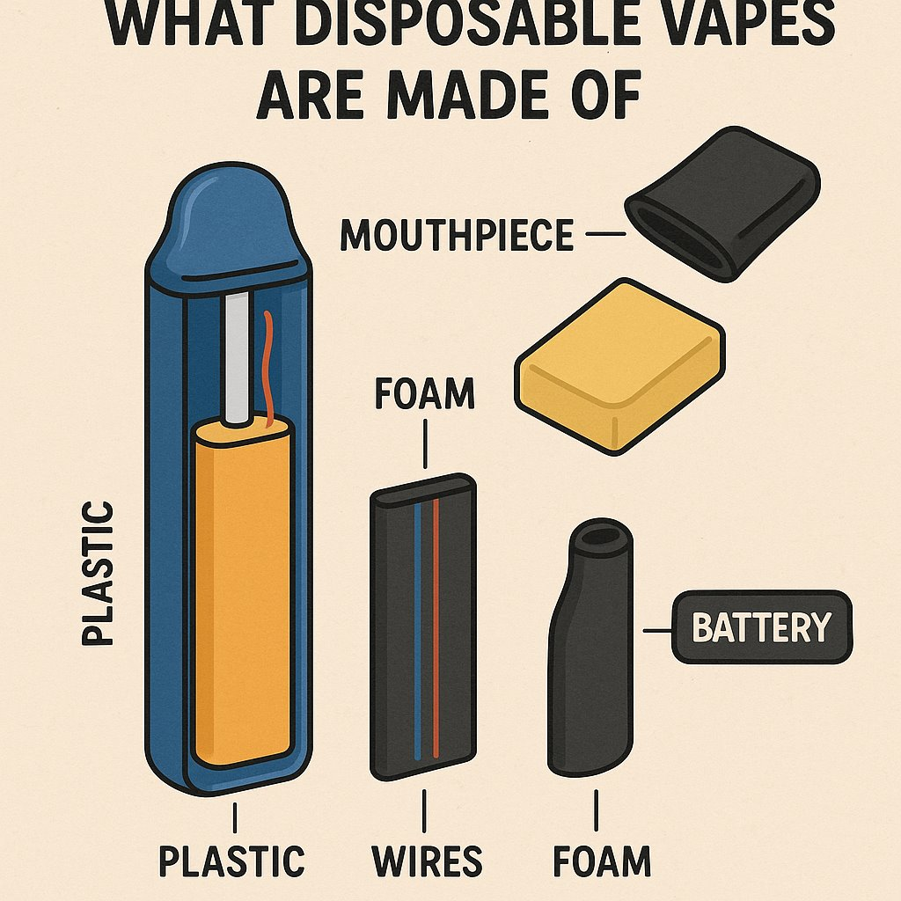
Vaping Quiz
True or false?
Vapes are bad for the environment
TRUE - Vapes are bad for the planet
Vapes contain plastic, metals and foam which cannot be easily recycled and go straight into landfill. The vapes release harmful chemicals into the soil. It’s estimated that 8.2 million are thrown away each week in Britain.

Slide 10
Vaping Quiz
True or false?
Vaping can help someone quit smoking
Notes:
TRUE - Vaping can help smokers quit.

Slide 11
Vaping Quiz
True or false?
Vaping can help someone quit smoking.
TRUE - Vaping can help smokers quit.
Some adults might use vaping to help them stop smoking. This is because vapes allow a person to take in nicotine without some harmful toxins found in cigarettes. However, this doesn't mean vaping is harmless. Vapes contain nicotine and lots of chemicals that trick the brain into thinking the vape tastes sweet or fruity. These chemicals may lead to long term health problems and nicotine is addictive

Slide 12

Vaping Quiz
True or false?
?
Vaping has no side effects
Notes:
FALSE - Vaping does have some side effects.

Slide 13
Vaping Quiz
True or false?
?
Vaping has no side effects
FALSE - Vaping does have some side effects.
Vaping can make someone cough, give them a dry and irritated mouth and throat, and cause headaches, grumpy, and problems concentrating.
Vaping affects young peoples' brains and lungs and makes the heartbeat faster.

Slide 14
Vaping Quiz
True or false?
Nicotine should be avoided by some groups of people
Notes:
TRUE - Nicotine is not recommended for non-smokers, children and pregnant women.

Slide 15
Vaping Quiz
True or false?
Nicotine should be avoided by some groups of people
TRUE - Nicotine is not recommended for non-smokers, children and pregnant women.
That’s because nicotine is harmful to children and unborn babies. Vaping is also harmful to people who have asthma.
Many of the long-term risks of vaping are unknown. Non-smokers should not start vaping.

Slide 16
Reflect:
Na
What is one fact about vaping that surprised you most?

