Slide 1

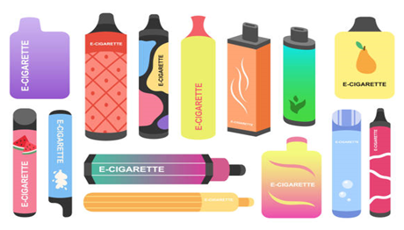

talk about |
vaping
Introduction to vapes and vaping

Slide 2


What do we need to help us breathe?
Activity:
Take a deep breath in through our nose, hold it for a moment... and now slowly breathe out through your mouth.
When we breathe in, what is it that our body needs from the air?​
And what do we breathe out? ​
What vital organs keep us alive through breathing? ​
Oxygen
Carbon Dioxide
Our lungs.... that's why it's so important that we keep them clean and healthy​

Slide 3
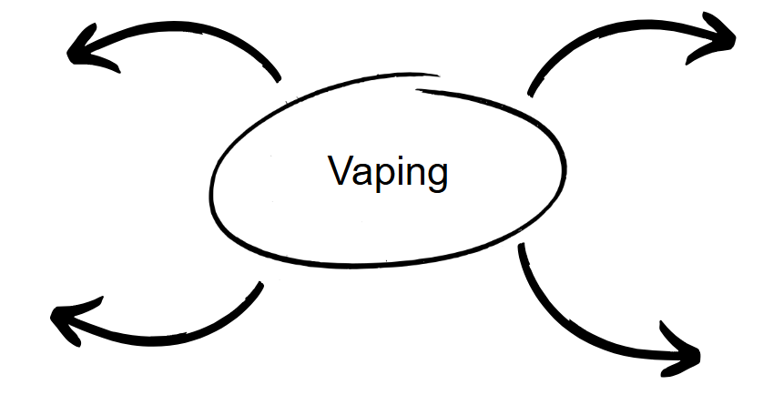




What do you already know about vaping?
Notes:
Teacher Notes - This slide can be printed out if appropriate. Students should complete the mind map either individually, or in small groups, with everything they already know about vaping. Teachers should reassure the students that it’s okay if they don’t know anything at all. If this is the case, students can put a question mark (?) on their mindmap. Some students might know more than four things about vaping; if this is the case, they can add to their mind map by drawing extra lines. Alternatively, the facilitator can opt to complete a class mind-map on the board. If the teacher choses the latter, students could be given 1 minute thinking time, before giving their answers. Be mindful That some students may associate the topic of vaping with their family members or personal experiences. If this occurs, kindly refer students to Ground Rule 4, “Careful Sharing”, as agreed upon by the class, to ensure a safe and respectful learning environment. Ask the students to share their answers.

Slide 4
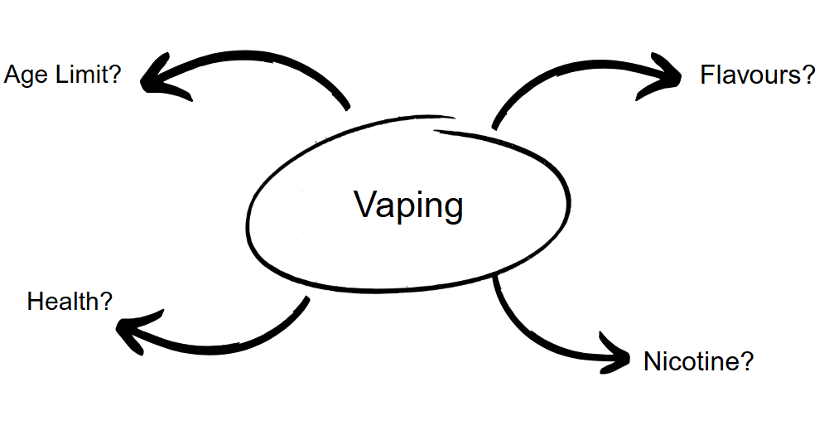
What did you say?...
What do you already know about vaping?​
​

Slide 5
Vapes – what are they?
Vapes are sometimes called "e-cigarettes". The "e" stands for "electric".
Vapes are small electronic device for people to breathe in a flavoured mist called "vapour".
Inside the vape, liquid is heated up which makes the vapour. This liquid contains Nicotine and Flavouring Chemicals.
Vapes are not meant to be used by children as they harm lungs and brain.
They can be used to help adults to quit smoking.

Slide 6
Vapes – What does vaping liquid have in it?
be
Vegetable glycerol:​
This help make the vapour so it’s visible, like a mist. ​
Chemicals:​
These trick the brain into thinking the vape tastes like sweets or fruit. They can damage the lungs. Some vapes use nut oils that cause allergic reactions and some young people have been hospitalised.
Nicotine:​ This is a drug that can make people want to keep using it. It is addictive. Nicotine is found in cigarettes, too.
Notes:
Teacher Notes - Highlight what the liquid contains:
- Vegetable Glycerol: This helps make the vapour visible. It is often used in cooking to help bind ingredients together and is considered safe to eat, however, we do not know what the long-term effects of vegetable glycerol are when inhaled. - Chemicals: These trick the brain into thinking the vape tastes like sweets or fruits. These chemicals can damage the lungs. Some people even have allergic reactions to the nut oils that are found in some vapes.
- Nicotine: This is a drug that can make people want to keep using the vape. It is addictive. Nicotine is also found in cigarettes.

Slide 7
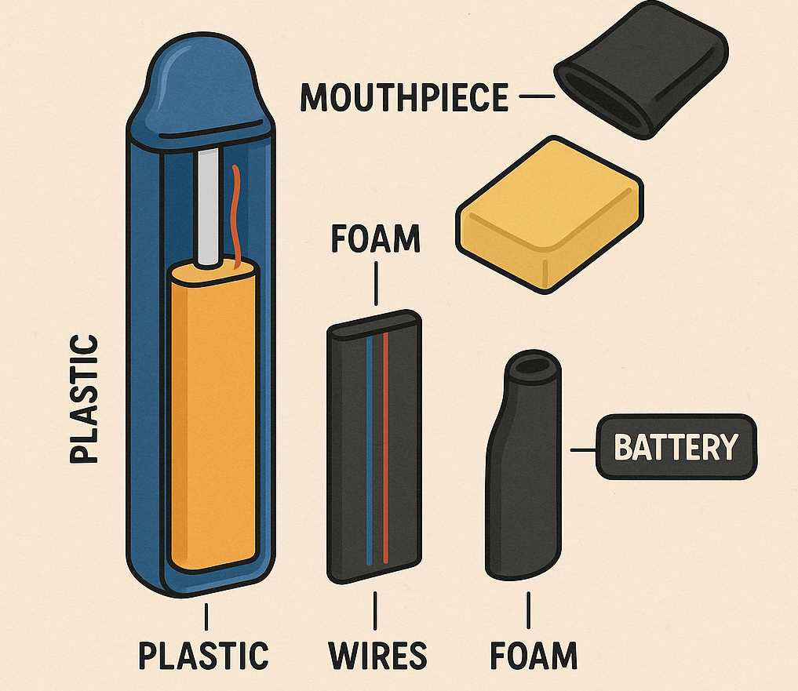
Vapes – what are they made from?
Vapes are sometimes called "e-cigarettes". The "e" stands for "electric".
Vapes are made from materials which are difficult to recycle such as: plastic, foam, aluminium and lithium.

Slide 8


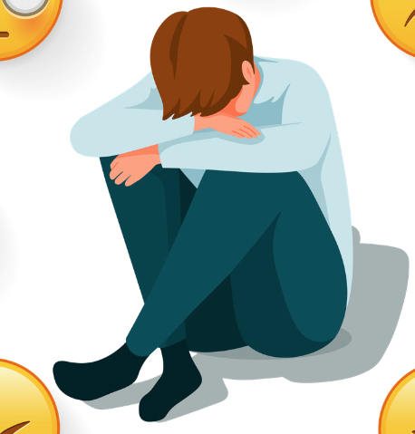





A bit more about
nicotine…
If someone stops using nicotine, their body can react in uncomfortable ways, called withdrawal.
Use the emojis to work out how a person might feel when they stop using nicotine.
Nicotine is a drug that makes our bodies release a burst of energy. This can make a person feel more awake, jumpy, and ready to react quickly. It also makes a person's breathing and heartbeat faster. This feeling wears of and it can make a person feel tired.
Feeling restless or jumpy​​
Feeling sick​​​
Problems sleeping​​​​​
Having trouble focusing​​​​
Getting headaches or shaky hands
Feeling
bad-tempered​
These uncomfortable feelings can lead a person to need more nicotine to stop these withdrawal feelings. This makes nicotine addictive. ​​ Nicotine is found in vapes,
as well as in cigarettes
TRUSTED​ ADULT
Notes:
Teacher Notes – Facilitators should be mindful that some students may have family members who vape and might feel worried. Remind students about the "Trusted Adult" symbol, which is also included in their workbooks.

Slide 9
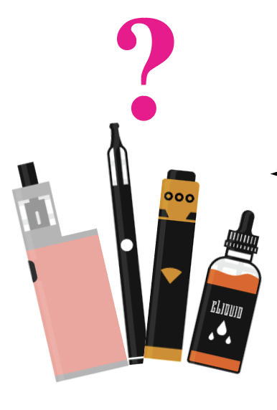

Decisions about Vaping
Why do people choose to vape, or not to vape?
a) Discuss a reason why adults might choose to vape.
b) Discuss a reasons why most young people choose not to vape.

Slide 10


Why Do Some Adults Choose to Vape?
To help them quit smoking
Notes:
Teacher Notes - Adults choose to vape to stop smoking, they think vaping calms them down, and they enjoy different flavours. Despite the answers, emphasise that the main reason adults should vape is to help them stop smoking. Remind the students that it is not recommended to start vaping if a person doesn’t smoke because of the negative long-term health impacts.

Slide 11
Why Do Most Young People Choose NOT To Vape?
It is bad for their lungs
Vapes contain harmful chemicals
They don't want to get addicted to nicotine
It is illegal
They might get in trouble at school

Slide 12
What can you remember?
Na
Na
True or False: Vapes don't contain sweets or fruit, they contain chemicals that trick the brain into thinking the vape tastes sweet or fruity.
Sometimes vapes are called "e-cigarettes". What does the "e" stand for?
Na
Na
Name two things that a vape contain.
Give one reason why an adult might choose to vape

Slide 13
What can you remember?
Na
Na
True or False: Vapes don't contain sweets or fruit, they contain chemicals that trick the brain into thinking the vape tastes sweet or fruity.
True
Sometimes vapes are called "e-cigarettes". What does the "e" stand for?
Electric
Na
Na
Name two things that a vape contain.
Nicotine, flavourings, chemicals, plastic, foam, battery
Give one reason why an adult might choose to vape
To quit smoking

Slide 14

If you are worried about anything we have talked about today, you can find support or information from Childline or talk to a trusted adult.
Childline has a website and a free, confidential telephone counselling service for children. Call: 0800 1111
https://www.childline.org.uk/
Children aged 10+ can visit Kooth.
Kooth is a free, safe, and anonymous online mental health and wellbeing platform. https://www.kooth.com/
Need to talk?

