Slide 1

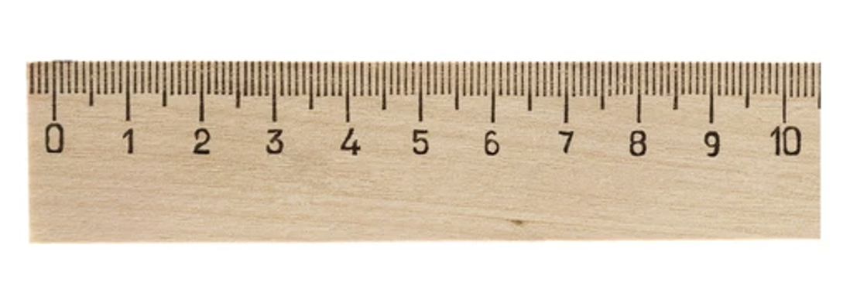

talk about |
vaping
The Ruler of Confidence
Before we start our lesson on vaping, rate your knowledge! Some people might be “very knowledgeable”, but others might be “not sure”. Circle a number on the ruler to show how confident you feel about your knowledge on vaping.
Notes:
Teacher Notes - Teachers can ask young people to rate their knowledge and understanding of vaping out of 10 on the “ruler of confidence”, providing a baseline. This can be repeated at the end of input as a measure of progress. This could be done at the start and end of the full unit to assess knowledge development.

Slide 2

The Ruler of Confidence: Before The Vaping Session
Not sure
Need to know more
Very knowledgeable
Notes:
Teacher Notes - This can be printed out for students to use if appropriate. If the facilitator prefers not to print, students can discreetly write down their confidence rating in their PSHE exercise book. Alternatively, the teacher could gather a whole-class response by asking students to write a number on a mini whiteboard or show a number using their fingers. To maintain anonymity, the teacher could ask students to close their eyes during the whole class activity.

Slide 3
Talk About |
Vaping
The Ruler of Confidence
Now we have finished our lesson on vaping, rate your knowledge!
Circle a number on the ruler to show how confident you feel about your knowledge on vaping after the lesson.

Slide 4
The Ruler of Confidence: After The Vaping Session
Not sure
Need to know more
Very knowledgeable
Notes:
Teacher Notes - This can be printed out for students to use if appropriate. If the facilitator prefers not to print, students can discreetly write down their confidence rating in their PSHE exercise book. Alternatively, the teacher could gather a whole-class response by asking students to write a number on a mini whiteboard or show a number using their fingers. To maintain anonymity, the teacher could ask students to close their eyes during the whole class activity.

Slide 5
Talk About |
Vaping
Postcard Activity.
Imagine your friend lives in a country where the government is still deciding whether vaping should be legal. You are writing them a postcard to explain what you’ve learnt.
On your postcard, draw a picture that shows the risks or dangers of vaping. On the other side, write a short message (3–5 sentences) to your friend explaining what they need to know about vaping and why you think it shouldn’t be allowed for young people.
Notes:
Teacher Notes – This task could be completed at the end of a vaping session, or unit as a visual summary of what the students have learnt.

Slide 6
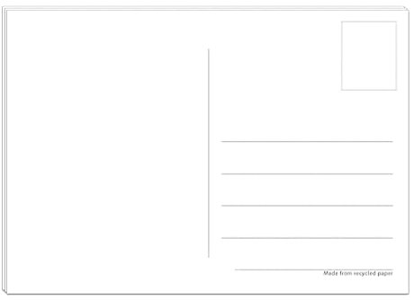
Notes:
Teacher Notes – Teachers can print this as a template for the students.

