Slide 1


Vaping:
Fake/unregulated vapes
Nicotine pouches
Nicotine dependency
PSE Lesson S4 – S6
Notes:
Summary of Curriculum for Excellence Experiences & Outcomes
I am developing a range of skills which can support decision making about substance use. I can demonstrate strategies for making informed choices to maintain and improve my health and wellbeing and can apply these in situations that may be stressful or challenging or involve peer pressure. HWB 4-40a
I understand the local, national and international impact of substance misuse. HWB 4-43c
I understand the positive effects that some substances have on the mind and body, but I am also aware of the negative and serious physical, mental, emotional, social and legal consequences of substances HWB 4-38a
After accessing options and the consequences of my decisions, I can identify safe and unsafe behaviours and actions. HWB 4-41a
I can develop my understanding of the interaction between humans and the environment by describing and assessing the impact of human activity on an area. SOC 4-10a
Through investigation, I can explain how images of substance use, and misuse can influence people’s behaviour. HWB 4-39a
I know how to access information and support for substance-related issues. HWB 4-40b

Slide 2
Respectful
Listening
Group agreement
Focused
Careful Sharing
Anything else?
Notes:
Activity Slide: Group Agreement
Teacher/Facilitator establishes a group agreement with young people.
Prompts on slide can be used to gather other ideas through class discussion/post it note suggestions from young people.
‘Careful sharing’ refers to pupils not feeling pressured to directly disclose theirs/others use of nicotine and considering what/how much they wish to share about themselves.
Teacher/Facilitator will be aware of child protection and health & wellbeing procedures for their own setting should anything arise following lesson/workshop.

Slide 3
Types of vapes and nicotine products: strength and effects
How to recognise fake vapes versus regulated vapes
What we will explore today?
The law and vaping: new tobacco and vapes bill
Influencers, social media and advertising
Advice and information on how to cut down or quit
Vapes and the environment
Notes:
Information Slide: What we will explore today
Teacher/Facilitator shares summary of the learning outcomes for lesson/workshop with young people.

Slide 4
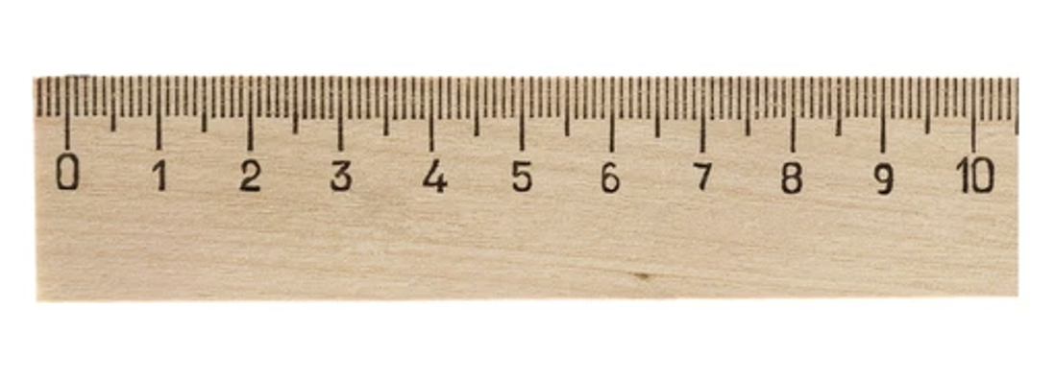
The
confidence ruler
Not sure
Need to know more
Very knowledgeable
Notes:
Activity Slide: The Confidence Ruler
Teacher/Facilitator can ask young people to rate their knowledge and understanding around vaping and the topics to be covered in the lesson out of 10, providing a baseline. This can be repeated at the end of input as a measure of progress.
How confident are you in what you already know about Vaping? Fake vapes? Dope or THC vapes? The new laws on vaping?

Slide 5


Recap: What is vaping?
Vaping is using an electronic device to inhale a vapour. On heating the liquid (e-liquid or juice) becomes a mist that can be inhaled.
This liquid usually contains nicotine, propylene glycol and vegetable glycerine (which gives vapour) artificial flavourings, and other chemicals.
The highest strength legal vape usually has 20mg/ml which is around 2% nicotine.
Notes:
Discussion Slide: Recap: What is vaping?
Teacher/Facilitator poses questions: What is Vaping? Does anyone know what vapes contain?
Vaping is using an electronic device to inhale a vapour. On heating the liquid (e-liquid or juice) becomes a mist that can be inhaled.
This liquid usually contains nicotine, propylene glycol and vegetable glycerine (which gives vapour) artificial flavourings, and other chemicals.
The highest strength legal vape usually has 20mg/ml around 2% nicotine.

Slide 6

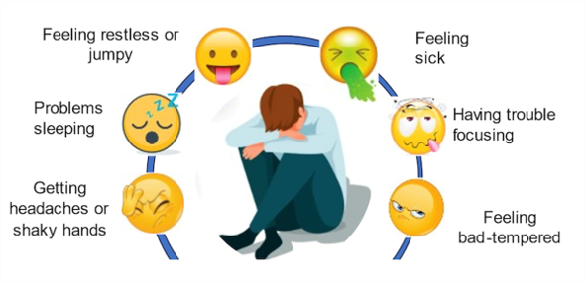
Recap: Nicotine dependency cycle
When you’re a teenager your brain is developing fast. Nicotine gets into your brain and mimics natural brain chemicals that make you feel good. But it also stimulates your brain’s appetite for more. It re-wires your brain, changing the brain chemistry so that soon your brain is craving more and more nicotine all the time. If you don’t get some it makes you feel anxious, you can’t concentrate on the things that matter. You’re constantly thinking about when you can get more. You begin to lose control over your choice to vape or not.
Martin Dockrell Tobacco Control Programme Lead, Department of Health & Social Care
Notes:
Information Slide: Recap: Nicotine dependency cycle
Teacher/Facilitator shares information with young people.

Slide 7
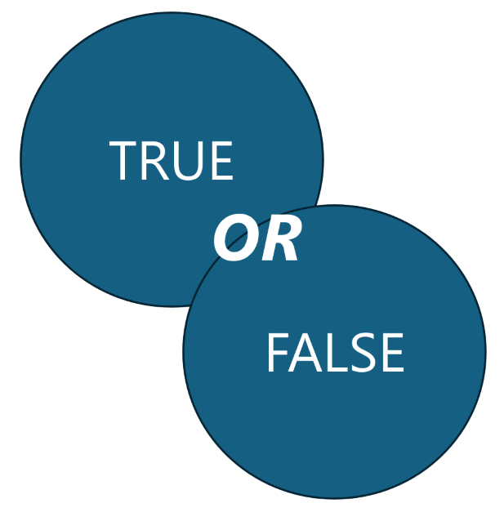
Vaping: True or False?
How much do we know?
​
Notes:
Slide 7
Activity Slide: Vaping True OR False
This activity can be facilitated as a whole class activity, without need for printing, by using the slides. It could also be delivered with movement where young people can be invited to cross the circle if they believe statement to be True. Or each side of the room could be allocated True OR False status with young people moving to the side they feel is the correct answer. To facilitate for individuals or in small groups pupils can be provided with statements to sort into True OR False. Each group placing statements to Left for True OR Right for False.
Talk over answers as a full class whilst holding space for further discussion.
Vaping True OR False Statements
"Vaping may harm a person’s lungs.” TRUE
“A vape has around 2% nicotine” TRUE
"Vaping is just water vapor, so it’s safe.” FALSE
"There are illegal chemicals in UK vapes.” TRUE
"Vapes are not risk-free, they contain nicotine (a stimulant) which is addictive and can harm young people health" TRUE
"Nicotine in vapes is safe for young people.” FALSE
"Nicotine increases the risk of harm from other substances in the future.” TRUE
"Vaping may help adults who smoke to quit.” TRUE
"While some adults use vaping as a smoking cessation tool, studies show that most young people who vape have never smoked.” TRUE
"Nicotine raises blood pressure and can cause feelings of anxiety” TRUE

Slide 8
Vaping: True or False?
"Vaping may harm a person’s lungs.”
Notes:
Slide 7
Activity Slide: Vaping True OR False
This activity can be facilitated as a whole class activity, without need for printing, by using the slides. It could also be delivered with movement where young people can be invited to cross the circle if they believe statement to be True. Or each side of the room could be allocated True OR False status with young people moving to the side they feel is the correct answer. To facilitate for individuals or in small groups pupils can be provided with statements to sort into True OR False. Each group placing statements to Left for True OR Right for False.
Talk over answers as a full class whilst holding space for further discussion.
Vaping True OR False Statements
"Vaping may harm a person’s lungs.” TRUE
“A vape has around 2% nicotine” TRUE
"Vaping is just water vapor, so it’s safe.” FALSE
"There are illegal chemicals in UK vapes.” TRUE
"Vapes are not risk-free, they contain nicotine (a stimulant) which is addictive and can harm young people health" TRUE
"Nicotine in vapes is safe for young people.” FALSE
"Nicotine increases the risk of harm from other substances in the future.” TRUE
"Vaping may help adults who smoke to quit.” TRUE
"While some adults use vaping as a smoking cessation tool, studies show that most young people who vape have never smoked.” TRUE
"Nicotine raises blood pressure and can cause feelings of anxiety” TRUE

Slide 9
Vaping: True or False?
“A vape has around 2% nicotine”
Notes:
Slide 7
Activity Slide: Vaping True OR False
This activity can be facilitated as a whole class activity, without need for printing, by using the slides. It could also be delivered with movement where young people can be invited to cross the circle if they believe statement to be True. Or each side of the room could be allocated True OR False status with young people moving to the side they feel is the correct answer. To facilitate for individuals or in small groups pupils can be provided with statements to sort into True OR False. Each group placing statements to Left for True OR Right for False.
Talk over answers as a full class whilst holding space for further discussion.
Vaping True OR False Statements
"Vaping may harm a person’s lungs.” TRUE
“A vape has around 2% nicotine” TRUE
"Vaping is just water vapor, so it’s safe.” FALSE
"There are illegal chemicals in UK vapes.” TRUE
"Vapes are not risk-free, they contain nicotine (a stimulant) which is addictive and can harm young people health" TRUE
"Nicotine in vapes is safe for young people.” FALSE
"Nicotine increases the risk of harm from other substances in the future.” TRUE
"Vaping may help adults who smoke to quit.” TRUE
"While some adults use vaping as a smoking cessation tool, studies show that most young people who vape have never smoked.” TRUE
"Nicotine raises blood pressure and can cause feelings of anxiety” TRUE

Slide 10
Vaping: True or False?
“Vaping is just water vapour, so it’s safe.”
Notes:
Slide 7
Activity Slide: Vaping True OR False
This activity can be facilitated as a whole class activity, without need for printing, by using the slides. It could also be delivered with movement where young people can be invited to cross the circle if they believe statement to be True. Or each side of the room could be allocated True OR False status with young people moving to the side they feel is the correct answer. To facilitate for individuals or in small groups pupils can be provided with statements to sort into True OR False. Each group placing statements to Left for True OR Right for False.
Talk over answers as a full class whilst holding space for further discussion.
Vaping True OR False Statements
"Vaping may harm a person’s lungs.” TRUE
“A vape has around 2% nicotine” TRUE
"Vaping is just water vapor, so it’s safe.” FALSE
"There are illegal chemicals in UK vapes.” TRUE
"Vapes are not risk-free, they contain nicotine (a stimulant) which is addictive and can harm young people health" TRUE
"Nicotine in vapes is safe for young people.” FALSE
"Nicotine increases the risk of harm from other substances in the future.” TRUE
"Vaping may help adults who smoke to quit.” TRUE
"While some adults use vaping as a smoking cessation tool, studies show that most young people who vape have never smoked.” TRUE
"Nicotine raises blood pressure and can cause feelings of anxiety” TRUE

Slide 11
Vaping: True or False?
"There are illegal chemicals in UK vapes.”
Notes:
Slide 7
Activity Slide: Vaping True OR False
This activity can be facilitated as a whole class activity, without need for printing, by using the slides. It could also be delivered with movement where young people can be invited to cross the circle if they believe statement to be True. Or each side of the room could be allocated True OR False status with young people moving to the side they feel is the correct answer. To facilitate for individuals or in small groups pupils can be provided with statements to sort into True OR False. Each group placing statements to Left for True OR Right for False.
Talk over answers as a full class whilst holding space for further discussion.
Vaping True OR False Statements
"Vaping may harm a person’s lungs.” TRUE
“A vape has around 2% nicotine” TRUE
"Vaping is just water vapor, so it’s safe.” FALSE
"There are illegal chemicals in UK vapes.” TRUE
"Vapes are not risk-free, they contain nicotine (a stimulant) which is addictive and can harm young people health" TRUE
"Nicotine in vapes is safe for young people.” FALSE
"Nicotine increases the risk of harm from other substances in the future.” TRUE
"Vaping may help adults who smoke to quit.” TRUE
"While some adults use vaping as a smoking cessation tool, studies show that most young people who vape have never smoked.” TRUE
"Nicotine raises blood pressure and can cause feelings of anxiety” TRUE

Slide 12
Vaping: True or False?
"Nicotine in vapes is safe for young people.”
Notes:
Slide 7
Activity Slide: Vaping True OR False
This activity can be facilitated as a whole class activity, without need for printing, by using the slides. It could also be delivered with movement where young people can be invited to cross the circle if they believe statement to be True. Or each side of the room could be allocated True OR False status with young people moving to the side they feel is the correct answer. To facilitate for individuals or in small groups pupils can be provided with statements to sort into True OR False. Each group placing statements to Left for True OR Right for False.
Talk over answers as a full class whilst holding space for further discussion.
Vaping True OR False Statements
"Vaping may harm a person’s lungs.” TRUE
“A vape has around 2% nicotine” TRUE
"Vaping is just water vapor, so it’s safe.” FALSE
"There are illegal chemicals in UK vapes.” TRUE
"Vapes are not risk-free, they contain nicotine (a stimulant) which is addictive and can harm young people health" TRUE
"Nicotine in vapes is safe for young people.” FALSE
"Nicotine increases the risk of harm from other substances in the future.” TRUE
"Vaping may help adults who smoke to quit.” TRUE
"While some adults use vaping as a smoking cessation tool, studies show that most young people who vape have never smoked.” TRUE
"Nicotine raises blood pressure and can cause feelings of anxiety” TRUE

Slide 13
Vaping: True or False?
"Vaping may help adults who smoke to quit.”
Notes:
Slide 7
Activity Slide: Vaping True OR False
This activity can be facilitated as a whole class activity, without need for printing, by using the slides. It could also be delivered with movement where young people can be invited to cross the circle if they believe statement to be True. Or each side of the room could be allocated True OR False status with young people moving to the side they feel is the correct answer. To facilitate for individuals or in small groups pupils can be provided with statements to sort into True OR False. Each group placing statements to Left for True OR Right for False.
Talk over answers as a full class whilst holding space for further discussion.
Vaping True OR False Statements
"Vaping may harm a person’s lungs.” TRUE
“A vape has around 2% nicotine” TRUE
"Vaping is just water vapor, so it’s safe.” FALSE
"There are illegal chemicals in UK vapes.” TRUE
"Vapes are not risk-free, they contain nicotine (a stimulant) which is addictive and can harm young people health" TRUE
"Nicotine in vapes is safe for young people.” FALSE
"Nicotine increases the risk of harm from other substances in the future.” TRUE
"Vaping may help adults who smoke to quit.” TRUE
"While some adults use vaping as a smoking cessation tool, studies show that most young people who vape have never smoked.” TRUE
"Nicotine raises blood pressure and can cause feelings of anxiety” TRUE

Slide 14
Vaping: True or False?
"Nicotine raises blood pressure and can cause feelings of anxiety”
Notes:
Slide 7
Activity Slide: Vaping True OR False
This activity can be facilitated as a whole class activity, without need for printing, by using the slides. It could also be delivered with movement where young people can be invited to cross the circle if they believe statement to be True. Or each side of the room could be allocated True OR False status with young people moving to the side they feel is the correct answer. To facilitate for individuals or in small groups pupils can be provided with statements to sort into True OR False. Each group placing statements to Left for True OR Right for False.
Talk over answers as a full class whilst holding space for further discussion.
Vaping True OR False Statements
"Vaping may harm a person’s lungs.” TRUE
“A vape has around 2% nicotine” TRUE
"Vaping is just water vapor, so it’s safe.” FALSE
"There are illegal chemicals in UK vapes.” TRUE
"Vapes are not risk-free, they contain nicotine (a stimulant) which is addictive and can harm young people health" TRUE
"Nicotine in vapes is safe for young people.” FALSE
"Nicotine increases the risk of harm from other substances in the future.” TRUE
"Vaping may help adults who smoke to quit.” TRUE
"While some adults use vaping as a smoking cessation tool, studies show that most young people who vape have never smoked.” TRUE
"Nicotine raises blood pressure and can cause feelings of anxiety” TRUE

Slide 15
Vaping: True or False?
"While some adults use vaping as a smoking cessation tool, studies show that most young people who vape have never smoked.”
Notes:
Slide 7
Activity Slide: Vaping True OR False
This activity can be facilitated as a whole class activity, without need for printing, by using the slides. It could also be delivered with movement where young people can be invited to cross the circle if they believe statement to be True. Or each side of the room could be allocated True OR False status with young people moving to the side they feel is the correct answer. To facilitate for individuals or in small groups pupils can be provided with statements to sort into True OR False. Each group placing statements to Left for True OR Right for False.
Talk over answers as a full class whilst holding space for further discussion.
Vaping True OR False Statements
"Vaping may harm a person’s lungs.” TRUE
“A vape has around 2% nicotine” TRUE
"Vaping is just water vapor, so it’s safe.” FALSE
"There are illegal chemicals in UK vapes.” TRUE
"Vapes are not risk-free, they contain nicotine (a stimulant) which is addictive and can harm young people health" TRUE
"Nicotine in vapes is safe for young people.” FALSE
"Nicotine increases the risk of harm from other substances in the future.” TRUE
"Vaping may help adults who smoke to quit.” TRUE
"While some adults use vaping as a smoking cessation tool, studies show that most young people who vape have never smoked.” TRUE
"Nicotine raises blood pressure and can cause feelings of anxiety” TRUE

Slide 16
Vaping: True or False?
"Nicotine increases the risk of harm from other substances in the future.”
Notes:
Slide 7
Activity Slide: Vaping True OR False
This activity can be facilitated as a whole class activity, without need for printing, by using the slides. It could also be delivered with movement where young people can be invited to cross the circle if they believe statement to be True. Or each side of the room could be allocated True OR False status with young people moving to the side they feel is the correct answer. To facilitate for individuals or in small groups pupils can be provided with statements to sort into True OR False. Each group placing statements to Left for True OR Right for False.
Talk over answers as a full class whilst holding space for further discussion.
Vaping True OR False Statements
"Vaping may harm a person’s lungs.” TRUE
“A vape has around 2% nicotine” TRUE
"Vaping is just water vapor, so it’s safe.” FALSE
"There are illegal chemicals in UK vapes.” TRUE
"Vapes are not risk-free, they contain nicotine (a stimulant) which is addictive and can harm young people health" TRUE
"Nicotine in vapes is safe for young people.” FALSE
"Nicotine increases the risk of harm from other substances in the future.” TRUE
"Vaping may help adults who smoke to quit.” TRUE
"While some adults use vaping as a smoking cessation tool, studies show that most young people who vape have never smoked.” TRUE
"Nicotine raises blood pressure and can cause feelings of anxiety” TRUE

Slide 17
Vaping: True or False?
"Vapes are not risk-free, they contain nicotine (stimulant) which is addictive and can harm young people’s health"
Notes:
Slide 7
Activity Slide: Vaping True OR False Quiz
This activity can be facilitated as a whole class activity, without need for printing, by using the slides. It could also be delivered with movement where young people can be invited to cross the circle if they believe statement to be True. Or each side of the room could be allocated True OR False status with young people moving to the side they feel is the correct answer. To facilitate for individuals or in small groups pupils can be provided with statements to sort into True OR False. Each group placing statements to Left for True OR Right for False.
Talk over answers as a full class whilst holding space for further discussion.
Vaping True OR False Statements
"Vaping may harm a person’s lungs.” TRUE
“A vape has around 2% nicotine” TRUE
"Vaping is just water vapor, so it’s safe.” FALSE
"There are illegal chemicals in UK vapes.” TRUE
"Vapes are not risk-free, they contain nicotine (a stimulant) which is addictive and can harm young people health" TRUE
"Nicotine in vapes is safe for young people.” FALSE
"Nicotine increases the risk of harm from other substances in the future.” TRUE
"Vaping may help adults who smoke to quit.” TRUE
"While some adults use vaping as a smoking cessation tool, studies show that most young people who vape have never smoked.” TRUE
"Nicotine raises blood pressure and can cause feelings of anxiety” TRUE

Slide 18
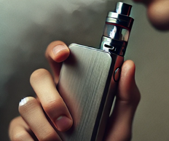
Insights
What percentage of under 16s vape regularly in Scotland?
10%
15%
20%
30%
over 50%
Notes:
Activity Slide: Insights
Teacher/Facilitator leads quiz either directly from the slides with a show of hands or by asking pupils to stand up when they think the answer is correct (and then sit down again) or answers can be placed in the four corners of the room. Young people select answers by moving to corresponding corner where they think the answer is correct.
Insights activity supports social norms approach and ensures that prevalence is not exaggerated.
Further discussion can focus on whether national statistics reflect young people’s local experience and explore their thoughts around this. Have they been surprised by the data? Why might fewer young people vape than they thought?
Answer: 10%
References for all statistics:
Scottish Schools Adolescent Lifestyle and Substance (SALSUS)
https://www.gov.scot/collections/scottish-schools-adolescent-lifestyle-and-substance-use-survey-salsus/
Scottish Government Health and Wellbeing Census
https://www.gov.scot/publications/health-and-wellbeing-census-scotland-2021-22/pages/substance-use/
ASH Scotland
https://ashscotland.org.uk/wp-content/uploads/2024/06/Smoking-and-vaping-statistics-factsheet_June_2024.pdf

Slide 19
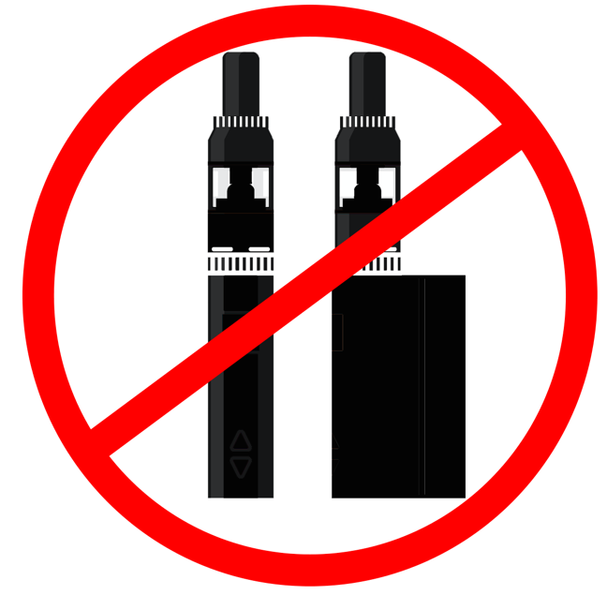
Insights
What percentage of 16 – 24-year-olds in Scotland DON’T vape?
40%
52%
78%
87%
Notes:
Activity Slide
Teacher/Facilitator leads quiz either directly from the slides with a show of hands or by asking pupils to stand up when they think the answer is correct (and then sit down again) or answers can be placed in the four corners of the room. Young people select answers by moving to corresponding corner where they think the answer is correct.
Insights activity supports social norms approach and ensures that prevalence is not exaggerated.
Further discussion can focus on whether national statistics reflect young people’s local experience and explore their thoughts around this. Have they been surprised by the data? Why might fewer young people vape than they thought?
Answer: 78%
References for all Scottish statistics
Scottish Schools Adolescent Lifestyle and Substance (SALSUS)
https://www.gov.scot/collections/scottish-schools-adolescent-lifestyle-and-substance-use-survey-salsus/
Scottish Government Health and Wellbeing Census
https://www.gov.scot/publications/health-and-wellbeing-census-scotland-2021-22/pages/substance-use/
ASH Scotland
https://ashscotland.org.uk/wp-content/uploads/2024/06/Smoking-and-vaping-statistics-factsheet_June_2024.pdf

Slide 20
Insights
All vapes contain the same amount of nicotine?
Yes, always
Yes, they must by law
It depends on the vape
No, vapes contain no nicotine
Vapes are sold with varying levels of nicotine.​ The highest amount of nicotine a UK regulated vape can contain is 20mg/ml with up to 2ml of liquid. ​
However, in Glasgow, Trading Standards seized around 6,000 fake vapes (2024) mostly because their tanks were too large, or the nicotine levels were too high. Others contained THC, Spice and/or other dangerous chemicals.
Notes:
A UK standard legal vape delivers a similar amount of nicotine as 20 cigarettes.
A UK-regulated vape with the highest legal nicotine level (20mg/ml) contains 2ml of liquid and 40mg of nicotine. This delivers, on average, about 20mg of nicotine to the user.
A pack of 20 cigarettes contains 200 to 300mg of nicotine. This delivers, on average, 20 to 30mg of nicotine to the smoker.
Activity Slide
Teacher/Facilitator leads quiz either directly from the slides with a show of hands or by asking pupils to stand up when they think the answer is correct (and then sit down again) or answers can be placed in the four corners of the room. Young people select answers by moving to corresponding corner where they think the answer is correct.
Insights activity supports social norms approach and ensures that prevalence is not exaggerated.
Further discussion can focus on whether national statistics reflect young people’s local experience and explore their thoughts around this. Have they been surprised by the data? Why might fewer young people vape than they thought?
Answer: C) It depends on the vape and the cigarette
In Glasgow, Trading Standards seized about 6,000 illegal vapes this financial year, mostly because their tanks were too large or the nicotine levels were higher than allowed.
Source from trading standards Jan 2025 email

Slide 21
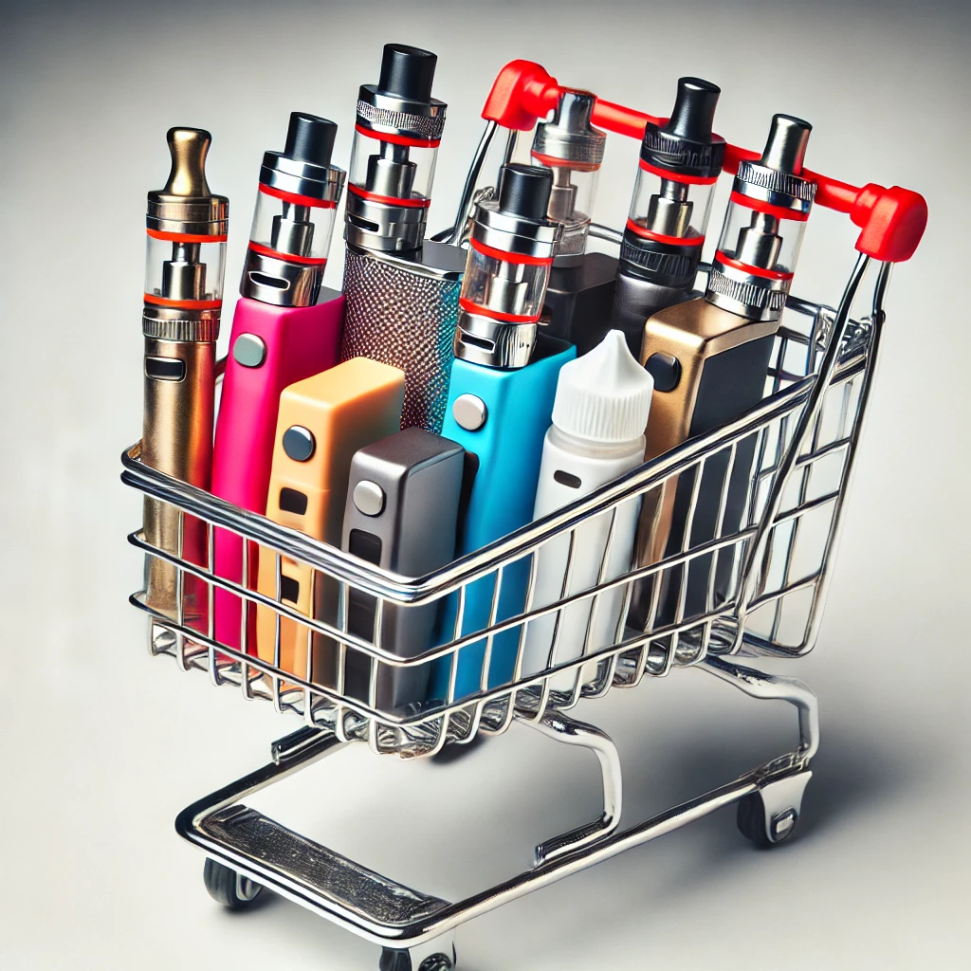
Insights
What % of vapes sold are fake/unregulated?
25%
12%
33%
2%
Some vapes labelled as "0% Nicotine" were seized and tested by Glasgow Trading Standards. Tests revealed that these vapes did contain nicotine. The packaging had been altered, with original labelling covered by "0% Nicotine" stickers.
Notes:
Activity Slide
Teacher/Facilitator leads quiz either directly from the slides with a show of hands or by asking pupils to stand up when they think the answer is correct (and then sit down again) or answers can be placed in the four corners of the room. Young people select answers by moving to corresponding corner where they think the answer is correct.
Insights activity supports social norms approach and ensures that prevalence is not exaggerated.
Further discussion can focus on whether national statistics reflect young people’s local experience and explore their thoughts around this. Have they been surprised by the data? Why might fewer young people vape than they thought?
Answer: C) 33%
Source – Glasgow Trading Standards Jan 2024 email
References for all statistics
Scottish Schools Adolescent Lifestyle and Substance (SALSUS)
https://www.gov.scot/collections/scottish-schools-adolescent-lifestyle-and-substance-use-survey-salsus/
Scottish Government Health and Wellbeing Census
https://www.gov.scot/publications/health-and-wellbeing-census-scotland-2021-22/pages/substance-use/
ASH Scotland
https://ashscotland.org.uk/wp-content/uploads/2024/06/Smoking-and-vaping-statistics-factsheet_June_2024.pdf

Slide 22












Vapes and Social Media
Have you seen adverts for Vapes on social media?
YouTube
Telegram
TikTok
Instagram
Snapchat
Can you think of anything else ?
X (Twitter)
Facebook
Discord
Twitch
Google
Anything missing?
Notes:
Activity Slide: Vapes and Social Media
Teacher/Facilitator asks all young people to stand. Then as each social media option is shared young people sit down if they have never seen vapes promoted on this site. All standing again for each option.
Further class discussion can happen around: What was the message? How were they presented? What age range was the likely audience?

Slide 23
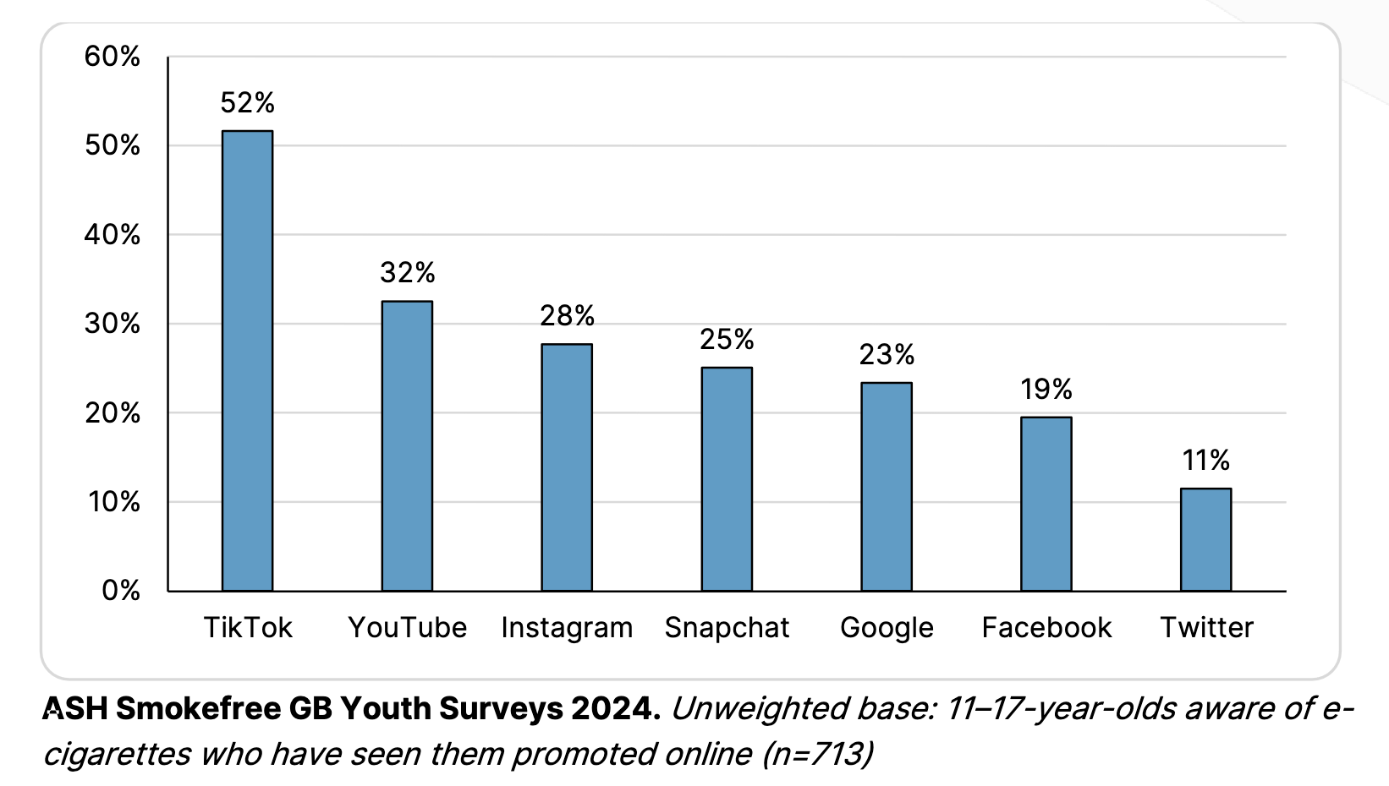
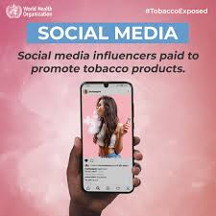
Vapes and Social Media:
What do you feel about it?
Can you think of anything else ?
Notes:
Discussion Slide
Teacher/Facilitator shares with young people and hold discussion around vapes and their prevalence/promotion on social media.

Slide 24
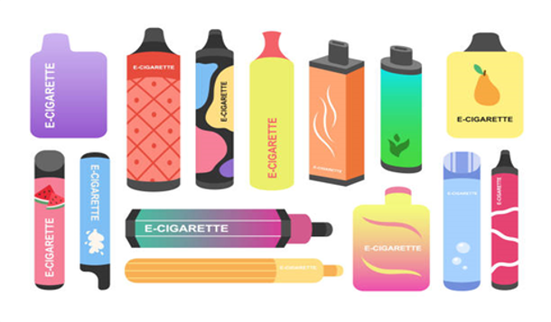
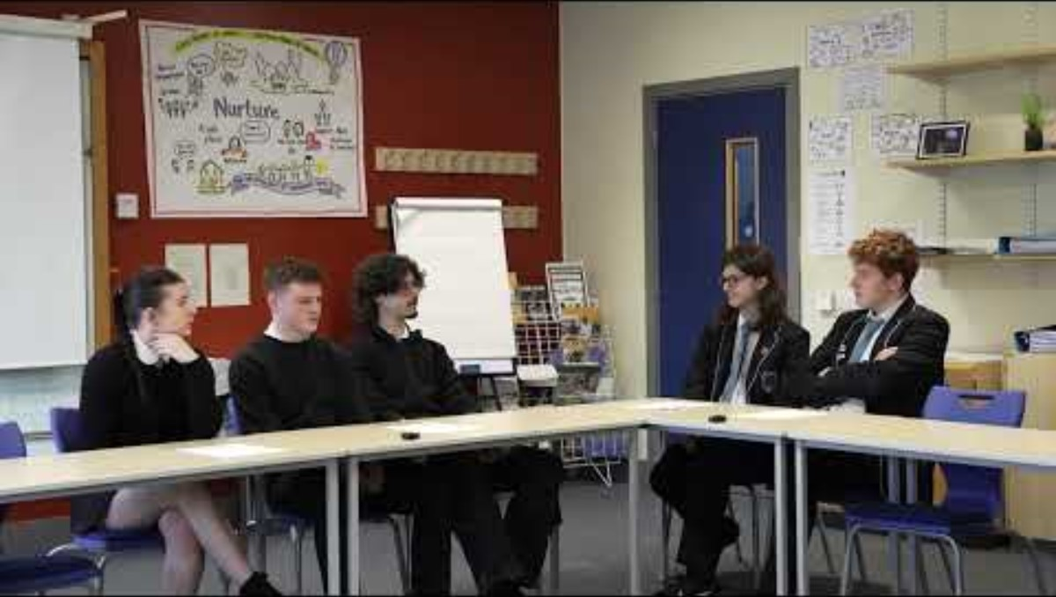
What would you do to reduce the appeal of vaping to younger teenagers?
Watch the short clip of young people discussing how vapes are promoted.
Notes:
Discussion Slide: What would you do to reduce the appeal of vaping to younger teenagers?
Teacher/Facilitator poses questions for class discussion: What are manufacturers of vapes doing to promote them? What could you do reduce the appeal of vaping to younger teenagers?

Slide 25
What would you do to reduce the appeal of vaping to younger teenagers?
Watch the short clip of young people discussing how vapes are promoted:
What ideas do they discuss to reduce the appeal to young people?
Discuss as a group. What other ideas are there to reduce the appeal of vaping to younger teenagers?
Notes:
Discussion Slide: What would you do to reduce the appeal of vaping to younger teenagers?
Teacher/Facilitator poses questions for class discussion: What are manufacturers of vapes doing to promote them? What could you do reduce the appeal of vaping to younger teenagers?

Slide 26

Vaping and the law:
Research Task
What can you find out about current laws around vaping in:
Scotland and the UK
China
Australia
What changes are planned with the UK Tobacco and Vapes Bill?
https://bills.parliament.uk/bills/3879
What can you find out about the Scottish Government’s Tobacco & Vaping Framework?
https://www.gov.scot/publications/tobacco-vaping-framework
Notes:
Activity Slide: Vaping and the law: Research Task
What can you find out about current laws around vaping in:
Scotland and the UK
China
Australia
What changes are planned with the UK Tobacco and Vapes Bill?
https://bills.parliament.uk/bills/3879
What can you find out about the Scottish Government’s Tobacco & Vaping Framework?
https://www.gov.scot/publications/tobacco-vaping-framework
China:
In China, the vaping industry is heavily regulated, with a focus on limiting youth access and promoting public health. Specifically, the sale of flavored vapes are prohibited, and online sales are also banned.
Flavors: The sale of vapes with flavors other than tobacco is strictly prohibited. This ban aims to reduce the appeal of vapes to young people.
Online Sales: Selling vapes online is also prohibited.
Young people: Vapes cannot be sold to young people.
Packaging: Vape packaging must include strong warnings about the health risks and the prohibition of use by children.
Public Spaces: Using vapes is prohibited in schools and other places where young people may gather.
Australia:
In Australia, the sale of all vapes, regardless of nicotine content, is restricted to pharmacies for the purpose of smoking cessation or managing nicotine dependence. Adults aged 18 and over can purchase vapes with a nicotine concentration of 20 mg/ml or less from participating pharmacies without a prescription after consulting with a pharmacist. Individuals under 18, or those seeking higher nicotine concentrations, require a prescription for vapes.
Key aspects of the vaping laws:
Sale Restrictions: All vapes, including those without nicotine, can only be sold in pharmacies.
Age Restrictions: Individuals under 18 need a prescription to access vapes.
Nicotine Concentration: Vapes with 20 mg/mL or less nicotine can be purchased over-the-counter by adults otherwise, a prescription is needed.
Pharmacist Consultation: Before purchasing a vape without a prescription, individuals must consult with a pharmacist, who will discuss the product, dosage, and other smoking cessation options.
Limited Supply: A maximum of one month's supply can be purchased in a month.
Enforcement: New penalties apply for the unlawful importation, manufacture, advertisement, supply, and commercial possession of vapes.

Slide 27
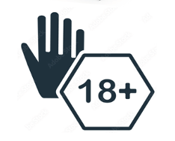

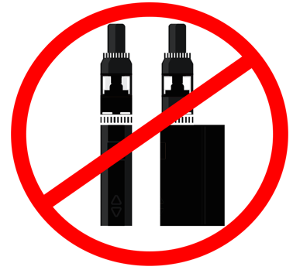
Vaping and the law
It's illegal for someone 18 and older to buy vapes for anyone under 18. This is called proxy buying.
Shops must not sell vapes to anyone under 18.
If someone looks under 25 a retailer must ask for proof of age.
A person must be still be 18+ to buy a nicotine free vape/liquid.
Most public places don’t allow vaping: trains, buses, stations, shops, restaurants and planes.
Single use (disposable) vapes are now illegal. All vapes must be rechargeable and refillable.
THC vapes are illegal.
Notes:
Information Slide: Vaping and the law
Teacher/Facilitator shares information with young people.
It's illegal for someone 18 and older to buy vapes for anyone under 18. This is called proxy buying.
Shops must not sell vapes to anyone under 18.
If someone looks under 25 a retailer must ask for proof of age.
A person must be still be 18+ to buy a nicotine free vape/liquid.
Most public places don’t allow vaping: trains, buses, stations, shops, restaurants and planes.
Single use (disposable) vapes are now illegal. All vapes must be rechargeable and refillable.
THC vapes are illegal.

Slide 28
Why do some young people vape?
When we asked, local young people in Greater Glasgow and Clyde why they vaped, they said:
“I liked the taste of them”.
“I wanted to be cool and felt if I said no it would be embarrassing”.
“It was a trend and I felt pressured into it”.
“It calms me down. I would get angry and that would make me feel calmer”.
Notes:
Discussion Slide: Why do some young people vape?
Teacher/Facilitator opens class discussion around reasons why young people may vape. We know most young people who vape have never smoked before. This is an open discussion designed to ensure young people have a voice around the issue.
Young people vape for a variety of reasons, including:
Curiosity: Many try vaping out of curiosity about the flavours, experience, or the device itself.
Peer Pressure: Social influence from friends or peers who vape can encourage young people to try it.
Perception of Safety: Some believe vaping is less harmful than smoking traditional cigarettes.
Flavors: The wide range of appealing flavours, such as fruit, candy, and desserts, attracts younger users.
5.Stress Relief: Some view vaping to cope with stress, anxiety, or other emotional challenges.
Advertising and Social Media: Marketing and the portrayal of vaping on social media can make it appear trendy or cool.
Nicotine Addiction: For those who have tried vaping, the nicotine content can lead to dependency, keeping them vaping.
Easy Accessibility: Despite restrictions, vapes are often easy for young people to access.

Slide 29
Youth perceptions of vaping?
Can you design a survey to gather information about attitudes to vaping in your school/community?
Consider the following areas:
Health
Usage Trends
Social Influences
https://forms.office.com/
https://www.surveymonkey.com/
Notes:
Activity Slide: Youth perceptions of vaping?
Can you design a survey to gather information about attitudes to vaping in your school/community?
Consider the following areas:
Health
Usage Trends
Social Influences
https://forms.office.com/
https://www.surveymonkey.com/

Slide 30
Youth perceptions of vaping: Scottish Government Findings
Health
There are growing concerns about potential health risks, especially for young people.
Vaping is less harmful for adults who smoke.
More research needed around dual use with tobacco and vaping during pregnancy.
Usage Trends
In adults, regular use is mainly among people who have smoked.
Most young people who vape have never smoked.
Social Influences
In Greater Glasgow & Clyde young people shared that peer influence and social media are the main reasons that they chose to vape.
Trendy images, colours and flavours can drive youth experimentation.
Notes:
Information Slide: Youth perceptions of vaping: Scottish Government Findings
Teacher/Facilitator shares with young people.
In Scotland, young people's perceptions of vaping are shaped by various factors, including social influences, health awareness, and regulatory changes. Key insights include:
Perceived Harmfulness and Social Acceptance
Health Concerns: Many Scottish youths recognise potential health risks associated with vaping, though some perceive it as less harmful than traditional smoking.
Social Influences: Peer pressure and the portrayal of vaping in media contribute to its perception as a socially acceptable or even trendy activity among some young people.
Prevalence and Usage Trends
Increasing Experimentation: Experimentation with e-cigarettes has risen among Scottish adolescents, with a notable increase in occasional use.
Regular Use: Despite increased experimentation, regular use remains relatively low and is primarily observed among current or former smokers.
Calls for action on stopping tobacco smoking and youth vaping - News - Public Health Scotland
Young People and Vaping - ASH Scotland
Key findings - Vaping – Youth perceptions and attitudes: evidence briefing - gov.scot

Slide 31

Why do we overestimate the number of young people who vape?
Scottish Government’s Health & Wellbeing Census (2022)
Vape use had doubled for 11-17yrs from 2021
40% of young people vaping had never smoked
YouGov survey (2022) showed:
Showed % regular use of vapes:
4.3% of 13 yrs
10% of 15 yrs
ASH UK research (2024)
85% of 11-15 yrs had not tried vaping
Less than 5% of 11-15 yrs regular use
Notes:
Information Slide: Why do we overestimate the number of young people who vape?
Teacher/Facilitator shares with young people.
A social norms approach ensures that prevalence is not exaggerated, and young people are aware that most young people are not vaping regularly.
References for all statistics
Scottish Schools Adolescent Lifestyle and Substance (SALSUS)
https://www.gov.scot/collections/scottish-schools-adolescent-lifestyle-and-substance-use-survey-salsus/
Scottish Government Health and Wellbeing Census
https://www.gov.scot/publications/health-and-wellbeing-census-scotland-2021-22/pages/substance-use/
ASH Scotland
https://ashscotland.org.uk/wp-content/uploads/2024/06/Smoking-and-vaping-statistics-factsheet_June_2024.pdf

Slide 32
Why do we overestimate the number of young people who vape?
'Media Influence'
'Negativity bias'
'We notice what concerns us'
'Moral panic'
'Vapes prominently displayed in shops'
Notes:
Discussion Slide: Why do we overestimate the number of young people who vape?
Teacher facilitates class discussion around perceptions of numbers of young people who vape. Are the statistics surprising? What can young people think of as to why we might perceive numbers of young people vaping to be higher than reality?

Slide 33
Why do most young people choose NOT to vape?
I want to save my money
Nicotine harms the teenage brain
I don't want to get addicted
I don't know long term effects
I want to perform well in sport and fitness
Notes:
Discussion Slide: Why do most young people choose NOT to vape?
Teacher/Facilitator opens class discussion, which builds on the social norms approach, around reasons why most young people do not vape. This is an open discussion designed to ensure young people have a voice around the issue and can identify their own positive reasons for not vaping.
Young people may choose not to vape for several reasons, including:
Health Concerns: Awareness of the potential health risks, such as lung damage or nicotine addiction, can discourage vaping.
Lack of Interest: Some simply don’t find vaping appealing or see no reason to try it.
Parental or Educational Influence: Strong guidance from parents, teachers, or role models may steer them away from vaping.
Athletic Performance: Athletes might avoid vaping to maintain their fitness and lung health.
Financial Reasons: Vaping can be expensive, and some young people may not want to spend money on it.
Social Norms: Being part of a peer group that doesn’t vape can reduce the likelihood of trying it.
Moral or Ethical Beliefs: Personal values or beliefs may lead them to avoid substances like nicotine.
Negative Perceptions: Some view vaping as unappealing, unattractive, or associated with certain stereotypes.

Slide 34
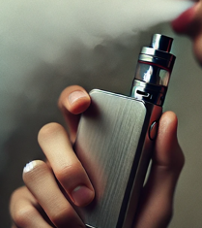
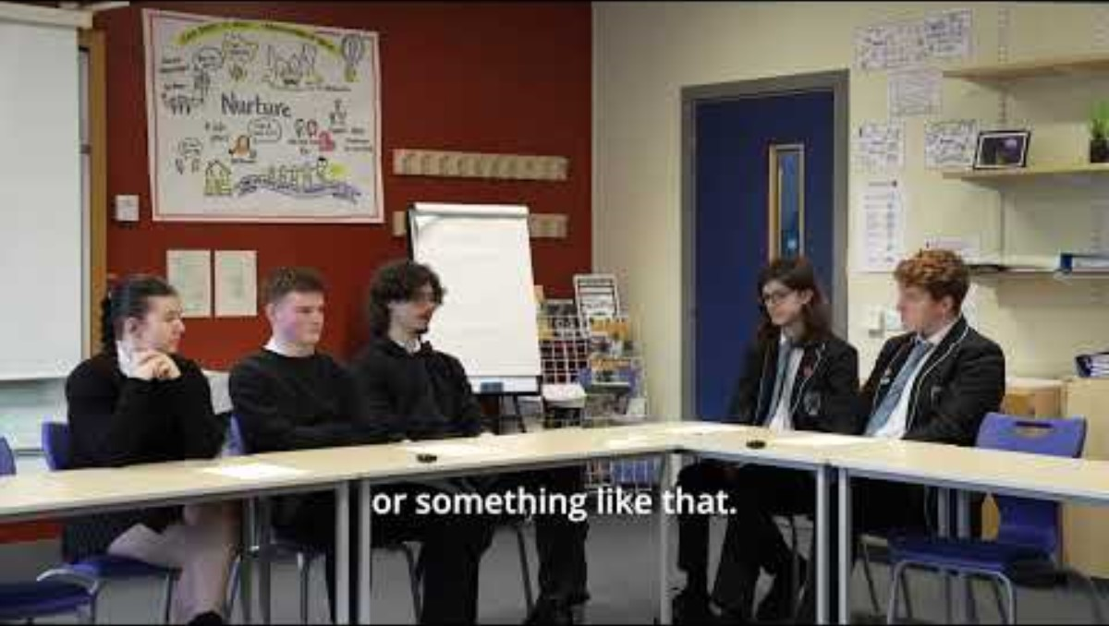
How can vaping affect young people?
Watch the short clip where young people discuss Vaping and finances.
Notes:
Activity Slide: How can vaping affect young people?
Teacher facilitates activity. Draw a person on the board.
Individually or in groups pupils can take 5 mins to note as many impacts of vaping as possible, using post its, then bring up their answers to surround the person.
Support pupils to categorise these impacts into areas?
Physical health
Mental health
Finance
Environment

Slide 35

How can vaping affect young people?
Draw a person on the board.
Take 5 mins to note as many impacts of vaping as possible, Using post-its, surround your person.
Can you categorise these impacts into areas?
Physical health
Mental health
Finance
Environment
There may be many more...
Notes:
Activity Slide: How can vaping affect young people?
Teacher facilitates activity. Draw a person on the board.
Individually or in groups pupils can take 5 mins to note as many impacts of vaping as possible, using post its, then bring up their answers to surround the person.
Support pupils to categorise these impacts into areas?
Physical health
Mental health
Finance
Environment

Slide 36
How can vaping affect young people?
Vaping is not risk-free. Vaping can lead to both short/medium-term health impacts. Longer term impacts are not yet known:
Nicotine Addiction:
Nicotine is a stimulant and highly addictive. Using nicotine during teenage years can lead to nicotine dependency and risk of using other substances.
Teenage Brain Development:
Nicotine can harm the developing brain. Early use of nicotine can impact parts of the brain that control concentration, learning, mood and impulse control.
Known Short Term Effects:
Short-term effects of coughing, dizziness, sore throats, lung inflammation, gum issues and headaches. Longer-term effects are not yet known.
Sports Performance:
Vaping may affect sporting performance due to breathlessness, lung inflammation and irritation. This can make it harder to breathe and do well in sports.
Notes:
Information Slide: How can vaping affect young people?
Teacher/Facilitator shares information with young people.
Info taken from NHS Greater Glasgow & Clyde Vaping and Young People Briefing Paper

Slide 37

Recap: Vapes and the environment
Vapes contain batteries, chemicals and difficult to recycle plastics:
When dumped in landfill vapes cause dangerous chemicals to pollute our soil, water and oceans.
The plastics and toxic waste affect birds and animals.
Valuable metals and rare resources are needed for vapes. Over 40 tonnes of lithium was thrown out with disposable vapes in the UK in 2022. That’s enough to make batteries for 5000 electric cars.
To reduce the environmental impact from June 2025 all vapes must be refillable and rechargeable.
Notes:
Information Slide: Recap: Vapes and the environment
Teacher/Facilitator shares information with young people.
Rather than decomposing, plastic turns into “microplastics” which continue to pollute the environment, our food and drinking water
•Disposable vaping devices also contain lithium batteries which, if damaged, can pose a fire hazard when thrown away
•Lithium is also a very valuable metal but tonnes of it each year is being thrown away and ends up in landfill or waste incinerators. This lithium could be used in things like electric cars which could help us address climate change
•Disposable vaping devices are classed as Waste Electrical and Electronic Equipment (WEEE) and should be being recycled
•Explore safe disposal of disposable vaping devices and other electrical equipment via recycling schemes. You can find your closest centre on the Recycle Your Electricals website.
Vapes contain minerals needed to make the country more eco-friendly
Vapes are made using plastic and critical minerals that are in demand for green technologies that will help tackle climate change.
Each single-use vape contains on average 0.15g of lithium.
With more than 8 million thrown away every week, this adds up to 40 tonnes of lithium a year, equivalent to the lithium in batteries inside 5,000 electric vehicles, according to Material Focus.
They also contain copper, which is "vital for a lot of infrastructure" such as rail and EV charging, said Libby Peake from thinktank Green Alliance.
https://ashscotland.org.uk/wp-content/uploads/2024/06/Smoking-and-vaping-statistics-factsheet_June_2024.pdf

Slide 38





Vaping and your environment:
Research Project
Research what could be done to reduce the impact of vaping on your school/community:
Make vapes more environmentally friendly
Use laws or penalties to ensure that the 'polluter pays’
Reduce use of vapes
Address the manufacturers of vapes​
Improve rates of proper recycling​
Can your research become part of your school policy?
Notes:
Activity Slide: Vaping and your environment Research Project
Teacher explains that research task is for pupils to identify what could be done to reduce the impact of vaping on their school/community.
Pupils can build on the survey approaches around perceptions of vaping. They may be supported to form a focus group/link with school’s existing mechanisms for gathering pupil voice and leadership. Their findings and ideas could be integral in creating a school policy on Vaping/nicotine products.

Slide 39

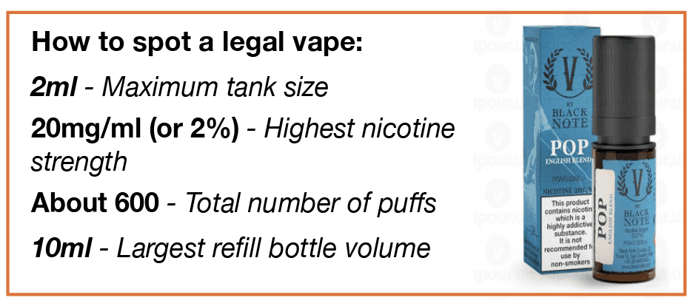
Unregulated/fake vapes
1 in 3 vapes sold in shops, online, from dealers and on social media do not comply with UK regulations and are unsafe.
These products when tested contained substances including lead, nickel, chromium, acetaldehyde, formaldehyde spice or THC.
Any single use disposable vapes are fake.
Fake vapes can contain high nicotine levels.
Over 6,000 fake vapes were seized in Glasgow in 2024 and 1.9 million across the UK.
Packaging should have a
Health warning saying
"This product contains nicotine which is a highly addictive substance"
Notes:
Information Slide: Unregulated/fake vapes
Teacher/Facilitator shares information with young people.
Sources: Trading Standards Glasgow and UK

Slide 40
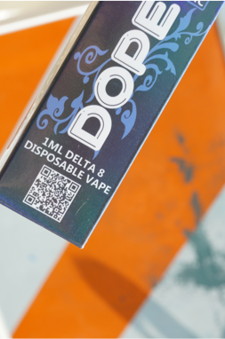
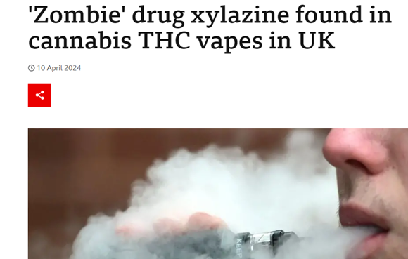
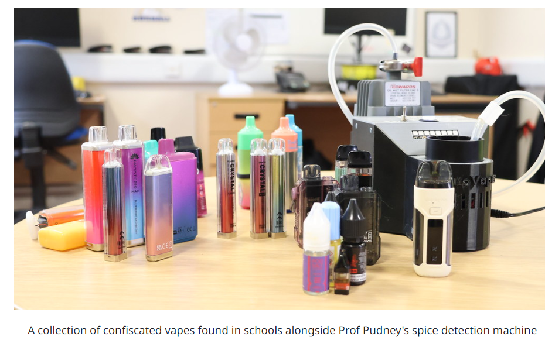
THC and Spice in vapes
Cannabis vape are illegal products that can contain high levels of THC (psychoactive part of cannabis).
It's not possible to know the exact substance nor the amount of THC in the vape.
Inhaling THC using a vape can lead to a person consuming very high amounts very quickly, sometimes leading to medical treatment.
THC vapes can cause negative side effects due to the high levels of the substance
Testing of these products has shown many are fake and made with synthetic cannabis (Spice) which is highly dangerous.
A study showed 1 in 6 vapes tested from schools in the UK were found to contain Spice in 2024.
Notes:
Information Slide: THC and Spice in vapes
Teacher/Facilitator shares information on slide with young people.
Some illegal vapes contain Tetrahydrocannabinol (THC) which is the psychoactive ingredient in cannabis, the part that gives a 'high'. Others have been found to contain SPICE which is a harmful synthetic substance designed to mimic THC, it has very negative side effects.
Millions of illicit vapes and tobacco products seized by Trading Standards - National Trading Standards
English school children unwittingly smoking spice-spiked vapes, finds University of Bath
https://www.knowthescore.info/drug/synthetic-cannabinoids/?streetname=spice

Slide 41
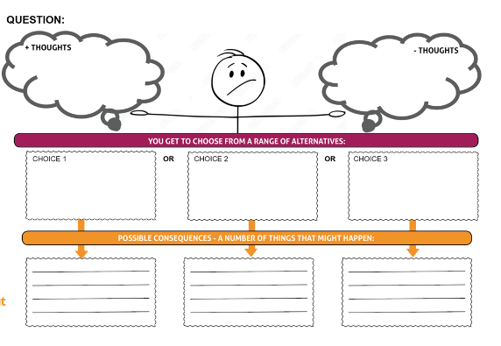
Making choices
Situation:
Joe's friends are trying to convince him to try a THC vape with them on a camping trip.
In groups:
Discuss the situation
What +ve and –ve thoughts might Joe have?
Agree 3 possible choices Joe could make
Play each choice forward in your mind. What are the consequences of each choice?
Can you think of anything else ?
Notes:
Activity Slide: Making Choices
Teacher/Facilitator explains to young people the ‘Making Choices’ framework. A printable blank template can be used.
In groups:​
Discuss the question​
What +ve and –ve thoughts might Joe have?​
Agree 3 possible choices Joe could make​
Play each choice forward in your mind. What are the consequences of each choice?
This activity supports young people to explore the feeling of being torn between options and use the technique of linking cause and effect to support decision making.
Exam stress is a common reason young people have shared for starting to vape. The question can be altered to suit or young people can be encouraged to create relevant questions for the Making Choices approach.

Slide 42
Making choices
Situation:
Joe's friends are trying to convince him to try a THC vape with them on a camping trip.
Choice 1
Joe decides to join in and uses the THC vape with his friends.
Consequences?
Choice 2
Joe chooses not to use the THC vape and stays awake to keep an eye on his friends who do use it.
Consequences?
Choice 3
Joe decides he feels uncomfortable and makes his own way home.
Consequences?
Can you think of anything else ?
Notes:
Activity Slide: Making Choices
Teacher/Facilitator explains to young people the ‘Making Choices’ framework. A printable blank template can be used.
In groups:​
Discuss the question​
What +ve and –ve thoughts might Joe have?​
Agree 3 possible choices Joe could make​
Play each choice forward in your mind. What are the consequences of each choice?
This activity supports young people to explore the feeling of being torn between options and use the technique of linking cause and effect to support decision making.
Exam stress is a common reason young people have shared for starting to vape. The question can be altered to suit or young people can be encouraged to create relevant questions for the Making Choices approach.

Slide 43
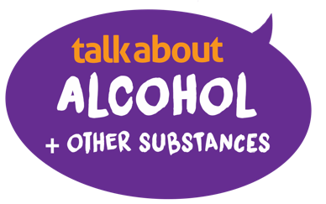

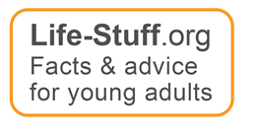
ns
How to avoid Vape Spiking
Vape spiking is:
addition of substances such as THC/Spice, or another dangerous substance to a vape without someone knowing.
.
Safety tips:
Don’t share vapes
Sharing a vape with anyone makes someone more vulnerable to spiking. Especially if it is someone you don’t know.
Notes:
Information Slide: How to avoid vape spiking
Teacher/Facilitator shares information with young people.

Slide 44

ns
How to avoid Vape Spiking
Ensure no one can tamper with vape:
Keep vapes safe. Store securely like a phone or bank card.
If a vape has moved/isn’t where someone thought it was, it could have been spiked – so don’t use it.
If a vape is dropped or lost and found again don’t use it
The advice is not to use it as someone can’t be sure it hasn’t been spiked.
.
Notes:
Information Slide
Teacher/Facilitator shares with young people.

Slide 45
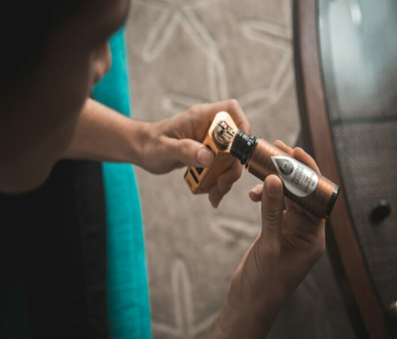

ns
If you see or suspect spiking of any kind report it to
Police Scotland by calling 101
How to report Vape Spiking or fake vapes
If you think a business is selling vapes to under 18s or is selling unregulated vapes, you can report the business to Trading Standards.
Visit the Consumer Advice website:
https://consumeradvice.scot/
Notes:
Information Slide: How to avoid vape spiking
Teacher/Facilitator shares information on slide with young people. Discussion can take place around young people feeling empowered to use the website link to trading standards/report any concerns regarding vape spiking to Police Scotland using 101.

Slide 46
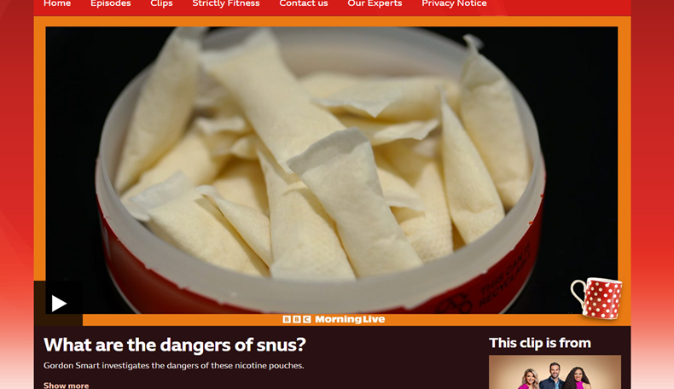
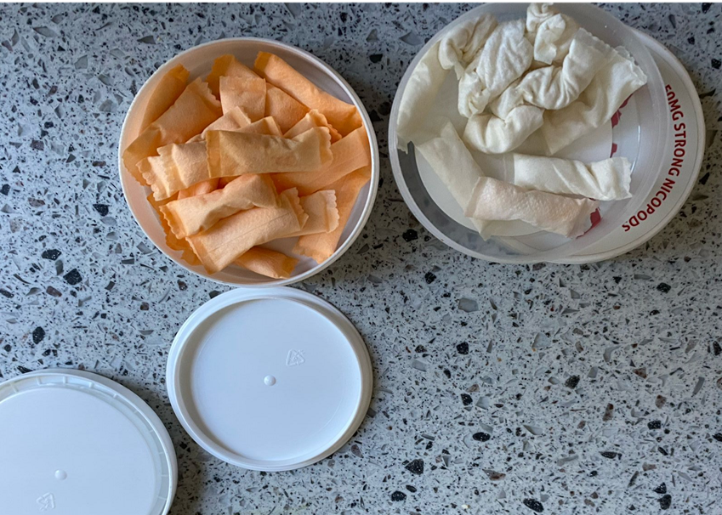
Nicotine pouches
Nicotine pouches, often referred to as white snus, are flavoured small sachets that contain synthetic or plant-based nicotine, sweeteners and chemical flavourings.
These pouches do not contain tobacco. At present they are NOT regulated by tobacco legislation and may contain any level of nicotine.
Nicotine pouches contain high levels of nicotine, which can make a person feel dizzy and sick.
Research suggests nicotine pouches can lead to oral issues like ulcers and receding gums, increased heart rate and blood pressure.
Notes:
Information Slide
Teacher/Facilitator shares information with young people.
In Scotland and the UK, nicotine pouches are not covered by tobacco or vaping regulations. Nicotine pouches are not required to adhere to the same controls on advertising and retail displays as tobacco, nor age of sale restrictions which are in place for cigarettes and vapes. This is expected to change with the tobacco and vapes bill currently progressing through parliament. However, this means at present pouches can contain any level of nicotine, with higher strength pouches containing 50mg or more.
BBC One - Morning Live, What are the dangers of snus?
https://ashscotland.org.uk/briefing/nicotine-pouches/
A UK market analysis report for 2023 reported a significant growth of the nicotine pouches sector for the second year running. In 2023 the two most popular nicotine pouches brands sales grew by 121% and 54% respectively.
A 2023 review concluded that, whilst there is no published data on the impact of nicotine pouches on oral health, prolonged regular use may give an increased risk of oral problems such as receding gums and persistent ulcers.
A report by Loughborough University published in May 2024 found one in five (20%) professional footballers in England currently use and two in five (40%) have used nicotine pouches at least once
A health risk assessment on nicotine pouches by the German Federal Institute for Risk Assessment concluded that the main risk of using nicotine pouches is the high levels of nicotine which has strong effects on the cardiovascular system. Pouches also present high risks for children, pregnant and breastfeeding women, and people with cardiovascular disease.

Slide 47
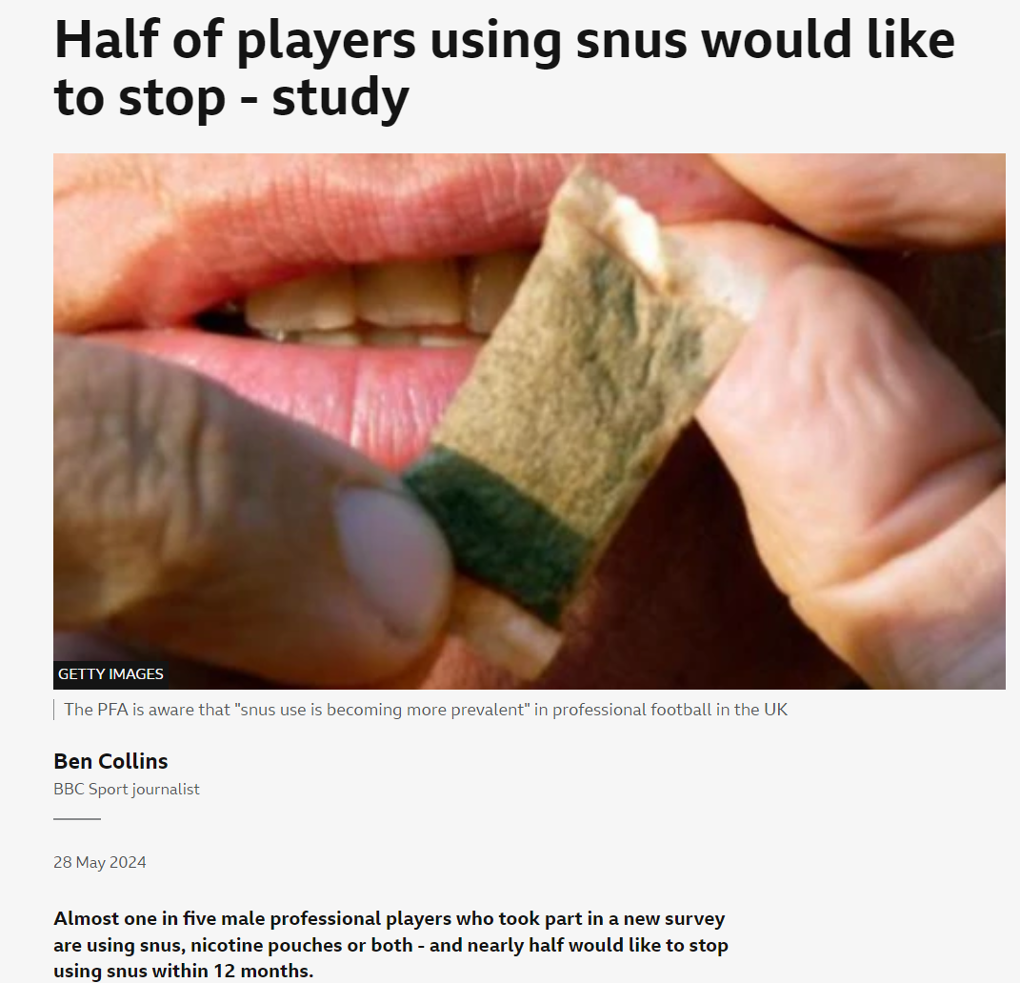
Nicotine pouches
Influencers and sports people using nicotine pouches:
What do you think?
Why might over half now want to stop?
What do you feel about the role of influencers promoting nicotine products?
What do you feel is important about the sale of these products?
Notes:
Discussion Slide: Nicotine pouches
Teacher/Facilitator opens class discussion around reasons why footballers started using Snus/pouches and why they wish to stop now. Encourage discussion around the influences and marketing around these products.
https://www.bbc.co.uk/sport/football/articles/c100p6572n4o

Slide 48
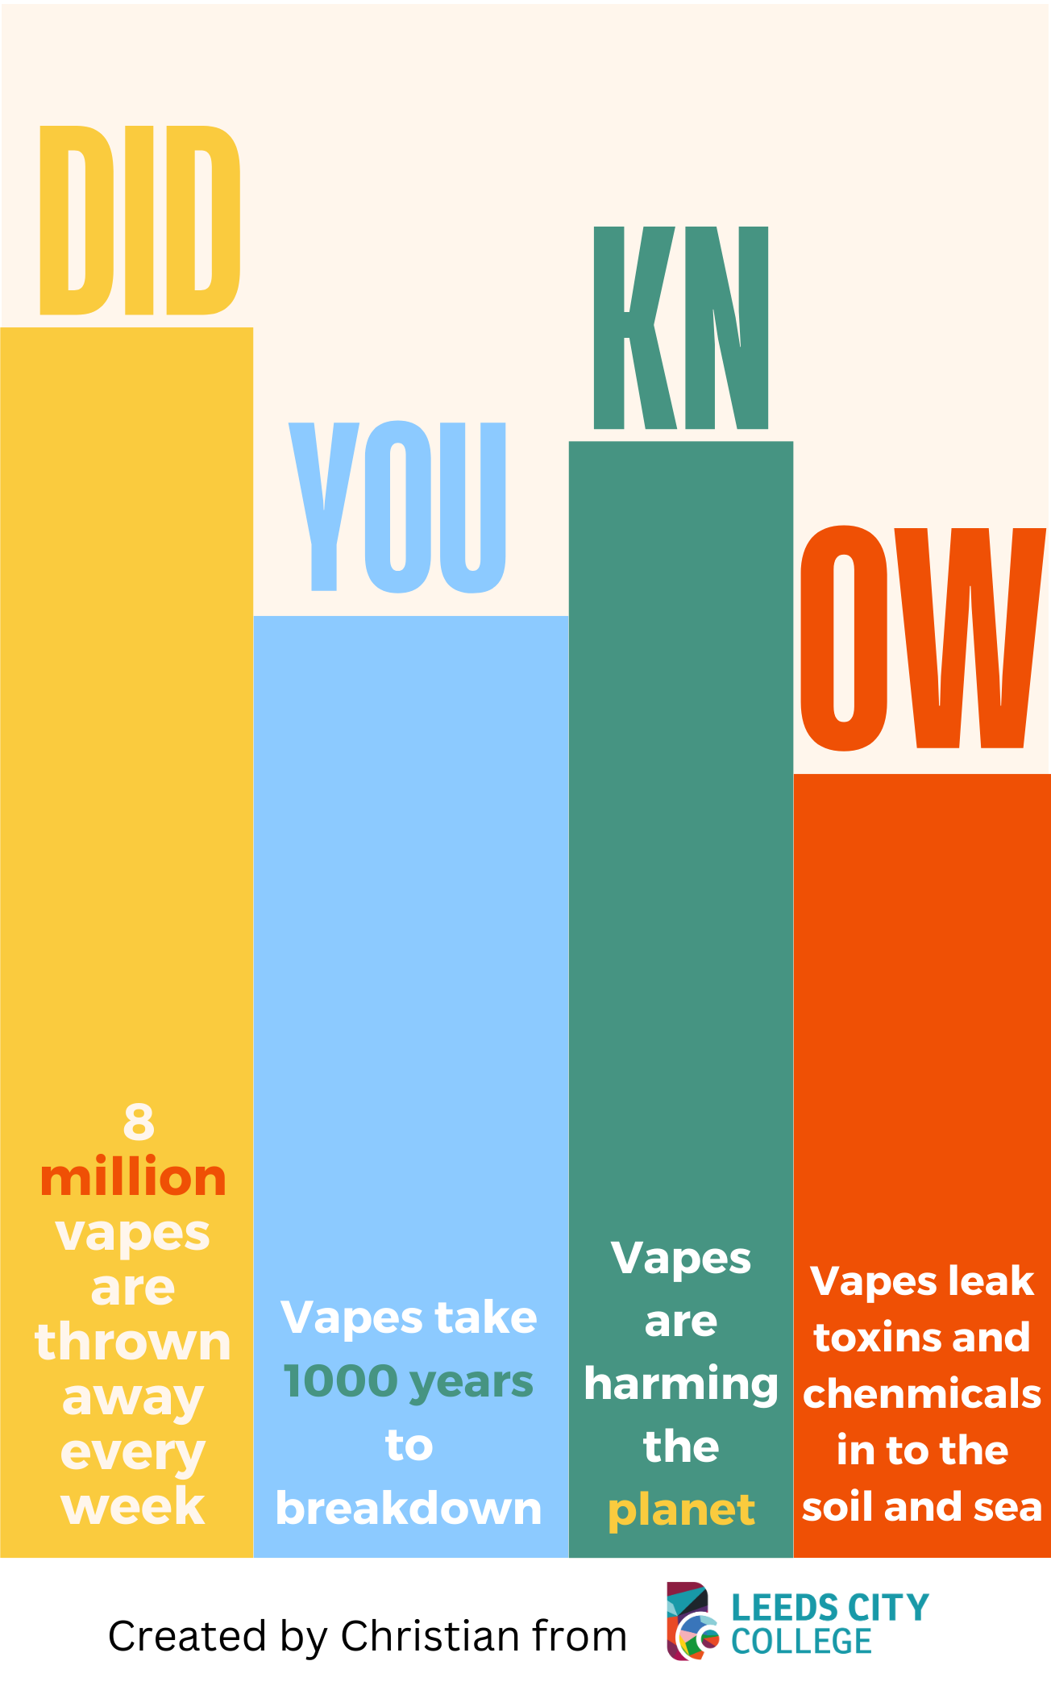

Plan a campaign
In groups:
Think about how you can make a positive impact around vaping and young people in your local area.
You could:
Produce a poster or short presentation for a local primary school about the health harms of vaping
OR
Produce a poster or short presentation raising awareness about the environmental issues
OR
Write a letter to your MSP to influence laws or policies on vaping in Scotland.
Notes:
Activity Slide
Teacher/Facilitator to explain activity to young people:
In groups:
Think about how you can make a positive impact around vaping and young people in your local area.
You could:
Produce a poster or short presentation for a local primary school about the health harms of vaping
OR
Produce a poster or short presentation raising awareness about the environmental issues
OR
Write a letter to your MSP to influence laws on vaping in Scotland.

Slide 49
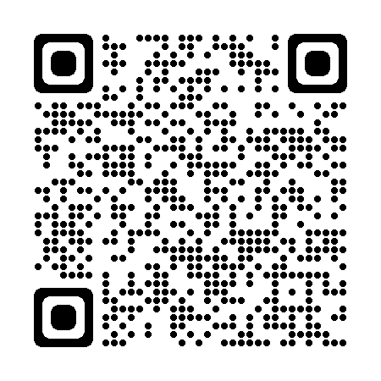
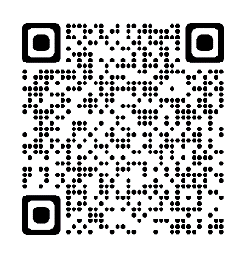
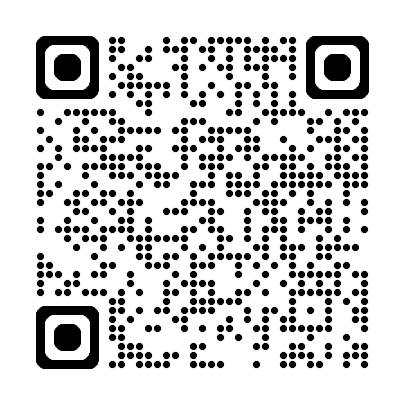
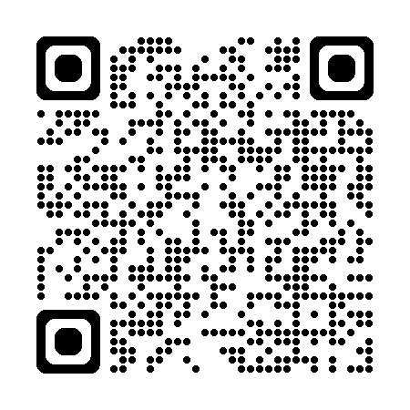
How to support someone around vaping
In groups
Research what information is available on vaping in your local area. These websites can help.
Create a leaflet signposting young people to information around vaping.
Childline
NHSinform
Childline.org.uk
nhsinform.scot
Quit Your Way Youth
Breathing Space
Breathingspace.scot
nhsggc.scot
Notes:
Activity Slide
Teacher/Facilitator to explain activity to young people:
In groups
Research what support is available on vaping in your local area. The websites will help.
Create a leaflet signposting young people to help & advice around vaping.
Title suggestions for leaflets
"Your Guide to [Topic]"
"Helpful Tips and Resources for [Audience/Topic]"
"Everything You Need to Know About [Topic]"
"Quick Reference Guide to [Topic]"
"Essential Advice for [Audience/Topic]"
"Your Go-To Information on [Topic]"
"Practical Guidance for [Audience/Topic]"
"Support and Advice for [Audience/Topic]"
"Know More About [Topic]"
"Expert Insights and Tips for [Topic]"
"How-To Guide for [Audience/Topic]"
"Stay Informed: [Topic]"
"Step-by-Step Guide to [Topic]"
"Answers and Solutions for [Audience/Topic]"
"The Complete Resource on [Topic]"

Slide 50




Where to go for help and information
Where to go for help and support
Quit your way website: with tips to cut down & stop
https://www.nhsggc.scot/your-health/quit-your-way/quit-your-way-youth/
Quit your way Information guide: Facts about vaping
https://talkabouttrust.org/resources/schools/nhs-ggc-vaping-information-guide
NHS Inform website: with tips to cut down & stop
https://www.nhsinform.scot/campaigns/vaping/
ChildLine: Advice and information for young people
https://www.childline.org.uk/info-advice/you-your-body/drugs-alcohol-smoking/vaping/
Can you think of anything else ?
Notes:
Information Slide: Where to go for help and information
Teacher shares information with young people. Links can be accessed together as a class to familiarise young people with the resources.
Quit your way Youth - NHSGGC
Young people and vaping briefing paper - NHSGGC
Vaping addiction soon takes hold | NHS inform
Encourage discussion about accessing support. How easy is this for young people to do? Who are their trusted adults both in and out of school?
Video short can be watched together which contains tips for cutting down and stopping.

Slide 51


How do you feel now?
The
confidence ruler
Still not sure
Need to know more
Very knowledgeable
Notes:
Activity Slide: The confidence ruler
Teacher/Facilitator can ask young people to rate their knowledge and understanding around vaping out of 10, following the input.
How confident are you NOW in your knowledge and understanding about Vaping ?

