Slide 1



What do we know?
Finding out more about physical, social and environmental effects
Vaping
PSE Lesson S1 – S3
Notes:
Summary of Curriculum for Excellence Experiences & Outcomes:
I am developing a range of skills which can support decision making about substance use. I can demonstrate strategies for making informed choices to maintain and improve my health and wellbeing and can apply these in situations that may be stressful or challenging or involve peer pressure.
HWB 3-40a / HWB 4-40a
I understand the positive effects that some substances can have on the mind and body but I am aware of the negative and serious physical, mental, emotional, social and legal consequences of the misuse of substances. HWB 3-38a
After assessing options and the consequences of my decisions, I can identify safe and unsafe behaviours and actions. HWB 3-41a. HWB 4-41a
I understand the impact that ongoing misuse of substances can have on a person’s health, future health choices and options. HWB 3-43a
I know that popular culture, the media and peer groups as well as own attitudes and values can influence how I feel about substance use and recognise the impact this may have on my actions. HWB 3-39a
I can identify the possible consequences of an environmental issue (such as Vaping) SOC 3-10a
Through investigating substance misuse in my local community, I can reflect on specific issues and discuss how they are being addressed HWB 3-43b.
I know how to access information and support for substance-related issues HWB 3-3-40b

Slide 2
Respectful
Group
agreement
Listening
Focused
Careful Sharing
Anything else?
Notes:
Activity Slide: Group Agreement
Teacher/Facilitator establishes a group agreement with young people.
Prompts on slide can be used to gather other ideas through class discussion/post it note suggestions from young people.
‘Careful sharing’ refers to pupils not feeling pressured to directly disclose theirs/others use of nicotine and considering what/how much they wish to share about themselves.
Teacher/Facilitator will be aware of child protection and health & wellbeing procedures for their own setting should anything arise following lesson/workshop.

Slide 3
How nicotine affects a person
What are we learning?
Understanding levels of risk around vaping
Exploring why most young people don't vape
Vaping and the environment
Risks around unregulated vapes
Notes:
Activity Slide: Group Agreement
Teacher/Facilitator establishes a group agreement with young people.
Prompts on slide can be used to gather other ideas through class discussion/post it note suggestions from young people.
‘Careful sharing’ refers to pupils not feeling pressured to directly disclose theirs/others use of nicotine and considering what/how much they wish to share about themselves.
Teacher/Facilitator will be aware of child protection and health & wellbeing procedures for their own setting should anything arise following lesson/workshop.

Slide 4

The
confidence
ruler
Not sure
Need to know more
Very knowledgeable
Notes:
Activity Slide: The Confidence Ruler
Teacher/Facilitator can ask young people to rate their knowledge and understanding around vaping and the topics to be covered in the lesson out of 10, providing a baseline. This can be repeated at the end of input as a measure of progress.
How confident are you in what you already know about Vaping? The new laws on vaping?

Slide 5
What is Vaping?
Vaping is the use of an electronic device to inhale vapour coming from a heated liquid that can contain:
Propylene glycol and vegetable glycerine
Nicotine – a stimulant drug
Flavourings and artificial chemical sweeteners
The highest strength legal vape has the nicotine level of 20mg/ml or 2%.
Notes:
Discussion Slide: What is Vaping?
Teacher/Facilitator poses question: What is Vaping? Does anyone know what vapes contain?
Click for the answers to inform discussion.
Image created by ChatGPT

Slide 6
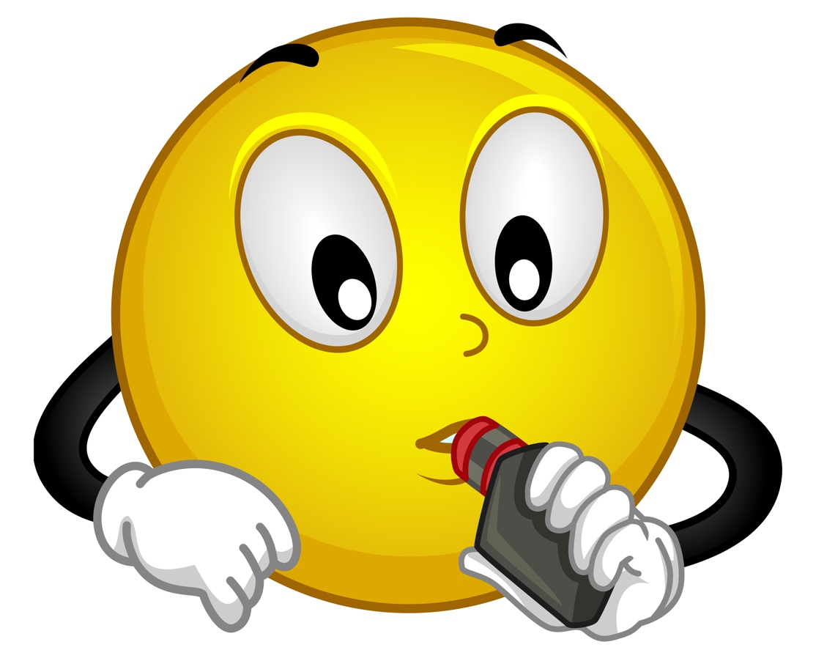
Vaping Quiz
How much do you know?
TRUE or FALSE?
Most young people in Scotland vape.
Notes:
Activity Slides 5 - 20: Vaping Quiz
Teacher facilitates quiz through class discussion, encouraging young people to share any prior knowledge/questions or thoughts. See teacher notes for other methods of delivery.
FALSE – The majority of young people do not vape.
ASH UK statistics from 2024 show that only 18% of 11 – 17-year-olds have EVER vaped.
Only 4.5% of 11 – 17 year olds vape regularly.

Slide 7
Vaping Quiz
How much do you know?
'Most young people in Scotland vape.'
FALSE – The majority (75%) of young people in Scotland choose not to vape.
In 2022 just 1 in 4 15-year-olds had vaped in the last month (25%)
Just 4% of 13-year-olds vape regularly.
Notes:
Activity Slides 5 - 20: Vaping Quiz
Teacher facilitates quiz through class discussion, encouraging young people to share any prior knowledge/questions or thoughts. See teacher notes for other methods of delivery.
FALSE – The majority of young people do not vape.
Sources
ASH Scotland's Literature review Sept 2023
SALSUS
The 2022 Health Behaviour in School Age Children (HBSC)
The Scottish Health and Wellbeing Census 2021/22 (HWC)
ASH UK statistics from 2024 show that only 18% of 11 – 17-year-olds have EVER vaped.
Only 4.5% of 11 – 17 year olds vape regularly.

Slide 8


Vaping Quiz
How much do you know?
TRUE or FALSE?
All vapes contain the same amount of nicotine.
Notes:
Activity Slides 5 - 20: Vaping Quiz
Teacher facilitates quiz through class discussion, encouraging young people to share any prior knowledge/questions or thoughts. See teacher notes for other methods of delivery.
TRUE - A cigarette contains 1 – 1.5mg of nicotine and LEGAL vapes contain up to 20mg, so a similar amount of nicotine to 20 cigarettes.
1/3rd of vapes sold are illegal and we don’t know what’s in them. Some have very high levels of nicotine.

Slide 9
Vaping Quiz
How much do you know?
'All vapes contain the same amount of nicotine'
FALSE-
Vapes are sold with varying levels of nicotine.
The highest amount of nicotine a UK regulated vape can contain is (20mg/ml) with up to 2ml of liquid.
Trading Standards have shared that a third of all vapes sold are unregulated and it is not possible to know what is in them.
Notes:
Activity Slides 5 - 20: Vaping Quiz
Teacher facilitates quiz through class discussion, encouraging young people to share any prior knowledge/questions or thoughts. See teacher notes for other methods of delivery.
TRUE - Vaping myths and the facts - Better Health - NHS
1/3rd of vapes sold are illegal and we don’t know what’s in them. Some have very high levels of nicotine.

Slide 10

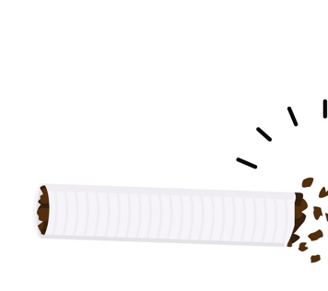
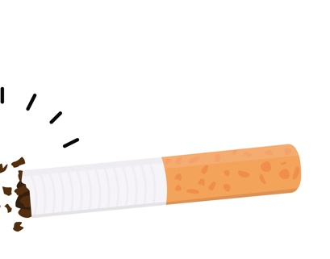
Vaping Quiz
How much do you know?
TRUE or FALSE?
Vaping can help someone quit smoking.
Notes:
Activity Slides 5 - 20: Vaping Quiz
Teacher facilitates quiz through class discussion, encouraging young people to share any prior knowledge/questions or thoughts. See teacher notes for other methods of delivery.
TRUE - Vaping can help smokers quit.
When someone who smokes wants to quit, they will crave nicotine.
Vaping delivers nicotine in a less harmful way, by vaporising e-liquid instead of burning tobacco into smoke.

Slide 11
Vaping Quiz
How much do you know?
'Vaping can help someone quit smoking.'
TRUE - Vaping can help someone quit smoking.
When someone who smokes wants to quit, they will crave nicotine.
Vaping delivers nicotine in a less harmful way, by vaporising e-liquid instead of burning tobacco into smoke.
Nicotine vaping is not risk-free, but it is less harmful than smoking.
Quit Your Way NHS Greater Glasgow & Clyde provide a confidential and youth friendly service to young people who wish to stop smoking.
This includes tailored support through telephone, face to face or virtual support sessions and access to nicotine replacement products. To find out more drop in to your local pharmacy, call 0800 916 8858 or visit our website.
Here is the link to our vaping resource pack
Notes:
Activity Slides 5 - 20: Vaping Quiz
Teacher facilitates quiz through class discussion, encouraging young people to share any prior knowledge/questions or thoughts. See teacher notes for other methods of delivery.
TRUE - Vaping can help smokers quit.
When someone who smokes wants to quit, they will crave nicotine.
Vaping delivers nicotine in a less harmful way, by vaporising e-liquid instead of burning tobacco into smoke.

Slide 12

Vaping Quiz
How much do you know?
?
TRUE or FALSE?
Vaping has no side effects.
Notes:
Activity Slides 5 - 20: Vaping Quiz
Teacher facilitates quiz through class discussion, encouraging young people to share any prior knowledge/questions or thoughts. See teacher notes for other methods of delivery.
FALSE - Vaping does have some side effects.
Vaping can make someone cough, give them a dry and irritated mouth and throat, and cause headaches, irritability, and problems concentrating. Vapes sold illegally often contain other substances like THC causing serious side effects.

Slide 13
Vaping Quiz
How much do you know?
?
'Vaping has no side effects.'
FALSE - Vaping does have some side effects.
Vaping can cause short-term effects such as coughing, dizziness, sore throats and headaches.
The long-term effects are not yet known. Put simply, people who don’t smoke should not vape.
Fake Vapes (6,000 seized in Glasgow in 2024) can contain other substances like THC or SPICE causing serious health effects.
Notes:
Activity Slides 5 - 20: Vaping Quiz
Teacher facilitates quiz through class discussion, encouraging young people to share any prior knowledge/questions or thoughts. See teacher notes for other methods of delivery.
FALSE - Vaping does have some side effects.
Vaping can make someone cough, give them a dry and irritated mouth and throat, and cause headaches, irritability, and problems concentrating. Vapes sold illegally often contain other substances like THC causing serious side effects.
Source Glasgow Trading Standards

Slide 14

Vaping Quiz
How much do you know?
TRUE or FALSE?
Vaping can help people with stress.
Notes:
FALSE - Young people may turn to vaping to try to deal with stress or anxiety, creating a cycle of nicotine dependence. But nicotine dependency can be a source of stress in itself. Nicotine does not relax a person or support them with stress.

Slide 15
Vaping Quiz
How much do you know?
'Vaping can help people with stress.'
FALSE - Young people have shared they have tried vaping to deal with stress or anxiety, creating a cycle of nicotine dependence. Nicotine dependency can be a source of stress itself.
Nicotine does not support people with stress. It can disrupt sleep and increase anxiety.
Notes:
Activity Slides 5 - 20: Vaping Quiz
Teacher facilitates quiz through class discussion, encouraging young people to share any prior knowledge/questions or thoughts. See teacher notes for other methods of delivery.
FALSE - Young people may turn to vaping to try to deal with stress or anxiety, creating a cycle of nicotine dependence. But nicotine dependency can be a source of stress in itself. Nicotine does not relax a person or support them with stress.

Slide 16

Vaping Quiz
How much do you know?
TRUE or FALSE?
There are currently no laws in Scotland around supply of vapes to under 18's.
Notes:
Activity Slides 5 - 20: Vaping Quiz
Teacher facilitates quiz through class discussion, encouraging young people to share any prior knowledge/questions or thoughts. See teacher notes for other methods of delivery.
FALSE - There are already laws in the UK around who can vape.
Vaping is illegal for under 18s or for someone to buy vapes for Under 18’s. If someone over 18 supplies vapes to anyone under 18 they can also be prosecuted.
A ban on the sale and supply of disposable vapes in Scotland is due by April 2025. Measures will also include restrictions on vape flavours and promotion, as well as changing age limits for buying tobacco.

Slide 17

Vaping Quiz
How much do you know?
'There are currently no laws in Scotland around supply of vapes to Under 18's.'
FALSE - There are strict laws in Scotland around who can sell or supply vapes to Under 18's.
It is illegal for someone to buy, or supply vapes to Under 18's. If an adult over 18 supplies vapes to anyone under 18, they can be fined, prosecuted and have their shop closed.
Disposable vapes are now illegal to sell or supply to ANYONE.
There is hope new laws coming in 2026 may also restrict vape flavours and promotion, as well as changing age limits for buying tobacco.
Notes:
FALSE - There are already laws in the UK around who can vape.
Vaping is illegal for under 18s or for someone to buy vapes for Under 18’s. If someone over 18 supplies vapes to anyone under 18 they can also be prosecuted.
A ban on the sale and supply of disposable vapes in Scotland is due by April 2025. Measures will also include restrictions on vape flavours and promotion, as well as changing age limits for buying tobacco.

Slide 18

Vaping Quiz
How much do you know?
TRUE or FALSE?
Nicotine is harmful for the teenage brain.
Notes:
Activity Slides 5 - 20: Vaping Quiz
Teacher facilitates quiz through class discussion, encouraging young people to share any prior knowledge/questions or thoughts. See teacher notes for other methods of delivery.
TRUE - Nicotine is not recommended for non-smokers, children/young people and pregnant women.
Nicotine can harm the developing adolescent brain. The brain keeps developing until about age 25. As nicotine affects brain development, this can make it harder to learn and concentrate. Some of the brain changes are permanent and can affect mood and ability to control impulses into adulthood.

Slide 19
Vaping Quiz
How much do you know?
'Nicotine is harmful for the teenage brain'
TRUE - Nicotine is harmful for the teenage brain
Nicotine can change the developing teenage brain. The brain continues developing until around age 25.
As nicotine affects brain development, this can make it harder to learn and concentrate. Some of the brain changes can affect mood and ability to control impulses.
Notes:
Activity Slides 5 - 20: Vaping Quiz
Teacher facilitates quiz through class discussion, encouraging young people to share any prior knowledge/questions or thoughts. See teacher notes for other methods of delivery.
TRUE - Nicotine is not recommended for non-smokers, children/young people and pregnant women.
Nicotine can harm the developing adolescent brain. The brain keeps developing until about age 25. As nicotine affects brain development, this can make it harder to learn and concentrate. Some of the brain changes are permanent and can affect mood and ability to control impulses into adulthood.

Slide 20

Vaping Quiz
How much do you know?
TRUE or FALSE?
UK Laws control what substances vapes contain.
Notes:
Activity Slides 5 - 20: Vaping Quiz
Teacher facilitates quiz through class discussion, encouraging young people to share any prior knowledge/questions or thoughts. See teacher notes for other methods of delivery.
TRUE. There are laws in the UK to control what vapes contain
For example, vapes can have a maximum tank size of 2ml and nicotine level of 20mg/ml.
Trading Standards say 33% of vapes sold are ‘illegal’, however. You can’t know what’s in these devices.

Slide 21
Vaping Quiz
How much do you know?
'UK laws control what substances vapes contain.'
TRUE. There are strict laws in UK to control what vapes contain.
For example, legal vapes have a maximum tank size of 2ml and nicotine level of 20mg/ml.
Trading Standards say 33% of vapes sold are ‘fake’, and we can’t know what’s in these devices.
In some recent research, 1 in 6 vapes tested from over 38 schools in the UK contained SPICE.
Notes:
Activity Slides 5 - 20: Vaping Quiz
Teacher facilitates quiz through class discussion, encouraging young people to share any prior knowledge/questions or thoughts. See teacher notes for other methods of delivery.
TRUE. There are laws in the UK to control what vapes contain
For example, vapes can have a maximum tank size of 2ml and nicotine level of 20mg/ml.
Trading Standards say 33% of vapes sold are ‘illegal’, however. You can’t know what’s in these devices.
Source Trading standards
English school children unwittingly smoking spice-spiked vapes, finds University of Bath
Millions of illicit vapes and tobacco products seized by Trading Standards - National Trading Standards

Slide 22
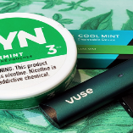
How does nicotine
affect us?
Nicotine causes the body to release adrenaline, a hormone that makes us alert and stimulated (fight or flight)
Adrenaline causes an increase in speed of breathing and heart rate and blood pressure, this may cause dizziness
Nicotine also causes release of dopamine, linked to feelings of satisfaction and pleasure.
After vaping or smoking for a while, the body starts to release less dopamine naturally.
Notes:
Information Slide: How does nicotine affect us?
Teacher/Facilitator shares with young people.
Nicotine is a chemical that comes from tobacco plants. It’s found in cigarettes, vapes, and some other products. When people use these products, nicotine gets into their body.
Nicotine affects the brain by releasing adrenaline, it’s also very addictive. That means it’s hard to stop using it once you start. Over time, it can harm the brain and body, especially in young people, because the brain is still developing until your mid-20s.
Using nicotine can make it harder to focus, learn, and control your emotions. That’s why it’s better to stay away from nicotine and make choices that keep your body and brain healthy.
Image created by ChatGPT

Slide 23

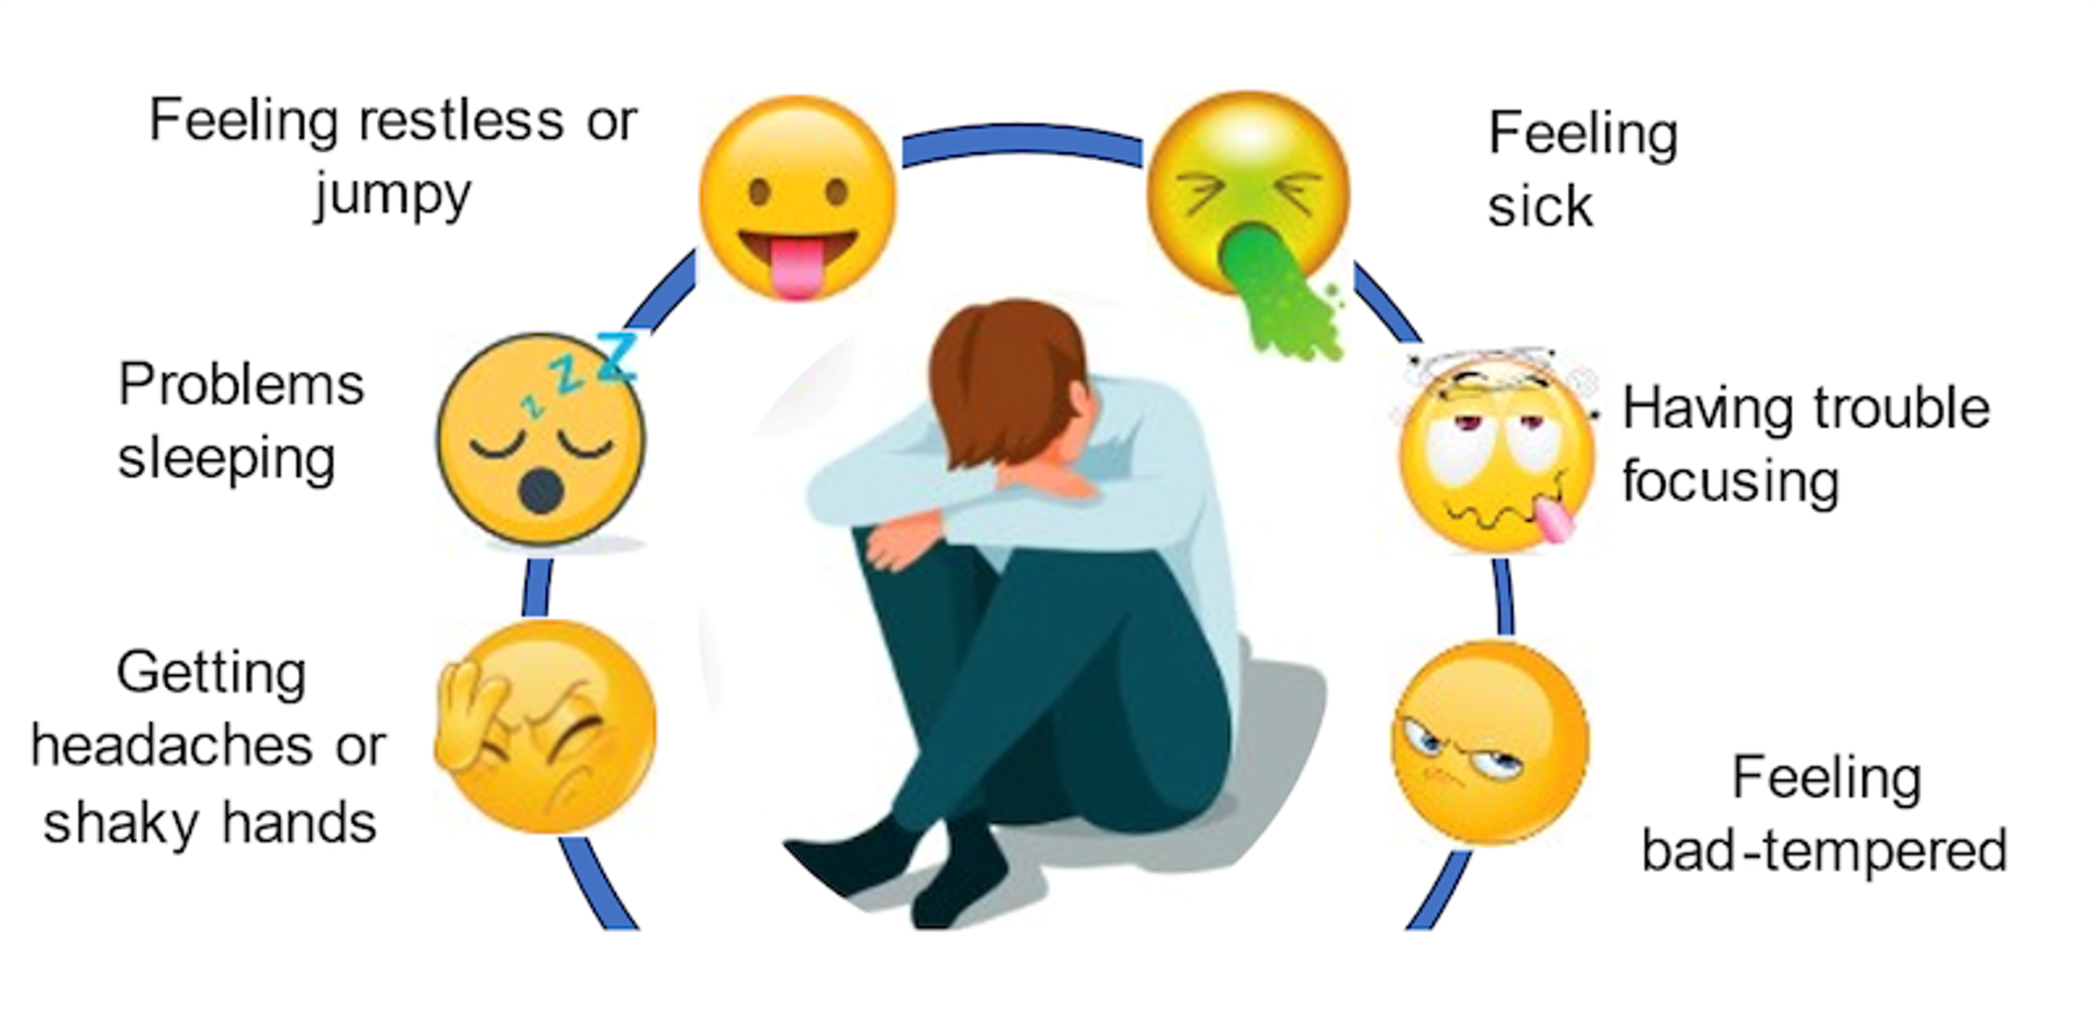

Nicotine
Withdrawal
As nicotine levels fall, the body can react in uncomfortable ways, called withdrawal. Including:
Nicotine can make someone more anxious and affect their mental health and wellbeing
These uncomfortable feelings can lead a person to need/crave more nicotine to stop these withdrawal feelings. This makes nicotine addictive.
Notes:
Information Slide: Nicotine Withdrawal
Teacher/Facilitator shares with young people.
If someone stops using nicotine, their body can react in uncomfortable ways, called withdrawal. These can include:
Feeling restless/jumpy. Feeling sick. Trouble focusing. Feeling bad-tempered. Headaches. Feeling shaky. Problems sleeping
These uncomfortable feelings can lead a person to need more nicotine to stop these withdrawal feelings. This makes nicotine addictive.
Regular nicotine use can negatively impact mental health by increasing anxiety, stress, and depression symptoms, as well as making it harder to quit. While some individuals may use nicotine to cope with stress, it's a temporary solution that can lead to a cycle of addiction and worsening mental health problems as nicotine use can disrupt the brain's dopamine production, leading to a decline in mood and a vicious cycle of nicotine dependence.
Research by ASH Scotland published in 2021 found that many young people are not aware of the negative impacts smoking can have on mental health and wellbeing.
Research suggests that nicotine can affect adolescents’ brain development, increasing the risk of future substance use, exacerbating difficulties in managing emotions and increasing the risk of depression.
Young people in Scotland (16-24-year-olds) with mental health issues, including depression and anxiety, are twice as likely to smoke or vape. The 2022 Scottish Health and Wellbeing Census found that 12.3% of 13 and 15-year-olds with a long-term health condition vaped compared to 5.1% of those without.
A study published in 2024 found 18-25-year-olds in England that used vapes were more likely to have poorer sleep quality and higher anxiety symptoms.
Young people with mental health issues are more likely to transition from youth experimentation to long-term addiction.
Stopping smoking for your mental health - NHS
Young People, Mental Health and Smoking - ASH Scotland

Slide 24
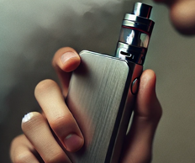
How can vaping affect teenagers?
Vaping isn’t risk-free and can have lasting effects on health!
Nicotine Addiction
May affect brain development (risks)
May affect lung health
Risk of other addictions
Social and emotional effects
Expense
Sports performance
Toxins in system
We don't know the long-term health effects yet, especially on teenagers
Notes:
Information Slide: How can vaping affect teenagers?
Teacher/Facilitator shares with young people.
Vaping can affect teenagers in several ways:
Nicotine Addiction: Many vapes contain nicotine, which is highly addictive. Teenagers' brains are still developing, making them more vulnerable to addiction. This can lead to cravings and make quitting harder later.
Brain Development: Nicotine can harm brain development, affecting areas that control attention, learning, and impulse control. This can have long-term effects on memory and behaviour.
Lung Health: Vaping can irritate and damage the lungs. Some chemicals in vape liquid can cause inflammation and other respiratory issues, even though it might seem less harmful than smoking.
Risk of Other Addictions: Young people who vape may be more likely to try cigarettes or other substances later.
Social and Emotional Effects: Peer pressure and the habit of vaping can create stress, impact school performance, and interfere with relationships.
It’s important for young people to know that vaping isn’t risk-free and can have lasting effects on their health.

Slide 25
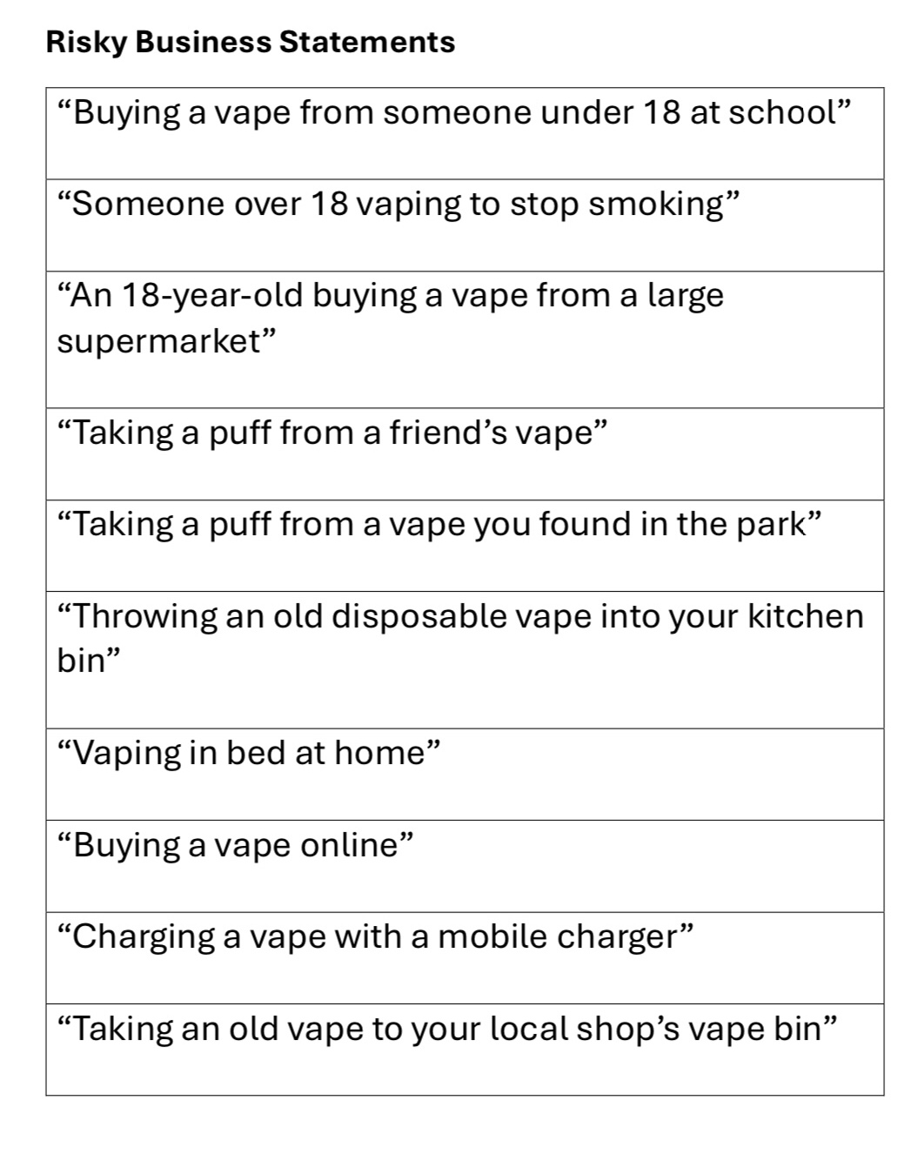


Risky Business
In groups:
Discuss each statement & agree where to place it on the risk scale – closer to High Risk or Low Risk.
As a class:
Discuss where each group put each statement and why.
High Risk
Low Risk
Can you think of anything else ?
Notes:
Activity Slide: Risky Business
In groups:
Discuss each statement & agree where to place it on the risk scale – closer to High Risk (Left) or Low Risk (Right)
As a class:
Discuss answers with reasons. Open dialogue to allow young people to share their own perceptions around risk.
Other options for this activity are to run entirely as a class discussion, allocating one side of room High Risk and one side of room Low Risk, young people moving to either side accordingly. Statements can be printed out, cut and stuck into jotters with young people using High Risk and Low Risk as headings.
“Buying a vape from someone under 18 at school”
“Someone over 18 vaping to stop smoking”
“An 18-year-old buying a vape from a large supermarket”
“Taking a puff from a friend’s vape”
“Taking a puff from a vape you found in the park”
“Throwing an old disposable vape into your kitchen bin”
“Taking an old disposable vape to your local shop’s vape bin”
“Charging a vape with a mobile charger”
“Buying a vape online”
“Vaping in bed at home”
Teacher notes provide guidance around level of risk for above statements.

Slide 26
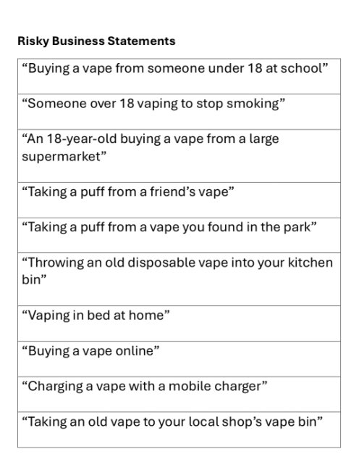
Notes:
Activity Slide: Risky Business
In groups:
Discuss each statement & agree where to place it on the risk scale – closer to High Risk (Left) or Low Risk (Right)
As a class:
Discuss answers with reasons. Open dialogue to allow young people to share their own perceptions around risk.
Other options for this activity are to run entirely as a class discussion, allocating one side of room High Risk and one side of room Low Risk, young people moving to either side accordingly. Statements can be printed out, cut and stuck into jotters with young people using High Risk and Low Risk as headings.
“Buying a vape from someone under 18 at school”
“Someone over 18 vaping to stop smoking”
“An 18-year-old buying a vape from a large supermarket”
“Taking a puff from a friend’s vape”
“Taking a puff from a vape you found in the park”
“Throwing an old disposable vape into your kitchen bin”
“Taking an old disposable vape to your local shop’s vape bin”
“Charging a vape with a mobile charger”
“Buying a vape online”
“Vaping in bed at home”
Teacher notes provide guidance around level of risk for above statements.

Slide 27
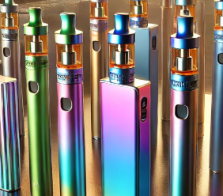

Vaping and the law
It's illegal for over 18’s to buy vapes for anyone under 18. This is called proxy buying.
Shops must not sell vapes to anyone under 18.
If someone looks under 25 a retailer must ask for proof of age.
A person must be 18 even if a vape is nicotine free
Many public places don’t allow vaping: trains, buses, stations, shops, restaurants and planes.
Single use disposable vapes are now illegal – so any single use vape will be FAKE
6,000 fake vapes were seized in Glasgow in 2024.
Many containing SPICE and other dangerous substances
Notes:
Information Slide: Vaping and the law
Teacher/Facilitator shares with young people.
It's illegal for over 18’s to buy vapes for anyone under 18. This is called proxy buying.
Shops must not sell vapes to anyone under 18.
If someone looks under 25 a retailer must ask for proof of age.
A person must be 18 even if a vape is nicotine free
Many public places don’t allow vaping: trains, buses, stations, shops, restaurants and planes.

Slide 28
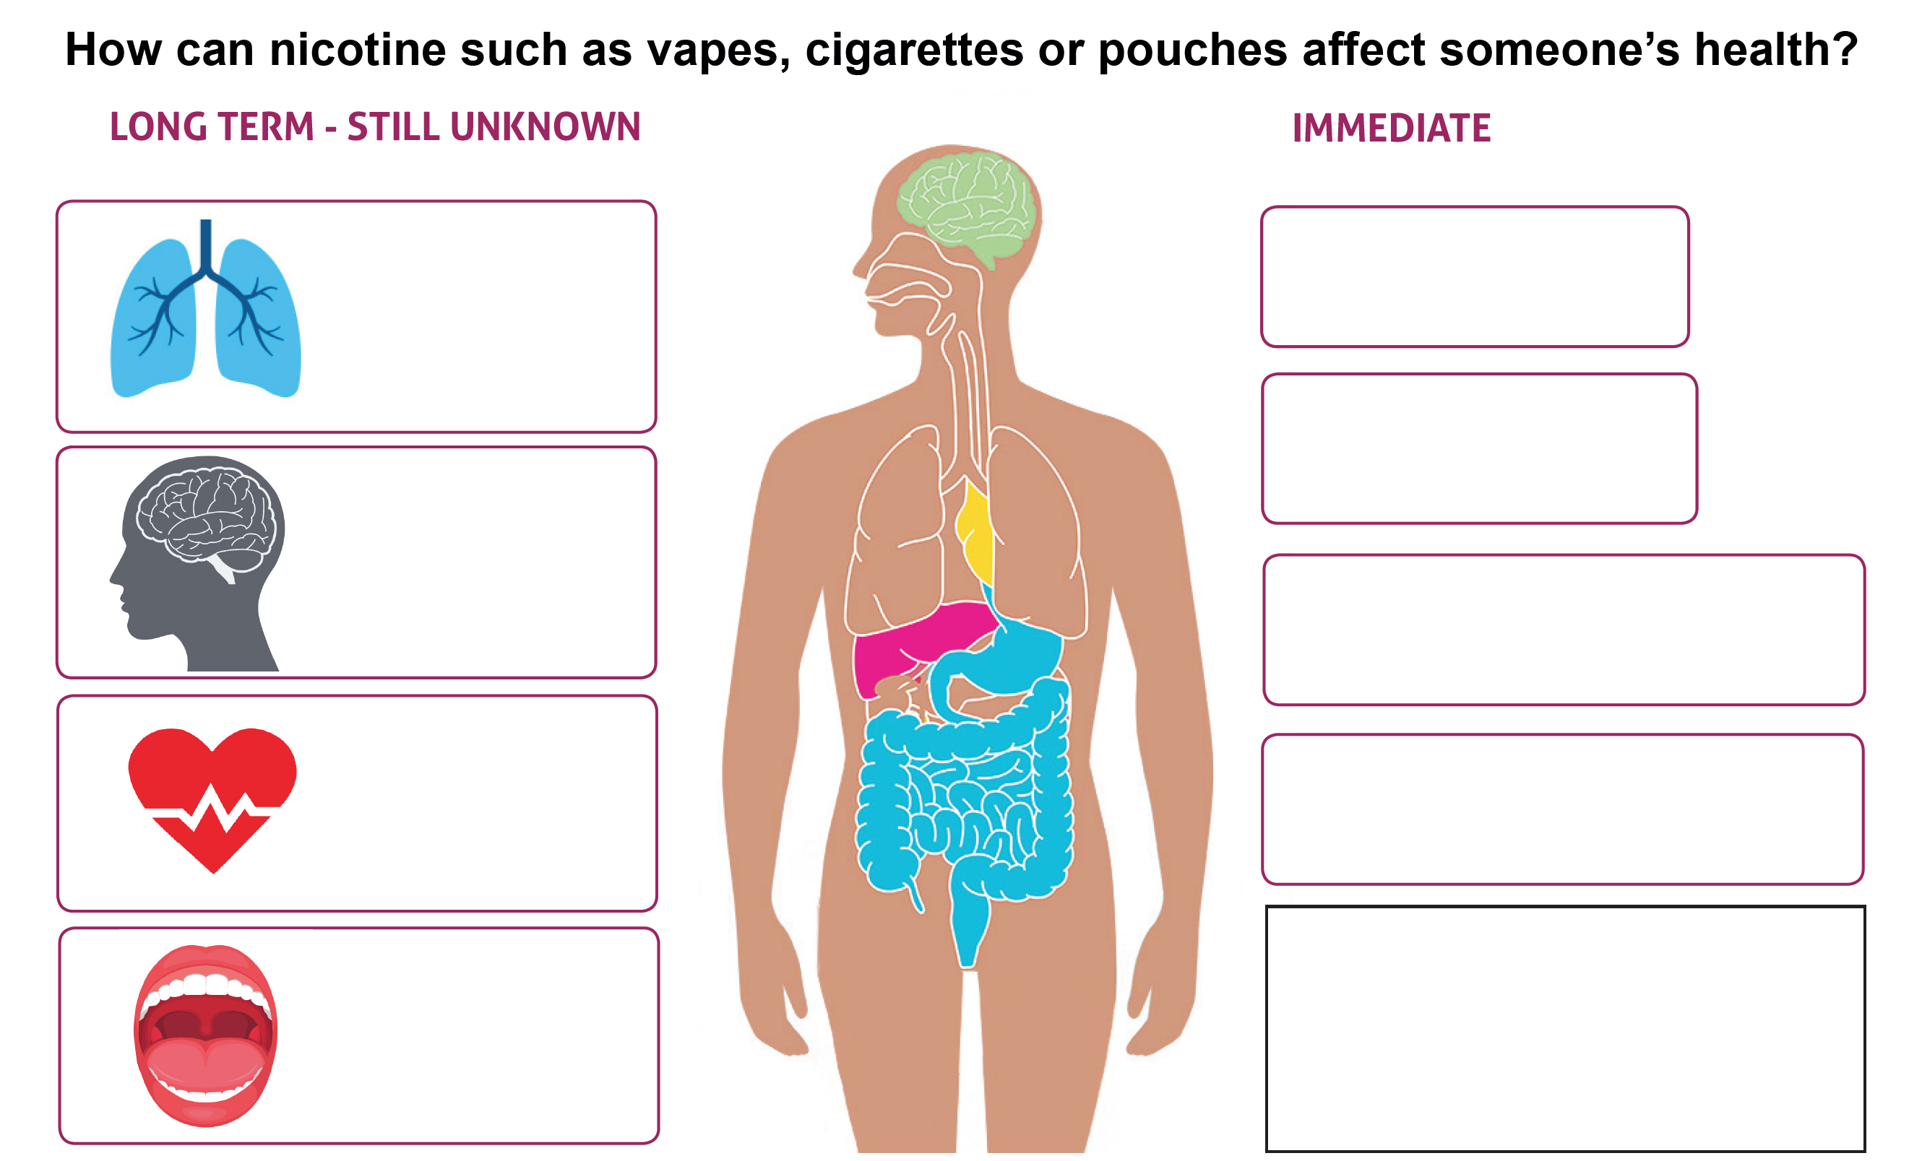
How vaping may affect health
How does vaping effect someone’s health?
Think of an answer for each box.
Discuss your answers as a class.
Can you think of anything else ?
Notes:
Activity Slide: How vaping may affect health
Using their knowledge about nicotine addiction, withdrawal, and the harmful chemicals contained in vapes, students can guess some of the immediate and long-term effects. Students can use emojis to assist them in expressing their thoughts. Reveal the answers on the following slide.
We don’t know the long-term effects of vaping. Could you think of what these might be?
In relation to research - it’s very difficult to establish facts as many people who vape have also smoked.

Slide 29
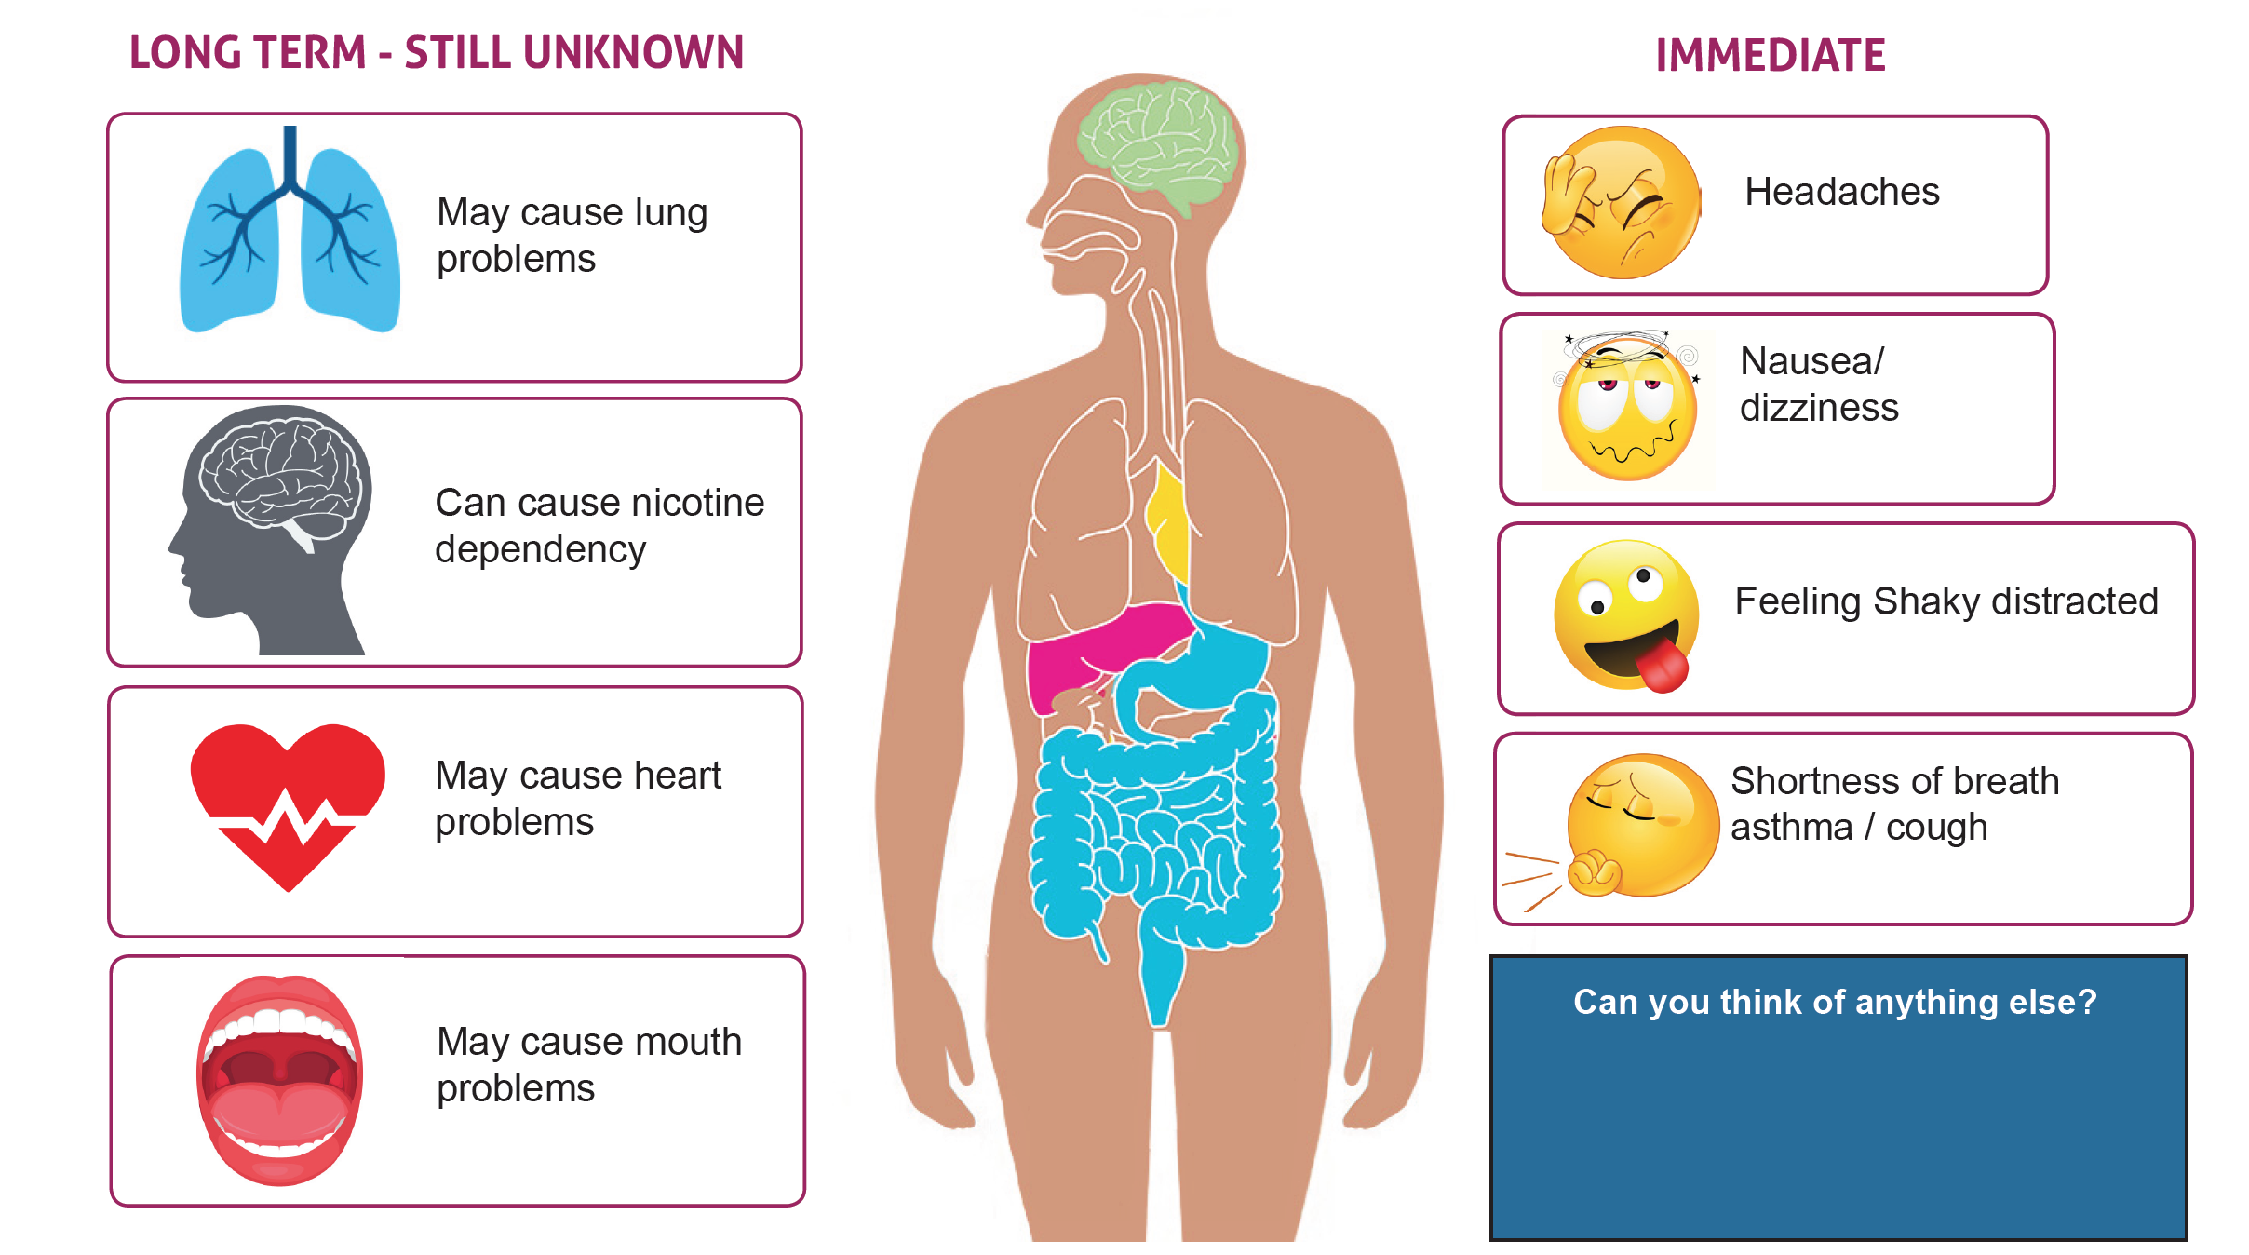
How vaping may affect health
Taste buds
Can you think of anything else ?
Notes:
Activity Slide: How vaping may affect health
Using their knowledge about nicotine addiction, withdrawal, and the harmful chemicals contained in vapes, students can guess some of the immediate and long-term effects. Students can use emojis to assist them in expressing their thoughts. Reveal the answers on the following slide.
We don’t know the long-term effects of vaping. Could you think of what these might be?
In relation to research - it’s very difficult to establish facts as many people who vape have also smoked.

Slide 30


Why do most young people ​
NOT vape?
Of those who said they had vaped at least once, 55% said they were worried it would be bad for their health.
Because
It’s illegal
They don't like the taste
Bad for the planet
Nicotine is addictive
Waste of money
Sport and fitness – affects lungs
Notes:
Discussion Slide: Why do most young people NOT vape?
Teacher/Facilitator opens class discussion, which builds on the social norms approach, around reasons why most young people do not vape. This is an open discussion designed to ensure young people have a voice around the issue and can identify their own positive reasons for not vaping.
Young people may choose not to vape for several reasons, including:
1.Health Concerns: Awareness of the potential health risks, such as lung damage or nicotine addiction, can discourage vaping.
2.Lack of Interest: Some simply don’t find vaping appealing or see no reason to try it.
3.Parental or Educational Influence: Strong guidance from parents, teachers, or role models may steer them away from vaping.
4.Athletic Performance: Athletes might avoid vaping to maintain their fitness and lung health.
5.Financial Reasons: Vaping can be expensive, and some young people may not want to spend money on it.
6.Social Norms: Being part of a peer group that doesn’t vape can reduce the likelihood of trying it.
7.Moral or Ethical Beliefs: Personal values or beliefs may lead them to avoid substances like nicotine.
8.Negative Perceptions: Some view vaping as unappealing, unattractive, or associated with certain stereotypes.

Slide 31
Why DO some young people vape?
When we asked, local young people in Greater Glasgow and Clyde why they vaped, they said:
“I wanted to be cool and felt if I said no it would be embarrassing”.
“I liked the taste of them”.
“It was a trend and I felt pressured into it”.
“It calms me down. I would get angry and that would make me feel calmer”.
Notes:
Discussion Slide: Why DO some people vape?
Teacher/Facilitator opens class discussion around reasons why young people may vape. We know most young people who vape have never smoked before. This is an open discussion designed to ensure young people have a voice around the issue.
Young people vape for a variety of reasons, including:
1.Curiosity: Many try vaping out of curiosity about the flavours, experience, or the device itself.
2.Peer Pressure: Social influence from friends or peers who vape can encourage young people to try it.
3.Perception of Safety: Some believe vaping is less harmful than smoking traditional cigarettes.
4.Flavors: The wide range of appealing flavours, such as fruit, candy, and desserts, attracts younger users.
5.Stress Relief: Some use vaping as a way to cope with stress, anxiety, or other emotional challenges.
6.Advertising and Social Media: Marketing and the portrayal of vaping on social media can make it appear trendy or cool.
7.Nicotine Addiction: For those who have tried vaping, the nicotine content can lead to dependency, keeping them vaping.
8.Easy Accessibility: Despite restrictions, vapes are often easy for young people to access.

Slide 32

Conscience alley
Can you think of anything else ?
Notes:
Activity Slide: Conscience Alley
Divide the group into two and ask groups to face each. Name each group: Red/Green/Circles/Squares etc.
Outline the scenarios on the slide and give groups 5 minutes to prepare ‘for/against’ ‘give in/resist’ statements to read out as the volunteer walks down the alley.
Support a volunteer to walk down the alley with statements from each group being shared with the ‘for/against’ advice. For example, “Don’t do it, because you’re asking them to break the law”, or “it might make you ill” OR “It will be really fun and you’ll look a loser if you don’t join in,” or “Yeah, it’ll be much more fun if you do”.
Facilitate discussion around how to prepare for ‘hot contexts. If possible, ask the volunteer to explain how it felt to ‘be in two minds.’
The activity can be followed up with small groups acting out role play scenarios of different situations and sharing how they would resist in a proactive positive way.
If young people are resistant to taking part in role play element this activity can be run as a whole class or small group discussion. As an individual task the scenario could form the basis for a piece of creative writing.

Slide 33

Conscience alley
What are the options?
Beth and her friends follow an influencer on tiktok. She’s been talking about vaping and how much it helps her feel calm and happier. Beth's friend is old enough to buy vapes and suggests getting some for everyone to try.
Lucas is alone at home with his older sister Emmie and her boyfriend, Eliot. Their parents are out. Eliot’s vaping. Eliot tries to get Lucas to have a puff as he thinks it's funny.
You decide
How do you decide?
Notes:
Activity Slide: Conscience Alley
Divide the group into two and ask groups to face each. Name each group: Red/Green/Circles/Squares etc.
Outline the scenarios on the slide and give groups 5 minutes to prepare ‘for/against’ ‘give in/resist’ statements to read out as the volunteer walks down the alley.
Support a volunteer to walk down the alley with statements from each group being shared with the ‘for/against’ advice. For example, “Don’t do it, because you’re asking them to break the law”, or “it might make you ill” OR “It will be really fun and you’ll look a loser if you don’t join in,” or “Yeah, it’ll be much more fun if you do”.
Facilitate discussion around how to prepare for ‘hot contexts. If possible, ask the volunteer to explain how it felt to ‘be in two minds.’
The activity can be followed up with small groups acting out role play scenarios of different situations and sharing how they would resist in a proactive positive way.
If young people are resistant to taking part in role play element this activity can be run as a whole class or small group discussion. As an individual task the scenario could form the basis for a piece of creative writing.

Slide 34
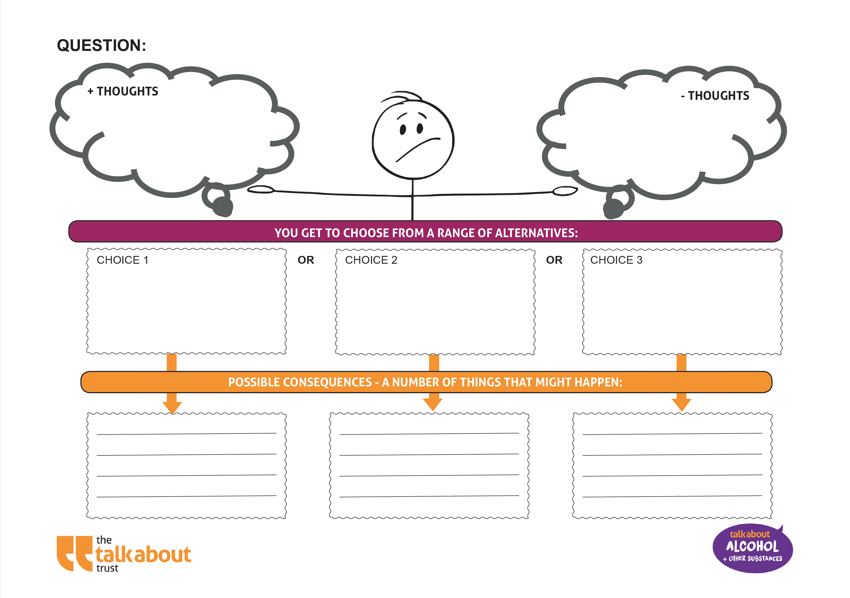
Making choices
Question:
Should Zoe start vaping to help with exam stress and anxiety
In groups:
Discuss the question
What +ve and –ve thoughts might Zoe have?
Agree 3 possible choices Zoe could make
Play each choice forward in your mind. What are the consequences of each choice?
Can you think of anything else ?
Notes:
Activity Slide: Making Choices
Teacher/Facilitator provides young people with ‘Making Choices’ blank template.
In groups:
Discuss the question
What +ve and –ve thoughts might Zoe have?
Agree 3 possible choices Zoe could make
Play each choice forward in your mind. What are the consequences of each choice?
This activity supports young people to explore the feeling of being torn between options and use the technique of linking cause and effect to support decision making.
Exam stress is a common reason young people have shared for starting to vape. The question can be altered to suit or young people can be encouraged to create relevant questions for the Making Choices template.

Slide 35
Making choices
Choice 1
Takes up vaping
Consequences?
Choice 2
Chooses not to vape but continues to be stressed and anxious about exams?
Consequences?
Choice 3
Chooses not to vape and instead plans a revision timetable, with breaks to go for walks or a run. She tells her friends how she's feeling
Consequences?
Notes:
Activity Slide: Making Choices
Teacher/Facilitator provides young people with ‘Making Choices’ blank template.
In groups:
Discuss the question
What +ve and –ve thoughts might Zoe have?
Agree 3 possible choices Zoe could make
Play each choice forward in your mind. What are the consequences of each choice?
This activity supports young people to explore the feeling of being torn between options and use the technique of linking cause and effect to support decision making.
Exam stress is a common reason young people have shared for starting to vape. The question can be altered to suit or young people can be encouraged to create relevant questions for the Making Choices template.

Slide 36










Breathing tools – In for 7, out for 11/ or Box Breathing – empties mind.
Some people say they vape to help with stress​ or anxiety
Phone and device routine
Stay hydrated
Go out every day – walk or sport
Eat well
Avoid too much caffeine
What are more effective ways of REALLY helping with stress, sleep or anxiety?​
Listen to a podcast,
book or favourite music play list
Hobbies
Notes:
Discussion Slide: Effective ways to reduce anxiety & improve sleep
Teacher asks young people to create a list of positive diversionary activities that support staying calm and relaxed. This could be collated using post it notes and flip chart paper, or managed as class or group discussion.
Ideas include: sport, talking to friends and family, going for a run or getting out in nature, spending time with pets, lighting candles and having a bath, gaming or many other strategies.
You can choose to show this slide with some useful options that help after the class has discussed the options through the choice’s activity.
Phone and device routine
Blue light from our devices disrupts our sleep. Advise young people to come off devices an hour before bed. Leave outside the room with notifications turned off.
Breathing tools - In for 7, out for 11/ Box Breathing supports the nervous system.
Link for further explanation of box breathing
https://www.bhf.org.uk/informationsupport/heart-matters-magazine/wellbeing/breathing-exercises#box
Video link https://youtu.be/49MgCs6EfB0?list=PLHRK1gBgxSGOqOQXqLtOuaJMG0tNw52_Y

Slide 37
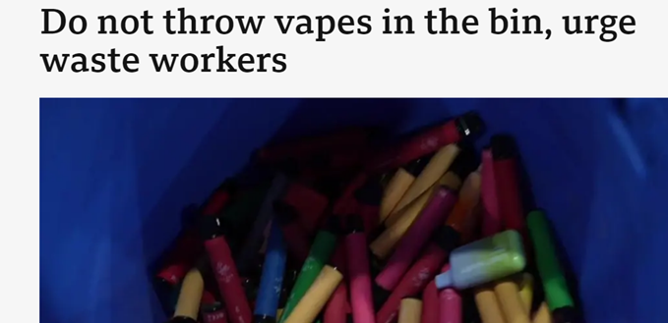
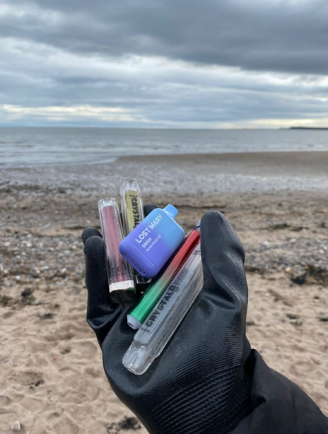

Around 8.2 million disposable vapes are thrown away each week in the UK. Enough to fill over 139 football pitches every year.
How vaping harms the environment
Single-use vapes contain batteries, chemicals and hard to recycle plastics.
These are dumped in landfill causing dangerous chemicals to pollute our soil, water and oceans.
The plastics and toxic waste affect birds and animals.
40 vapes go into landfill every 5 seconds.
Valuable metals and rare earths are wasted. Over 40 tonnes of lithium was thrown out with disposable vapes in the UK in 2022. That’s enough to make batteries for 5,000 electric cars
This is part of the reason why since June 2025 any single use vapes are illegal.
Notes:
Information Slide: How vaping harms the environment​
Teacher/Facilitator shares with young people. ​
Plastic Waste: Many vape pens and e-cigarettes are made from plastic, which is not biodegradable. When discarded improperly, these devices contribute to plastic pollution, which can harm wildlife and pollute the oceans. The small parts, like mouthpieces and cartridges, are especially problematic as they are often too small to be properly recycled.​
Battery Pollution:​ Many disposable vapes contain batteries, which contribute to electronic waste (e-waste). Improper disposal of these devices can lead to hazardous materials, such as lithium and other heavy metals, leaching into the soil and water, contaminating ecosystems​
Nicotine Leaks: E-liquid used in vapes contains nicotine, a toxic substance. When disposed of improperly, such as in landfills or through leaks in packaging, nicotine can seep into the soil and water, causing potential harm to plants, animals, and aquatic life.​
Littering:​ Disposable vapes, pods, and packaging are often littered, making parks, streets, and beaches dirty.​
Harm to Wildlife:​ Animals might eat vape pods or batteries by mistake, which can make them very sick or even kill them.​
Non-Recyclable Materials:​ Many vape parts can’t be recycled, so they end up in landfills and pollute the environment.​
Production Impact: The production of vape products requires resources, including plastics, metals, and chemicals. Mining and manufacturing processes contribute to pollution, greenhouse gas emissions, and resource depletion, negatively impacting the environment.​
Carbon Footprint: The production, shipping, and disposal of vape products have a carbon footprint. The use of disposable vapes or frequent replacements of pods increases this impact, contributing to global warming.​
Air Pollution: While vaping produces less air pollution than traditional cigarette smoking, the vapor emitted can still contribute to air quality degradation in some areas, especially when large numbers of people vape in crowded spaces.​
Source https://www.circularonline.co.uk/news/8-2-million-vapes-thrown-away-or-recycled-incorrectly-every-week/?utm_source=chatgpt.com
References for all Scottish statistics
Scottish Schools Adolescent Lifestyle and Substance (SALSUS)
https://www.gov.scot/collections/scottish-schools-adolescent-lifestyle-and-substance-use-survey-salsus/
Scottish Government Health and Wellbeing Census
https://www.gov.scot/publications/health-and-wellbeing-census-scotland-2021-22/pages/substance-use/
ASH Scotland
https://ashscotland.org.uk/wp-content/uploads/2024/06/Smoking-and-vaping-statistics-factsheet_June_2024.pdf

Slide 38

Vaping & The Environment
In small groups select one ‘aspect’ of the impact on the environment.
Research further information about this.
Consider ways to reduce this impact.
Groups can present to class and discuss/debate which ‘aspect’ is most harmful.
Identify and share solutions found to reduce impact on environment.
Plastic Waste
Air Pollution
Battery Pollution
Carbon Footprint
Nicotine Leaks
Littering
Production Impact
Harm to Wildlife
Non-Recyclable Materials
Notes:
Activity Slide: Vaping & the environment
Teacher/Facilitator supports class to complete activity:
In small groups select one ‘aspect’ of the impact on the environment.
Research further information about this.
Consider ways to reduce this impact.
Groups can present to class and discuss/debate which ‘aspect’ is most harmful
Identify and share solutions found to reduce impact on environment
Plastic Waste: Many vape pens and e-cigarettes are made from plastic, which is not biodegradable. When discarded improperly, these devices contribute to plastic pollution, which can harm wildlife and pollute the oceans. The small parts, like mouthpieces and cartridges, are especially problematic as they are often too small to be properly recycled.
Battery Pollution: Many disposable vapes contain batteries, which contribute to electronic waste (e-waste). Improper disposal of these devices can lead to hazardous materials, such as lithium and other heavy metals, leaching into the soil and water, contaminating ecosystems
Nicotine Leaks: E-liquid used in vapes contains nicotine, a toxic substance. When disposed of improperly, such as in landfills or through leaks in packaging, nicotine can seep into the soil and water, causing potential harm to plants, animals, and aquatic life.
Littering: Disposable vapes, pods, and packaging are often littered, making parks, streets, and beaches dirty.
Harm to Wildlife: Animals might eat vape pods or batteries by mistake, which can make them very sick or even kill them.
Non-Recyclable Materials: Many vape parts can’t be recycled, so they end up in landfills and pollute the environment.
Production Impact: The production of vape products requires resources, including plastics, metals, and chemicals. Mining and manufacturing processes contribute to pollution, greenhouse gas emissions, and resource depletion, negatively impacting the environment.
Carbon Footprint: The production, shipping, and disposal of vape products have a carbon footprint. The use of disposable vapes or frequent replacements of pods increases this impact, contributing to global warming.
Air Pollution: While vaping produces less air pollution than traditional cigarette smoking, the vapor emitted can still contribute to air quality degradation in some areas, especially when large numbers of people vape in crowded spaces.

Slide 39
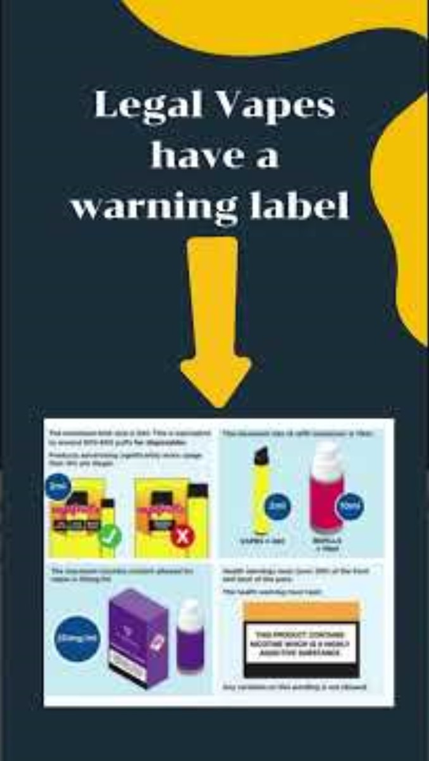
Many vapes are not what they seem
Can you think of anything else ?
Notes:
Video Short

Slide 40

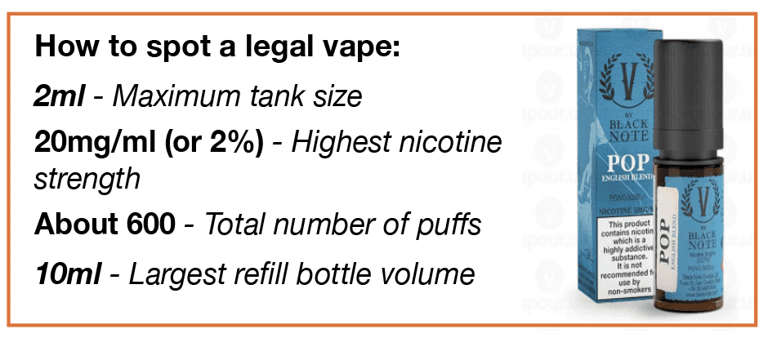
Unregulated/fake vapes
1 in 3 vapes sold in shops, online, from dealers and on social media do not comply with UK regulations and are unsafe.
These products when tested contained substances including lead, nickel, chromium, acetaldehyde, formaldehyde spice or THC.
Any single use disposable vapes are fake.
Fake vapes or Big Puff vapes (6000-9000 puffs) contain high levels of nicotine.
Over 6,000 fake vapes were seized in Glasgow in 2024 and 1.9 million across the UK.
Packaging should have a
Health warning saying
"This product contains nicotine which is a highly addictive substance"
Notes:
Information Slide: Unregulated/fake vapes
Teacher/Facilitator shares information with young people.
Sources: Trading Standards Glasgow and UK

Slide 41
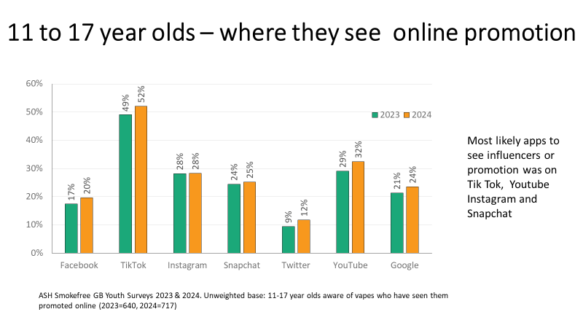
Have you seen vapes on social media?
Can you think of anything else ?
Notes:
Discussion Slide: Have you seen vapes on social media?
Teacher/Facilitator shares with young people and holds discussion around vapes and their prevalence/promotion on social media.

Slide 42
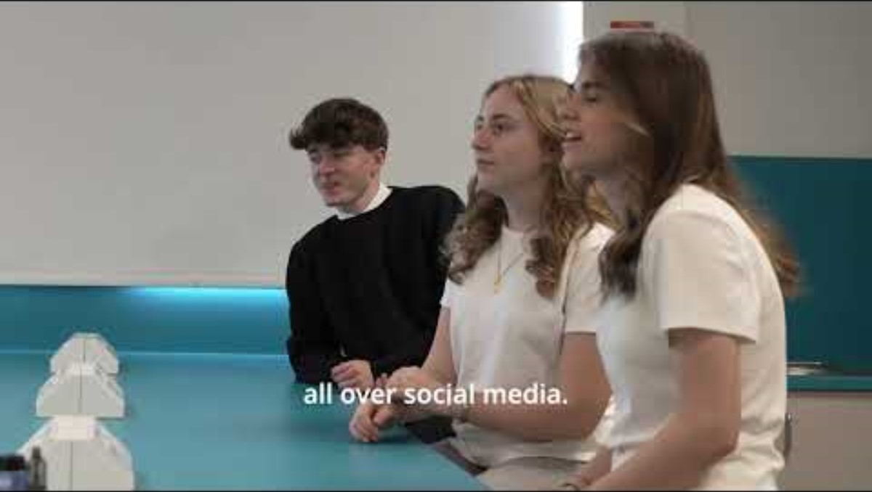
Discussion: Vapes & Social Media
Watch the short clip of young people discussing vapes and social media.
Notes:
Discussion Slide: Vapes & Social Media
Teacher/Facilitator poses questions for class discussion:
What are manufacturers of vapes doing to promote them? Do you think influencers are making money from promotion? If you were First Minister, what would you do to stop marketing of vapes to young people?
This can be extended to become a full research project for young people who are engaged. This stretches them towards Level 4 CfE.

Slide 43
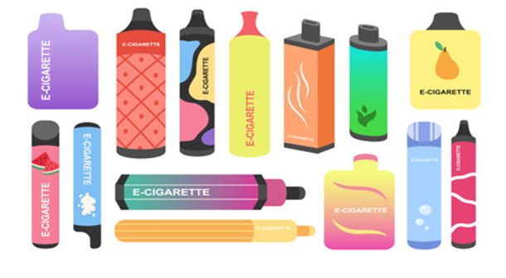
Discussion: Vapes & Social Media
Thinking about the discussion you watched:
What are manufacturers of vapes doing to promote them?
Do you think influencers are making money from promotion?
If you were First Minister, what would you do about marketing of vapes to young people?
Notes:
Discussion Slide: Vapes & Social Media
Teacher/Facilitator poses questions for class discussion:
What are manufacturers of vapes doing to promote them? Do you think influencers are making money from promotion? If you were First Minister, what would you do to stop marketing of vapes to young people?
This can be extended to become a full research project for young people who are engaged. This stretches them towards Level 4 CfE.

Slide 44


Where to go for help and support
Quit your way website: with tips to cut down & stop
https://www.nhsggc.scot/your-health/quit-your-way/quit-your-way-youth/
Quit your way Information guide: Facts about vaping
https://talkabouttrust.org/resources/schools/nhs-ggc-vaping-information-guide
NHS Inform website: with tips to cut down & stop
https://www.nhsinform.scot/campaigns/vaping/
Can you think of anything else ?
ChildLine: Advice and information for young people
https://www.childline.org.uk/info-advice/you-your-body/drugs-alcohol-smoking/vaping/
Notes:
Information Slide: Where to go for help and support
Teacher shares information with young people. Links can be accessed together as a class to familiarise young people with the resources.
Quit your way Youth - NHSGGC
Young people and vaping briefing paper - NHSGGC
Vaping addiction soon takes hold | NHS inform
Encourage discussion about accessing support. How easy is this for young people to do? Who are their trusted adults both in and out of school?
Video short can be watched together which contains tips for cutting down and stopping.

Slide 45
How do you feel now?
The
confidence
ruler
Still not sure
Need to know more
Very knowledgeable
Notes:
Activity Slide: The Confidence Ruler
Teacher/Facilitator can ask young people to rate their knowledge and understanding around vaping out of 10, following the input.
How confident are you NOW in your knowledge and understanding about Vaping?

