Slide 1



Vaping
The TALK ABOUT Trust is a youth charity that works across the UK to ensure young people are equipped to make safer choices around alcohol and other substances such as vaping and cannabis.
The TALK ABOUT Trust supports 11 to 25-year-olds with advice, workshops and resources on a range of life choices via schools, children’s homes, pupil referral units, youth and sports clubs. We train teachers and youth workers, empower parents and carers and provide diversionary activities for young people.
Primary 5-7
Notes:
Summary of Curriculum for Excellence Experiences & Outcomes
I understand the impact that misuse of substances can have on individuals, their families and friends. HWB 2-43a
I understand the effect that a range of substances including tobacco and alcohol can have on the body. HWB 2-38a
I know that alcohol and drugs can affect people’s ability to make decisions. HWB 2-40a
I can identify the different kinds of risks associated with the use and misuse of a range of substances HWB 2-41a
I can discuss the environmental impact of human activity and suggest ways in which we can live in a more environmentally responsible way. SOC 2-08a
I know that popular culture, the media and peer groups as well as own attitudes and values can influence how I feel about substance use and recognise the impact this may have on my own actions. HWB 2-39a

Slide 2
Respectful
Our Ground Rules for Learning
Listening
Focused
Careful Sharing
TRUSTED
ADULT
Anything else?
Notes:
Discussion Slide: Ground Rules for Learning
Before beginning the lesson, teachers should set clear expectations. Read through each “ground rule” with the class. Teachers can check pupils’ understanding of the ground rules by asking them for a thumbs-up to confirm their agreement. It is important to note that some pupils may know adults who vape. Information about how vaping affects health might cause concern for these students. Teachers should be mindful of this and direct students to the "Trusted Adult" symbol. Teachers may wish to remind students of what a trusted adult is and provide examples, such as a parent, teacher, or other member of staff. The slides also include an opportunity to ask students if there are any additional ground rules they think would be useful to follow during the lesson.
Success Criteria:
I can recognise the ways in which my decisions impact me and others around me.

Slide 3
What vaping and nicotine are
The effects on our bodies and brains
What we will learn about today
How to make healthy choices
The impact on our environment
Notes:
Information Slide : What we will learn about today
Teacher shares summary of the learning outcomes for lesson with young people.

Slide 4
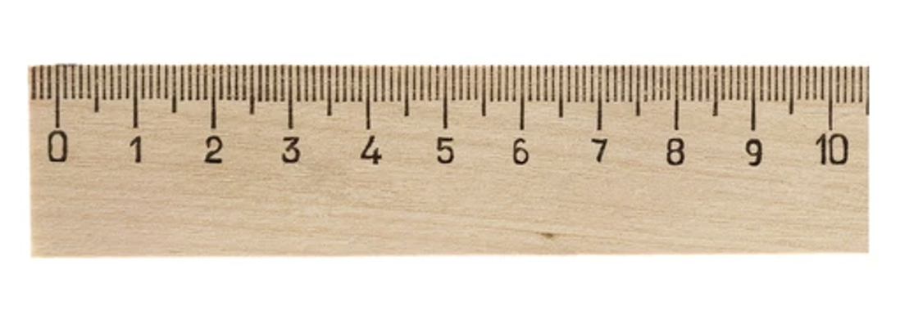
The
confidence ruler
Not sure
Need to know more
Very knowledgeable
Notes:
Activity Slide: The Confidence Ruler
Teachers can ask young people to rate their knowledge and understanding around vaping out of 10, providing a baseline. This can be repeated at the end of input as a measure of progress.
How confident are you in what you already know about Vaping?

Slide 5
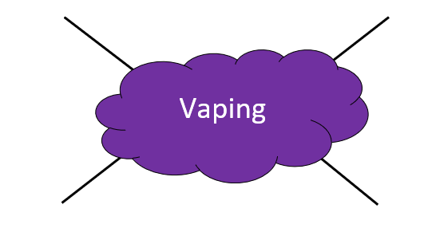




What do you already know about vaping?
Have you heard the terms “vape” or “vaping” before?
Write down all the things you know about vaping.
Notes:
Activity Slide: What do you already know about vaping?
Young people asked to make a mind map in jotter or on paper, individually or as a group, detailing their prior knowledge/current understanding about vaping.
Teacher Note: This task is to assess student's current knowledge about vaping. Be mindful that students may associate the topic of vaping with family members or personal experiences. Reminder of ‘Careful Sharing’ ground rule helpful.
Teacher can support students to understand importance of discussing issues in general terms, using distancing techniques/hypothetical situations rather than personal disclosures etc.

Slide 6


Decisions about Vaping
Write down a reason why adults might vape
Write down three reasons why most young people decide not to vape
Notes:
Activity Slide: Decisions about Vaping
Ask the students to write down their answers considering why people decide to vape and why people decide not to vape.
Teacher Notes: This activity reinforces vaping as a smoking cessation tool and helps students explore why people choose not to vape by identifying potential risks, health concerns, or personal values that align with making positive life choices. This can reinforce their own decisions to avoid harmful behaviours.

Slide 7
Decisions about Vaping
Write down a reason why adults might vape
Write down three reasons why most young people decide not to vape
To help them stop smoking
Bad for me?
Get into trouble?
It’s addictive
Notes:
Activity Slide: Decisions about Vaping
Ask the students to write down their answers considering why people decide to vape and why people decide not to vape.
Teacher Notes: This activity reinforces vaping as a smoking cessation tool and helps students explore why people choose not to vape by identifying potential risks, health concerns, or personal values that align with making positive life choices. This can reinforce their own decisions to avoid harmful behaviours.

Slide 8

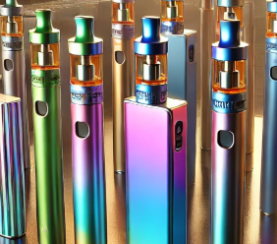
Vaping Quiz
True or false?
TRUE or FALSE?
Most vapes contain nicotine
Notes:
Activity Slide:
True and False cards are displayed on opposite sides of the room. Pupils are asked to move to the answer they think is correct. Encourage discussion where not all pupils agree.
Answer: TRUE - Must vapes contain nicotine. Many vapes contain a high dose of nicotine which is addictive and bad for people’s health.

Slide 9
Vaping Quiz
True or false?
TRUE - Most vapes contain nicotine
Most vapes contain a high dose of nicotine which is addictive and bad for young people's health.
Notes:
TRUE - Must vapes contain nicotine. Many vapes contain a high dose of nicotine which is addictive and bad for people’s health.

Slide 10


Vaping Quiz
True or false?
TRUE or FALSE?
Vapes are bad for the environment
Notes:
Activity Slide:
True and False cards are displayed on opposite sides of the room. Pupils are asked to move to the answer they think is correct. Encourage discussion where not all pupils agree.
Answer: TRUE - Vapes are bad for the planet. Vapes contain plastic, metals and foam which cannot be recycled and go straight into landfill. The vapes release harmful chemicals into the soil. It is estimated that 5 million are thrown away each week in Britain.

Slide 11
Vaping Quiz
True or false?
TRUE - Vapes are bad for the environment
Vapes are harmful to the environment as they contain plastic, batteries and chemicals which make them hard to recycle properly and most go straight into landfill.
More than a million are thrown away each day harming wildlife, causing fires and releasing toxins into our water and soil.
Notes:
TRUE - Vapes are bad for the planet. Vapes contain plastic, metals and foam which cannot be recycled and go straight into landfill. The vapes release harmful chemicals into the soil. It is estimated that 8.2 million vapes are thrown away each week in Britain.
Thirteen vapes are discarded every second in the UK, adding up to more than a million each day. As vapes are powered by lithium-ion batteries, they can cause fires if disposed of or recycled incorrectly. They are also toxic to the environment and wildlife if they end up as litter.
www.materialfocus.org.uk

Slide 12

Vaping Quiz
True or false?
?
TRUE or FALSE?
Vaping has no side effects
Notes:
Activity Slide:
True and False cards are displayed on opposite sides of the room. Pupils are asked to move to the answer they think is correct. Encourage discussion where not all pupils agree.
Answer: FALSE - Vaping does have some side effects. Vaping can make people cough, give them a dry or sore mouth and throat, and even cause headaches. It can also make it harder to focus and make someone feel grumpy.

Slide 13
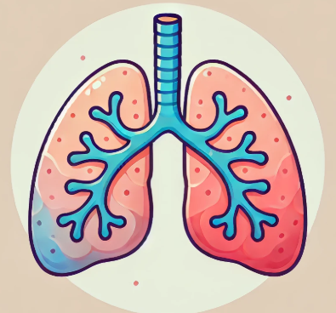

Vaping Quiz
True or false?
?
FALSE - Vaping does have side effects
Short-term effects can be coughing, dizziness, sore throats and headaches. The long-term effects are not fully known.
It can also make it harder to focus and make someone feel grumpy.
Notes:
FALSE - Vaping does have some side effects. Vaping can make people cough, give them a dry or sore mouth and throat, and even cause headaches. It can also make it harder to focus and make someone feel grumpy.

Slide 14

Vaping Quiz
True or false?
TRUE or FALSE?
It is illegal to give or sell a vape to a young person under 18
Notes:
Activity Slide:
True and False cards are displayed on opposite sides of the room. Pupils are asked to move to the answer they think is correct. Encourage discussion where not all pupils agree.
Answer: FALSE - There are laws in the UK around who can vape. Vaping is illegal for under 18s or for someone to buy vapes for Under 18’s. If someone over 18 gives vapes to anyone under 18 they are acting illegally.

Slide 15

Vaping Quiz
True or false?
TRUE - It is illegal to give or sell a vape to a young person under 18
If someone over 18 gives or sells vapes to anyone under 18 that is illegal.
Notes:
FALSE - There are laws in the UK around who can vape. Vaping is illegal for under 18s or for someone to buy vapes for Under 18’s. If someone over 18 gives vapes to anyone under 18 they are acting illegally.

Slide 16
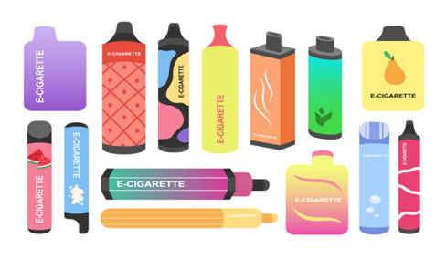
Vapes: What are they?
Vapes are electronic devices for people to breathe in a flavoured mist, or vapour.
This vapour comes from a heated liquid inside the vape that contains nicotine and flavouring chemicals.
Vapes are not to be used by young people.
They can be used to help adults to stop smoking.
Notes:
Information Slide: Vapes: What are they?
Teacher shares with young people.
Vapes are electronic devices for people to breathe in a flavoured mist, or vapour.
This vapour comes from a heated liquid inside the vape that contains Nicotine and Flavouring Chemicals.
Vapes are not meant to be used by children
They can be used to help adults to stop smoking.

Slide 17
What does vaping liquid have in it?
be
Vegetable glycerol​:
Makes it visible, like a mist. ​
Nicotine:​
This is a drug that can make people want to keep using it. It is addictive.
Chemicals and artificial flavours:​
These are for flavour. Some may damage lungs.
Notes:
Information Slide: What does vaping liquid have in it?
Teacher shares information with young people.
Vaping liquid contains:
Vegetable glycerol​:
Makes it visible, like a mist. ​
Chemicals:​
These are for flavour. Some can damage your lungs.
Nicotine:​
This is a drug that can make people want to keep using it. It is addictive.

Slide 18

TRUSTED
ADULT
What is nicotine?
Nicotine is a chemical that can change how we feel.
This can make a person feel more awake, jumpy, and ready to react quickly.
It also makes a person's breathing and heartbeat faster. This feeling wears off and it can make a person feel tired..
Notes:
Information Slide: What is nicotine?
Teacher shares with young people.
Teacher Notes: Teachers should be mindful that some students may have family members who vape and might feel worried. Remind students about the "Trusted Adult" symbol.
Nicotine is a chemical that comes from tobacco plants. It’s found in cigarettes, vapes, and some other products. When people use these products, nicotine gets into their body.
Nicotine affects the brain by making it feel good for a little while, but it’s also very addictive. That means it’s hard to stop using it once you start. Over time, it can harm the brain and body, especially in young people, because the brain is still developing until mid-20s.
Using nicotine can make it harder to focus, learn, and control your emotions. That’s why it’s better to stay away from nicotine and make choices that keep your body and brain healthy.

Slide 19

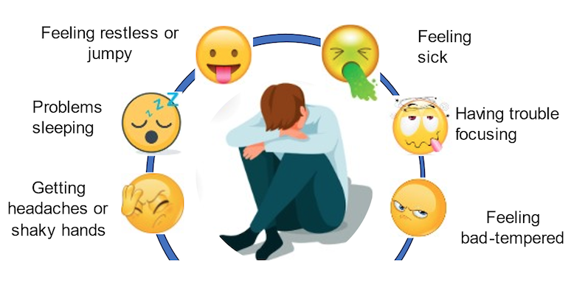
TRUSTED
ADULT
Nicotine withdrawal
When someone stops using nicotine, their body can react in uncomfortable ways, called withdrawal.
Notes:
Information Slide: Nicotine Withdrawal
Teacher shares with young people.
If someone stops using nicotine, their body can react in uncomfortable ways, called withdrawal. These can include:​
Feeling restless/jumpy​
Feeling sick​
Trouble focusing​
Feeling bad-tempered​
Headaches​
Feeling shaky​
Problems sleeping​
These uncomfortable feelings can lead a person to need more nicotine to stop the withdrawal feelings. This makes nicotine addictive.

Slide 20
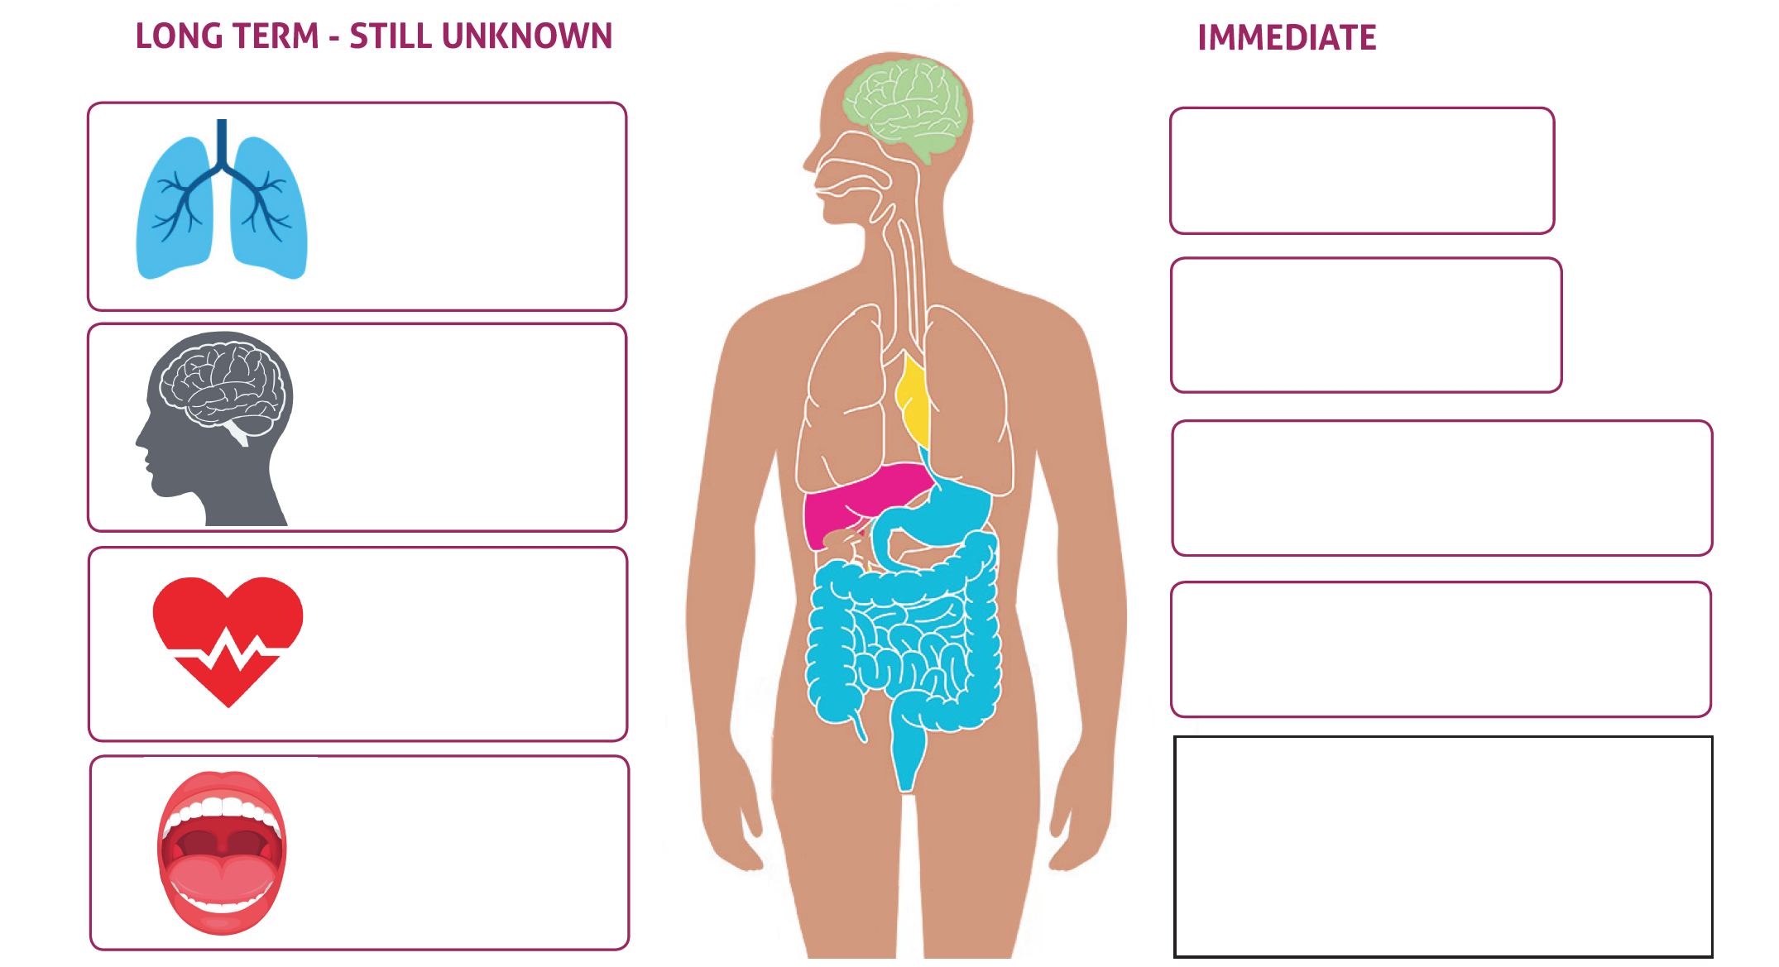










How can vaping affect someone's health?
Notes:
Activity Slide: How can vaping effect someone’s health?
Teacher Notes: Using their knowledge about nicotine addiction, withdrawal, and the harmful chemicals contained in vapes, students can guess some of the immediate and long-term effects. Students can use emojis to assist them in expressing their thoughts. Reveal the answers on the following slide.
We don’t know the long-term effects of vaping. Could you think of what these might be?

Slide 21
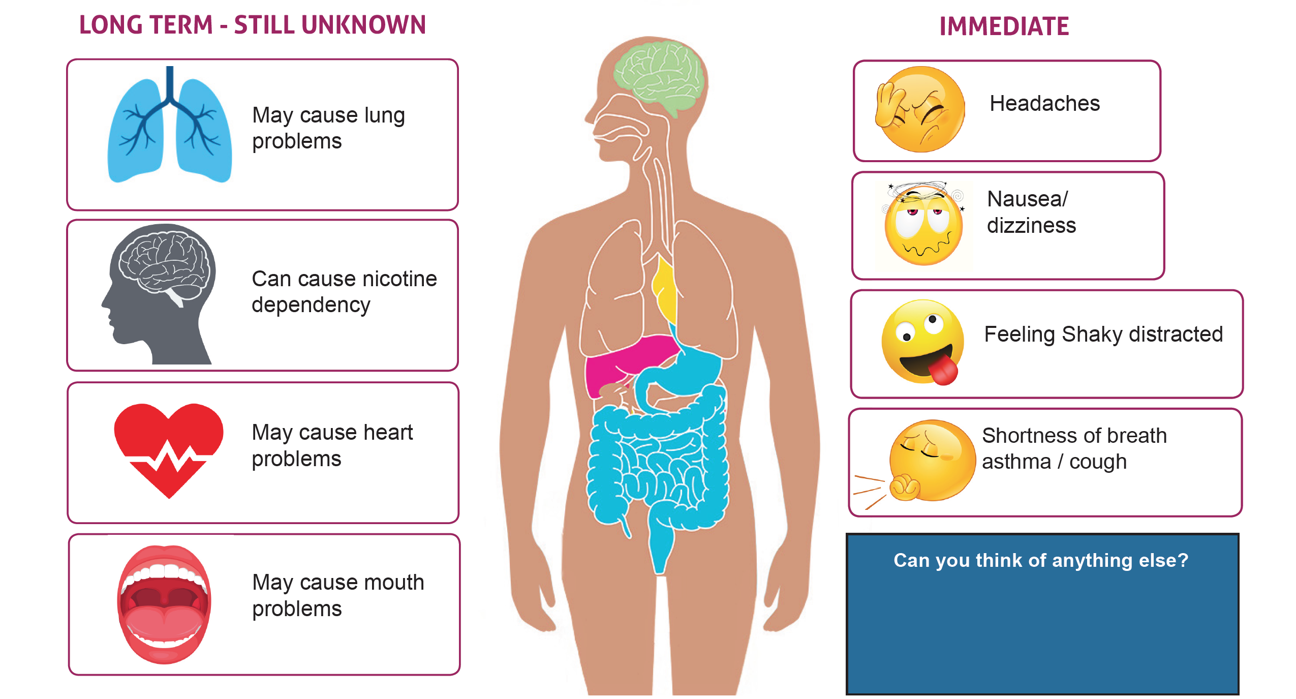
How can vaping affect someone's health?
TRUSTED
ADULT
Notes:
Activity Slide: How can vaping effect someone’s health?
Teacher Notes: Reveal the answers. Highlight to the students that some people use vaping as a method to stop smoking, emphasise that for adults who smoke vaping is less harmful but not without risk. Be mindful that some students might feel worried if someone in their family vapes. Remind students that they can speak to a trusted adult if they are concerned.
Young people may need support to understand the concept of ‘nicotine dependency’. Class discussion can explain that being dependent on something means a person feels like they need it, becomes fixed on having that thing.
Suggestions on slide may be some of the long-term effects of vaping- but this is something scientists are still researching.

Slide 22

What do we need to help us breathe?
Activity:
Take a deep breath in through our nose, hold it for a moment... and now slowly breathe out through your mouth.
When we breathe in, what is it that our body needs from the air?​
And what do we breathe out? ​
What vital organs keep us alive through breathing? ​
Oxygen
Carbon Dioxide
Our lungs....
That's why it's so important that we keep them clean and healthy​.
How did it make you feel? Calm? Relaxed?
Notes:
Activity: What do we need to help us breathe?
Teacher guides pupils to “take a deep breath in through your nose, hold it for a moment... and now slowly breathe out through your mouth.” After the breath pupils are encouraged to reflect around: How did it make you feel? Calm? Relaxed?
Discussion can be held around why nose breathing is preferable for an inhale, to filter the air around us, keeping our lungs safe. Mouth breathing is ideal for an exhale to breathe out ‘toxins’ such as carbon dioxide etc. Comparing size differences of nostrils with mouth makes sense, also highlighting features nostrils have for keeping our air pure such as tiny hairs.
Teacher Notes: The aim of this activity is to help pupils focus on their lungs.
This activity links to the next slide which asks pupils to think creatively about what helps them stay calm and relaxed.

Slide 23

Staying calm and relaxed…what works for YOU?
Some people say they use a vape to feel less stressed or calm.
Vaping doesn’t calm you down.
Can you think of better ways to feel less stressed or anxious?
Can you think of better ways to feel less stressed or anxious?
Digital
detox​
Eatwell
Notes:
Activity: Staying calm and relaxed...What works for YOU?
Teacher leads discussion around:
Some people say they vape to feel less stressed or calm.
Vaping doesn’t calm you down.
Can you think of any good ways to boost your mood?
Teacher Notes:
Suggestions from our focus groups with young people included:
going for a walk/ playing with fidgets/ talking to mum/ eating nice food/ watching a movie/ having a nap/ Visiting gran and grandad/ drinking some water/ gaming/ listening to music/ colouring in/ texting my friends/ going out to play /screaming into a pillow/ breathing in and out/ being with my dog/ singing /reading /going to my room/ taking time alone/ being in a quiet space/ doing my favourite sport/ counting to 1000/ tidying up/ dancing /punching a punch bag
Other things to recommend include:
Winding down before going to sleep having a digital detox an hour before bed. Having a shower or bath and playing relaxing music.
Fresh air every day Just half an hour outside each day, whatever the weather can really improve mental health. A routine such as a walk around the block, the park or to the shops is fine.
Exercise This doesn’t have to mean going to the gym or taking up an expensive sport – there are lots of free apps for exercises – and a brisk walk or jog counts or using a bike to get around on is great. We speed up our heart rate, get our blood circulating and release endorphins by having exercise that make us feel livelier and happier.
Take up a hobby keeping ourselves busy and active helps our mental health – a hobby can be music, playing an instrument, taking cool photos, learning to cook or knit! The more fulfilled we are the less likely we are to feel lonely, anxious or bored.
Sharing our worries – connecting with people is important so no matter how shy we are, making sure we talk to our family, friends.

Slide 24

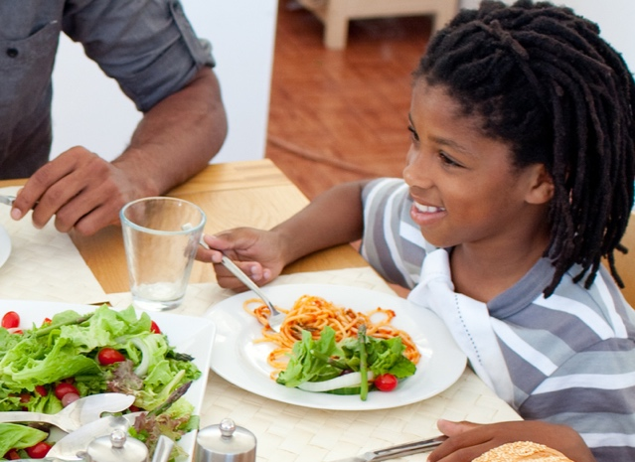
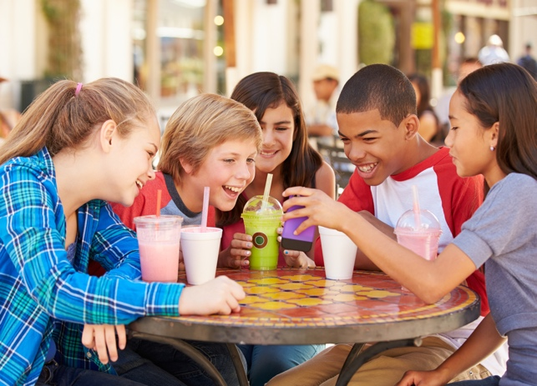


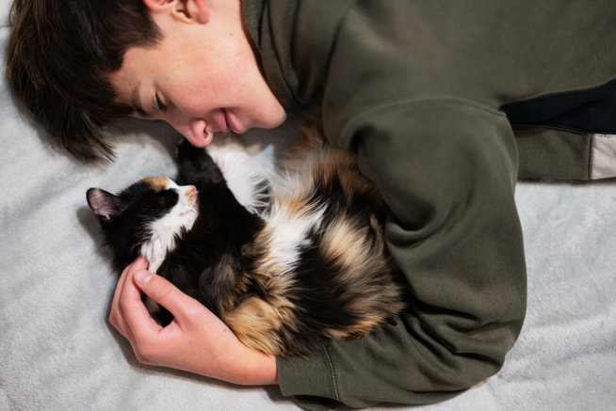
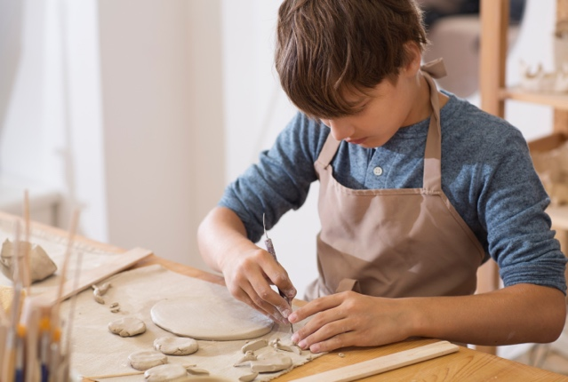





Winding
down before
going to sleep ​
Playing with friends​​​​​
Eating well​​​​​
Fresh air
every day​​
​
Gaming
Cuddling pets​​​​​
Hobbies​​​
Reading​​​​​
Sharing our worries​​​​​
Counting to 10 and breathing slowly
​Exercise/sports ​​​​
Listening to music​​​​​
Notes:
Activity: Staying calm and relaxed...What works for YOU?
Teacher leads discussion around:
Some people say they vape to feel less stressed or calm.
Vaping doesn’t calm you down.
Can you think of any good ways to boost your mood?
Teacher Notes:
Suggestions from our focus groups with young people included:
going for a walk/ playing with fidgets/ talking to mum/ eating nice food/ watching a movie/ having a nap/ Visiting gran and grandad/ drinking some water/ gaming/ listening to music/ colouring in/ texting my friends/ going out to play /screaming into a pillow/ breathing in and out/ being with my dog/ singing /reading /going to my room/ taking time alone/ being in a quiet space/ doing my favourite sport/ counting to 1000/ tidying up/ dancing /punching a punch bag
Other things to recommend include:
Winding down before going to sleep having a digital detox an hour before bed. Having a shower or bath and playing relaxing music.
Fresh air every day Just half an hour outside each day, whatever the weather can really improve mental health. A routine such as a walk around the block, the park or to the shops is fine.
Exercise This doesn’t have to mean going to the gym or taking up an expensive sport – there are lots of free apps for exercises – and a brisk walk or jog counts or using a bike to get around on is great. We speed up our heart rate, get our blood circulating and release endorphins by having exercise that make us feel livelier and happier.
Take up a hobby keeping ourselves busy and active helps our mental health – a hobby can be music, playing an instrument, taking cool photos, learning to cook or knit! The more fulfilled we are the less likely we are to feel lonely, anxious or bored.
Sharing our worries – connecting with people is important so no matter how shy we are, making sure we talk to our family, friends.

Slide 25
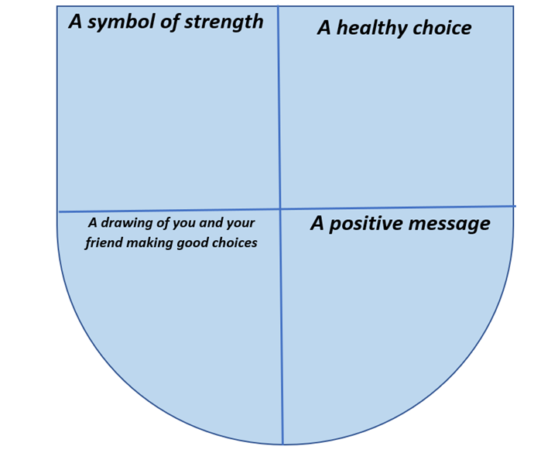
Healthy choice shield
Here is an example you can use to help you...
A shield is used to protect knights in battle.​
Create a shield to show your choice of healthy options. ​
Our healthy choices shield can remind us how to protect our health!
Notes:
Activity: Healthy Choice Sheild
Teacher supports pupils to:
Design a shield to show making healthy choices.
Our healthy choices shield will be used to remind us how to protect our health!
Teacher Notes: This activity aims to help students understand that making healthy choices protects both our physical and mental well-being. Sharing the template on the board can support pupils, along with their own answers from the previous activity.

Slide 26




Healthy choice shield
Here is an example you can use to help you...
A drawing of you and your friend making healthy choices
I AM STRONG!
Notes:
Activity: Healthy Choice Sheild
Teacher supports pupils to:
Design a shield to show making healthy choices.
Our healthy choices shield will be used to remind us how to protect our health!
Teacher Notes: This activity aims to help students understand that making healthy choices protects both our physical and mental well-being. Sharing the template on the board can support pupils, along with their own answers from the previous activity.

Slide 27




Vaping and the environment
When we throw used items into the bin, they break down and mix with the soil.
How long it takes depends on what the item is made of.
Some things are good for the soil, but others can be harmful.
An apple breaks down in a few weeks and is good for the soil, but a plastic bottle takes hundreds of years to break down and can leave tiny harmful pieces called microplastics in the soil.
In groups:
In turn, take each item and think about where it should go on the timeline to show how long you think each item takes to break down.
Notes:
Activity: Vaping and the environment
In groups:
Take each item and think about where it should go on the timeline to show how long you think each item takes to break down.
This can be done as a full class discussion using the slides. Cards can also be printed to encourage active learning. Teachers could put cards in a box and allow young people to pick out an object. Pupils could hold a card each and order themselves against the timeline.

Slide 28

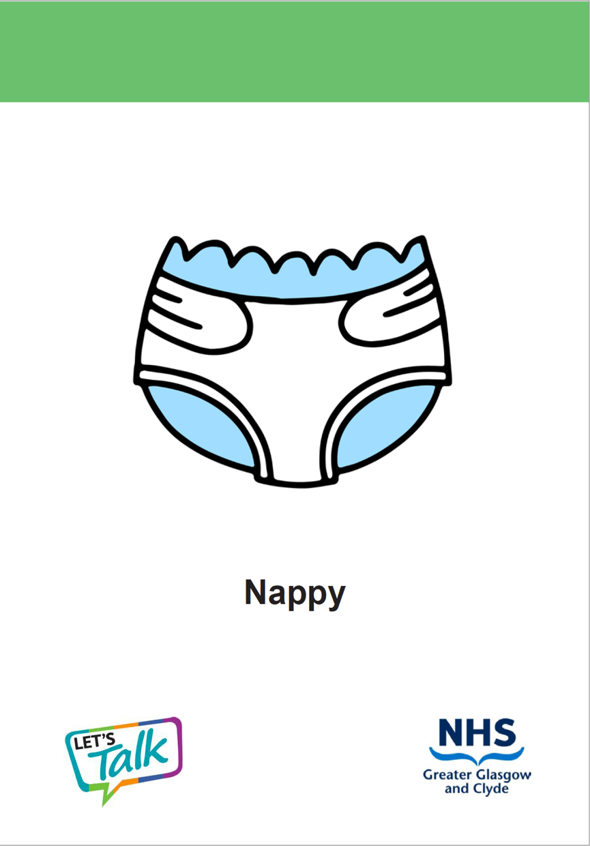
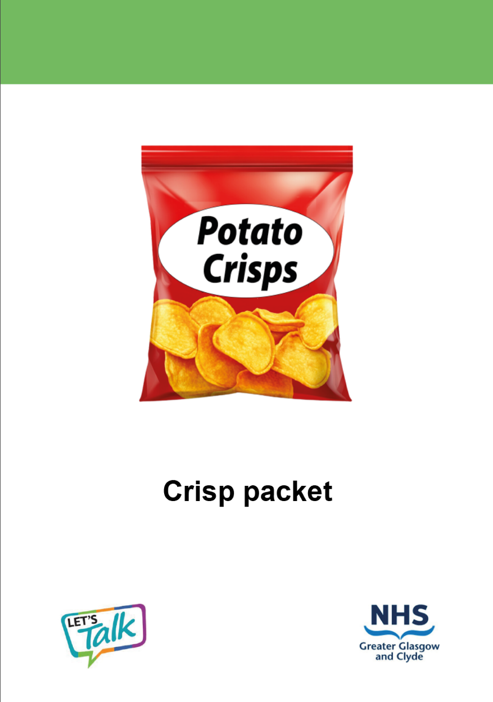
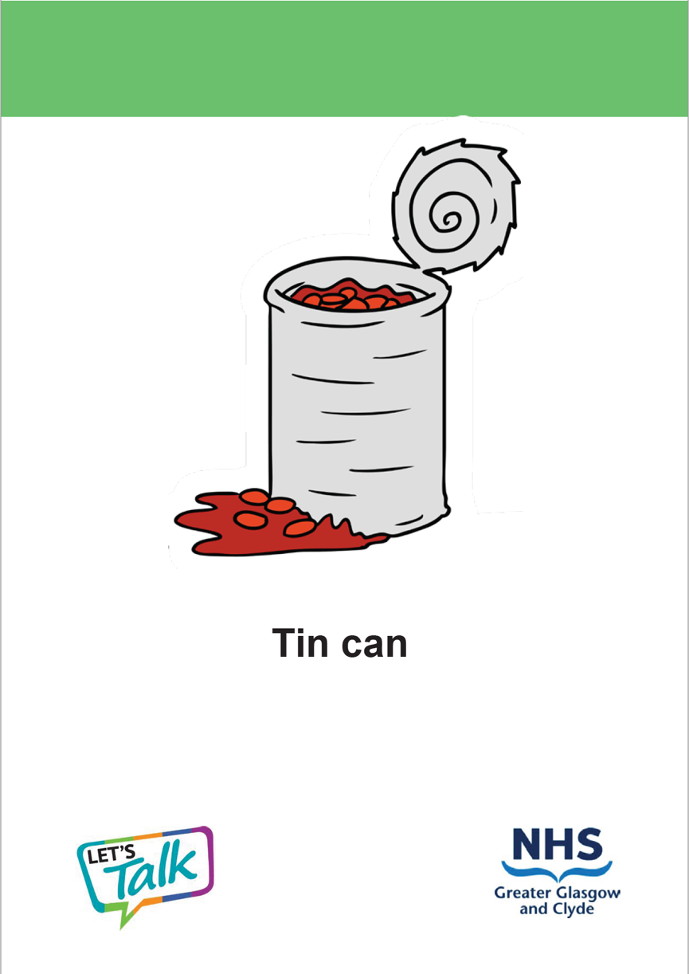
Vaping and the environment
Can you think of anything else ?
Notes:
Activity: Vaping and the environment
In groups:
Take each item and think about where it should go on the timeline to show how long you think each item takes to break down.
This can be done as a full class discussion using the slides. Cards can also be printed to encourage active learning. Teachers could put cards in a box and allow young people to pick out an object. Pupils could hold a card each and order themselves against the timeline.

Slide 29
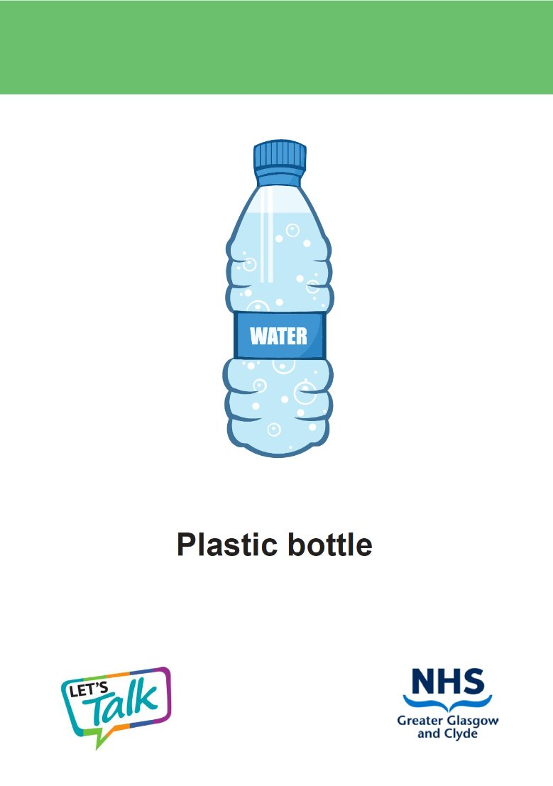
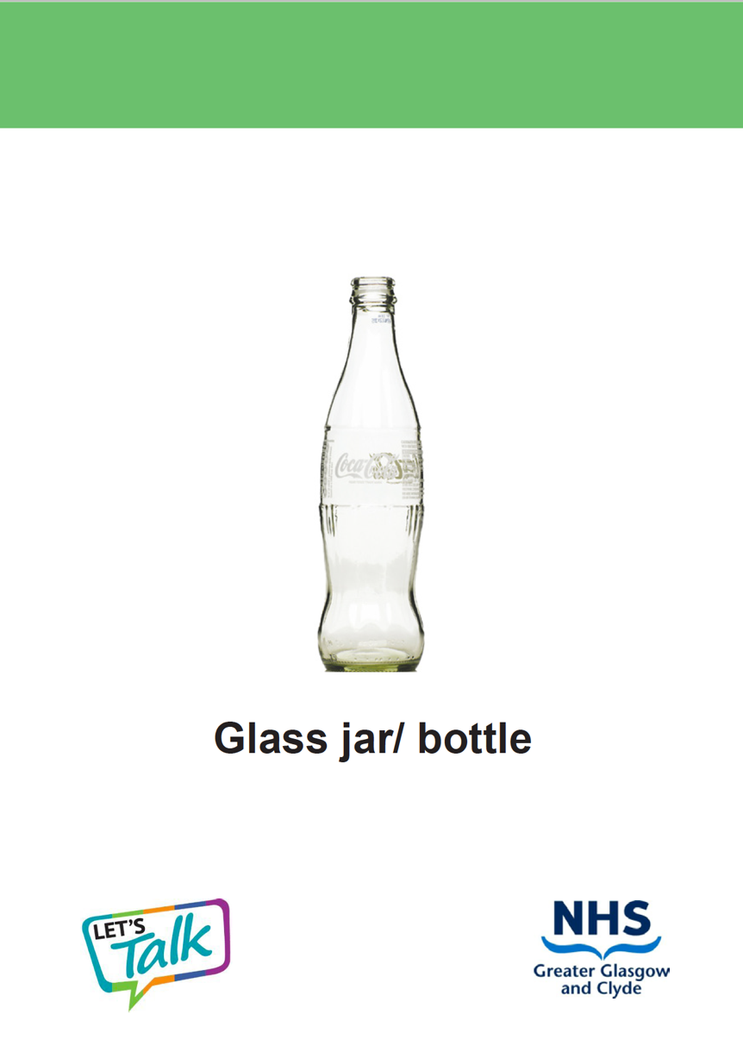
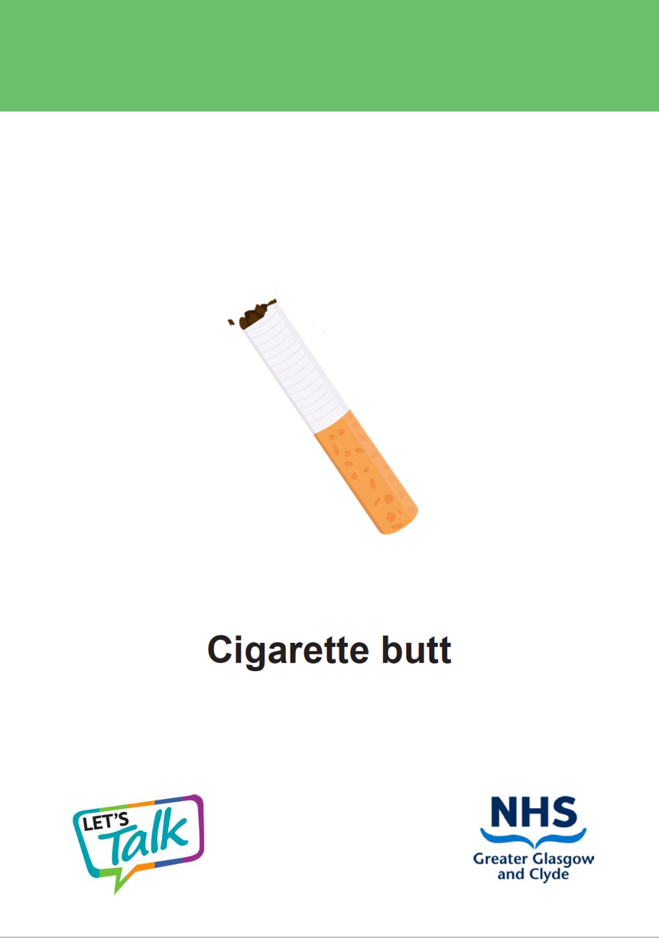
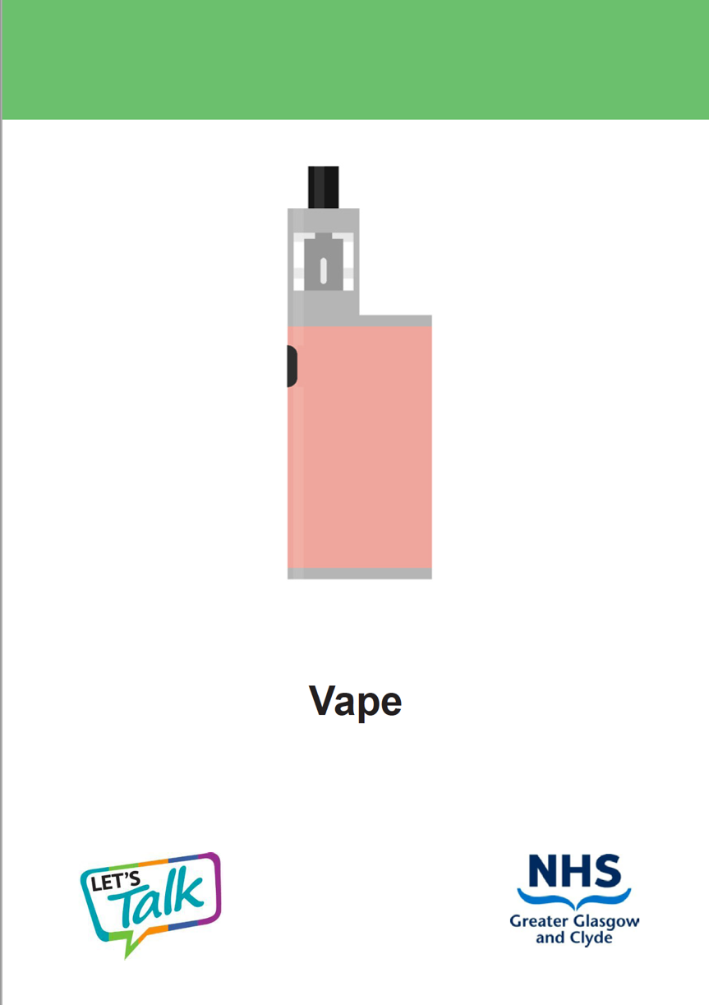
Vaping and the environment
Can you think of anything else ?
Notes:
Activity: Vaping and the environment
In groups:
Take each item and think about where it should go on the timeline to show how long you think each item takes to break down.
This can be done as a full class discussion using the slides. Cards can also be printed to encourage active learning. Teachers could put cards in a box and allow young people to pick out an object. Pupils could hold a card each and order themselves against the timeline.

Slide 30
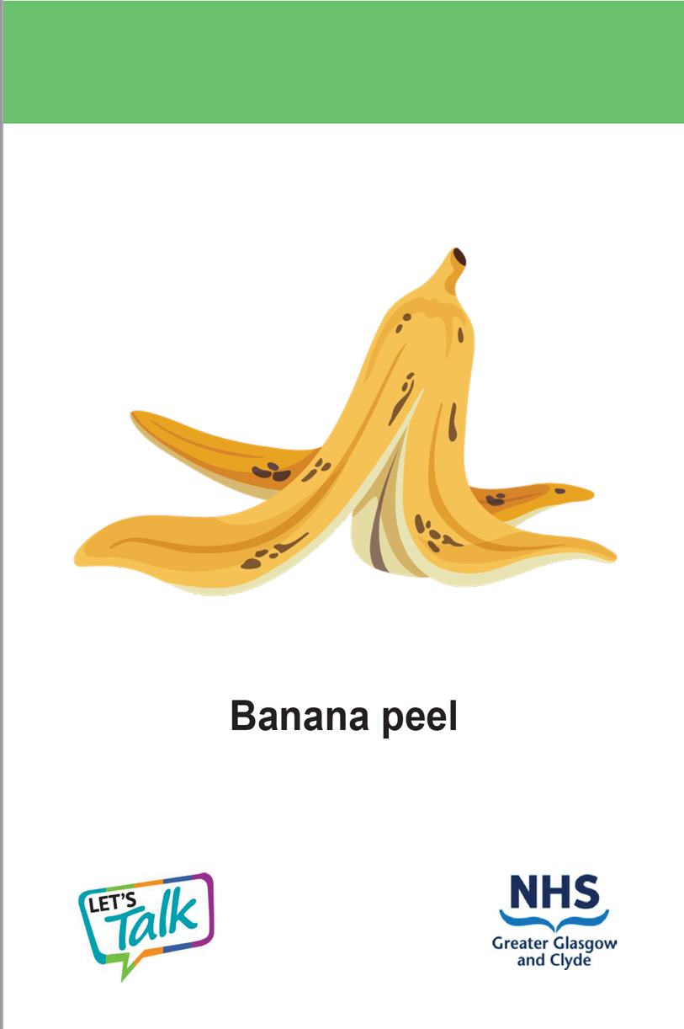
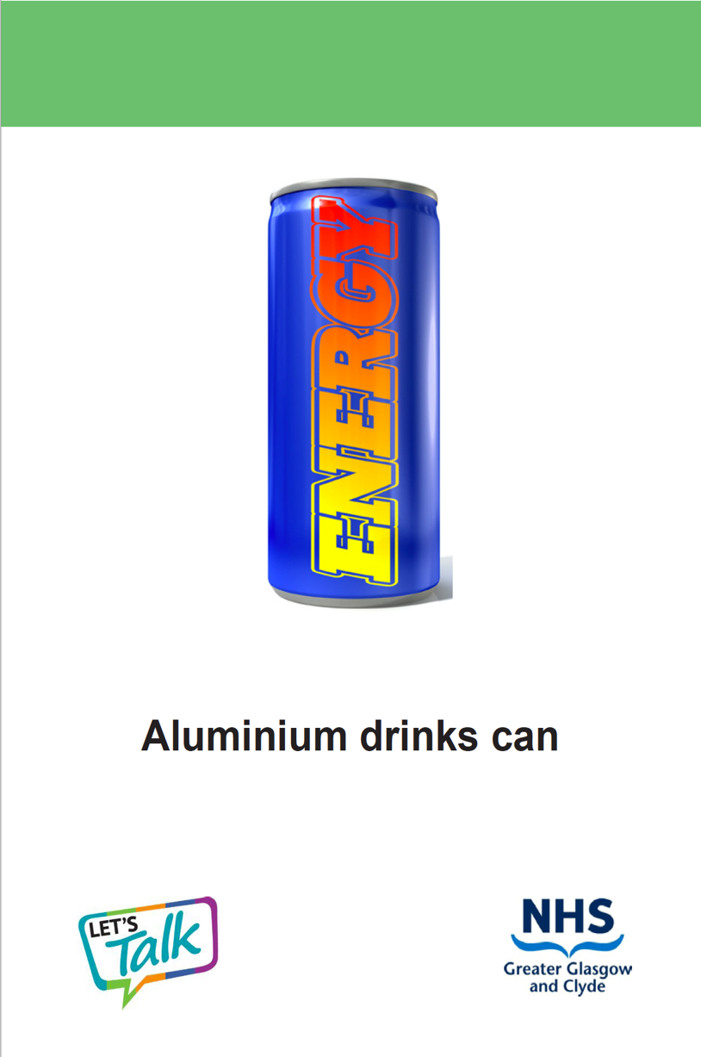
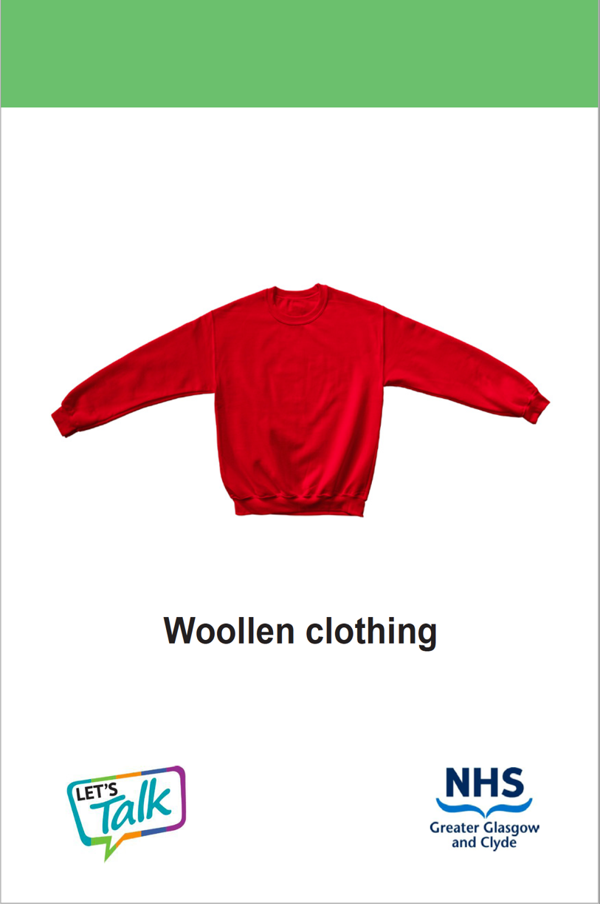
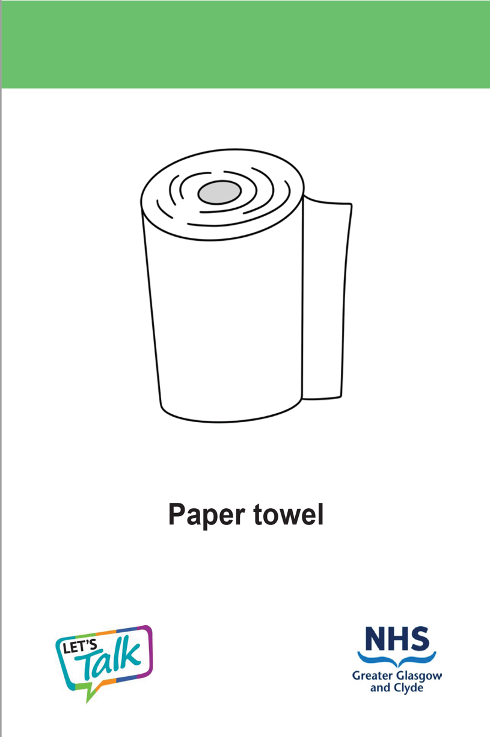
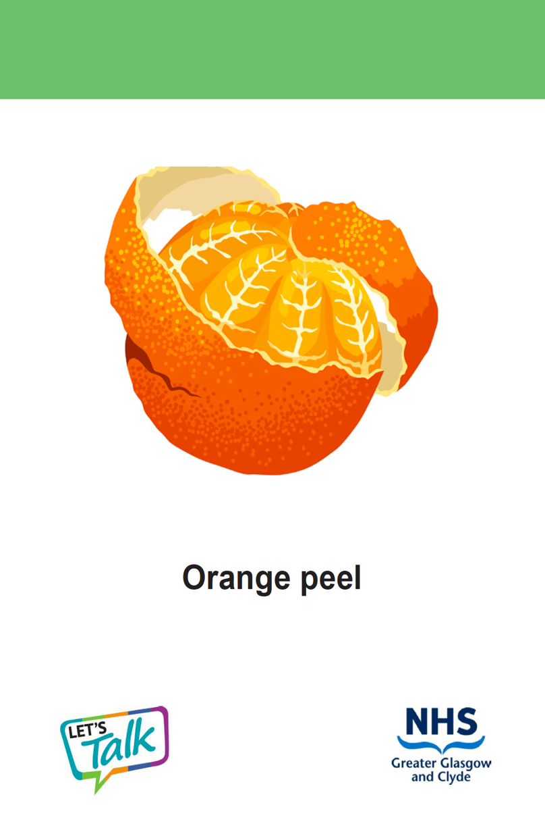
Vaping and the environment
Can you think of anything else ?
Notes:
Activity: Vaping and the environment
In groups:
Take each item and think about where it should go on the timeline to show how long you think each item takes to break down.
This can be done as a full class discussion using the slides. Cards can also be printed to encourage active learning. Teachers could put cards in a box and allow young people to pick out an object. Pupils could hold a card each and order themselves against the timeline.

Slide 31

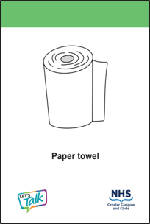

Vaping and the environment
2 WEEKS
4 WEEKS
4 WEEKS
6 WEEKS
Can you think of anything else ?
Notes:
Apple - An apple core takes only 2 weeks to break down and releases organic matter into the soil, this means that it is good for the soil.
Underpants - A disposable nappy takes 30-40 years to break down. Disposable nappies are made from wood pulp, cotton and materials that are made from plastic. This plastic causes the disposable nappy to break down slowly and can leak some dangerous chemicals into the soil.
Crisps - A person could enjoy a packet of crisps in a few minutes, but the packet takes 70-80 years to break down.
This is because many crisp packets are made from “metallised” plastic film which leaches harmful plastics into the soil.
Tin can - A tin can takes 50 years to break down. However, the metal it is made of, tin, can be recycled many times. This means it can be remade into different products. This is much better for the environment that throwing it away.

Slide 32

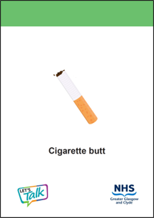
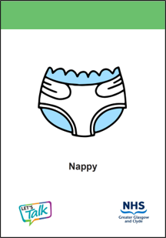
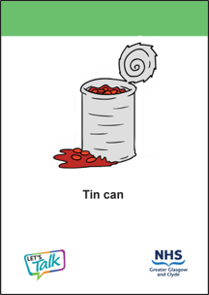
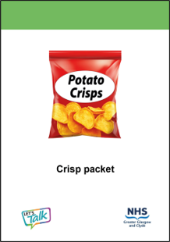
Vaping and the environment
1 YEAR
5 – 10 YEARS
30 – 40 YEARS
50 YEARS
70 – 80 YEARS
Notes:
Woolen clothing - Woollen clothing is made from sheep fur. This means it breaks down easily and is not harmful for the soil.
Paper towel - A paper towel takes about 4 weeks to break down. This is because it is made from either recycled or pulp paper which is made from wood. This means it is safe to break down into the soil.
Orange peel - takes about 4 weeks to break down. Orange peels are natural and so are good for the soil.
Banana peel - takes about 6 weeks to break down. Orange peels are natural and so are good for the soil.
Aluminium drinks can - You can a enjoy a can of fizzy drink in 20 minutes, but it will take 200 years for the can to break down! This is because the can is made of a mental called aluminium and is lined with plastic. When the can breaks down, it can leak microplastics and other chemicals into the soil.

Slide 33

Vaping and the environment
200 YEARS
500 YEARS
1000 YEARS
1 – 2 MILLION YEARS
Can you think of anything else ?
Notes:
Plastic bottle - A person might take a few hours to drink a bottle of water, but the bottle takes 500 years to break down. Plastic bottles leach harmful chemicals called microplastics into the soil. This is why we should always use reusable water bottles that can last us a life-time!
Glass jar - A glass jar can take 1 to 2 million years to break down! Luckily, glass can be made into new products, a process called recycling. This is much better for the environment than throwing them away.
Vape - Even though a person might use a vape for a few weeks, it can take up to 1,000 years to break down.
When a vape breaks down, it contributes to plastic waste in oceans, landfills which are harmful to wildlife and eco systems. The plastics and battery take leach harmful chemicals and microplastics into the soil.
Cigarette - A cigarette butt takes 5-10 years to break down and can only break down in certain conditions. This is because part of the cigarette is made from plastic fibres.

Slide 34
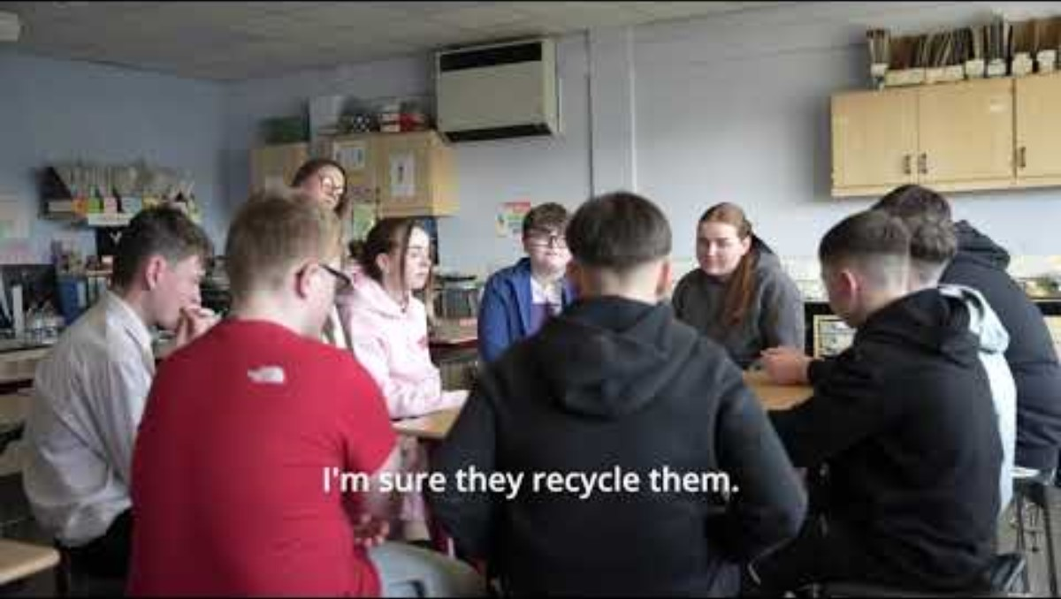





Vaping and the environment
Watch the short clip of young people discussing vaping and the environment.
Notes:
Activity: Vaping and the environment
Teacher shares information with the class. Young people can create a poster demonstrating their knowledge on how vaping affects the environment and showing ways to reduce harm.

Slide 35
Vaping and the environment
Having listened to their discussion now think and discuss the effects of plastic, batteries and chemicals in vapes on the environment.
What could help reduce this negative impact.
Produce a poster to raise awareness of the impact of vaping on the environment.
Notes:
Activity: Vaping and the environment
Teacher shares information with the class. Young people can create a poster demonstrating their knowledge on how vaping affects the environment and showing ways to reduce harm.

Slide 36

Vaping and the environment
Here are some ideas for your poster raising awareness about the impact of vaping on the environment
Choose not to vape for the planet and good health
Encourage people to recycle any old vapes
Make it compulsory for shops selling vapes to recycle them
Single use (disposable) vapes are now illegal. They are unsafe as we don't know what is in them.
Notes:
Activity: Vaping and the environment
Teacher shares information with the class. Young people can create a poster demonstrating their knowledge on how vaping affects the environment and showing ways to reduce harm.

Slide 37
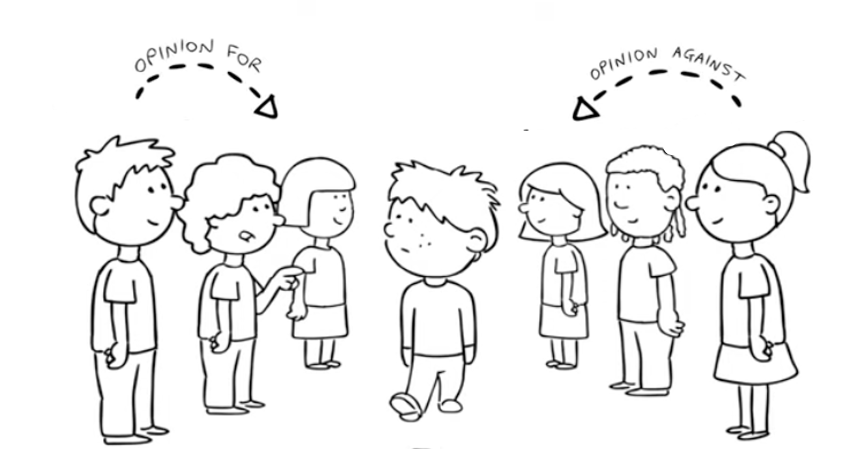

Conscience Alley Role Play
Instructions:
Stand in two equal lines opposite each other
One person has a role play to read out and walk down the middle asking each person what they should do
The greens on one side think of reasons why the volunteer should refuse the offer in the role play.
The reds on the other side give reasons why the volunteer should say yes to the offer in the role play.
Notes:
Activity: Conscience Alley Role Play
This is a whole class activity. Divide the group equally into two and ask them to face each other about a metre apart and ask for a volunteer to walk down the alley. One side can be called ‘greens’ and the opposite side ‘reds’.
One person has a role play to read out and walk down the middle asking each person what they should do
The greens on one side think of reasons why the volunteer should refuse the offer in the role play
The reds on the other side give reasons why the volunteer should say yes to the offer in the role play

Slide 38
Conscience Alley Role Play
Jack and Molly are playing at Molly’s house after school.
Molly’s mum vapes and leaves her vape in one of the kitchen drawers.
Molly says:
“Why don’t we try my Mum’s vape? She does it all the time so I’m sure it’s okay, it makes these big clouds when you blow out, come on, it will be fun!”.
Jack knows that vapes are harmful for children but doesn’t want to disappoint his friend.
What should he do?
Learning
Digital
detox​
Eatwell
Notes:
Activity:
This is a whole class activity. Divide the group equally into two and ask them to face each other about a metre apart and ask for a volunteer to walk down the alley. One side can be called ‘greens’ and the opposite side ‘reds’.
One person has a role play to read out and walk down the middle asking each person what they should do
The greens on one side think of reasons why the volunteer should refuse the offer in the role play
The reds on the other side give reasons why the volunteer should say yes to the offer in the role play

Slide 39


Conscience Alley Role Play
Learning
In pairs take it in turns to suggest different scenarios and practising ‘fudging’ answers to resist/refuse the person
Callum is playing in the park with friends when a friend’s older cousin offers him a vape, saying,
‘Go on have a puff it tastes just like sweets.’ Callum feels nervous and doesn’t want to seem uncool. What should he do?
Digital
detox​
Eatwell
Notes:
Activity: Conscience Alley Role Play
In pairs take it in turns to suggest different scenarios and practicing ‘fudging’ answers to resist/refuse the person.
Callum is playing in the park with friends when a friend’s older cousin offers him a vape, saying,
‘Go on have a puff it tastes just like sweets.’ Callum feels nervous and doesn’t want to seem uncool. What should he do?

Slide 40

The
confidence ruler
Where is
your knowledge on vaping now?
Not sure
Need to know more
Very knowledgeable
Notes:
Activity Slide: The confidence ruler
Teacher can ask pupils to rate their knowledge and understanding around vaping out of 10, following the input.
How confident are you NOW in your knowledge and understanding about Vaping?

Slide 41
Need to talk?
If you are worried anything we have talked about today, you can find support or information
Childline Scotland is a free, confidential telephone counselling service for children and young people.
Call: 0800 1111
https://www.childline.org.uk/
Notes:
Further signposting for support. On pupil slide details for child line are shared.
Please see further support, information and guidance for teaching staff:
Quit your way Youth - NHSGGC
Young people and vaping briefing paper - NHSGGC
Vaping addiction soon takes hold | NHS inform

