Slide 1


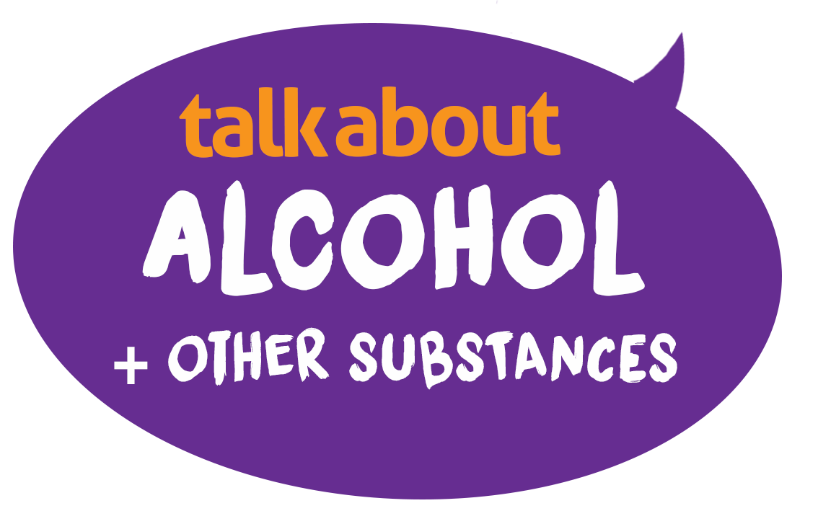
Vaping Quiz
How much do you know? True or false?
1. Vaping is less harmful than smoking
Notes:
TRUE - Vaping is less harmful than smoking.
The vapour from heating an e-liquid is much less harmful than the smoke from burning tobacco for someone trying to give up smoking. But vaping isn’t harm free, as they contain nicotine which is addictive, and chemicals.

Slide 2


Vaping Quiz
How much do you know? True or false?
2. Most vapes contain nicotine
Notes:
TRUE - A cigarette contains 1 – 1.5mg of nicotine and LEGAL vapes (1/3rd sold are illegal and we don’t know what’s in them) contain up to 20mg, so a similar amount of nicotine to a whole packet of cigarettes

Slide 3


Vaping Quiz
How much do you know? True or false?
3. Vaping can help someone quit smoking
Notes:
TRUE - Vaping can help smokers quit.
As smokers quit, they crave nicotine. Vaping delivers nicotine in a less harmful way, by vaporising e-liquid instead of burning tobacco into smoke.

Slide 4


Vaping Quiz
How much do you know? True or false?
4. Vapes are bad for the environment
Notes:
TRUE - Vapes are bad for the planet
Vapes contain plastic, metals and foam. It’s estimated that 5 million are thrown away each week in Britain.

Slide 5

Vaping Quiz
How much do you know?
?
5. Vaping has no side effects
Notes:
FALSE - Vaping does have some side effects.
Vaping can make someone cough, give them a dry and irritated mouth and throat, and cause headaches, irritability, and problems concentrating. Vapes sold illegally often contain other substances like THC causing serious side effects.

Slide 6


Vaping Quiz
How much do you know?
6. Scientists are sure that there are no long-term risks from vaping
Notes:
6. Scientist are sure that there are no long-term risks from vaping
FALSE - The risks of long-term vaping are unknown.
Basically, vaping hasn’t been around long enough to know the health effects of long-term use. But they’re likely to be far less than smoking. Put simply, don’t start if you don’t smoke.

Slide 7

Vaping Quiz
How much do you know?
7. Second-hand vapour is not as harmful as second-hand smoke
Notes:
7. Second-hand vapour is not as harmful as second-hand smoke
TRUE - Second-hand vapour is not as harmful as second-hand smoke.
Currently there’s no evidence to show that second-hand vapour is harmful. However, it’s best not to vape around children and be considerate of others.

Slide 8

Vaping Quiz
How much do you know?
8. There are currently no laws in the UK around who can vape
Notes:
8. There are currently no laws in the UK around who can vape
FALSE - There are laws in the UK around who can vape.
Vaping is illegal for under 18s or for someone to buy vapes for Under 18’s. So, if someone over 18 supplies vapes to anyone under 18 they can also be prosecuted.

Slide 9

Vaping Quiz
How much do you know?
9. Nicotine should be avoided by some groups of people
Notes:
9. Nicotine should be avoided by some groups of people
TRUE - Nicotine is not recommended for non-smokers, children and pregnant women.
That’s because nicotine is harmful to children and unborn babies, and the unknown risks of long-term use mean non-smokers shouldn’t start.

Slide 10

Vaping Quiz
How much do you know?
10. UK laws control what substances vapes contain
Notes:
10. UK laws control what substances vapes contain
TRUE. There are laws in the UK to control what vapes contain
For example, vapes can have a maximum tank size of 2ml and nicotine level of 20mg/ml.​
UK Trading Standards say 25% of vapes sold are ‘illegal’, however. So you can’t know what’s in these devices

