Slide 1



talk about | cannabis
Making Choices
bite size

Slide 2



Conscience alley
Practising resisting peer pressure
Aisha is at the party and a boy asks her to sit down with him. He is smoking cannabis and offers some to Aisha.
Samir is in the park with a group of friends and one of the boys, who Samir doesn’t know well asks if he wants to try some cannabis for free. The boy says that Samir could try it out at home before his parents get back from work.
There's always a choice, make sure you keep you and your friends safe!
Notes:
Conscience Alley instructions
Divide the group equally into two and ask the groups to face each other about a metre apart. One side will be called greens and the opposite side reds.
Ask for a volunteer to walk down the alley.
Ask the volunteer to read out a prepared statement. Here are two examples: “Aisha is at the party and a boy asks her to sit down with him. He is smoking cannabis and offers some to Aisha,” or
“Samir is in the park with a group of friends and one of the boys, who Samir doesn’t know well asks if he wants to try some cannabis for free. The boy says that Samir could try it out at home before his parents get back from work”.
Allow the groups five minutes to think about what advice they will give the volunteer. The greens give reasons to refuse/resist and stay safe and the reds give the reasons to say yes.
Ask the volunteer to walk down the alley, with a red or green alternating to give that character advice as to the decision they should make.
Hence, the greens might say, “Don’t do it, because you’re asking them to break the law”, or “it might make you ill” and the reds might say, “It will be really fun and you’ll look a loser if you don’t join in,” or “Yeah, it’ll be much more fun if you do”.
This activity reflects the realistic peer pressure that young people can face and offers an excellent opportunity to talk about risk taking and how to plan answers to resist peer pressure. The activity can be followed up with small groups acting out role play scenarios of different situations and how they would resist in a proactive positive way.

Slide 3
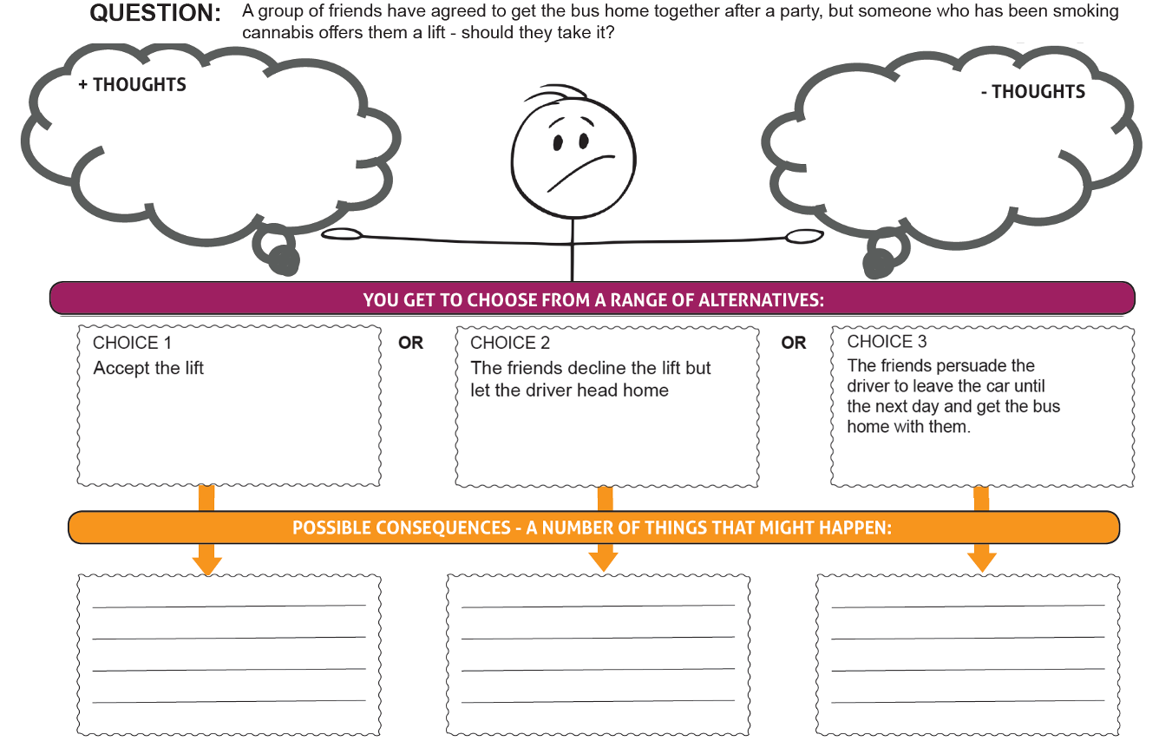


Making choices

Slide 4
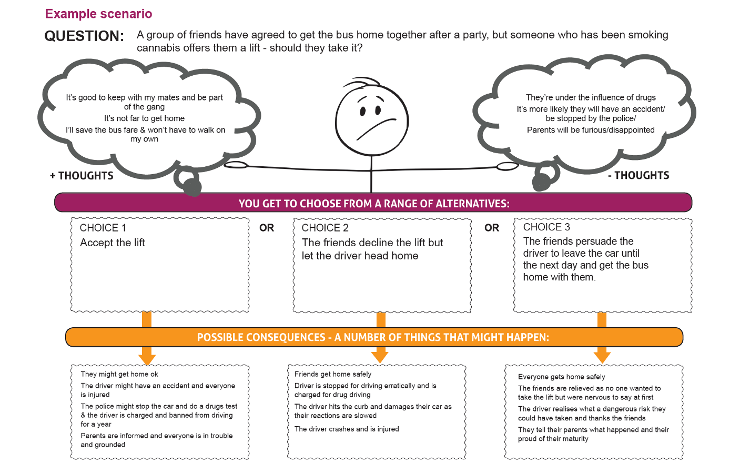
Making choices
Notes:
Alternative scenarios:
Beth and her friends follow on instagram/ TikTok a local older girl who is really cool and fashionable. In her last few posts she has been talking about vaping and how much it helps her feel calmer and happier. One of Beth's friends is now old enough to by vapes and suggests getting some for everyone to try.
Lucas is alone at home with his older sister Emmie and her boyfriend, Eliot. Their parents are out for the evening and as it's still warm, they sit out in the garden. Eliot has a fruit flavour vape bar that smells just like sweets. Eliot tries to get Lucas to have a puff as he thinks it's funny.

Slide 5
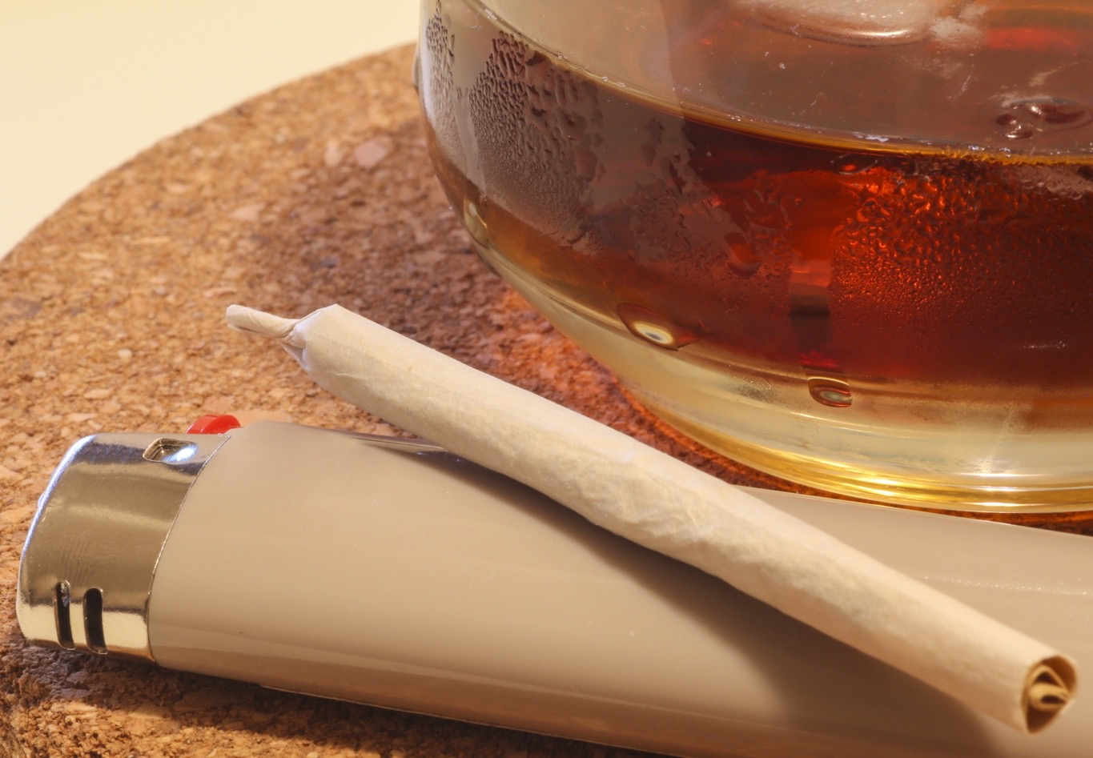

Using alcohol and cannabis together
Having alcohol and cannabis allows the body to absorb THC faster. This can lead to the cannabis having a much stronger effect.
Alcohol and cannabis are both depressants (downers) so they both slow down the nervous system. Judgement, reaction time and coordination are affected more.
Cannabis affects basic control functions in the brain, such as throwing up, and so can stop someone being sick after drinking too much. This could mean an increased risk of alcohol poisoning.
​If driving, one drink and a single joint will affect someone's coordination and judgement the same as being over the drink drive limit.

