Slide 1


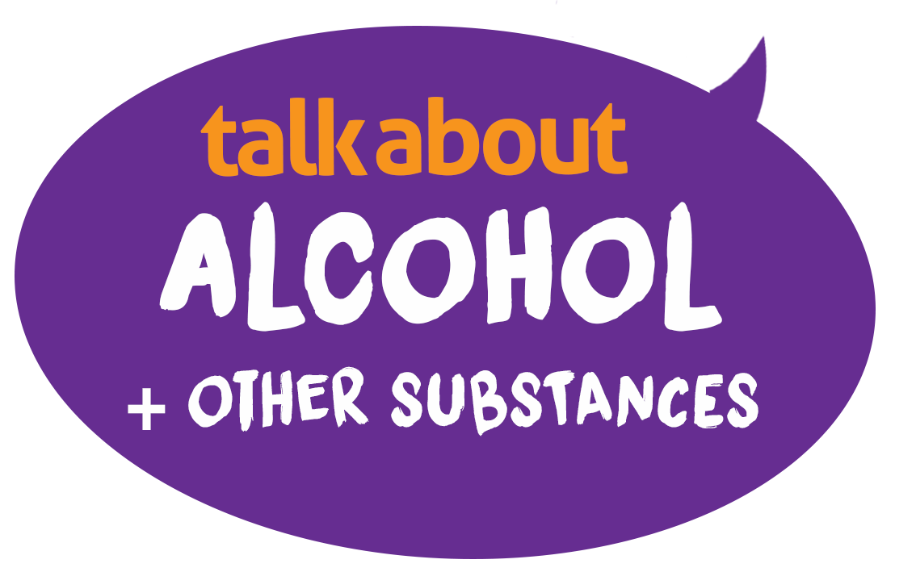

Tools and information to use with young people to enable conversations about use and risks.
The Alcohol Education Trust is a charity dedicated to working with young people across the UK
LESSON 1
talk about |drugs
Influences and choices
alcoholeducationtrust.org
life-stuff.org
talkaboutalcohol.com
Winner of the Best Secondary Education Resource
Education Resource Awards 2025

Slide 2


We will
Explore who and what influences our choices
Look at the teenage brain and the effect drug and substances have on brain development
Learn about different categories of drugs legal and illegal and their effects and the laws
LEARNING OBJECTIVES

Slide 3

?
Respect
Listen
No personal info
Not laughed at
Where to get help?
Ask it basket
It’s OK not to know
Confidentiality
OK to pass
GROUND RULES
How will we behave in today’s session?

Slide 4
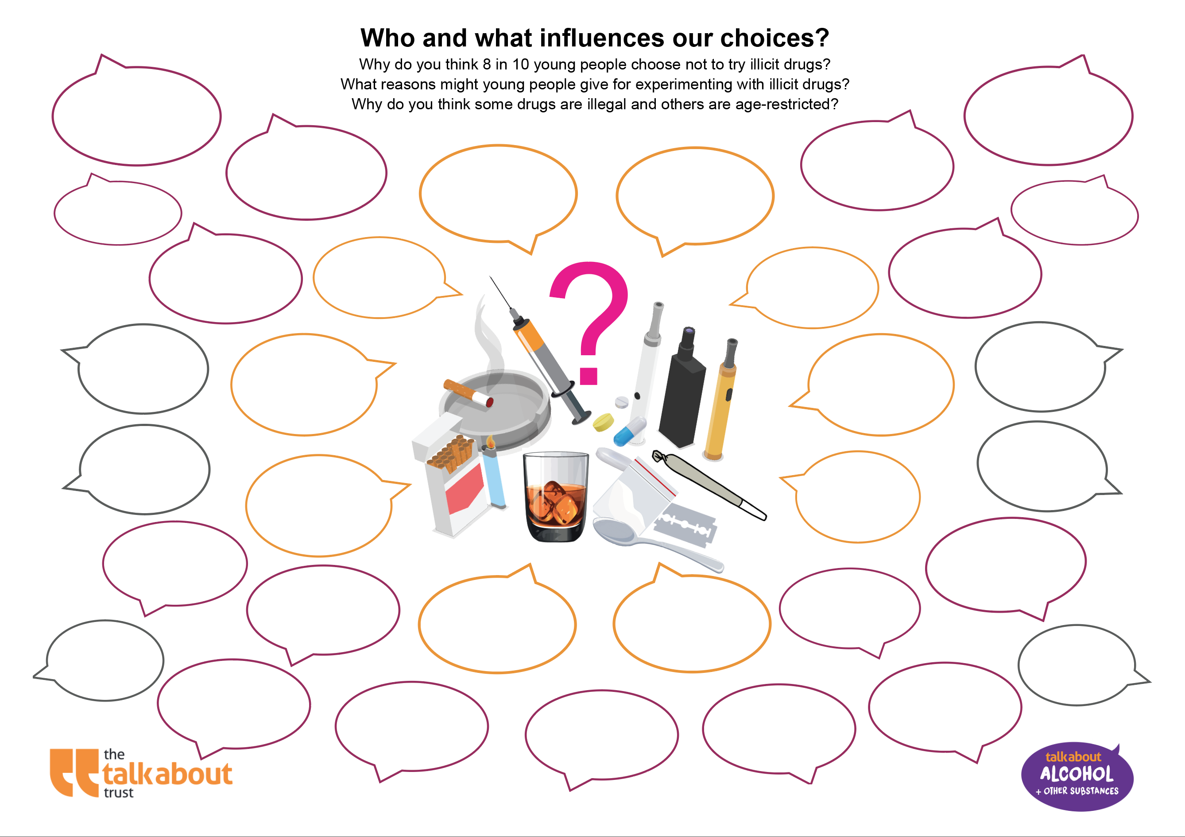
Who and what influences our choices ?
Why do some people choose to try substances and others not ?
Notes:
Prior to this activity
Outline for pupils the definition of a drug: “a medicine or other substance which has a physiological effect when ingested or otherwise introduced into the body.” i.e. A drug is something that changes how the body functions and feels.
Activity
If possible have pupils sitting in groups around tables with post it notes/paper and pens
Ask pupils to work in groups and allocate one question to each group. Allow 3 minutes for them to discuss and write down answers.
Ask each group to nominate one spokesperson to answer the question given
Write the groups answers on the white board,a nd if using a student workbook or the worksheet, ask them to fill in the answers
Consider the risk of different influences and the protective factors of family and friends
Let the answers inform the 3rd question as a discussion 'why do you think illicit drugs are illegal and why there are legal controls for nicotine and alcohol'

Slide 5
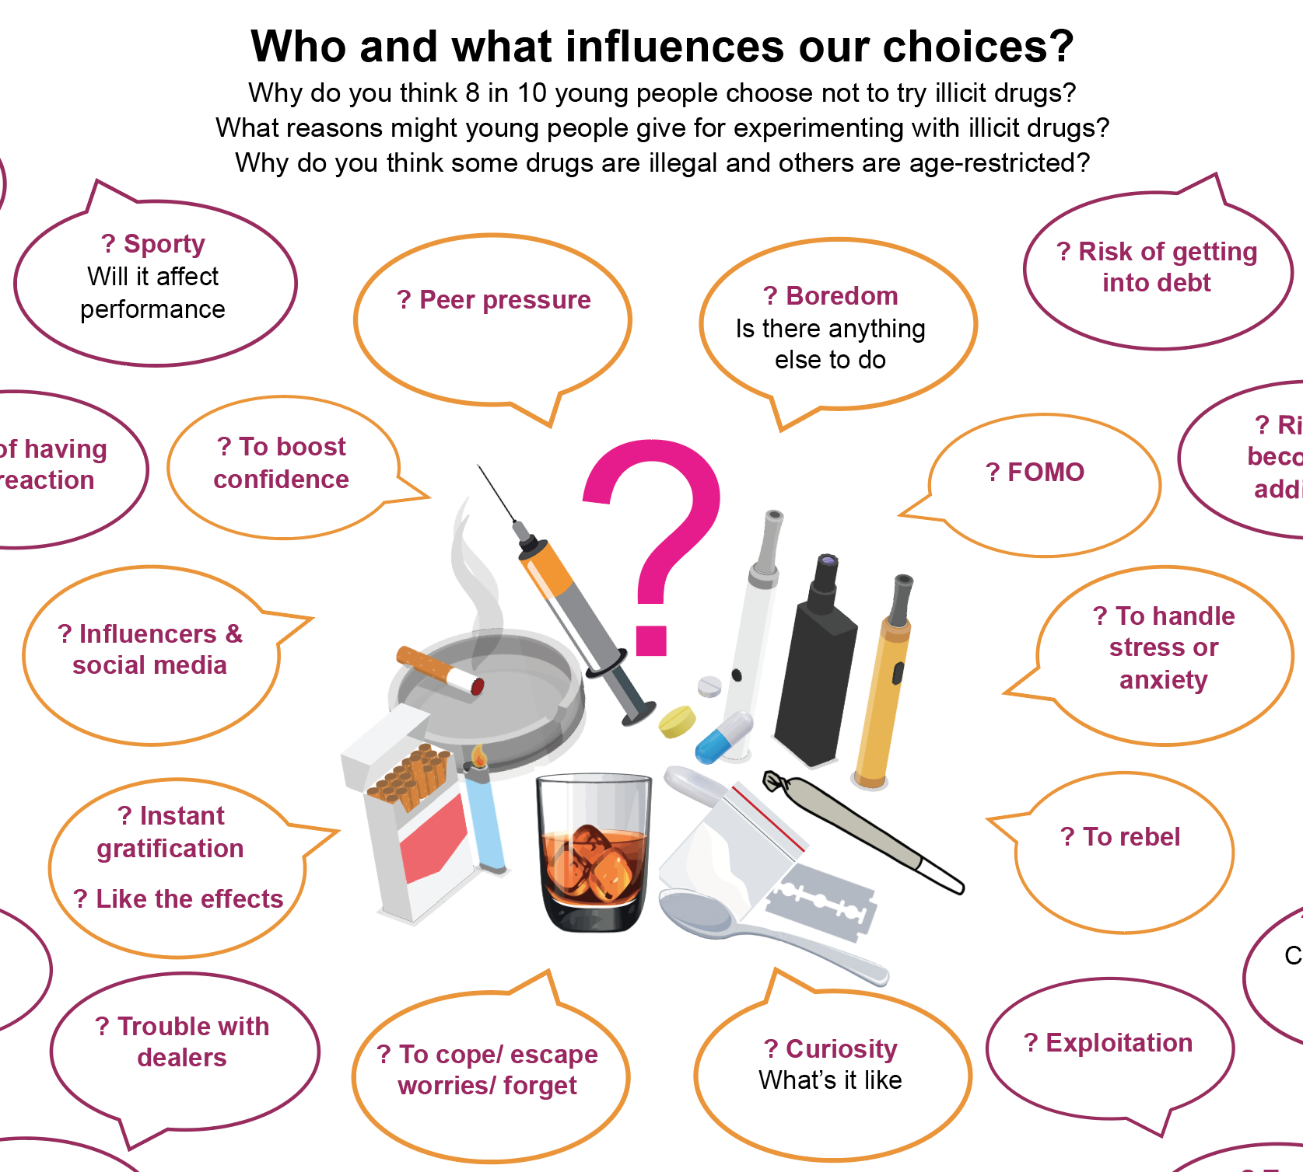
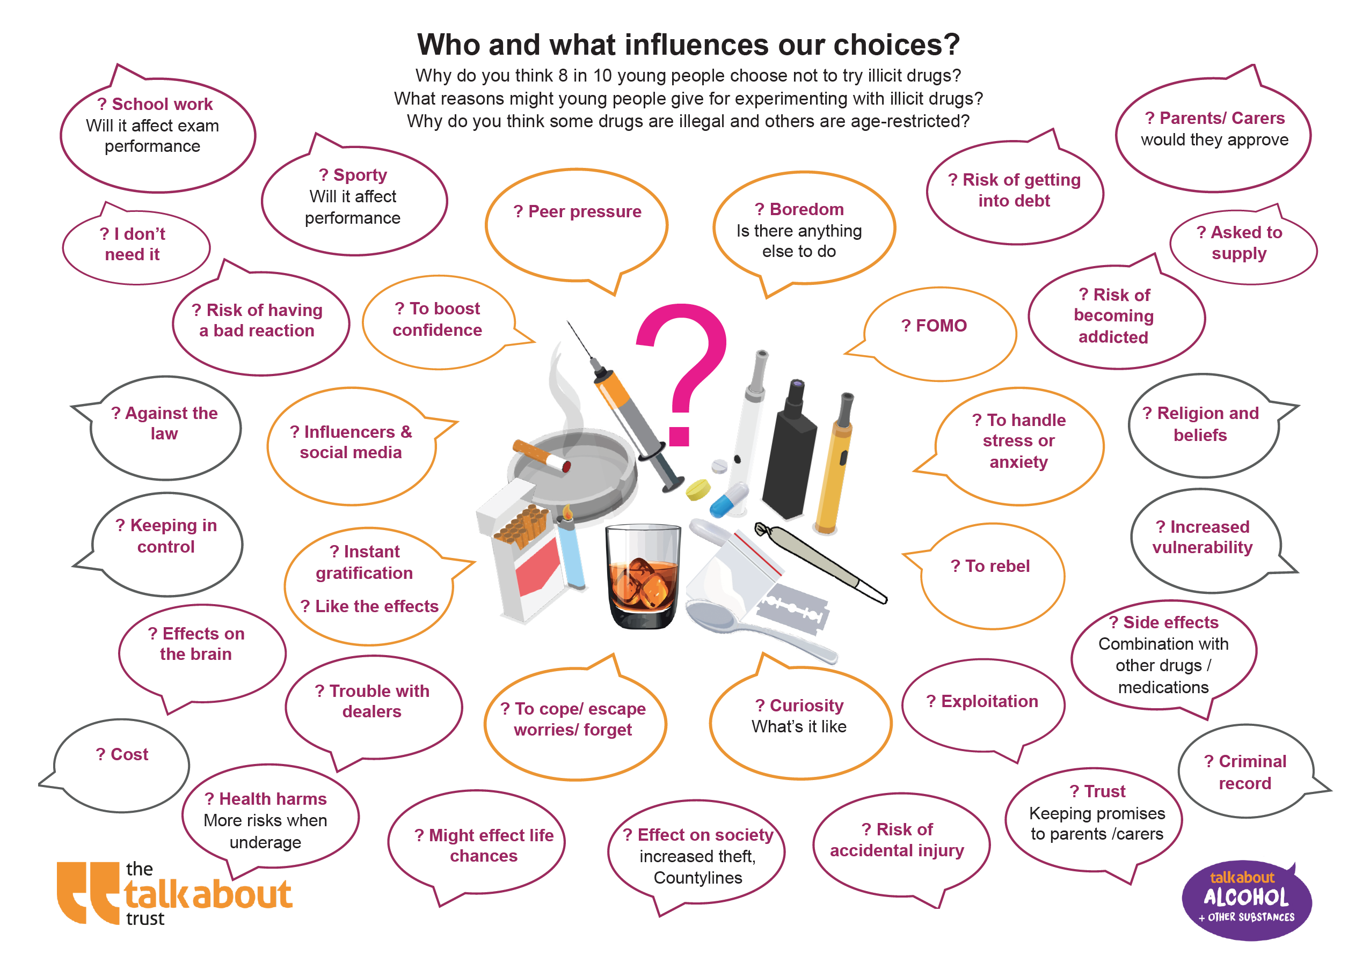
Who and what influences our choices ?
Why do some people choose to try substances and others not ?

Slide 6
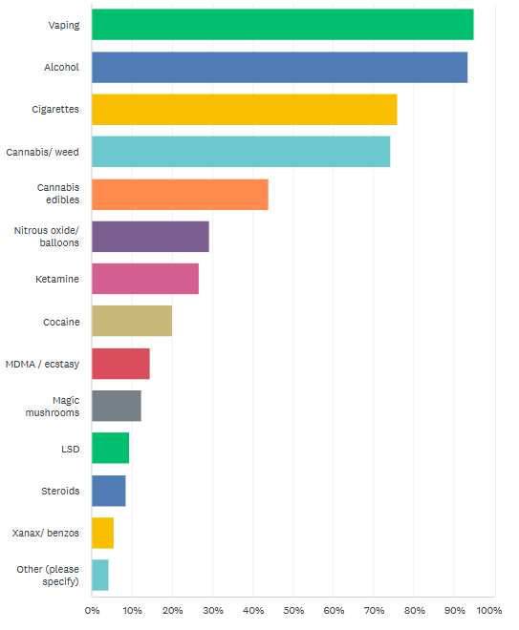
Substances teenagers believe are most used by their year group.
Vaping
Alcohol
Cigarettes
4. Cannabis (weed)
5. Cannabis (edibles)
6. Nitrous oxide
7. Ketamine
8. Cocaine
9. MDMA/ecstasy
10. Magic mushrooms
11. LSD
12. Steroids
13. Xanax
14. Other
95%
93%
76%
74%
44%
30%
27%
20%
15%
12%
9%
9%
6%
4%
So, what’s out there?
What do older teenagers think?
Based on responses of 6,356 15 to 18- year-olds, academic year 2022-2023
Source: DSM Foundation 2023

Slide 7
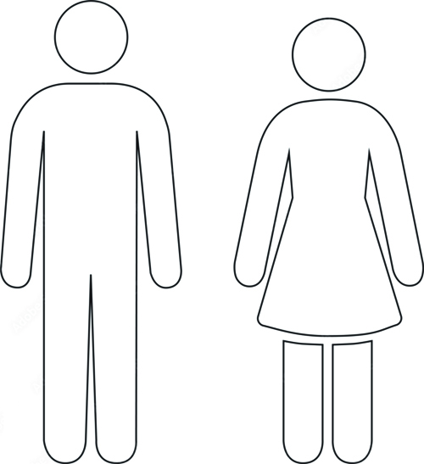

Is that true? How many young people use substances?
How many 11 to 15 year-olds have been offered illegal drugs?
3 in 10 11 to 15-year-olds have been offered illegal drugs
How many 11 to 15 year-olds have tried illegal drugs?
Less than 2 in 10 11 to 15-year-olds have tried illegal drugs – just 13% in the last NHS Digital survey
Notes:
It may surprise you to know that according to the drugs misuse survey, the proportion of 16-24 year-olds ever having tried cannabis is 26%, down from 44.5% in 2002.
About 16% of 16-24 year-olds have used cannabis in the past year.
Of those 16-24 year olds reporting any drug use in the past year, 63% say their use is infrequent (once a month or less).

Slide 8
So, what’s normal?
How many adults use cannabis regularly?
1 in 10 adults use cannabis regularly
1 in 3 having tried out of curiosity or use it occasionally
What proportion of young people 11 to 15 year-olds don't use vapes?
8 in 10 11 to 15-year-olds don't use vapes . Less than 10% of 16 – 19 year olds vape more than weekly
Sources: ASH and davidhammond.ca/projects/tobacco-vaping/itc-youth-tobacco-ecig/
Notes:
It may surprise you to know that according to the drugs misuse survey, the proportion of 16-24 year-olds ever having tried cannabis is 26%, down from 44.5% in 2002.
About 16% of 16-24 year-olds have used cannabis in the past year.
Street cannabis is getting stronger and more addictive. 94% of police seizures were high-potency cannabis in 2018 compared to 51% in 2005.
8 in 10 under 16’s choose not to vape regularly
(more have tried once or twice)

Slide 9
So, what’s normal?
What proportion of young adults aged 16-24 don't drink alcohol?
3 in 10 16 to 24-year-olds don't drink alcohol
What proportion of young adults aged 16-24 avoid drinking heavily or getting drunk ?
and ​more than 8 in 10 (84%) of 16 to 24-year-olds don't get drunk, or drink heavily
Notes:
A large majority of teenagers DON’T regularly go out and get drunk, or drink heavily
Most teenagers do not go out to get drunk: In fact, the majority of school-going children across Europe have never had a whole drink.
The number of teenagers under 15 years experimenting with alcohol is falling in the UK.
n England, only 6% of 11 – 15 year-olds drink at least weekly (down from 20% in 2003) – i.e. 94% don’t (<1% of 11 year-olds drink rising to 14% of 15 year-olds)
56% of 11 – 15 year-olds have never drunk alcohol (up from 41% in 2000). The proportion of pupils who have had an alcoholic drink increases from 15% of 11 year-olds to 73% of 15 year-olds.
Among 16-24 year olds, 19% of men and 9% of women drank more than 21 units in 2016, down from 23% and 13% in 2011. 14% drink more than 50 units.
Also in this age group, 16% of men and 17% of women said they binge drink. (down from 31% and 28% in 2006 respectively)
That means an overwhelming majority (84% of young men and 83% young women) go out to enjoy themselves and socialise and not to get drunk

Slide 10
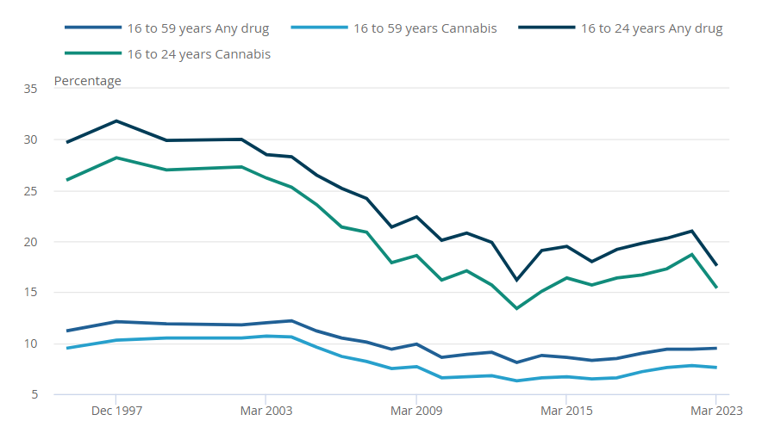
We’re often told things are getting worse!
Trends in ‘any drug’ use in the last year among adults aged 16 to 59 and 16 to 24-year-olds, 1995-2023
Note: COVID may have lowered use due to lockdown 2020/21
Findings from the 2018/19 Crime Survey for England and Wales
Notes:
All drug use has fallen significantly among 16 – 24 year olds over the last 20 years as this slide shows, from over 30% to 16%, but worryingly, prior to the COVID lockdown, use did seem to be creeping up again.
So why do we think use is showing signs of increasing? (more dealers, more available, more pushers, attitudes?)
Note: COVID may have lowered use due to lockdown 2020/21

Slide 11


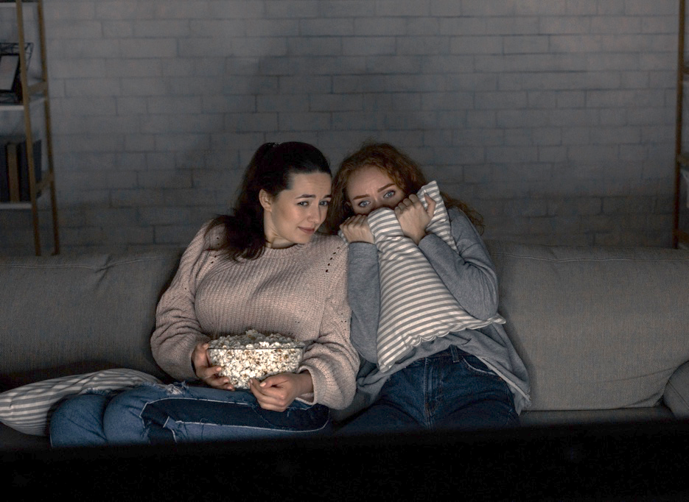
Why might someone think that more young people are using substances than is actually the case?
If people in a friendship group use cannabis, or vape, then it seems to be normal and what everyone else is doing – a bit like going to a town centre on a Saturday night where clubs and bars will be full of those who drink – it’s them who you notice and not the big majority who are at home/ at the cinema/ bowling/ working/ with friends and not drinking.
It’s the same with illegal drugs - a few have tried on occasions, but very few young people (not even 2 in 10) choose to use regularly.

Slide 12
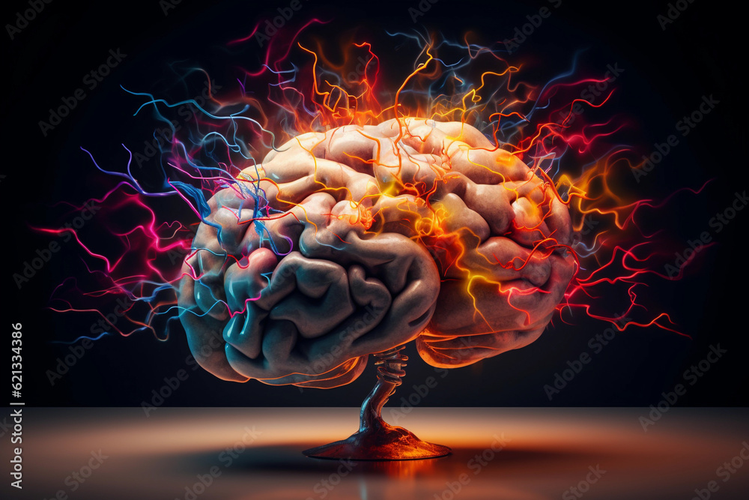

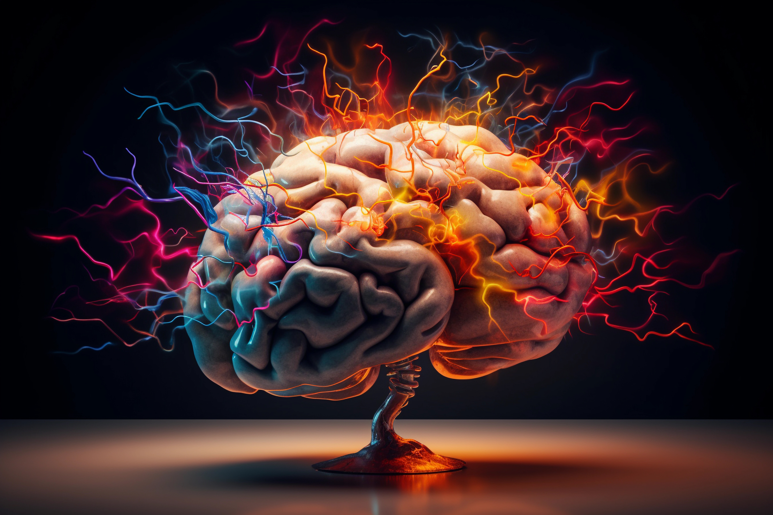
Your amazing brain – and how it changes
DURING TEENAGE YEARS...
The brain is adult size from age 9
But it is not fully mature until age 25!
Your reactions are quicker
You can calculate better –
You are wired to learn faster!
White matter in the centre of the brain gets stronger and bigger, meaning....
BUT, Grey Matter gets smaller
DID you know this part of the teenage brain SHRINKS? It regulates our emotions and decision making
The last part of the brain to mature is the pre-frontal cortex ​
This is linked to good
judgement/ empathy,
self-control and being able to think ahead ​
Teenagers rely more on a part of the brain called the amygdala to make decisions and solve problems.
The amygdala is associated with strong emotions, impulses, aggression and instinctive behaviour ​
​​​
Notes:
Teenagers - Wired to learn faster, better plasticity, increased excitability – 25 years to mature
Grey matter decreases during adolescents because the prefrontal cortex is still developing, teenagers rely on a part of the brain called the amygdala to make decisions and solve problems more than adults do. The amygdala is associated with emotions, impulses, aggression and instinctive behaviour
Grey matter is the brain tissue that processes information, and contains all of the organ’s neurons. While brain development continues into adulthood, grey matter growth peaks before adolescence, then shrinks – grey matter is what helps us control our emotions, be considerate of others (empathy), helps us make good decisions and safer judgements. Less grey matter is linked to “disinhibition”: impulsive behaviour, rule-breaking behaviour and less ability to consider consequences… which is why teenagers take more risks and are more impulsive than adults
Frontal lobe – judgement/empathy, self control – last to mature. Part of this is
Prefrontal cortex – bigger than in any other species, decision making, inhibition/planning/social interaction and social awareness.
Addiction – form of synaptic plasticity – can also learn a strengthening of bad pathways long term
Substance misuse can prevent normal process of brain development
Stress – long term risk of depression
Adolescence is one of the most rapid phases of human development. While their bodies are still developing, even small amounts of alcohol have a much greater effect on the organs of children than on adults. The brain, our main organ, continues to develop until our early twenties and can be easily affected by alcohol, including two key areas that are undergoing momentous changes at this time:
The hippocampus, responsible for memory and learning. Studies show that heavy and extended alcohol use is associated with a 10 per cent reduction in the size of the hippocampus. It also shows that the function of the hippocampus is uniquely sensitive to alcohol in adolescence and that alcohol may be poisonous to the nerve cells causing damage or destruction.
The prefrontal lobe, important for planning, judgement, decision making, impulse control and language. Research heavy drinking adolescents shows that these young people have smaller prefrontal lobes than those of the same age who do not drink.
https://www.healthywa.wa.gov.au/Articles/F_I/Information-for-parents-alcohol-and-the-developing-brain
According to the National Institute on Alcohol Abuse and Alcoholism of the USA, people who started drinking before age 15 were 50% more likely to become alcohol dependent as adults than those who didn’t. https://www.verywellmind.com/early-drinking-age-and-the-risk-of-alcoholism-69521
See also, Sarah Jayne Blakermore brainfacts.org and youtube.com/watch?v=6zVS8HIPUng

Slide 13

What do these brain changes mean?
It’s NORMAL for teenagers to be embarrassed by parents, moody, difficult, argumentative, hyper-sensitive, emotional and more self-conscious
And then add in hormones, pressures at school, relationships……
It's harder to think things through – more impulsive
It's harder to learn from risks that go wrong
More likely to make risky decisions with friends to show off
More likely to be influenced by peer pressure – want to fit in (FOMO)
And then add in alcohol, cannabis, nicotine or other substances to the mix
Teenagers grow out of this, but it’s why it’s important to pause and think things through, as choices made ‘in the moment’ can affect the rest of someone’s life​​​​​
Using substances affects teen brain development and changes reward pathways – making someone more likely to become dependent on alcohol, cannabis, nicotine or other substances the earlier regular use begins​​​​​​
​
Notes:
Because the prefrontal cortex is still developing, teenagers might rely on a part of the brain called the amygdala to make decisions and solve problems more than adults do. The amygdala is associated with emotions, impulses, aggression and instinctive behaviour
Inventing ourselves: the secret life of the teenage brain Sarah Jayne Blakemore (2018)

Slide 14
Legal drugs
Caffeine
- stimulant
Many energy drinks contain high levels of caffeine as well as coffee
Alcohol
- depressant (contents regulated by law, legal purchase age)
What are some of the main categories of drugs?
Nicotine
- stimulant (contents regulated by law, legal purchase age)
Medicines
- prescribed by GP and dose controlled
Note that sharing prescribed medicines is illegal and could lead to person becoming seriously ill or the person giving the medicine to be arrested for supply or harm to friends.
Notes:
Depressant substances reduce arousal and stimulation. They affect the central nervous system, slowing down the messages between the brain and body.¹
They can affect concentration and coordination and slow down a person’s ability to respond to unexpected situations. In small doses, they can cause a person to feel more relaxed and less inhibited.
Prescription medicines
Teach pupils the dangers associated with incorrect use of prescription (and ‘over the counter’) drugs such as painkillers, antidepressants and steroids.
Sharing prescribed medicines is illegal and could lead to person becoming seriously ill or the person giving the medicine to be arrested for supply or harm to friends
People should only take drugs prescribed to them personally by their doctor (and at the dose specified). They should tell their doctor if they:
experience side effects
feel their condition has worsened
take too much (and instructions say to tell doctor)
Explain that it is often unsafe to mix prescription drugs with other medicines or alcohol.
Teach pupils that there are some legal substances that people sometimes misuse as drugs.
Explain that any substance used for purposes other than those intended can be dangerous and could even cause death.

Slide 15

Categories of illegal drugs
In the UK, controlled drugs fall into three different categories, according to their danger or how harmful they are​:
Class A -
Considered the most dangerous drugs, with the highest potential for harm and addiction
​
Class B
These drugs are considered less harmful than Class A but still pose significant risks
​
Class C
These substances can still lead to significant harm and penalties if misused
​
Notes:
N.B. Explain that the age of criminal responsibility is 10 years old. This means that people aged 10 – 17 can be cautioned, tried for criminal offences and gain a criminal record.
Teach pupils that other countries have different laws and punishments for drug offences (e.g. drug trafficking). Add that if a person commits a crime in another country they are subject to that country’s legal system.
Taking any illegal drug into another country is highly dangerous and can result in tough punishments in that country (some examples can be explored).
People taking a prescription drug abroad should always take a prescription to prove it is theirs. They should check NHS advice on taking medicines abroad and check the rules for the country they are visiting. (*Travel abroad and drugs 45)

Slide 16
STIMULANTS (Uppers) Speed up messages travelling between the brain and body. Make a person feel more awake, alert, confident or energetic. Increase the heart rate, and blood pressure Can cause tremors, sweats, sleeplessness.
DEPRESSANTS (Downers) Affects the central nervous system, slowing down the messages between the brain and body. Can affect concentration and coordination Slow down a person’s ability to respond to unexpected situations Reduces arousal and stimulation.
Drug classifications based on their effects on the body
DISSOCIATIVES Gives a feeling of relaxation Causes people to feel separated or detached from their body or physical environment.
EMPATHOGENS Increase feelings of empathy and sociability. Often have both hallucinogenic and stimulant effects.
HALLUCINOGENS Psychedelic drugs that can potentially change the way people see, hear, taste, smell or feel Also affect mood and thought.
STEROIDS Anabolic steroids are used by athletes to increase muscle mass and speed up recovery. In young people, they can lead to aggression; extreme mood swings; anger; extreme irritability; delusions; impaired judgment.
OPIOIDS Class of drugs that derive from, or mimic, natural substances found in the opium poppy plant. Used primarily to relieve pain but can lead to feelings of euphoria.
CANNABOIDS Naturally occurring compounds found in the Cannabis plant. May lead to memory loss or paranoia.

Slide 17
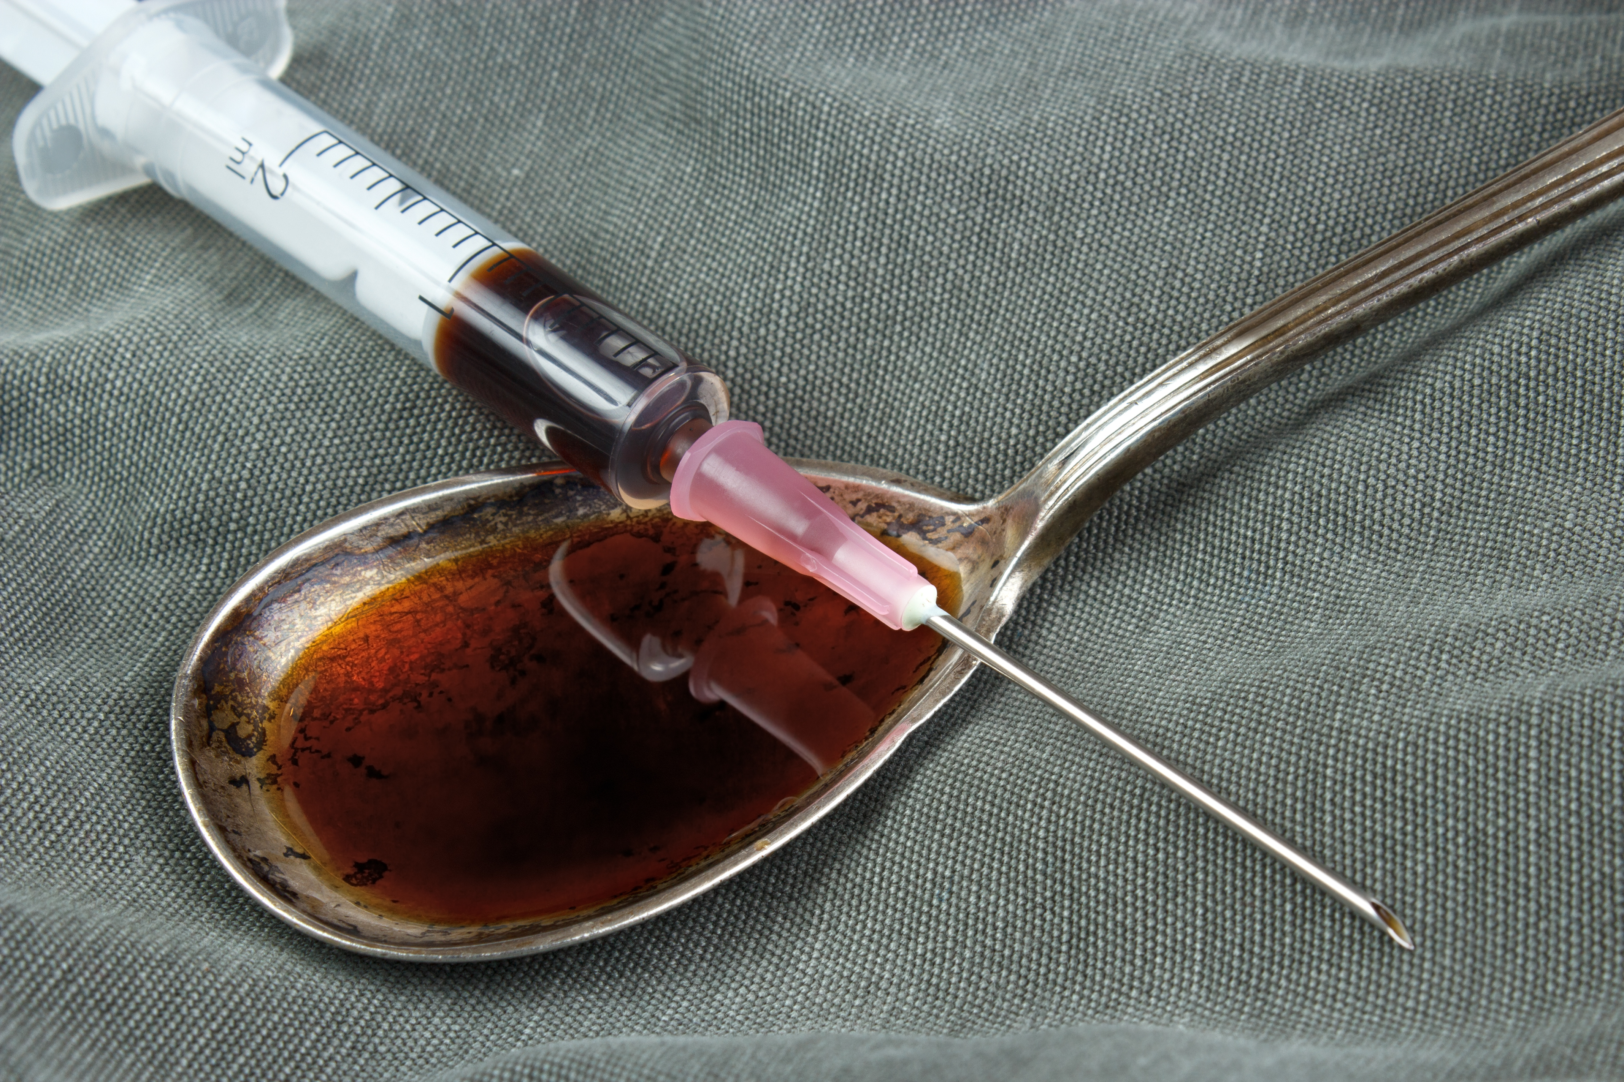
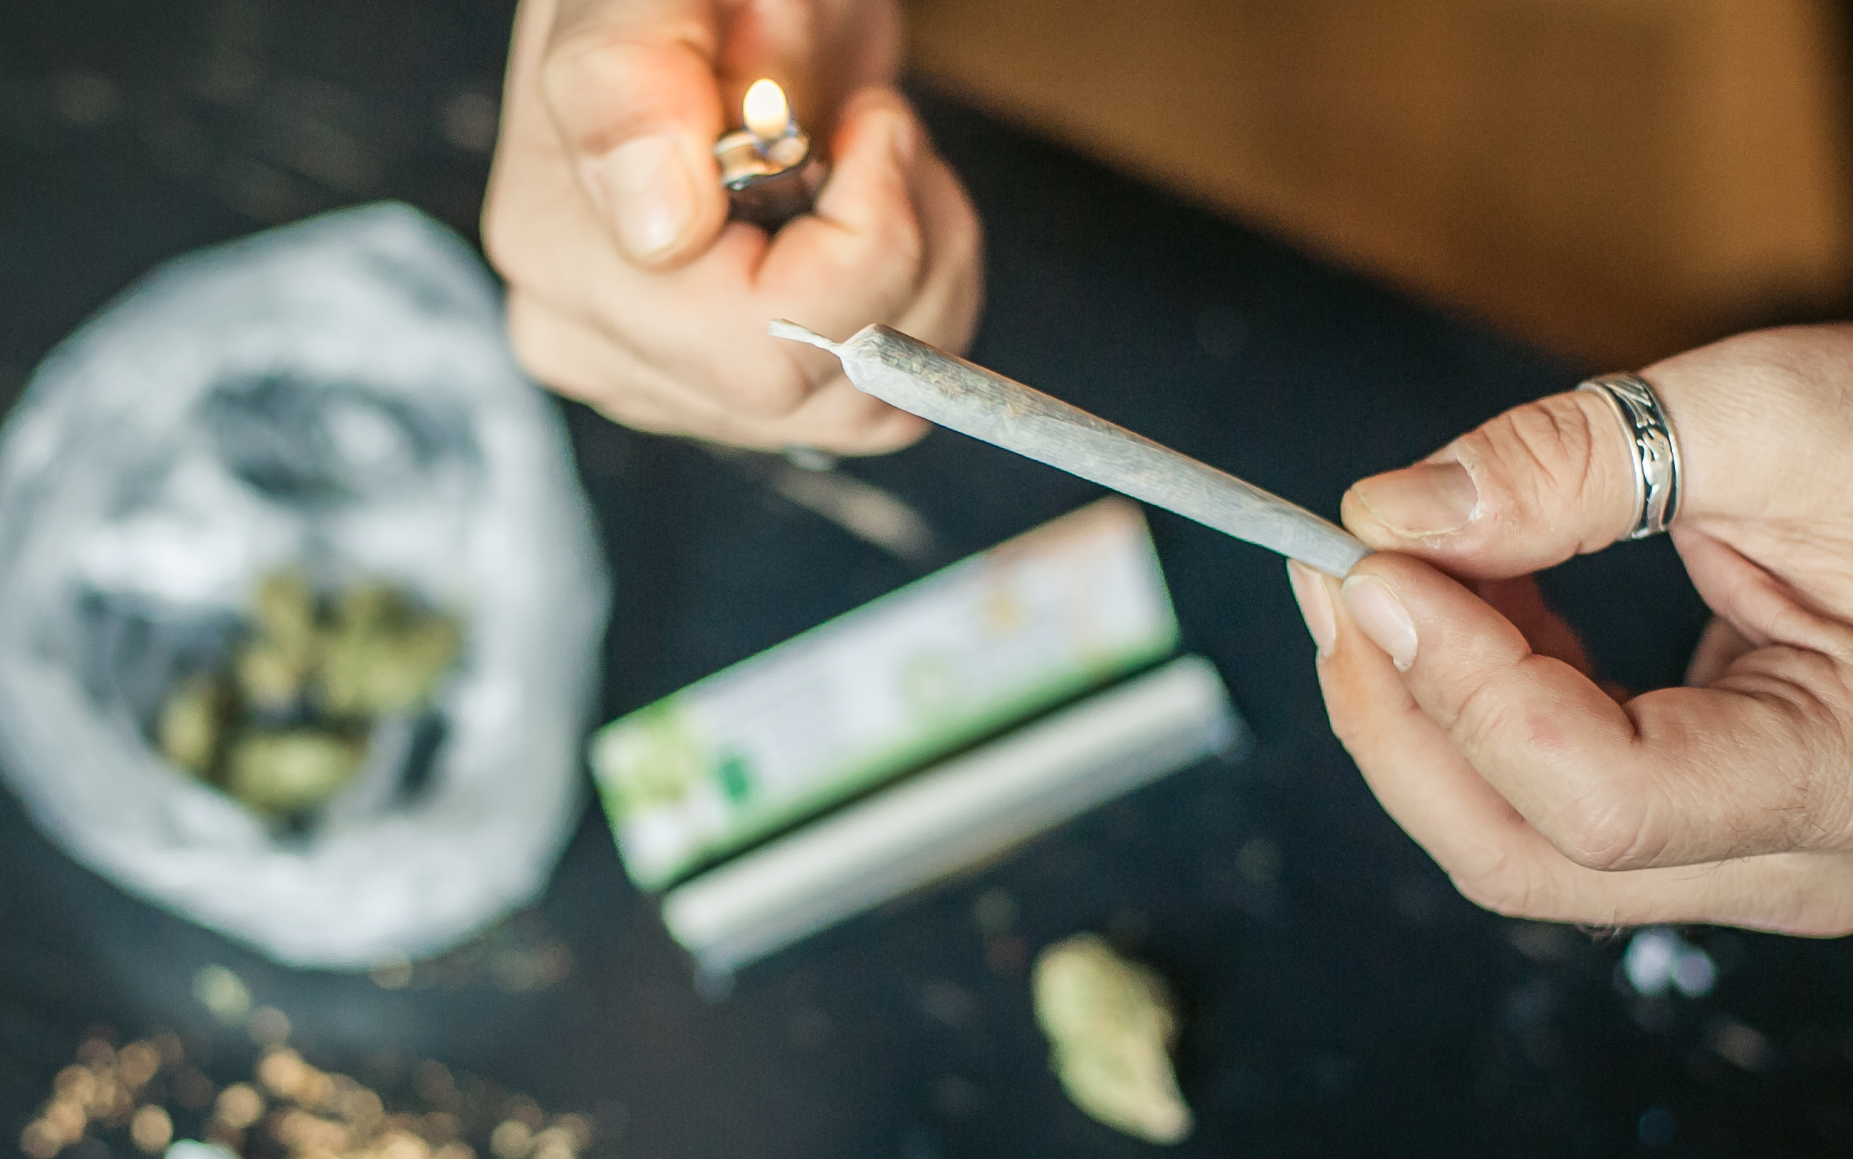
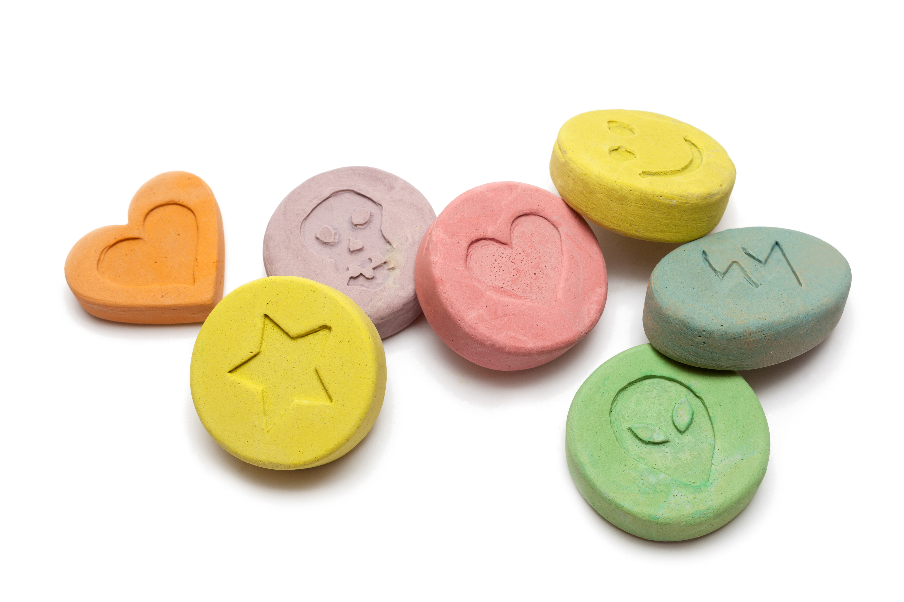
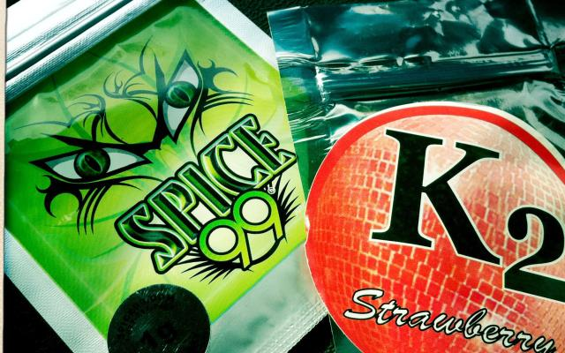
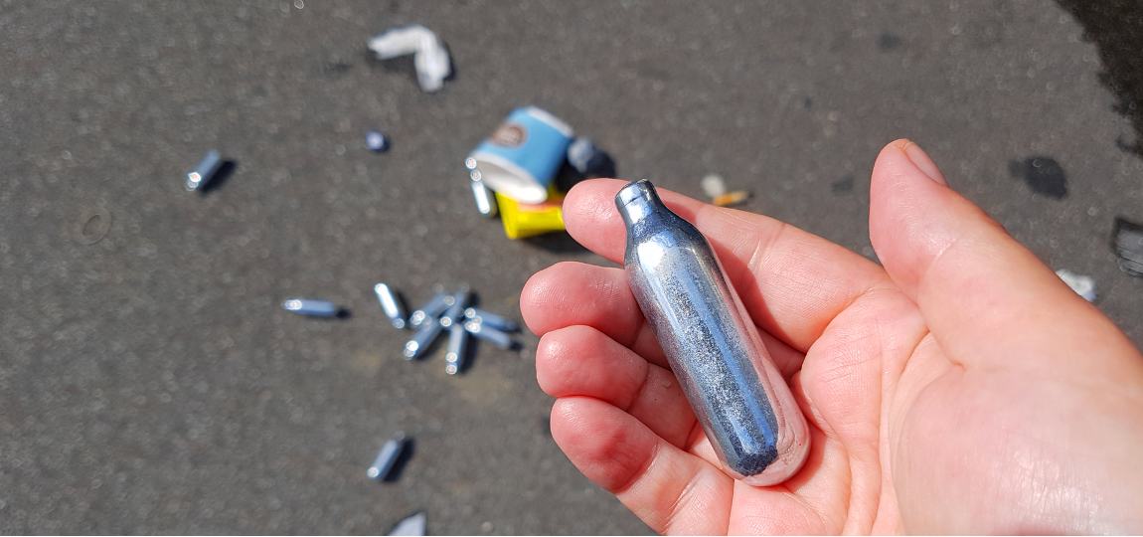
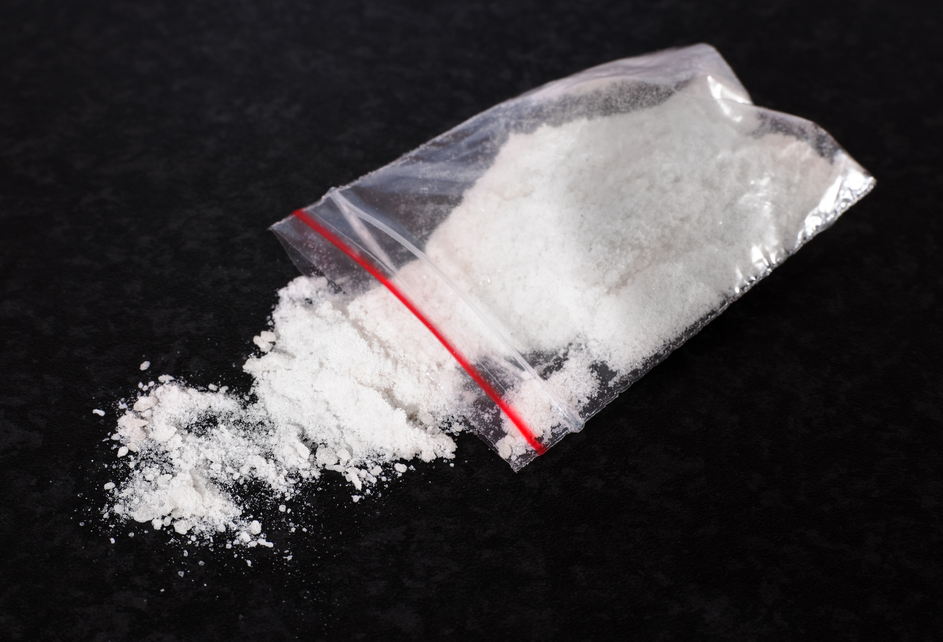
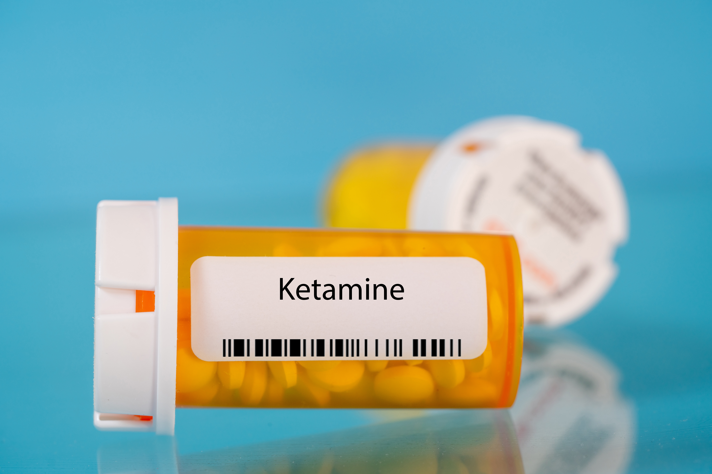
Categories of illegal drugs according to their effects and risks
Spend a few minutes deciding what class of drug the following are, and what effect they have on the body
Substance | Class | Effects
Heroin Snow/ Smack/
MDMA/ Molly/ E bomb/ X/ Pink legos/ Gold bars/ White clover
NOS Nangs/ Hippy crack/ Whippets/ Balloons
Ketamine/ Ket/ Green/ Bump/ Kit kat
Substance | Class | Effects
Cannabis Dope/ Ganja/ Weed/ Pot/ Dank
Spice Grass/ K2/ Red X/ Demon
Cocaine Charlie/ Coke/ Crack/ Blow/ Rocks
Notes:
Teacher information slides on all substances are available from:-

Slide 18

Categories of illegal drugs according to their effects and risks
Substance | Class | What is it? | Short term effects | Long term effects
Heroin Snow Smack | A | Opioid A depressant of the central nervous system, (i.e., it slows down brain function and particularly the control of breathing). | Feeling a pleasurable rush and a reduction in pain, but soon after use may also experience drowsiness, inability to think effectively, limbs feeling heavy or weighed down, dry mouth, nausea or vomiting, itchy skin, slowed heart rate and slowed breathing. | Long term, repeated use changes the physical structure and of the brain and how it works. Heroin can alter the brain’s white matter, which may affect decision-making abilities, the ability to regulate behaviour, and responses to stressful situations. Heroin is also very addictive.
MDMA/ Molly E bomb/ X Pink legos Gold bars White clover | A | Empathogen a stimulant and psychedelic substance | Feeling happy and loved up, but also: raised body temperature, high risk of dehydration or over hydration, faster heart-beat causing nausea, anxiety, panic attacks, confused episodes, paranoia. | Prolonged MDMA use can lead to confusion, impaired ability to pay attention, increased impulsiveness, memory loss, lowered interest in sex, aggressive behaviour.
NOS Nangs, Hippy crack, Whippets Balloons | C | Hallucinogen and a psychoactive substance and a sedative | Feelings of euphoria, relaxation and calmness fits of giggles and laughter, change in voice. | Effects from repeated use of large amounts: dizziness, faintness, nerve damage, affects coordination (driving).
Ketamine/ Ket/ Green Bump Kit kat | B | Dissociative and a sedative | Numbness, chilled, loss of feeling, unable to move, confusion, agitation – disconnected from reality, memory loss, increased heart rate, nausea. | Bladder problems (frequent need to pee). Abdominal pain, liver damage, paranoia and memory loss.

Slide 19

Categories of illegal drugs according to their effects and risks
Substance | Class | What is it? | Short term effects | Long term effects
Cannabis Dope/ Ganja Weed/ Pot Dank | B | Cannabinoid Cannabis can be classed as a depressant, stimulant, or hallucinogen | Feelings of relaxation and euphoria , but also anxiety, panic, mistrust, and general fear with unexpectedly potent doses, or in individuals who don’t use the substance regularly. Other effects include altered sensory perception (such as an increase in sensitivity to sound), changes in the perception of time, mood changes, impaired body movement, impaired cognition and memory, increased heart rate, bloodshot eyes. Individuals who use higher doses of marijuana may also experience psychotic symptoms such as hallucinations and delusions. | Respiratory difficulties, pregnancy-related risks, an increased risk of testicular cancer, adolescent brain development issues, psychiatric disorders, addiction, increased risk of other substance use disorders. As yet the consequences of long-term high potency use are unknown, as high strength cannabis hasn't been available until relatively recently.
Spice Grass K2/ Red X Demon | B | Synthetic cannabinoid | Euphoric feelings, altered perception and feelings of relaxation, but may also result in increased heart rate, hypertension, heart attack, vomiting, hallucinations, paranoia, severe anxiety, panic attacks and aggression. | The long-term effects are largely unknown as it is a relatively new drug. However, heart damage and kidney damage are severe effects that have been reported as well as causing seizures.
Cocaine Charlie/ Coke/ Crack/ Blow/ Rocks | A | Stimulant | Raised heart rate, body temperature and blood pressure, excitable and chatty behaviour, dilated pupils, feeling very alert and confident, decreased appetite, restlessness, heightened sexual desire, risky behaviour, drug addiction, nausea, odd, erratic, aggressive or violent behaviour, anxiety and paranoia, depression, seizures, psychosis (difficulty to know what is real and what is not), fit or heart attack, death. | Permanent damage to heart and brain, damage to or loss of the cartilage that divides the nostrils if cocaine is snorted, respiratory problems or failure if cocaine is smoked (such as in the form of crack), vein damage, ulcers and gangrene (loss of blood supply to body tissue) if cocaine is injected, severe weight loss, hallucinations, sexual problems and infertility, mood swings, ongoing psychosis, depression and anxiety, mental health issues, tolerance and desire to take more of the drug.

Slide 20
How can we know what’s in them?
We can’t!!!
How can we know what’s in illicit drugs?
There are no rules, regulations or ingredient lists for illegal drugs bought online or supplied by dealers – so someone can't know the dose/ strength/ additives/ chemicals in a substance without having it tested
One in 7 vapes in schools contain spice
No drug is risk-free, including prescribed medicines

Slide 21
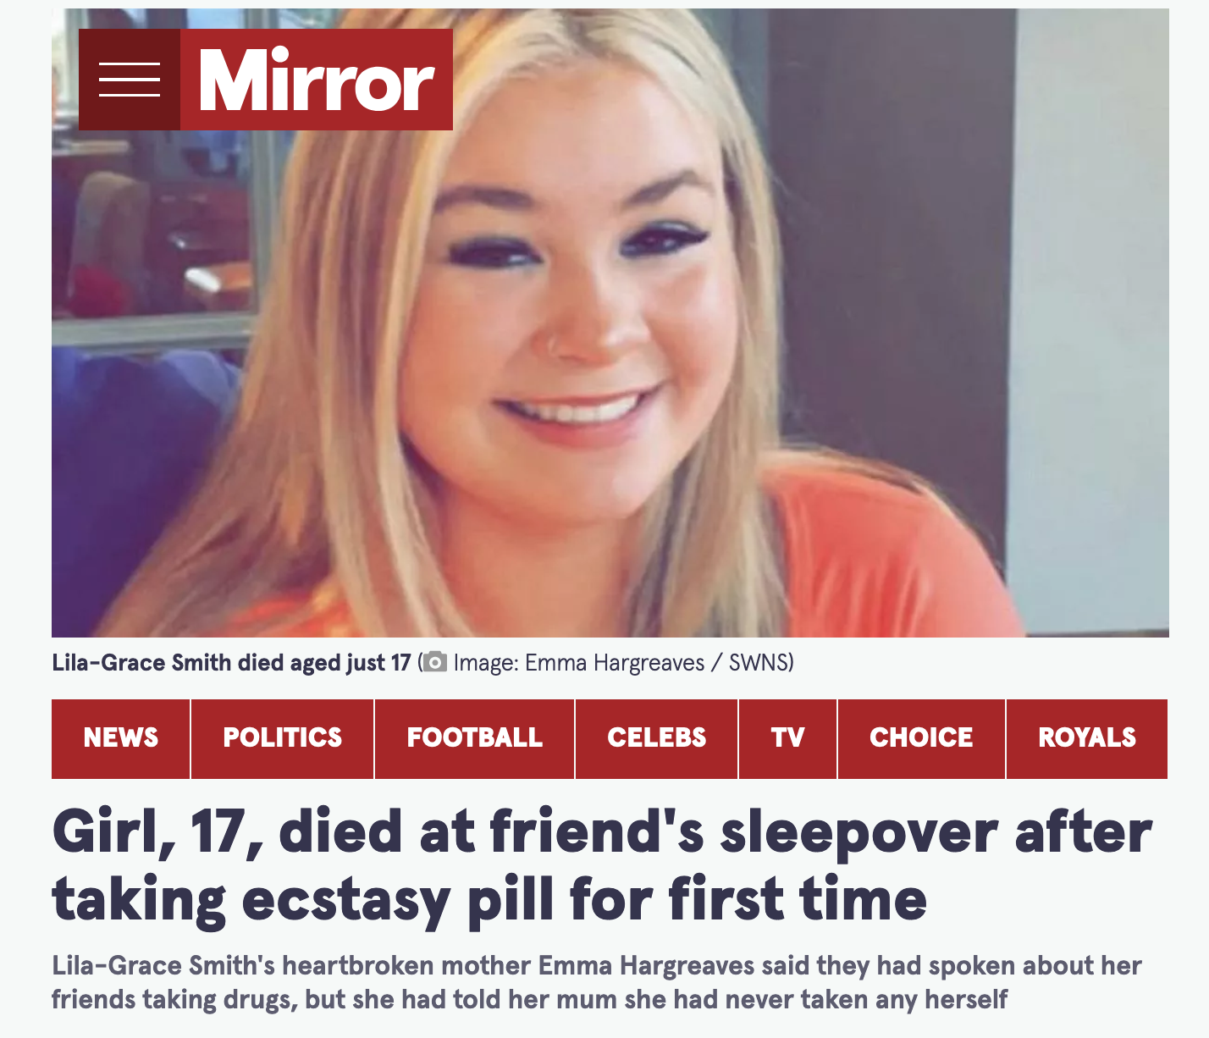
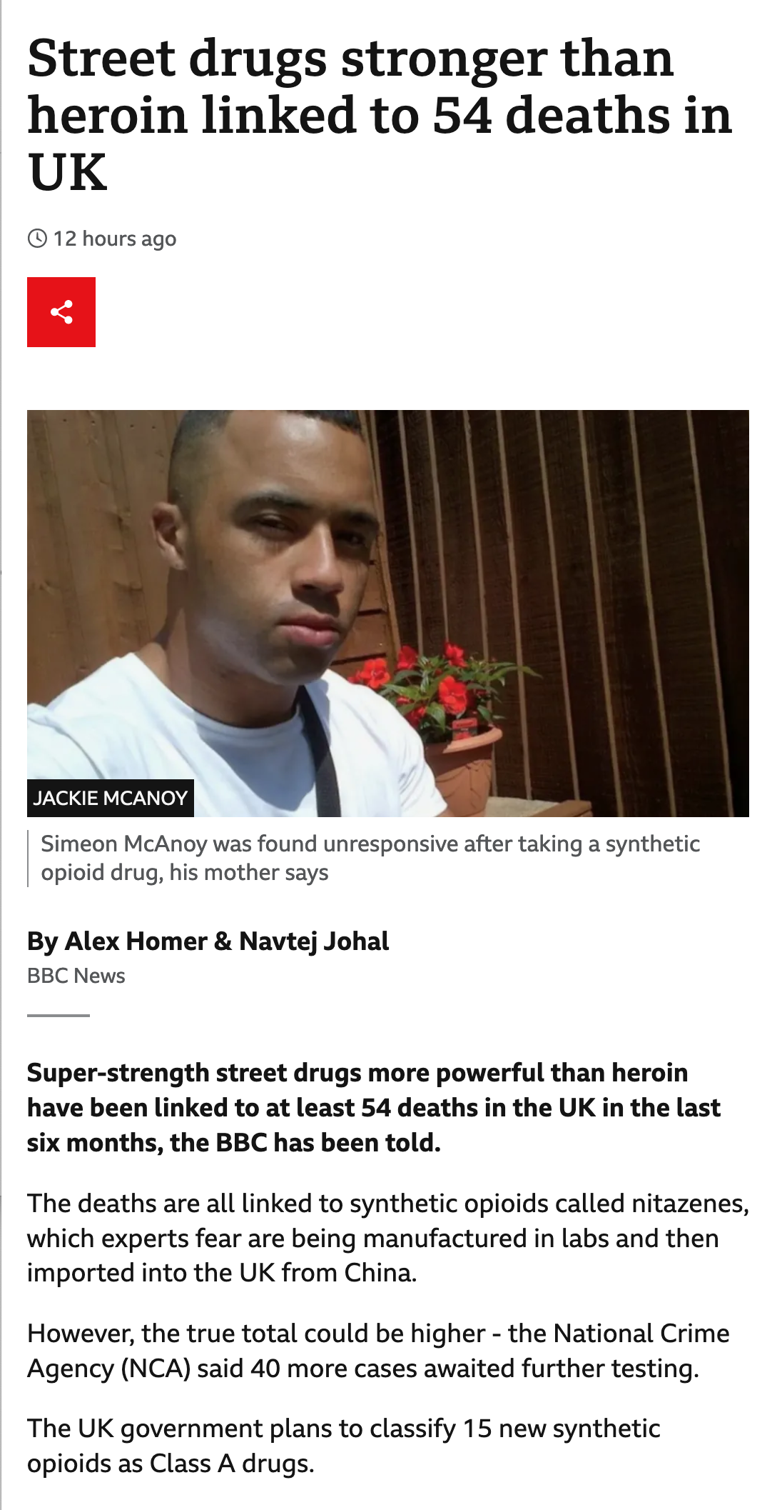
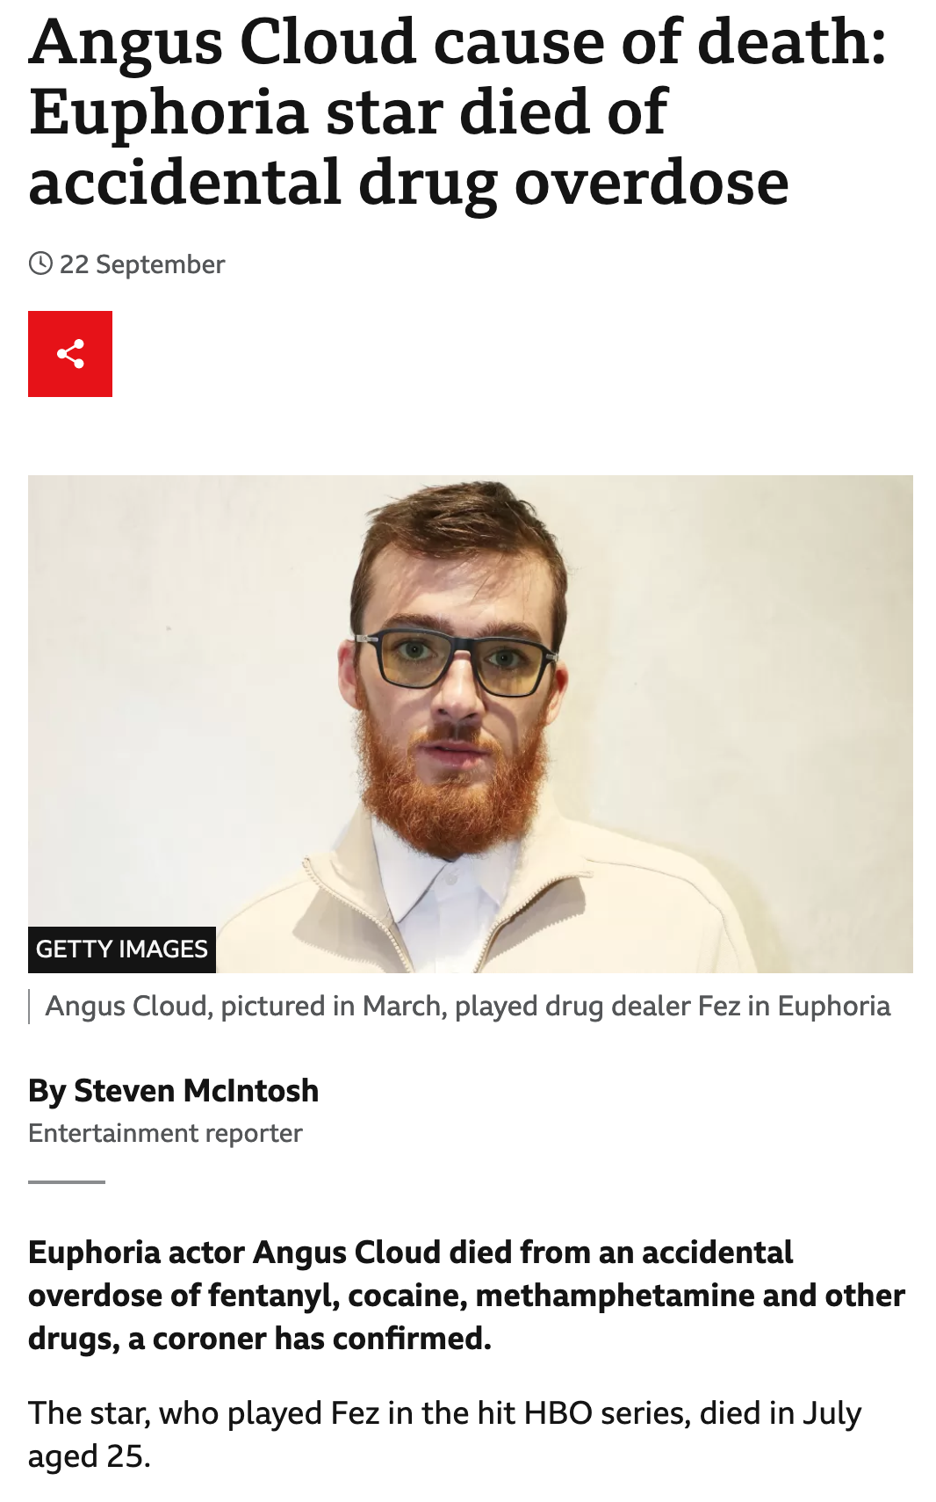
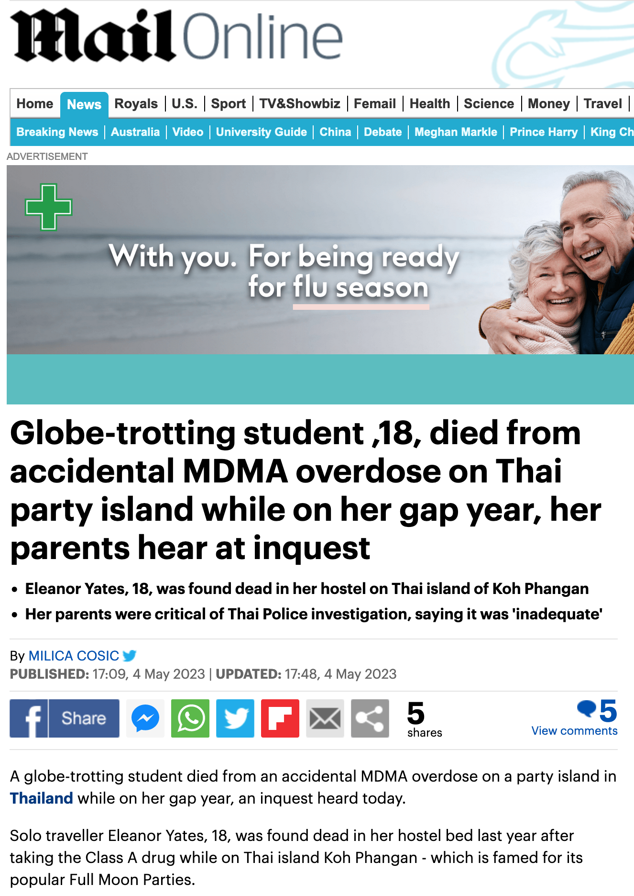
Illicit drugs
How can we know what’s in illicit drugs?

Slide 22
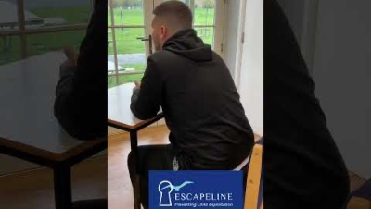


Ex victim of county lines
This young man was groomed into a gang at age 8. Here he briefly tells us why we can never know what ingredients are in any illegal drugs
How does legal and illegal drug production differ?
Why do producers of illegal drugs add other substances to their products?
Why are the effects of illegal drugs unpredictable?
With thanks to Escapeline
Notes:
How does legal and illegal drug production differ?
Why do producers of illegal drugs add other substances to their products?
Why are the effects of illegal drugs unpredictable?
In 2022, there were 4,561 drug-related deaths registered in the UK, with a significant portion involving multiple substances. Specifically, cocaine was involved in 894 deaths, representing a notable rise compared to previous years. Cocaine-related deaths have been increasing over the last decade, driven by both an increase in cocaine use and its potency .
Cocaine has a high potential for drug abuse and addiction with 5–6% of users become dependent in their first year of use.
75% of all cocaine-related hospital admissions in Europe are in the UK
Deaths related to drug poisoning in England and Wales: 2022 registrations
https://www.ons.gov.uk/peoplepopulationandcommunity/birthsdeathsandmarriages/deaths/bulletins/deathsrelatedtodrugpoisoninginenglandandwales/2022registrations
From Bumps to Binges: Overview of Deaths Associated with Cocaine in England, Wales and Northern Ireland (2000–2019)Brian Rooney, Pola Sobiecka, Kirsten Rock, and Caroline Copeland
From Bumps to Binges: Overview of Deaths Associated with Cocaine in England, Wales and Northern Ireland (2000–2019) - PMC (nih.gov)
J Anal Toxicol. 2023 Apr; 47(3): 207–215.
Published online 2023 Jan 6. doi: 10.1093/jat/bkad002
PMCID: PMC10037635
PMID: 36611264

Slide 23
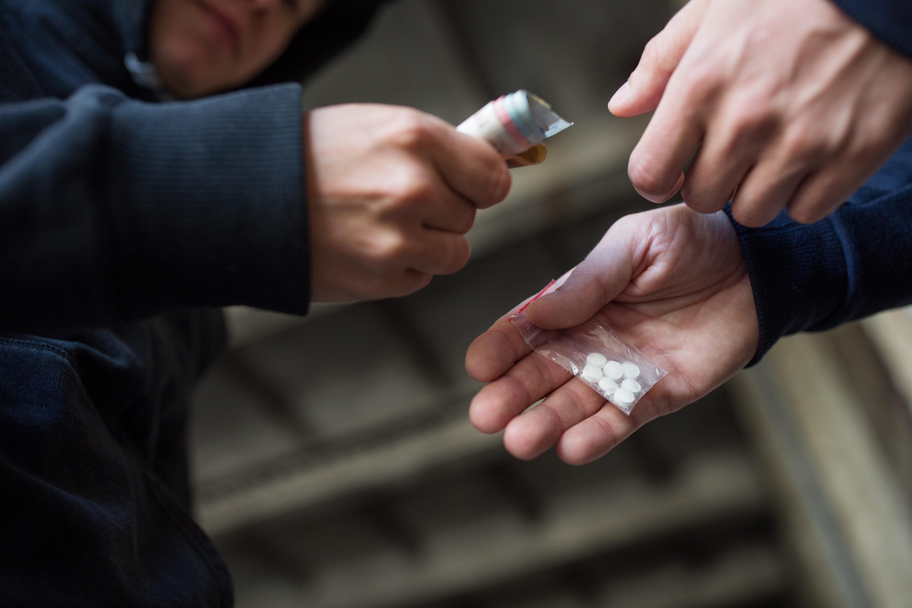
After watching the true-life account of dealing, can you explain ……
How legal and illegal drug production differs?
Why producers of illegal drugs add other substances to their products?
Why the effects of illegal drugs are unpredictable?

Slide 24
WHAT CAN YOU REMEMBER?
CAN YOU……
List 3 things that might influence a young person's decision on whether to use drugs or not
WHAT CAN YOU REMEMBER?
Give a reason why someone can never know what's in an illegal drug
Say what proportion of 11 to 15-year-olds use illicit drugs

Slide 25

Where to go for help and support
​
Childline
The UK’s free, confidential helpline for children and young people. Trained volunteers are on hand to provide advice and support, by phone and online, 24 hours a day.
0800 11 11
Drugfam
Free helpline for those affected by someone else’s drug or alcohol use, including bereavement.
0300 888 3853 drugfam.co.uk
Frank
Information about drugs, their effects and the law. Support and advice on drugs and alcohol -
talk to a FRANK advisor on
0300 123 6600 talktofrank.com
Know The Score
For information about drugs and a live chat function where you can ask questions or ask for help.
0333 230 9468 knowthescore.info
Kooth
An online mental wellbeing community. Access free, safe and anonymous
kooth.com
Talk About Alcohol and other substances
talkaboutalcohol.com
Tellmi
A website that allows you to share your problems anonymously and receive free and immediate support and advice
tellmi.help
Young Minds
UK children and young people's mental charity
healthyoungminds.org.uk
Notes:
There is a full list of where to go for help and support in the toolkit

Slide 26
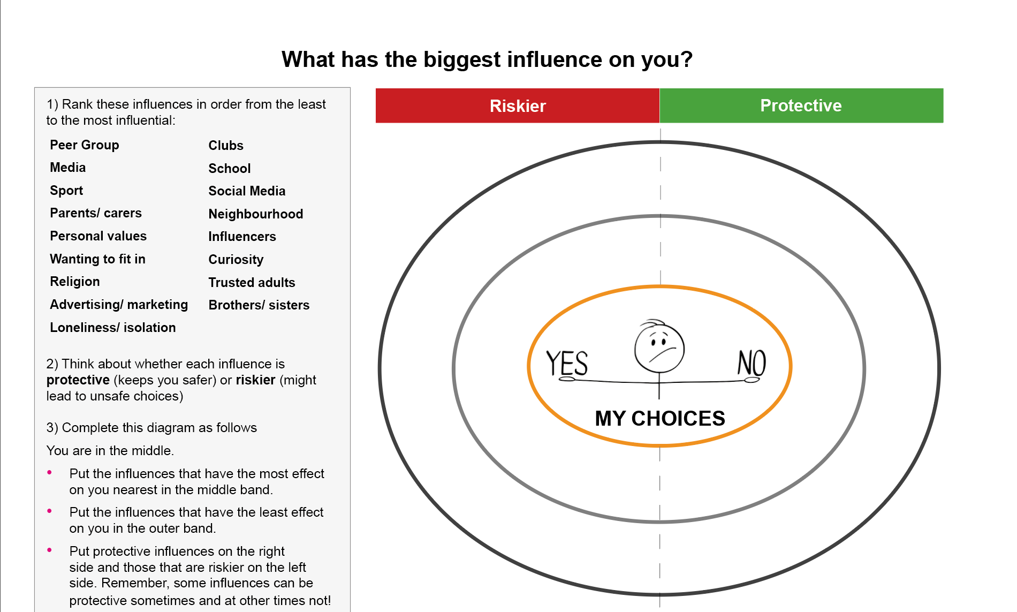
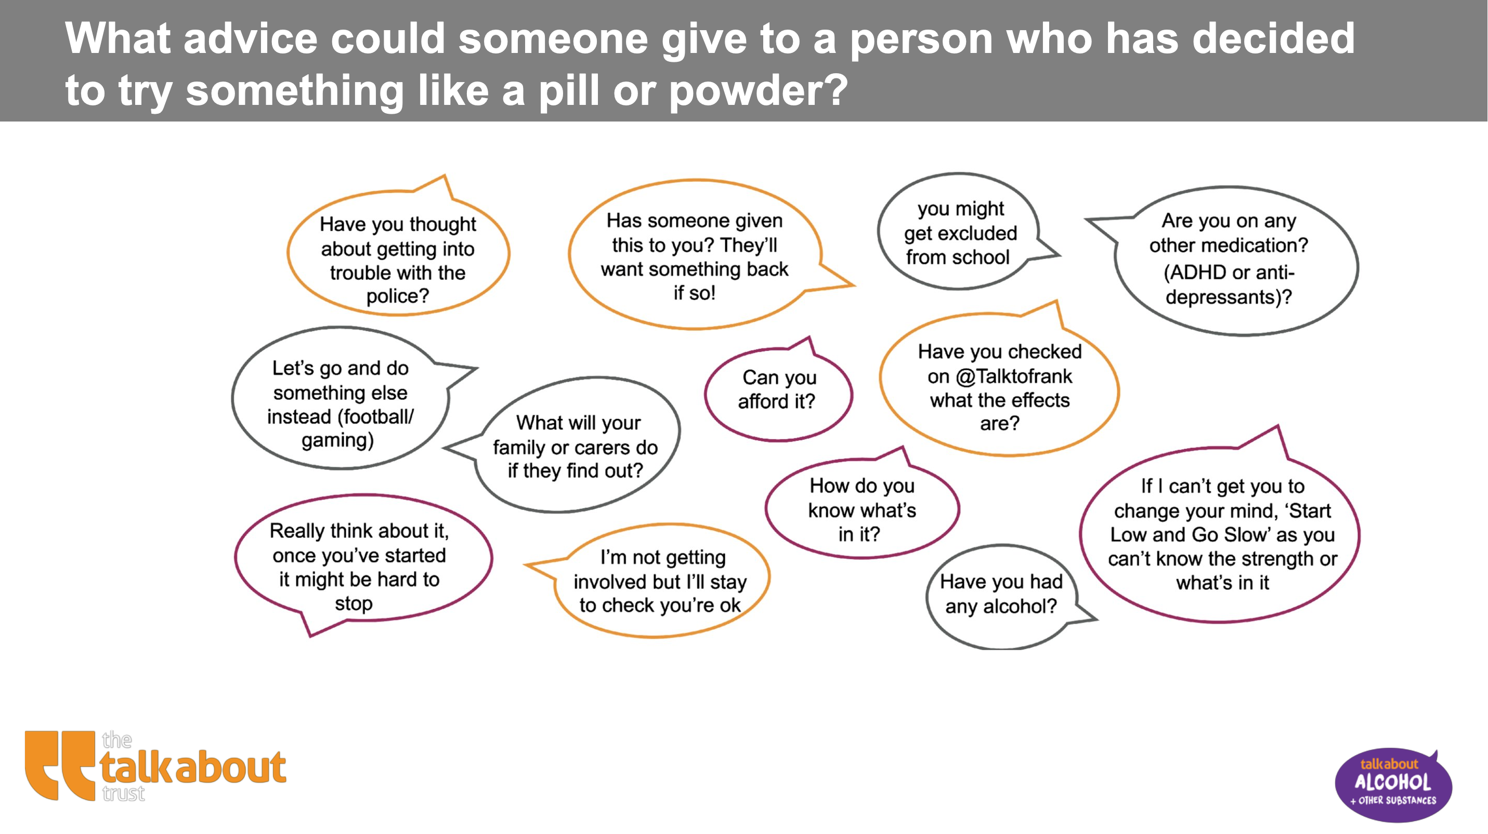
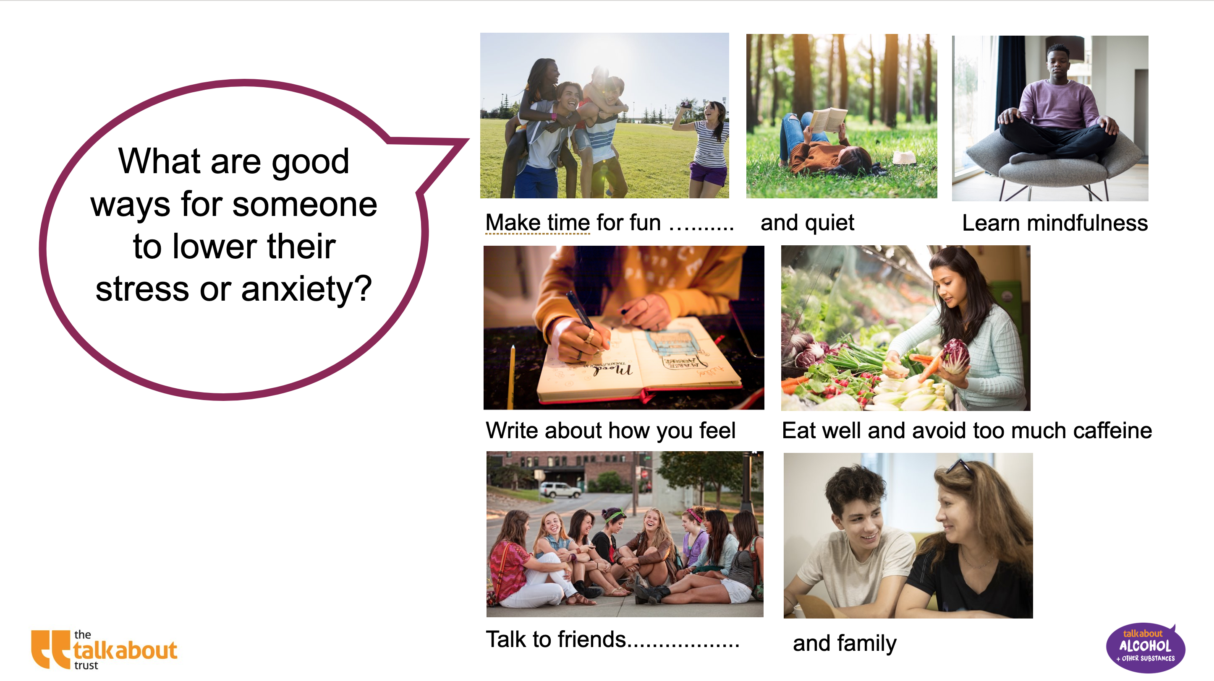
Additional enrichement and content that can be used as standalone activities or in tutor time
Influences
bite size activity
​What advice could someone give to a person who has decided to try something like a pill or powder?
bite size activity
Activities and strategies that can help our mental health and wellbeing bite size activity​​

