Slide 1





talk about | what has the biggest influence on you?
bitesize activity
Notes:
These scenarios can be used using conscience alley (put a link to the demo video online) or with the supportive friend/adult question version below. This can also be a whole class activity, working on each scenario in groups and then presenting to class.

Slide 2
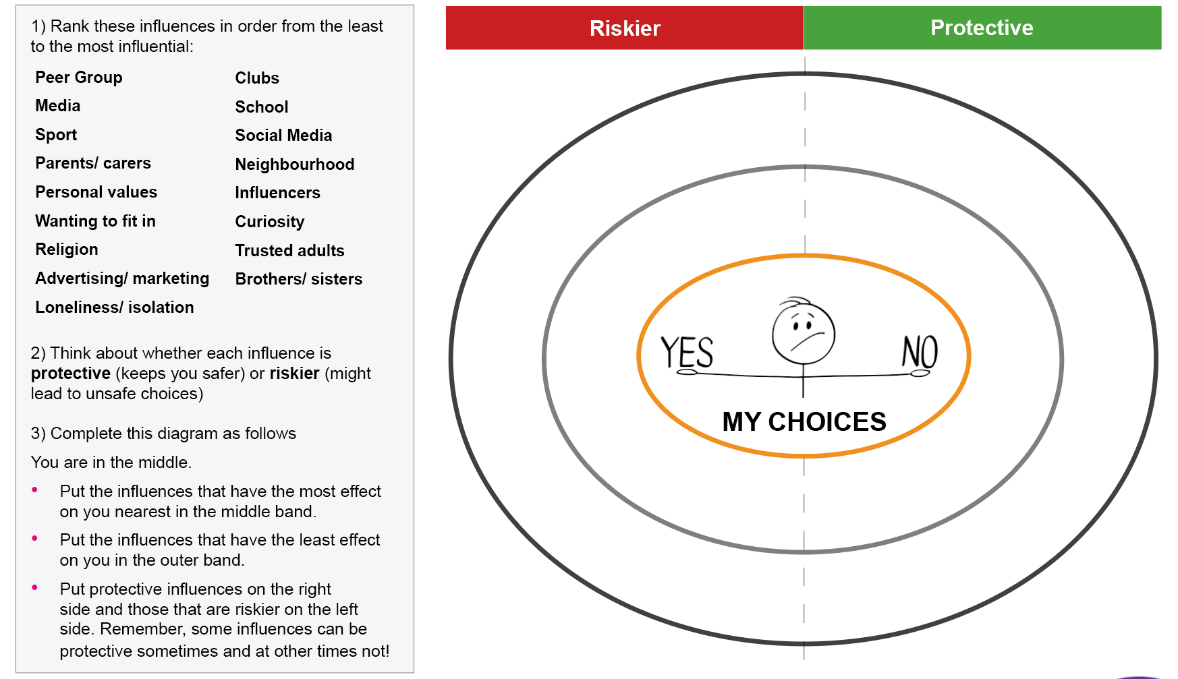


What has the biggest influence?

