Slide 1




talk about | vapes, cigarettes, pouches and the environment
An ecological disaster?
bite size
The TALK ABOUT Trust is a youth charity that works across the UK to ensure young people are equipped to make safer choices around alcohol and other substances such as vaping and cannabis.
The TALK ABOUT Trust supports 11 to 25-year-olds with advice, workshops and resources on a range of life choices via schools, children’s homes, pupil referral units, youth and sports clubs. We train teachers and youth workers, empower parents and carers and provide diversionary activities for young people.
Notes:
The TALK ABOUT Trust is a youth charity that works across the UK to ensure young people are equipped to make safer choices around alcohol and other substances such as vaping and cannabis.
The TALK ABOUT Trust supports 11 to 25-year-olds with advice, workshops and resources on a range of life choices via schools, children’s homes, pupil referral units, youth and sports clubs. We train teachers and youth workers, empower parents and carers and provide diversionary activities for young people.

Slide 2
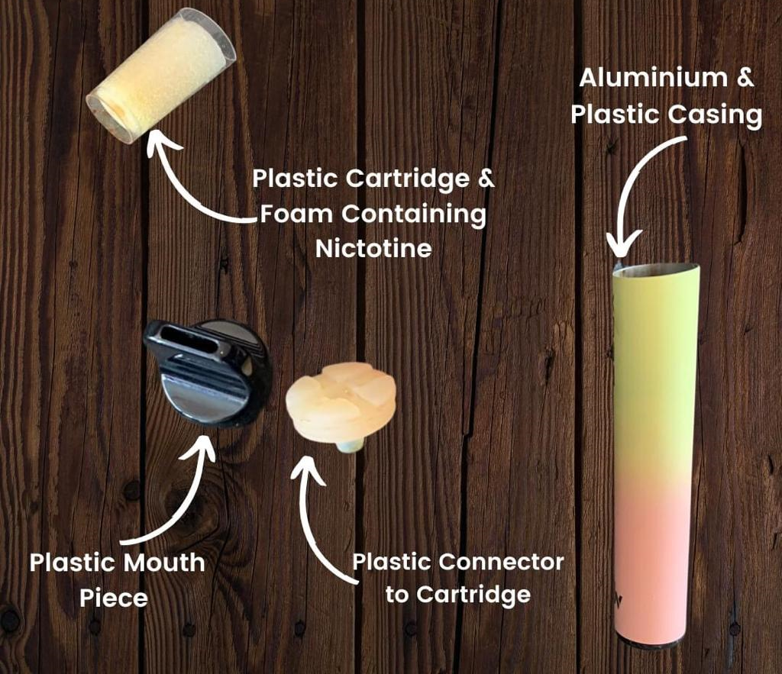


What's in a single use vape?
​
​Cartridge/Pod ​​
A closed system pod that contains the e-liquid, made from propylene glycol, vegetable glycerin, and flavorings, and usually nicotine. ​​
Battery
Usually a lithium-ion battery that powers the vape. On average, disposible vape batteries contain 0.15g of lithium
​
Coil ​
A heating element (often copper wire) wrapped in cotton that absorbs e-liquid and turns it into vapour when heated by the battery. ​
​​
Notes:
E-cigarettes, also known as vapes or vape pens, have surged in popularity in recent years with one in four 11 – 15 year olds having vaped in the UK, 1 on 10 regularly (Smoking, Drinking and Drug Use among Young People in England, 2023 - NHS England Digital
These battery-powered devices heat a liquid into an aerosol mist, which the user inhales. The liquid typically contains nicotine, flavourings, and other chemicals.
The aerosol from e-cigarettes is not just water vapour but may contain harmful chemicals like acrolein, formaldehyde, and acetaldehyde. Trading standards estimate that 25% of vapes onsa le are illicit /conterfiet and we can have no idea of what is in them. ! In 6 vapes confiscated in UK schools in 2023 were found to contain Spice for example English school children unwittingly smoking spice-spiked vapes, finds University of Bath

Slide 3
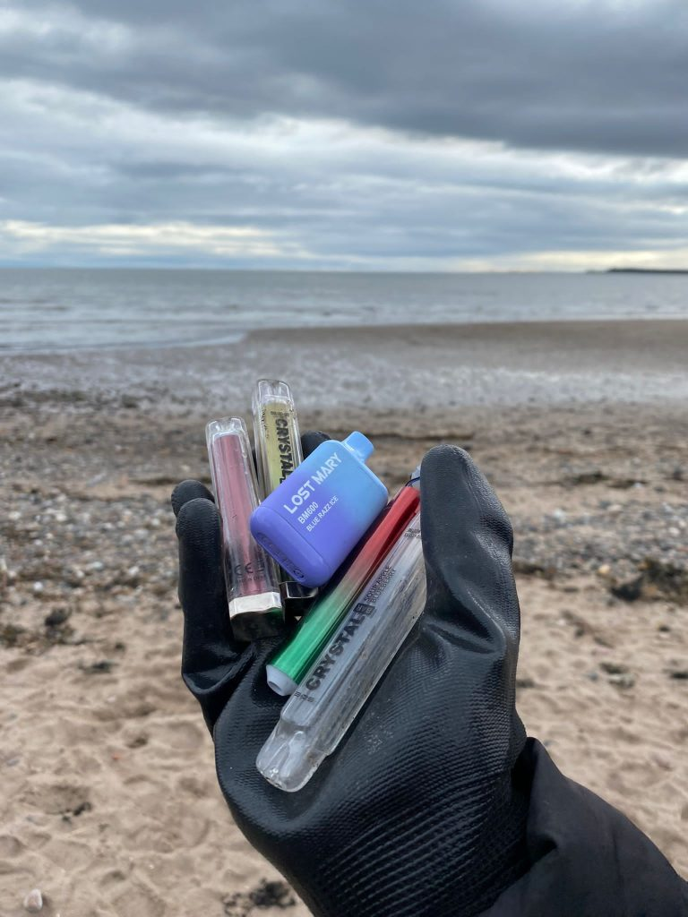
Disposable vapes – an ecological disaster?
According to ONS 5.1 million people in the country used a vape or e-cigarette in 2023 and 10% of people aged 16 and over vape regularly rising to 16% of 16 to 24-year-olds.
Greenpeace says we bin nearly 5 million vapes each week – that’s roughly 8 vapes every second. ​75 per cent of UK users admit they ‘never’ recycle their used devices (Green Wings Project).
​
Single use waste has to go somewhere. Some enters the environment as litter, some goes for recycling, while the rest ends up in landfills.
Single-use vapes contain batteries and difficult to recycle plastics.
These are dumped in landfill causing dangerous chemicals to pollute our soil, water and oceans.
The plastics and toxic waste affect birds and animals.
Discarded vapes pose a fire hazard
Notes:
Globally, close to 844 million vapes are dumped yearly, with Europe accounting for 55% of total e-waste collected. A staggering 5 million single-use vapes are discarded every week in the UK, representing a 4x increase from 2022. In the US, 150 million vapes are being discarded yearly, while Canada produced close to 1 million tonnes of e-waste in 2020.
Here are 3 concerning impacts of e-cigarettes and vapes:
Air pollution and climate change
Hazardous waste
Impact on wildlife
Rather than decomposing, plastic turns into “microplastics” which continue to pollute the environment, our food and drinking water
•Disposable vaping devices also contain lithium batteries which, if damaged, can pose a fire hazard when thrown away
•Lithium is also a very valuable metal but tonnes of it each year is being thrown away and ends up in landfill or waste incinerators. This lithium could be used in things like electric cars which could help us address climate change
•Disposable vaping devices are classed as Waste Electrical and Electronic Equipment (WEEE) and should be being recycled
•Explore safe disposal of disposable vaping devices and other electrical equipment via recycling schemes. You can find your closest centre on the Recycle Your Electricals website.
While vaping may produce fewer greenhouse gas emissions than smoking cigarettes, the e-cigarette industry is still responsible for a sizable carbon footprint from manufacturing, packaging, and shipping products and e-liquids around the globe. The emissions from this supply chain can contribute to climate change.
Used vape pens, e-cigarette cartridges, and disposable e-cigarettes all end up in landfills where the batteries and circuit boards can leach toxic heavy metals like lead into soil and groundwater. Nicotine from discarded e-liquid bottles also poses dangers to wildlife and the environment. This is largely due to the low adoption of proper collection, recycling, and disposal of this e-waste. Birds, fish, and mammals can experience nicotine poisoning, and the solvents and flavourings also have adverse effects. Improper disposal of vape products increases the likelihood of animals consuming these hazardous substances.
Source: English school children unwittingly smoking spice-spiked vapes, finds University of Bath Superfy | Is Vaping Bad for the Environment
Are disposable vapes bad for the environment? - Greenpeace UK
Earth Day: Planet vs Plastic in the Age of Disposable Vapes – UNESCO Centre For Water Law, Policy and Science (dundee.ac.uk)
Planet of the vapes: How big a problem are e-cigarettes, and where can they be recycled? | Euronews
A Review of Environmental Pollution from the Use and Disposal of Cigarettes and Electronic Cigarettes: Contaminants, Sources, and Impacts (mdpi.com)

Slide 4
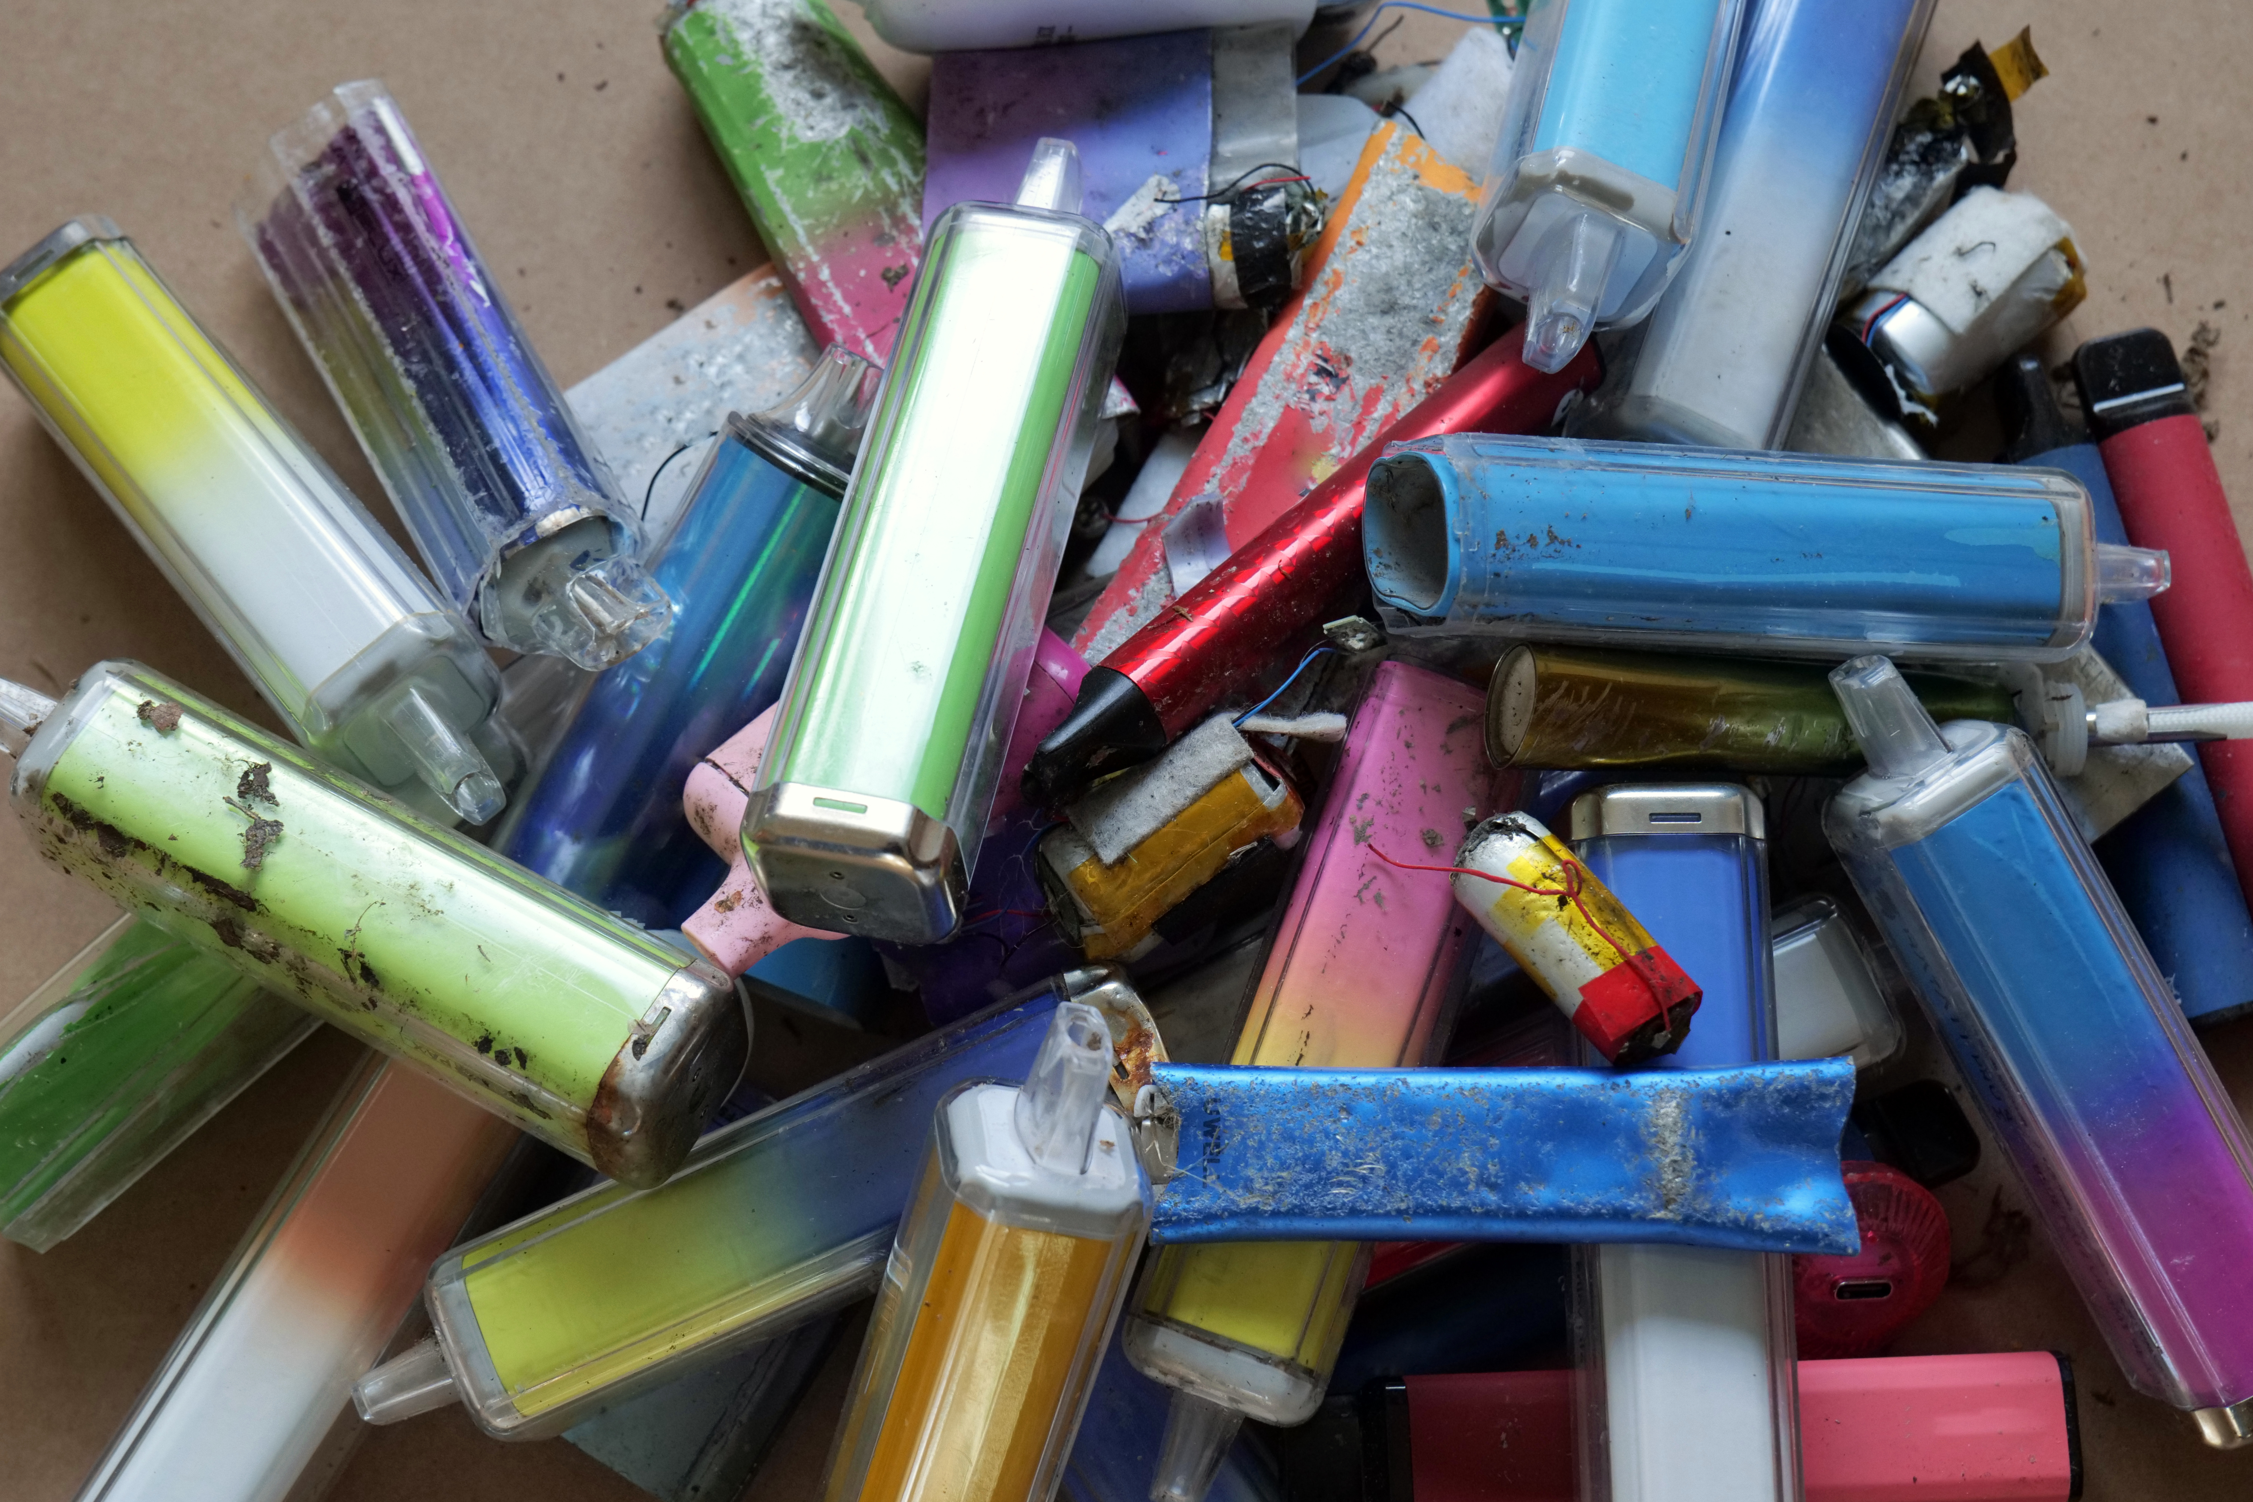
Precious resources
Research published in 2023 by Material Focus found only 17% of disposable vapes are recyclable. They, and Greenpeace estimate that over 40 tonnes of lithium was thrown out with disposable vapes in the UK in 2022. That’s enough to make batteries for 5,000 electric cars
Notes:
Vapes contain minerals needed to make the country more eco-friendly
Vapes are made using plastic and critical minerals that are in demand for green technologies that will help tackle climate change.
Each single-use vape contains on average 0.15g of lithium.
With more than 5 million thrown away every week, this adds up to 40 tonnes of lithium a year, equivalent to the lithium in batteries inside 5,000 electric vehicles, according to Material Focus.
They also contain copper, which is "vital for a lot of infrastructure" such as rail and EV charging, said Libby Peake from thinktank Green Alliance.

Slide 5
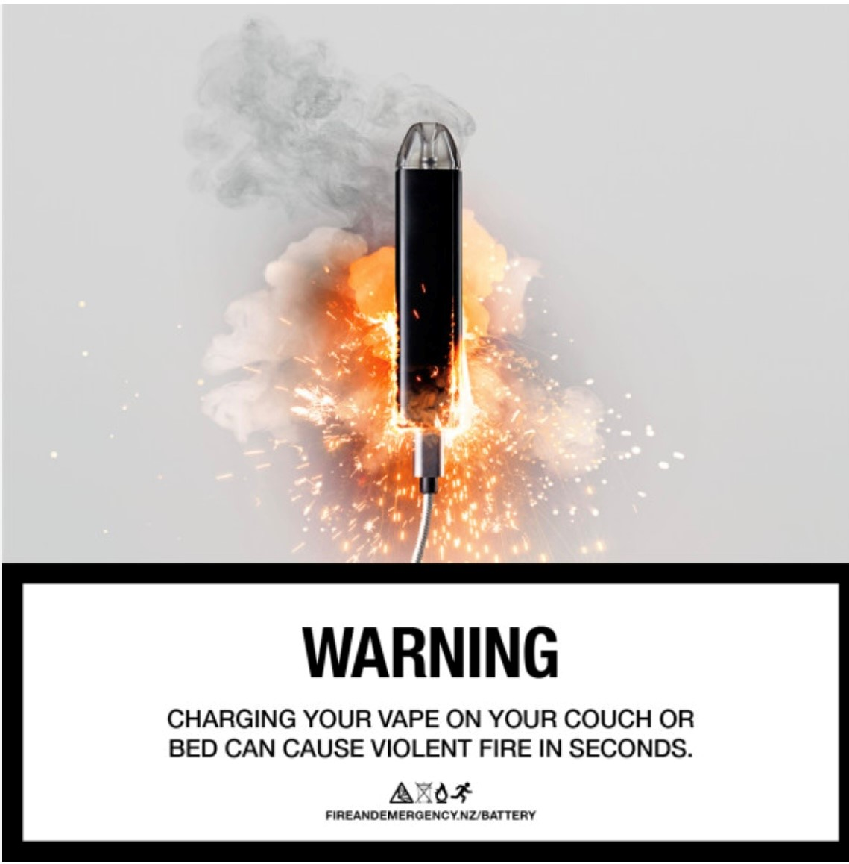
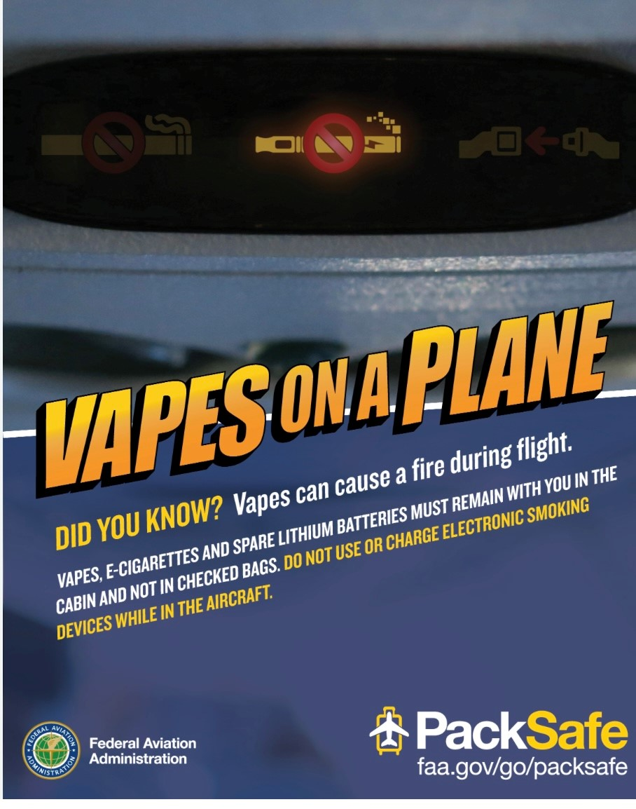
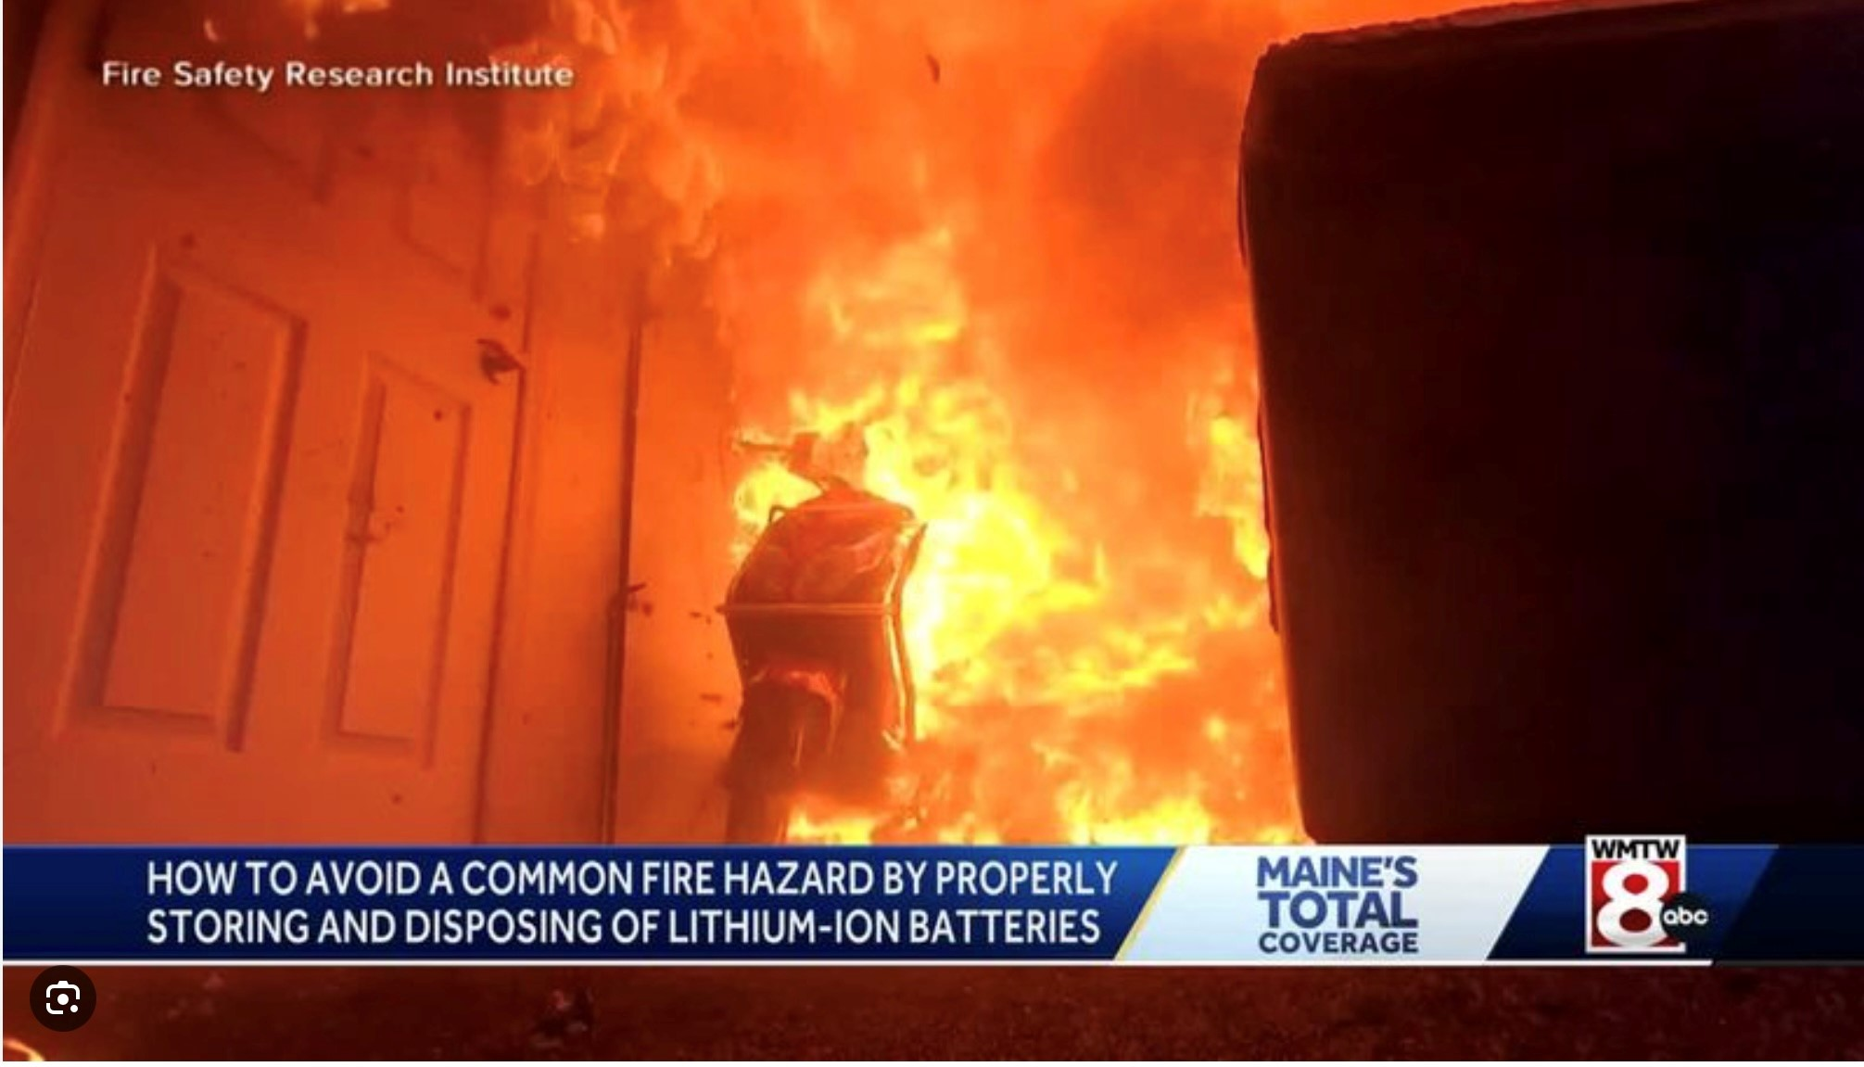
Vapes and Cigarettes can be a fire hazard
The primary cause of these incidents is typically related to the lithium-ion batteries used in vape devices.​
Lithium-ion batteries are commonly found in many electronic devices, including smartphones, laptops, and vapes. While these batteries are generally safe when used and maintained properly, they can pose risks if mishandled or if there are manufacturing defects.​
Fire brigades were called to 1,760 fires linked to lithium-ion batteries in 2025, equating to 4.8 fires a day, an increase of 147% over the past three years.
Many incidents have occurred inside homes, while incorrect disposal of batteries has also contributed to fires in refuse vehicles and recycling centres. (Source: The Guardian)
​
​
Most legal vaping devices are designed with safety features to prevent fires, but there is always a small risk of malfunction or user error that can lead to a fire.
Remember, too, that one in three vapes are counterfeit, so will be much riskier

Slide 6
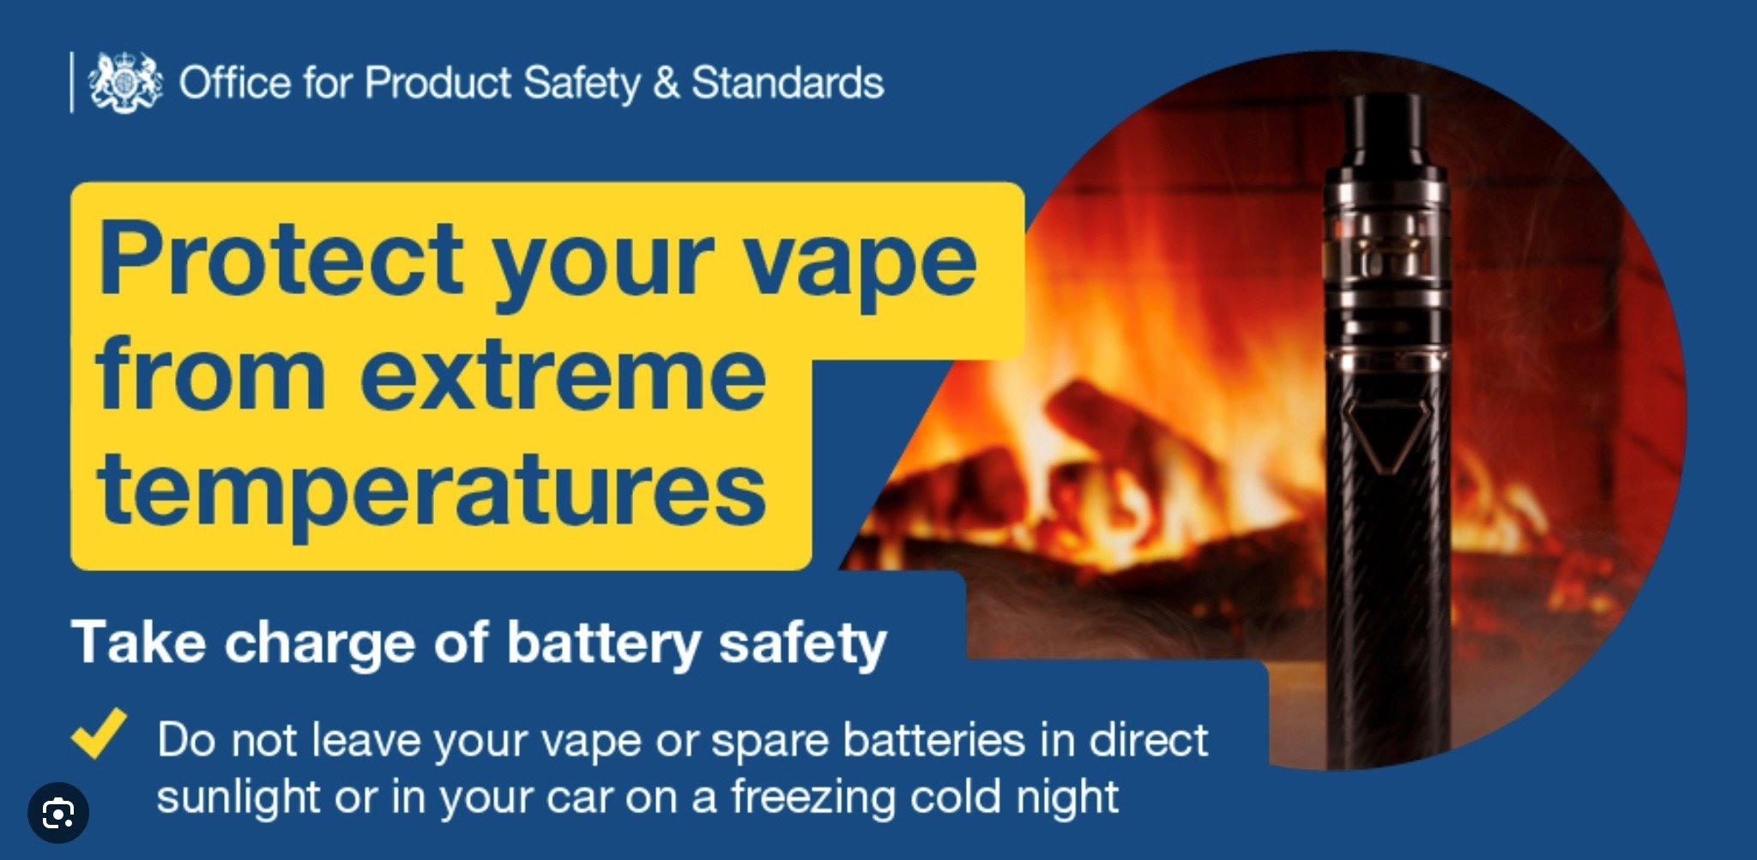
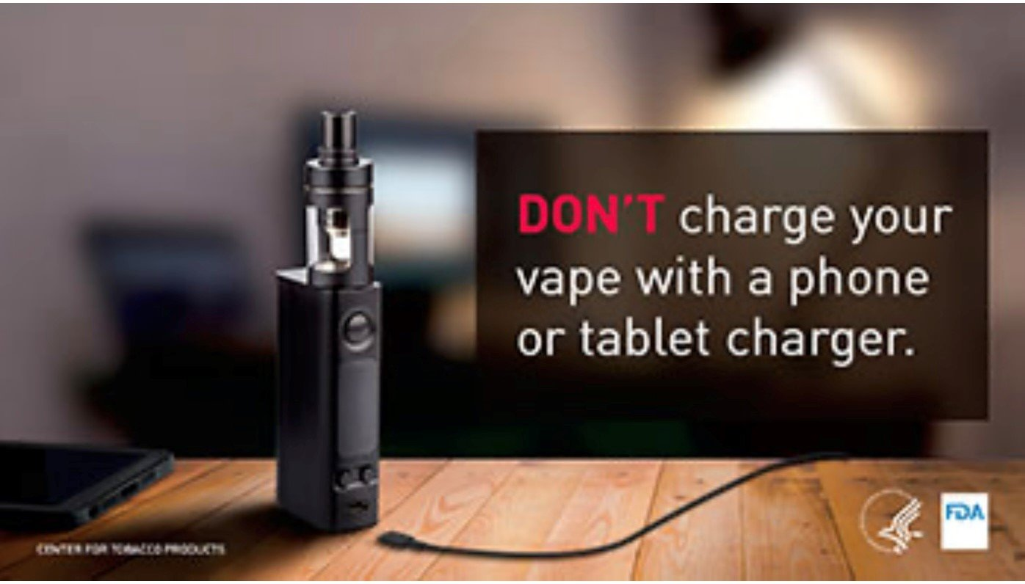
Batteries and charging keeping ourselves, our family and our home safe
The risk around vapes is related to their batteries
and how they’re charged, so things to think about:-
Avoid leaving on car or van dashboards, or any extremes of high or low temperatures.
Protect batteries against being damaged, crushed or punctured and immerse in water or spilt drink.
Batteries shouldn’t come into contact with metal items such as coins or keys in a pocket or bag, as this can cause a short circuit and explosion.
Avoid keeping vapes in pockets of trousers, dresses or jackets.
Only use the chargers that came with the device, not a phone charger.
Avoid leave a vape charging unattended or on overnight.
Don’t leave items continuously on charge (after the charge cycle is complete). Saves energy too!
Be careful not to cover batteries with clothes that are on charge, in case of overheating.

Slide 7


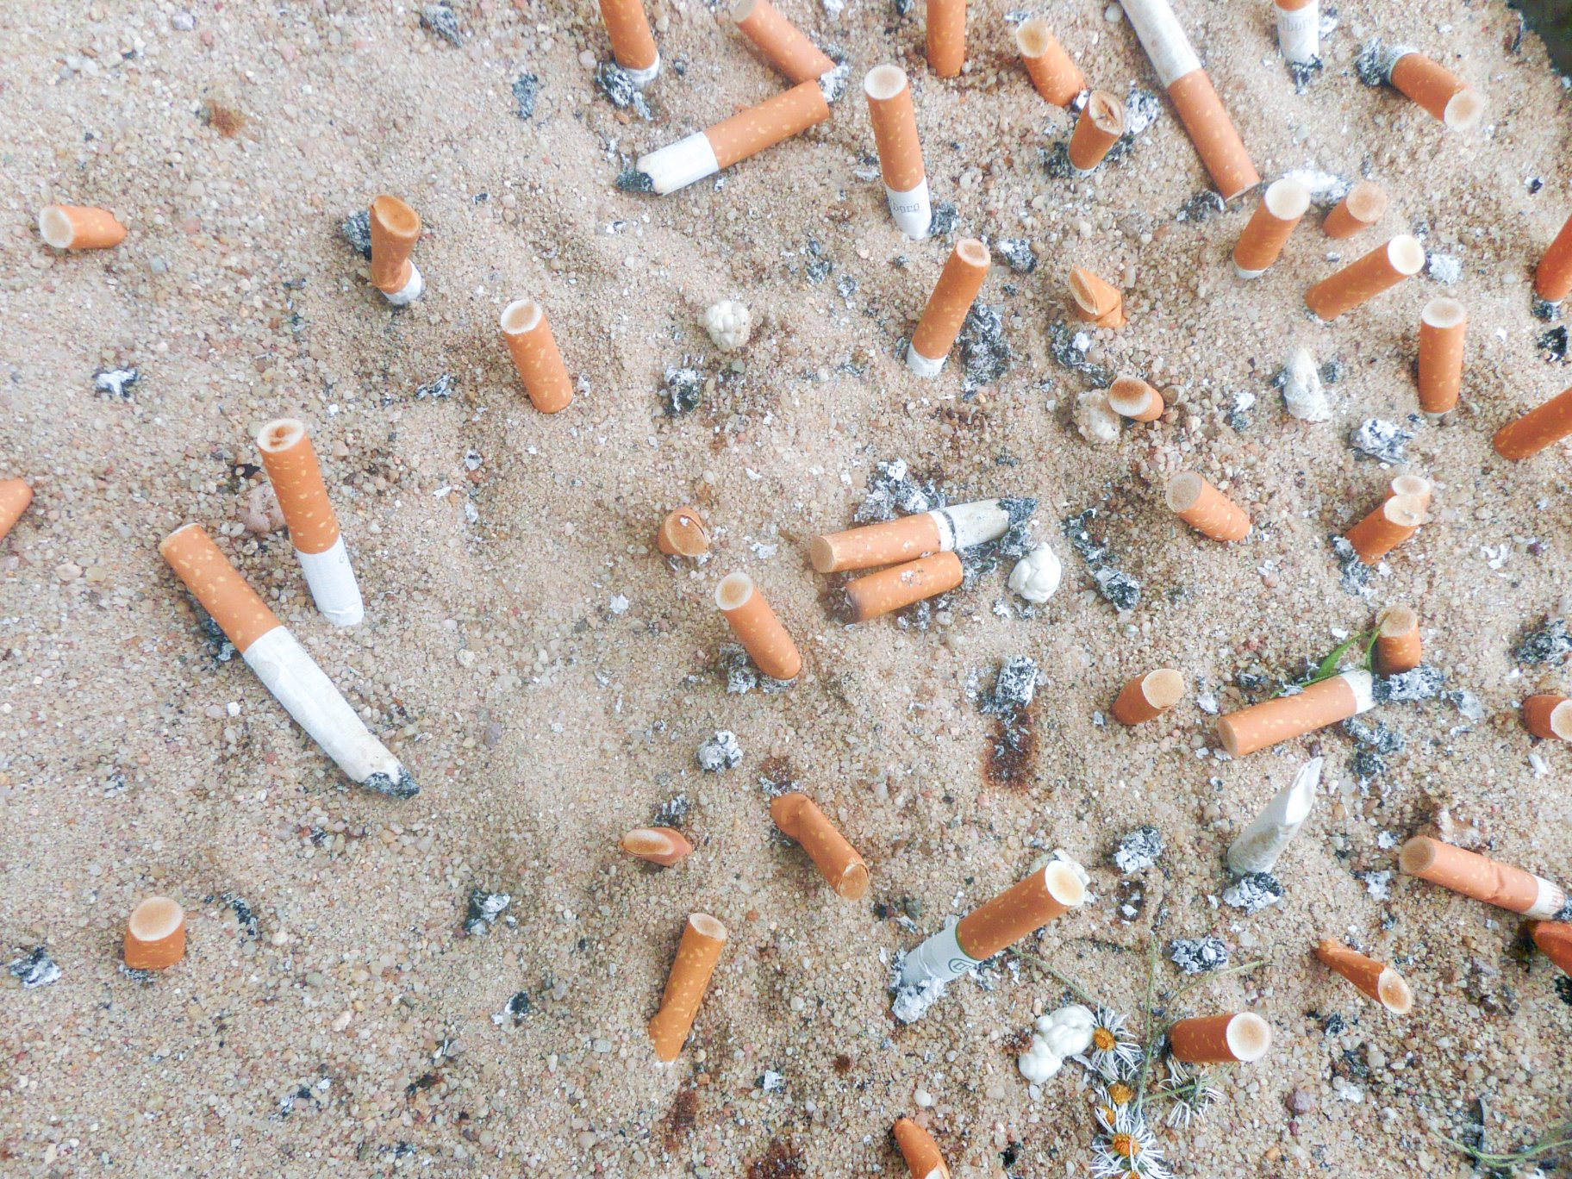
…and the effect of cigarettes
Around six trillion cigarettes are manufactured each year globally using 5.3 million hectares of land and 600 million trees.
Cigarettes are the most littered item on the planet with 4.5 trillion cigarette butts polluting our pavements, parks, soil, rivers, beaches and oceans.
All of this produced 25 megatons of solid waste, 55 megatons of waste-water, almost 84 megatons of CO₂ emissions to climate change – approximately 0.2% of the global total.
Notes:
Cigarette butts are the most littered item worldwide—with 766,571 metric tons making their way to the environment—and can take up to 10 years to decompose, releasing toxins into the water and soil. The production process of tobacco also contributes to deforestation and uses harmful pesticides. Moreover, secondhand smoke can also contribute to air pollution
Traditional smoking’s environmental toll is primarily seen in the production and disposal of cigarettes. This process contributes to deforestation, water pollution, and littering, with cigarette butts being a major source of litter worldwide — 1,134,292 units were discovered from cleaning up waterways and beaches around the world in 2021.

Slide 8

Around 6.0 million people aged 18 years and over (12%) smoked cigarettes in the UK in 2023; this is the lowest level on record
18 to 24 years have had the largest reduction in smoking falling from 25% in 2011 to 9.8% in 2023, which is great news.
BUT we have 1 million young people using nicotine products such as vapes and pouches that are not smokers.
Cigarette butts are the most littered item on the planet
Notes:
Cigarette butts are the most littered item worldwide—with 766,571 metric tons making their way to the environment—and can take up to 10 years to decompose, releasing toxins into the water and soil. The production process of tobacco also contributes to deforestation and uses harmful pesticides. Moreover, secondhand smoke can also contribute to air pollution. So, in many ways, smoking is detrimental to our environment Traditional smoking’s environmental toll is primarily seen in the production and disposal of cigarettes. This process contributes to deforestation, water pollution, and littering, with cigarette butts being a major source of litter worldwide — 1,134,292 units were discovered from cleaning up waterways and beaches around the world in 2021.
; the lowest proportion of current smokers since records began in 2011, based on our estimates from the Annual Population Survey (APS).
One million people who never regularly smoked now vape in England | UCL News - UCL – University College London
Lancet 2024

Slide 9

What are some possible solutions to tackling the waste?
How could the products be changed or regulated to make them more sustainable?
Do you have any ideas for raising awareness of the impact of e cigarettes, cigarettes and disposable vapes on wildlife and the planet?​
​
Design a campaign to raise awareness of the effect of cigarettes or vapes on the world​
Notes:
Circular Product Focus
More recycling leads to more materials being reused for product manufacture and reduces the need for virgin raw materials from the earth. By designing products with end-of-life in mind, organisations, including vape manufacturers, can provide a significant benefit to the environment.
Dedicated Vape Collection?
Vapes could be collected in a safer and more efficient way, leading to more recycling, and reducing the number of vapes going to landfills
A levy on producers?
Banning of single use products?
About Material Focus - What we do - WEEE

Slide 10
What surprised you about the information we looked at today
What two take aways do you think could really make a difference going forward?
Where to go to learn more:
  Greenpeace - greenpeace.org.uk
  UNESCO - healtheducationresources.unesco.org/
  Material Focus - materialfocus.org.uk
Reflection and recap

