Slide 1


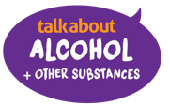
talk about | dependency and substance misuse disorder
bitesize
Tools and information to use with young people to enable conversations about use and risks.
The Alcohol Education Trust is a charity dedicated to working with young people across the UK
alcoholeducationtrust.org
life-stuff.org
talkaboutalcohol.com

Slide 2



Stand up if the percentage or statement is true
What proportion of 16 to 18-year-old students do you think...
vape regularly? 25%, 35%, 40%, 50%
smoke? 63%, 51%, 44%, 32%, 25%, 10%, 6%
use cannabis more than occasionally?
10%, 16%, 24%, 32%, 40%, 48%, 56%
Stand up when you think the answer is right (and then sit down again)
How many 16 to 24-year-olds do you think...
drink alcohol? 54%, 65%, 70%, 82%, 91%
regularly get drunk? 60%, 50%, 40%, 30%, 20%, <20%
How many young people under 18 do you think...
need to seek advice for substance use each year?
<5000, <8000, <10000, >11000, >15000
What is the most common substance young people under 18 seek advice for?
Alcohol, cocaine, cannabis, MDMA, ketamine, NOS, nicotine?
Are there more young men or young women under 18 needing support each year? Young men, young women
Notes:
Sources
Health Behaviour in School-aged Children (HBSC) study (who.int)

Slide 3
Stand up if the percentage or statement is true
What proportion of 16 to 18-year-old students do you think...
vape regularly? 25%, 35%, 40% or 50%
smoke? 63%, 51%, 44%, 32%, 25%, 10%, 6%
use cannabis more than occasionally? 10%, 16%, 24%, 32%, 40%, 48% or 56%
How many 16 to 24-year-olds do you think...
drink alcohol? 54%, 65%, 70%, 82% or 91%
regularly get drunk? 60%, 50%, 40%, 30%, 20%, <20%
How many young people under 18 do you think...
need to seek advice for substance use each year?
<5000, <8000 <10000, >11000, >15000
What is the most common substance young people under 18 seek advice for?
Alcohol, cocaine, cannabis, MDMA, ketamine, NOS, or nicotine?
Are there more young men or young women under 18 needing support each year?
Young men, or young women
Source: Young people's substance misuse treatment statistics 2022 to 2023: report - GOV.UK​
Health Survey for England, 2022​
​
Notes:
Sources of statistics: report - GOV.UK (www.gov.uk))
ASH 2024
Smoking, drinking and drug use among young people in England - NHS England Digital
Smoking, Drinking and Drug Use among Young People in England, 2023 - NHS England Digital
The International Tobacco Control study (ITC, an international cohort study on smoking and vaping) found that 24% of people aged 16-to-19 years in England reported having vaped in the past 30 days in 2022 and 38% in the last year. 8% almost daily .
Trends in smoking and vaping among young people: Findings from the ITC Youth Survey, 2023 (davidhammond.ca)
The Office for National Statistics has published data on e-cigarette use in Great Britain. It showed that, in 2022, 16-to-24-year-olds were more likely to report daily or occasional vaping than all other age groups
HBSC WHO data

Slide 4
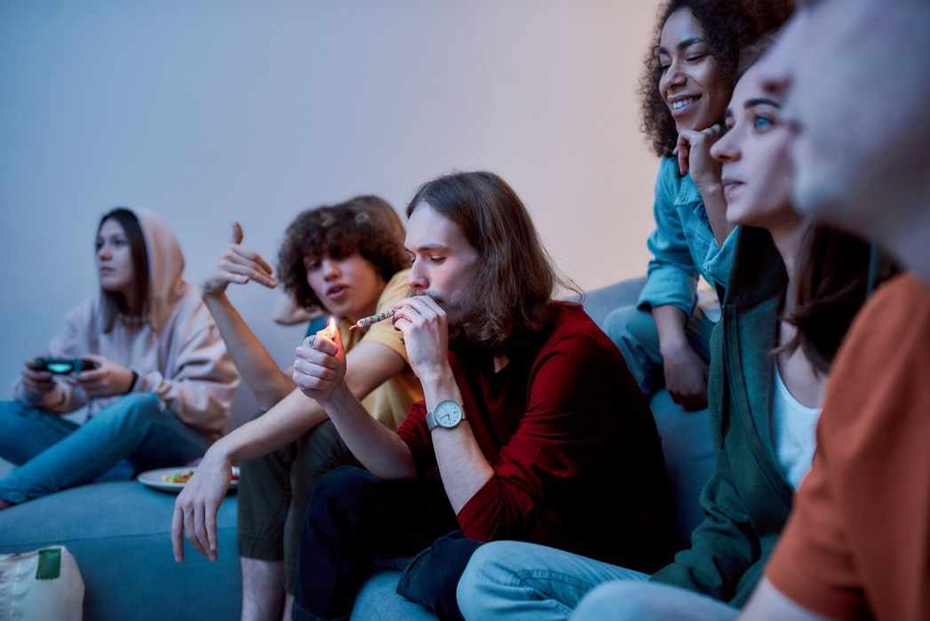


8 out of 10 young people choose not to use drugs or to get drunk regularly. Of those who experiment or use cannabis occasionally, most will not go on to use regularly.
However, each year about 12,000 teenagers need help for substance dependency - that’s 34 young people every day in England. ​
Everyone starts out thinking they can control their use and it’s just a bit of fun – but our brains don’t work like that – The traffic light signs can help someone recognise if a problem is developing ​
Notes:
8 out of 10 young people choose not to use drugs or to get drunk regularly. Of those who experiment of use cannabis occasionally, most will not go on to use regularly.
However, each year about 12,000 teenagers need help for substance dependency -that’s 34 young people every day in England. Everyone starts out thinking they can control their use and it’s just a bit of fun – but our brains don’t work like that – The traffic light signs can help someone recognise if a problem is developing

Slide 5

Addiction is defined as not having control over doing, taking or using something to the point where it could be harmful to the person.
Being addicted means that not having a substance (like nicotine, alcohol, cannabis or other drugs) or not doing something (like gaming or gambling) causes withdrawal symptoms (like headaches, agitation, shaking) so the person carries on to stop the craving and so the cycle continues.
Use can get out of control because someone needs more and more to satisfy a craving and achieve the "high".
Notes:
Addiction: what is it? - NHS (www.nhs.uk)

Slide 6
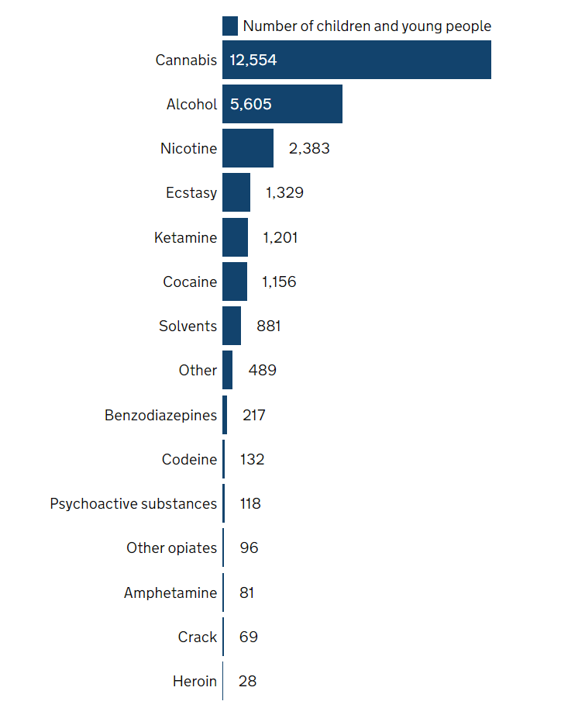
In 2023/24 14,300 teenagers needed treatment for substance misuse
87% due to cannabis, 39% due to alcohol and 17% due to nicotine
Notes:
There were 12,418 young people in structured treatment with drug and alcohol services between 1 April 2022 and 31 March 2023. Almost two-thirds were male (62%), a similar proportion to the previous year. The median age was nearly 16 years old for girls and for boysWhen young people enter treatment, they can record up to 3 substances that they have a problem with. Numbers in this section are based on all substances recorded during their treatment.
Figure 2 shows the substance that young people in treatment report having problems with, and the numbers of each. The vast majority of young people in treatment (87% of all in treatment) said they have a cannabis problem. Nearly half (44%) said they had a problem with alcohol. Young people's substance misuse treatment statistics 2022 to 2023: report - GOV.UK (www.gov.uk)

Slide 7
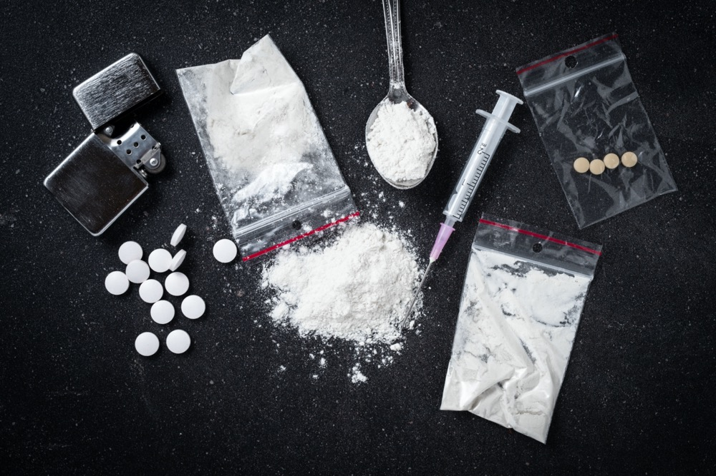
Personal risk and safety
As there are no laws or regulations with illegal drugs, each batch can be a different strength or mixed with cheap or poisonous ingredients.
Fake man-made drugs can be 10 times stronger or more – like spice – (synthetic cannabis), nitazines and fentanyl (man-made opiods)

Slide 8
How do people know if a problem is developing with substances?
1. Experimental: Very occasional use, often linked to curiosity.
2. Recreational: Moderate and sporadic use, one of many recreational activities (such as with a group of friends or at a party).
3. Regular: Using frequently (even daily) taking on own and becomes a key focus. Begins to dominate life – unpredictable behaviour / self- harm/ money problems/ lethargy/ unreliable/ moody. At risk of being recruited by dealers to pay for habit.
4. Dependency: Drug use is not controlled due to it being the main focus of everyday life and money. Unable to work/ function/ self- care. According to the NHS, approximately 10% of users will develop dependency on cannabis.
Notes:
8 out of 10 young people choose not to use drugs or to get drunk regularly. Of those who experiment of use cannabis occasionally, most will not go on to use regularly.
However, each year about 12,000 teenagers need help for substance dependency -that’s 34 young people every day in England. Everyone starts out thinking they can control their use and it’s just a bit of fun – but our brains don’t work like that – The traffic light signs can help someone recognise if a problem is developing

Slide 9

Questions that can help someone recognise the signs of problem use developing
There are questions that can help someone understand if their behaviour is becoming problematic and their health and wellbeing is at risk.
A person may have a higher risk of experiencing harm if they answer 'yes' to any of these questions:
Have they ever tried to stop, cut down or control their gambling /vaping /drinking/ cannabis use and not managed to?
2. Have they ever lied to their family, friends or others about how often they vape/smoke/drink? Or how much they spend on gambling ?
3. Do they spend a lot of time thinking about gambling / next smoke/ drink/ fix?
4. Has their substance use/ gambling/ gaming had a negative effect on their life?

Slide 10
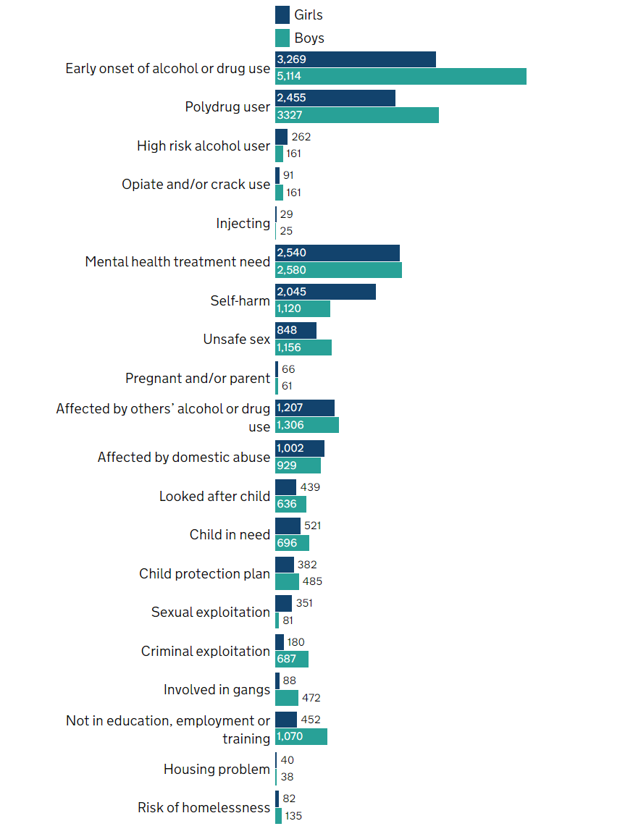
Are some young people at more risk than others?
The younger someone is when they start drinking/ using cannabis/ nicotine regularly, the higher the risk of addiction
The more substances that are used together, the higher the risk – like cannabis and alcohol

Slide 11
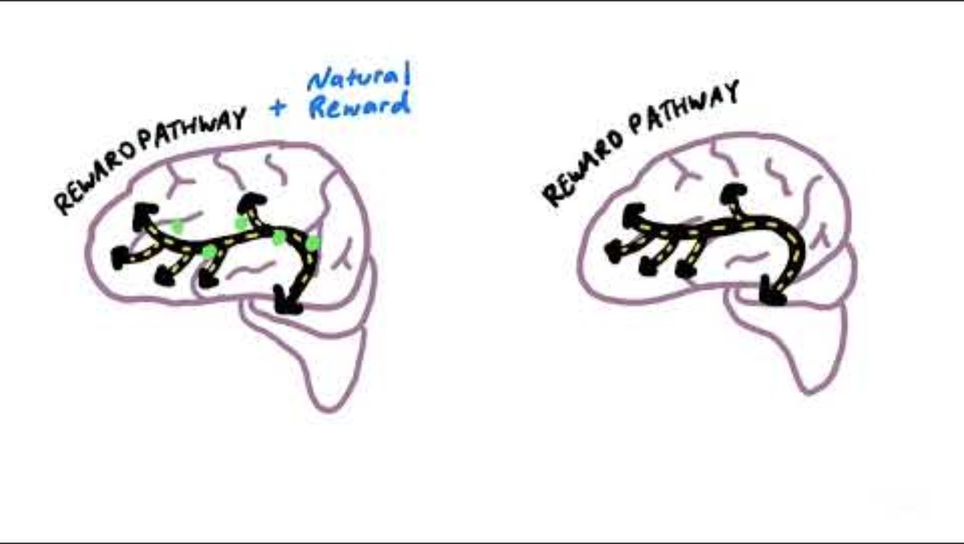
Understanding addictive behaviour
Dopamine is our bodies 'happy hormone' - a reward for ‘good behaviours’ that keep us alive, such as eating, sleeping and sex. Our brain rewards those actions with a dopamine hit – a feeling of pleasure and satisfaction.
https://www.youtube.com/watch?v=RZ5LH634W8s
Addictive substances – and behaviour such as gambling can HIJACK our natural reward pathway and give someone a much higher dopamine rush initially up to 10 times higher – the body then reacts by producing less dopamine and less dopamine receptors as someone uses more. –
This means someone needs more or to repeat the behaviour (we call this ‘tolerance’) to try and get the same high.
Some people may take more, more often or swap to something stronger to try and find the same feeling again
How an Addicted Brain Works > News > Yale Medicine
Notes:
How an Addicted Brain Works > News > Yale Medicine

Slide 12
Write down what things you think someone can be addicted to
Then think about what things you associate with addiction?
Notes:
Ask the class to think individually or in small groups what things someone can be addicted to – the most common associations with addiction are alcohol, drugs, nicotine and gambling. Other addictions include sex/porn, gaming, shopping and junk food for example.
Then ask the class what words they associate with addiction
Consider any words used – do they induce stigma or judgement
Be mindful that children may have lived experience of addiction within the family so be careful to manage language.
stigma means labeling, stereotyping and discrimination. One example is using disparaging or judgmental terms to refer to addiction,
And ensure that addiction is understood to be is an illness and not lack of will power.

Slide 13
What can someone be addicted to?
what words do you associate with addiction?
Lack of
self-control​
Cannabis
Drugs
Stealing/criminal record
Poor mental health
Forgetting worries
Gambling
Gaming
Trauma and sadness
Porn
Food
Homelessness
Money problems
Withdrawal/cold turkey
Nicotine
Phones
Gangs and dealing
Cannabis
Prison
Alcohol
Highs
Prescription medicines
Family problems
Notes:
Ask the class to think individually or in small groups what things someone can be addicted to – the most common associations with addiction are alcohol, drugs, nicotine and gambling. Other addictions include sex/porn, gaming, shopping and junk food for example.
Then ask the class what words they associate with addiction
Consider any words used – do they induce stigma or judgement
Be mindful that children may have lived experience of addiction within the family so be careful to manage language.
stigma means labeling, stereotyping and discrimination. One example is using disparaging or judgmental terms to refer to addiction,
And ensure that addiction is understood to be is an illness and not lack of will power.

Slide 14

Did any of the words chosen use blame or stigmatising language?
Stigma could be the belief that addiction is a personal choice showing a lack of willpower.
Self-stigma is when a person feels unworthy of help and results in people excluding themselves from services.
An addiction is a health condition. People should receive help and support, not judgement.
Drug, gambling and alcohol stigma can:
stop people who need treatment and support from getting help as they feel judged
affect the friends and family of people struggling with an alcohol, gambling or drug problem
People struggling with addiction should get the same support and treatment as those with any other health condition. This should be without fear of judgment.
We can help by having a kinder approach to those affected by focusing on understanding, hope and kindness.
83% of young people who sought help for their substance use successfully completed the programme
Notes:
I've asked KAthyrn to provide some trauma informed notes to go here

Slide 15

Empathy map activity
In small groups think about the scenario and person and be ready to feed back to the class
How might the person feel at each point?
What might help them manage the situation?
What is this person experiencing?
What do they hear?
What do they say?
What might motivate their behaviour?
How might someone be able to help them?
What do they need to do?
What are the similarities amongst those different scenarios?

Slide 16
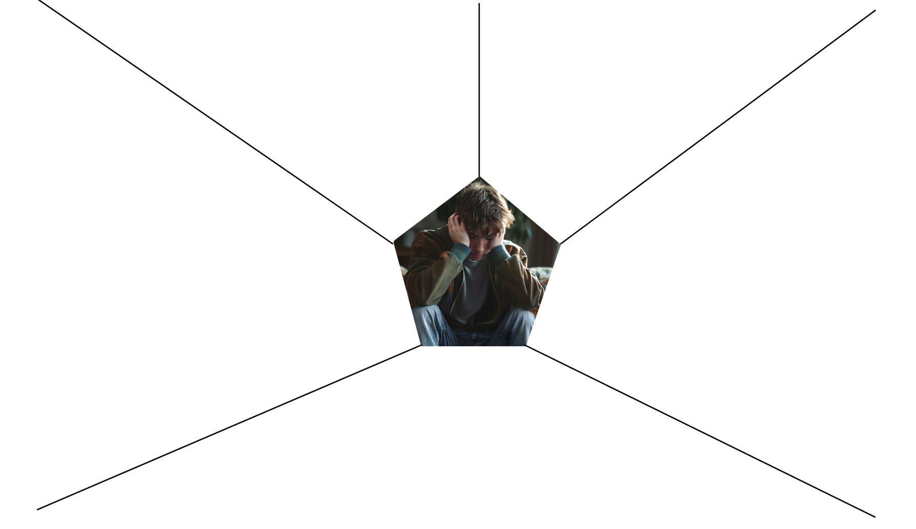
Use the empathy map to help understand how to support a dependent person
2. What might they HEAR?
What are they hearing others say?
What are they hearing from friends or family?
What do they think others may be saying
3. What might they SAY?​
What have we heard them say?​
What can we imagine them saying?​
1. WHAT is this person experiencing?
What is the situation they are in?
What behaviour have we observed?
What can we imagine them doing?
How might they be feeling?
4. What MOTIVATES their behaviour?​
What are their fears, frustrations and anxieties?​
What are their wants, needs, hopes and dreams?​
What other thoughts and feelings might motivate their behaviour?
5. What do they need to DO?
What do they need to do differently?
What decision(s) do they need to make?
What can they ask others to do?
What can other people do to support them?
Notes:
This scenario-based activity encourages participants to imagine and empathise with someone experiencing substance harm, providing the tools to understand motivations, explore harms and challenge stigma.
Divide the group into small groups and hand each team an Empathy Map.
Provide each group with a Scenario Card of a young person using a substance problematically
.Ask each group to spend some time reflecting on the various aspects highlighted on the Empathy Map
Ask each group to feedback and facilitate a discussion.
Questions for discussion might include:
How might the principal character(s) feel at each point?
What might help them manage the situation more competently?
• What is this person experiencing?
• What do they hear?
• What do they say?
• What motivates their behaviour?
• What do they need to do
• What are the similarities amongst those different scenarios?
• How does this inform their understanding of what influences a young person’s motivation and behaviour?
Consider asking the group to imagine what might happen next in those scenarios, leading to a range of possible conclusions, some positive, others less so, for each.

Slide 17

How does this inform your understanding of what influences a person’s motivation and behaviour?
Notes:
The what might happen next could lead to a range of possible conclusions, some positive, others less so, for each.
Ensure you are confident of sign posting on how to get help and support
The importance of supporting a friend to seek help and support
Avoiding stigma and stereotyping language

Slide 18





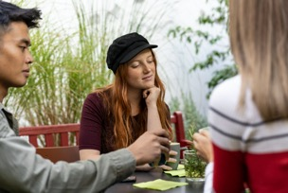
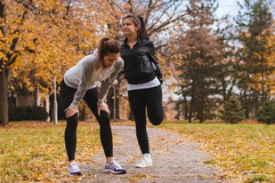


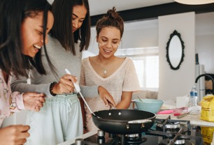




How we ensure we get a natural dopamine high?
Any ideas? ​
things to chill out like colouring or drawing​​​​​​​​​​​
cuddles with a pet
a relaxing bath with candles
a favourite playlist
relaxing with friends or family
a delicious cup of coffee
exercise - like running
football or the gym
dancing​​
cooking together
hobbies
get out in nature
doing things for others like volunteering
a punch bag
Notes:
A negative effect might include financial problems, relationship problems, or poor mental health including mental health issues like stress, anxiety and depression.

Slide 19



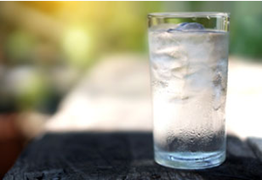

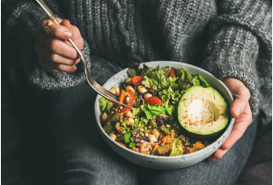


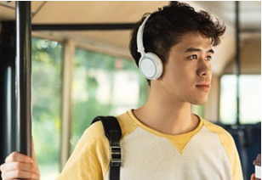
Breathing tools –
In for 7, out for 11/ or Box Breathing – empties mind.
Phone and device routine
Some people say they use cannabis to self-medicate to help with sleep or poor mental health​
Stay hydrated
Go out every day – walk
Eat well
Avoid too much caffeine
What are more effective ways of REALLY helping with sleep or anxiety?​
Listen to a podcast,
book or favourite play music play list
Notes:
Teacher asks young people to create a list of positive diversionary activities that support staying calm and relaxed. This could be collated using post it notes and flip chart paper, or managed as class or group discussion.
Ideas include: sport, talking to friends and family, going for a run or getting out in nature, spending time with pets, lighting candles and having a bath, gaming or many other strategies.
You can choose to show this slide with some useful options that help after the class has discussed the options through the choice’s activity.
Phone and device routine
Blue light from our devices disrupts our sleep. Advise young people to come off devices an hour before bed. Leave outside the room with notifications turned off.
Breathing tools - In for 7, out for 11/ Box Breathing supports the nervous system.
Link for further explanation of box breathing
https://www.bhf.org.uk/informationsupport/heart-matters-magazine/wellbeing/breathing-exercises#box
Video link https://youtu.be/49MgCs6EfB0?list=PLHRK1gBgxSGOqOQXqLtOuaJMG0tNw52_Y

Slide 20
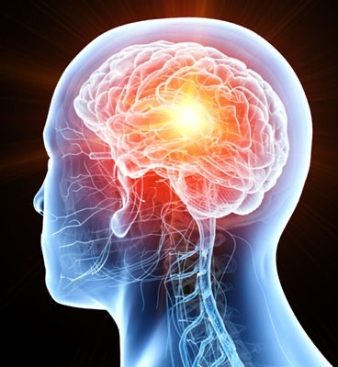

How can you help someone needing support?
Encourage them to keep a log of how often they are turning to a substance (nicotine/ cannabis/ alcohol) or a behaviour gaming/ gambling).
Note what the triggers are – social situations, on own, stress or anxiety, friendship group​.
Encourage them to start by being mindful and try to cut down first​​.
Have a plan with rewards for each step and a date to start​​​​.
​​​
Encourage them to tell loved ones and good friends who will support them.​​​​​
​​​​​
A GP, pastoral care, nurse or a trusted adult will always help and ensure counselling and the right help and support is given – or find an online chat and there are apps that help with quitting too.​​​​​​
​​​​
The earlier help is sought the better – never turn a blind eye….​​​​​​
Notes:
A team of scientists, led by the universities of Cambridge and Warwick in the UK in 2023 analysed brain imaging and behavioural data of over 800 young people at the ages of 14, 19 and 23.They found that, on average, teenagers who started smoking by 14 years of age had markedly less grey matter in a section of the left frontal lobe linked to decision-making and rule-breaking. Low grey matter volume in the left side of the ventromedial prefrontal cortex may be an “inheritable biomarker” for nicotine addiction, say researchers – with implications for prevention and treatment. In addition, the scientists found that the opposite, right part of the same brain region also had less grey matter in smokers. Importantly, loss of grey matter in the right prefrontal cortex appears to speed up only after someone has started smoking. This region is linked to the seeking of sensations. The team argue that less grey matter in the left forebrain could lower cognitive function and lead to “disinhibition”: impulsive, rule-breaking behaviour arising from a limited ability to consider consequences. This may increase the chances of smoking at a young age.
Once a nicotine habit takes hold, grey matter in the right frontal lobe shrinks, which may weaken control over smoking by affecting 'hedonic motivation': the way pleasure is sought and managed. Excessive loss of grey matter in the right brain was also linked to binge drinking and marijuana use.

Slide 21
talk about |Helping someone to quit/ cut down nicotine use
To save money
To feel like myself again
To do better at sport
To take back control
To have a better future
What are the
benefits?
To stop getting into trouble
To set a good example
People who care about me want me to quit
It's affecting my health
For the environment
Notes:
We have produced a leaflet ”Supporting young people to give up vaping or nicotine products”
for the teacher/professional to useour quitting nicotine booklet in the notes
https://talkabouttrust.org/resources/schools/supporting-young-people-to-give-up-vaping-or-nicotine-products/

Slide 22
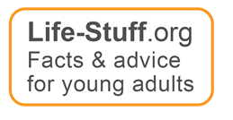
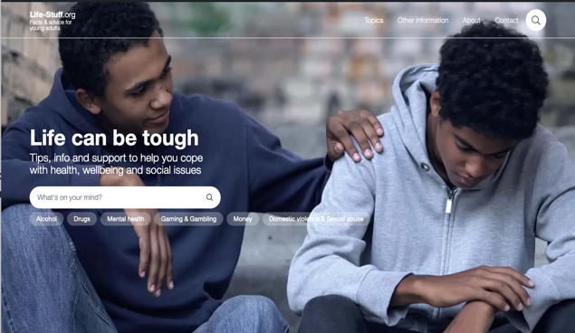
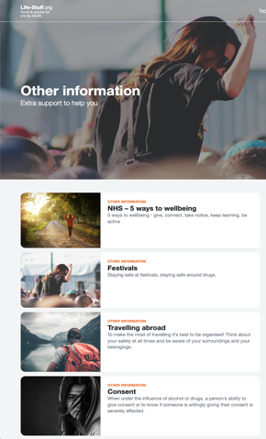

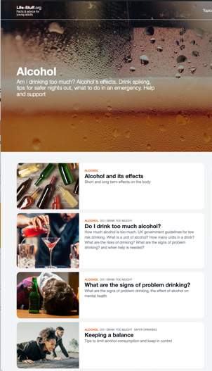
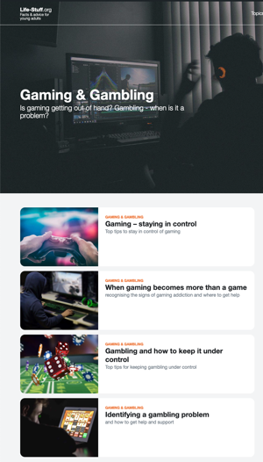
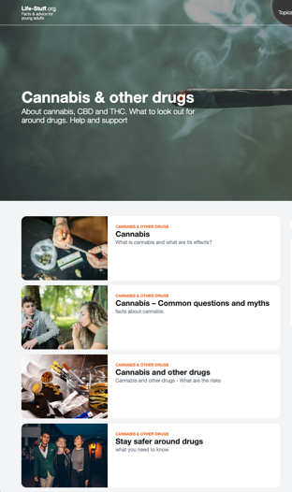
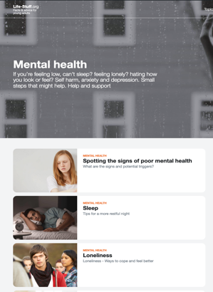
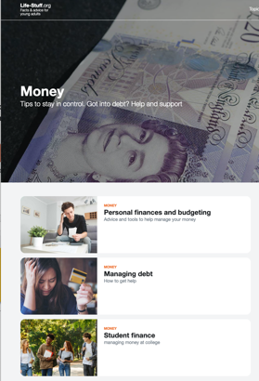
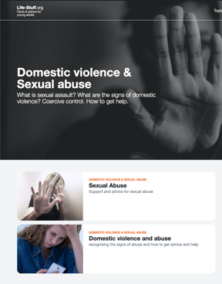
Advice hub Life-stuff.org
Facts and advice for young adults on all aspects of wellbeing
Alcohol
Cannabis
Gaming/gambling
Money worries
Mental health
Vaping
Quizzes
Advice and links to full sources of information

Slide 23

For some substance use becomes a real problem and luckily there are lots of people who can help – locally and nationally.

Slide 24
General Information:
life-stuff.org
drinkaware.co.uk
talktofrank.com
Support:
local services:
Taking Action On Addiction | A campaign website to bring more understanding and help reduce the stigma surrounding addiction actiononaddiction.org.uk/
plus:
Young Minds: youngminds.org.uk
Kooth: kooth.com 0800 11 11 (Freephone)​
Samaritans: 116 123
Drinkline: 0300 1231110
The Mix: themix.org.uk
Shout: the UK's free, confidential and 24/7 mental health text service for crisis support | Shout 85258 (giveusashout.org)
Know the score: knowthescore.info
Where to go for support
Adfam provides information and advice for families of alcohol and drug users. The website has a list of local family support services.
adfam.org.uk/help-for-families/finding-support/search-for-local-support
Alateen is part of the Al-Anon fellowship and has been developed for young people, aged 12 to 20, who are affected by a problem drinker.
al-anonuk.org.uk/alateen/
Tel: 0800 0086 811
We Are With You provides treatment, help and advice about alcohol and drugs for young people and adults. It manages more than 120 services in 80 locations in England and Scotland. wearewithyou.org.uk/
Notes:
The hardest thing to do is to make the first step to tell someone that they feel that their drinking has become a problem. Then there are lots of charities and organisations that can help the person or their family.

