Slide 1



bitesize activity
talk about |mental health
and wellbeing
What activities and strategies can help our mental health and wellbeing and help us cope with stress and anxiety

Slide 2


Working on your own or in small groups, think about simple things that could help someone reduce their anxiety or reduce stress.
You may prefer to draw pictures to share

Slide 3


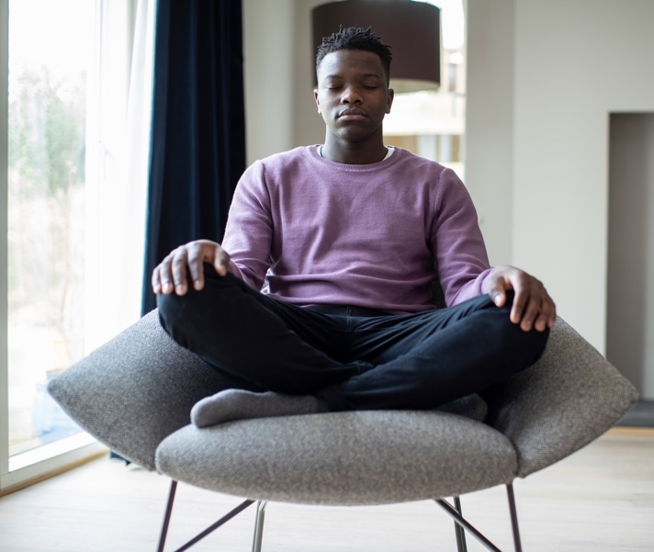
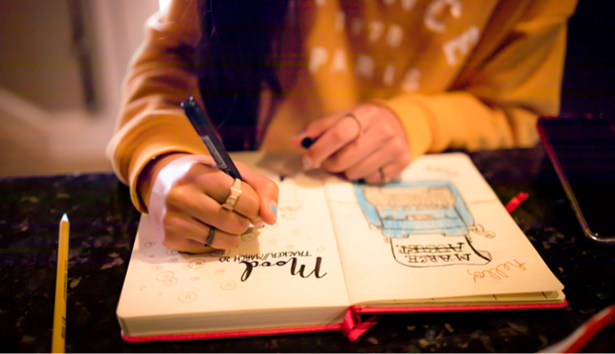

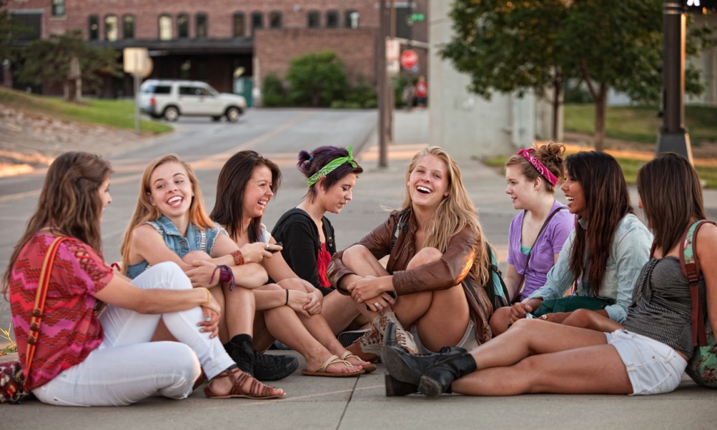
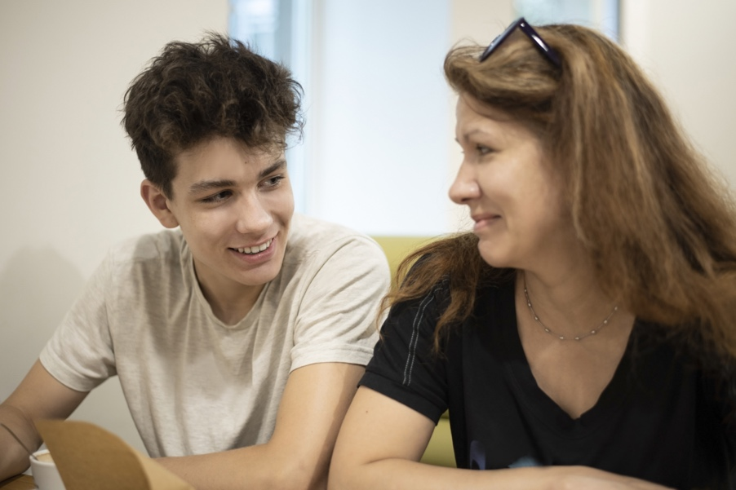
What are good ways for someone to lower their stress or anxiety?
Make time for fun ….......
and quiet​
Learn mindfulness
Write about how you feel
Eat well and avoid too much caffeine
Talk to friends..................
and family​​

Slide 4







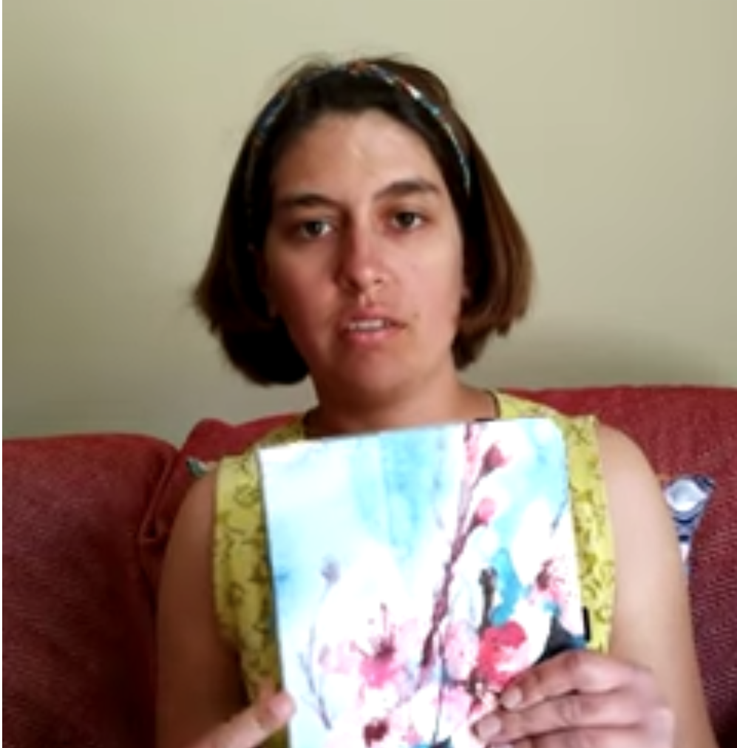
What are good ways for someone to lower their stress or anxiety?
Exercise
Listen to music
Get outside in nature
Spend time looking after animals
Get a good night's sleep
Volunteer
Get involved in cooking
​Practice breathing exercises to help reduce anxiety
Notes:
Breathing exercises (demonstrate using a book to breathe while tracing a finger along one side, hold second side, breathe out third side hold)
Film clip link for box breathing exercise. https://youtu.be/49MgCs6EfB0?list=PLHRK1gBgxSGOqOQXqLtOuaJMG0tNw52_Y

Slide 5
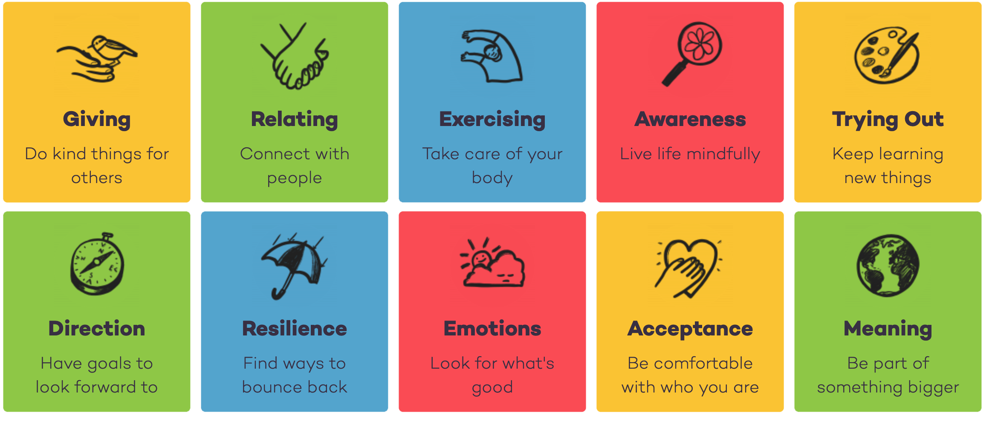
Key To Happier Living
G R E A T
D R E A M
SOURCE: actionforhappiness.org/

Slide 6

Where to go for help and support
Childline
The UK’s free, confidential helpline for children and young people. Trained volunteers are on hand to provide advice and support, by phone and online, 24 hours a day.
0800 11 11
Kooth​
An online mental wellbeing community. Access free, safe and anonymous​
Kooth.com
Tellmi
A website that allows you to share your problems anonymously and receive free and immediate support and advice
tellmi.help
Young Minds
UK children and young people's mental charity
healthyoungminds.org.uk
​

