Slide 1



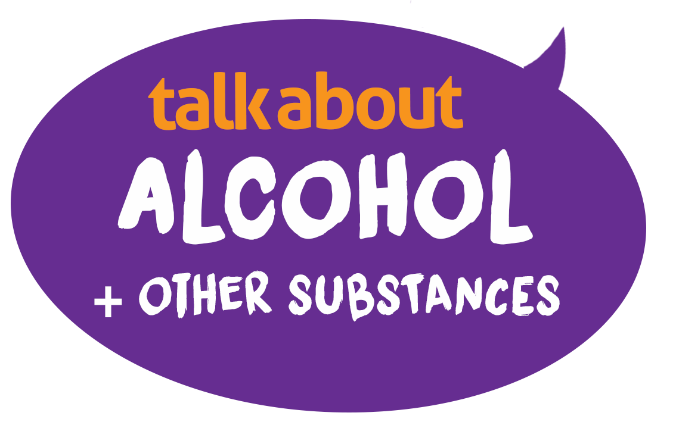

LESSON 4
talk about |vaping
The TALK ABOUT Trust is a youth charity that works across the UK to ensure young people are equipped to make safer choices around alcohol and other substances such as vaping and cannabis.
The TALK ABOUT Trust supports 11 to 25-year-olds with advice, workshops and resources on a range of life choices via schools, children’s homes, pupil referral units, youth and sports clubs. We train teachers and youth workers, empower parents and carers and provide diversionary activities for young people.
Winner of the Best Secondary Education Resource
Education Resource Awards 2025
Notes:
The TALK ABOUT Trust is a youth charity that works across the UK to ensure young people are equipped to make safer choices around alcohol and other substances such as vaping and cannabis.
The TALK ABOUT Trust supports 11 to 25-year-olds with advice, workshops and resources on a range of life choices via schools, children’s homes, pupil referral units, youth and sports clubs. We train teachers and youth workers, empower parents and carers and provide diversionary activities for young people.

Slide 2



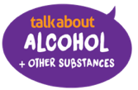
Respect
Listen
No personal info
Not laughed at
Where to get help?
Ask it basket
It’s OK not to know
Confidentiality
OK to pass
GROUND RULES
How will we behave in today’s session?
Notes:
Develop or reinforce existing ground rules/ group agreement drawn up with the students, add or emphasise any ground rules that are especially relevant to this lesson.
Mobile phones off or on silent?
Mention the ask it basket – students can ask questions in confidence by leaving a written note
Use distancing language – I know someone who
No finger pointing
Avoid Stigma and Fear Arousal

Slide 3

We will
Learn what vaping is and what vapes/puff bars can contain
Explore the short and long-term effects of nicotine
Explore the differences between nicotine products
Think about why someone may choose to vape
Examine laws in the UK relating to vaping
Consider the environmental impact of vaping
LEARNING OBJECTIVES

Slide 4
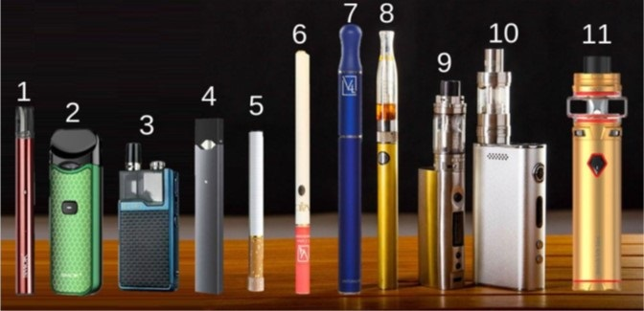

Vapes – what are they?
Vaping is the use of an electronic device to inhale vapour derived from a heated liquid.
The liquid can contain:
  propylene glycol and vegetable glycerine (which gives vapour)
Disposable vape stick
Reusable pod system
Refillable vape
Vuse/Juul style pod cartridge, reusable vape
Disposable cig-a-like design
Cartridge system reusable cig-a-like
Refillable vape pen design
Refillable vape pen design
Box mod with oversize tank
10. Large box mod, but legal sized tank
  Nicotine, which is addictive
  Flavourings, colouring and sweeteners
Notes:
Although cigarettes contain more nicotine, it is not all inhaled as with a vape due to the burning off in smoke that isn't inhaled.
Vapes are illegal for under 18’s due to the effect of nicotine on the immature brain (reduces grey matter) and unknown long term health risks.

Slide 5

… to get us thinking
This animation has been created by a Leeds Uni of The Arts student to help us think about the effect of vaping on our bodies, brains and the environment.
He uses humour and irony to get important points and facts across for us to think about

Slide 6


Slide 7

DISCUSSION – small groups
Discuss these questions, if possible one question per group, for a few minutes.
Feedback your answers to the whole class and talk through what you think the answers might be
Why do you think most teenagers chose not to vape?
Why might some adults choose to vape instead of smoking?
Is vaping worse than smoking for young people?
Why might under 18’s vape although it’s illegal?
What percentage of 11 to 15-year-olds have tried vaping a few times or more?
a) 10% b) 20% c) 30% d) 40% e) 50%
What other products contain nicotine?

Slide 8
Why do you think most teenagers chose not to vape?
Why do you think most teenagers chose not to vape?
Nearly a third (32%) of teenagers aged 13-18 say they have vaped at least once according to a survey carried out for BBC Bitesize and BBC Radio 5 Live. Of those who said they had vaped at least once, 55% said they were worried it would be bad for their health.
because
It’s illegal
don't like the taste
Bad for the planet,
especially disposables
nicotine is addictive
Waste of money
sport and fitness – affects lungs

Slide 9
Why do you think most teenagers chose not to vape?
8 in 10 under 16’s choose not to vape regularly (more have tried once or twice)
We are the experiment!
No-one knows the effect of vaping yet
We do know nicotine is addictive and changes the teenage brain
Vapes contain up to 2,000 chemicals – some tested have been found to include nickel, THC and SPICE
1 in 3 vapes sold are unregulated/illegal so they can contain anything

Slide 10
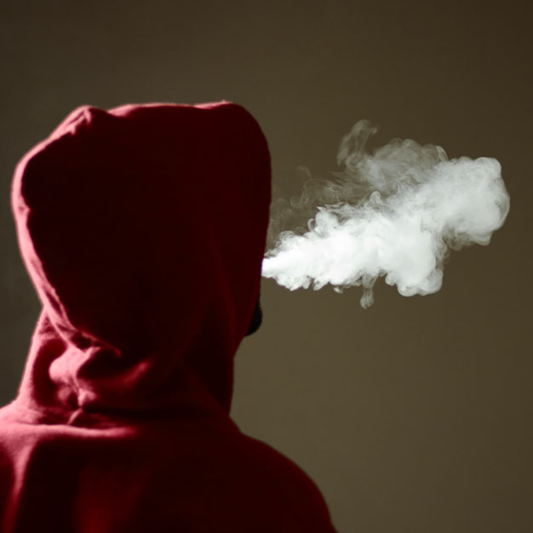

Why do some people choose to use vapes?
Why might under 18’s vape even though it’s illegal?
10%
because they like the taste
54%
to give it a try (curiosity)
(26% for those who have smoked)
be
20%
because other people use them
Just 2 in 10 young people under 15 vape. Most just a few times out of curiosity.
But some teenagers now feel vaping/nicotine is controlling them and they use often.
Notes:
The growing literature on what motivates young people to vape cites factors such as peer influence, social image, perceived lower health risks of vapes compared with cigarettes, ‘just to give it a try’ and because they ‘like the flavours’.
Other common reasons for vaping include to support mental health, reduce stress levels and address low self-esteem. Vapes are used as a perceived coping mechanism to address these. However, teens who vape for stress relief report significantly higher stress levels than young people who don’t vape.
These findings are similar to those for adolescent cigarette smoking behaviour, whereby cigarette smoking is commonly perceived to be a way to relieve stress

Slide 11
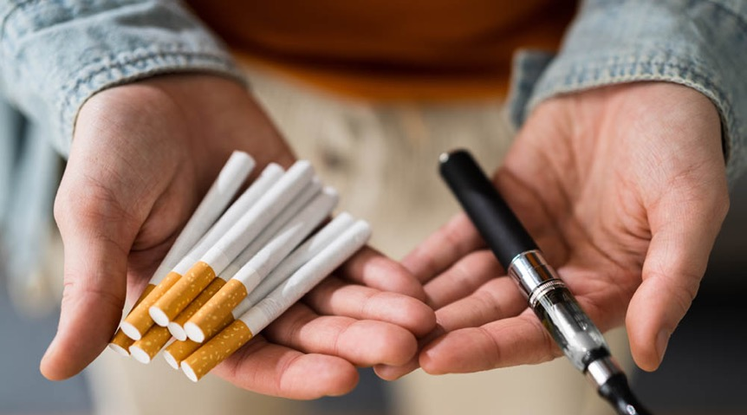
Smoking v Vaping
Why might some adults choose to vape instead of smoking?
When a cigarette is smoked, tobacco is burnt, releasing more toxins and smoke is inhaled.
1. Vapes help adults give up smoking
2. Most vapes, like cigarettes or nicotine patches and gum
give smokers the same stimulant as smoking
do not contain the tar and other chemicals like carbon monoxide found in cigarettes that cause lung cancer, heart disease and other illnesses.
For all smokers trying to give up, vaping is less harmful to their health than smoking cigarettes,
But this doesn’t mean vaping is safe.
76,000 people die from smoking related diseases in the UK each year.
If someone smokes,
vaping is much safer.
If someone doesn’t smoke,
they should avoid vaping.
contain high levels of nicotine

Slide 12
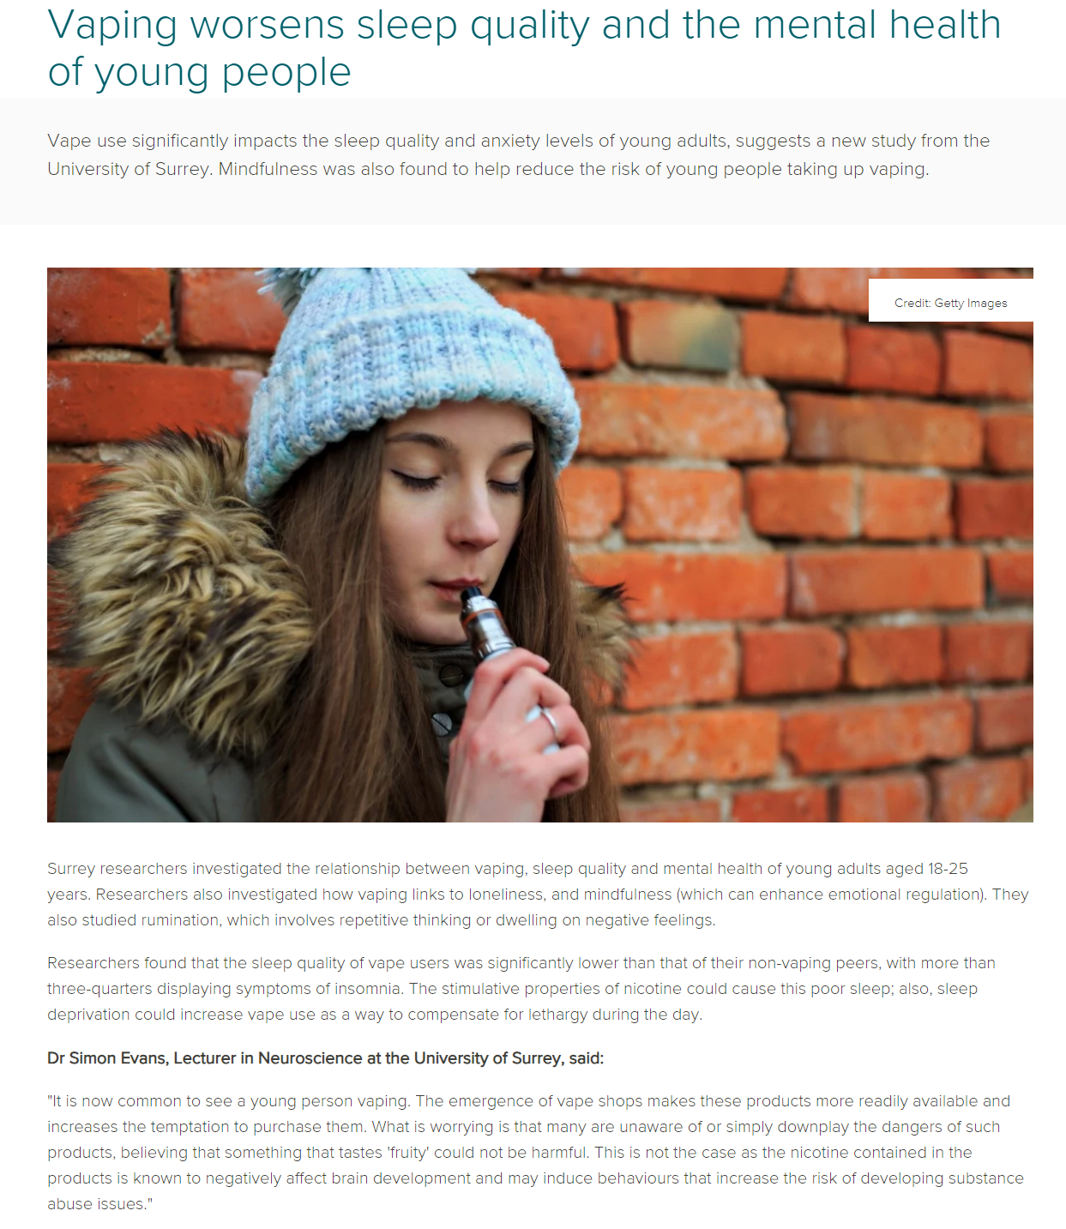


Is nicotine worse for teenagers?
When you’re a teenager your brain is developing fast. Nicotine gets into your brain and mimics natural brain chemicals that make you feel good. But it also stimulates your brain’s appetite for more. It re-wires your brain, changing the brain chemistry so that soon your brain is craving more and more nicotine all the time. If you don’t get some it makes you feel anxious, you can’t concentrate on the things that matter. You’re constantly thinking about when you can get more. You begin to lose control over your choice to vape* or not.
Martin Dockrell Tobacco Control Programme Lead Department of Health & Social Care:
* The same is true of smoking.
Notes:
A team of scientists, led by the universities of Cambridge and Warwick in the UK in 2023 analysed brain imaging and behavioural data of over 800 young people at the ages of 14, 19 and 23.They found that, on average, teenagers who started smoking by 14 years of age had markedly less grey matter in a section of the left frontal lobe linked to decision-making and rule-breaking. Low grey matter volume in the left side of the ventromedial prefrontal cortex may be an “inheritable biomarker” for nicotine addiction, say researchers – with implications for prevention and treatment. In addition, the scientists found that the opposite, right part of the same brain region also had less grey matter in smokers. Importantly, loss of grey matter in the right prefrontal cortex appears to speed up only after someone has started smoking. This region is linked to the seeking of sensations. The team argue that less grey matter in the left forebrain could lower cognitive function and lead to “disinhibition”: impulsive, rule-breaking behaviour arising from a limited ability to consider consequences. This may increase the chances of smoking at a young age.
Once a nicotine habit takes hold, grey matter in the right frontal lobe shrinks, which may weaken control over smoking by affecting 'hedonic motivation': the way pleasure is sought and managed. Excessive loss of grey matter in the right brain was also linked to binge drinking and marijuana use.

Slide 13
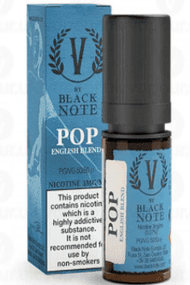
Vapes and e liquids… many are fake
Regulations in the UK restrict what chemicals can be used in vapes and limit the amount of nicotine
HOW TO SPOT A LEGAL VAPE
ILLEGAL VAPES
The highest strength legal vapes have the nicotine level of 20 cigarettes.
Many vapes and e liquids sold online, from dealers, given or from social media are illegal and can be unsafe.
2ml – maximum tank size
20mg/ml (or 2%) – highest nicotine strength
About 600 – total number of puffs
10ml – Largest refill bottle volume
A third of the packaging should be a health warning
Illegal vapes/ e liquids can contain much more
When tested, they have been found to contain lead, nickel, chromium, Spice, acetaldehyde, formaldehyde and nicotine levels of 100 plus cigarettes.
1 in 6 vapes confiscated in schools in 2024 contained SPICE
Notes:
Regulations in the UK restrict what chemicals can be used in vapes and limit the amount of nicotine to a maximum of 40mg per device
(a cigarette contains roughly 12 mg nicotine).
According to the UK government, e-cigarettes are heavily regulated, with the UK having some of the strictest regulation processes.
These rules make sure that e-cigarettes are up to a certain standard of quality and safety. The packaging and labels on vape products include information to help consumers make informed choices.
Some people have doubts about the ingredients in vape products, but it’s important to note that manufacturers are obligated to inform the UK Medicines and Healthcare Products Regulatory Agency (MHRA) by providing a detailed list of all the ingredients present in their products.

Slide 14
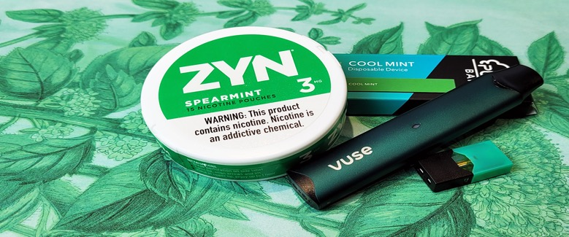

Nicotine causes the body to release adrenaline, a hormone that makes us hyper aware and jumpy (fight or flight)
A bit more about nicotine…
Adrenaline causes an increase in speed of breathing and heart rate
As someone inhales more the stimulant wears off and the person feels relaxed
The short-term effects of nicotine can include:
An increase in heart rate and blood pressure (dizziness)
Feeling jittery/ hyper
Feeling sick
Withdrawal symptoms lead to
Having problems concentrating
Having headaches and shaking when stop
Being irritable
Notes:
What do we learn about the effect of nicotine on young people? (It initially makes people feel good, it makes people want more, it can create more anxiety, it can be hard to concentrate, young people’s brains are possibly more sensitive to it, young people can lose control over their choices.)
What might be some signs that someone is addicted to nicotine? (Cravings, irritable when they don't have it, anxiety, trouble concentrating, headaches, thinking about vaping/smoking all the time.)
What behaviours might you see if someone is addicted to nicotine from vaping? (Vaping very regularly both with friends and alone, keeping secrets, or lying about how much they use it, doing more extreme things to be able to vape, e.g., borrowing money, vaping even when they want to cut down or stop.)

Slide 15
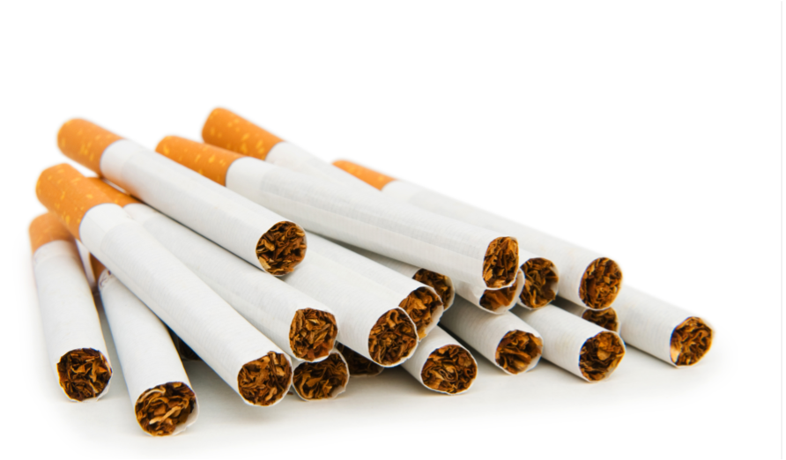
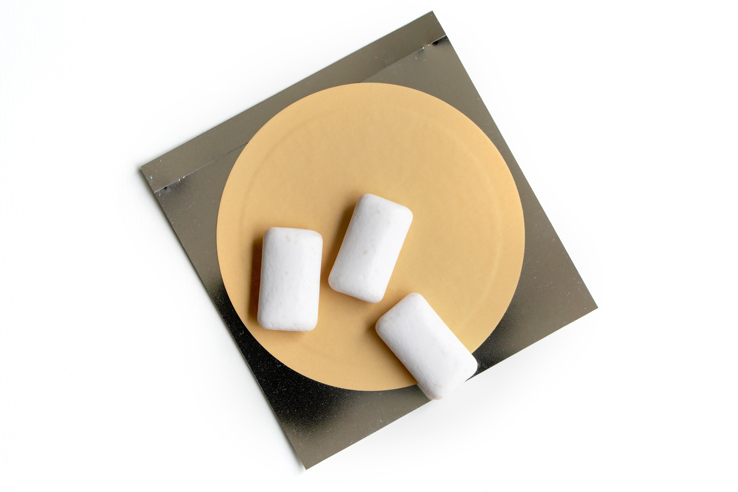
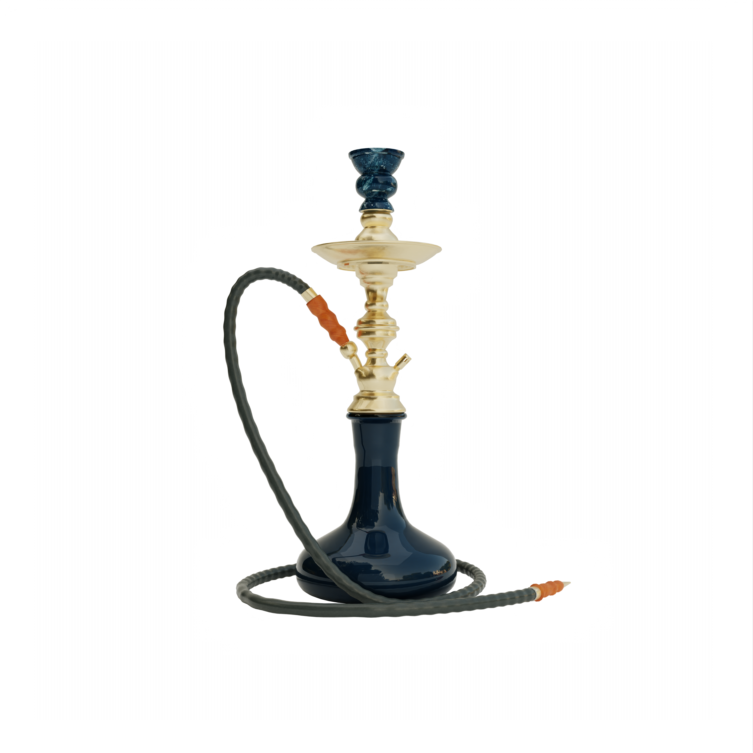
Other nicotine products
Cigarettes
deliver nicotine by burning tobacco, which can cause smoking-related illnesses such as lung cancer and heart disease.
Each cigarette contains 10mg of nicotine,
It is the tar and carbon monoxide inhaled as well as 67 other chemicals that are linked to cancer.
The Tobacco and Vapes Act, passed in 2026, makes it illegal to sell tobacco products to children born on or after 1 January 2009 to prevent the next generation from becoming addicted to tobacco.
Nicotine gum and patches
provide a low level of nicotine, without the tar, carbon monoxide and other poisonous chemicals present in tobacco smoke.
can help reduce unpleasant withdrawal effects, such as bad moods and cravings, which may occur when someone stops smoking.
can be bought from pharmacies and some shops and are also available on prescription from a doctor or NHS stop smoking service.
Shisha
usually made up of tobacco, molasses/sugar, and fruit flavourings.
It is smoked through a water pipe that is heated by charcoal to produce the smoke.
The truth is shisha is just as harmful as smoking cigarettes and causes many of the same diseases.
Notes:
ORIGINAL:
Cigarettes smoking delivers nicotine by burning tobacco, which can cause smoking-related illnesses such as lung cancer and heart disease. Each cigarette contains 2mg of nicotine, but it is the tar and carbon monoxide inhaled as well as 67 other chemicals that are linked to cancer.
Shisha Shisha is usually made up of tobacco, molasses/sugar, and fruit flavourings. It is smoked through a water pipe that is heated by charcoal to produce the smoke. Sometimes people assume smoking shisha is less harmful than smoking cigarettes. The truth is shisha is just as harmful as smoking cigarettes and causes many of the same diseases.
SNUS smokeless powdered tobacco mixed with salts and flavourings, like mint. The nicotine content varies among brands.. It is placed between the upper lip and gum for extended periods, SNUS is banned from sale in the UK and the EU (except in Sweden). Pouches are similar, a flavoured nicotine sachet.
Nicotine Gum and Patches provide a low level of nicotine, without the tar, carbon monoxide and other poisonous chemicals present in tobacco smoke. They can help reduce unpleasant withdrawal effects, such as bad moods and cravings, which may occur when someone stops smoking. So can be bought from pharmacies and some shops. They’re also available on prescription from a doctor or NHS stop smoking service.
Shisha is usually made up of tobacco, molasses/sugar, and fruit flavourings. It is smoked through a water pipe that is heated by charcoal to produce the smoke.
Smoking shisha can damage your health. Sometimes people assume smoking shisha is less harmful than smoking cigarettes. The truth is shisha is just as harmful as smoking cigarettes and causes many of the same diseases. Shisha smokers are also more likely to take up cigarette smoking because of their addiction to nicotine.
Facts about smoking shisha
Smoking shisha for an hour exposes you to 100 times more smoke than is found in a single cigarette. The smoke is cooled by water and can take on a fruity/herbal scent. Therefore it is inhaled more deeply and for longer, causing more sustained damage to your lungs and heart.
Shisha can be addictive because it contains nicotine. Even tobacco free shisha like herbal/fruit shisha is not safe. Tobacco free shisha still contains tar, high levels of carbon monoxide, and other toxic ingredients.
Water does not filter tobacco and other harmful toxins. When you smoke a shisha pipe you are inhaling carbon monoxide and other cancer causing chemicals.
Herbal and fruit shishas mask the odour of tobacco, which can give you a false sense of safety whilst smoking.
Sitting with people who smoke shisha is not safe because of secondary smoke inhalation.
Smoking shisha whilst pregnant can lead to your child having low birth weight.
Nicotine pouches are non-medicinal consumer pouches of nicotine which are placed in the mouth and sucked. Brands include Lyft, Skruf, Nordic Spirit and Velo. In the UK, these products are not captured by regulation of either tobacco or e-cigarettes and as such are only regulated under general consumer product safety regulations. Oral tobacco products are regulated and it is illegal to sell some products, such as snus, in the UK

Slide 16
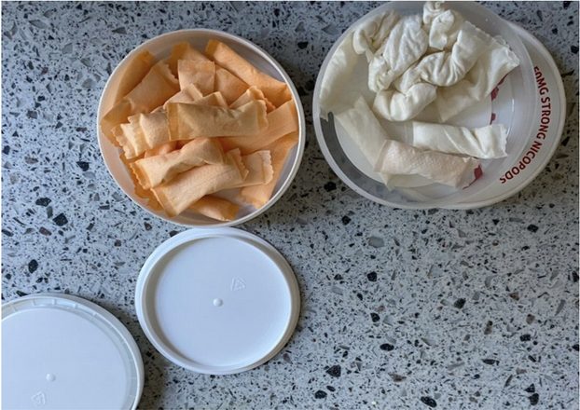
Other nicotine products
White SNUS/ Nicotine pouches
Flavoured mini sachet that contain synthetic nicotine and synthetic flavourings, sodium carbonate, and sweetners.
They are placed between the upper lip and gum
They often have a high pH value, an effect of the sodium carbonate, which allows the nicotine inside the pouch to penetrate the soft lining on the gum more quickly and enter the bloodstream, resulting in stronger nicotine kicks. (Source Institute of Odontology, University of Gothenburg.
The Tobacco and Vapes Act, that became law on April 29, 2026, means that pouches are now regulated by tobacco legislation so can't be given or marketed to under 18s.
They now need to display a warning, "This product contains nicotine, which is a highly addictive substance."
They can contain any level of nicotine, with high strength pouches containing 50mg+, compared to 1.8-2mg from a single cigarette.
Production controls: Minister have powers to limit maximum nicotine strengths, cap pouch sizes, regulate flavourings, and mandate specific packaging to reduce the appeal to children.
High-strength ban: The legislation creates specific offences for manufacturing and selling ultra-high-strength oral nicotine products. These measures are enforced by local trading standards.
See ASH Tobacco and Vapes Act overview or read the Official Bill Documents
SNUS
a smokeless powdered tobacco mixed with salts and flavourings, like mint. SNUS is banned from sale in the UK and the EU (except in Sweden).
Notes:
ORIGINAL:
Cigarettes smoking delivers nicotine by burning tobacco, which can cause smoking-related illnesses such as lung cancer and heart disease. Each cigarette contains 2mg of nicotine, but it is the tar and carbon monoxide inhaled as well as 67 other chemicals that are linked to cancer.
Shisha Shisha is usually made up of tobacco, molasses/sugar, and fruit flavourings. It is smoked through a water pipe that is heated by charcoal to produce the smoke. Sometimes people assume smoking shisha is less harmful than smoking cigarettes. The truth is shisha is just as harmful as smoking cigarettes and causes many of the same diseases.
SNUS smokeless powdered tobacco mixed with salts and flavourings, like mint. The nicotine content varies among brands.. It is placed between the upper lip and gum for extended periods, SNUS is banned from sale in the UK and the EU (except in Sweden). Pouches are similar, a flavoured nicotine sachet.
Nicotine Gum and Patches provide a low level of nicotine, without the tar, carbon monoxide and other poisonous chemicals present in tobacco smoke. They can help reduce unpleasant withdrawal effects, such as bad moods and cravings, which may occur when someone stops smoking. So can be bought from pharmacies and some shops. They’re also available on prescription from a doctor or NHS stop smoking service.
Shisha is usually made up of tobacco, molasses/sugar, and fruit flavourings. It is smoked through a water pipe that is heated by charcoal to produce the smoke.
Smoking shisha can damage your health. Sometimes people assume smoking shisha is less harmful than smoking cigarettes. The truth is shisha is just as harmful as smoking cigarettes and causes many of the same diseases. Shisha smokers are also more likely to take up cigarette smoking because of their addiction to nicotine.
Facts about smoking shisha
Smoking shisha for an hour exposes you to 100 times more smoke than is found in a single cigarette. The smoke is cooled by water and can take on a fruity/herbal scent. Therefore it is inhaled more deeply and for longer, causing more sustained damage to your lungs and heart.
Shisha can be addictive because it contains nicotine. Even tobacco free shisha like herbal/fruit shisha is not safe. Tobacco free shisha still contains tar, high levels of carbon monoxide, and other toxic ingredients.
Water does not filter tobacco and other harmful toxins. When you smoke a shisha pipe you are inhaling carbon monoxide and other cancer causing chemicals.
Herbal and fruit shishas mask the odour of tobacco, which can give you a false sense of safety whilst smoking.
Sitting with people who smoke shisha is not safe because of secondary smoke inhalation.
Smoking shisha whilst pregnant can lead to your child having low birth weight.
Nicotine pouches are non-medicinal consumer pouches of nicotine which are placed in the mouth and sucked. Brands include Lyft, Skruf, Nordic Spirit and Velo. In the UK, these products are not captured by regulation of either tobacco or e-cigarettes and as such are only regulated under general consumer product safety regulations. Oral tobacco products are regulated and it is illegal to sell some products, such as snus, in the UK

Slide 17
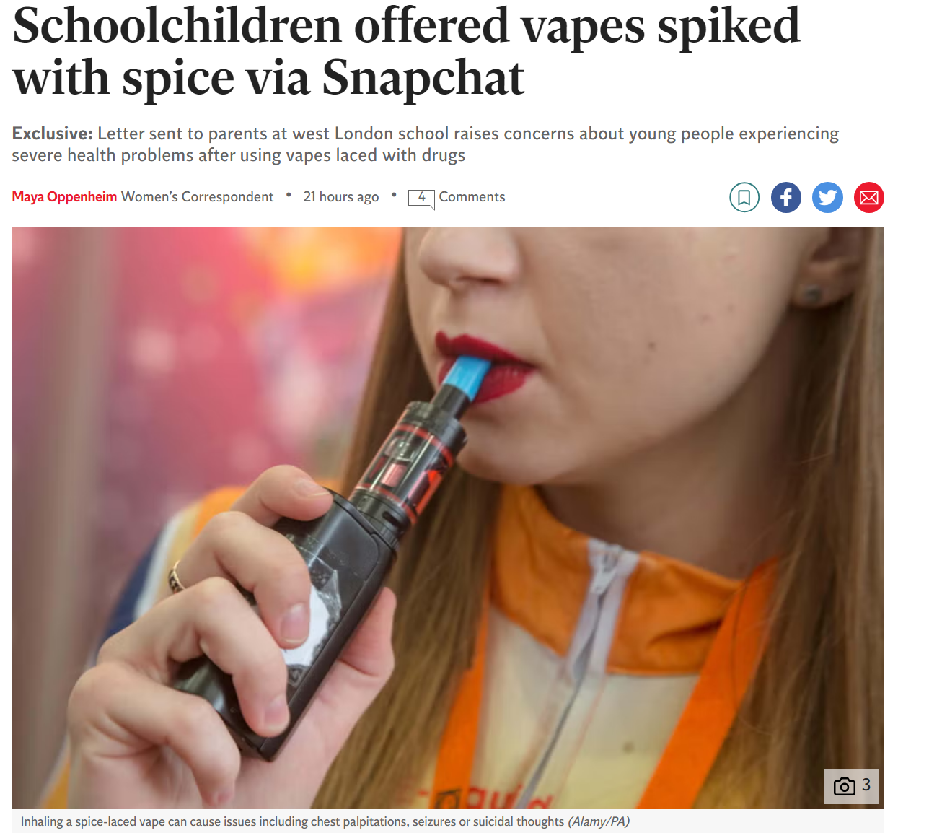
THC and Spice in vapes
Cannabis (weed) vape products can contain high levels of THC (the principal psychoactive constituent of cannabis
Because these products are unregulated, it’s not possible to be sure about the amount of THC – or any other substance!
Compared to smoking cannabis, vapes allow a larger amount of THC to be inhaled very quickly - this can lead to overdosing (most hospitalisations for vaping are linked to THC vapes).
They are more likely to cause negative side effects or long-term health problems.
Testing of these products has shown many are made with synthetic cannabis (Spice) which is highly dangerous.
Notes:
Cannabis (weed) vape products contain concentrated forms of the plant and THC levels can be many times higher than in the best-quality weed.
Compared to smoking cannabis, THC vapes allow a larger amount of THC to be inhaled very quickly - this can lead to overdosing (most hospitalisations for vaping are linked to THC vapes).
Because these products are unregulated, it’s not possible to be sure about their strength
They are more likely to cause negative side effects or long-term health problems.
Testing of these products has shown many are made with synthetic cannabis (Spice) which is highly dangerous.
Some vaping products are marketed as CBD or THC dope vapes. T
Vaping ‘spice’ or THC, or black-market e-liquids, carry unknown risks.

Slide 18

Why’s nicotine so hard to quit?
NICOTINE IS PHYSICALLY ADDICTIVE.
What behaviours might you see if someone is addicted to nicotine from vaping or smoking?
The nicotine gives a temporary high –
It can rev someone up, making them feel more alert, more focused and happier.
After a while, this becomes a regular, necessary fix, and having nicotine in the body feels normal.
Vaping/smoking very regularly both with friends and alone
keeping secrets or lying about how much they smoke/ vape
doing more extreme things to be able to vape/ smoke e.g. borrowing money, or
vaping/ smoking even when they want to cut down or stop
QUITTING CAUSES THE BODY TO HAVE CRAVINGS AND WITHDRAWAL SYMPTOMS
Notes:
1) The main reason why it is so difficult to quit smoking, vaping or using other tobacco products like pouches/ shisha/ SNUS is
NICOTINE IS PHYSICALLY ADDICTIVE.
2) The nicotine gives a temporary high. It can rev someone up, making them feel more alert, more focused and happier. After a while, this becomes a regular, necessary fix, and having nicotine in the body feels normal.
3) QUITTING CAUSES THE BODY TO HAVE CRAVINGS AND WITHDRAWAL SYMPTOMS. (such as headaches, fatigue, difficulty concentrating and nausea).

Slide 19
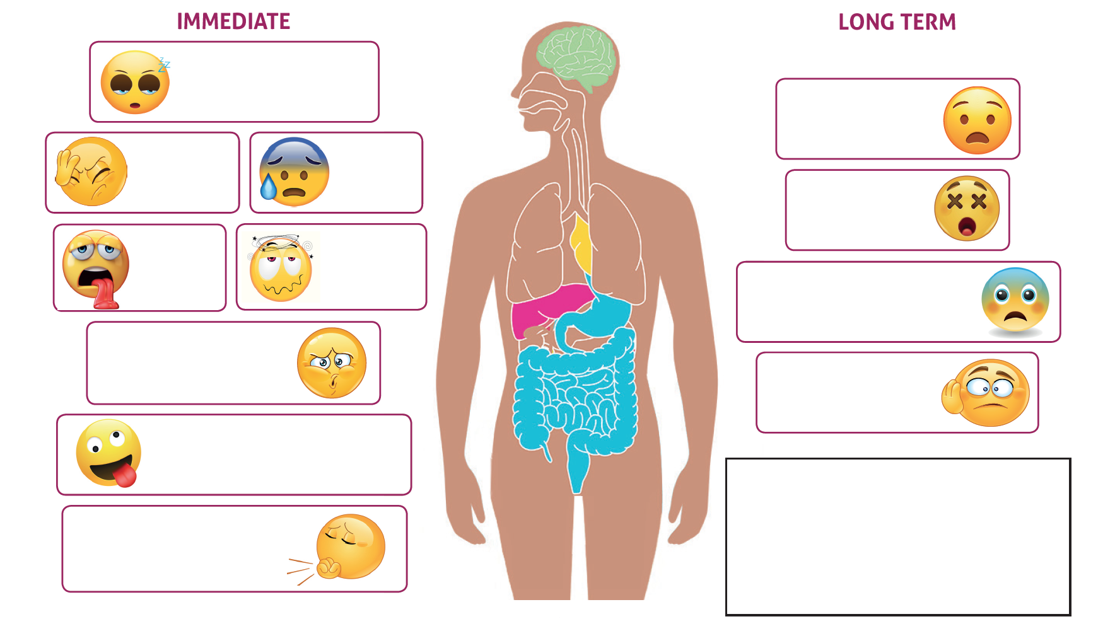
How can vaping effect someone's health
Blank sheet

Slide 20
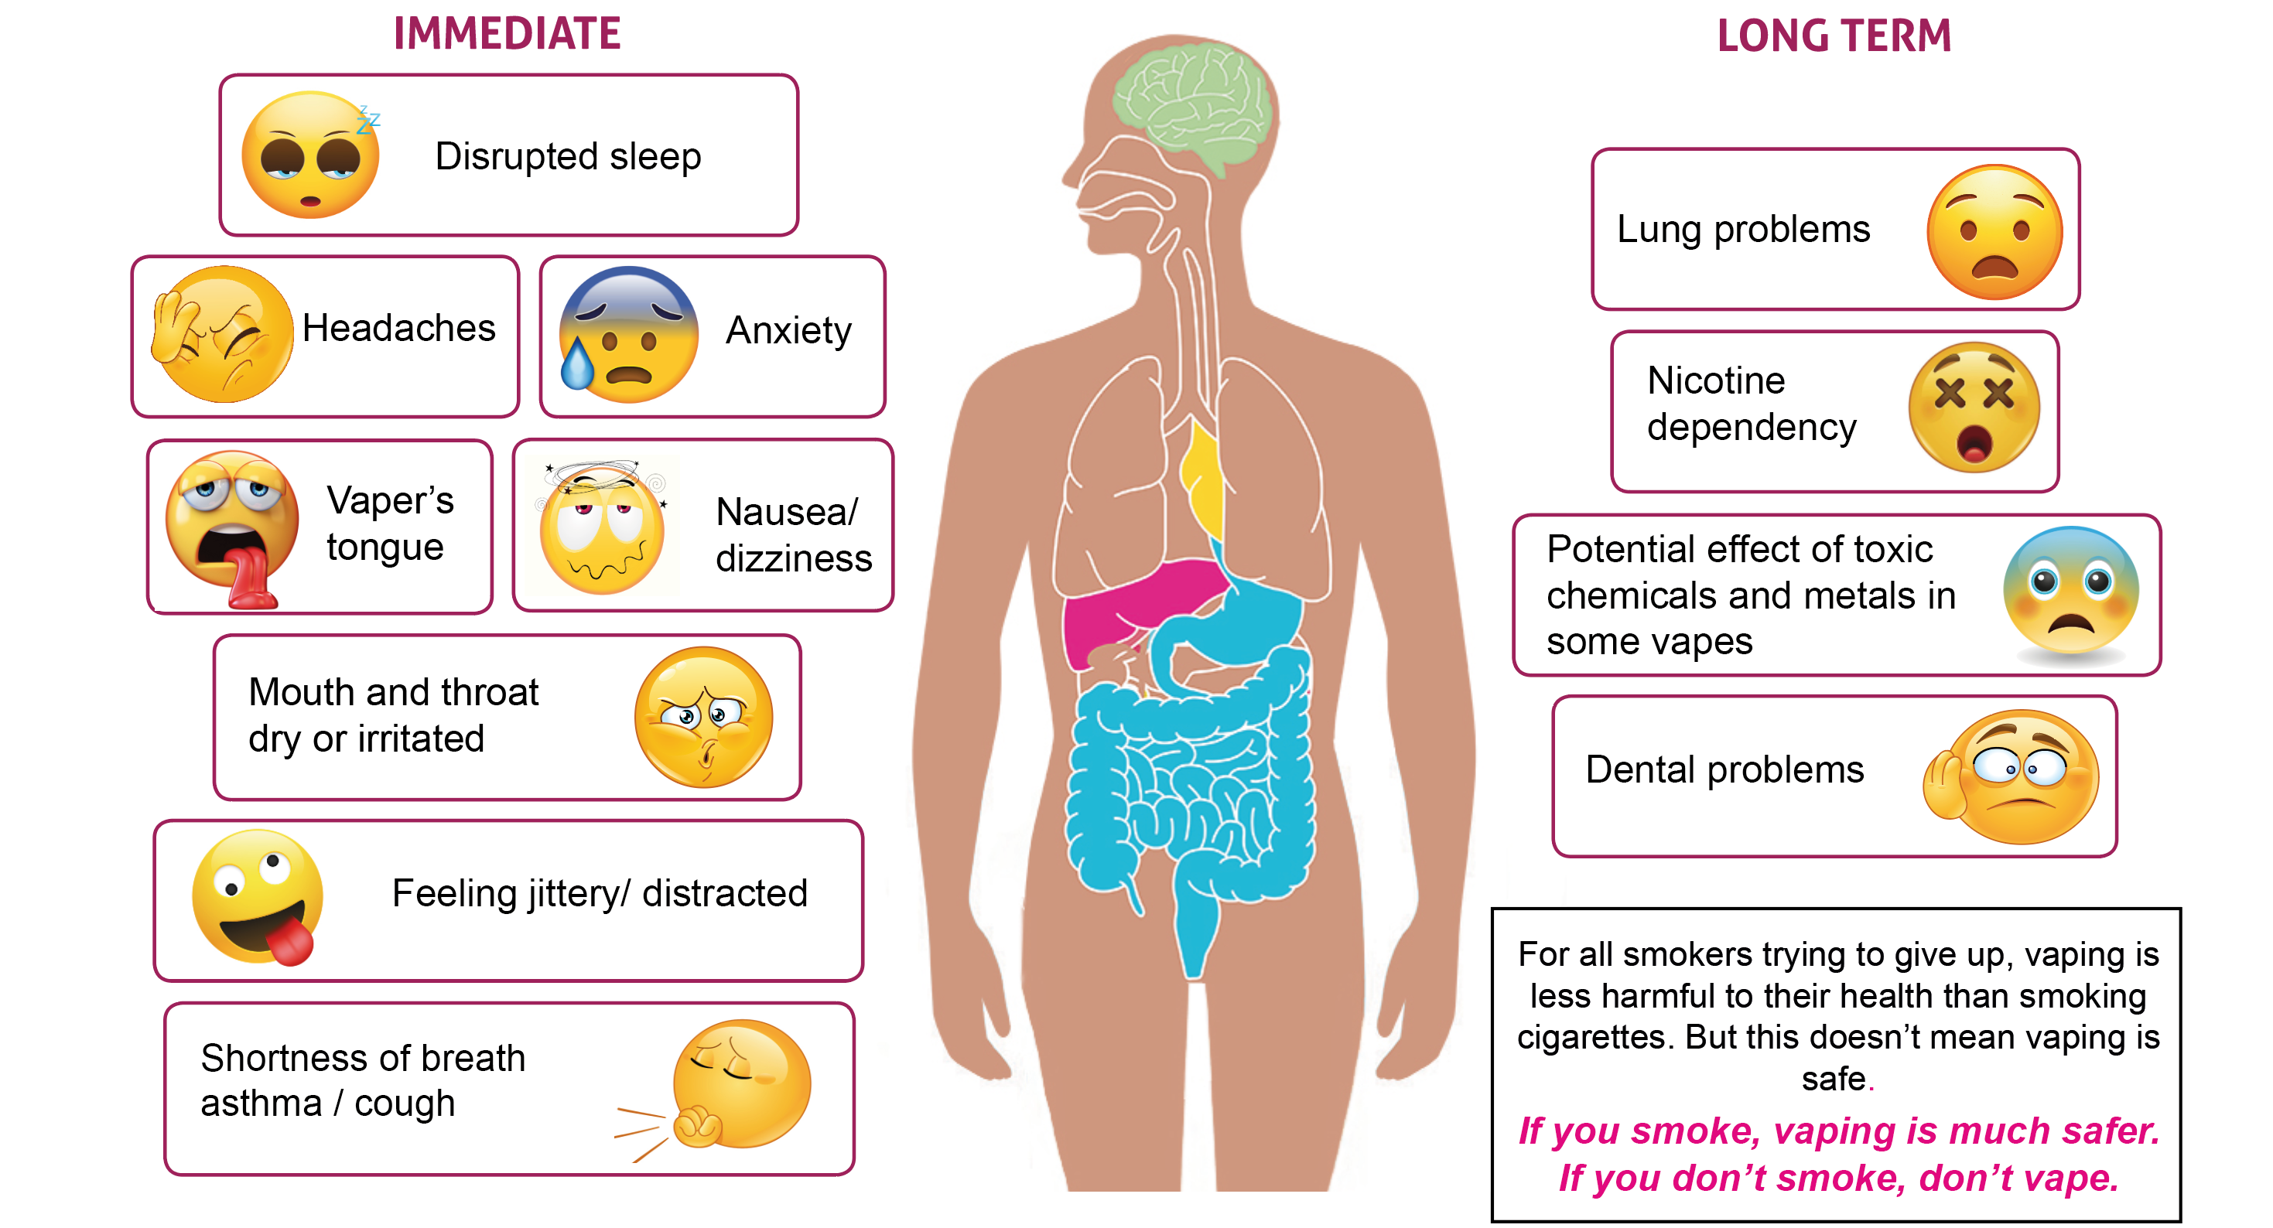
How can vaping effect someone's health

Slide 21
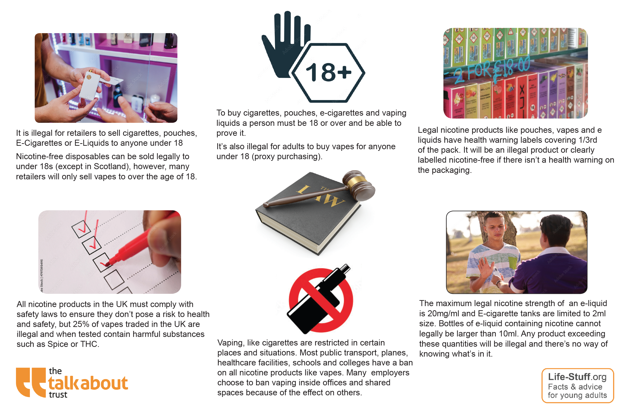
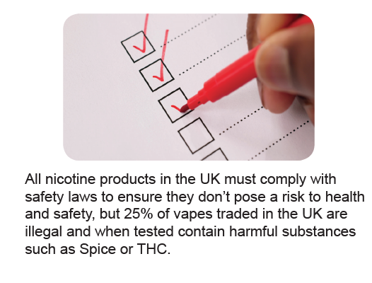
Vaping and the Law

Slide 22
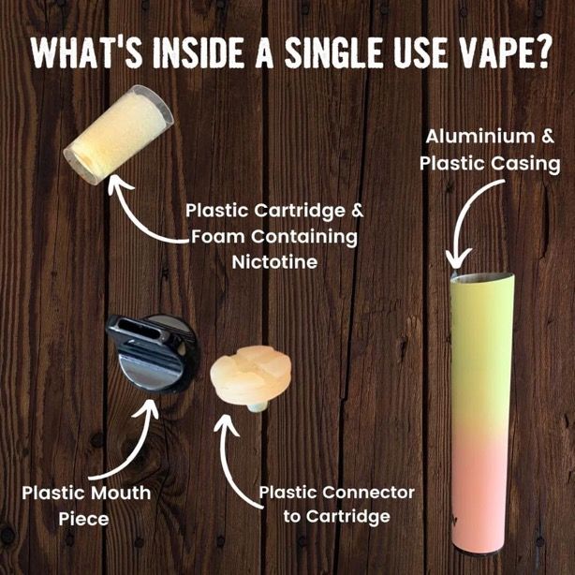
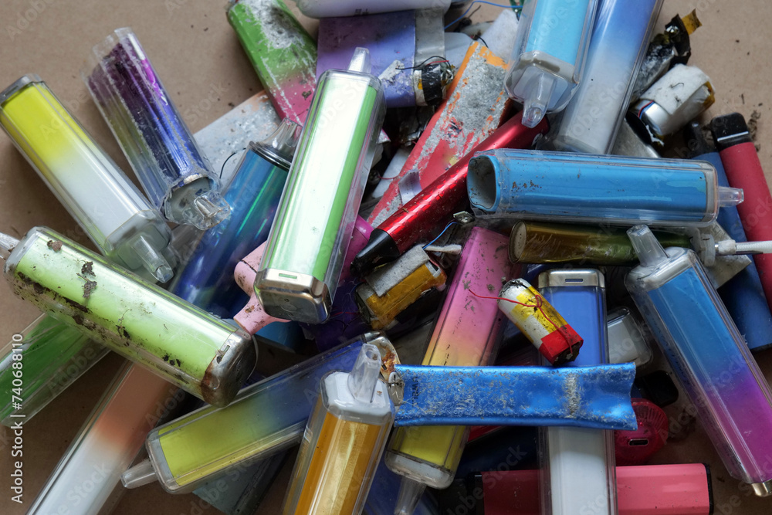

Disposable vapes and the planet
Single-use vapes contain batteries and difficult to recycle plastics.
These are dumped in landfill causing dangerous chemicals to pollute our soil, water and oceans.
The plastics and toxic waste affect birds and animals.
Over 40 tonnes of lithium was thrown out with disposable vapes in the UK in 2022. That’s enough to make batteries for 5,000 electric cars!
ONS say that 5.1 million adults vape in the UK and 1 in 6 young people aged 16 – 24
Greenpeace says we bin nearly 5 million vapes each week – that’s roughly 8 vapes every second.
Single use waste that has to go somewhere. Some enters the environment as litter, some goes for recycling, while the rest ends up in landfills.
Notes:
Rather than decomposing, plastic turns into “microplastics” which continue to pollute the environment, our food and drinking water
•Disposable vaping devices also contain lithium batteries which, if damaged, can pose a fire hazard when thrown away
•Lithium is also a very valuable metal but tonnes of it each year is being thrown away and ends up in landfill or waste incinerators. This lithium could be used in things like electric cars which could help us address climate change
•Disposable vaping devices are classed as Waste Electrical and Electronic Equipment (WEEE) and should be being recycled
•Explore safe disposal of disposable vaping devices and other electrical equipment via recycling schemes. You can find your closest centre on the Recycle Your Electricals website.

Slide 23


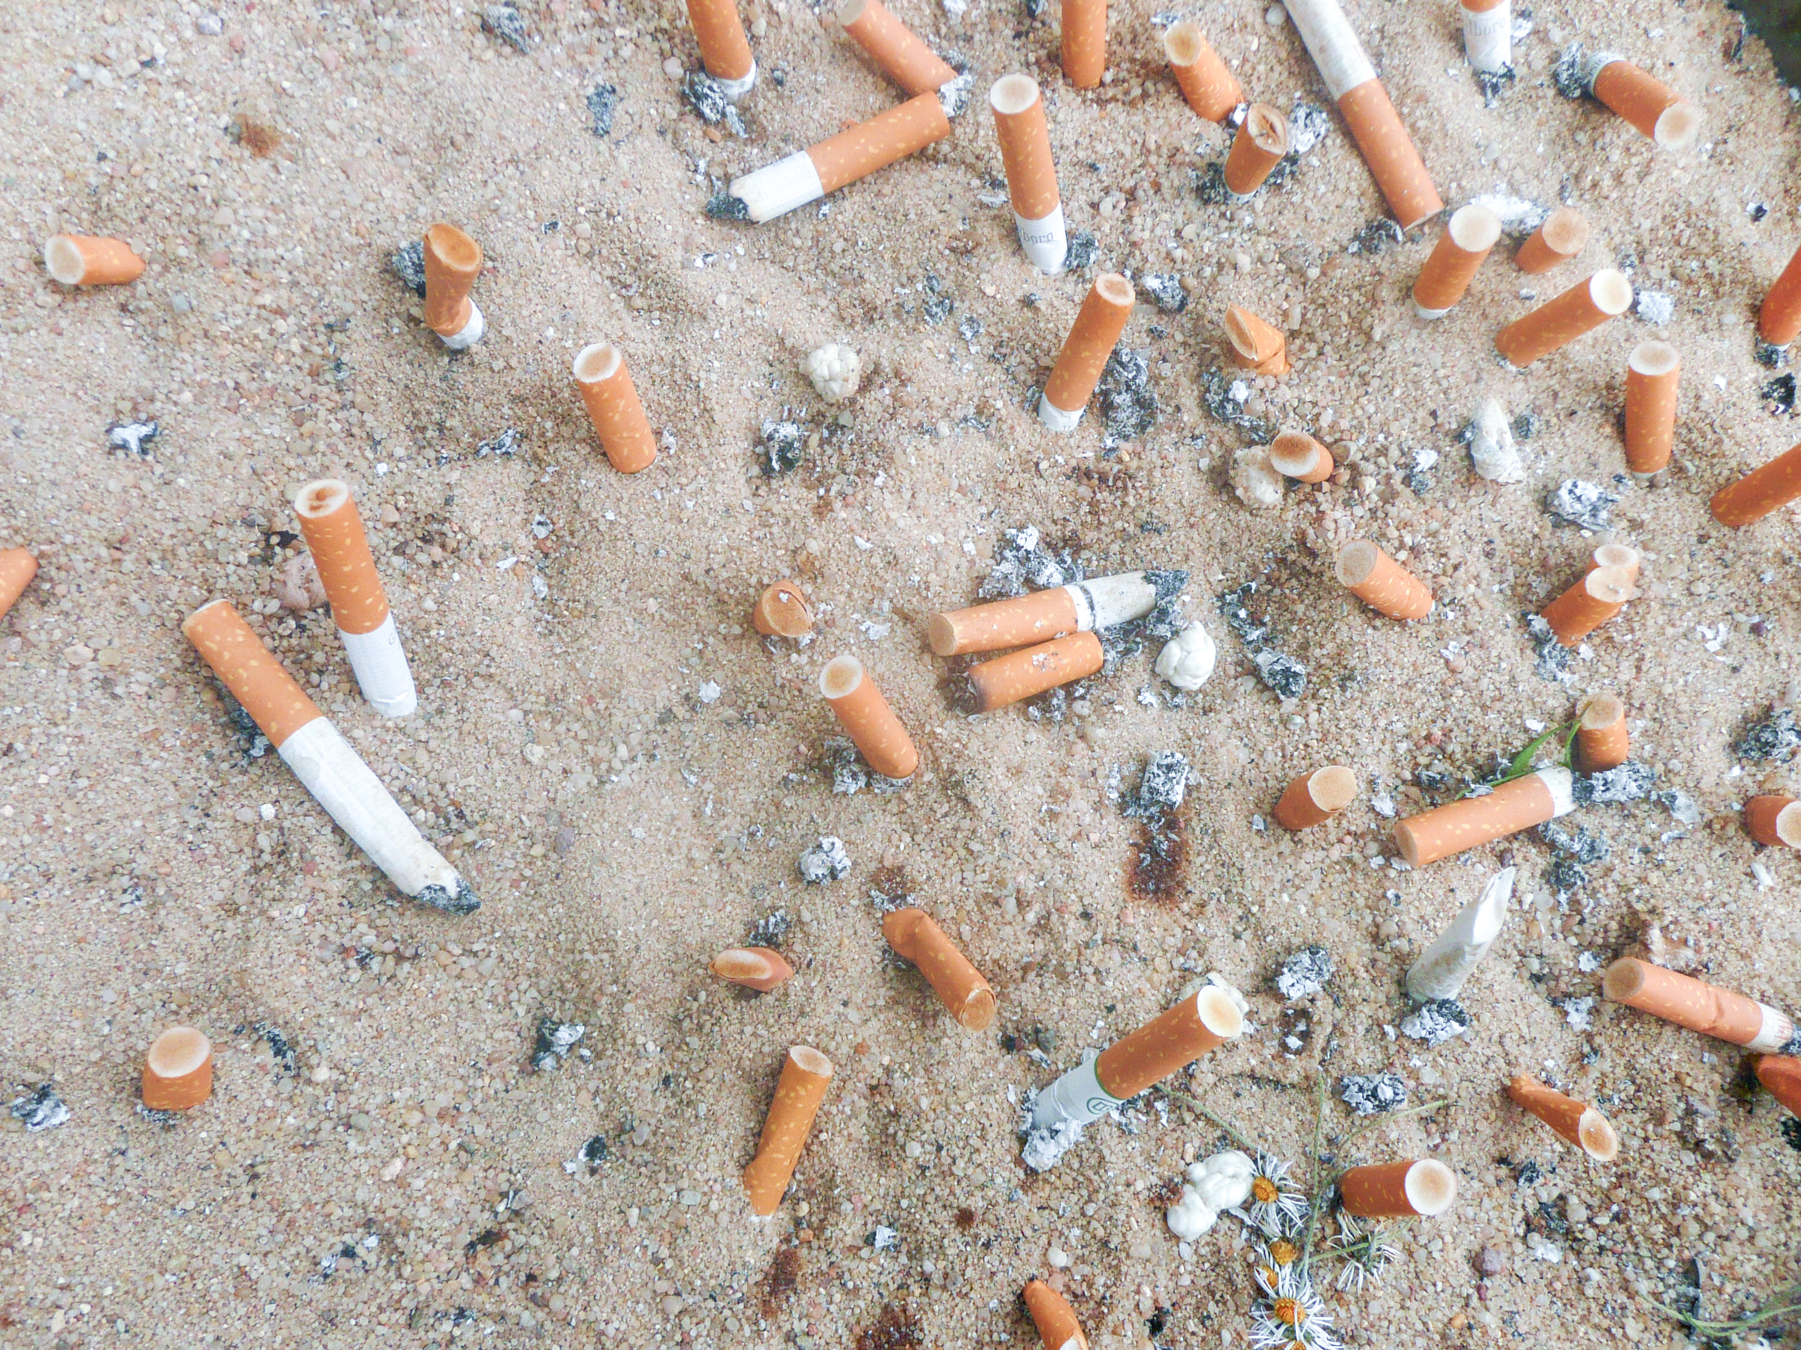
…and
the effect of cigarettes
Cigarettes are the most littered item on the planet with 4.5 trillion cigarette butts polluting our pavements, parks, soil, rivers, beaches and oceans.
All of this produced 25 megatons of solid waste, 55 megatons of waste-water, almost 84 megatons of CO₂ emissions to climate change – approximately 0.2% of the global total.
Around six trillion cigarettes are manufactured each year globally using 5.3 million hectares of land and 600 million trees.
Notes:
See slide 28 of the Teachers’ Toolkit
More information:
Zafeiridou et al. 2018). https://doi.org/10.1021/acs.est.8b01533.
https://ash.org.uk/uploads/Tobacco-Environment.pdf

Slide 24
Reflection
How do these facts make you feel?
What do you think should happen?
How could we reduce the effect on the environment?
Notes:
See slide 28 of the Teachers’ Toolkit
More information:
Zafeiridou et al. 2018). https://doi.org/10.1021/acs.est.8b01533.
https://ash.org.uk/uploads/Tobacco-Environment.pdf

Slide 25
Influencers and social media
?
80% of young people aged 11-17 years say that they see e-cigarettes being promoted
Why do you think influencers promote vapes, cannabis products or alcohol?
How do dealers use social media to sell vapes and other drugs?
Would someone buying vapes through Telegram, TikTok or Snapchat – or even eBay and Amazon know what was in them?
Notes:
The industry and commercial context
Examining the role of marketing, advertising and availability of substances/products on exposure and consumption. Questions to explore:
Why are vaping devices and products sold in flavours that are likely to appeal to children and young people?
Why are vaping devices and products sold in bright colours that are likely to appeal to children and young people?
What product placement techniques do the vaping industry use to promote their products (for example social media/influencers)? Are there similarities with the tobacco industry now or historically? What does their approach tell you about their target audiences?
What thoughts, feelings and emotions are advertisers and marketeers trying to elicit in response to their products? Are these realistic? What are they not telling you?
What are the differences in advertising regulation of tobacco and vaping devices? What impact does this have on your/young people’s exposure to vaping and messages about vaping?
What are the links between tobacco companies and vape companies? (you could use the example of electric vehicle manufacturers here which are largely the same companies that produce petrol/diesel vehicles but they expand/adapt to their audience’s needs in order to maintain their business).

Slide 26
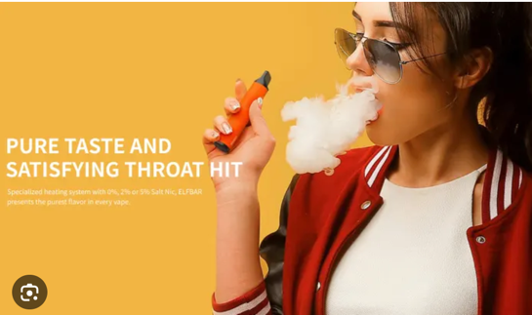





What do you think manufacturers of vapes are doing to promote them?

Slide 27
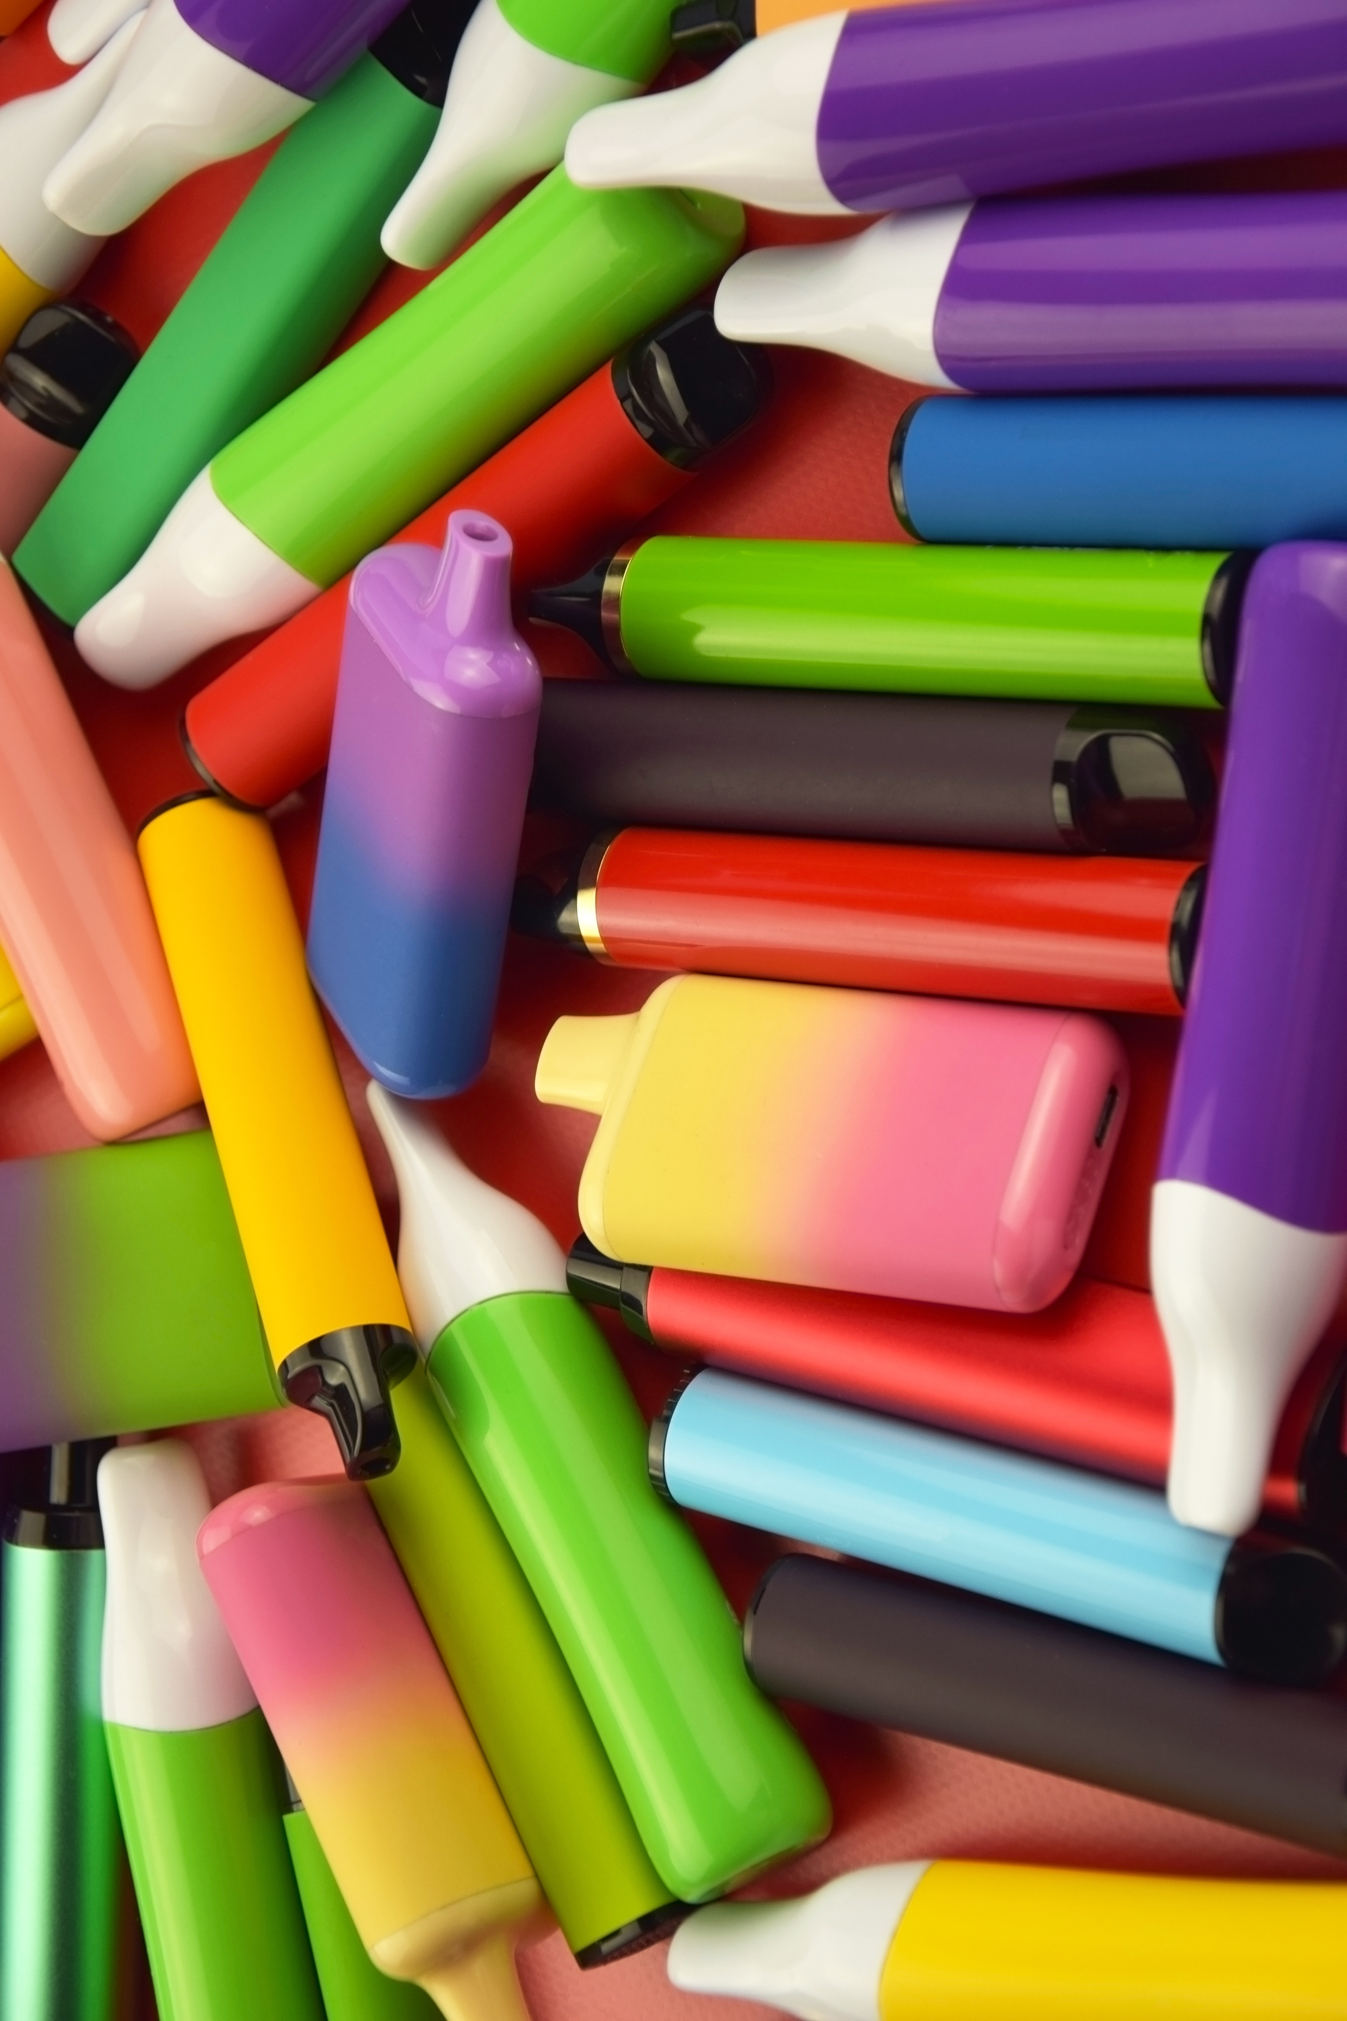
Did you know....
Although China is one of the main producers and suppliers of single use vapes, they have a ban on selling vapes on-line and have banned flavoured vapes in China, but they allow them to be produced and exported to the UK
What do you think about this fact?
How does this make you feel?

Slide 28
?
Either in small groups, or as a class, come up with ideas to reduce vaping among young people
Advertising? Price?
What would you do?
Disposable vapes?
Flavours? Nicotine levels?
If you were Prime Minister, what would you do?
Packaging? Social Media?
The Law?
Notes:
You could ask pupils to do this in poster form in working groups or to make a short presentation to the class.
Alternatively this can be a whole class discussion – votes could be taken on the most popular solutions

Slide 29


Worried about vaping?
Where to go for help and support
Whether you currently vape or not, if you have any concerns at all around vaping, speak to a trusted adult.
If you or a friend are currently vaping and want some support to stop, you can visit the FRANK website, call their helpline or use their text service (Text 82111) talktofrank.com/drug/vapes
If you want any support around resisting peer pressure, Childline offer some excellent tips: childline.org.uk/info-advice/friends-relationships-sex/friends/peer-pressure/
For further information and film clips on vaping
  life-stuff.org
  talkaboutalcohol.com
  The Mix

Slide 30
WHAT CAN YOU REMEMBER?
CAN YOU……
Explain the key difference between vaping and smoking?
WHAT CAN YOU REMEMBER?
Give a reason why young people specifically should avoid vaping
Give 2 examples of the short-term effects of nicotine on health and 2 on the long-term effects

Slide 31
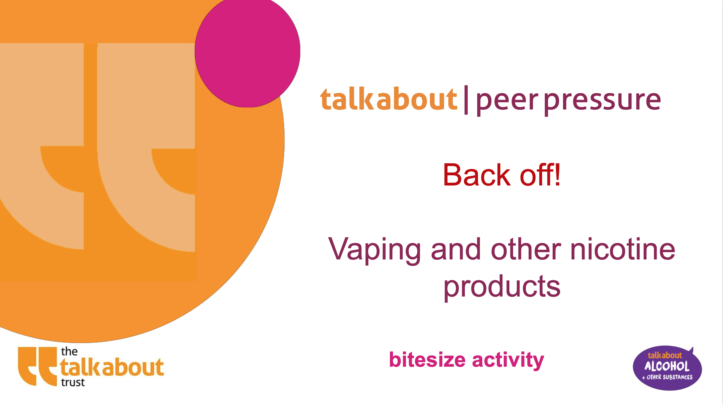
WHAT CAN YOU REMEMBER?
Additional enrichment and content that can be used as standalone activities or in tutor time
WHAT CAN YOU REMEMBER?
Peer pressure – vaping and other nicotine products

